Slide 1


Periods of solar activity and orbital asymmetry of solar radiation deposition into the terrestrial atmosphere
https://solargsm.com/solar-activity/
V. Zharkova^{1,2}, I.Vasilieva^{2,3}, S.Shepherd⁴ and E.Popova^{2,5}
1 – MPEE, University of Northumbria, Newcastle upon Tyne, UK
2 - ZVS Research Enterprise Ltd., London, UK
3 – Solar Physics Dept., Main Astronomical Observatory, Kyiv, Ukraine
4 - PRIMAL Research Group, Sorbonne Universite, Paris, France
5 - Centro de Investigación en Astronomía, Universidad Bernardo O’Higgins, Santiago, Chile
https://www.scirp.org/journal/paperinformation.aspx?paperid=124007
https://solargsm.com/publications/

Slide 2
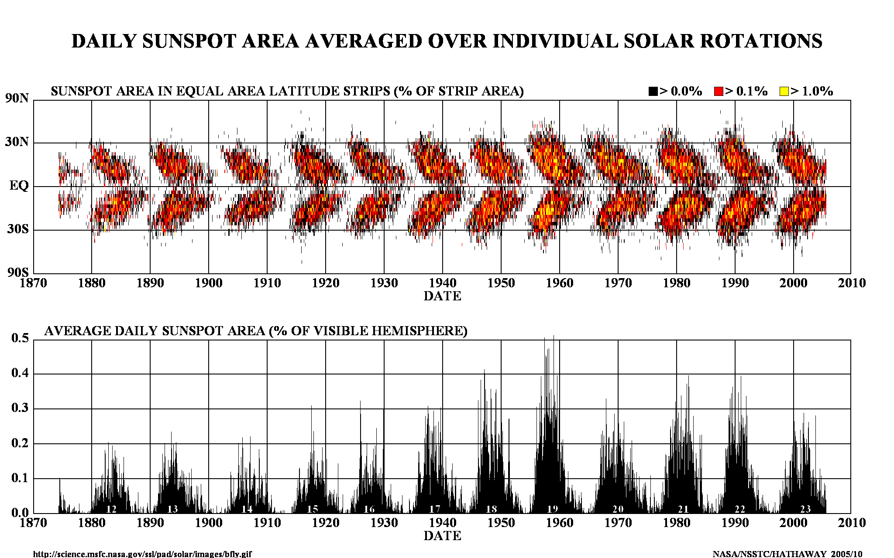
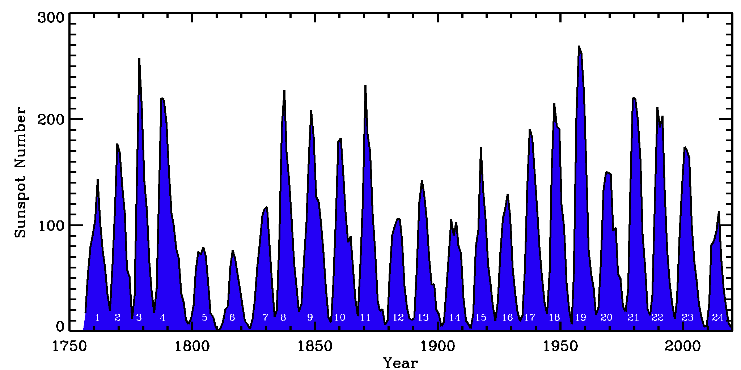
Current solar activity index

Slide 3
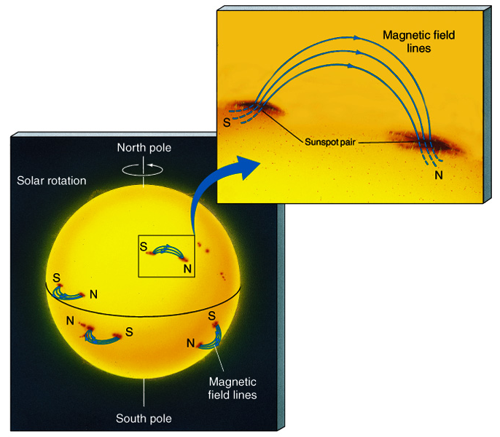
Sunspots & Magnetic Fields
The magnetic field in a sunspot is 1000x greater than the surrounding area
Sunspots are almost always in pairs at the same latitude with each member having opposite polarity
All sunspots in the same hemisphere have the same magnetic configuration

Slide 4
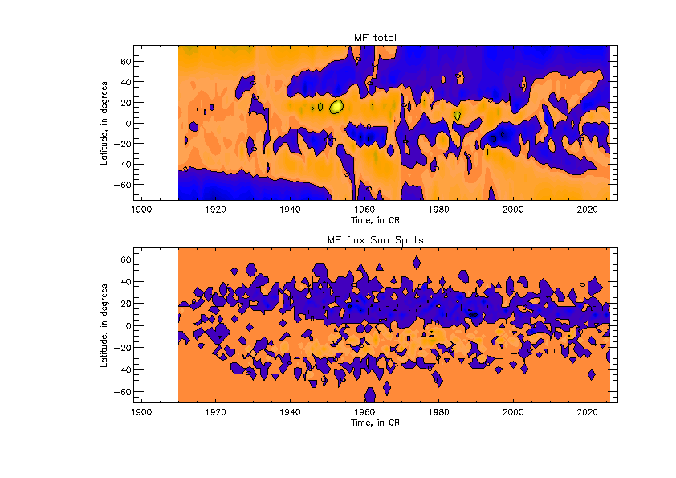
New proxy for solar activity index
SBMF (top) and sunspot MF (bottom)–
(Zharkov et al, 2008, Stix 1976)
Cycle 23 -Solar Background MF
Sunspot MF

Slide 5
Fitting the PCs to measured in cycle 24 and prediction to 25-26
Eigen vectors come in pairs, here are PCs
Zharkova et al, 2015 https://www.nature.com/articles/srep15689

Slide 6
S Summary curve of 2 PCs v
(Zharkova et al, 2015)

Slide 7
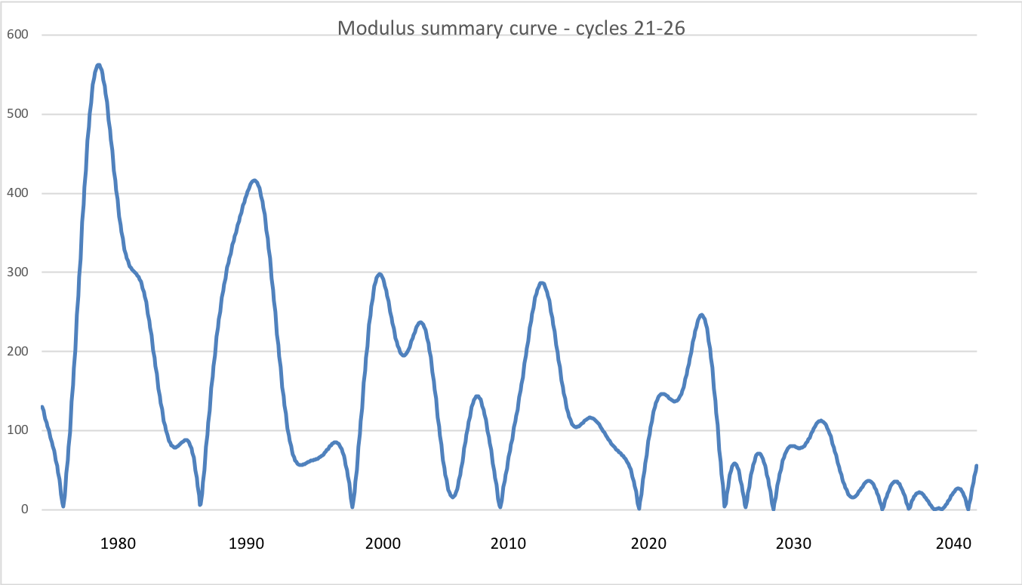
Modulus summary curve
Zharkova et al, 2015, SciRep; 2020, Temp., Zharkova et al, 2022, MNRAS s sunsdata
(Shepherd et al, 2014 ; Zharkova et al, 2015)
Cycle 21
Cycle 22
Cycle 23
Confirmed by
Katiashvili, 2020, ApJ;
Obridko et al, 2021, MNRAS
Velasco-Herrera et al, 2021
Cycle 21
Cycle 22
Cycle 23
Cycle 24
Cycle 25
Cycle 26

Slide 8
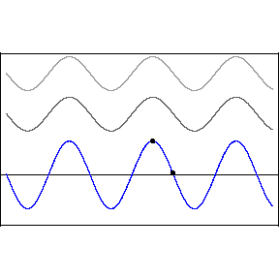
Interference
The two waves interference
y₁(x,t)=Acos(kx-ωt) (top wave),
y₂(x,t)=Acos(kx-ωt+D) (middle wave)
y(x,t)=y₁(x,t)+ y₂(x,t)
resulting wave with amplitude B
ω – frequency, k –wave number,
x – wave displacement
D – phase difference
A - Amplitude
D=0 constructive interference, B=2A
D=π (180º) –destructive interference, B= 0

Slide 9
Predicted solar activity (Zharkova et al, 2015, SR https://www.nature.com/articles/srep15689)
Zharkova et al, 2015, Nature SR
Observational result, dynamo model was not yet considered
Discovery of grand solar cycles :350-400 years
In addition to 11 year cycles
https://solargsm.com/solar-activity/ - my webpage

Slide 10
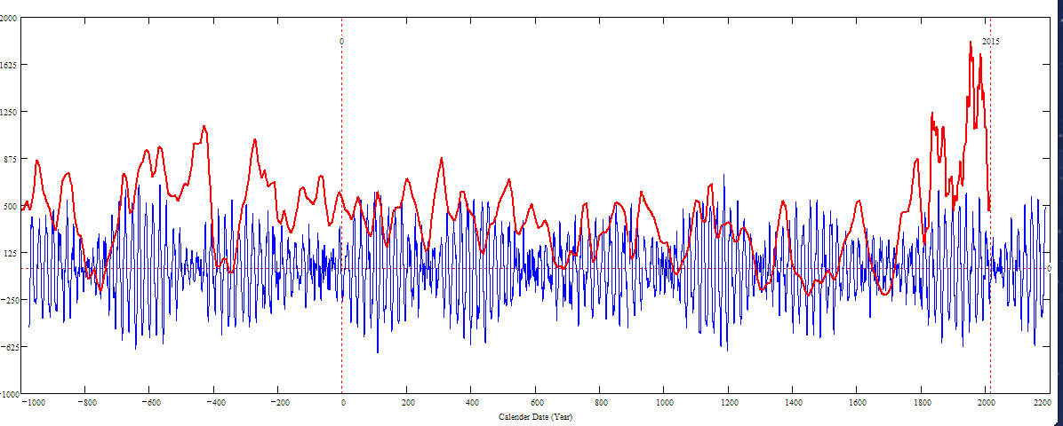
Double dynamo summary curve for 3000 years (blue) versus the s/s curve by Solanki et al. 2004 (red)
Homeric minimum^{[13]} | 750 BCE | 550 BCE
Oort minimum | 1040 CE | 1080 CE
Medieval maximum | 1100 | 1250
Wolf minimum | 1280 | 1350
Spörer Minimum | 1450 | 1550
Maunder Minimum | 1645 | 1715
Dalton Minimum | 1790 | 1820
Zharkova et al, 2015, 2018
Sporer minimum in 1400-1600 in C¹⁴ is caused by s/n Vela Junior
Oort
Wolf
Maunder
Homeric
Periods – grand cycle: 350-400 years and super-grand cycle :2000-2100 years

Slide 11
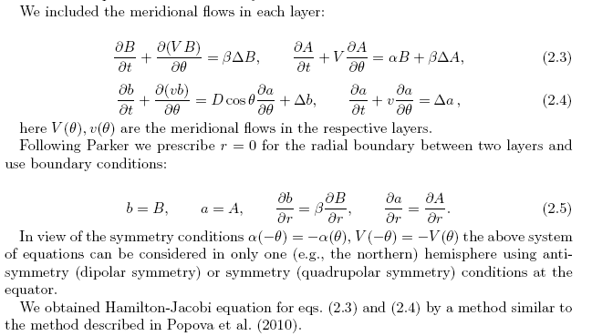
2 layer dynamo model explaining some PCA features
Zharkova et al, 2015, Popova et al, 2013

Slide 12
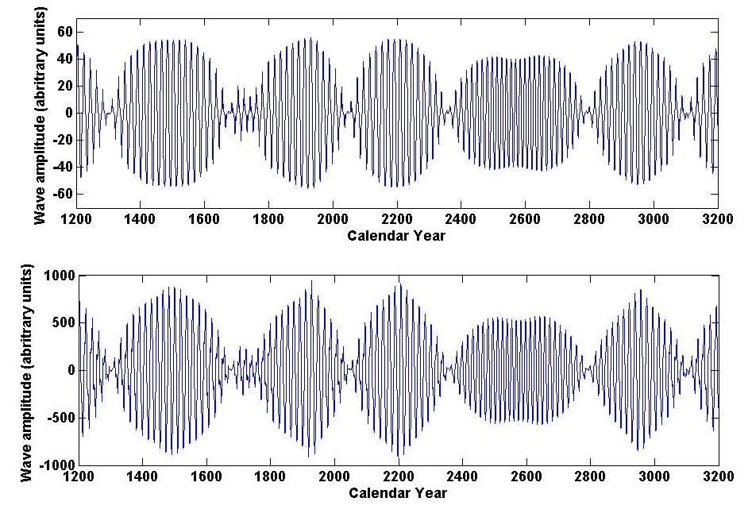
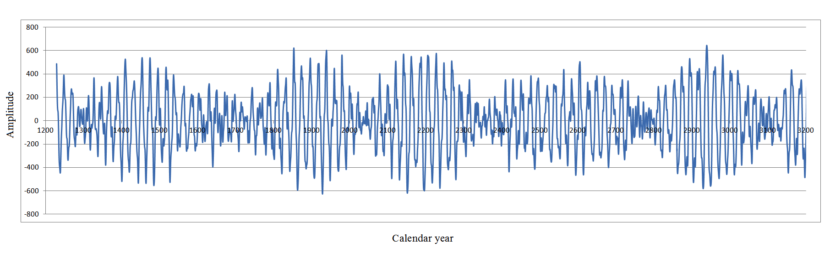
Dynamo model (top) and summary curve (bottom
Summary dynamo wave
on the millennium scale (Zharkova et al, 2015, Nature SR)
Popova et al, 2013
Zharkova et al, 2015, SR https://www.nature.com/articles/srep15689

Slide 13
Summary: new proxy of solar activity
New proxy of SA - Principal components (eigen vectors) of SBMF
EVs are paired – double dynamo waves
The strongest 2 EVs (PCs) cover more than 40% of variance or 67% of SD
Prediction of the solar activity on a millennium scale shows grand solar cycle with a period of 350-400 years
Next grand solar minimum is underway in 2020-2053
Prediction for 3000-10000 years backwards fits the main grand minima and warming periods
https://solargsm.com/solar-activity/

Slide 14
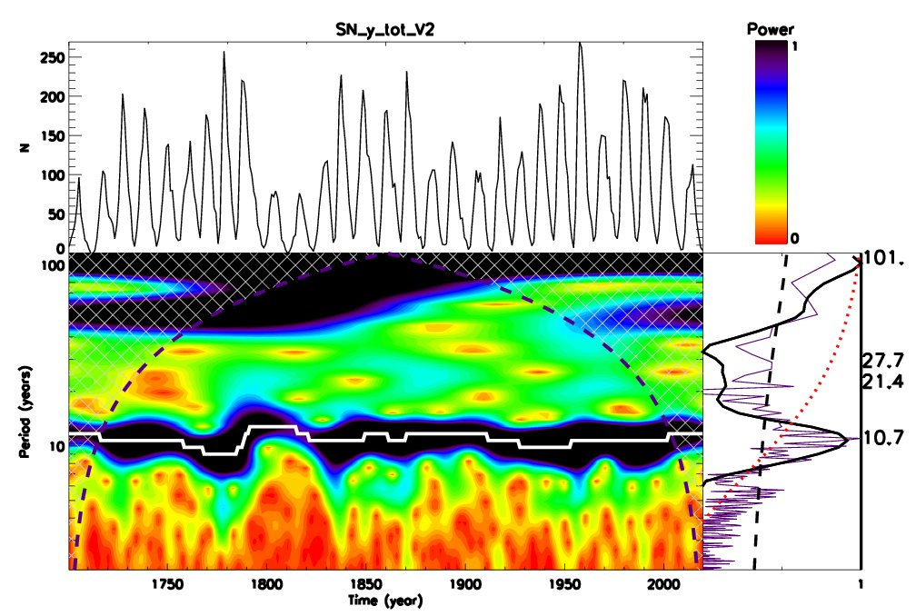
Wavelet spectral analysis
Averaged sunspot numbers SSN Wavelet analysis of SSN
Main periods – 10.7 and 101 years
Period of 50-55 years – lower than a red noise level

Slide 15
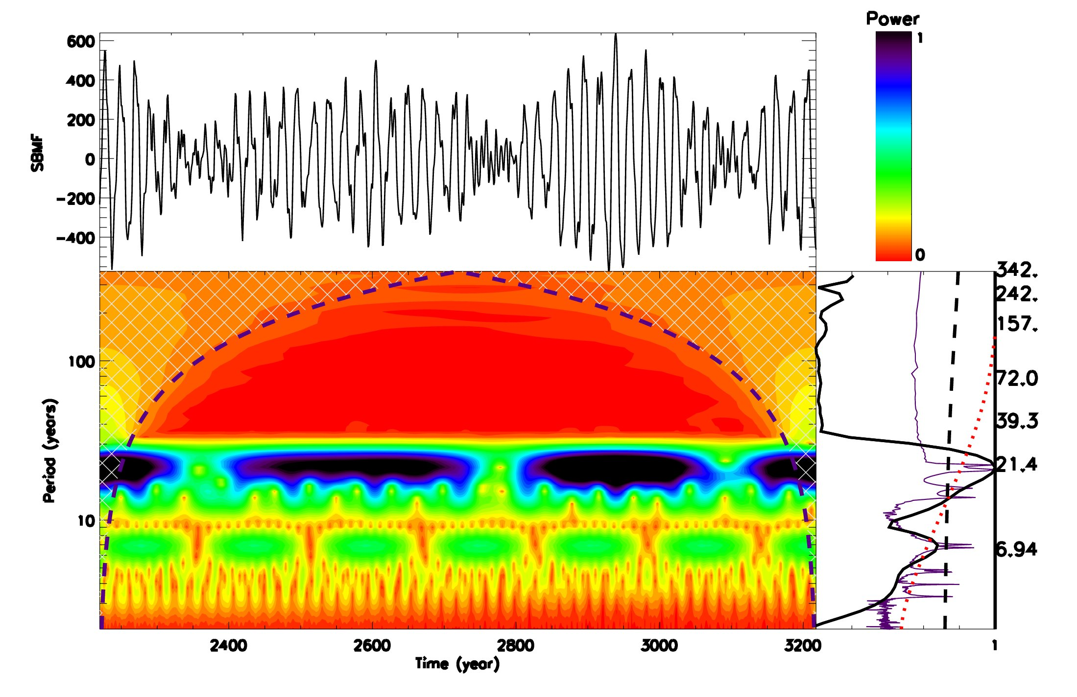
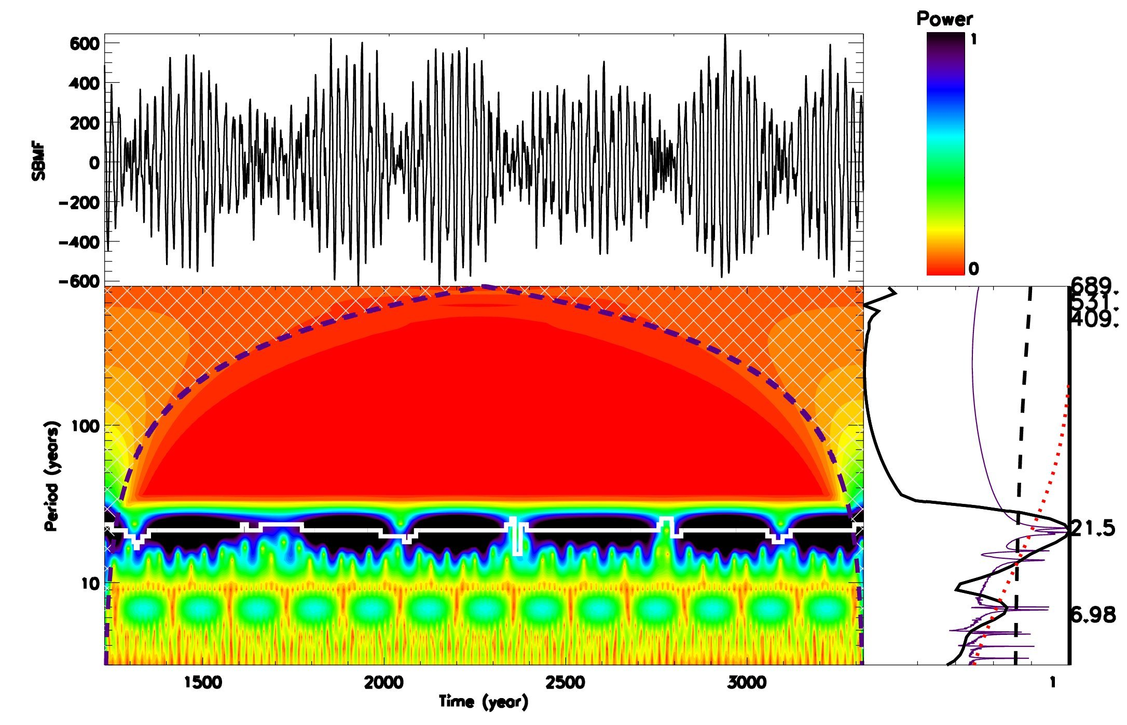
Wavelet spectral analysis
Summary curve of two largest eigen vectors
Main periods – 21.5 and 342 years

Slide 16
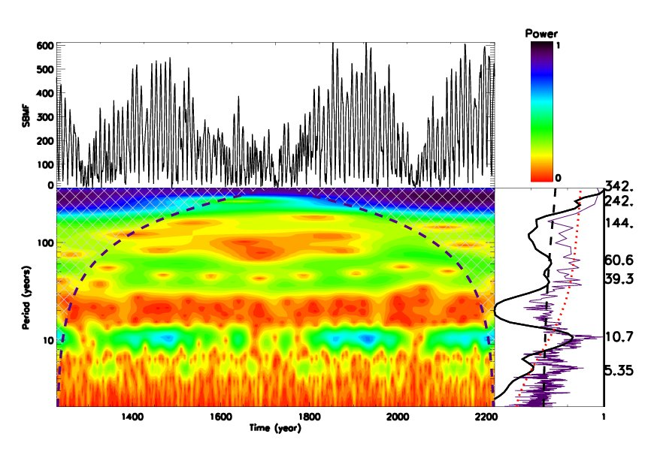
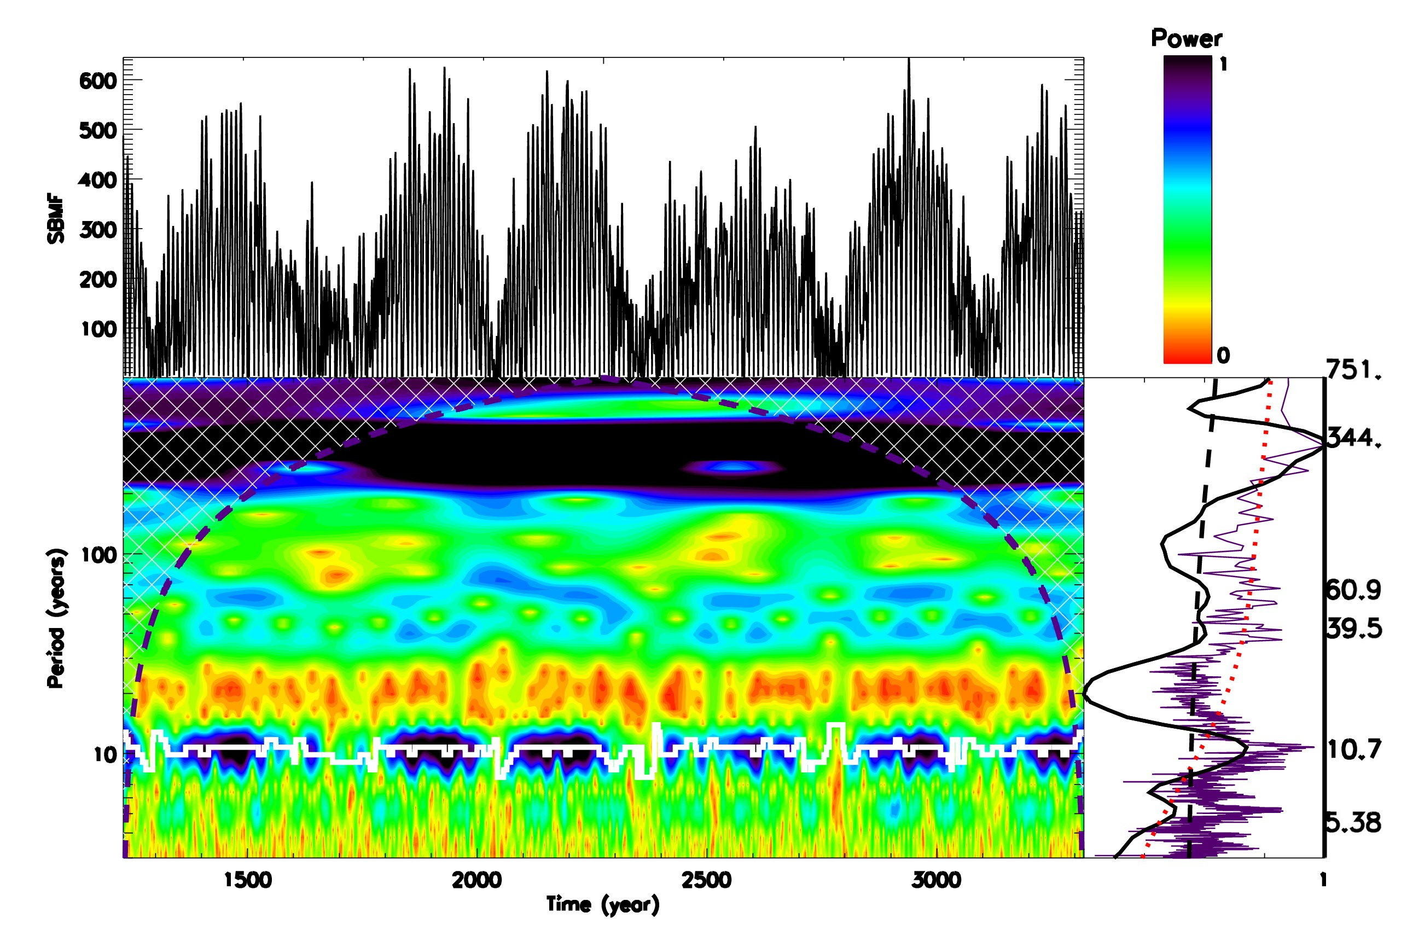
Wavelet spectral analysis
Modulus summary curve of two largest eigen vectors
Main periods – 21.5 and 344 years

Slide 17
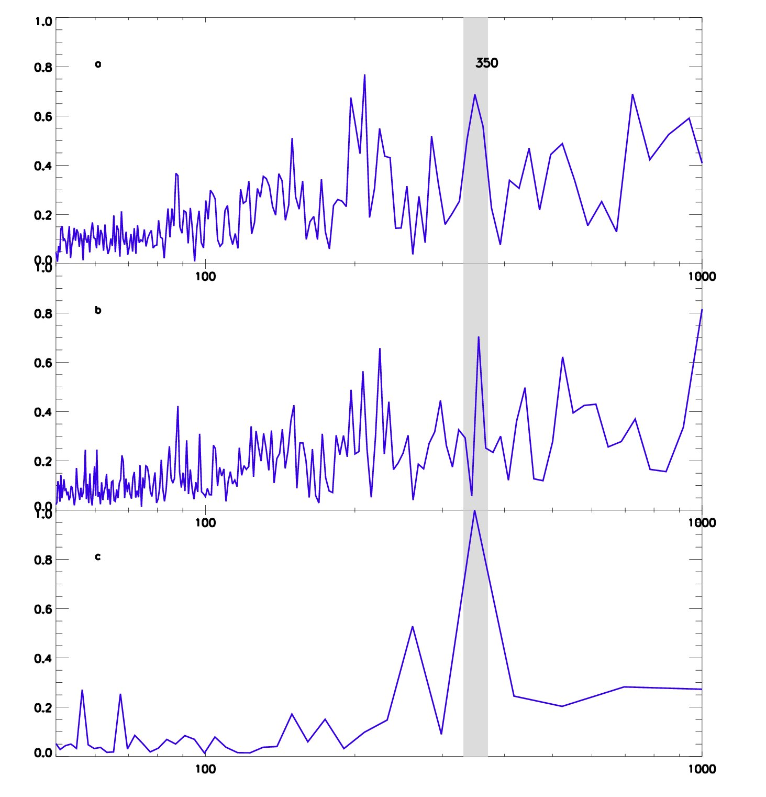
Fourier analysis of total solar irradiance (TSI) variations
Period of 350 years
Similar to the periods of grand solar cycles

Slide 18
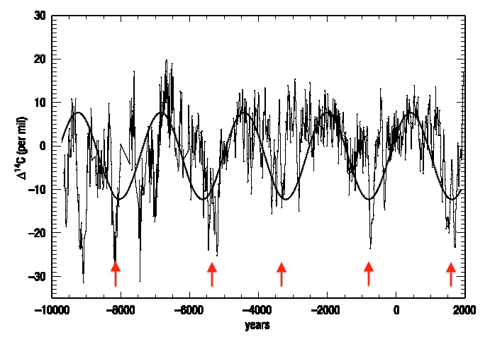
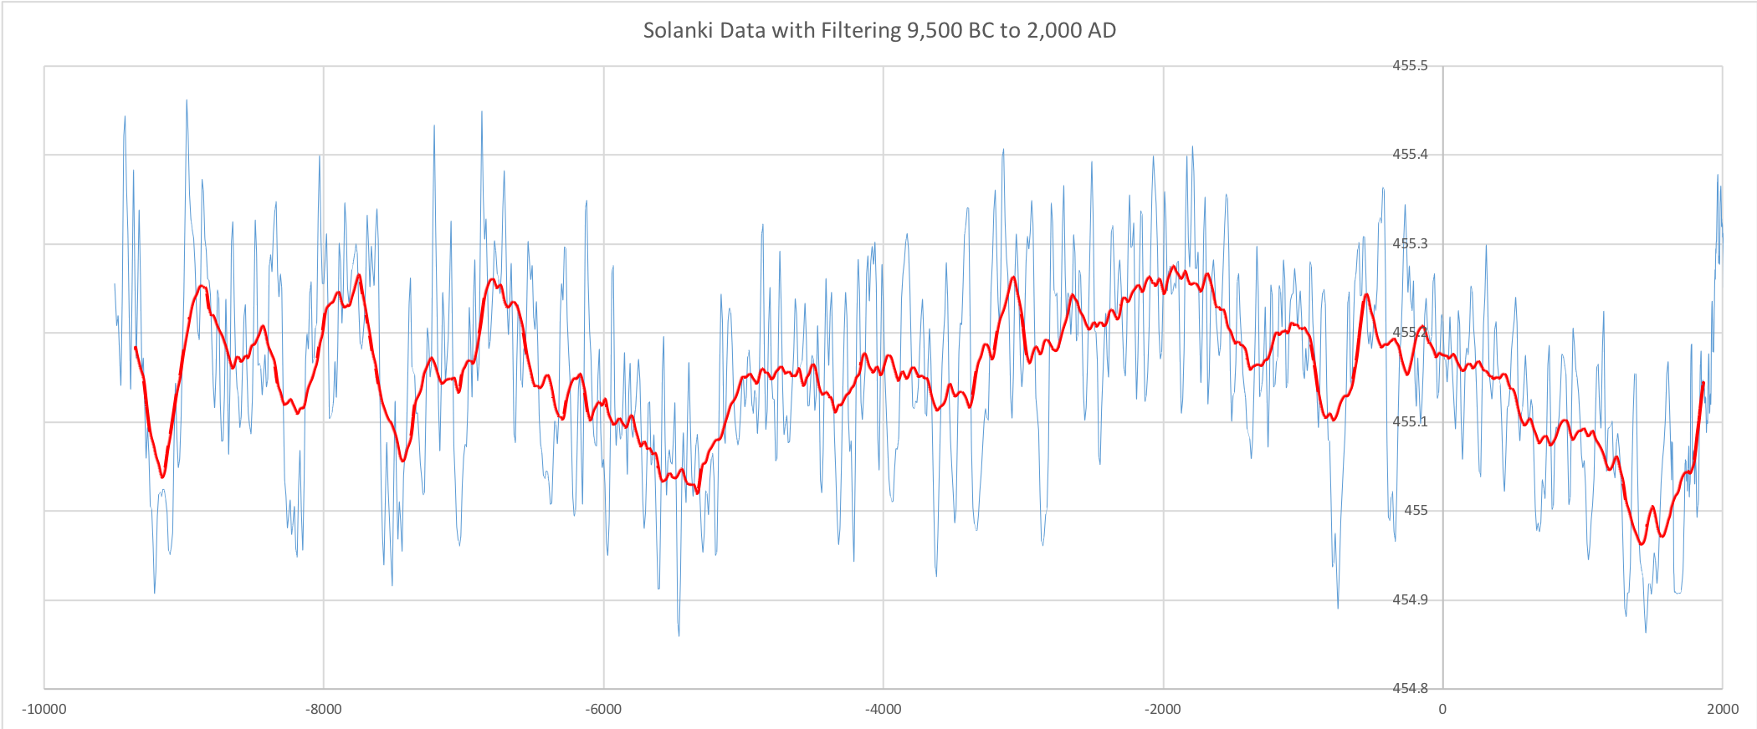
Solar irradiance variations
from the abundances of isotopes C14 and Be10 in biomass
Reimes et al, 2009
Vieira et al, 2011

Slide 19
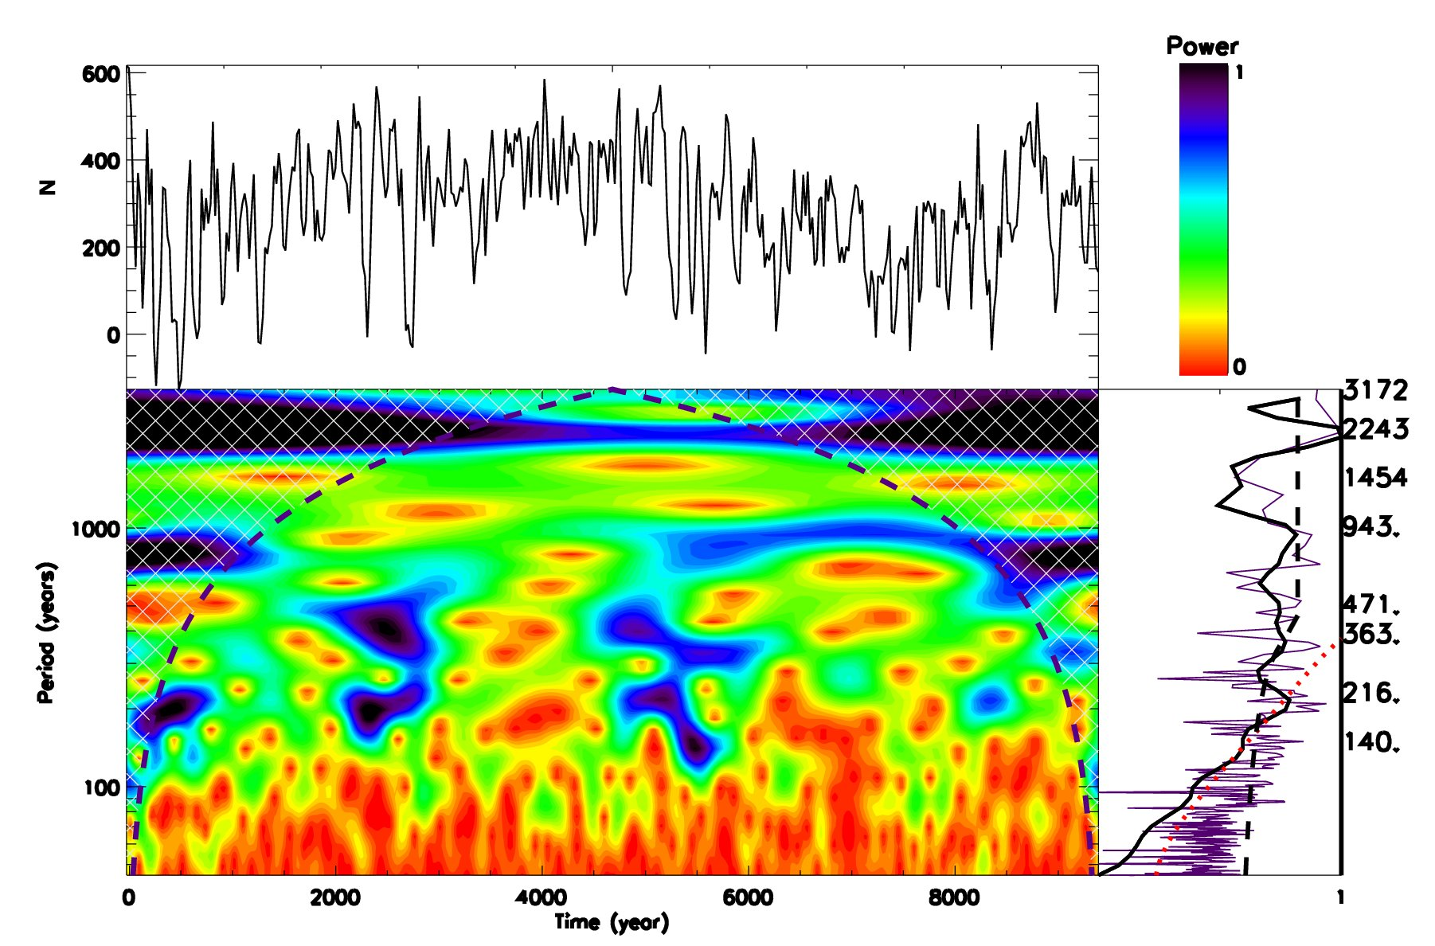
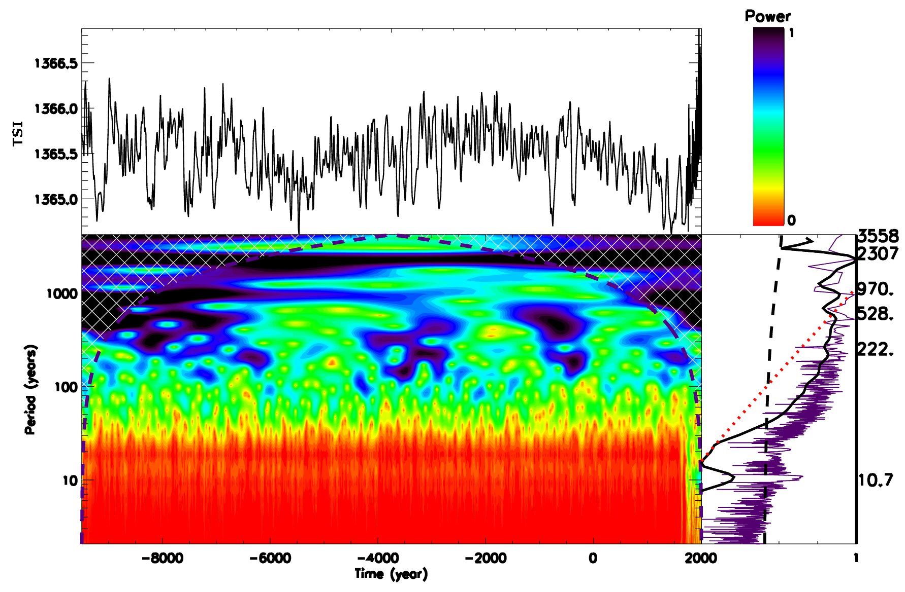
Wavelet spectral analysis of TSI (C14 and Be10 isotopes)
TSI by Steinhilber et al, 2012 TSI by Vieira et al, 2011
Main periods – 10.7, 216, 363 and 2243-2300 years

Slide 20
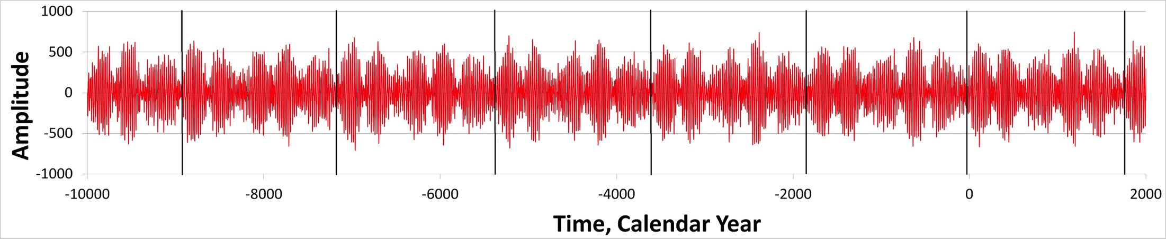
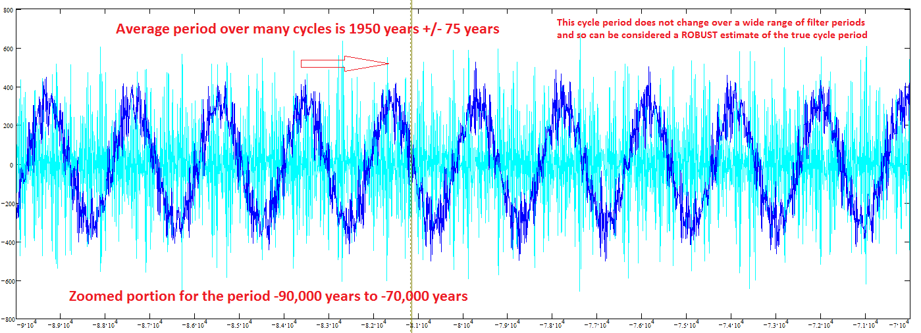
Solar magnetic field (top) and
Mbaseline oscillations (bottom)
(ZharkovlZharkova et., 2019, 2021al, 2018, 2019, 220 ture SR)
Reames et al, 2009
¹⁴C in trees

Slide 21
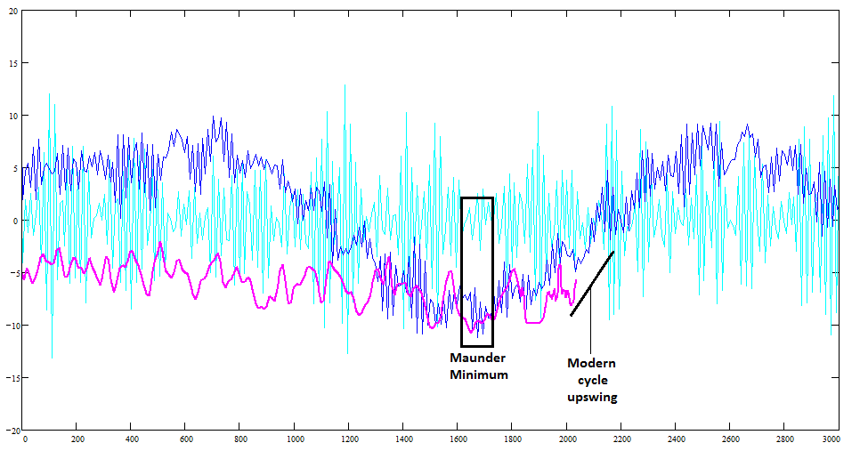
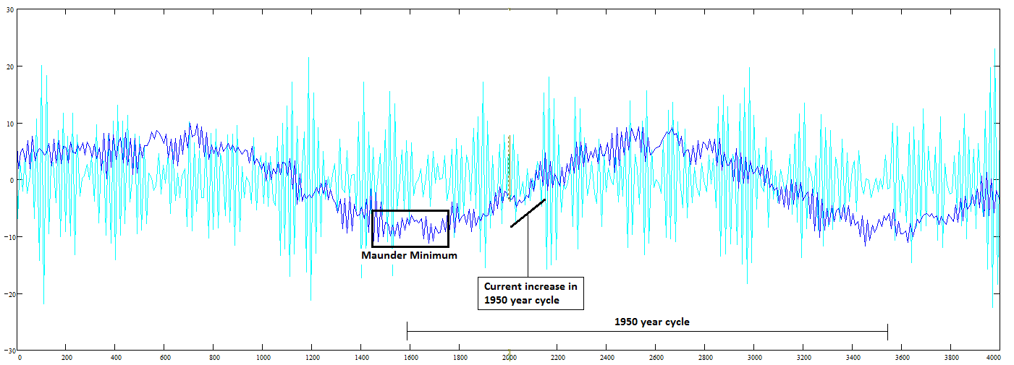
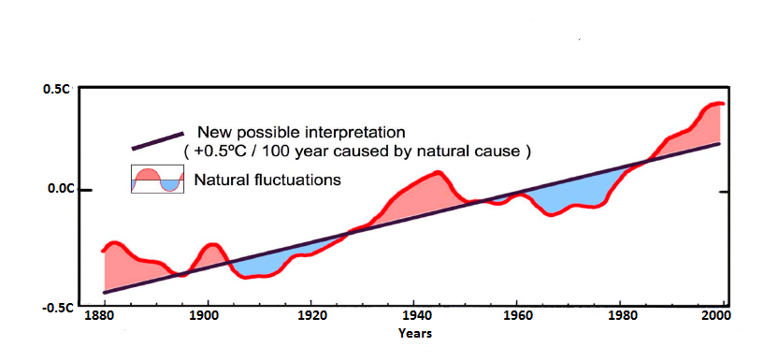
2000-2100 year oscillations (Zharkova et al, 2019, 2020) of the MF baseline coincides with that of the solar irradiance (Vierra et al, 2011)
(Akasofu, 2011)
Zharkova et al, 2019, 2020

Slide 22
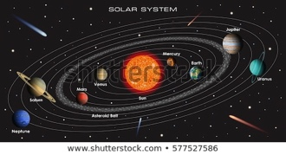
What are the reasons of solar irradiance oscillations?
→ Sun, Earth and other planets motion (Milankovich cycles)

Slide 23
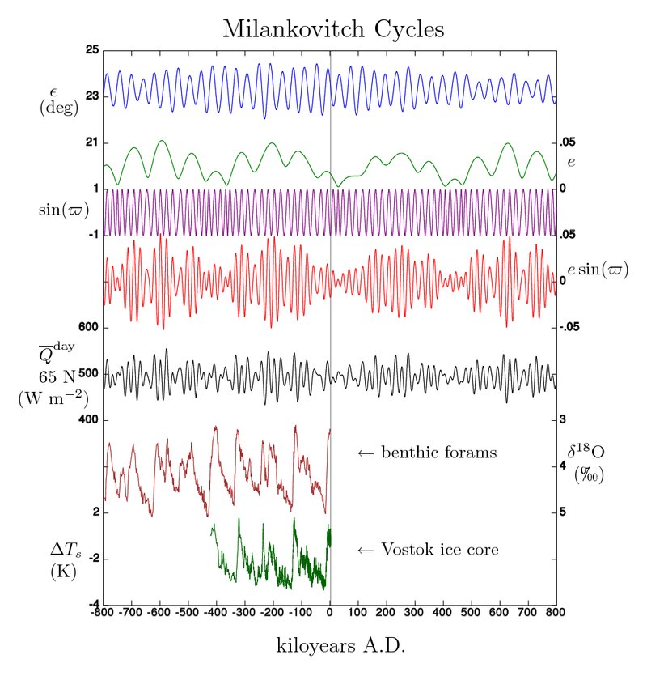
Obliquity (axial tilt) (ε) (22º.1-24º.5)
current 23.5 - T~41 000 years
Eccentricity (e). Change on semi-minor axis
T~100-400K years effects of Jupiter and Saturn
Longitude of perihelion (sin(ϖ) ).
Precession index (e sin(ϖ) ) –
Axial - Earth's axis of rotation relative to fixed
stars – T~ 25,771.5 y
Apsidal - orbit ellipse relative to fixed stars – T~113 000 y
Orbital inclination – T~ 70 000 y
Earth's movements:
  1.1 Orbital shape (eccentricity)
  1.1.1 Effect on temperature
  1.1.2 Effect on lengths of seasons
  1.2 Axial tilt (obliquity)
  1.3 Axial precession
  1.4 Apsidal precession
  1.5 Orbital inclination (
2

Slide 24
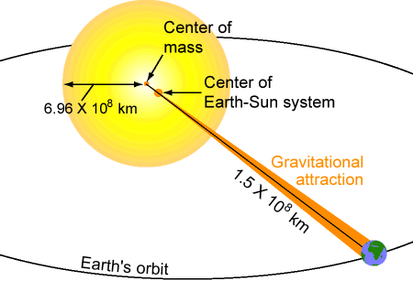
Solar Inertial Motion
Solar inertial motion is the motion of the Sun around the centre of mass of the Solar System due to variable positions of the giant planets (J-Jupiter, S-Saturn, U-Uranus, N-Neptune).
The Sun moves inside a circular area which has a diameter of 0.02 AU (= 4.3 solar radii = 3.106 km). The Sun moves with a velocity between 9 and 16 m/s.
6.96x10⁵ km
Charvátová, I., The solar motion and the variability of solar activity, Adv. Space Res., 8, 7, 147-150, 1988.
Charvátová, I., On the relation between solar motion and solar activity in the years 1730-1780 and 1910-60, Bull. Astr. Inst. Czech., 41, 200-204, 1990.
Charvátová, I., Solar-terrestrial and climatic variability during the last several millennia in relation to solar inertial motion, J. Coast. Res., 17, 343-354, 1995.
Charvátová, I., Can origin of the 2400-year cycle of solar activity be caused by solar inertial motion? Annales Geophysicae, 18, 399-405, 2000.

Slide 25
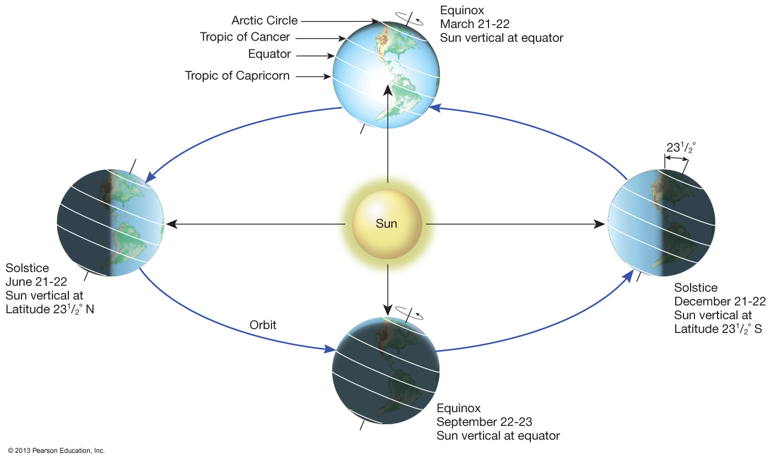
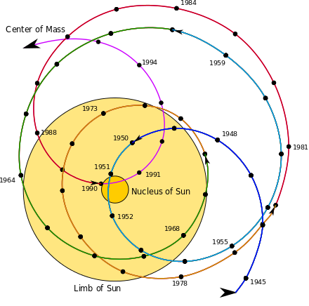
SIM effects on the Earth via solar irradiance
Objection from AGW people
https://youtu.be/vDgUmTq4a2Q
The Sun moves inside a circular area which has a diameter of 0.02 AU (= 4.3 solar radii = 3.106 km). The Sun moves with a velocity between 9 and 16 m/s.
S. Perminov, E.D. Kuznetsov, 2018
SIM imposed by planets Jupiter, Saturn, Neptune and Uranus
Charvatova, 1988,
Palus et al, 2007
Rice et al, PP comments #72, 96

Slide 26
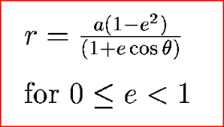



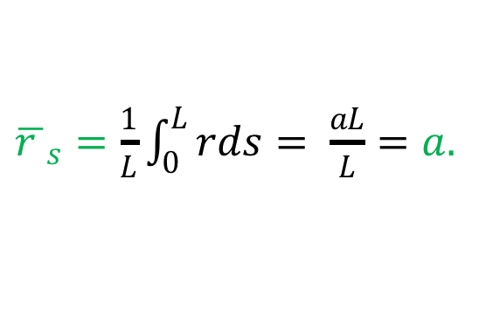
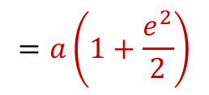
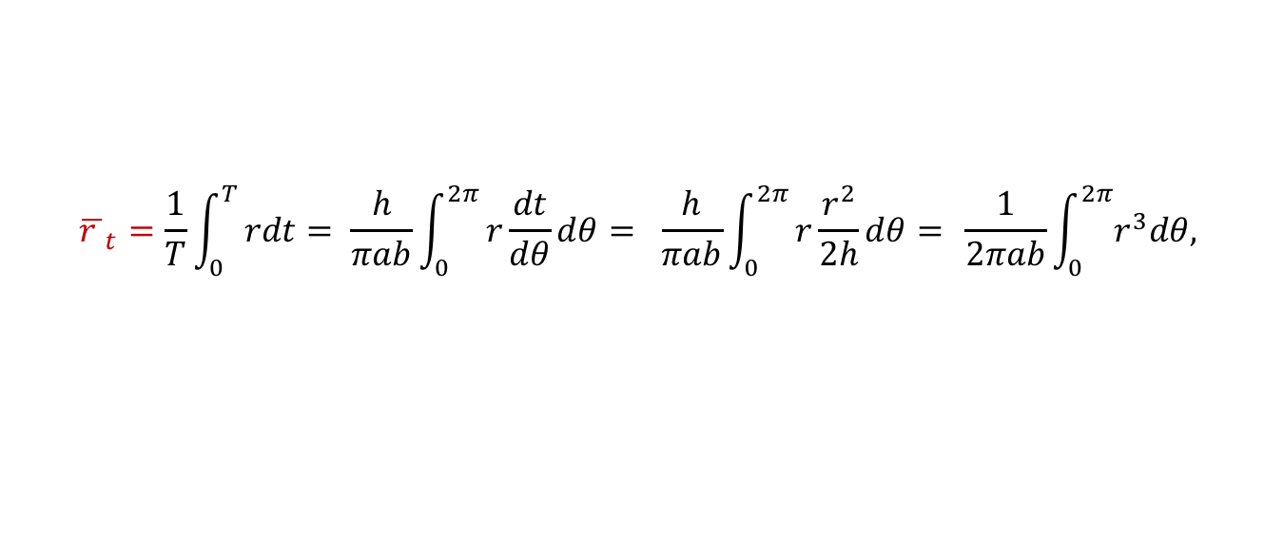
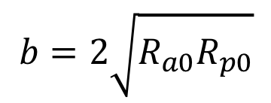
Average S-E distances – pure calculus, Stein, 1977
3rd Kepler’s law:
By angle theta:
$${\overline{r }}_{θ}=\frac{1}{2π}\int_{0}^{2π}{rdθ= \frac{1}{2π}}\int_{0}^{2π}{\frac{pe }{1−ecosθ} dθ= \frac{2πpe}{2π\sqrt{1−e^{2}}}= \frac{a\left(1−e^{2 }\right)}{\sqrt{1−e^{2}}}}=$$
$$a\sqrt{1−e^{2}}=b$$
By time:
$${\overline{r }}_{t}=\frac{1}{T}\int_{0}^{T}{rdt= \frac{h}{πab}\int_{0}^{2π}{r\frac{dt}{dθ}dθ= \frac{h}{πab}\int_{0}^{2π}{r\frac{r^{2}}{2h}dθ= }}}\frac{1}{2πab}\int_{0}^{2π}{r^{3}dθ, }$$
$$=a\left(1+\frac{e^{2}}{2}\right)$$
By arc:
${\overline{r }}_{s}=\frac{1}{L}\int_{0}^{L}{rds= \frac{aL}{L}}=a.$
$$b=2\sqrt{R_{a0}R_{p0}}$$
$$r_{1}+r_{2}=2a=R_{a}+R_{p}$$

Slide 27
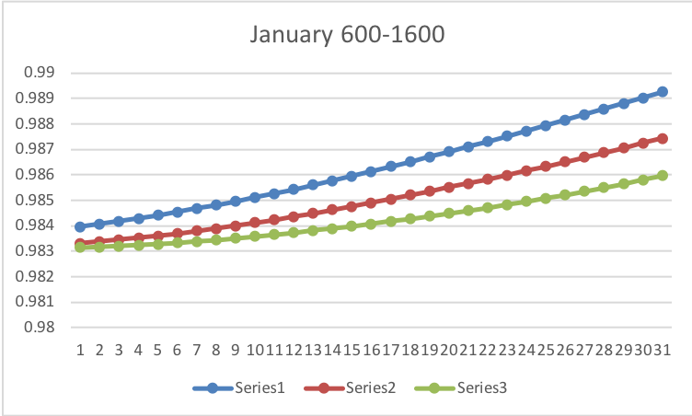
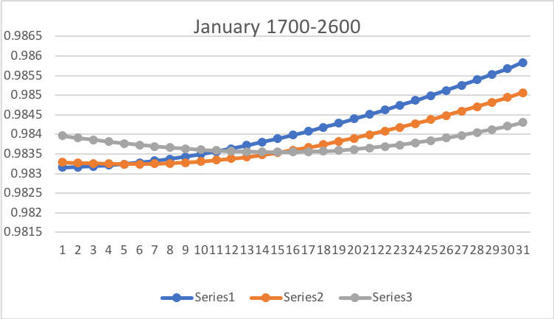
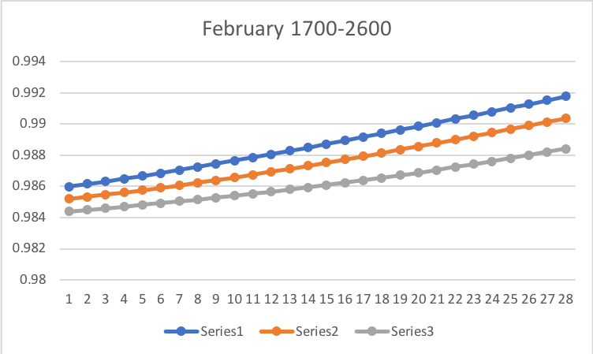
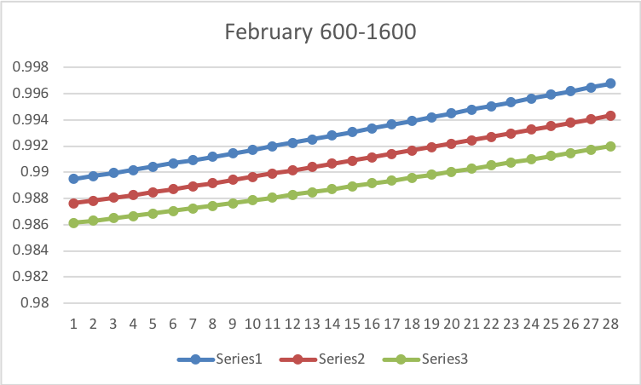
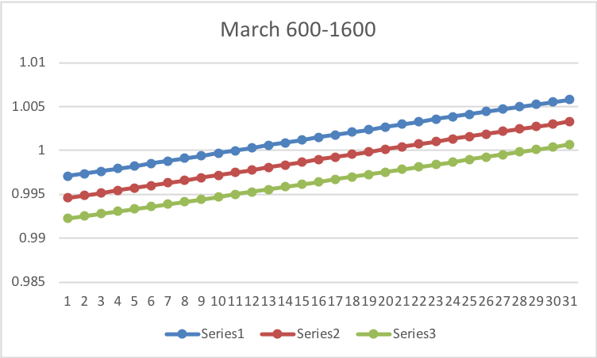
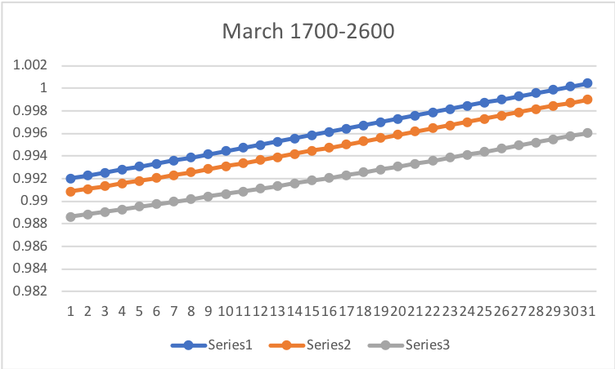
Real Sun-Earth distances
600
1700
1100
2020
2600
1600
https://www.intechopen.com/online-first/millennial-oscillations-of-solar-irradiance-and-magnetic-field-in-600-2600

Slide 28
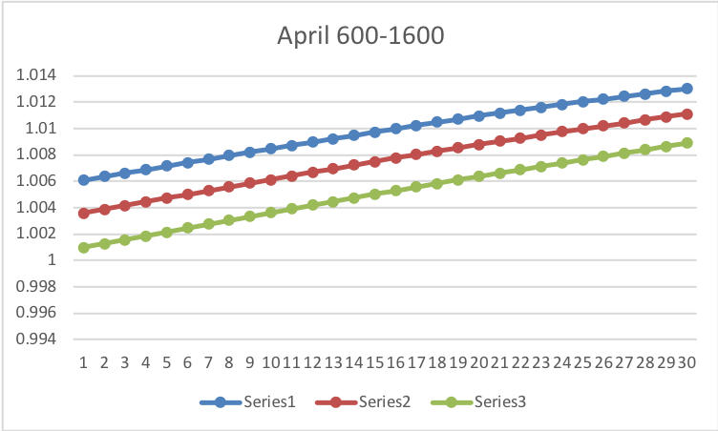
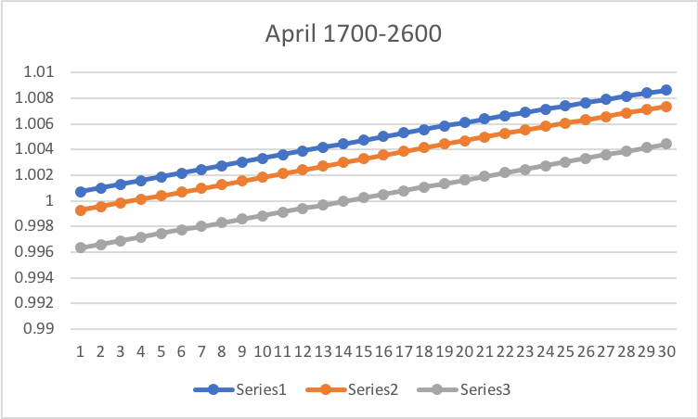
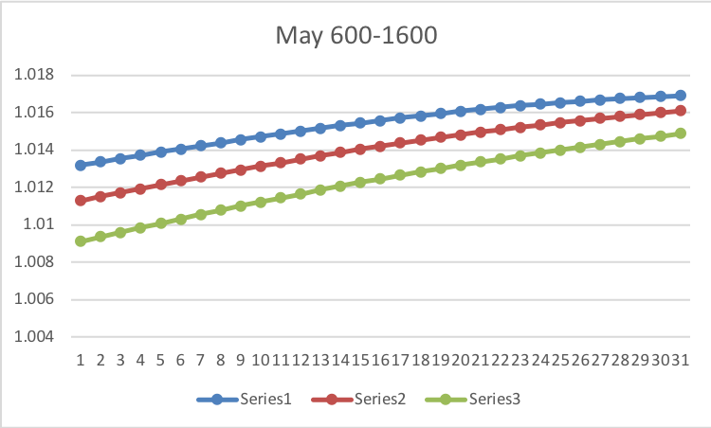
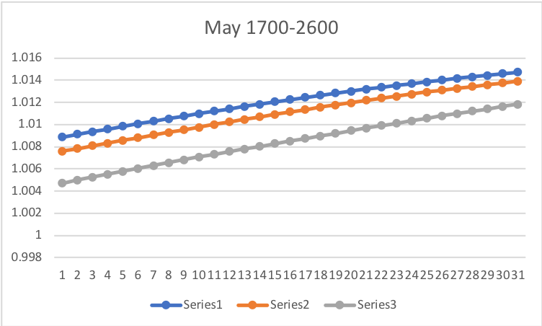
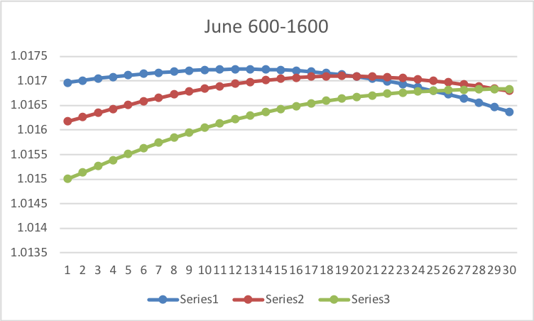
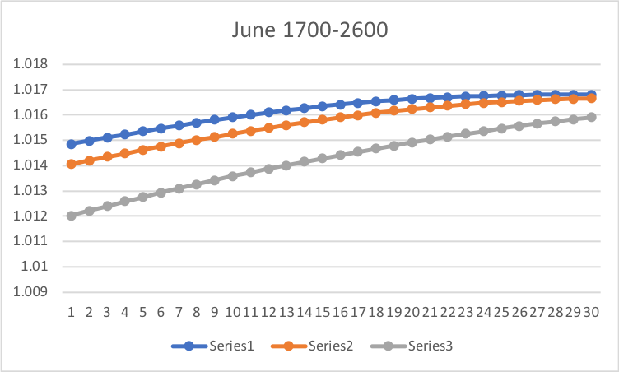
Real Sun-Earth distances

Slide 29
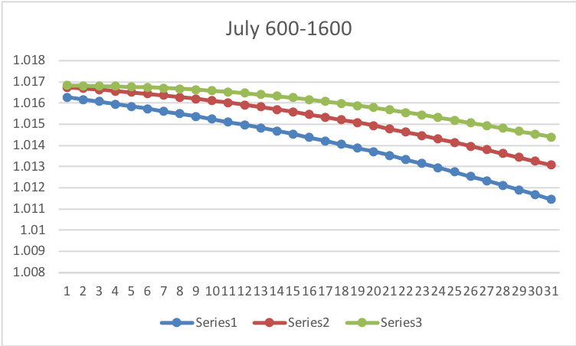
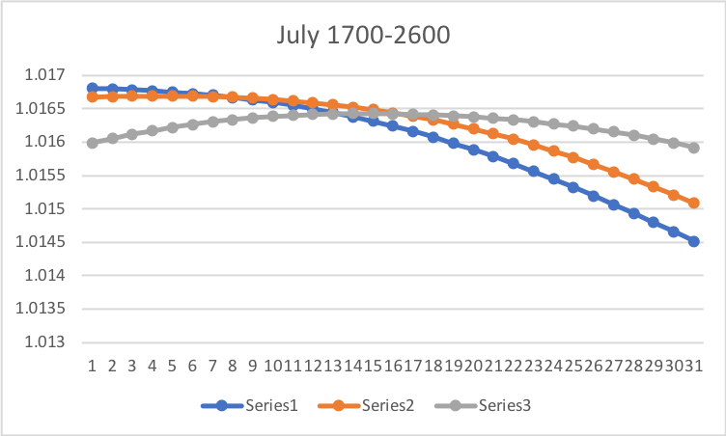




Real Sun-Earth distances

Slide 30






Real Sun-Earth distances

Slide 31


Annual variations of the mean monhly S-E distances (ephemeris)
in M1 (600-1600) and M2 (1700-2600) Zharkova, 2020 https://arxiv.org/pdf/2008.00439.pdf, 2023 https://www.scirp.org/journal/paperinformation.aspx?paperid=124007
M1 – aphelion is in June, shifting to mid-July in M2
a - Sun - in the ellipse focus
b - Sun shifted by SIM to spring equinox

Slide 32
Zharkova et al, 2023 https://www.scirp.org/journal/paperinformation.aspx?paperid=124007
2020
Aphelion →. 5 July
Perihelion → 5 January
2600
Aphelion →. 16 July
Perihelion → 16 January
SIM effects on the Earth via solar irradiance
https://youtu.be/vDgUmTq4a2Q
S. Perminov, E.D. Kuznetsov, 2018
SIM imposed by planets Jupiter, Saturn, Neptune and Uranus
Charvatova, 1988,
Palus et al, 2007
Rice et al, PP comments #72, 96

Slide 33







Solar irradiance
2600
1600
2020
1100
$S=\frac{I_{sun}}{d^{2}}$ → S₁ $d^{2\text{1}}$ =S₂ $d^{2\text{2}}$
inverse squared law
600
1700

Slide 34






Solar irradiance

Slide 35






Solar irradiance

Slide 36






Solar irradiance

Slide 37


Annual TSI variations in M1 (600-1600) and M2 (1700-2600)
Zharkova, 2021 https://www.intechopen.com/online-first/millennial-oscillations-of-solar-irradiance-and-magnetic-field-in-600-2600 )
M1: TSI significantly increases in February – June, and decreases in June-December. M2: the aphelion shifts to mid-July →TSI decrease in July – January is not fully compensated!

Slide 38


Variations of the total annual TSI in M1 (600-1600) and M2 (1600-2600) taken from the TSI averaged for each month (left) and daily TSI (right)
https://arxiv.org/pdf/2008.00439.pdf
Zharkova et al, 2019, Zharkova, 2020
There is extra solar forcing caused by gravitation of planets, which is a likely reason of the main part of global warming
Extra solar forcing
Not considered so far!

Slide 39

Terrestrial temperature
The mechanisms considered
1) direct forcing by the Total Solar Irradiance variations
2) solar ultraviolet and extreme ultraviolet variability and
3) Cosmic Ray modulation on cloud cover
What is missed?
Let’s explore…
Akasofu, 2011

Slide 40
Point 1. Global Warming Over Last Century (Hardy, 2017)
with extra-solar radiation
Total Temperature Balance if extra 5 W/m^2 radiation is added:
  Solar warming over last century:
  for solar anomaly ΔTSI = 2.6‰ → ΔT_{Sun} = ΔTSI x S_{S} = 0.44°C
  CO₂ warming over last century:
  100 ppm CO₂ at ECS = 0.70°C → ΔT_{CO2} = 0.30°C
  Full agreement with observed temperature increase: 0.74°C
  Full agreement with observed cloud cover changes
60%
40%
We have extra 20-25 W/m^2 radiation every year!
Hence, the hating comes from this radiation!

Slide 41

SIM solar forcing and green house (GH) effects
Increase of SI with a decrease of S-E distance would lead to the increase of T by 1.2C by 2010, and by further 2.5-3.0 C in 2500.
The terrestrial temperature increase induced by change of the S-E distance can only account for the baseline temperature variations (straight line) here and in Akasofu’s curve (2010).
K.Rice Pubpeer comment #38 (shown in the figure on the right) that whole T is defined by the blue curve. The T increase above the baseline is interpreted by the current terrestrial models Including GH gases
Harde et al., 2017 (IJAS, id 9251034) modelled radiative transfer of CO2 with extra solar forcing of the similar magnitudes found from SIM → T increase: 60% solar and 40% by CO2
K.Rice Pubpeer comment #38

Slide 42

Stop The Climate Stupidity
We are back to where we were 1,300 years ago.

Slide 43
Predicted solar activity (Zharkova et al, 2015, SR https://www.nature.com/articles/srep15689)
Zharkova et al, 2015, Nature SR
Observational result, dynamo model was not yet considered
The Sun entered the grand solar minimum in 2020 until 2053
https://solargsm.com/solar-activity/ - my webpage

Slide 44
Conclusions
Spectral analysis shows that solar activity in the past 320 years defined by averaged sunspot number (SSN) and by modulus summary curve (MSC) of two largest eigen vectors have the same period of 10.7 years
The summary curve of eigen vectors reveals the periods of 21.5 years (magnetic solar cycle) and 344 years (grand solar cycle) – double dynamo action
The Earth had many Hallstatt’s cycles of two-millennial TSI variations as recorded from the isotopes C14 and Be10 in the terrestrial biomass
Spectral analysis of the TSI variations reveals the periods of 350 years (Fourier) and 2243 -2300 years (wavelet+Fourier)
The baseline of summary curve of SBMF detects weak variations with a period of ~2100-2200 years – Hallstatt’s cycle
MF baseline variations are closely linked to the solar inertial motion (SIM) about the barycentre of the solar system as ephemeris of S-E distances shown
Owing to change of S-E distances TSI from 1600 to 2500 increases by 20-25 W/m² per year (10-12 W/m² per hemisphere)
Increase of TSI with a decrease of S-E distances leads to the increase of T by 1.5C by 2100, and by further 2.5-3.0 C by 2500.
Similar increases of terrestrial temperature were recorded at first centuries of AD during Roman empire

Slide 45

Thanks for your attention!

