Slide 1


Comparison of solar activity indices: sunspots versus eigen vectors
https://solargsm.com/solar-activity/
V. Zharkova^{1,2}, I.Vasilieva^{2,3}, S.Shepherd⁴ and E.Popova^{2,5}
1 – MPEE, University of Northumbria, Newcastle upon Tyne, UK
2 - ZVS Research Enterprise Ltd., London, UK
3 – Solar Physics Dept., Main Astronomical Observatory, Kyiv, Ukraine
4 - PRIMAL Research Group, Sorbonne Universite, Paris, France
5 - Centro de Investigación en Astronomía, Universidad Bernardo O’Higgins, Santiago, Chile
https://academic.oup.com/mnras/article/521/4/6247/7109272?searchresult=1&login=false
https://solargsm.com/publications/

Slide 2
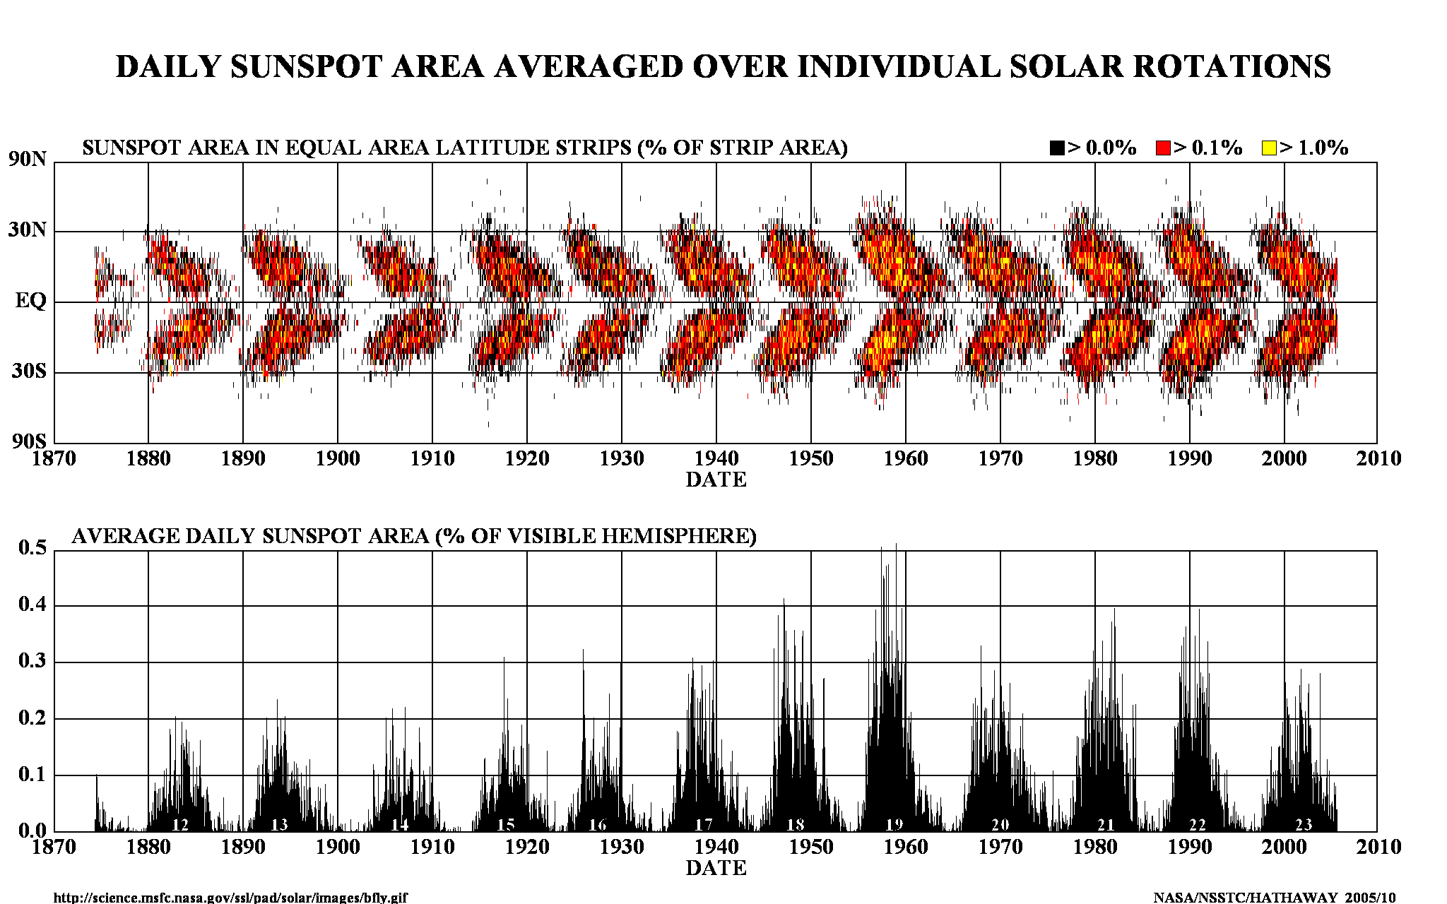
Current solar activity index

Slide 3
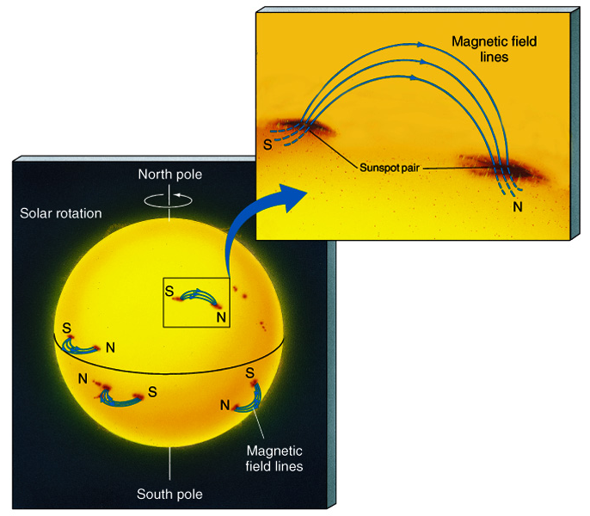
Sunspots & Magnetic Fields
The magnetic field in a sunspot is 1000x greater than the surrounding area
Sunspots are almost always in pairs at the same latitude with each member having opposite polarity
All sunspots in the same hemisphere have the same magnetic configuration

Slide 4
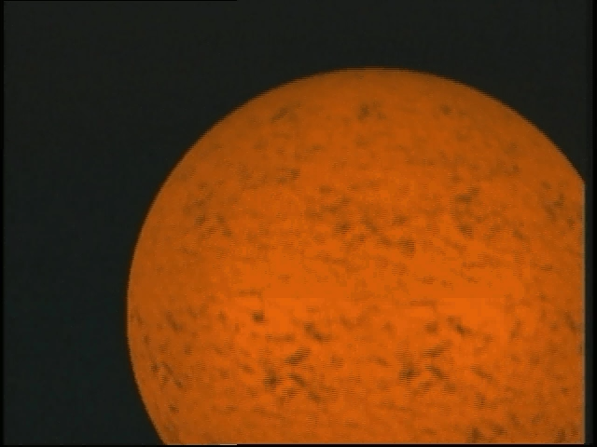
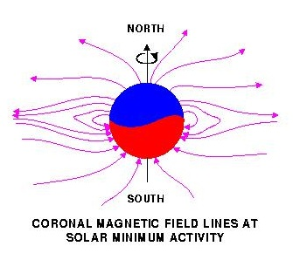
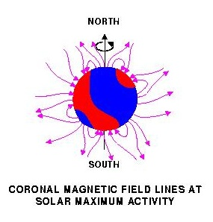
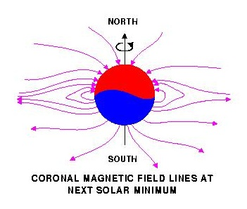
Solar magnetic field reversal
Strong toroidal magnetic fields (TMF) forming Active Regions (ARs)
are created in a shear layer beneath the base of the Solar Convection zone (SCZ).

Slide 5
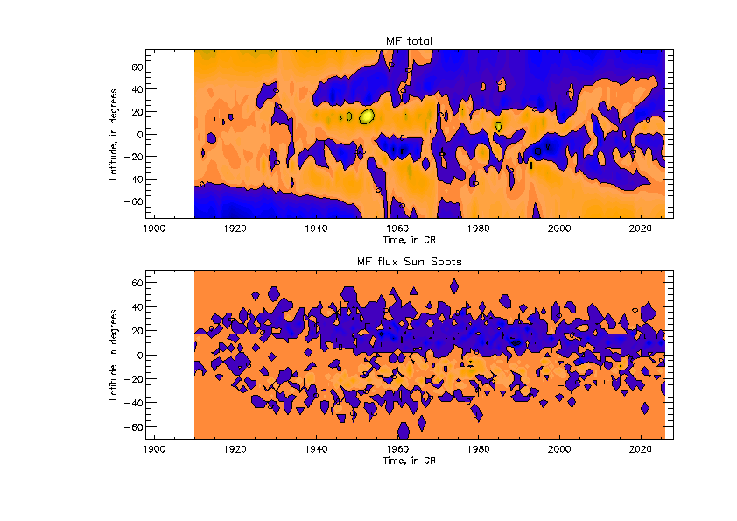
New proxy for solar activity index
SBMF (top) and sunspot MF (bottom)–
(Zharkov et al, 2008, Stix 1976)
Cycle 23 -Solar Background MF
Sunspot MF

Slide 6
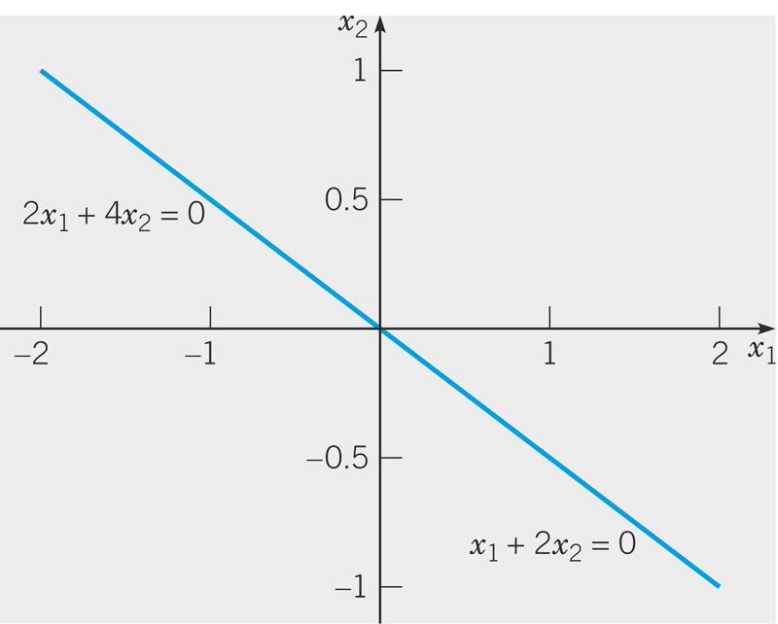
Example 5: Homogeneous Systems
Solve the system
By substitution we have
Or det(A)=(2)(2)-(4)(1)=0
Note that the system has an
infinite set of solutions
Since x₂ is arbitrary, set x₂=c.
Then x₁=-2c and all solutions
have the form
This is the eigen vector showing the blue line direction

Slide 7
Similar approach with PCA – waves are found from C-matrix
Introduced by Pearson (1901) and Hotelling (1933) to describe the variation in a set of multivariate data in terms of a set of uncorrelated variables
We typically have a data matrix of n observations on p correlated variables x₁,x₂,…x_{p}
PCA looks for a transformation of the x_{i} into p new variables y_{i} that are uncorrelated

Slide 8
Calculating eignevalues and eigenvectors of solar MF from covariance matrix C
The eigenvalues λ_{i} are found by solving the equation
det(C-λI)=0
Eigenvectors are columns of the matrix A such that
C=A D A^{T}
Where eigen values D=
Var(Y_{i})= λ_{i} for all i=1…p

Slide 9
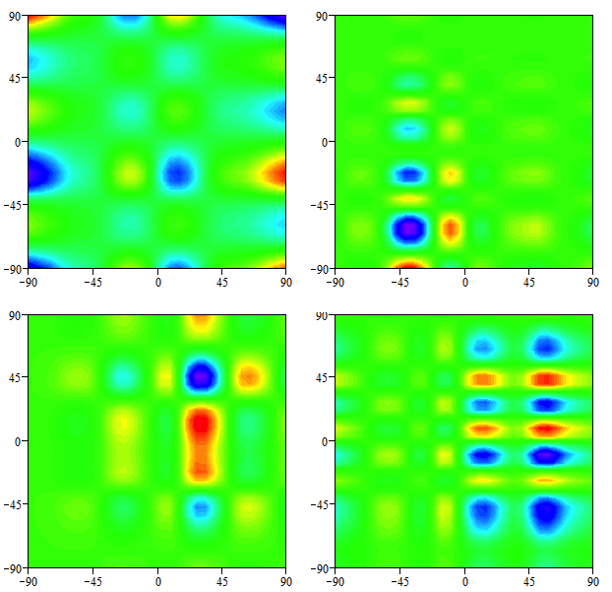
Cross-correlation of 8 EOFs
Zharkova et al., 2012
21-23

Slide 10
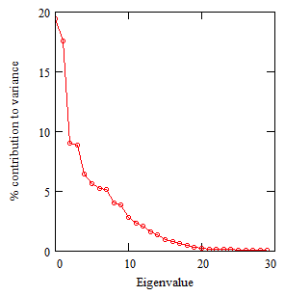
SBMF results: Scree plot
Eigenvalues vs variances
(Zharkova et al, 2012)
- 2 main eigenvalues covering 40% of variance –
(67% of SDV) -
- 3 pairs (6 eigenvalues) to cover
Dipole magnetic sources
Quadruple magnetic sources

Slide 11
Fitting the PCs to measured in cycle 24 and prediction to 25-26
Eigen vectors come in pairs, here are PCs
(Shepherd et al, 2014, Zharkova et al, 2015)

Slide 12
Mathematical laws from PCs: Symbolic regression -Hamiltonian approach (Schmidt and Lipton, 2009, Science)Schmidt & Lipson, 2009, Science)
Mathematical law for the first principal component:
F₁(t) = Σ_{k=1,..,5} A_{k} cos(ω_{k,1}t +ϕ_{k,1})cos(B_{k,1} cos(ω_{k,1}t +ϕ_{k,1})
Mathematical law for the second principal component:
F₂(t) = Σ_{k=1,..,5} A_{k} cos(ω_{k,2}t +ϕ_{k,2})cos(B_{k,2} cos(ω_{k,2}t +ϕ_{k,2})

Slide 13
S Summary curve of 2 PCs v
(Zharkova et al, 2015)

Slide 14
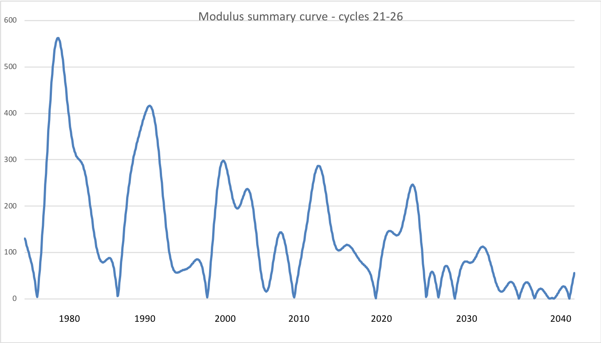
Modulus summary curve
Zharkova et al, 2015, SciRep; 2020, Temp., Zharkova et al, 2022, MNRAS s sunsdata
(Shepherd et al, 2014 ; Zharkova et al, 2015)
Cycle 21
Cycle 22
Cycle 23
Confirmed by
Katiashvili, 2020, ApJ;
Obridko et al, 2021, MNRAS
Velasco-Herrera et al, 2021
Cycle 21
Cycle 22
Cycle 23
Cycle 24
Cycle 25
Cycle 26

Slide 15
Predicted solar activity (Zharkova et al, 2015, SR https://www.nature.com/articles/srep15689)
Zharkova et al, 2015, Nature SR
Observational result, dynamo model was not yet considered
Discovery of grand solar cycles :350-400 years
In addition to 11 year cycles
https://solargsm.com/solar-activity/ - my webpage

Slide 16
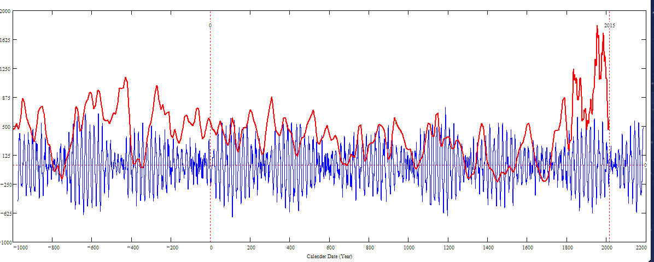
Double dynamo summary curve for 3000 years (blue) versus the s/s curve by Solanki et al. 2004 (red)
Homeric minimum^{[13]} | 750 BCE | 550 BCE
Oort minimum | 1040 CE | 1080 CE
Medieval maximum | 1100 | 1250
Wolf minimum | 1280 | 1350
Spörer Minimum | 1450 | 1550
Maunder Minimum | 1645 | 1715
Dalton Minimum | 1790 | 1820
Zharkova et al, 2015, 2018
Sporer minimum in 1400-1600 in C¹⁴ is caused by s/n Vela Junior
Oort
Wolf
Maunder
Homeric
Periods – grand cycle: 350-400 years and super-grand cycle :2000-2100 years

Slide 17
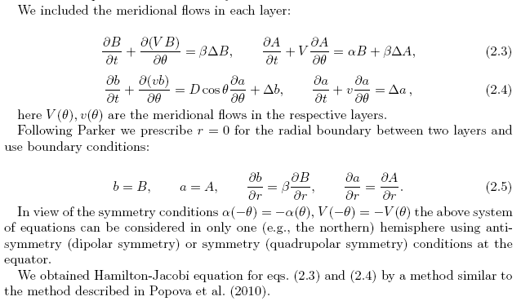
2 layer dynamo model explaining some PCA features
Zharkova et al, 2015, Popova et al, 2013

Slide 18
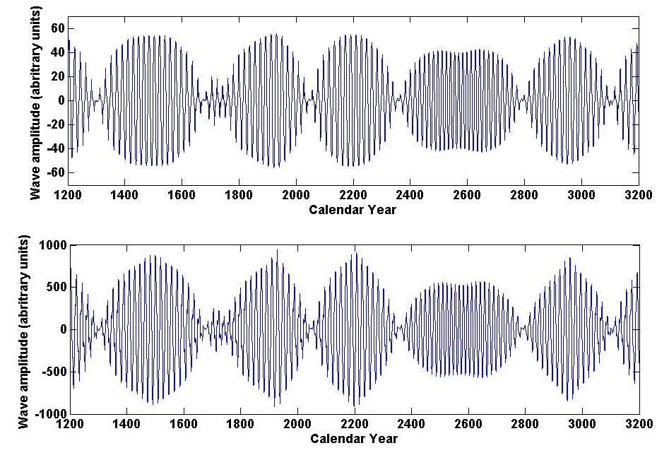
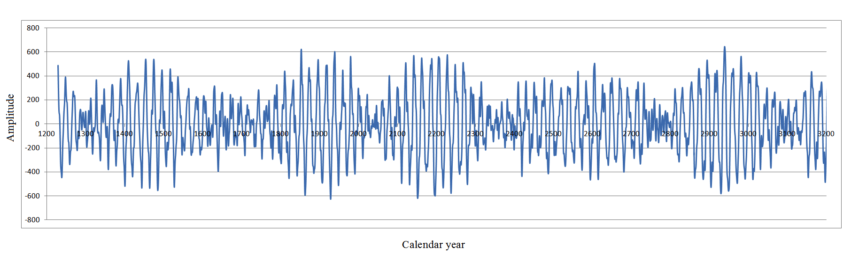
Dynamo model (top) and summary curve (bottom
Summary dynamo wave
on the millennium scale (Zharkova et al, 2015, Nature SR)
Popova et al, 2013
Zharkova et al, 2015, SR https://www.nature.com/articles/srep15689

Slide 19
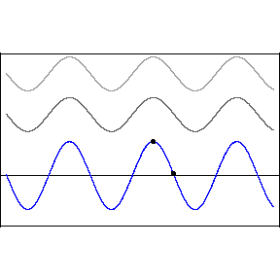
Interference
The two waves interference
y₁(x,t)=Acos(kx-ωt) (top wave),
y₂(x,t)=Acos(kx-ωt+D) (middle wave)
y(x,t)=y₁(x,t)+ y₂(x,t)
resulting wave with amplitude B
ω – frequency, k –wave number,
x – wave displacement
D – phase difference
A - Amplitude
D=0 constructive interference, B=2A
D=π (180º) –destructive interference, B= 0

Slide 20
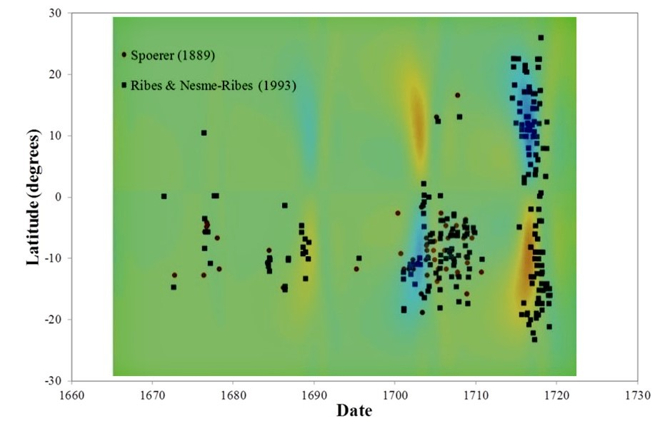
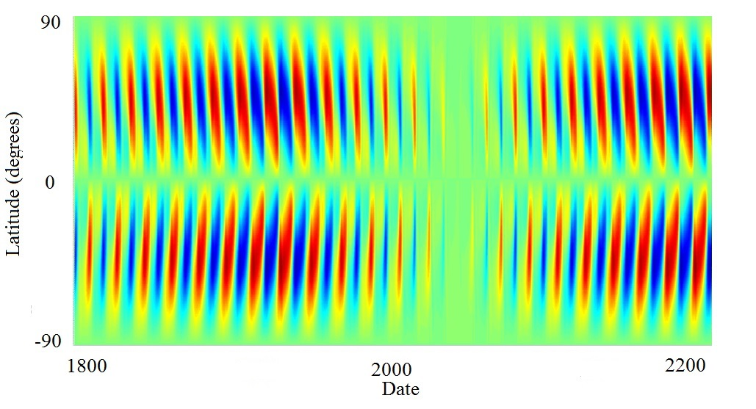
Maunder Grand Solar Minimum
Upcoming Grand Solar Minimum
Zharkova et al, 2015, 2023; Popova et al, 2018

Slide 21
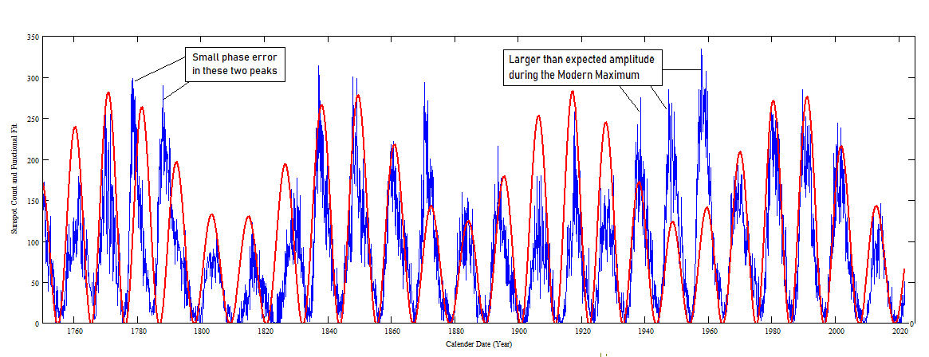
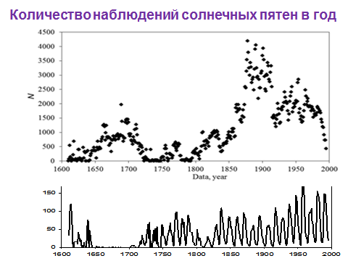
Verification of summary curve with sunspot index Zharkova et al, 2023
Red – averaged sunspot numbers;
Green – modulus summary curve
Zharkova et al, 2023

Slide 22
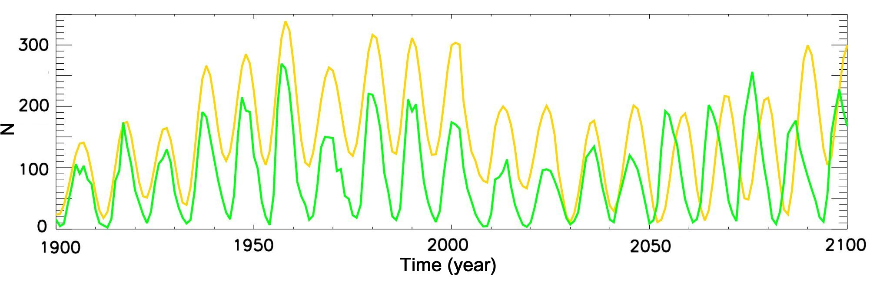
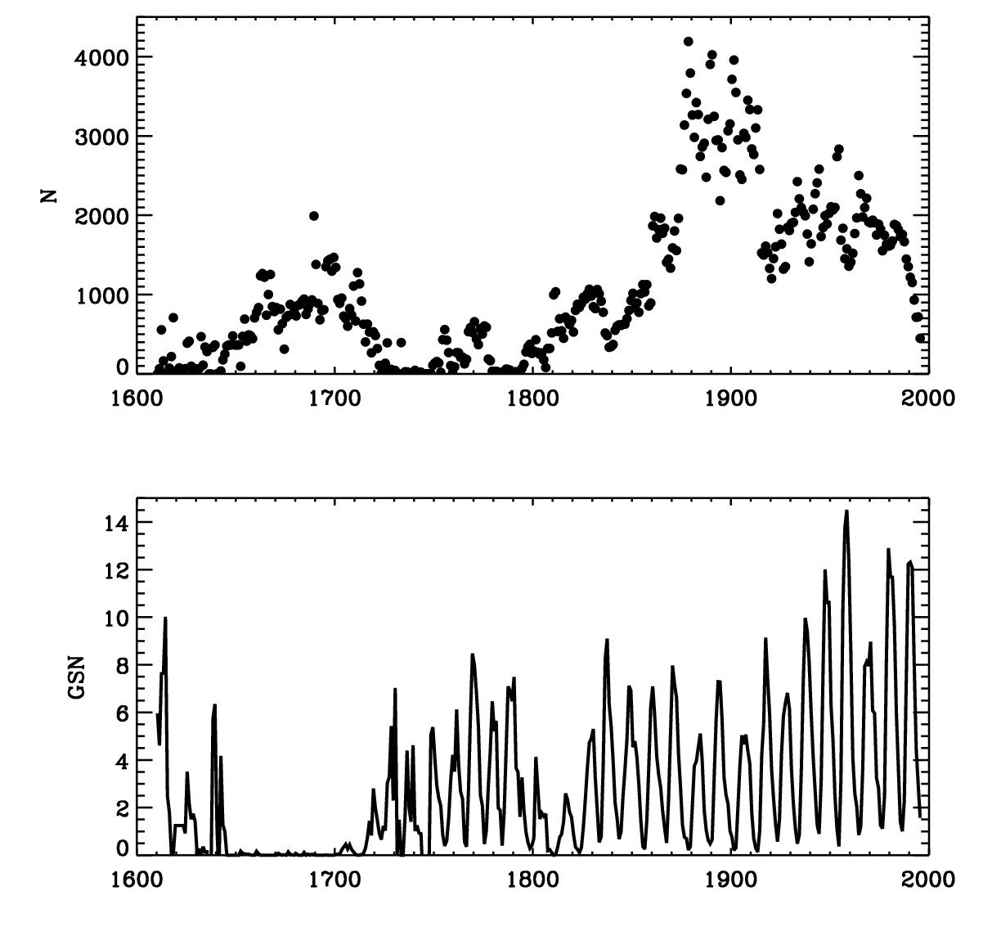
Number of sunspot observ ations was low in 17-19 centuries
Different calendars used in different ccounttries (Gregorian vs Julian)
sunspot index restored with Bayesian method Velasco-Hirrara et al, 2021, 2022
Number of sunspot observations
In the past
Current sunspot index

Slide 23
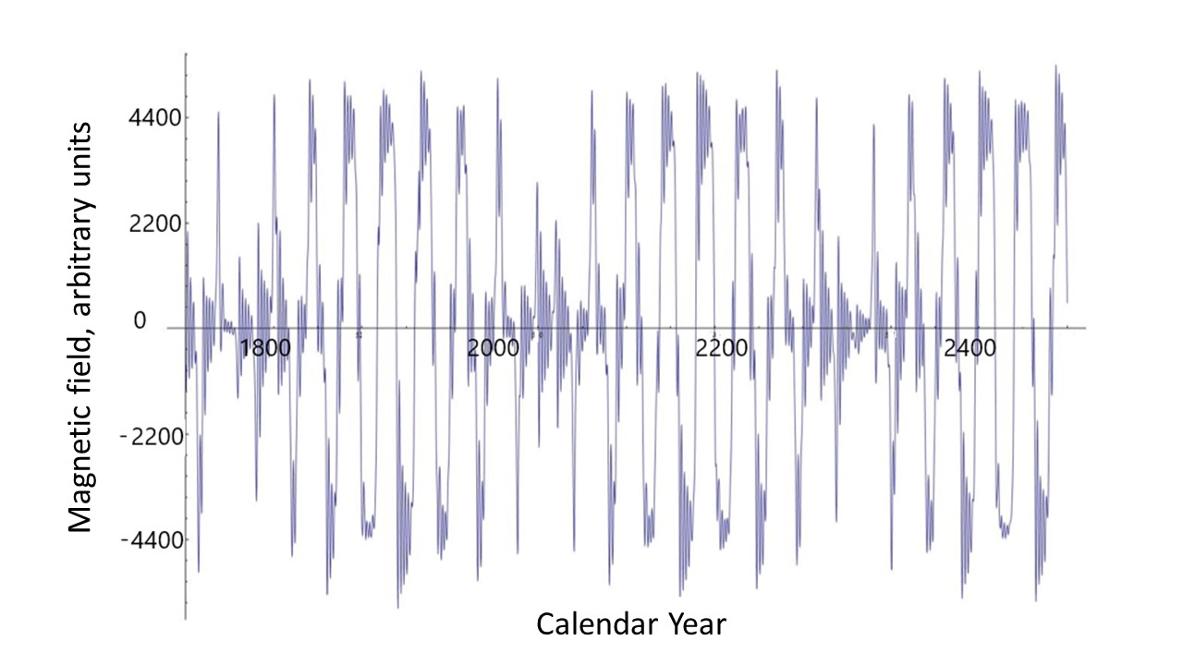
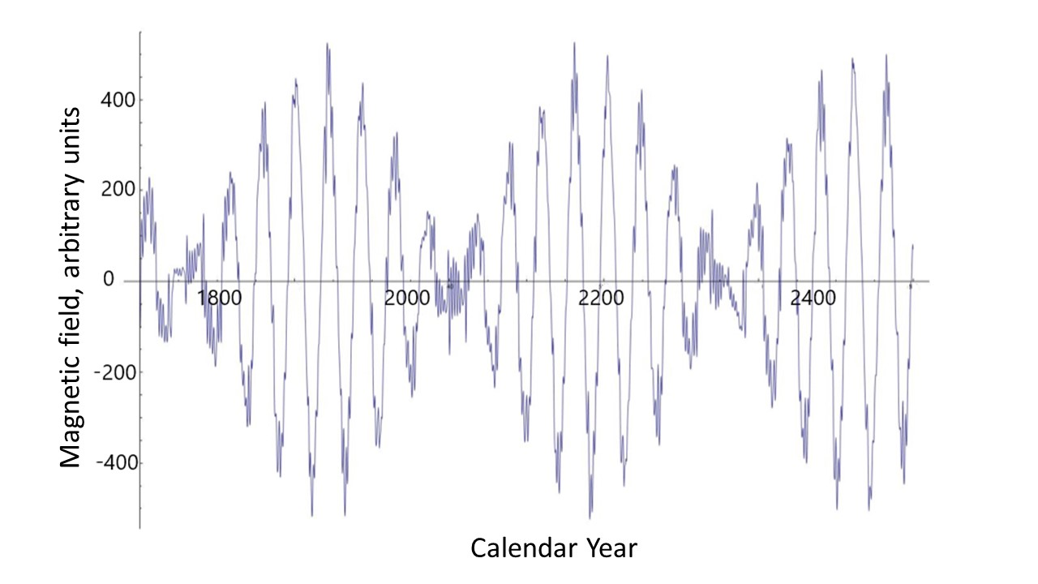
3. Different nature of MFL Poloidal (left, solar background) versus toroidal (right, sunspots) magnetic fields

Slide 24
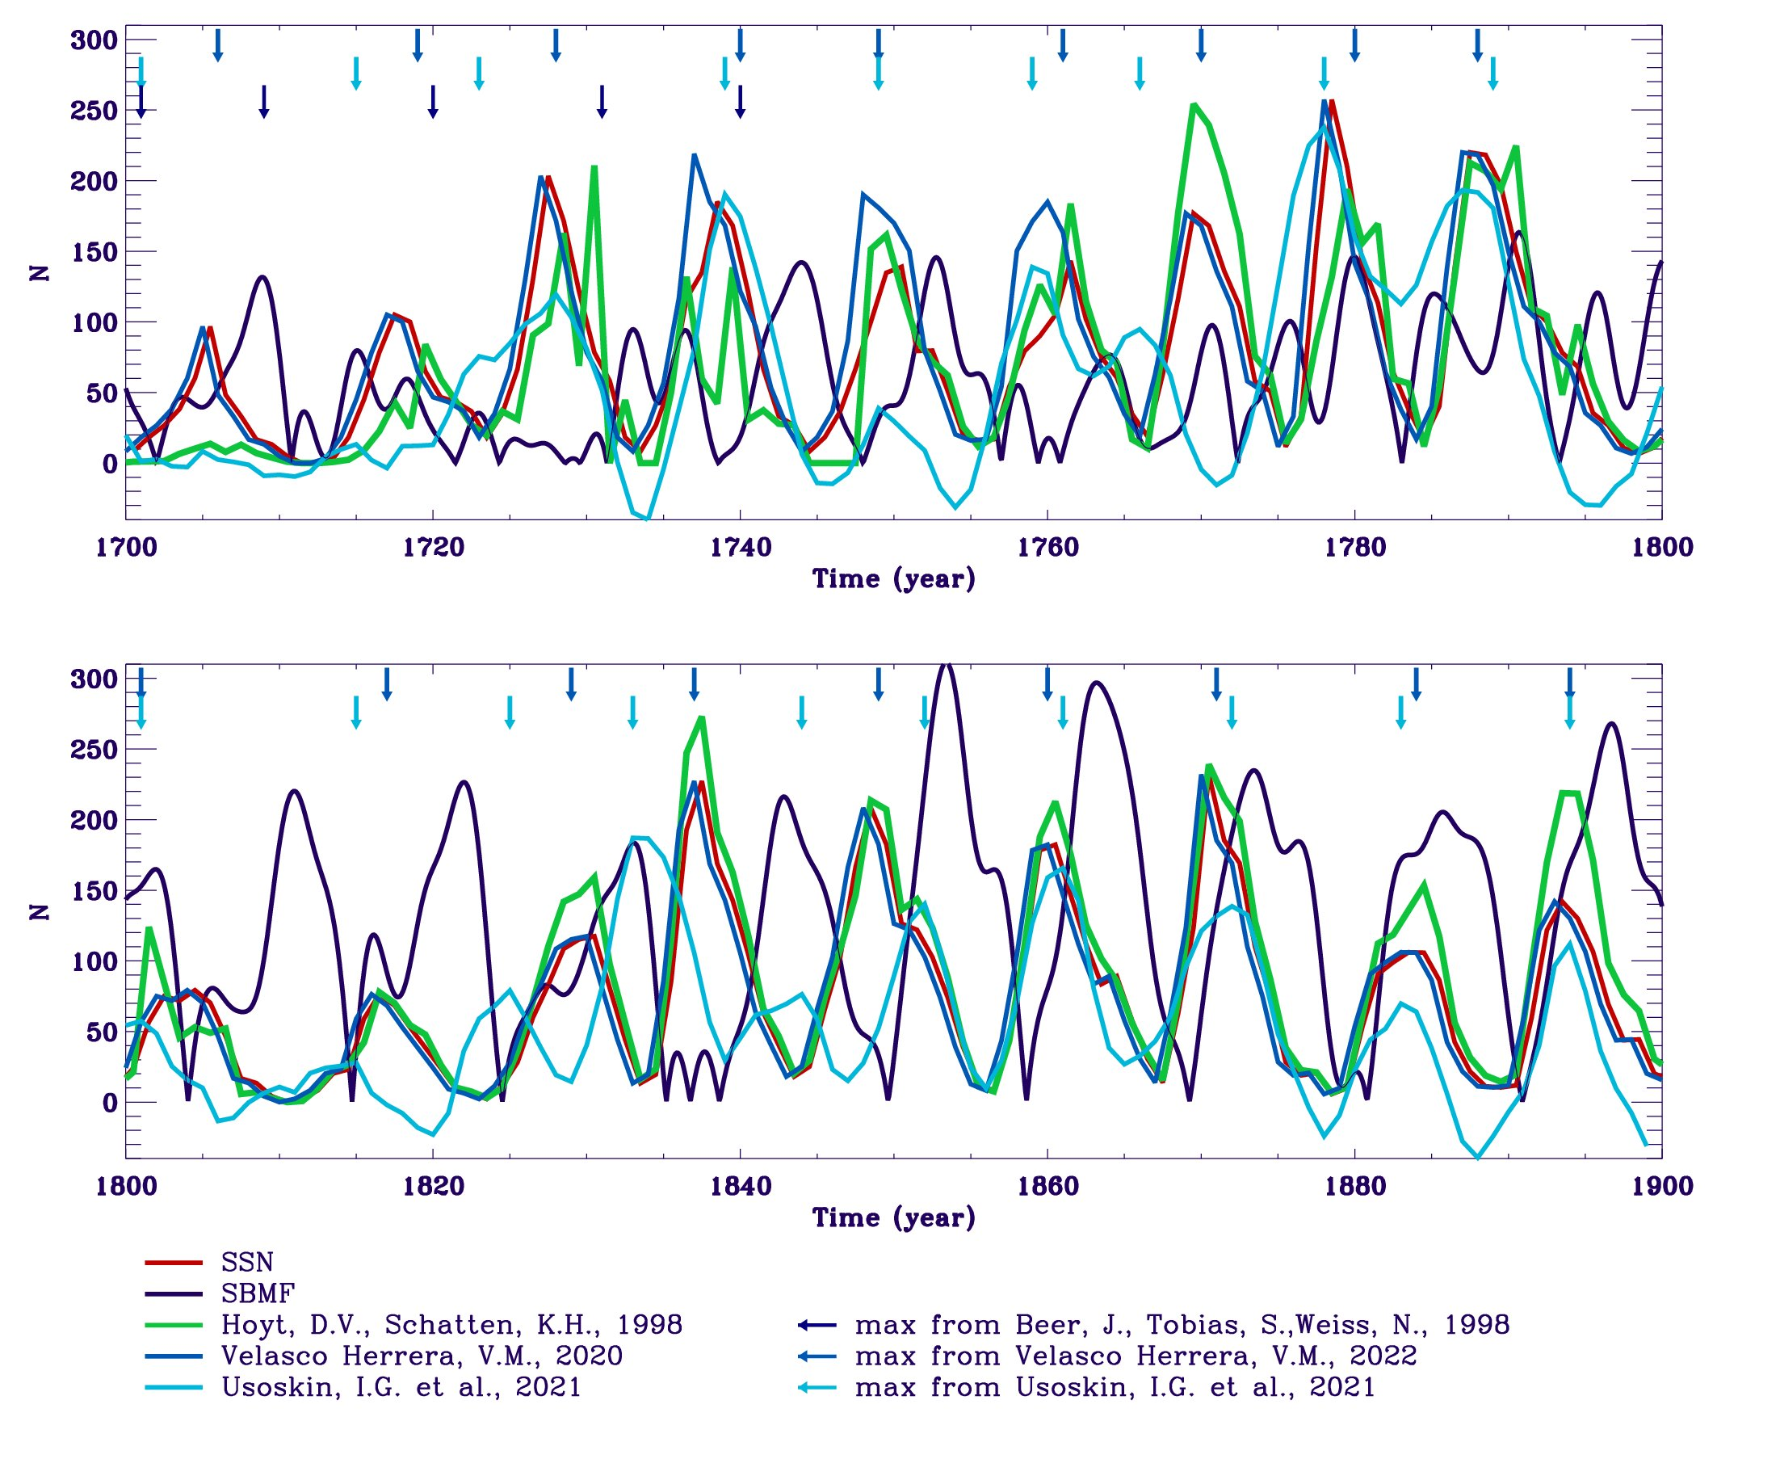
Revised maxima in sunspot index in the 18-19 centuries (Usoskin et al., 2021)

Slide 25
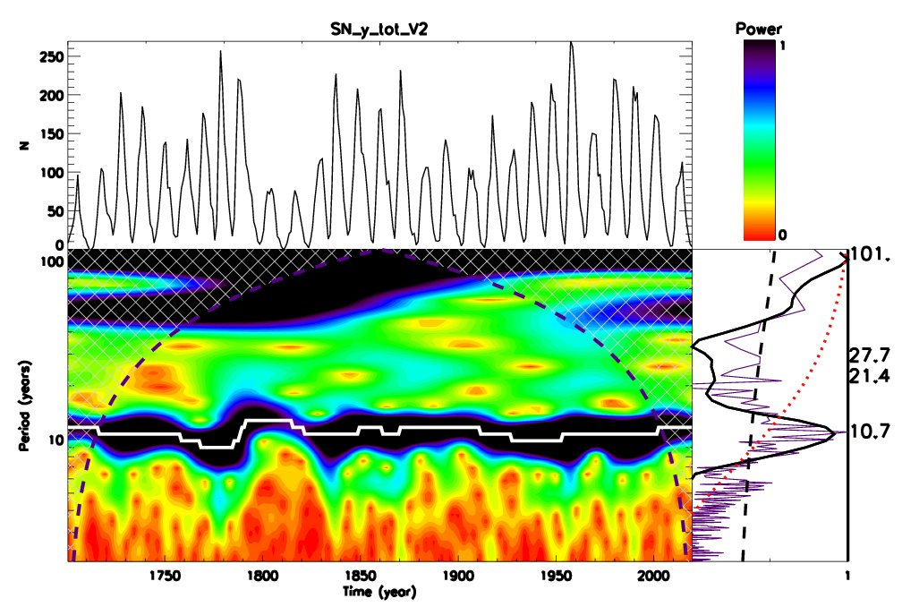
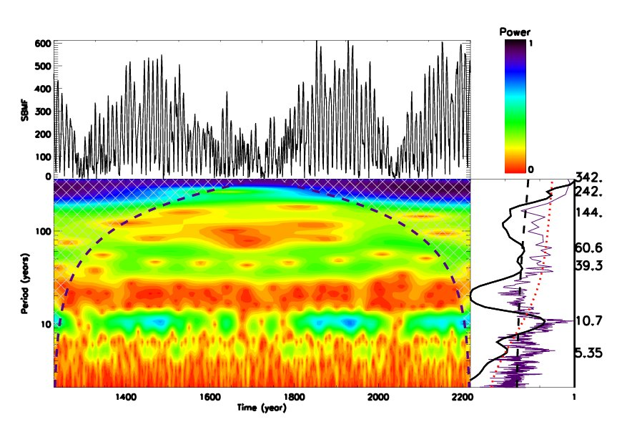
Wavelet spectral analysis confirms period of 10.7 years
Averaged sunspot numbers Modulus summary curve of PCs Z15
Main period – 10.7 years
Periods of 50-55 and 101 years – lower than a red noise level

Slide 26
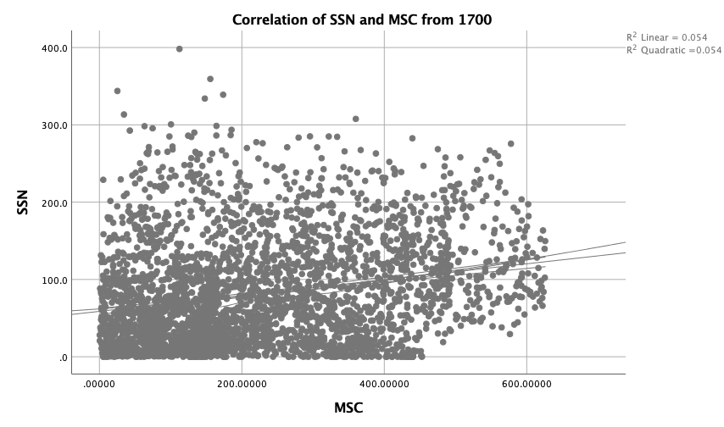
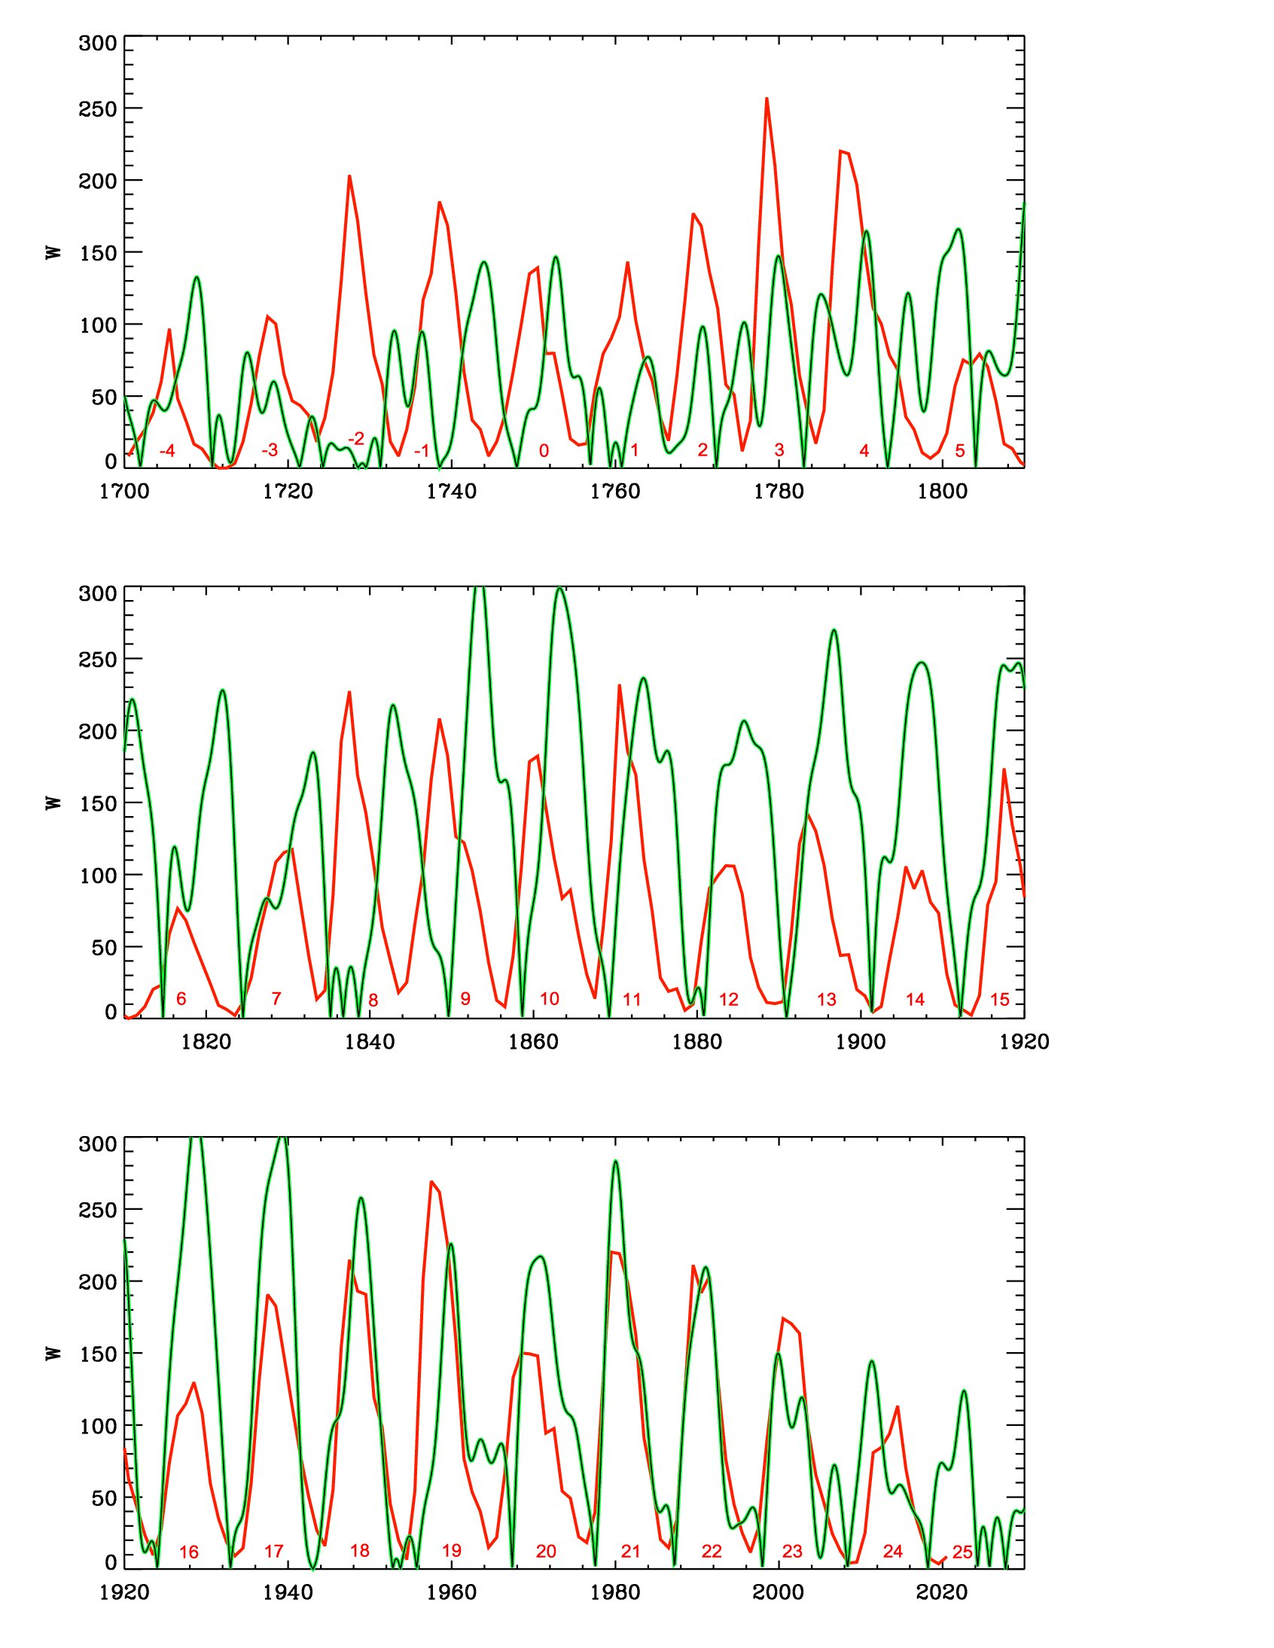
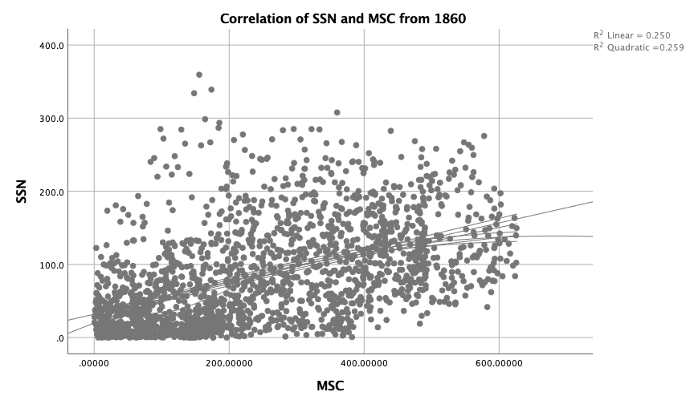
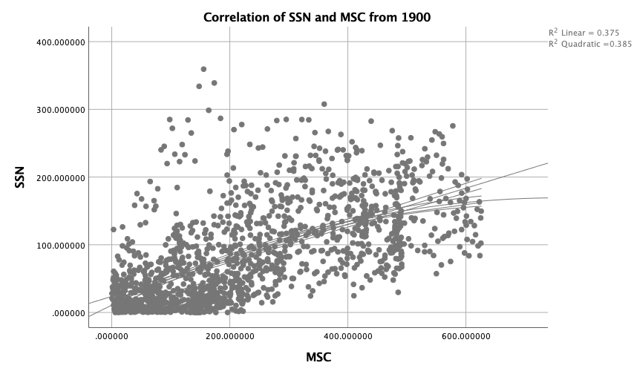
Correlation with SPSS of SSN with MSC
25%
56%
67%

Slide 27
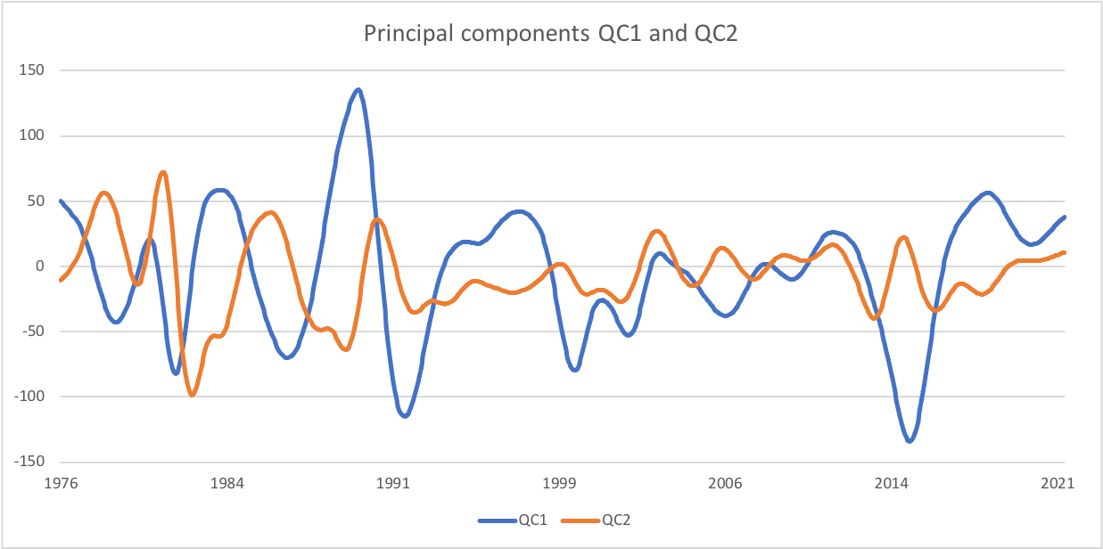
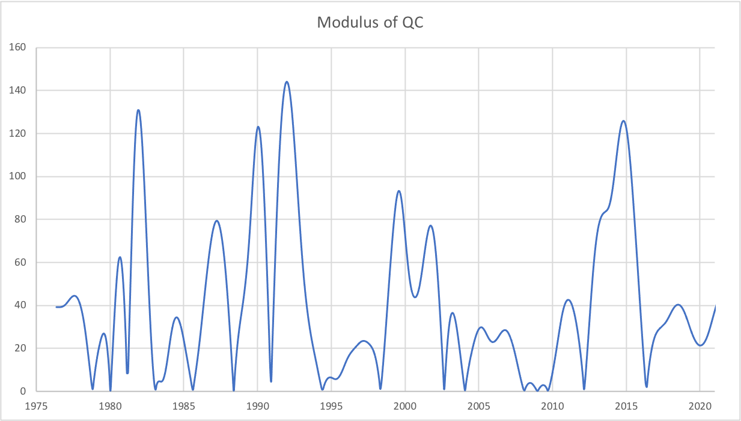
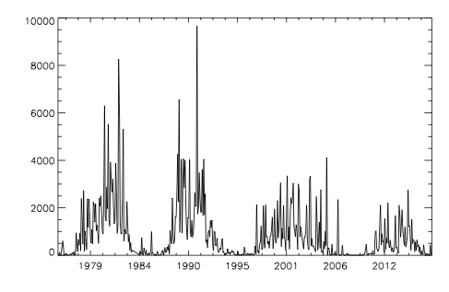
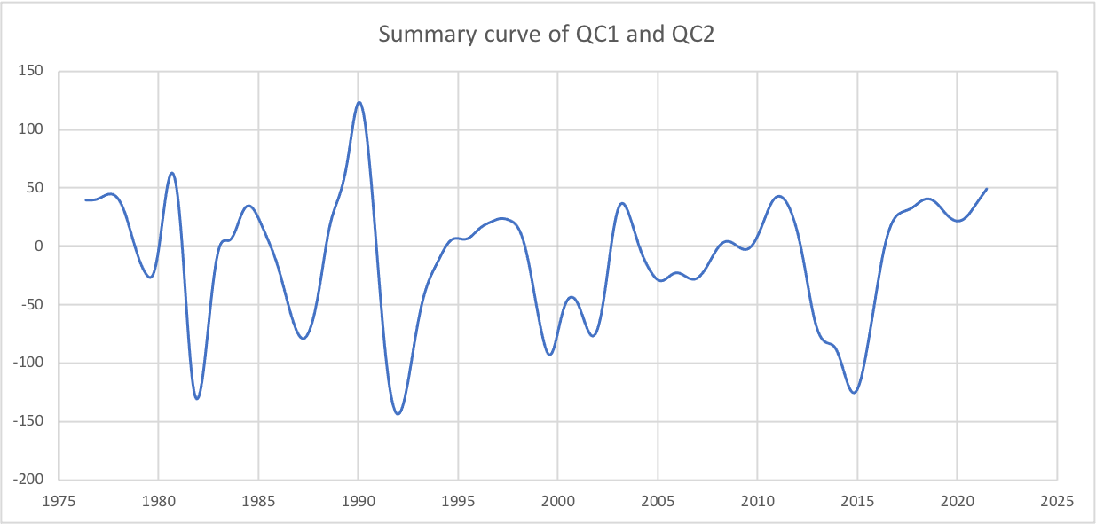
Quadruple components of Eigen Vectors correlate with SHR flux of flares
Zharkova and Shepherd, 2022, MNRAS, 512, 5085 https://solargsm.com/wp-content/uploads/2022/04/zharkova_shepherd_mnras22.pdf

Slide 28
Quadruple magnetic sources
Summary curve for the current grand cycle, Popova et al, 2018, JASTP

Slide 29
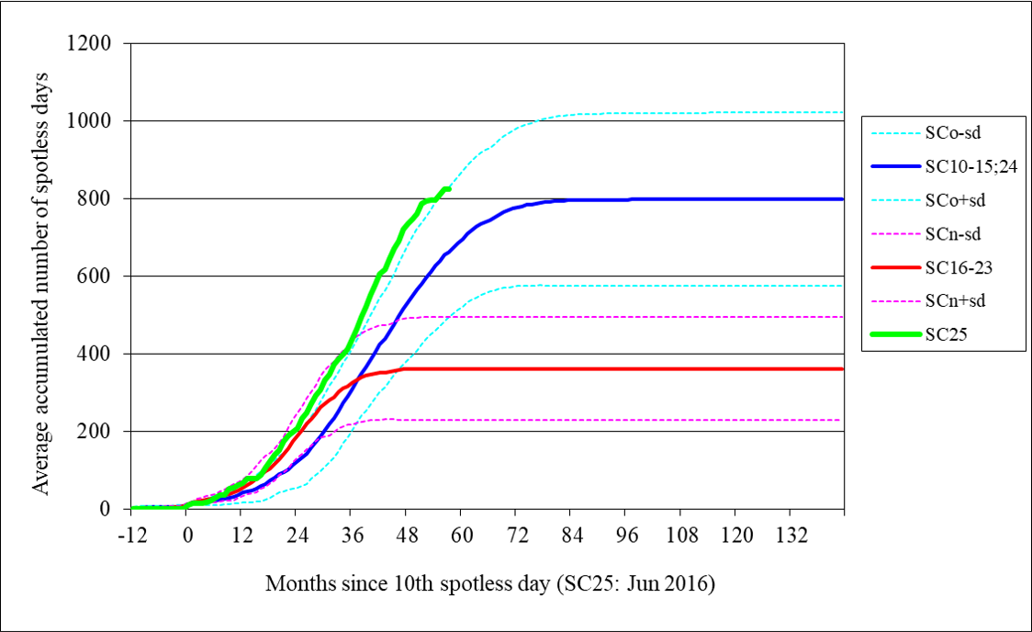
Modern grand solar minimum 2020-2053 – what to expect
Cycle 25 (green line) shows a steeper growth of the number of spotless days than any other cycles including the ones during Dalton min (cycles 15 and 24) (blue line)

Slide 30
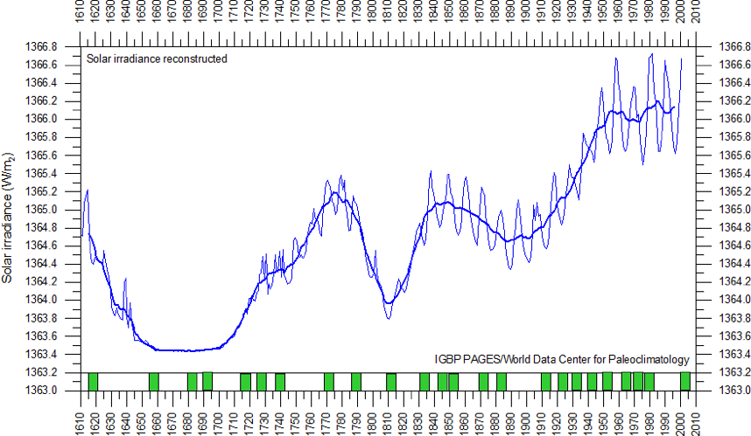
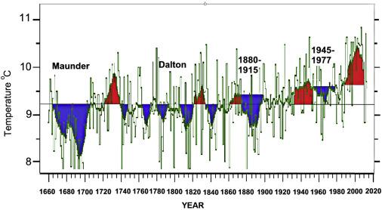
Solar irradiance and terrestrial temperature during MM
Lean et al, 1995, JGR
Lamb, 1972; Easterbrook, 2016
Authors | S, Maunder minimum, W/m² | S 1990-2000, W/m² | △S from MM, %
Lean et. Al., 1995 | 1363 | 1366 | 0.22
Steinhilber et al, 2012 | 1364 | 1366 | 0.22
Shirley et al., 1990 | --- | 1370 | 0.51
Wolff and Hickey, 1987 | --- | 1371 | 0.51
Lee et al., 1995 | --- | 1372 | 0.51
After the TSI data were re-normalized the old data are hardly usable

Slide 31
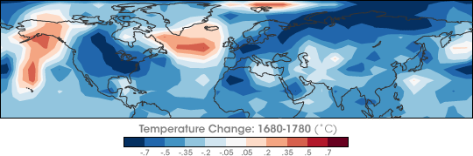
Temperature restoration during/after MM
(Shindell et al., 2001, Science)
The surface temperature of the Earth was reduced all over the Globe
Europe and North America went into a deep freeze
Alpine glaciers extended over valley farmland
Sea ice crept south from the Arctic
Dunab and Thames rivers & canals in the Netherlands froze regularly

Slide 32
Temperature restoration during MM
(Shindell et al., 2001, Science)
the drop in the temperature was related to dropped abundances of ozone created by solar ultra-violate light in the stratosphere, the layer of the atmosphere located between 10 and 50 kilometers from the Earth’s surface

Slide 33
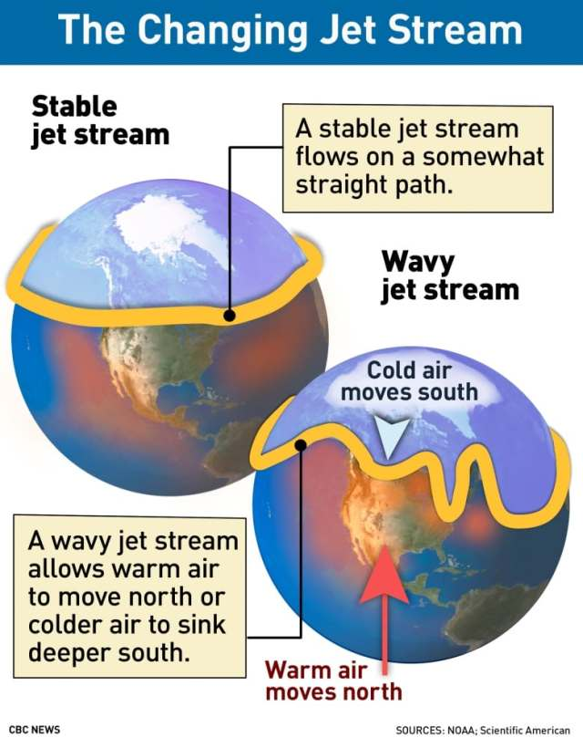
Less ozone affected planetary atmosphere waves
They, in turn, caused the giant wiggles in the jet stream as shown in picture on the left
It kicked the North Atlantic Oscillation (NAO)—the balance between a permanent low-pressure system near Greenland and a permanent high-pressure system to its south—into a negative phase
that led to Europe to remain unusually cold during the MM
Shindell et al., 2001

Slide 34
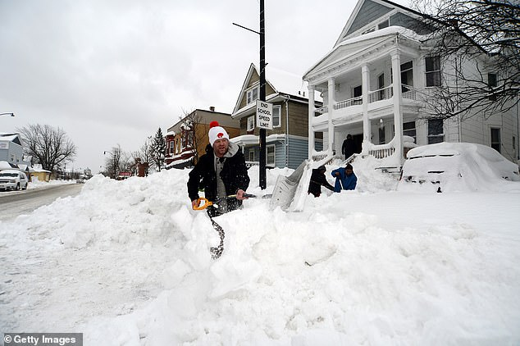
Snow blizzards in USA and Canada for 2 weeks in Dec ’22 –Jan’ 23

Slide 35
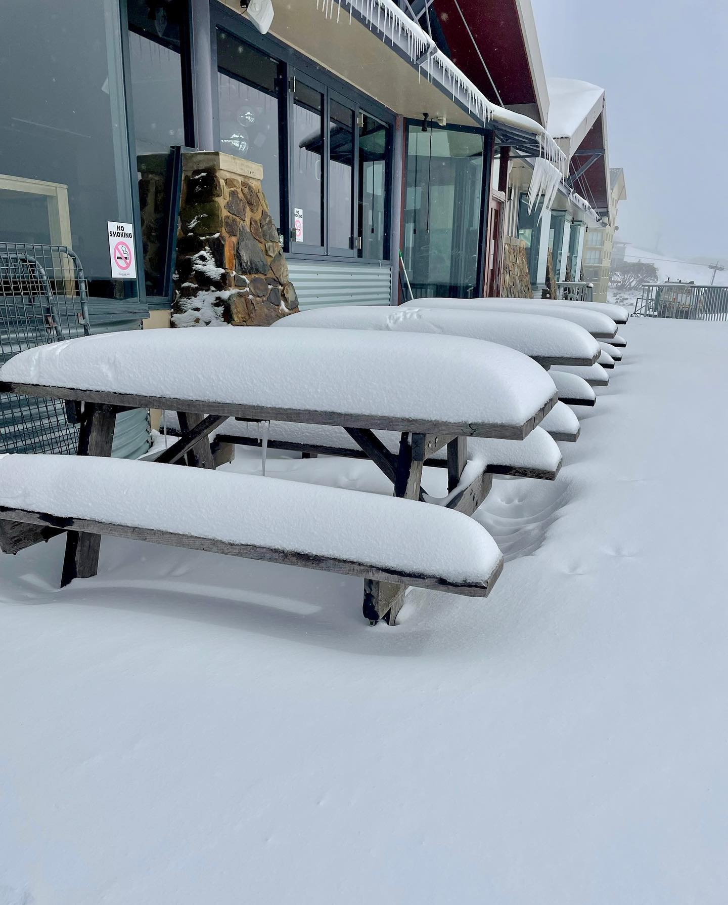
Late spring snow in Australia and NZ 22-30 November ’22
(analog of late May in Northern hemisphere)

Slide 36
Modern Grand Solar Minimum https://solargsm.com/solar-activity/
To occur in 2020 – 2053
This is a unique event in solar-terrestrial connection → will reveal the pros and cons of solar dynamo models
Decrease of solar magnetic field → big impact ozone reduction, high cloud formation, jet direction changes, cosmic rays increase
Increase of volcanic and earthquake activities
Effects on the terrestrial temperature via TSI, jets and volcanic activity
Shortage of vegetation periods can lead to possible food shortages in 2028-2042
Need inter-government efforts to avoid disasters

Slide 37

Thanks for your attention!

