Slide 1

Kinetic turbulence generated by accelerated particles in a reconnecting current sheet with magnetic islands
Valentina Zharkova (1) and Qian Xia (2)
1 -University of Northumbria, Newcastle upon Tyne, UK
2 – Culham Centre for Fusion Energy, Abingdon, UK
Funded by AFOSR, US
1
Notes:
1

Slide 2
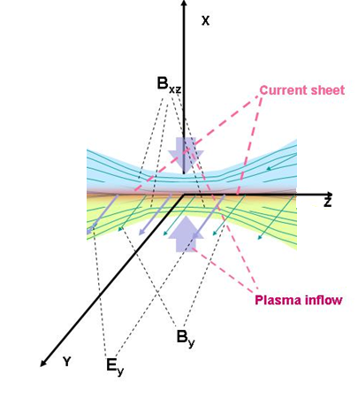
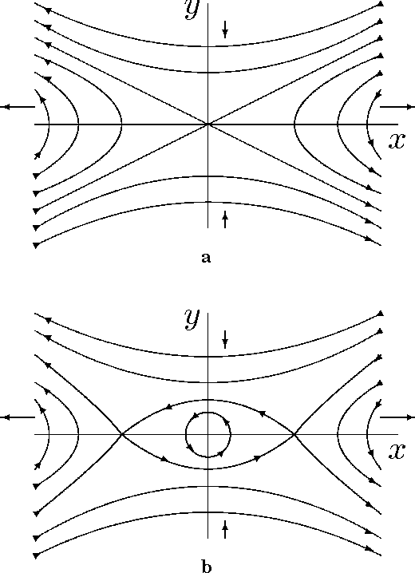
Physical model of reconnection current sheet
PIC simulations (2.5D - XOOPIC, 3D -VPIC)
A single X-null
O-type
(magnetic island)
Siversky and Zarkova, 2009, JPP, 75,
Zharkova and Khabarova, 2012, ApJ, 752, 35;
2015, Ann Geo, 33, 457;
Khabarova et al, 2020, ApJL, 894, L12
Xia and Zharkova, 2018, 2020, 2021a,b, A&A
Notes:
Tracking the plasma inflow
2

Slide 3
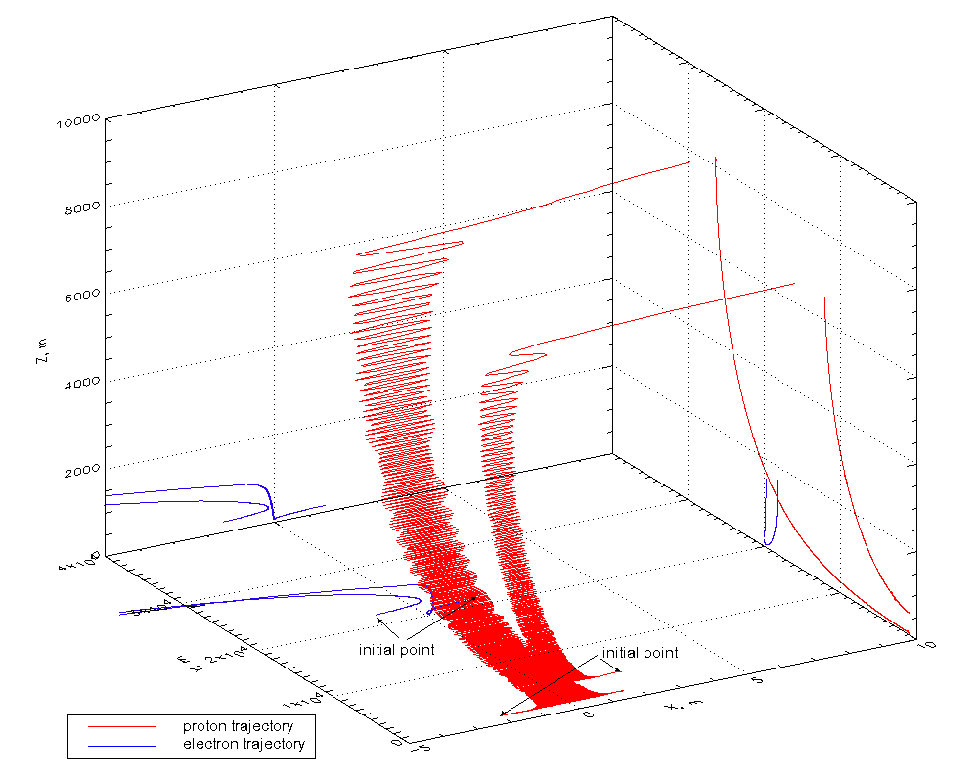
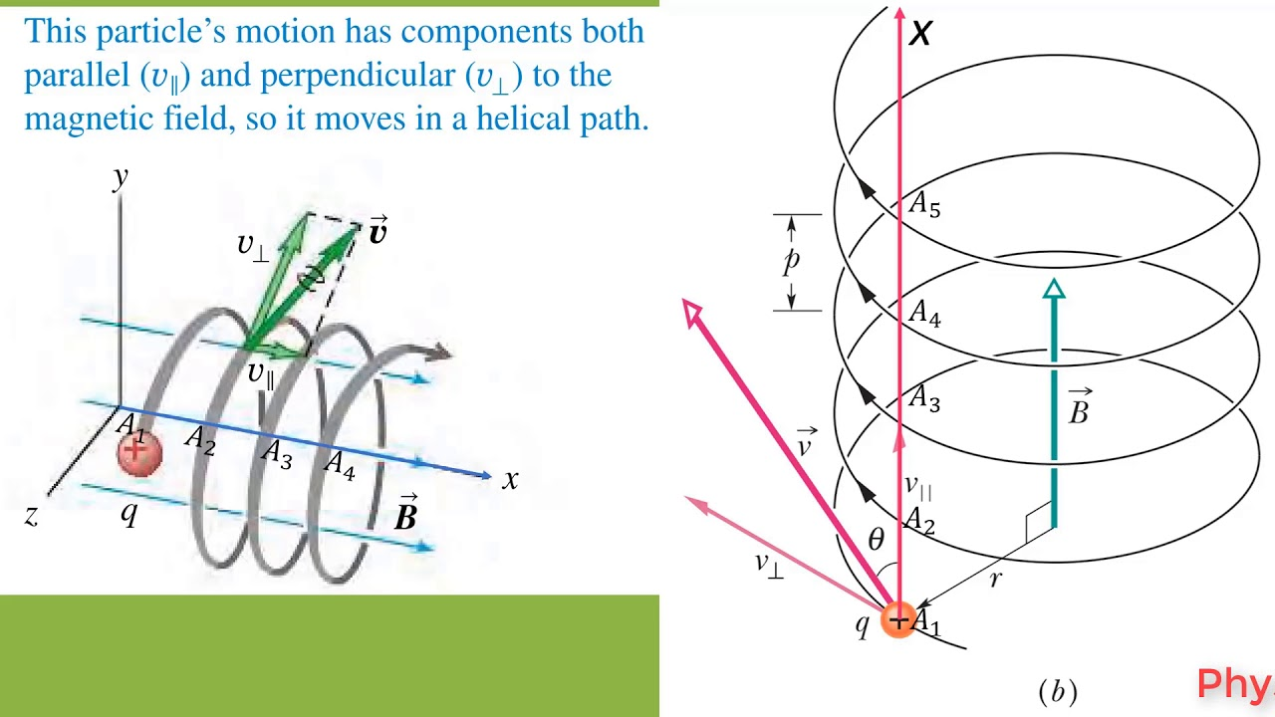
dN/d ε ~ A ε^{-1.5}
dN/d ε ~ B ε^{-2.0}
ZA 2009, JPP
TP: Zharkova & Gordovskyy, 2004, Apj; 2005, MNRAS, SSRv,
Zharkova and Agapitov, 2009, JPP

Slide 4
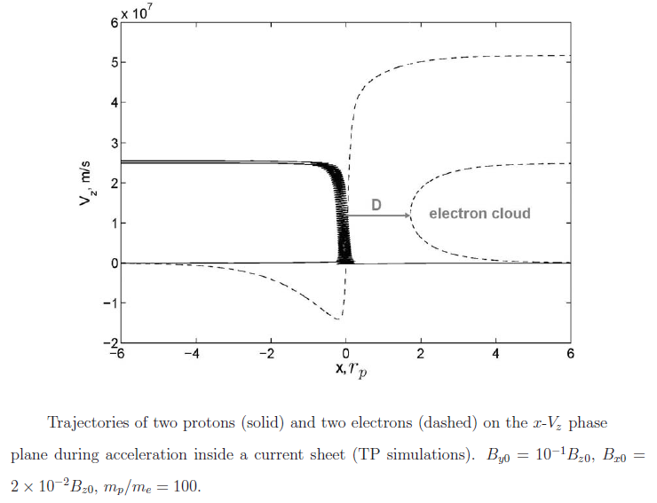
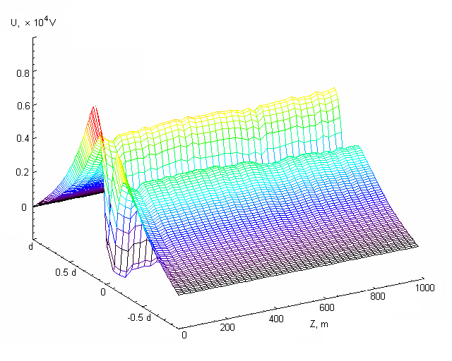


Trajectories of protons and electrons in PIC model of HCS
Siversky & Zharkova, 2009, JPP
Zharkova & Khabarova, 2012, ApJ
transit e
Bounced e
transit p
Bounced p
×10 V/km
Polarisation (Hall’s) electric field potential induced by separation of electrons from ions (Zharkova and Agapitov, 2009, JPP)
- full separation

Slide 5
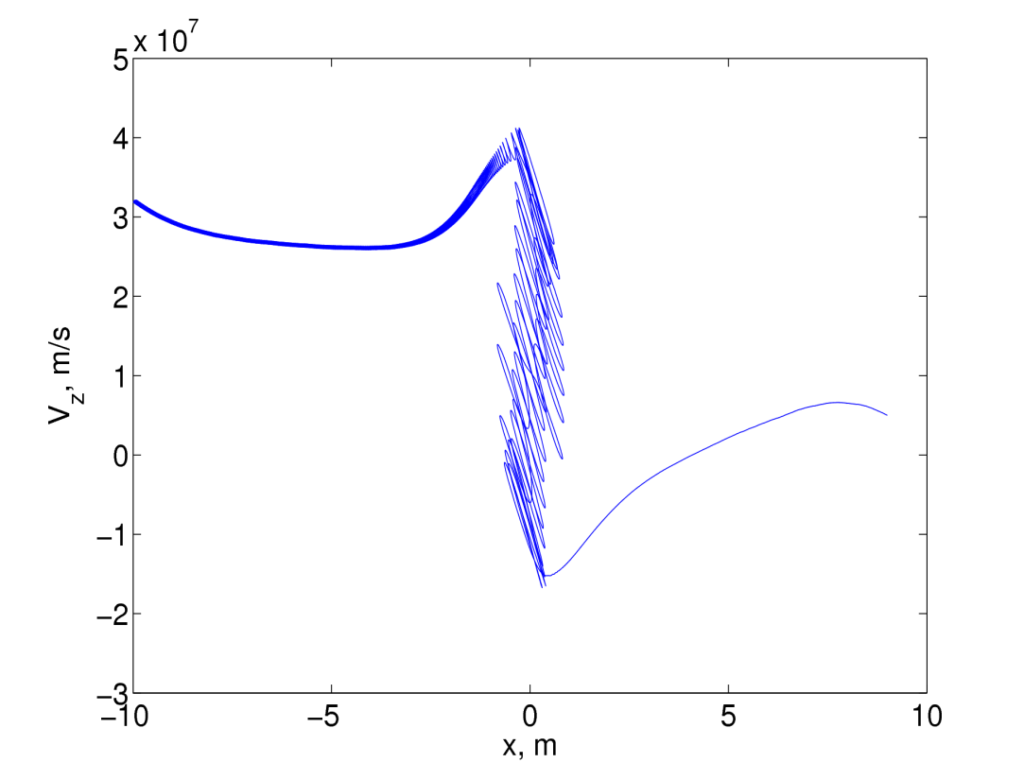
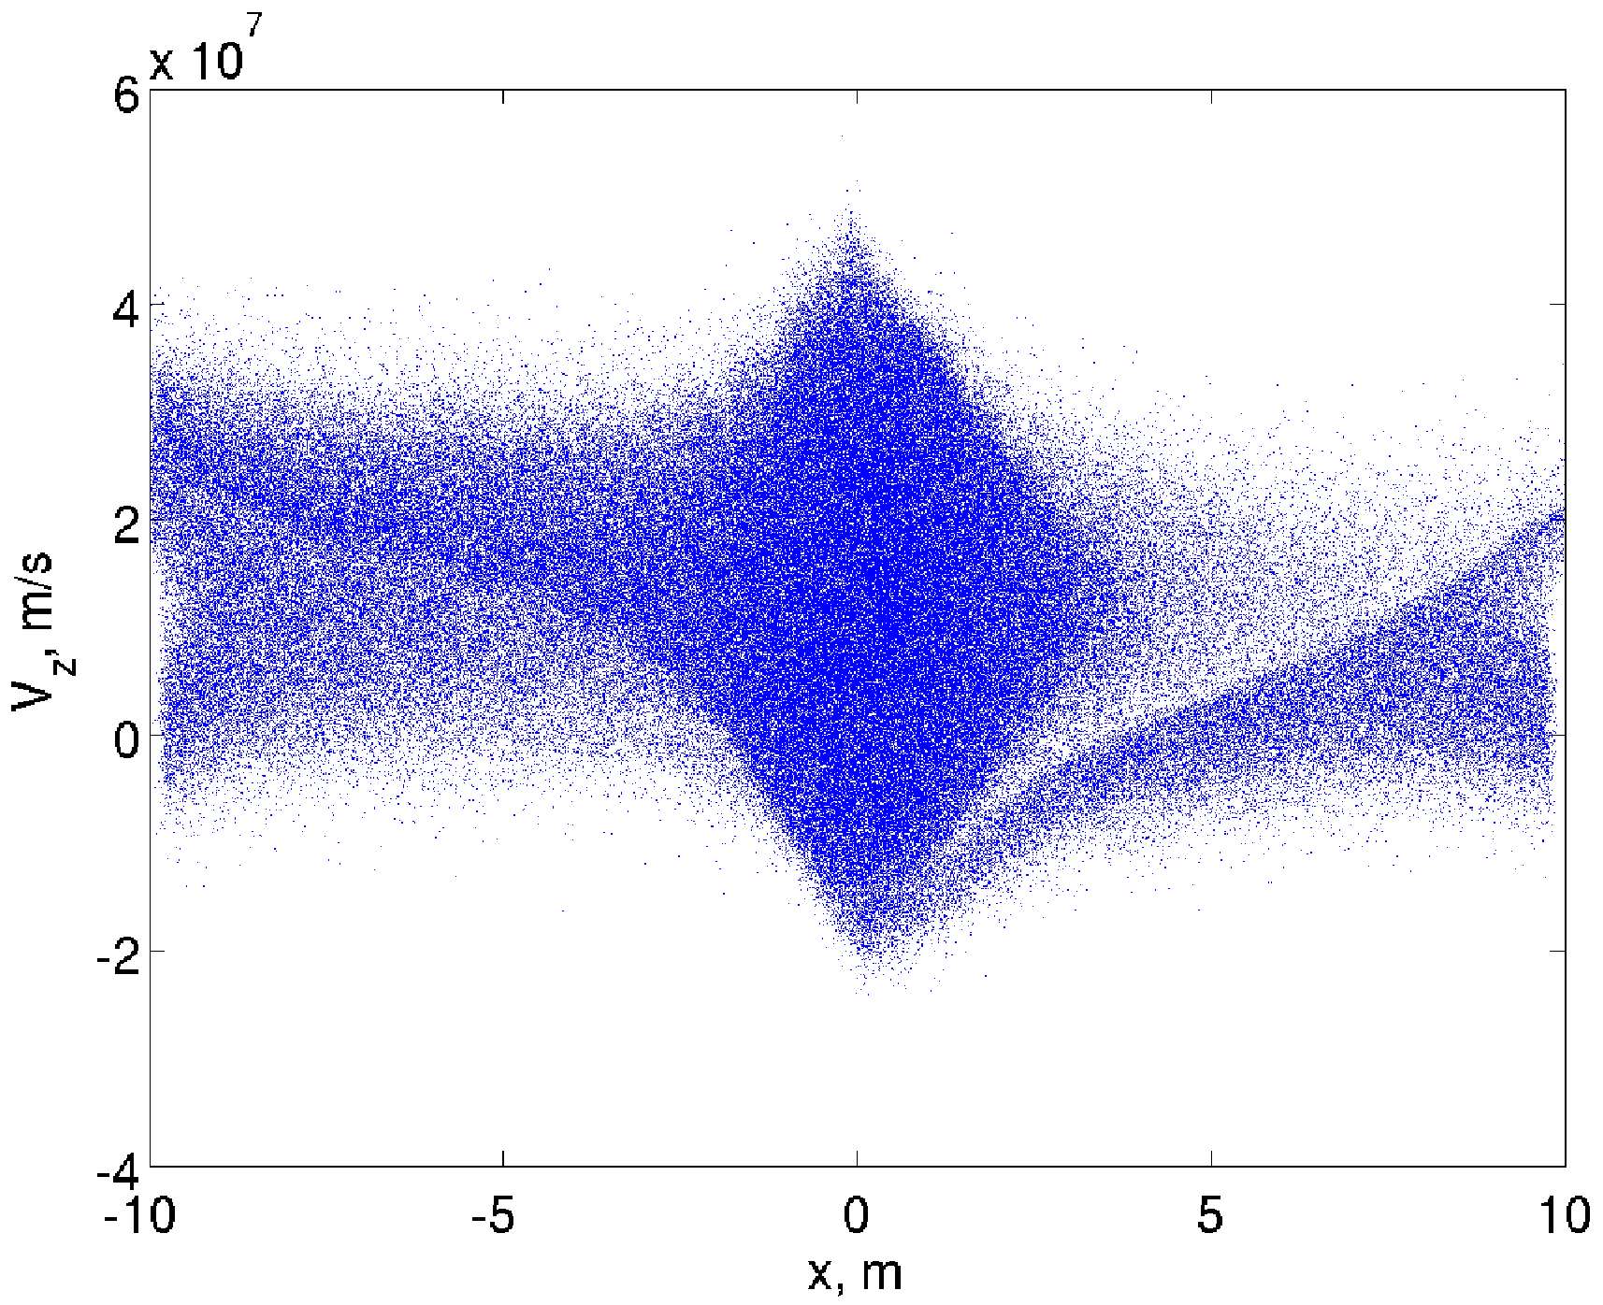
Trajectories of protons and electrons (both bounced and transit) in PIC model (solar corona) top source: electron clouds
P, x=+-10m
Vx=0
N=10⁴ cm⁻³
e, x=-10m
Vx=-5x10⁶
N=10⁴ cm⁻³
e, x=-10m
Vx=-5x10^6
N=10⁶ cm⁻³
e, x=10m
Vx=-1x10⁷
N=10⁴ cm⁻³

Slide 6
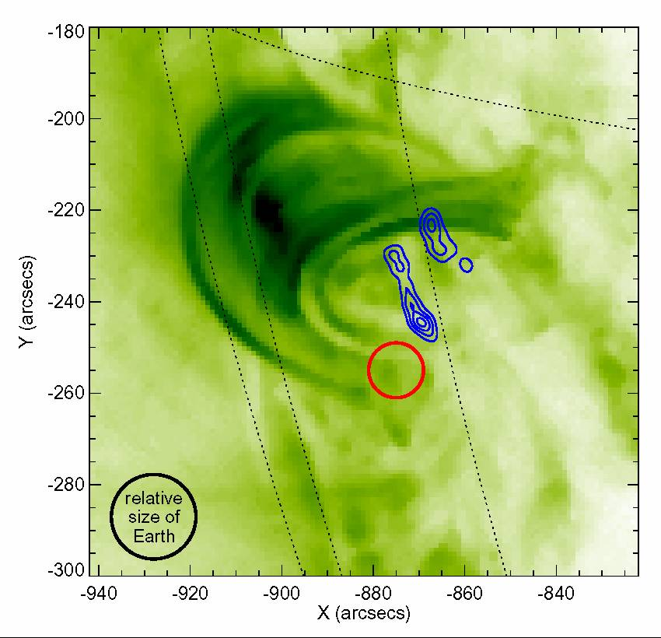
Separation of HXR (blue) and Gamma-ray (red) emission
Flare 23 July 2002, RHESSI,
Lin et al (2003)

Slide 7
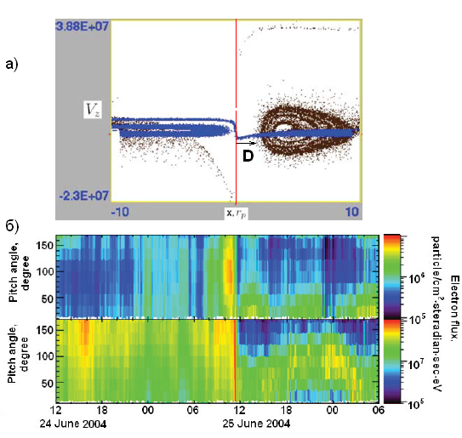
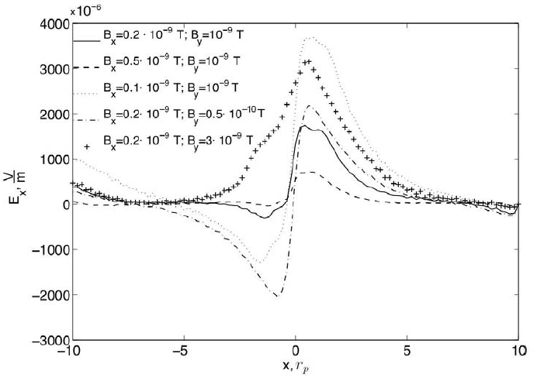
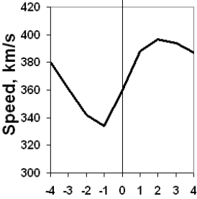
Electron PADs and ion velocities
Heliospheric current sheet
Quasi-continuous reconnection in the HCS can explain a few KEY puzzles in the observations of the dynamics of ions and electrons in the solar wind (see UKSP nugget 29)
.
T. Siversky, V.Zharkova, 2009, JPP, 75, 5
V. Zharkova et al, 2011, SSRv, 157, 359
V.Zharkova, O. Khabarova,2012, ApJ, 752, 35

Slide 8
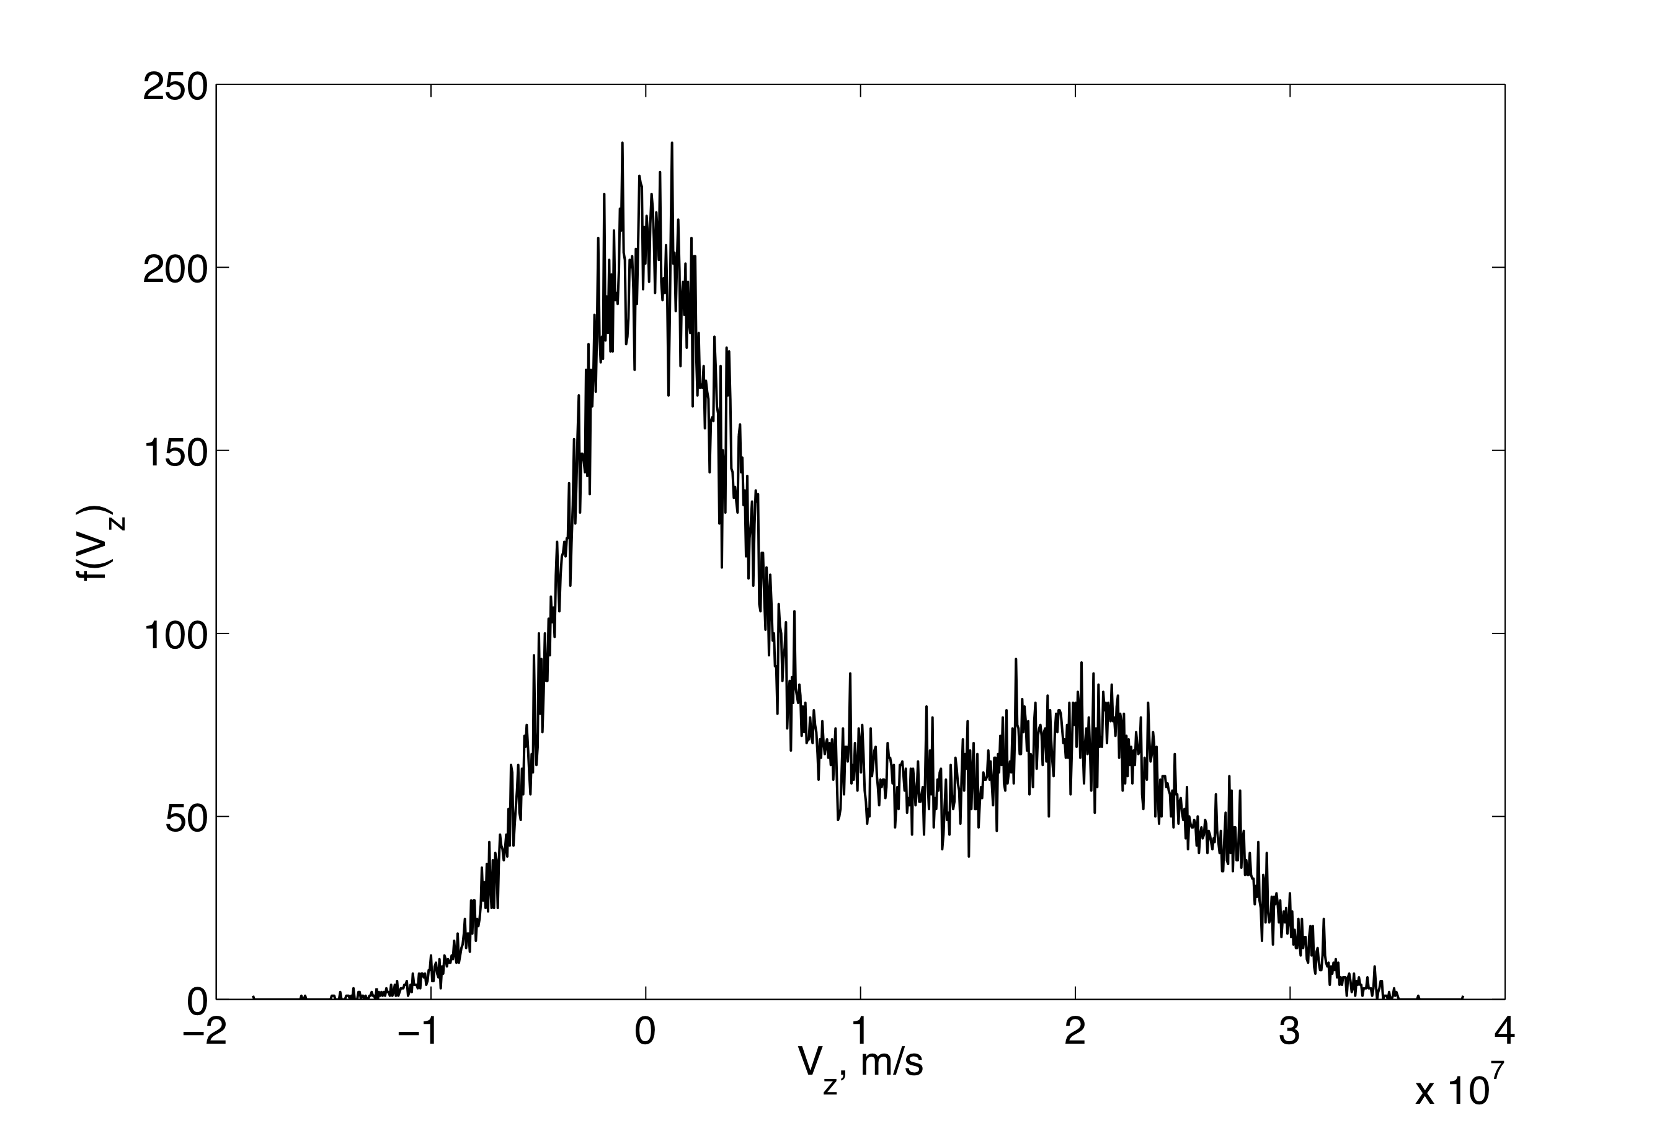
Electron energy distributions (X-nullpoint): main max – bounced, secondary max - transit
Transit e
Bounced e
PIC: electron distribution in RCS with a single X-nullpoint

Slide 9
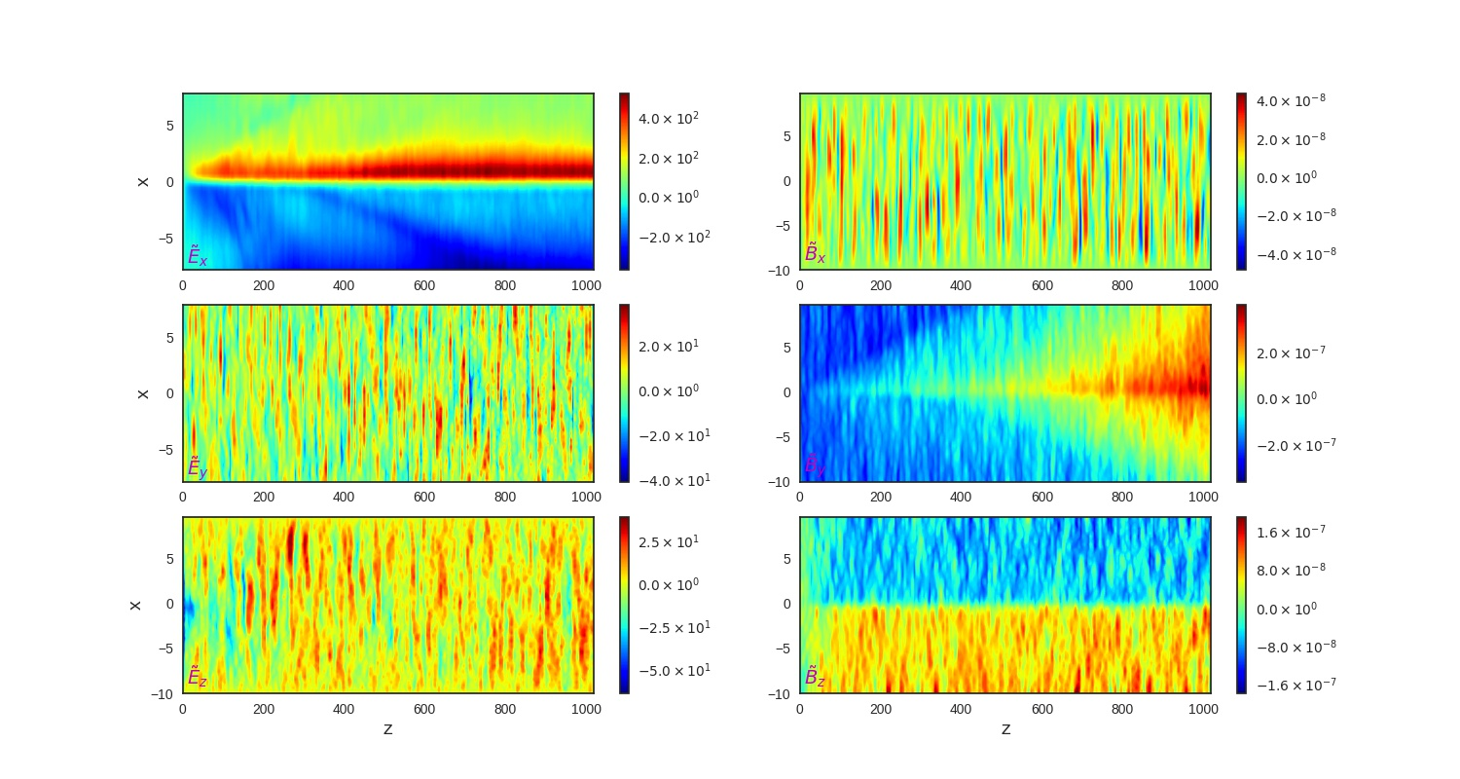
Electric and magnetic fields induced by accelerated particles
E
B

Slide 10
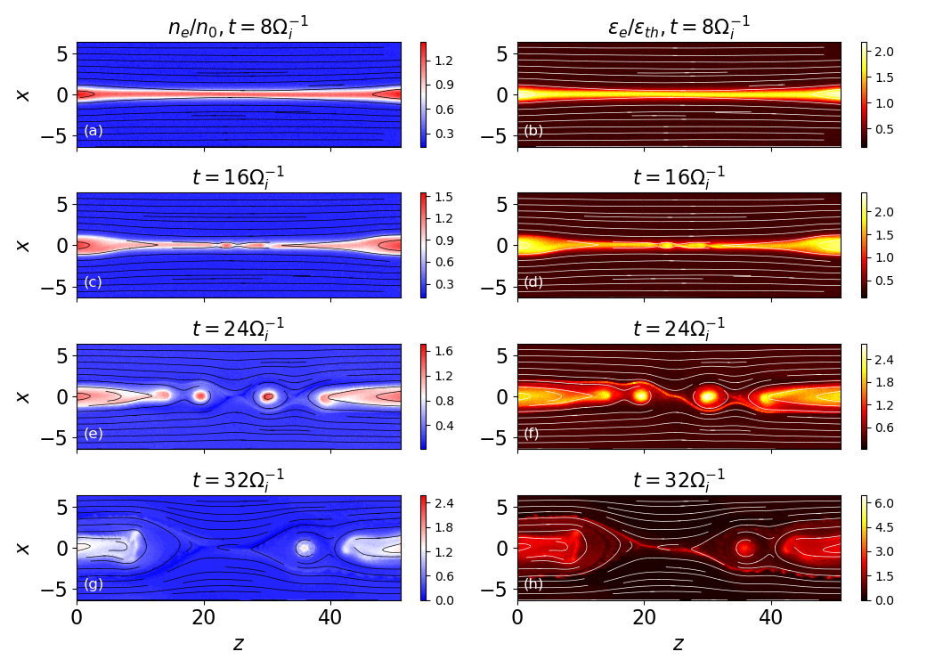
PIC simulation of 3D RCS with MIs
Simulations of magnetic reconnection is presented in a thin current sheet with 3D magnetic field topology affected by tearing instability → leads to formation of two large magnetic islands using particle-in-cell (PIC) approach.

Slide 11
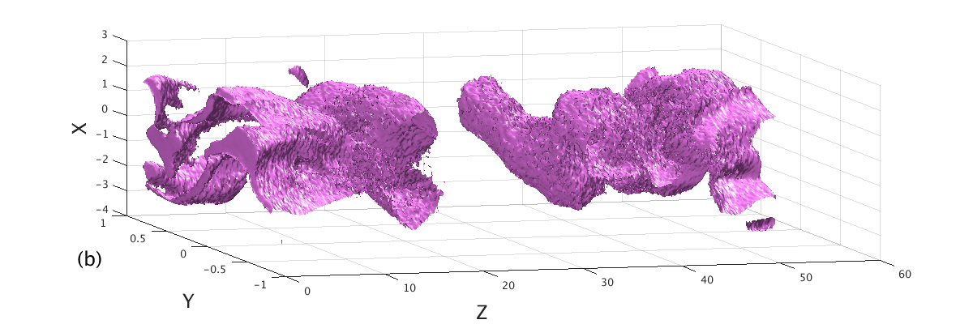
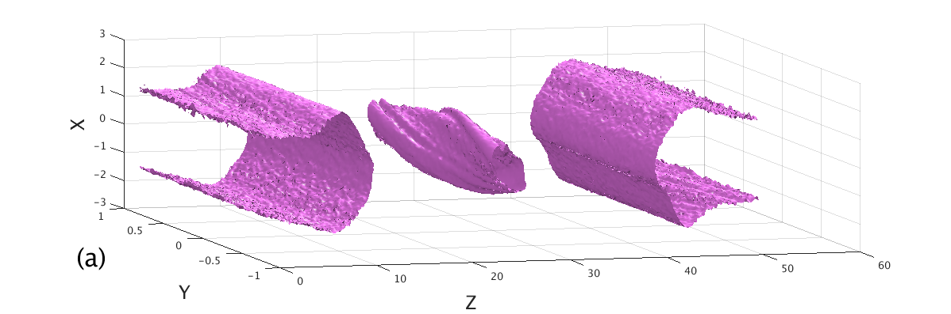
Strong guiding field suppresses kink instability along By direction
By=0
By=1
Isosurface of the electron energy distribution (the 35 \% contour of the max energy) for a strong guiding field (B_{y}=1) in the simulation box

Slide 12
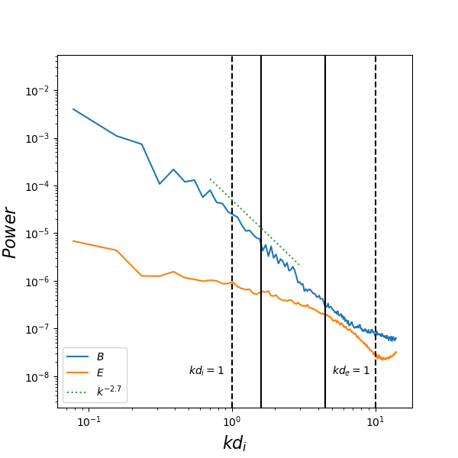
Turbulence spectrum vs wavenumbers
Power spectra vs wavenumbers of the electric (normalized by B_0 ^2 V_A^2) and magnetic fields (normalized by B_0 ^2).
The wave vector is normalised to d_i ^{-1} of n_0.
The corresponding k_{d_i}(n_0), k_{d_e}(n_0) are marked in dashed lines.
Solid lines indicate the ion gyroscale k_{pi}⁻¹ (left) and electron inertial scale calculated by the background density k_{de} (n_{b})⁻¹ (right).
Highest turbulence occurs just below lower hybrid frequency
Spectral index near kd_{i} =1 is -2.7

Slide 13
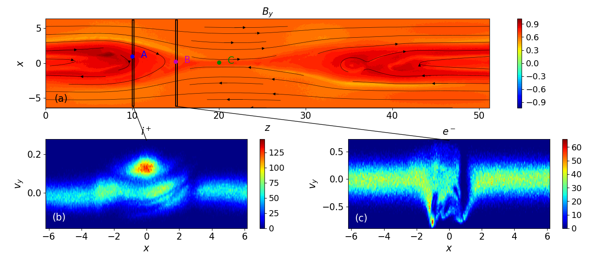
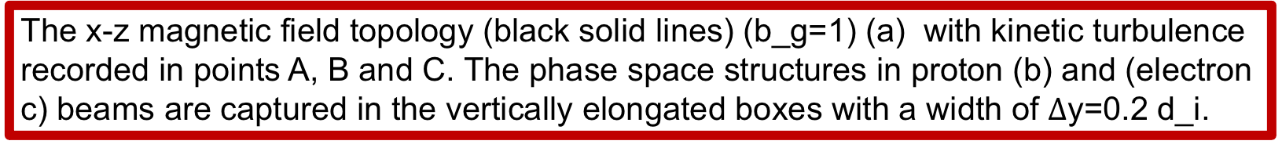
RCS with X and O-nullpoints
Kinetic turbulence is mainly generated by accelerated particle beams, which are found to evolve later into a phase-space hole indicating the beam breakage: at a distance of ~7d_i for electron and 12d_i for proton beams (d_i is a proton inertial length).
The x-z magnetic field topology (black solid lines) (b_g=1) (a) with kinetic turbulence recorded in points A, B and C. The phase space structures in proton (b) and (electron c) beams are captured in the vertically elongated boxes with a width of $Δ$y=0.2 d_i.

Slide 14
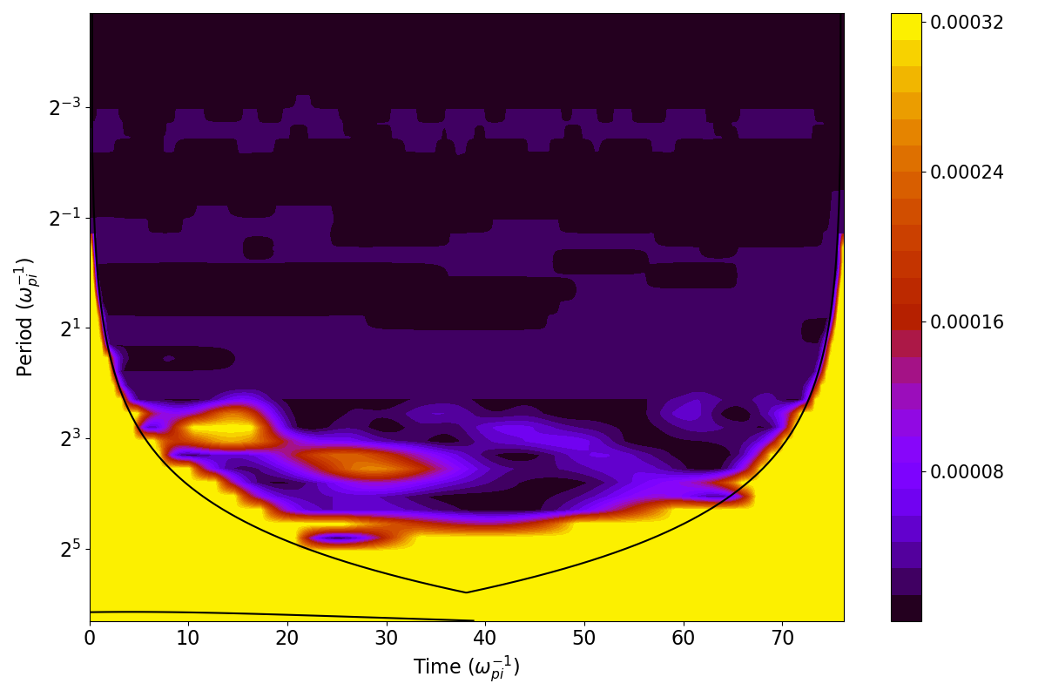
Wavelet power spectrum
Local wavelet power
spectrum of B_x (the
purple point B at z=15, x=0.25).
The solid dark curve
encloses the regions of > 95\% confidence.
The lower-hybrid frequency ω_{lh} strips 1 and 2 can be roughly drawn just above the period of 2³ (in the units of ω⁻¹ ).
The upper-hybrid frequency ω_{lh} strip 3 can be roughly drawn just above located below the period of 2⁻¹ ω⁻¹ , while the another purple strip 4 of this high-frequency turbulence is detected above the
electron plasma frequency, just below the period mark of 2⁻³ω⁻¹.
The lower-hybrid waves are seen in both frequency and wavelet analysis.
Lower hybrid turbulence – bottom purple 1 and yellow-red 2 patterns, high hybrid turbulence – top two purple strips 3-4

Slide 15
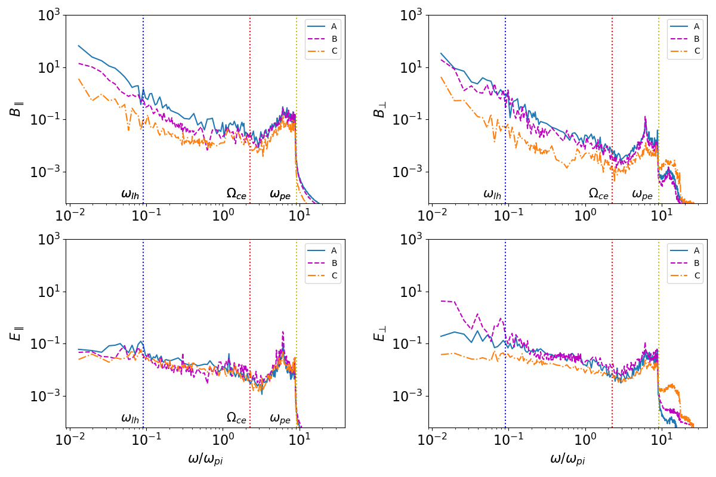
Frequency analysis
The spectra of kinetic turbulence as functions of frequency in points A,B and C
Noticeable lower-frequency turbulence occurring at lower hybrid frequency → oblique whistler waves (?).
High-frequency fluctuations of perpendicular electric field, or upper hybrid waves, to occur in vicinity of or not far away from X-nullpoints

Slide 16
Conclusions
In order to suppress substantial kink turbulence in the off-plane direction, a strong guiding field approach is used → leading to a significant polarisation electric field generated across the current sheet by separated particles with the opposite charges.
Particles of the same charge (transit and bounced) accelerated in 3D current sheets form the `bump-on-tail' velocity distributions in different locations of RCS and generate plasma turbulence owing to two beam instabilities.
Turbulence
From the phase space analysis →kinetic turbulence is mainly generated by accelerated particle beams, which are found to evolve later into a phase-space hole indicating the beam breakage: at a distance of ~7d_i for electron and 12d_i for proton beams (d_i is a proton inertial length).
In a wavenumber space the spectral index of the turbulent magnetic field near the ion inertial length is found to be -2.7 that is consistent with other estimations and measurements.
From the frequency spectra of electric and magnetic field of kinetic turbulence it was found that the high-frequency fluctuations of perpendicular electric field, or upper hybrid waves, to occur in vicinity of or not far away from X-nullpoints
Turbulent fluctuations near X-nullpoints or on the edges of magnetic islands are consistent with Langmuir or Bernstein waves generated by electrons when they move across the magnetic field lines.
The frequency spectra of turbulent waves generated in parallel and perpendicular directions to local magnetic field → noticeable turbulence at lower hybrid frequency
The lower-hybrid waves are seen in both frequency and wavelet analysis.
The fluctuations of the perpendicular electric field component of turbulence is consistent with a generation of oblique whistler waves on density fluctuations of accelerated particles.

