Slide 1


Pitch-angle distribution of accelerated electrons in 3D current sheets with magnetic islands
V. Zharkova-1,2, Q. Xia-3
1 – Northumbria University, UK; 2 – ZVS Research Enterprise Ltd, UK; 3 – Culham Fusion Centre, Abingdon, UK

Slide 2
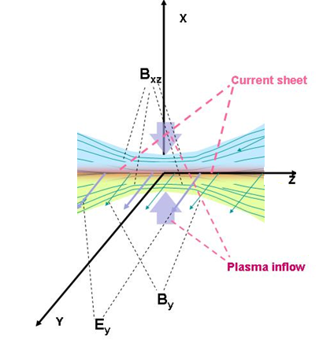
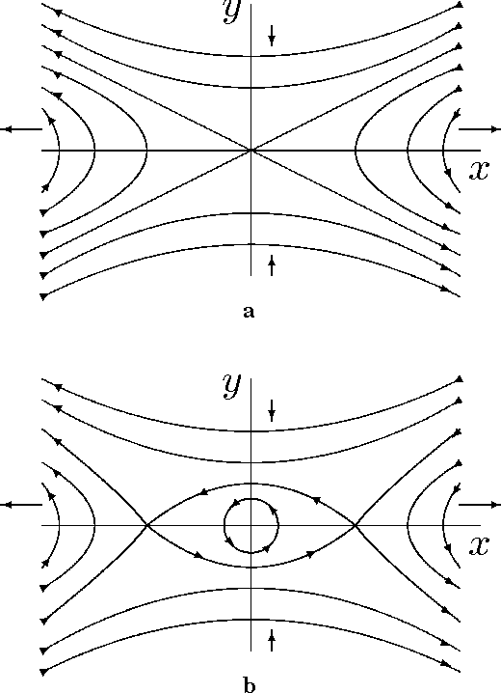
Physical model of reconnection current sheet
A single X-null
O-type
(magnetic island)
Zharkova and Khabarova, 2012,
ApJ, 752, 35; 2015, Ann Geo, 33, 457
Xia and Zharkova, 2018, 2020, 2021, A&A
Notes:
Tracking the plasma inflow
2

Slide 3
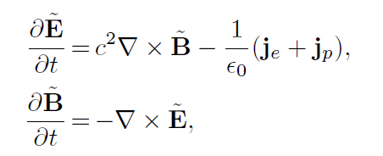
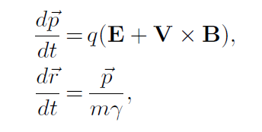
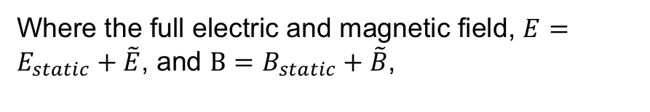
Particle-in-cell Approach
Static fields come from MHD scale,
Consider plasma feedback to presence of accelerated particles – induced electric and magnetic fields
Where the full electric and magnetic field, , and ,
J.P. Verboncoeur, et al 1995 – 2.5D XOOPIC
Bower et al, 2008 – 3D VPIC

Slide 4
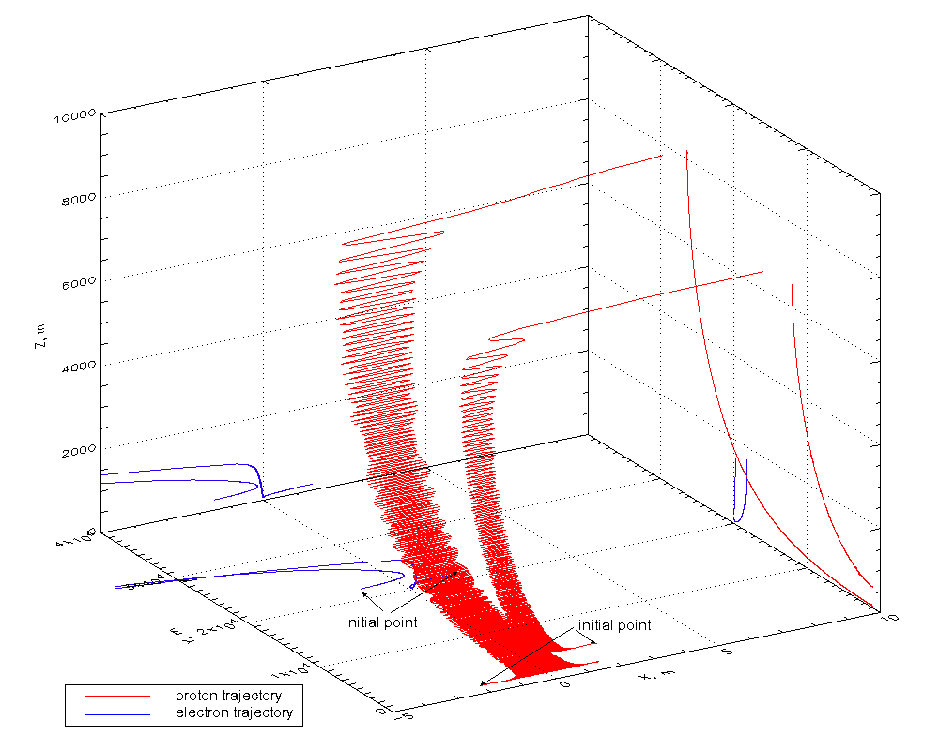
dN/d ε ~ A ε^{-1.5}
dN/d ε ~ B ε^{-2.0}
ZA 2009, JPP
Myth 1 –charge neutrality oR separation?

Slide 5
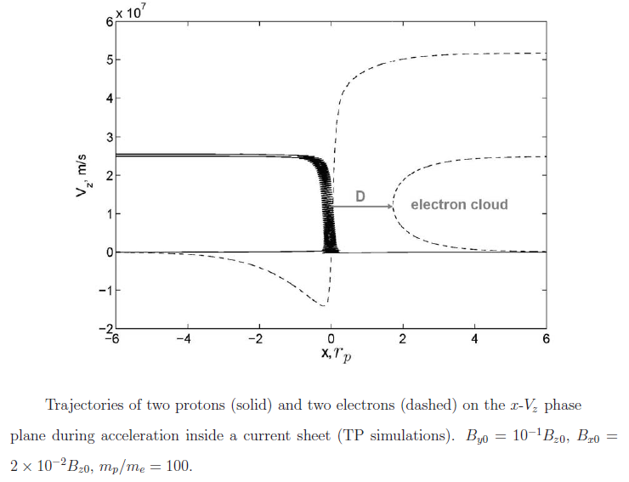
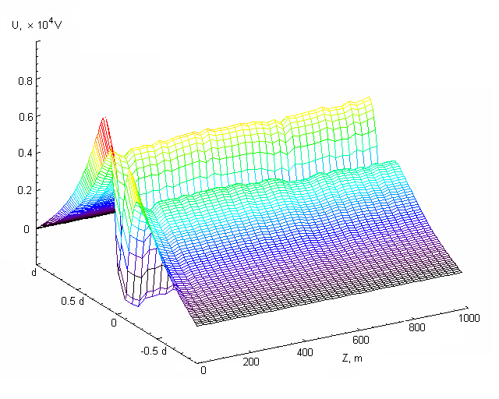


Trajectories of protons and electrons in PIC model of HCS
Zharkova and Khabarova, 2012, ApJ
transit e
Bounced e
transit p
Bounced p
×10 V/km
Polarisation (Hall’s) electric field potential induced by separation of electrons from ions (Zharkova and Agapitov, 2009, JPP)
- full separation

Slide 6
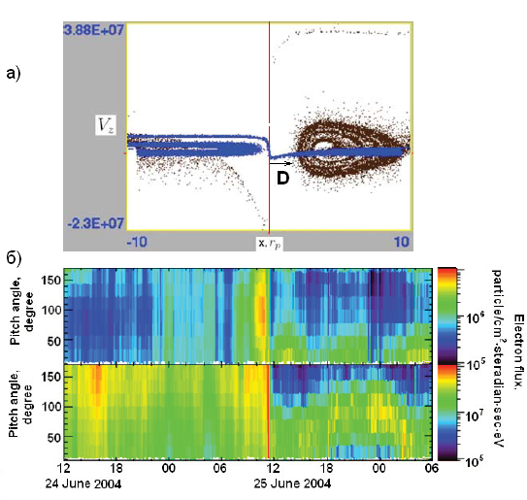
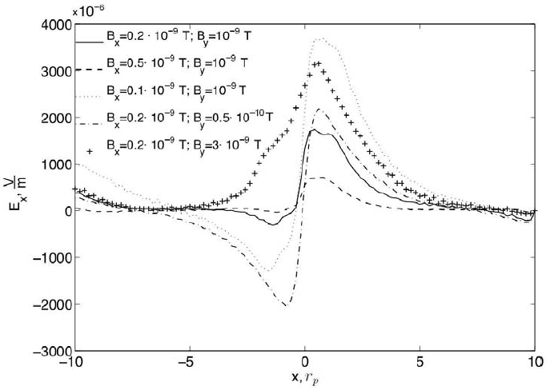
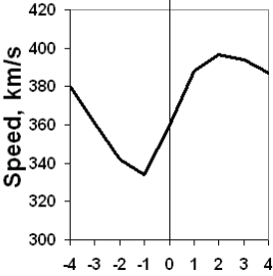
PADs of electrons (black) and protons (blue) plus observed PADS for electrons
Polarization electric field E_{x}
Ion velocities across the HCS
Quasi-continuous reconnection in the HCS can explain a few KEY puzzles in the observations of the dynamics of ions and electrons in the solar wind (see UKSP nugget 29)
.
T. Siversky, V.Zharkova, 2009, JPP, 75, 5
V. Zharkova et al, 2011, SSRv, 157, 359
V.Zharkova, O. Khabarova,2012, ApJ, 752, 35

Slide 7
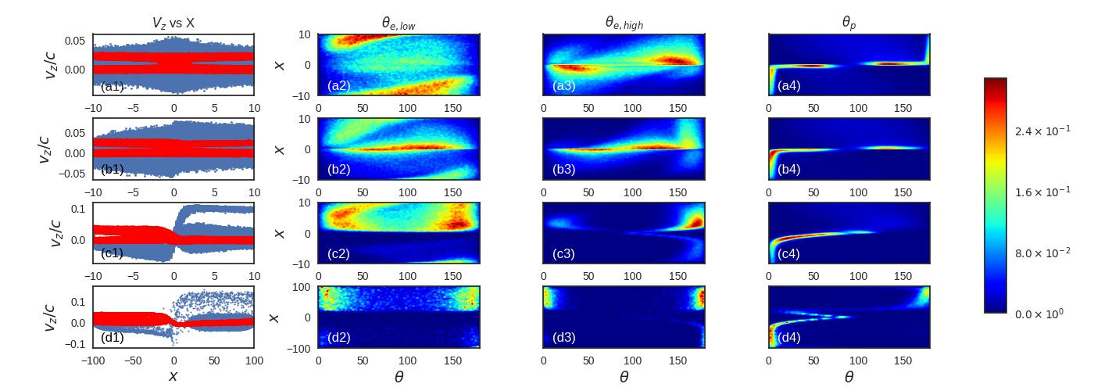
Effect of the guiding field, B_{g}
Asymmetric pitch-angle distributions with respect to the current sheet midplane
Xia and Zharkova, 2020, A&A
Notes:
7

Slide 8
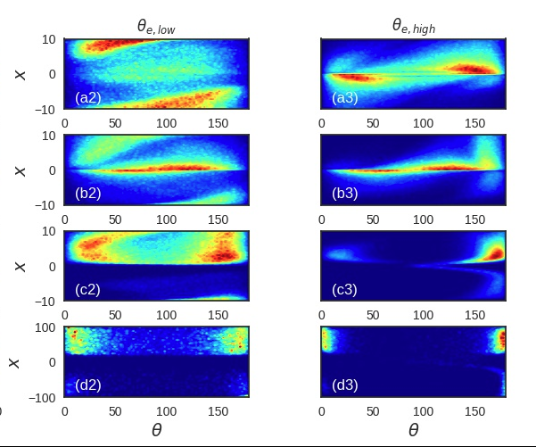
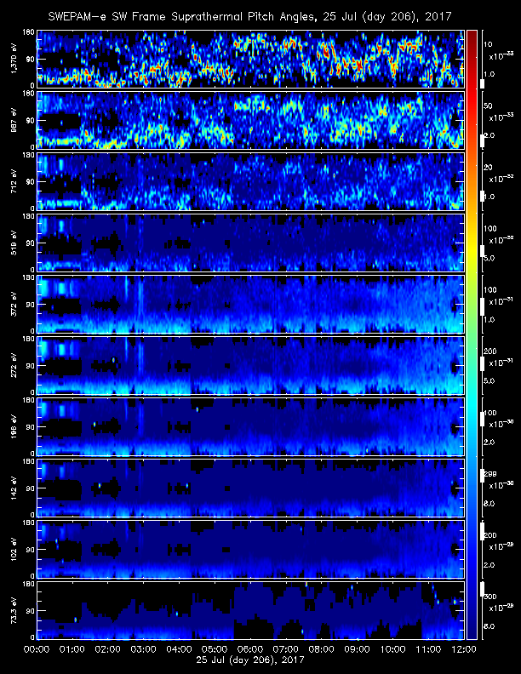
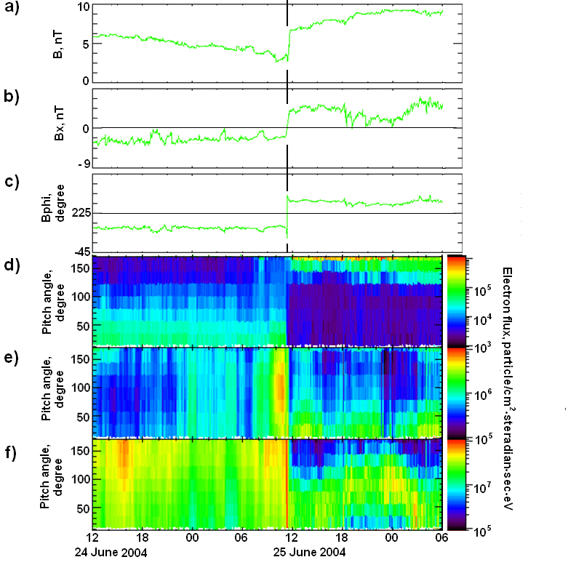
Effect of the guiding field B_{g} on PADs
Asymmetric pitch-angle distribution with respect to the current sheet midplane
By/B0 = 0 (a-first row), 0.1 (b-second row), 1.0 (c-third row), and 1.0 with d = 10 (d-fourth row):
Zharkova and Khabarova, 2012, Xia et al, 2021
Notes:
8

Slide 9
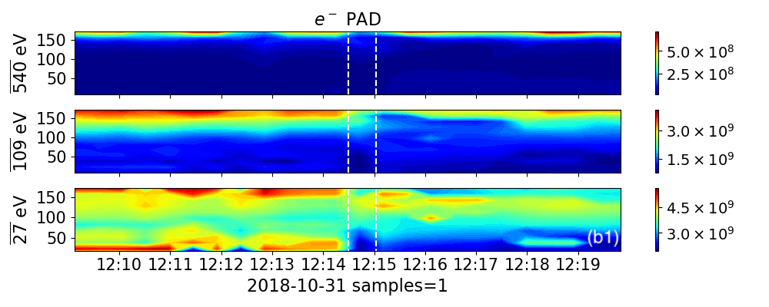
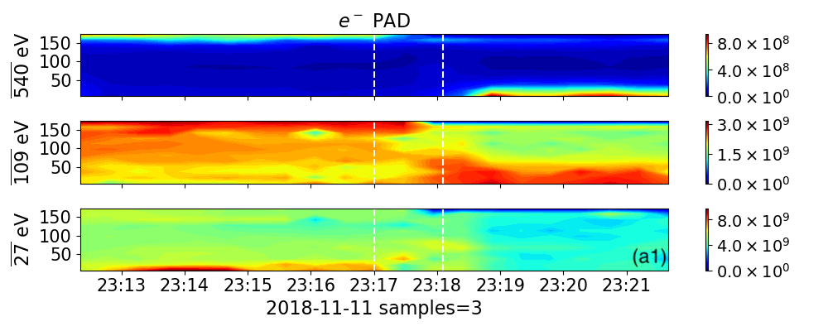
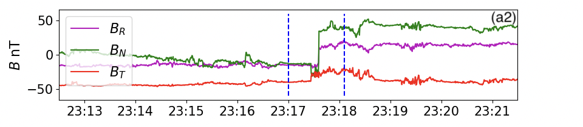
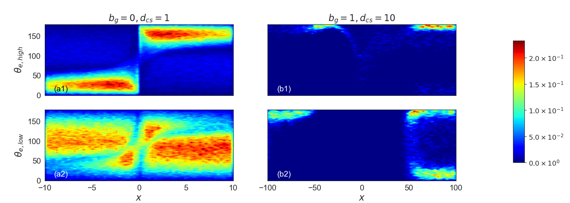
Parker’s probe observations
Simulated PADs

Slide 10
Merging magnetic islands in HCS
Notes:
Explain the data?

Slide 11
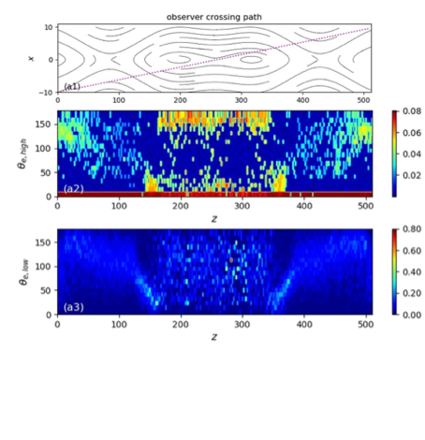
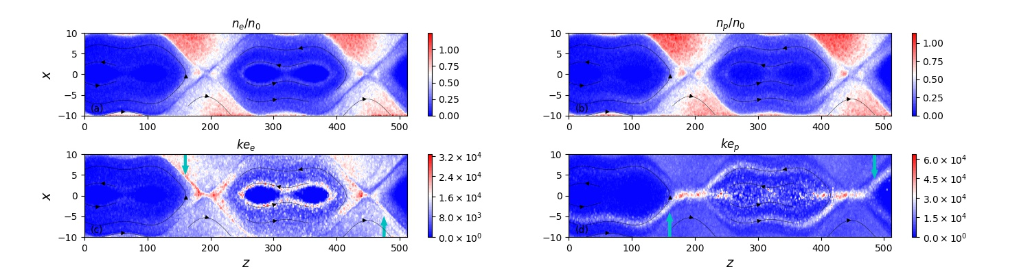
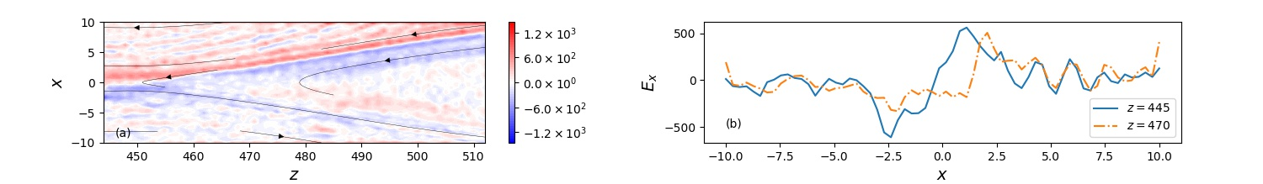
Coalescent Mis: density, energy, PADs
C
PADs of transit and bounced electrons
Polarization electric field Ex

Slide 12
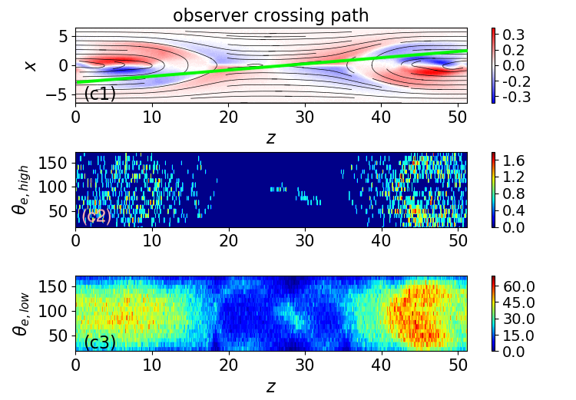
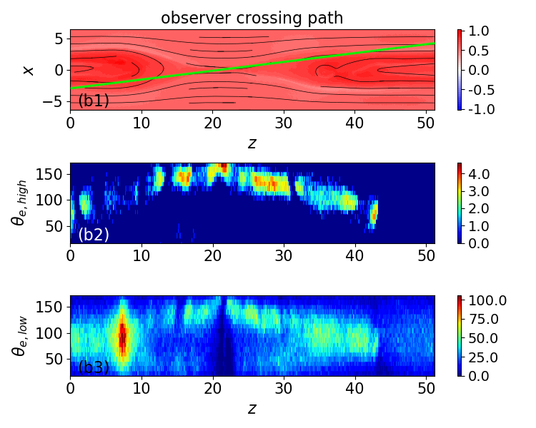

Slide 13
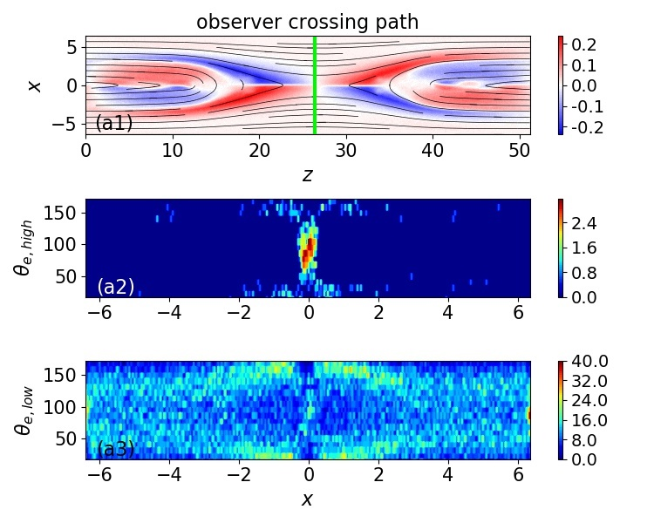
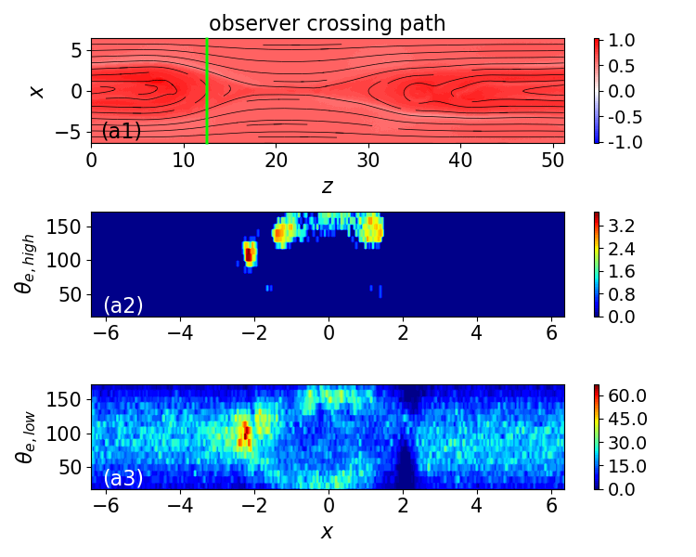

Slide 14
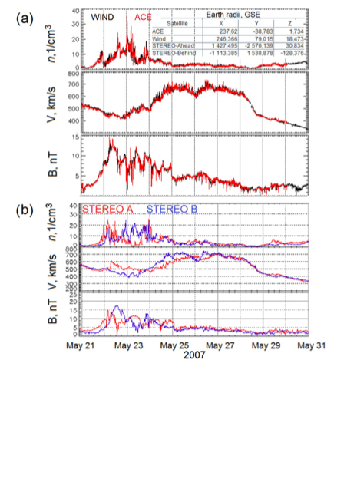
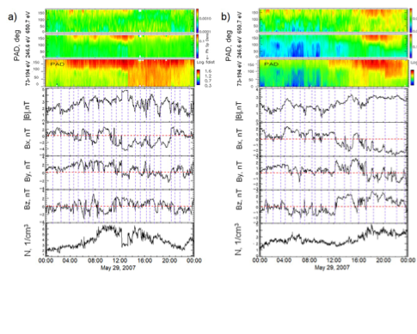
PAD three top panels (right column):
650.7, 246.6, and 73-194 eV energy channels from STEREO A (a) and STEREO B (b).
The highest-energy 650.7 eV STEREO PAD is completely different from the other PADs. It shows signatures of intermittent bi- directionality, following the location of MIs and CSs

Slide 15
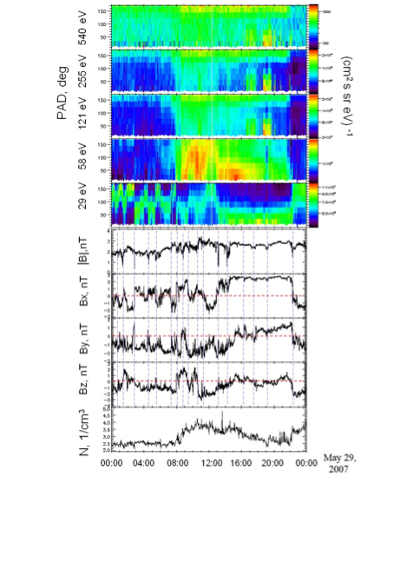
Electron PADs observed by WIND (left) and simulated by PIC (right)
Electrons of different energies, the IMF, and the density in the region filled with MIs as observed by the WIND spacecraft on 2007, May, 29.

Slide 16
Conclusions
Strong guiding field leads to the separation of electrons from protons with respect to the midplane of a current sheet (CS)
Separated particles generate a polarization electric field across the current sheet which is higher than reconnection electric field by 2 orders of magnitude
Magnetic field imposes its signatures on pitch-angle and energy distributions on particles entering a current sheet from the opposite (transit) and the same side (bounced particles)
Electrons can be accelerated to sub-relativistic energies in neighbouring X-nullpoints of a single magnetic island.
Protons and ions passing through CSs follow the direction of polarisation electric field induced by accelerated particles → hence, observed strange paths in the IMF reflect crossing current sheets
PADs of transit and bounced electrons are essentially different because of their different acceleration paths
PADs of accelerated electrons are shown to reflect magnetic topology of current sheets and can be compared with in-situ observations
PADs of transit (high energy) electrons are consistent with high-energy strahls while PADs of low energy electrons are often diffusive

