Slide 1


Joint effects of solar activity and solar orbital motion on terrestrial atmosphere
https://solargsm.com/solar-activity/
V. Zharkova^{1,2}, I.Vasilieva^{2,3}, S.Shepherd⁴ and E.Popova^{2,5}
1 – MPEE, University of Northumbria, Newcastle upon Tyne, UK
2 - ZVS Research Enterprise Ltd., London, UK
3 – Solar Physics Dept., Main Astronomical Observatory, Kyiv, Ukraine
4 - PRIMAL Research Group, Sorbonne Universite, Paris, France
5 - Centro de Investigación en Astronomía, Universidad Bernardo O’Higgins, Santiago, Chile
https://www.scirp.org/journal/paperinformation.aspx?paperid=124007
https://solargsm.com/publications/

Slide 2
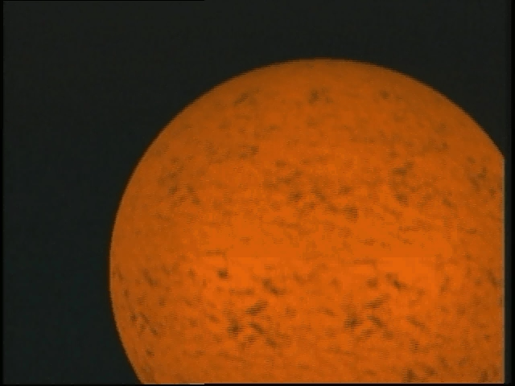
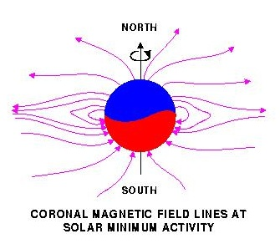
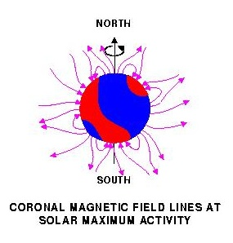
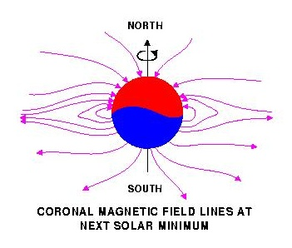
Solar magnetic field reversal
Strong toroidal magnetic fields (TMF) forming Active Regions (ARs)
are created in a shear layer beneath the base of the Solar Convection zone (SCZ).

Slide 3
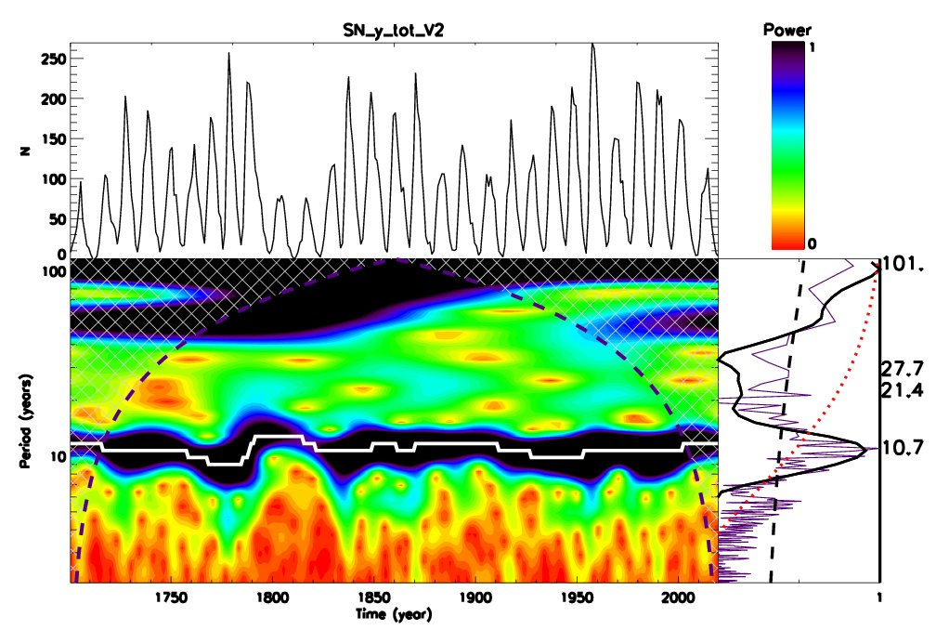
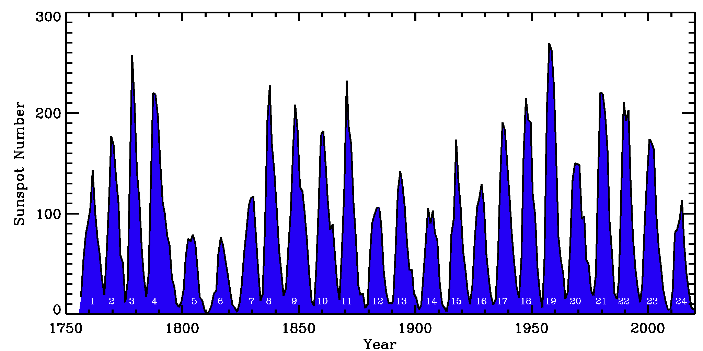
Wavelet spectral analysis of SSN – 10.7 and 101 years
Averaged sunspot numbers SSN Wavelet analysis
Global wavelet spectrum – black solid line
Fourier spectrum – indigo
95% CI – black dashed line
Axis Y: Main periods – 10.7 and 101 years
Period of 50-55 years – lower than a red noise level (red dotted line)

Slide 4
Fitting the PCs to measured in cycle 24 and prediction to 25-26
2-1. New proxy for solar activity index
two largest eigen vectors of SBMF (blue and red lines)
and their summary curve (black line)
Zharkova et al, 2015 https://www.nature.com/articles/srep15689

Slide 5
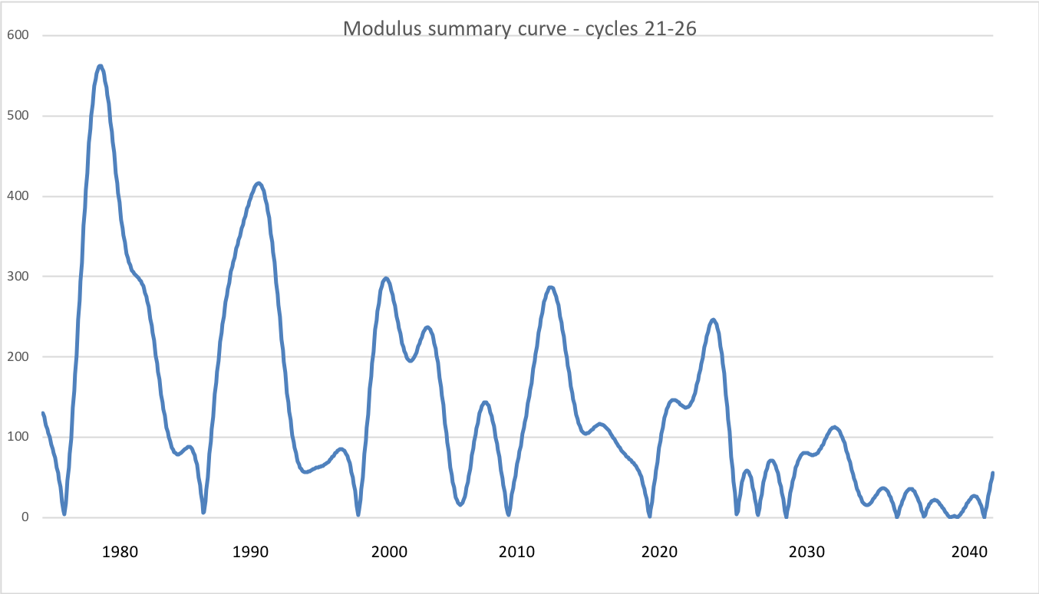
2-2. Modulus summary curve vs sunspot numbers SSN
Zharkova et al, 2015, SciRep; 2020, Temp., Zharkova et al, 2022, MNRAS s sunsdata
(Shepherd et al, 2014 ; Zharkova et al, 2015)
Cycle 21
Cycle 22
Cycle 23
Confirmed by
Katiashvili, 2020, ApJ;
Obridko et al, 2021, MNRAS
Velasco-Herrera et al, 2021
Cycle 21
Cycle 22
Cycle 23
Cycle 24
Cycle 25
Cycle 26

Slide 6
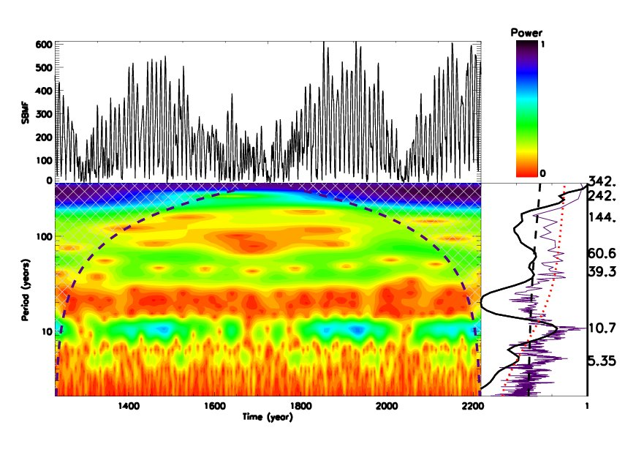
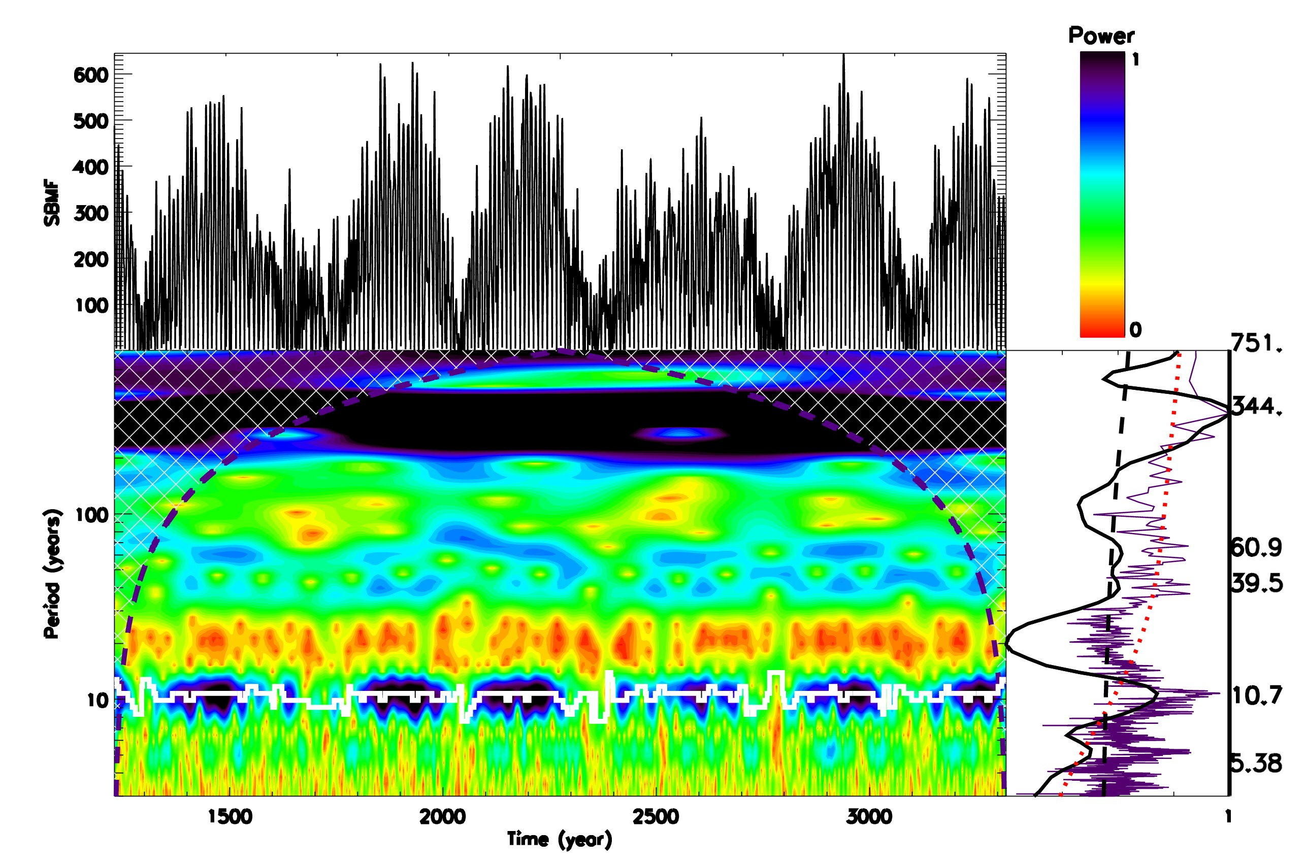
Wavelet spectral analysis of MSC
Modulus summary curve of two largest eigen vectors (dipole MF)
Global wavelet spectrum – black solid line
Fourier spectrum – indigo
95% CI – black dashed line
Main periods – 21.5 and 344 years

Slide 7
In 2020 the Sun entered
the grand solar minimum to last until 2053 →
not increase but decrease of temperature up to 1C
Observational result, dynamo model was not yet considered
https://www.nature.com/articles/srep15689)
https://solargsm.com/solar-activity/ - my webpage

Slide 8
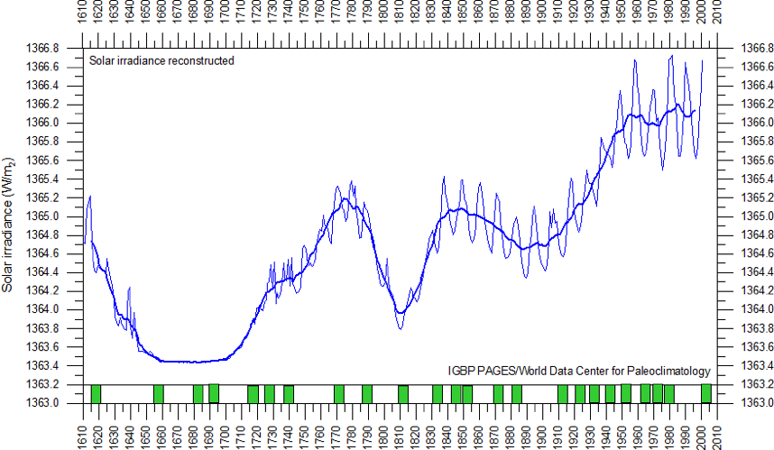
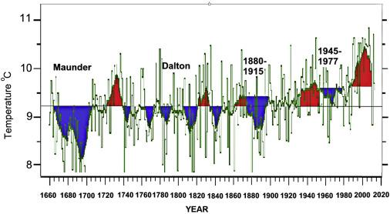
Solar irradiance and terrestrial temperature during MM
Lean et al, 1995, JGR
Lamb, 1972; Easterbrook, 2016
Authors | S, Maunder minimum, W/m² | S 1990-2000, W/m² | △S from MM, %
Lean et. Al., 1995 | 1363 | 1366 | 0.22
Steinhilber et al, 2012 | 1364 | 1366 | 0.22
Shirley et al., 1990 | --- | 1370 | 0.51
Wolff and Hickey, 1987 | --- | 1371 | 0.51
Lee et al., 1995 | --- | 1372 | 0.51
After the TSI data were re-normalized the old data are hardly usable

Slide 9
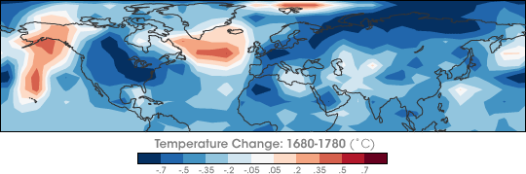
Temperature restoration during/after MM
(Shindell et al., 2001, Science)
The surface temperature of the Earth was reduced all over the Globe
Europe and North America went into a deep freeze
Alpine glaciers extended over valley farmland
Sea ice crept south from the Arctic
Danube and Thames rivers & canals in the Netherlands froze regularly

Slide 10
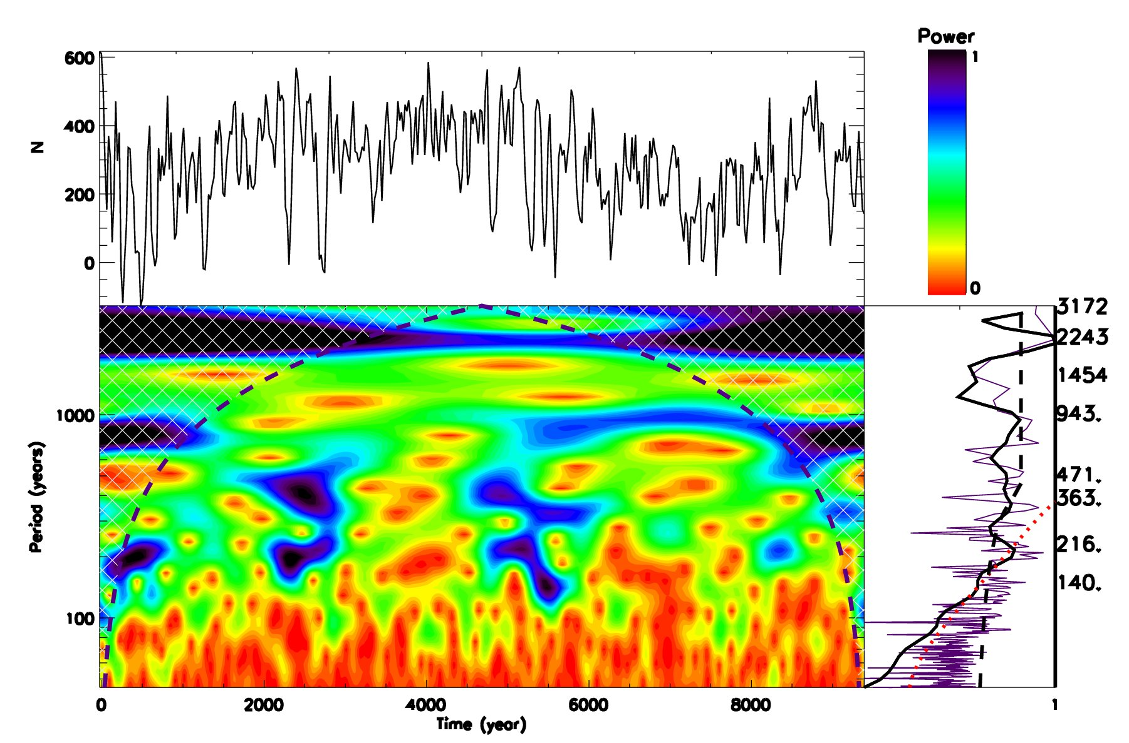
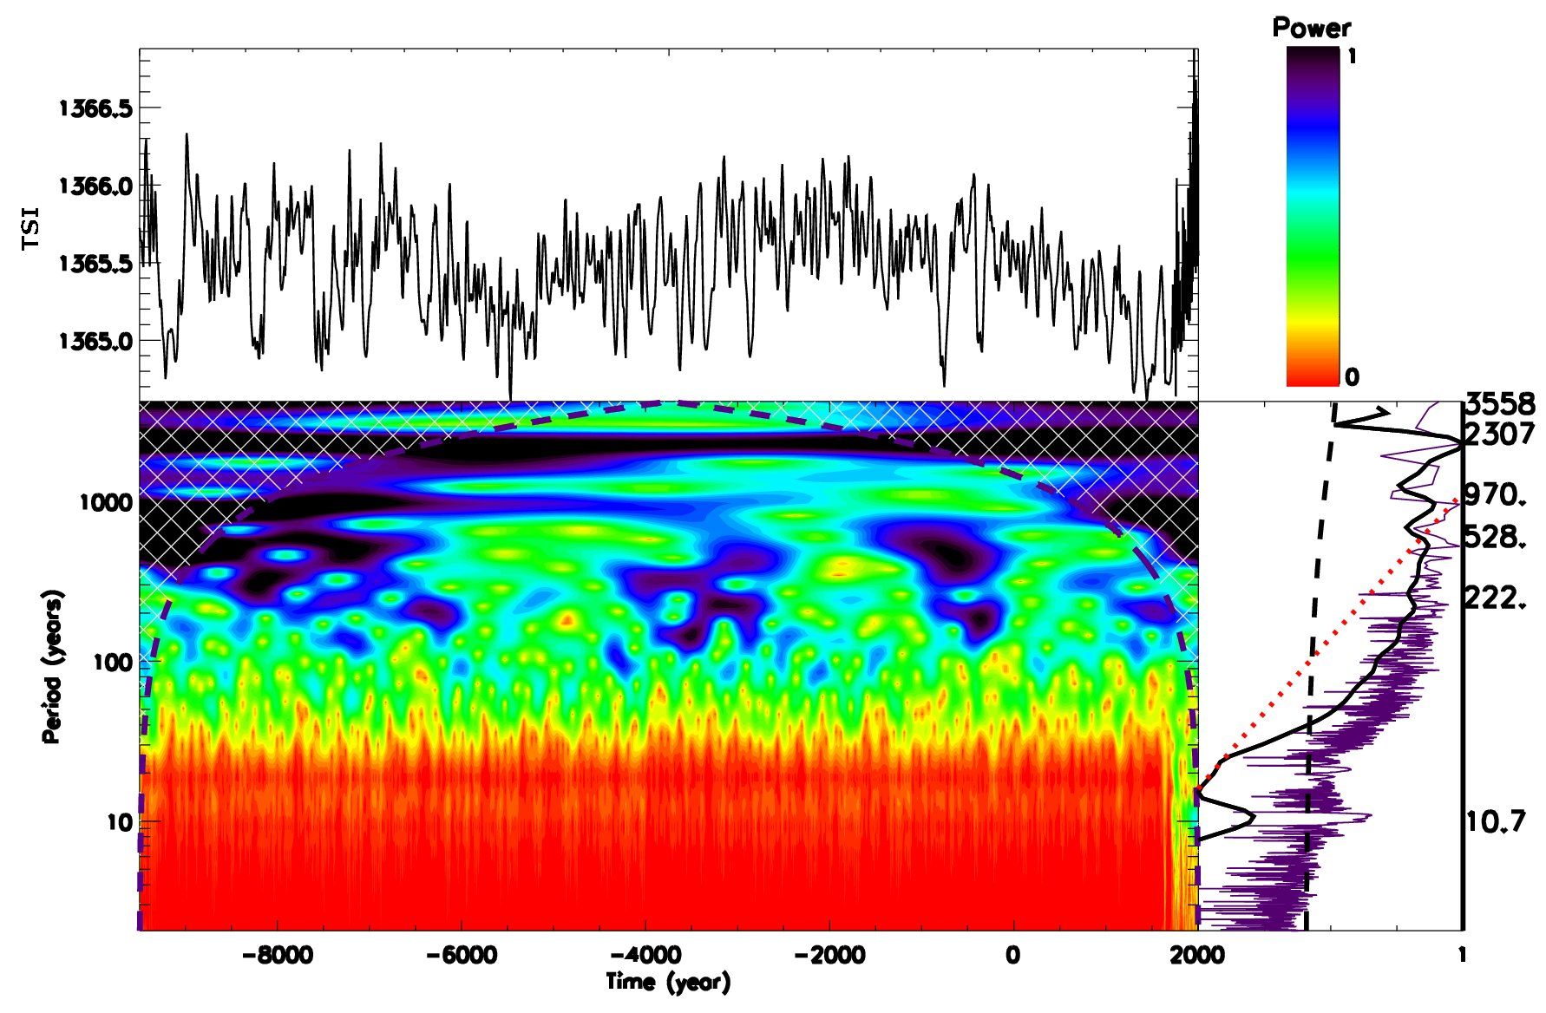
Hallstatt’s cycle - Wavelet spectral analysis of TSI (¹⁴C+¹⁰Be)
TSI by Steinhilber et al, 2012 TSI by Vieira et al, 2011
Main periods – 10.7, 216, 363 and 2243-2300 years (Hallstatt’s cycle)

Slide 11
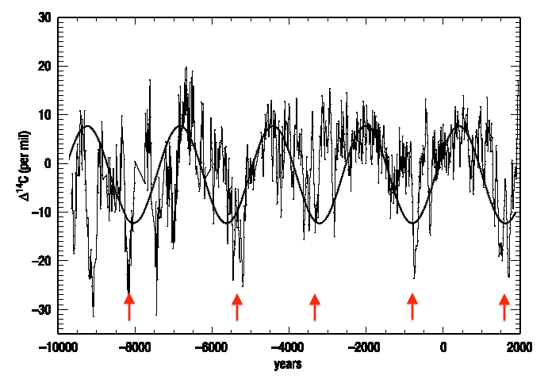
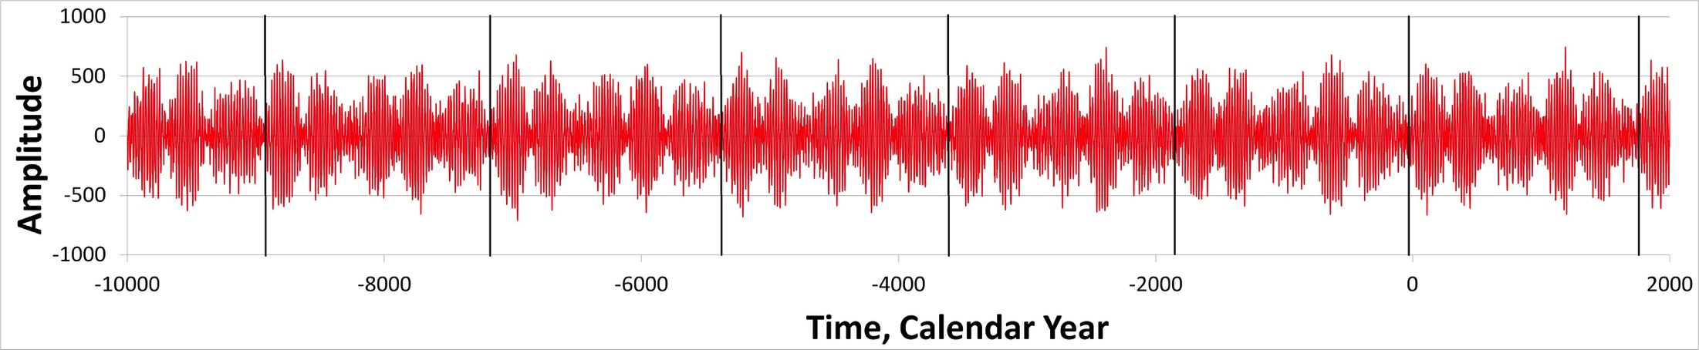
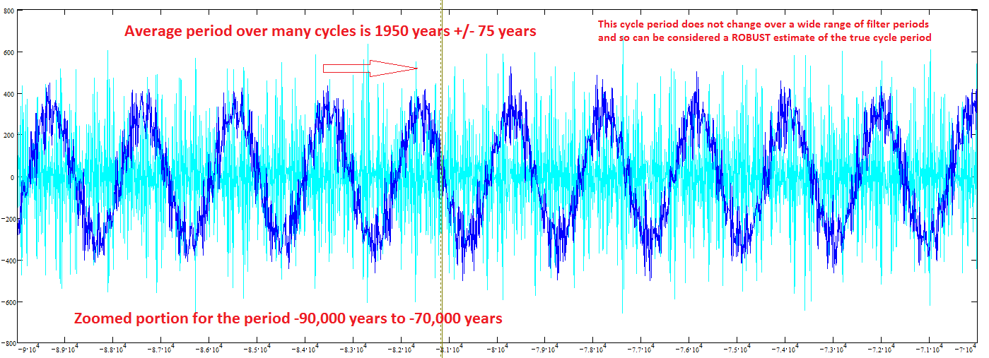
Solar magnetic field (top) and
Mbaseline oscillations (bottom)
(ZharkovlZharkova et., 2019, 2021al, 2018, 2019, 220 ture SR)
Reames et al, 2009
¹⁴C in trees
(Hallstatt’s cycle)

Slide 12
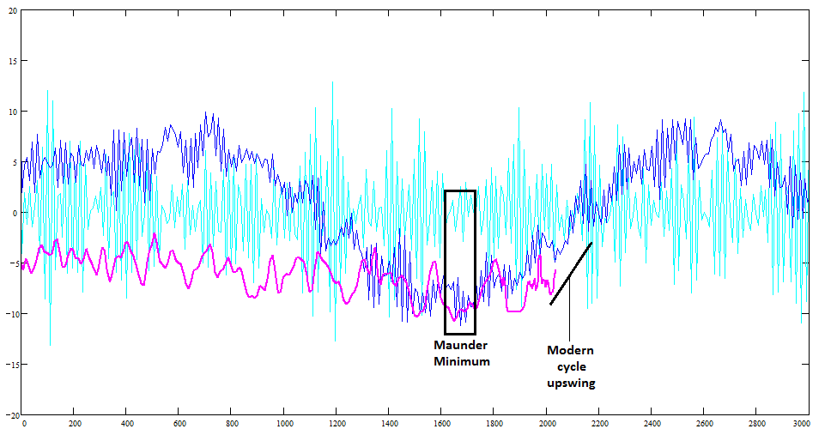
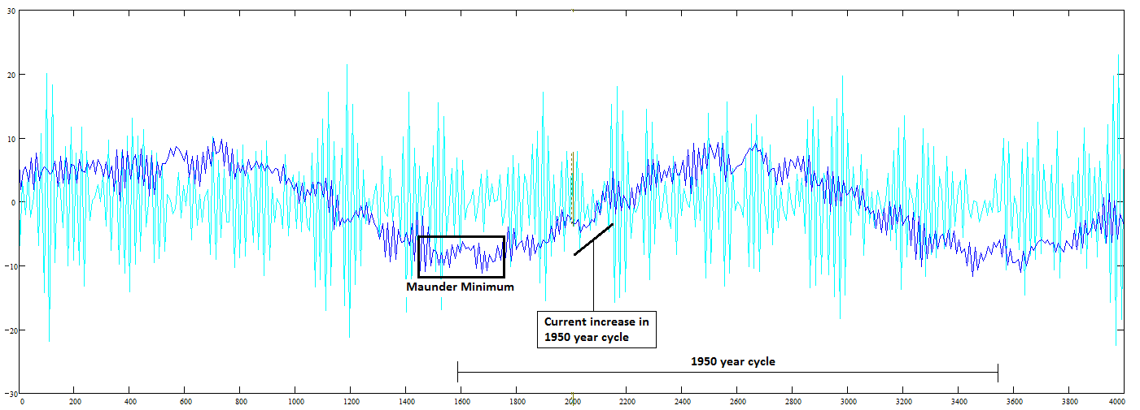
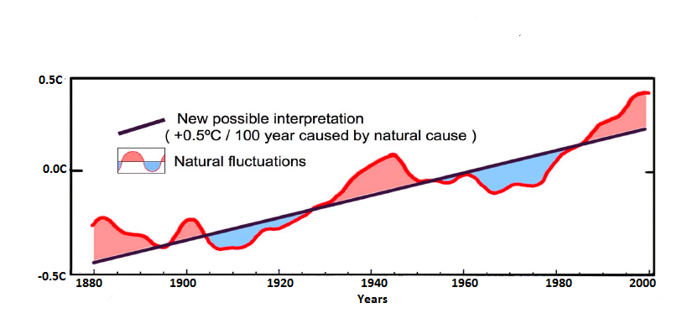
Modern Hallstatt’s cycle (Zharkova et al, 2019, 2020)
MF baseline coincides with solar irradiance (Vierra et al, 2011) and T
(Akasofu, 2011)
Zharkova et al, 2019, 2020

Slide 13
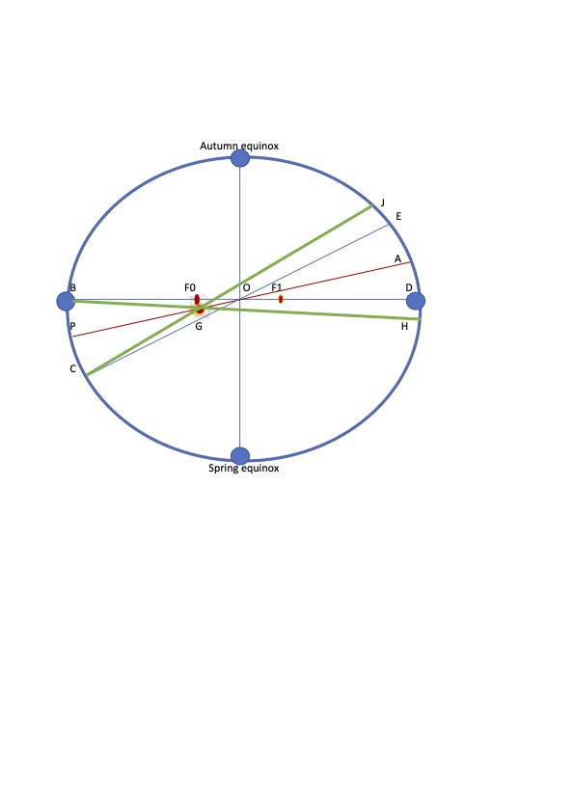
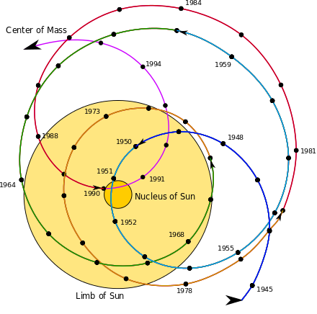
Zharkova et al, 2023 https://www.scirp.org/journal/paperinformation.aspx?paperid=124007
2020
Aphelion →. 5 July
Perihelion → 5 January
2600
Aphelion →. 16 July
Perihelion → 16 January
SIM effects on the Earth via solar irradiance
https://youtu.be/vDgUmTq4a2Q
Solar Inertial Motion
S. Perminov, E.D. Kuznetsov, 2018
SIM imposed by planets Jupiter, Saturn, Neptune and Uranus
Charvatova, 1988,
Palus et al, 2007
Rice et al, PP comments #72, 96

Slide 14
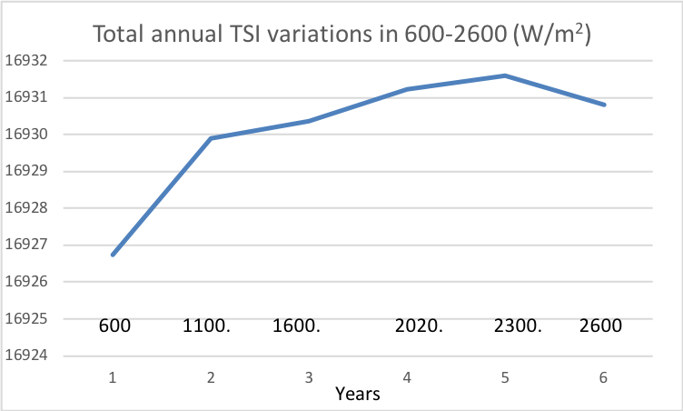
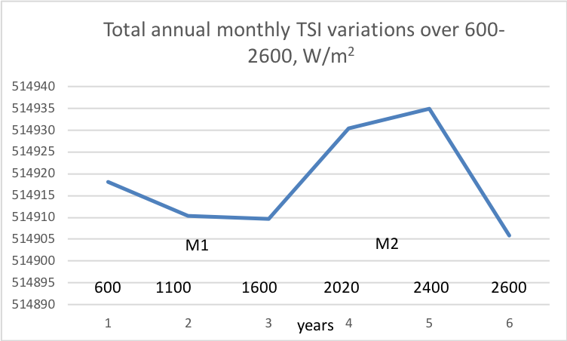
Variations of the total annual TSI in M1 (600-1600) and M2 (1600-2600) taken from the TSI averaged for each month (left) and daily TSI (right)
https://arxiv.org/pdf/2008.00439.pdf
Zharkova et al, 2019, Zharkova, 2020
There is extra solar forcing caused by gravitation of planets, which is a likely reason of the main part of global warming
Extra solar forcing
Not considered so far!
Extra 5 W/m² of TSI, 60% warming comes to Sun, 40% - to green house gasses (Hardy, 2017).
We have found extra TSI of 20 W/m² in 2020! It will last until 2500!

Slide 15
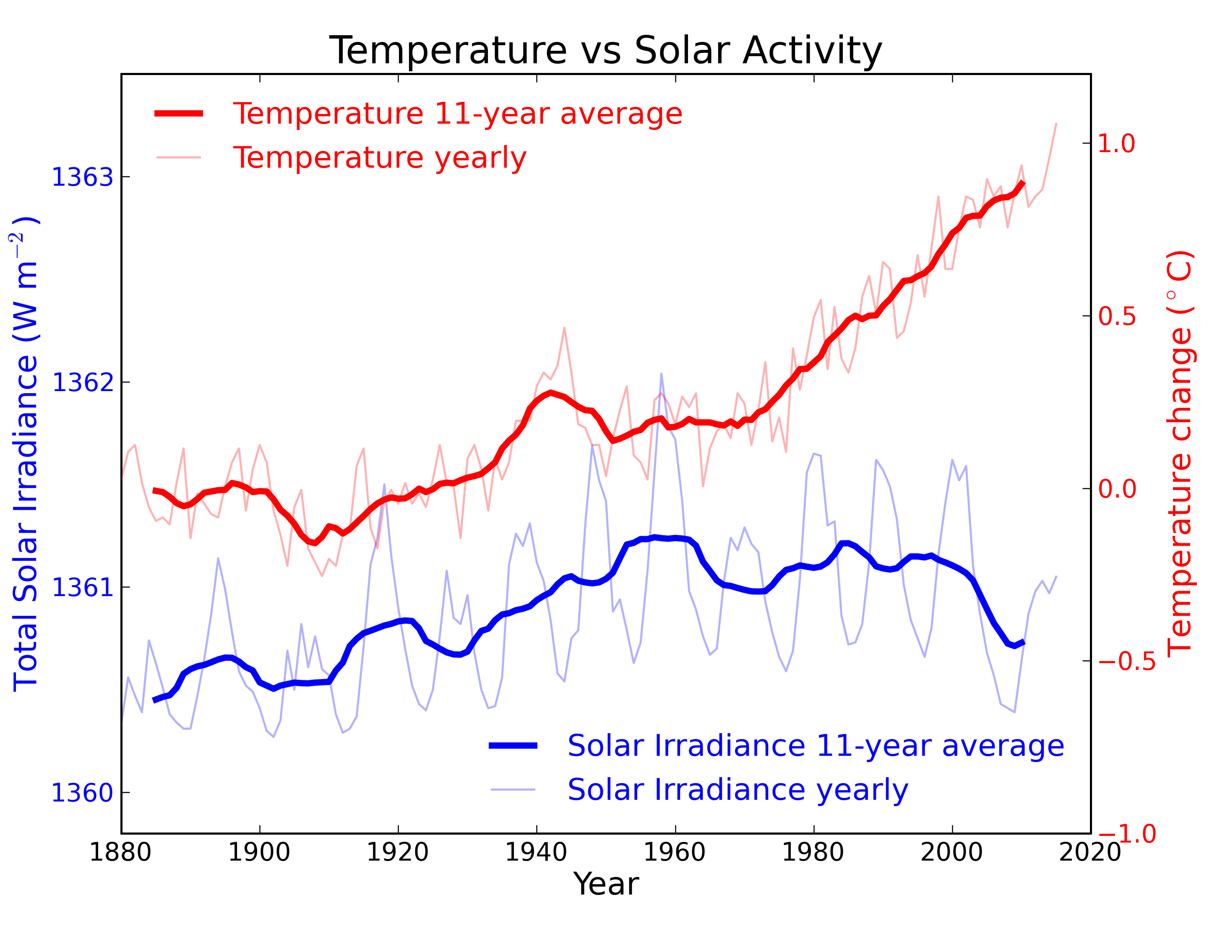
Solar dynamo effects:
a) two double dynamo 11 year waves
b) grand solar cycles & GSMs –wave beating
Solar inertial motion effects
Period of 2100-2200 years
increase of T by 1.5C by 2100, and by further by 2.5-3.0 C by 2500 interrupted by T decreases during GSMs .
During GSMs: a decrease of temperature up to 1C

Slide 16
Conclusions
Solar activity is defined by action of solar dynamo converting solar poloidal (background) into toroidal (sunspot) magnetic fields and vice versa during the period of 10.7 years
Solar dynamo acts in two layers with different speed of meridional circulation as derived from the summary curve of eigen vectors varying with the periods of 21.5 years (magnetic solar cycle) and 344-350 years (grand solar cycle)
Spectral analysis of the TSI variations reveals the periods 2243 -2300 years (wavelet+Fourier) Hallstatt’s cycles
The baseline of the summary curve of SBMF also reveals weak variations with a period of ~2100-2200 years – Hallstatt’s cycle
Hallstatt’s cycle variations are closely linked to the solar inertial motion (SIM) about the barycentre of the solar system → the ephemeris of S-E distances shown
A change of S-E distances from 1600 to 2500 leads to the TSI increase by 20-25 W/m² per year (10-12 W/m² per hemisphere)
Increase of TSI with a decrease of S-E distances (SIM) leads to the increase of T by 1.5C by 2100, and by further by 2.5-3.0 C by 2500.
The increases of terrestrial temperature will be interrupted by the decreases by 1C during two GSMs (2020-2053 and 2375-2415) caused by large reduction of solar activity.

