Slide 1


The Grand Solar Minimum –
What’s In Store
https://solargsm.com/solar-activity/
Prof. Valentina Zharkova
University of Northumbria, Newcastle upon Tyne, UK
ZVS Research Enterprise Ltd., London, UK
https://solargsm.com/publications/
With thanks to Drs. I.Vasilieva (MAO, Kyiv, Ukraine), S. Shepherd (UK),
E. Popova (Chile) and S. Zharkov (UK)

Slide 2
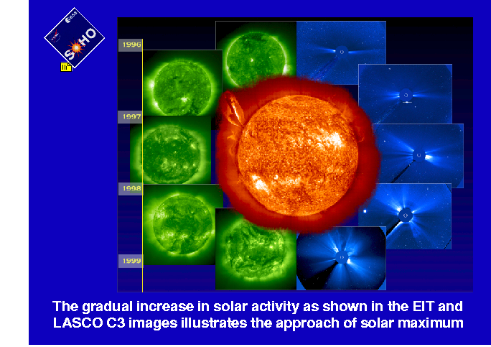
What is the active Sun?

Slide 3
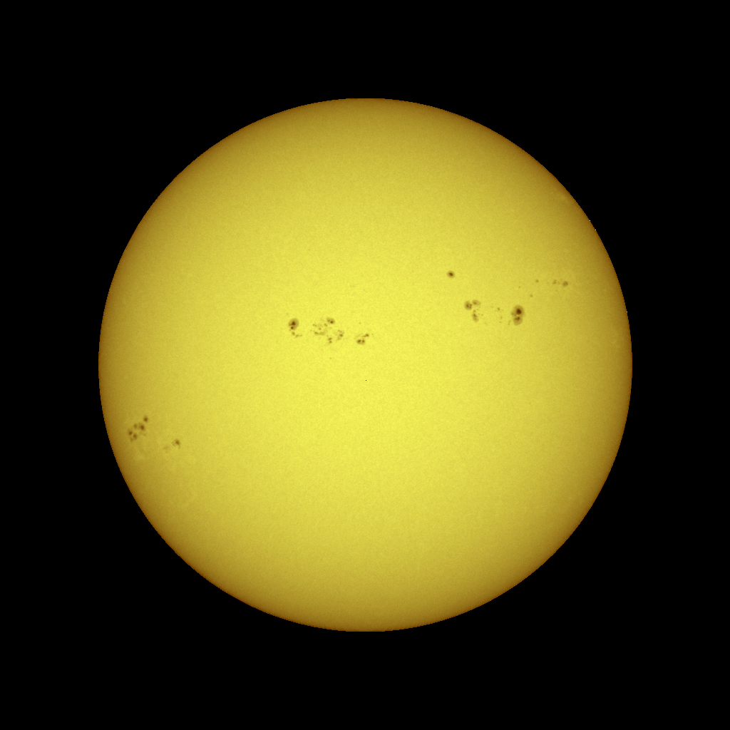
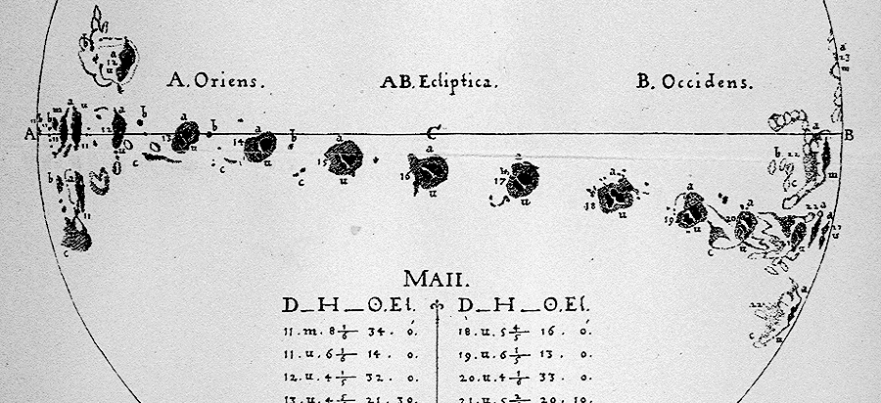

Solar activity
Sunspots are dark (and cooler) regions on the surface of the Sun. They have a darker inner region (the Umbra) surrounded by a lighter ring (the Penumbra).
Sunspots usually appear in groups that form over hours or days and last for days or weeks.
These early sunspot observations indicated that the Sun rotates once in about 27 days.
Solar activity index – average sunspot numbers
Sunspots

Slide 4
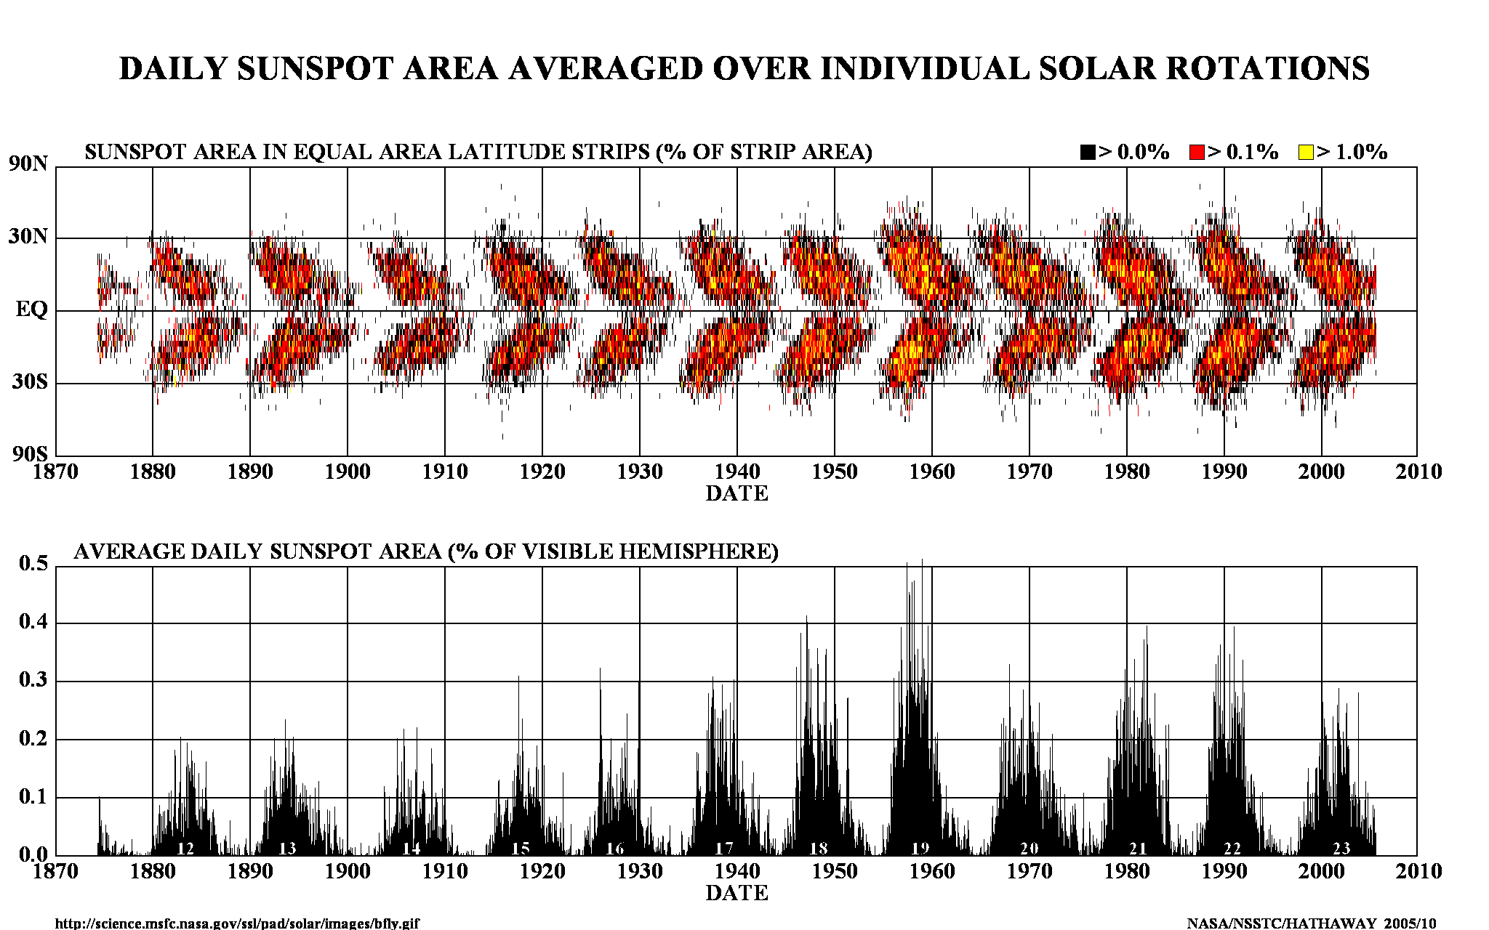
Current solar activity index

Slide 5
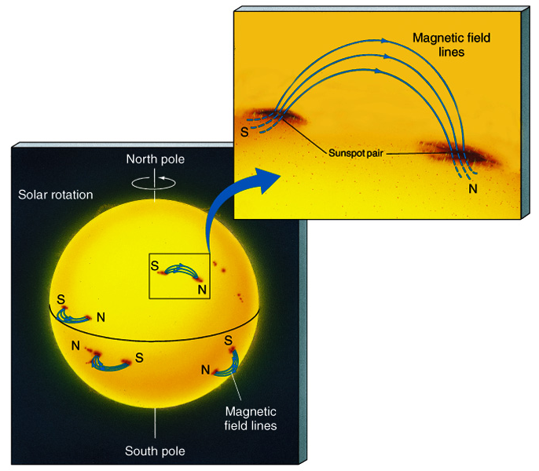
Sunspots & Magnetic Fields
The magnetic field in a sunspot is 1000x greater than the surrounding area
Sunspots are almost always in pairs at the same latitude with each member having opposite polarity
All sunspots in the same hemisphere have the same magnetic configuration

Slide 6
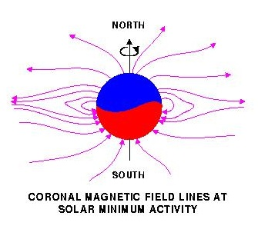
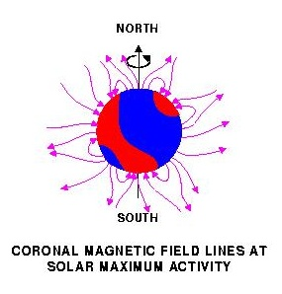
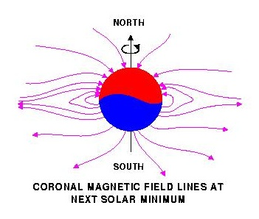
Solar magnetic field reversal
Strong toroidal magnetic fields (TMF) forming Active Regions (ARs)
are created in a shear layer beneath the base of the Solar Convection zone (SCZ).

Slide 7
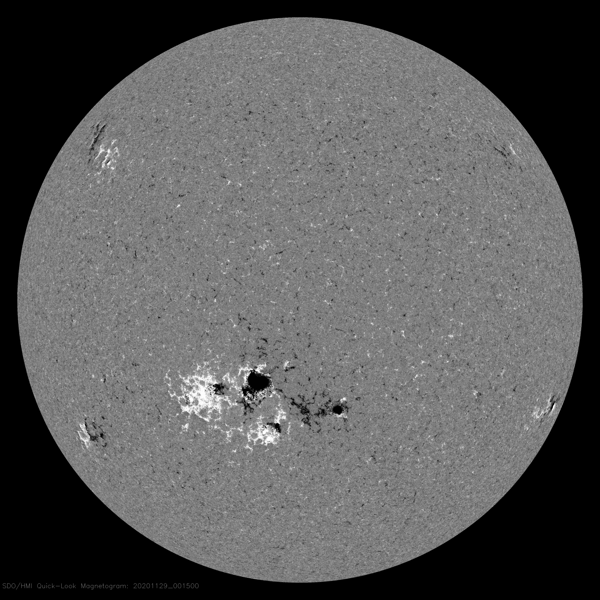
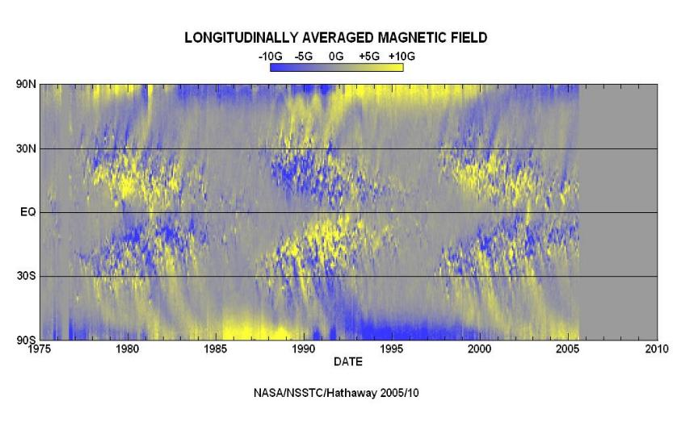
Magnetic field variations in cycles 21-23 (Hale’s law)
HMI Magnetogram 29 Nov 2020

Slide 8
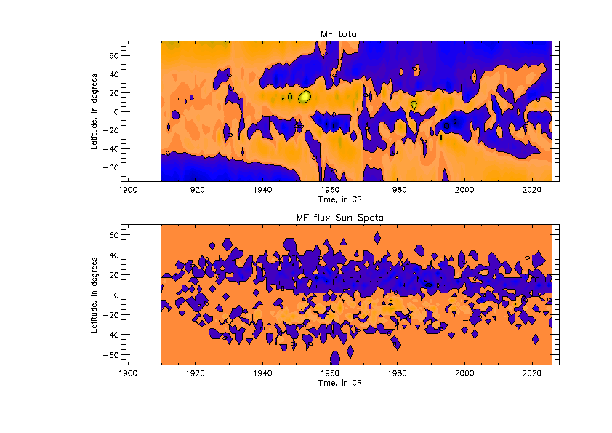
New proxy for solar activity index
SBMF (top) and sunspot MF (bottom)–
(Zharkov et al, 2008, Stix 1976)
Cycle 23 -Solar Background MF
Sunspot MF

Slide 9
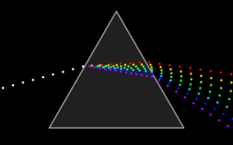
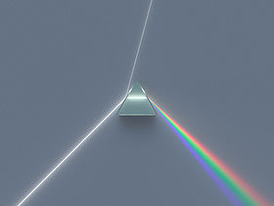
White light refraction into waves of different colors, or wavelengths

Slide 10
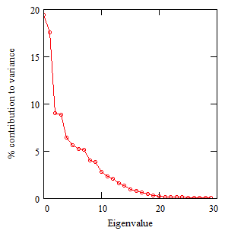
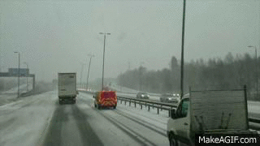
SBMF results: Scree plot (->prizm)
Eigenvalues vs variances (Zharkova et al, 2012)
- 2 main eigenvalues covering 40% of variance –
(67% of SDV) -
- 3 pairs (6 eigenvalues) to cover
Dipole magnetic sources
Quadruple magnetic sources

Slide 11
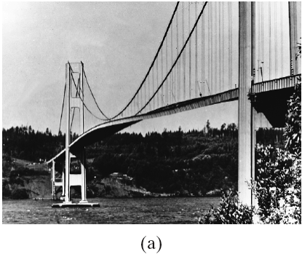
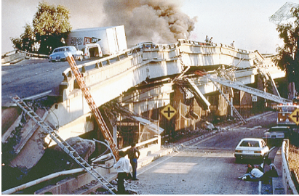
Forced Oscillations→ Resonance
Forced vibrations occur when there is a periodic driving force. This force may or may not have the same period as the natural frequency of the system.
If the forcing frequency is the same as the natural frequency, the amplitude can become quite large. This is called resonance.
(left) Large-amplitude oscillations of the Tacoma Narrows Bridge, due to gusty winds, led to its collapse (1940). (right) Collapse of a freeway in California, due to the 1989 earthquake.

Slide 12
Fitting the PCs to measured in cycle 24 and prediction to 25-26
Eigen vectors come in pairs, here are PCs
(Shepherd et al, 2014, Zharkova et al, 2015)

Slide 13
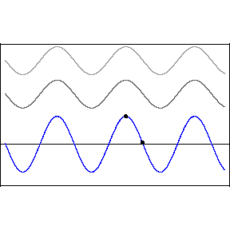
Interference
Two wave interference
the result of two or more → waves overlapping
y₁(x,t)=Acos(kx-ωt) (top wave)
y₂(x,t)=Acos(kx-ωt+D) (middle wave)
D – phase difference b/waves
Blue wave: resulting
D=0 constructive, 2A
D=π –destructive, 0

Slide 14
Mathematical laws from PCs: Symbolic regression -Hamiltonian approach (Schmidt and Lipton, 2009, Science)Schmidt & Lipson, 2009, Science)
Mathematical law for the first principal component:
F₁(t) = Σ_{k=1,..,5} A_{k} cos(ω_{k,1}t +ϕ_{k,1})cos(B_{k,1} cos(ω_{k,1}t +ϕ_{k,1})
Mathematical law for the second principal component:
F₂(t) = Σ_{k=1,..,5} A_{k} cos(ω_{k,2}t +ϕ_{k,2})cos(B_{k,2} cos(ω_{k,2}t +ϕ_{k,2})

Slide 15
S Summary curve of 2 PCs v
(Zharkova et al, 2015)

Slide 16
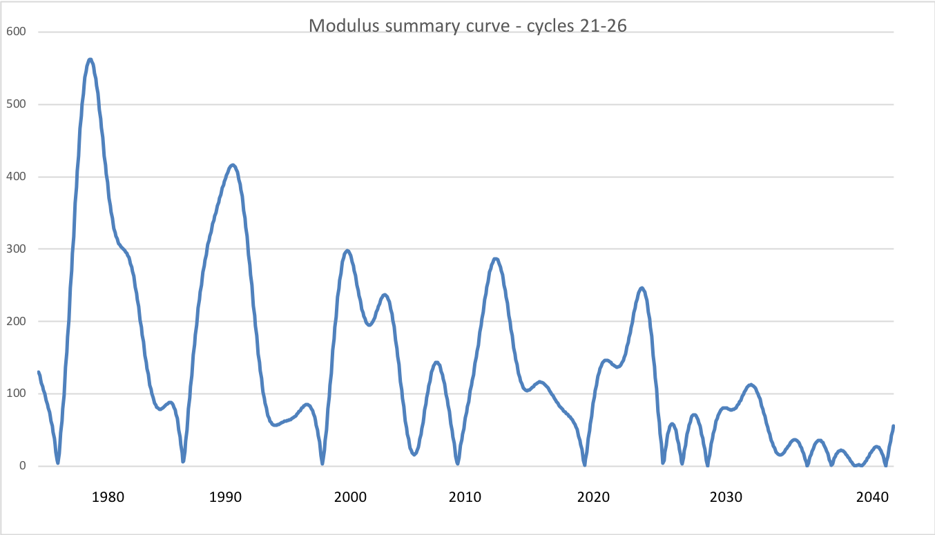
Modulus summary curve
Zharkova et al, 2015, SciRep; 2020, Temp., Zharkova et al, 2022, MNRAS s sunsdata
(Shepherd et al, 2014 ; Zharkova et al, 2015)
Cycle 21
Cycle 22
Cycle 23
Confirmed by
Katiashvili, 2020, ApJ;
Obridko et al, 2021, MNRAS
Velasco-Herrera et al, 2021
Cycle 21
Cycle 22
Cycle 23
Cycle 24
Cycle 25
Cycle 26

Slide 17
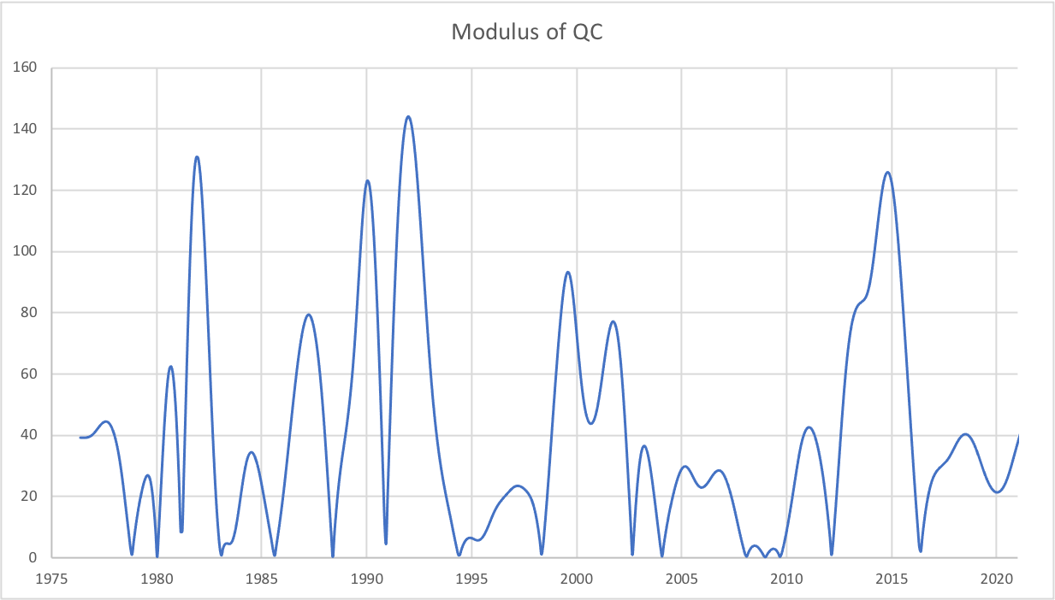
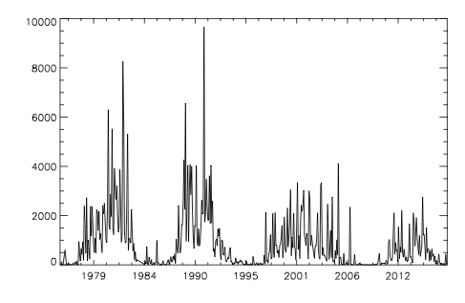
Quadruple summary curve linked
with SHR flare flux
https://solargsm.com/wp-content/uploads/2022/04/zharkova_shepherd_mnras22.pdf

Slide 18
Predicted solar activity (Zharkova et al, 2015, SR https://www.nature.com/articles/srep15689)
Zharkova et al, 2015, Nature SR
Observational result, dynamo model was not yet considered
Discovery of grand solar cycles :350-400 years
In addition to 11 year cycles
https://solargsm.com/solar-activity/ - my webpage

Slide 19
This result was reported at
the National Astronomy Meeting in Llandudno and covered by the RAS press-release https://nam2015.org/index.php/press-releases/64-irregular-heartbeat-of-the-sun-driven-by-double-dynamo
media https://www.sciencedaily.com/releases/2015/07/150709092955.htm and https://www.chroniclelive.co.uk/business/business-news/mini-ice-age-could-freeze-11607587
U-tube talks https://www.youtube.com/results?search_query=double+dynamo+and+grand+solar+minimum
See more on https://solargsm.com

Slide 20
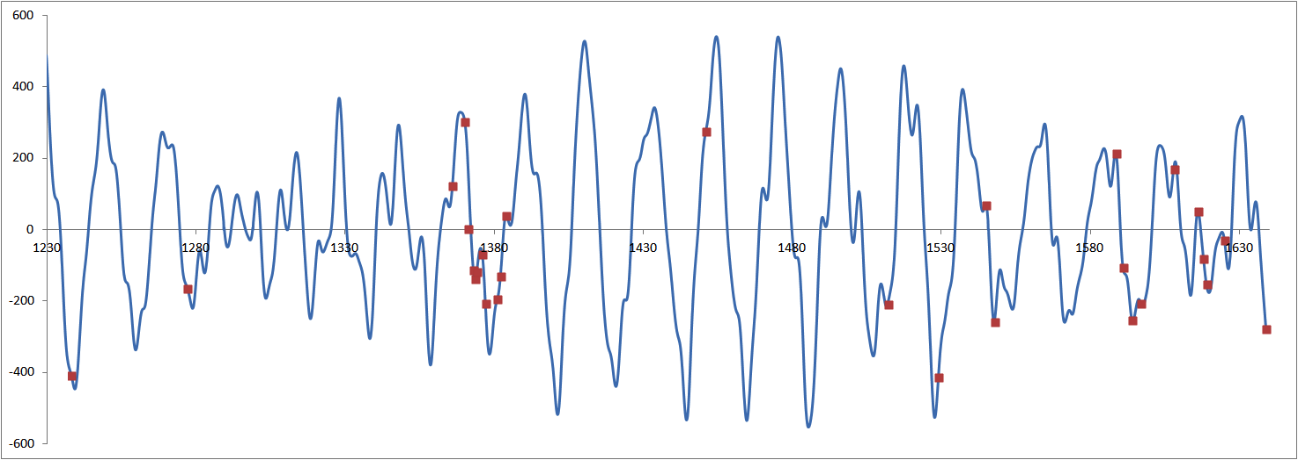
Verification of summary curve with large s/s for grand cycle prior MM (Zharkova etal, 2017, 2018) Wolf and Maunder grand minima
Zharkova et al, 2017
Severe diseases in China, no observers
New dynasty in China, Great Wall project

Slide 21
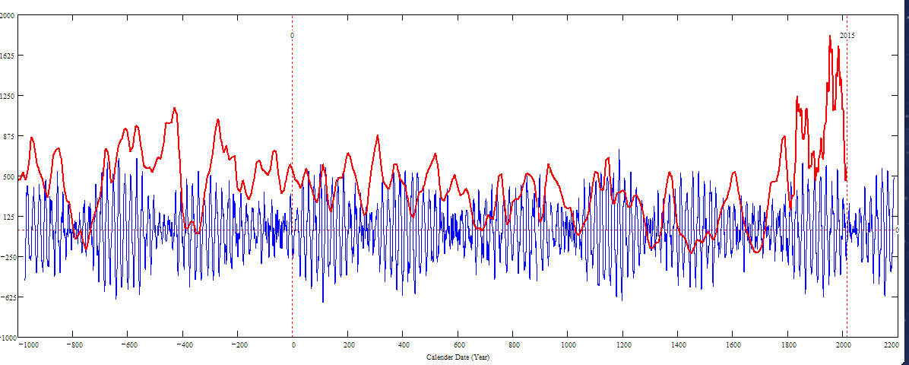
Updated curve for 3000 years (blue) versus a curve by Usoskin et al. (red)
1
2
3
4
5
Sporer minimum in1400-1600 in C¹⁴ is not from Sun!
1
2
3
4
5
1
2
Periods - grand:350-400 years and super-grand:1900-2000 years

Slide 22
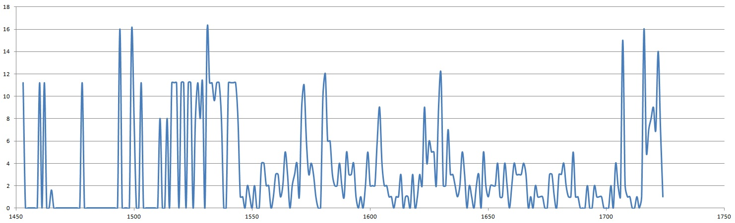

Slide 23
Double dynamo summary curve for 3000 years (blue) versus the s/s curve by Solanki et al. 2004 (red)
Homeric minimum^{[13]} | 750 BCE | 550 BCE
Oort minimum | 1040 CE | 1080 CE
Medieval maximum | 1100 | 1250
Wolf minimum | 1280 | 1350
Spörer Minimum | 1450 | 1550
Maunder Minimum | 1645 | 1715
Dalton Minimum | 1790 | 1820
Zharkova et al, 2015, 2018
Sporer minimum in 1400-1600 in C¹⁴ is caused by s/n Vela Junior
Oort
Wolf
Maunder
Homeric
Periods – grand cycle: 350-400 years and super-grand cycle :2000-2100 years

Slide 24
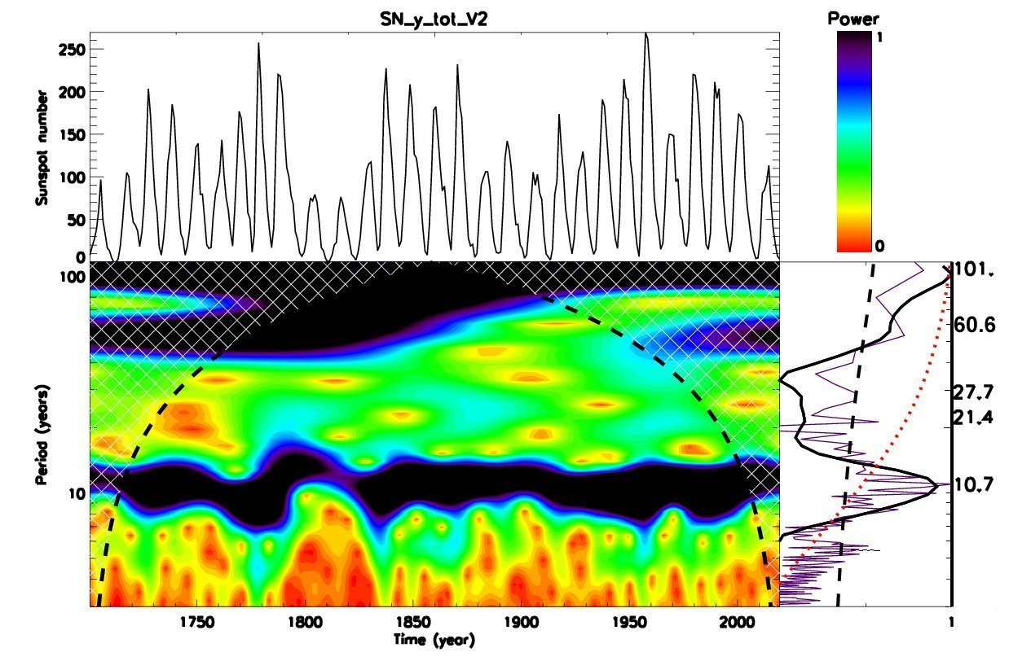
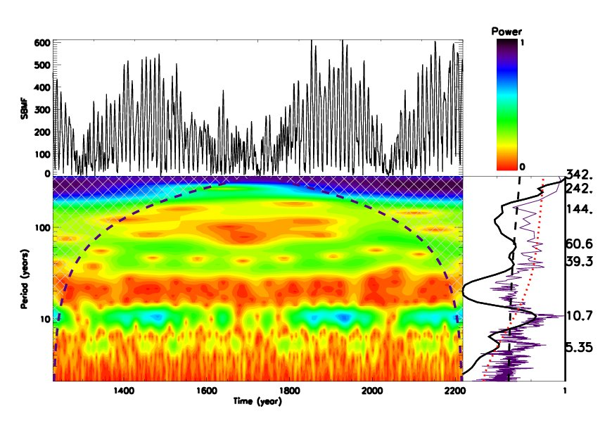
Wavelet spectral analysis
Averaged sunspot numbers Modulus summary curve of PCs Z15

Slide 25
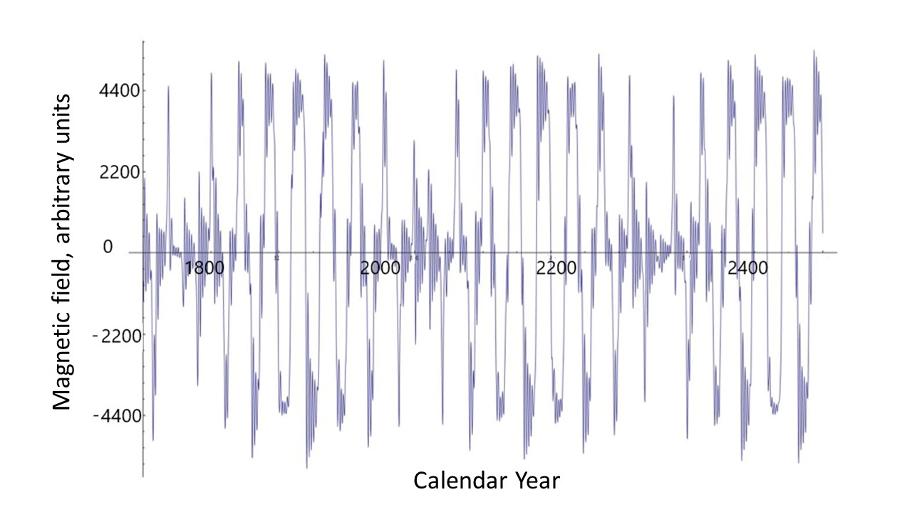
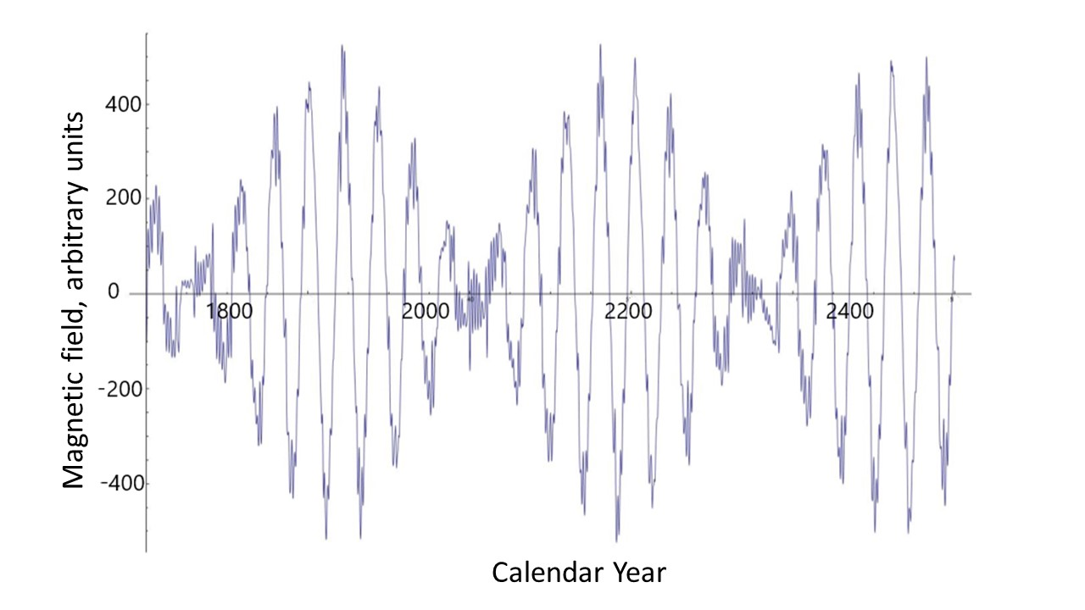
Poloidal (left) versus toroidal (right) magnetic fields
https://solargsm.com/wp-content/uploads/2023/04/zharkova_etal_mnras2023.pdf

Slide 26
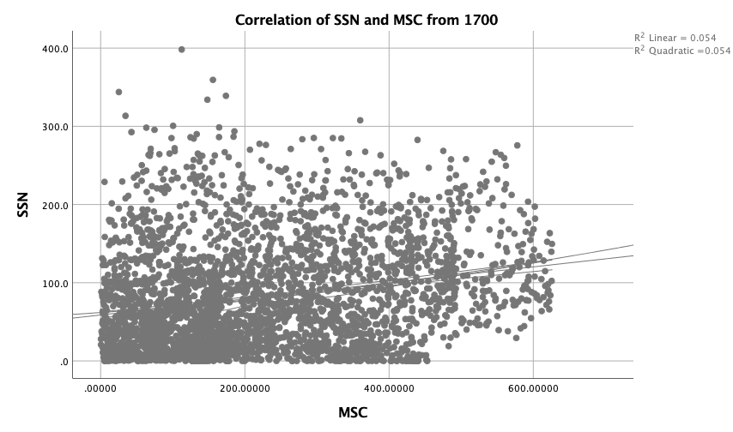
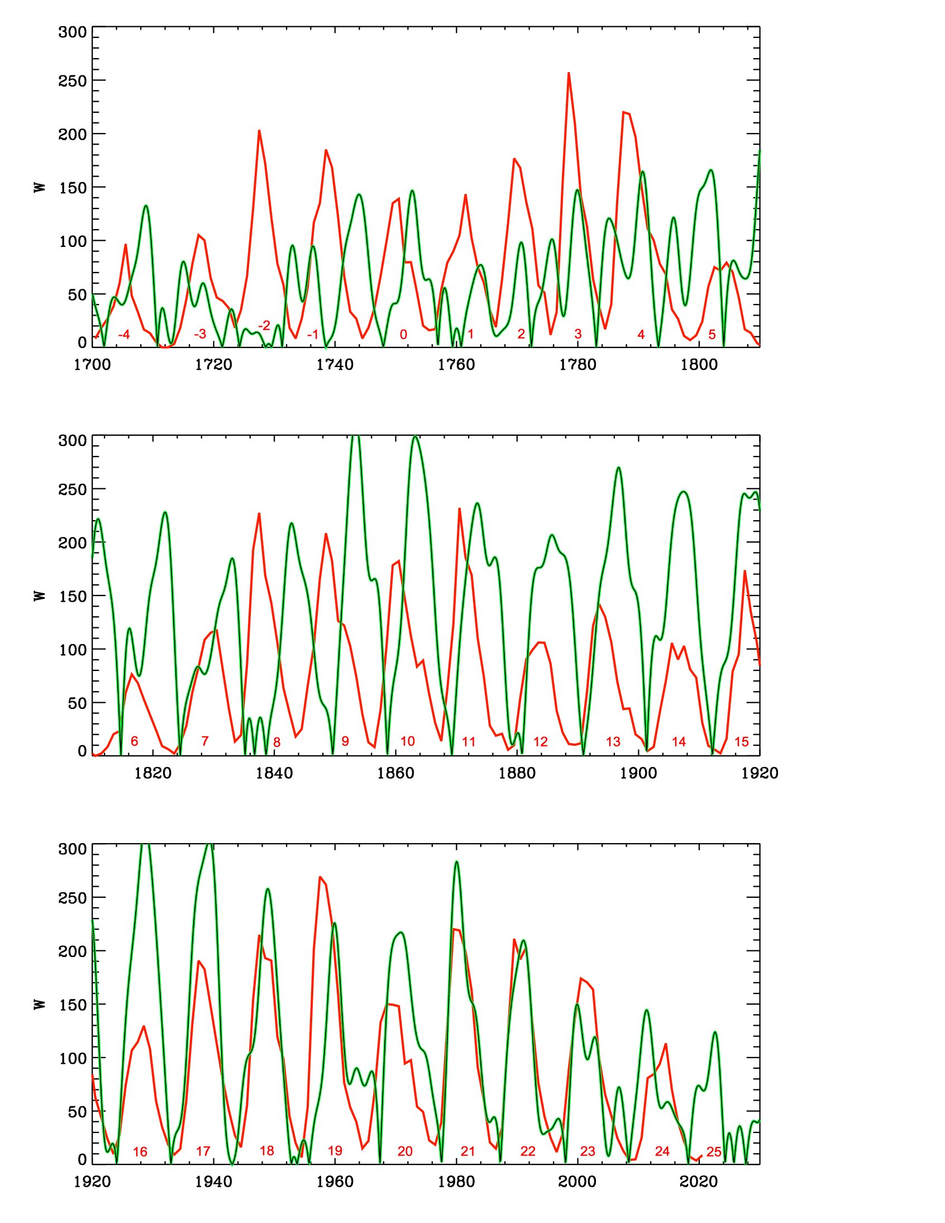
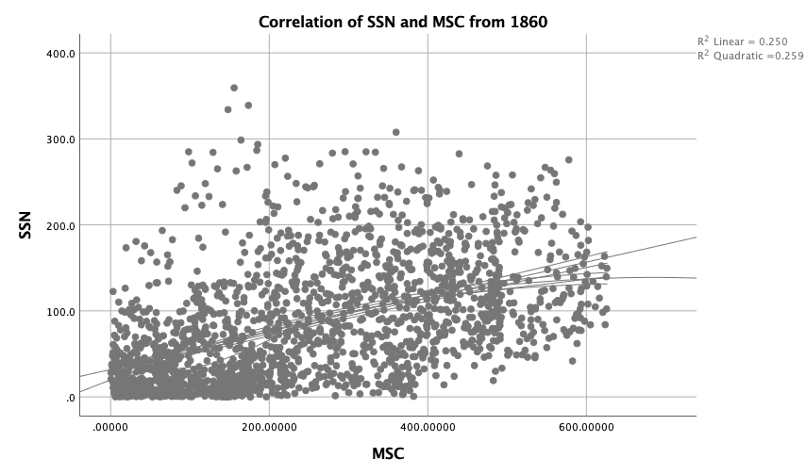
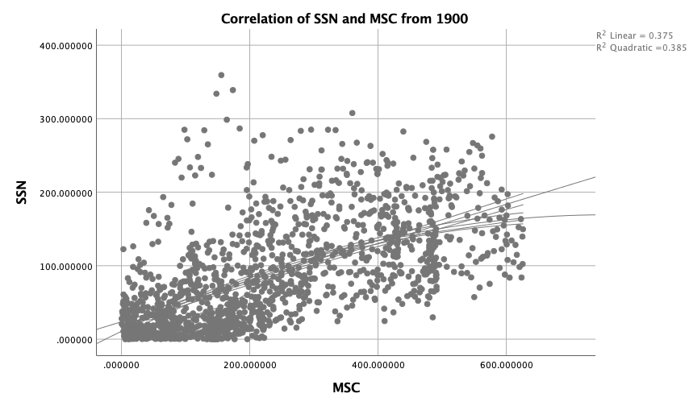
Correlation of SSN with MSC
25%
56%
67%
https://solargsm.com/wp-content/uploads/2023/04/zharkova_etal_mnras2023.pdf
With IBM SPSS package

Slide 27
Summary: new proxy of solar activity
New proxy of SA -Principal components of SBMF
PCs are paired – double dynamo waves
The strongest 2 PCs cover more than 40% of variance or 67% of SD
Prediction of the solar activity on a millennium scale shows grand solar cycle with a period of 350-400 years
Next grand solar minimum is underway in 2020-2053
Prediction for 3000-10000 years backwards fits the main grand minima and warming periods
https://solargsm.com/solar-activity/

Slide 28
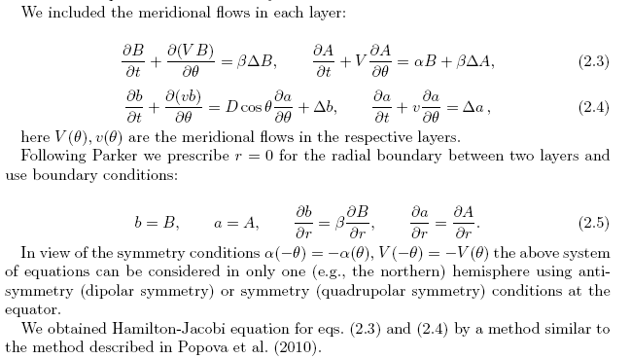
2 layer dynamo model explaining some PCA features
Zharkova et al, 2015, Popova et al, 2013

Slide 29
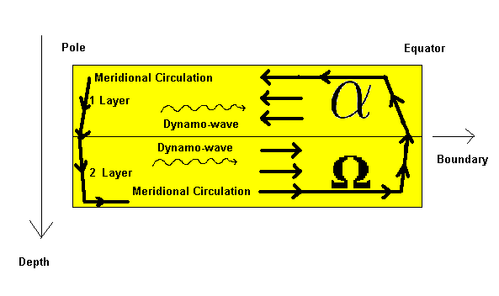
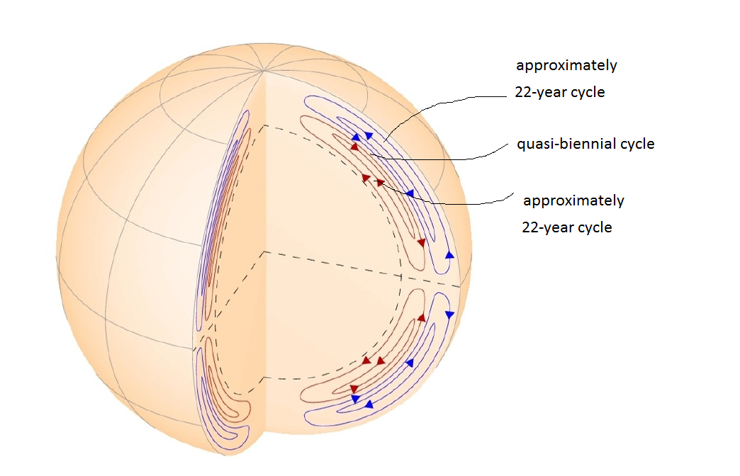
Two-Layer Medium observed with HMI
HMI/SDO heliosesimic observations
Zhao et al, 2013

Slide 30
Interference
Two wave interference
the result of two or more → waves overlapping
y₁(x,t)=Acos(kx-ωt) (top wave)
y₂(x,t)=Acos(kx-ωt+D) (middle wave)
D – phase difference b/waves
Blue wave: resulting
D=0 constructive, 2A
D=π –destructive, 0

Slide 31
Undamped Equation: Solution to Initial Value Problem (1 of 2)
Thus our solution is
To simplify the solution even further, let A = (ω₀ + ω)/2 and B = (ω₀ - ω)/2. Then A + B = ω₀t and A - B = ωt. Using the trigonometric identity
it follows that
and hence

Slide 32
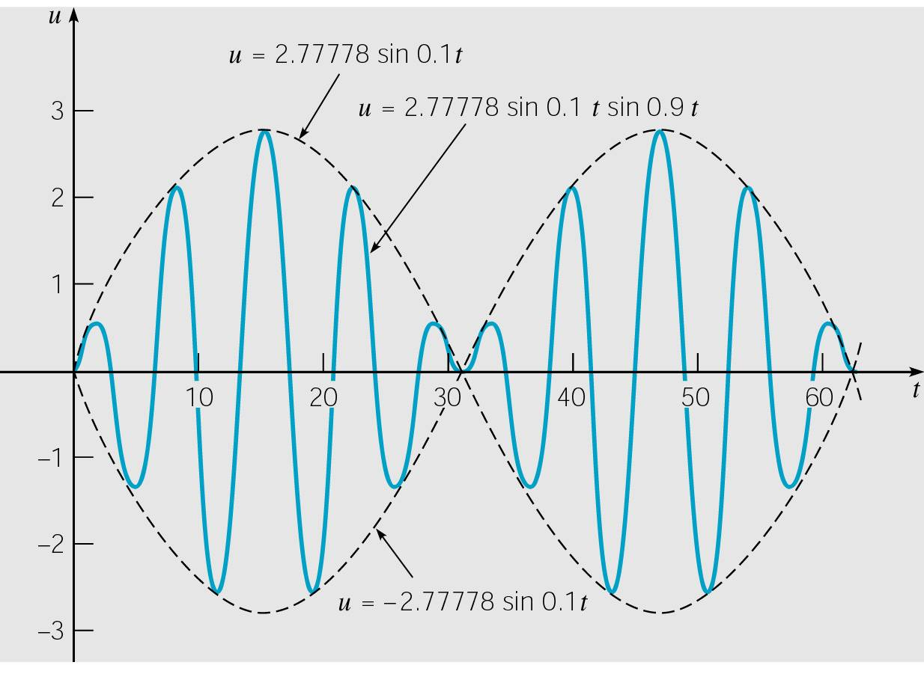
Undamped Equation: Beats (2 of 2)
Using the results of the previous slide, it follows that oscillations are described by the formula:
When |ω₀ - ω| ≅ 0, ω₀ + ω is much larger than ω₀ - ω, and
sin[(ω₀ + ω)t/2] oscillates more rapidly than sin[(ω₀ - ω)t/2] (amplitude of faster oscillation).
Thus motion is a rapid oscillation with frequency (ω₀ + ω)/2, but with slowly varying sinusoidal amplitude given by formula:
This phenomena is called a beat.
Beats occur with two tuning forks of
nearly equal frequency (beats used for tuning piano or violine)

Slide 33
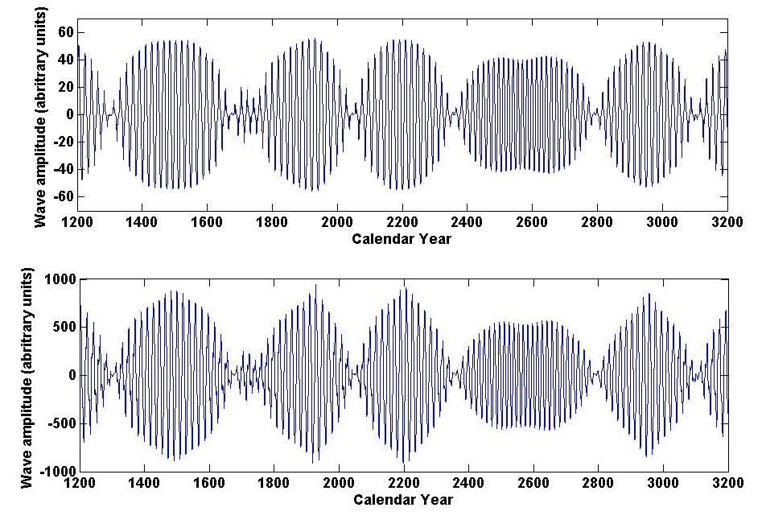
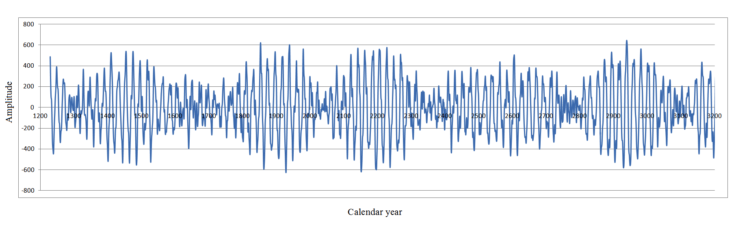
Dynamo model (top) and summary curve (bottom
Summary dynamo wave
on the millennium scale (Zharkova et al, 2015, Nature SR)
Popova et al, 2013
Zharkova et al, 2015, SR https://www.nature.com/articles/srep15689

Slide 34
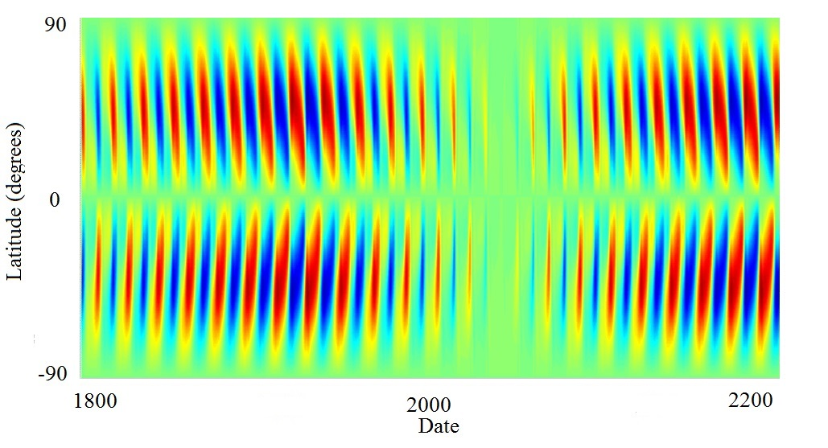
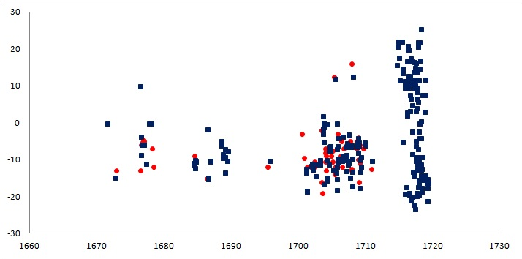
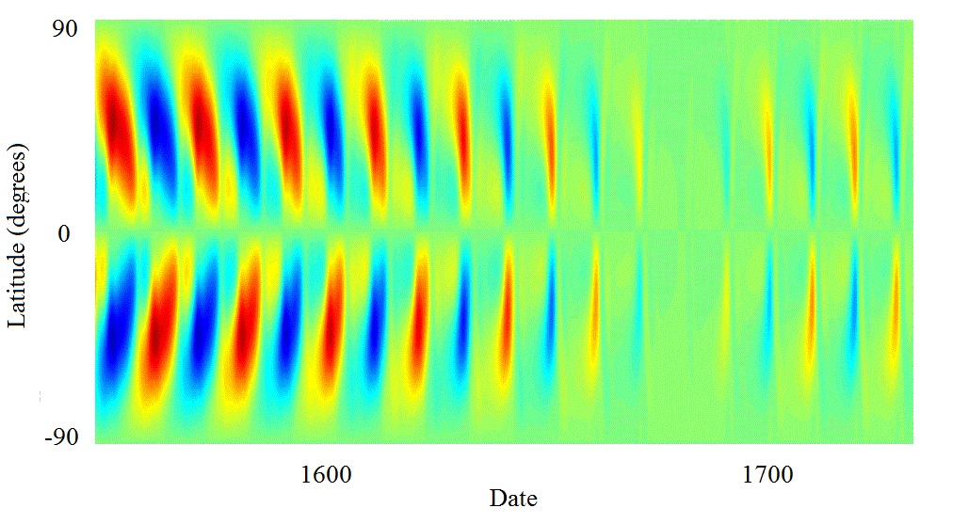
Upcoming Grand Solar Minimum
Maunder Grand Solar Minimum
Zharkova et al, 2015, Popova et al, 2018

Slide 35
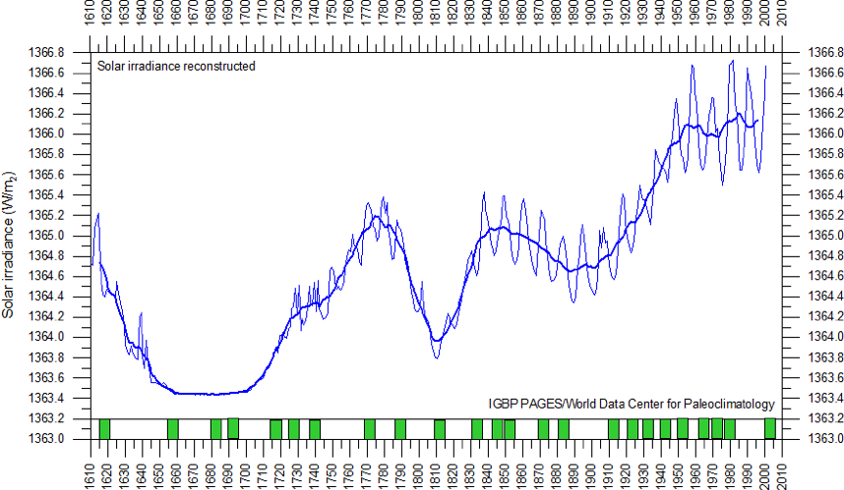
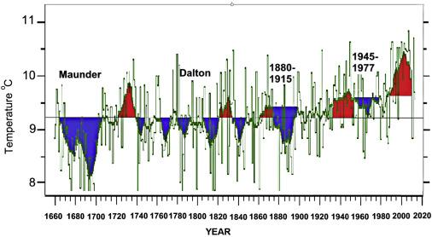
Solar irradiance and terrestrial temperature during MM
Lean et al, 1995, JGR
Lamb, 1972; Easterbrook, 2016
Authors | S, Maunder minimum, W/m² | S 1990-2000, W/m² | △S from MM, %
Lean et. Al., 1995 | 1363 | 1366 | 0.22
Steinhilber et al, 2012 | 1364 | 1366 | 0.22
Shirley et al., 1990 | --- | 1370 | 0.51
Wolff and Hickey, 1987 | --- | 1371 | 0.51
Lee et al., 1995 | --- | 1372 | 0.51
After the TSI data were re-normalized the old data are hardly usable

Slide 36
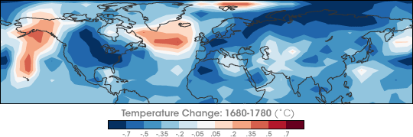
Temperature restoration during/after MM
(Shindell et al., 2001, Science)
https://earthobservatory.nasa.gov/images/7122/chilly-temperatures-during-the-maunder-minimum
The surface temperature of the Earth was reduced all over the Globe
Europe and North America went into a deep freeze
Alpine glaciers extended over valley farmland
Sea ice crept south from the Arctic
Dunab and Thames rivers & canals in the Netherlands froze regularly

Slide 37
Temperature restoration during MM
(Shindell et al., 2001, Science)
the drop in the temperature was related to dropped abundances of ozone created by solar ultra-violate light in the stratosphere, the layer of the atmosphere located between 10 and 50 kilometers from the Earth’s surface

Slide 38
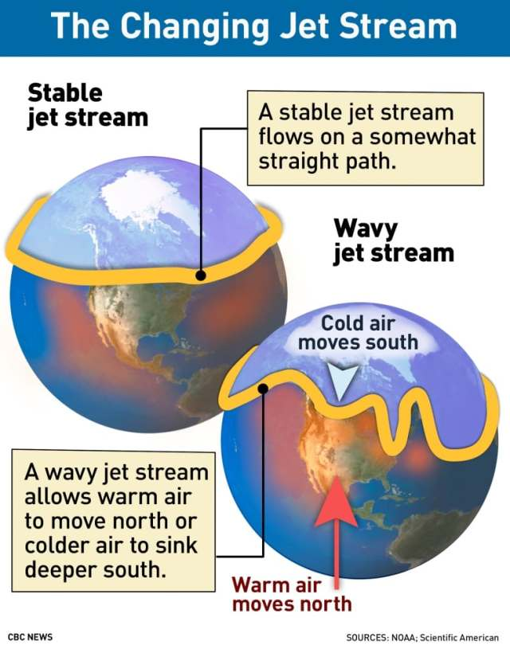
Less ozone affected planetary atmosphere waves
They, in turn, caused the giant wiggles in the jet stream as shown in picture on the left
It kicked the North Atlantic Oscillation (NAO)—the balance between a permanent low-pressure system near Greenland and a permanent high-pressure system to its south—into a negative phase
that led to Europe to remain unusually cold during the MM
Shindell et al., 2001

Slide 39
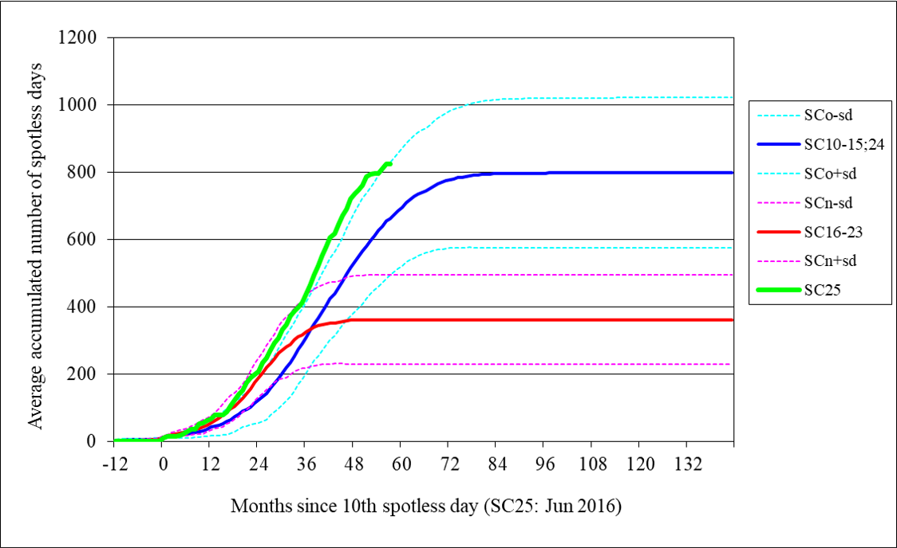
Cycle 25 (green line) shows a steeper growth of the number of spotless days than any other cycles including the ones during Dalton min (cycles 15 and 24) (blue line)

Slide 40
Modern Grand Solar Minimum 2020-2053
Snow in Carpathian mountains, snow Spain & Morocco, 2022
7, 14 July’19 July –Ukraine, 12 July 2019, 2021-2021 – many examples
Contrary to the prediction of JAMES HANSEN, 1989: “NEW YORK CITY’S WEST SIDE HIGHWAY WILL BE UNDERWATER BY 2009”
January 2020 snow and frost -2C was recorded in Amman, Arabia, first in 150 years
Early snow in Canada in September’ 20, May 21, Jan-Feb 24
Summer snow in south of Australia 2021

Slide 41
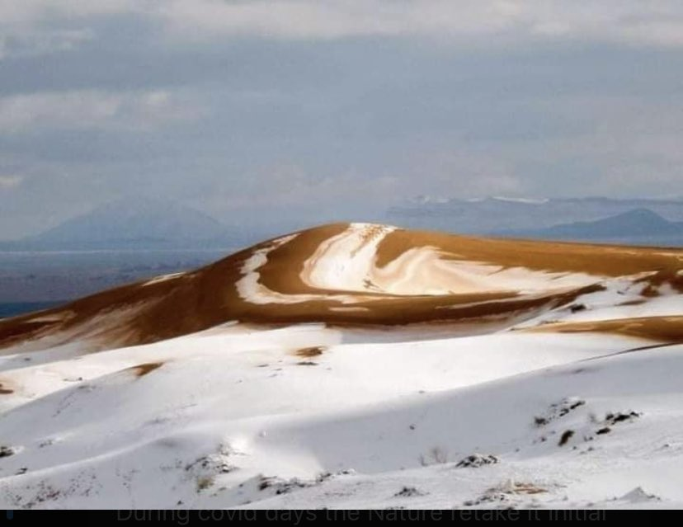
Snow in Africa’s desert 8 December 2020 https://twitter.com/GerryAMcG/status/1336420778582138886

Slide 42
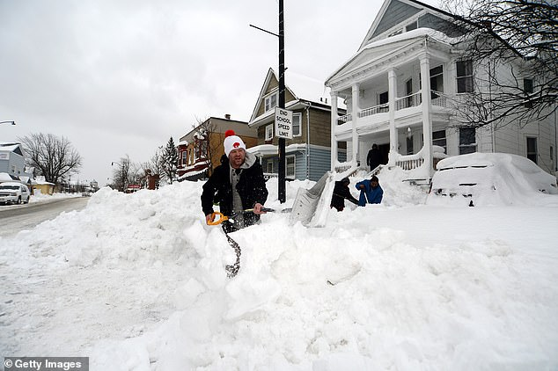
Snow blizzards in USA and Canada for 2 weeks in Dec ’22 –Jan’ 23

Slide 43
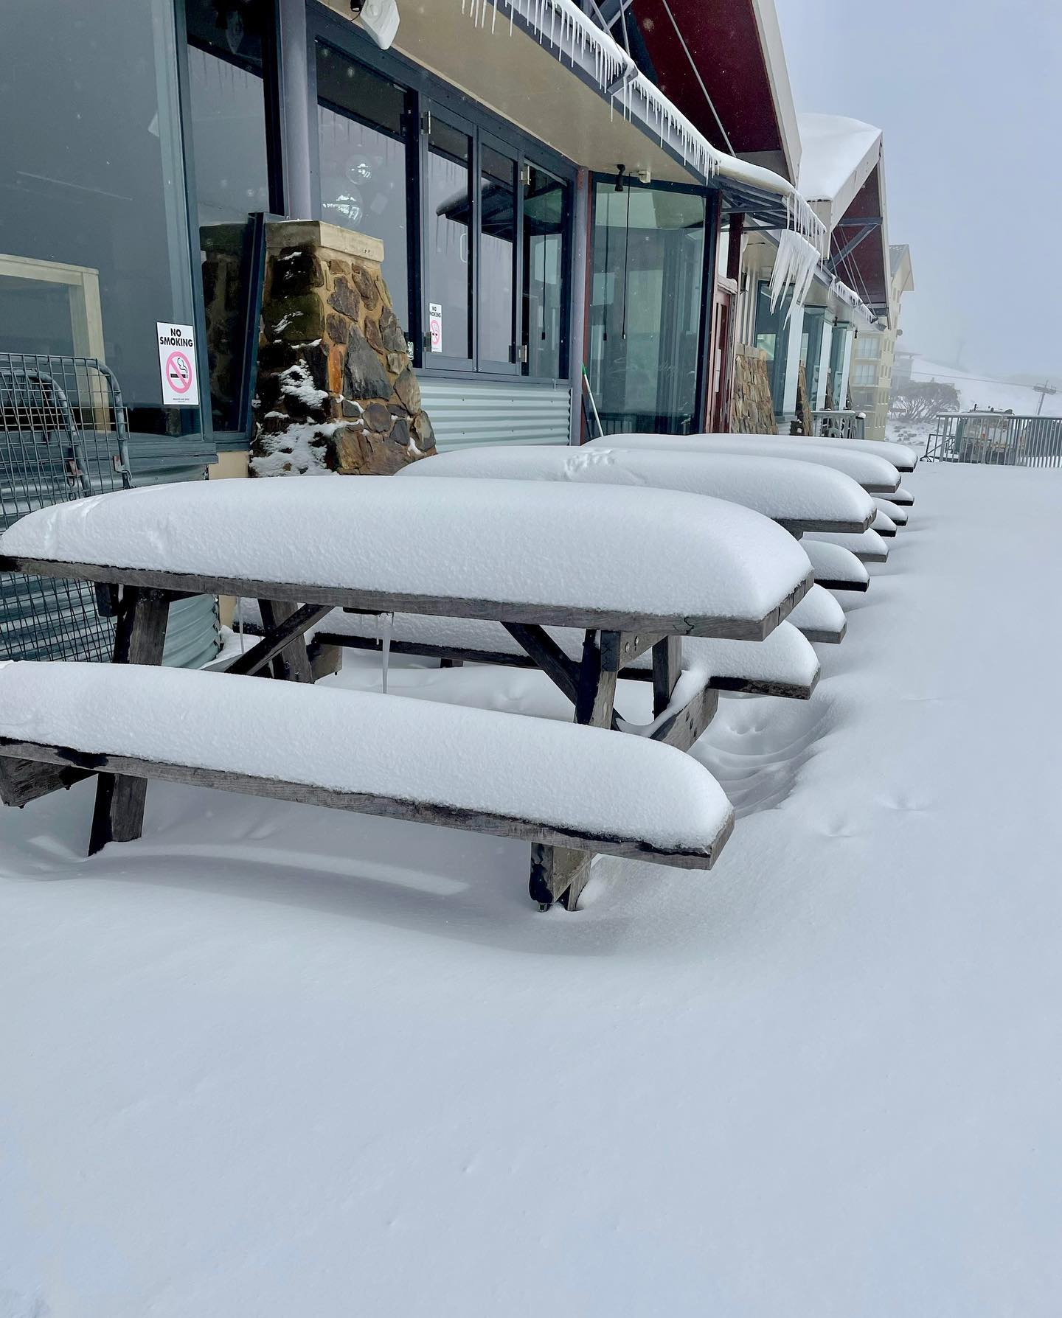
Late spring snow in Australia and NZ 22-30 November ’22
(analog of late May in Northern hemisphere)

Slide 44
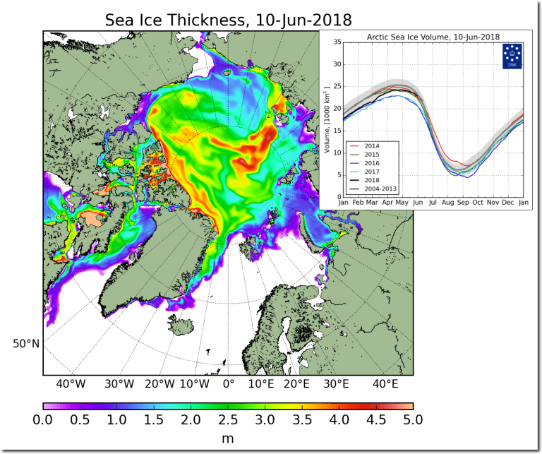
Modern GSM: Sea ice thickness increase in 2018-2020
Contrary to prediction of JAMES HANSEN, 1989: “NEW YORK CITY’S WEST SIDE HIGHWAY WILL BE UNDERWATER BY 2009”
Arctic sea ice thickness grown significantly in 2018 and continues to grow

Slide 45

Modern GSM is progressing –November 2020- June 2022
UNPRECEDENTED WINTER STORM HITS BRITISH COLUMBIA
Both NOAA and NASA appear to agree, if you read between the lines, with NOAA saying we’re entering a ‘full-blown’ Grand Solar Minimum in the late-2020s
NASA seeing this upcoming solar cycle (25) as “the weakest of the past 200 years”, with the agency correlating previous solar shutdowns to prolonged periods of global cooling here.

Slide 46


Slide 47
Modern Grand Solar Minimum https://solargsm.com/solar-activity/
To occur in 2020 – 2053
This is a unique event in solar-terrestrial connection → will reveal the pros and cons of solar dynamo models
Decrease of solar magnetic field → big impact ozone reduction, high cloud formation, jet direction changes, cosmic rays inclease
Increase of volcanic and earthquake activities
Effects on the terrestrial temperature via TSI, jets and volcanic activity
Shortage of vegetation periods can lead to possible food shortages in 2028-2042
Need inter-government efforts to avoid disasters

Slide 48

Terrestrial temperature recovery recovery after mini ice age during MM
Akasofu, 2011

Slide 49



Solar magnetic field (top) and
Mbaseline oscillations (bottom)
(ZharkovlZharkova et., 2019, 2021al, 2018, 2019, 220 ture SR)
Reames et al, 2009
¹⁴C in trees

Slide 50


2000-2100 year oscillations (Zharkova et al, 2019, 2020) of the MF baseline coincides with that of the solar irradiance (Vierra et al, 2011)
(Akasofu, 2010)
Zharkova et al, 2019, 2020

Slide 51

What are the reasons of solar irradiance oscillations?
→ Sun, Earth and other planets motion (Milankovich cycles)

Slide 52

Obliquity (axial tilt) (ε) (22º.1-24º.5)
current 23.5 - T~41 000 years
Eccentricity (e). Change on semi-minor axis
T~100-400K years effects of Jupiter and Saturn
Longitude of perihelion (sin(ϖ) ).
Precession index (e sin(ϖ) ) –
Axial - Earth's axis of rotation relative to fixed
stars – T~ 25,771.5 y
Apsidal - orbit ellipse relative to fixed stars – T~113 000 y
Orbital inclination – T~ 70 000 y
Earth's movements:
  1.1 Orbital shape (eccentricity)
  1.1.1 Effect on temperature
  1.1.2 Effect on lengths of seasons
  1.2 Axial tilt (obliquity)
  1.3 Axial precession
  1.4 Apsidal precession
  1.5 Orbital inclination (
2

Slide 53

Solar Inertial Motion
Solar inertial motion is the motion of the Sun around the centre of mass of the Solar System due to variable positions of the giant planets (J-Jupiter, S-Saturn, U-Uranus, N-Neptune).
The Sun moves inside a circular area which has a diameter of 0.02 AU (= 4.3 solar radii = 3.106 km). The Sun moves with a velocity between 9 and 16 m/s.
6.96x10⁵ km
Charvátová, I., The solar motion and the variability of solar activity, Adv. Space Res., 8, 7, 147-150, 1988.
Charvátová, I., On the relation between solar motion and solar activity in the years 1730-1780 and 1910-60, Bull. Astr. Inst. Czech., 41, 200-204, 1990.
Charvátová, I., Solar-terrestrial and climatic variability during the last several millennia in relation to solar inertial motion, J. Coast. Res., 17, 343-354, 1995.
Charvátová, I., Can origin of the 2400-year cycle of solar activity be caused by solar inertial motion? Annales Geophysicae, 18, 399-405, 2000.

Slide 54


Slide 55


Slide 56


SIM effects on the Earth via solar irradiance
Objection from AGW people
https://youtu.be/vDgUmTq4a2Q
The Sun moves inside a circular area which has a diameter of 0.02 AU (= 4.3 solar radii = 3.106 km). The Sun moves with a velocity between 9 and 16 m/s.
S. Perminov, E.D. Kuznetsov, 2018
SIM imposed by planets Jupiter, Saturn, Neptune and Uranus
Charvatova, 1988,
Palus et al, 2007
Rice et al, PP comments #72, 96

Slide 57








Average S-E distances – pure calculus, Stein, 1977
3rd Kepler’s law:
By angle theta:
$${\overline{r }}_{θ}=\frac{1}{2π}\int_{0}^{2π}{rdθ= \frac{1}{2π}}\int_{0}^{2π}{\frac{pe }{1−ecosθ} dθ= \frac{2πpe}{2π\sqrt{1−e^{2}}}= \frac{a\left(1−e^{2 }\right)}{\sqrt{1−e^{2}}}}=$$
$$a\sqrt{1−e^{2}}=b$$
By time:
$${\overline{r }}_{t}=\frac{1}{T}\int_{0}^{T}{rdt= \frac{h}{πab}\int_{0}^{2π}{r\frac{dt}{dθ}dθ= \frac{h}{πab}\int_{0}^{2π}{r\frac{r^{2}}{2h}dθ= }}}\frac{1}{2πab}\int_{0}^{2π}{r^{3}dθ, }$$
$$=a\left(1+\frac{e^{2}}{2}\right)$$
By arc:
${\overline{r }}_{s}=\frac{1}{L}\int_{0}^{L}{rds= \frac{aL}{L}}=a.$
$$b=2\sqrt{R_{a0}R_{p0}}$$
$$r_{1}+r_{2}=2a=R_{a}+R_{p}$$

Slide 58






600
1700
1100
2020
2600
1600
https://www.intechopen.com/online-first/millennial-oscillations-of-solar-irradiance-and-magnetic-field-in-600-2600

Slide 59







Slide 60







Slide 61







Slide 62











Ephemeris of S-E distances

Slide 63


Annual variations of mean S-E distances (ephemeris)
in M1 (600-1600) and M2 (1700-2600)
(Zharkova, 2020 https://arxiv.org/pdf/2008.00439.pdf )
M1 – aphelion is in June, shifting to mid-July in M2
a - Sun - in the ellipse focus
b - Sun shifted by SIM to spring equinox

Slide 64
2600
Aphelion →. 16 July
Perihelion → 16 January
SIM effects on the Earth via solar irradiance
https://youtu.be/vDgUmTq4a2Q
S. Perminov, E.D. Kuznetsov, 2018
SIM imposed by planets Jupiter, Saturn, Neptune and Uranus
Charvatova, 1988,
Palus et al, 2007
Rice et al, PP comments #72, 96

Slide 65







Solar irradiance
2600
1600
2020
1100
$S=\frac{I_{sun}}{d^{2}}$ → S₁ $d^{2\text{1}}$ =S₂ $d^{2\text{2}}$
inverse squared law
600
1700

Slide 66







Slide 67







Slide 68







Slide 69


Annual TSI variations in M1 (600-1600) and M2 (1700-2600)
Zharkova, 2021 https://www.intechopen.com/online-first/millennial-oscillations-of-solar-irradiance-and-magnetic-field-in-600-2600 )
M1: TSI significantly increases in February – June, and decreases in June-December. M2: the aphelion shifts to mid-July →TSI decrease in July – January is not fully compensated!

Slide 70


Variations of the total annual TSI in M1 (600-1600) and M2 (1600-2600) averaged for each month (left) and daily (right)
https://arxiv.org/pdf/2008.00439.pdf
Zharkova et al, 2019, Zharkova, 2020
There is extra solar forcing caused by gravitation of planets, which is a likely reason of the main part of global warming
Extra solar forcing
Not considered so far!

Slide 71
Global Warming Over Last Century (Hardy, 2017)
Total Temperature Balance if extra 5W/m^2 radiation is added:
  Solar warming over last century:
  for solar anomaly ΔTSI = 2.6‰ → ΔT_{Sun} = ΔTSI x S_{S} = 0.44°C
  CO₂ warming over last century:
  100 ppm CO₂ at ECS = 0.70°C → ΔT_{CO2} = 0.30°C
  Full agreement with observed temperature increase: 0.74°C
  Full agreement with observed cloud cover changes
60%
40%
We have extra 20-25 W/m^2 radiation every year!
Hence, the hating comes from this radiation!

Slide 72

Radiative Transfer:
What IPCC missed when interpreting the emission of CO2?
Puzzle: How IPCC models can account for extra-heating
from CO2
?

Slide 73


Slide 74
Imaginary Greenhouse effect and real Earth: conceptual frameworks
Fact 9
intersideral vacuum
100
100
H₂O skin radiating
to the cosmos
Glass pane
Air filled with water vapor
OPAQUE
to thermal infrared
100
100
100
H₂O an excellent heat-pipe
100
vacuum
200
H₂O Evaporation & convection
200
200
surface
soils
oceans
A glass pane in vacuum, the wall of a thermos bottle, a good insulator, is by no way a model for a turbulent and water-vapor laden air, which is an excellent heat-pipe, carrying latent and sensible heat!
No heat transfer by thermal infrared from the surface
as 200 - 200 = 0
No radiative carriage of heat through the air made opaque
by the water vapor
(T surface) / (T radiating pellicle) = ( (P surface)/ (P pellicle) )^{0,19}
Note : the flows 100 or 200 are not W/m² but simple numbers to help the understanding of what happens
Notes:
Fact 9: A water vapor laden atmosphere is an excellent heat pipe, thanks to evaporation, turbulent convection and condensation.
*** The solar heat is taken away from the surface by this heat pipe, the big blue arrow, and transferred to the skin of water vapor that radiates thermal infrared to the cosmos.
An opaque, I repeat OPAQUE, atmosphere cannot, can NOT, carry heat by infrared thermal radiation.
The heat pipe and the opaque atmosphere make the greenhouse effect disappear completely.
*** The bottom layer of the air absorbs the thermal infrared from the surface and radiates roughly as much thermal infrared to the surface: the net balance, or radiative transfer of heat, is zero between air and surface!
Heating by back-radiation is a nonsense.

Slide 75
The optical thickness τ of the atmosphere is the parameter to use to compute the diffuse radiation in an absorbing and radiating medium like the atmosphere (Chandrasekhar 1948, K. Ya. Kondratiev 1969)
f_{down} (ν, z) =
π ∫₀^{τ(ν,z)} B(ν, T(t')) 2 E₂(τ(ν, z) - t') dt’
f_{up}(ν, z) =
=π ∫_{τ(ν,z)}^{τmax} B(ν, T(t')) 2 E₂(t' - τ(ν, z)) dt’
f_{surface} (ν, z) = π B(ν, T_{surface} ) 2 E₃(t_{max} – τ(ν, z))
B Planck’s function, E₂ and E₃ exponential integral functions
80% of the thermal radiation from a body is produced in its skin or “pellicle”
of optical thickness τ = 1,07

Slide 76
Interpretation of the equation of radiative transfer
The formal solution of the radiative transfer equation yields the observed intensity of the radiation:
The frequency dependence of the emission and absorption components leads to the formation of emission and/or absorption features.

Slide 77

Radiative transfer in action
https://demonstrations.wolfram.com/ComputationOfRadiativeTransfer/
intensity of emission from the gray area on the left.
for tau<1 emission (green curve) the emitted intensity is proportional to the density of excited molecules (CO2)
for tau>1 it becomes saturated (red curve).
IPCC assumes that all CO2 emitting as green curve while its tau>>1, so it is emitting as the red curve (saturated).

Slide 78

SIM solar forcing and green house (GH) effects
Increase of SI with a decrease of S-E distance would lead to the increase of T by 1.2C by 2010, and by further 2.5-3.0 C in 2500.
The terrestrial temperature increase induced by change of the S-E distance can only account for the baseline temperature variations (straight line) here and in Akasofu’s curve (2010).
K.Rice Pubpeer comment #38 (shown in the figure on the right) that whole T is defined by the blue curve. The T increase above the baseline is interpreted by the current terrestrial models Including GH gases
Harde et al., 2017 (IJAS, id 9251034) modelled radiative transfer of CO2 with extra solar forcing of the similar magnitudes found from SIM → T increase: 60% solar and 40% by CO2
K.Rice Pubpeer comment #38

Slide 79
Modulus summary curve
Zharkova et al, 2015, SciRep; 2020, Temp., Zharkova et al, 2022, MNRAS s sunsdata
(Shepherd et al, 2014 ; Zharkova et al, 2015)
Cycle 21
Cycle 22
Cycle 23
Terrestrial temperature will decrease because of GSM
Confirmed by
Katiashvili, 2020, ApJ;
Obridko et al, 2021, MNRAS
Velasco-Herrera et al, 2021
Cycle 21
Cycle 22
Cycle 23
Cycle 24
Cycle 25
Cycle 26

Slide 80
Predicted solar activity (Zharkova et al, 2015, SR https://www.nature.com/articles/srep15689)
Zharkova et al, 2015, Nature SR
Observational result, dynamo model was not yet considered
The Sun entered the grand solar minimum in 2020 until 2053
https://solargsm.com/solar-activity/ - my webpage

Slide 81
Conclusions
Prediction of the solar activity on a millennium scale shows grand cycle variations with a period of 350-400 years – double solar dynamo in action
Global cooling: the modern GSM to occur in 2020 – 2053 → Different narratives for all the governments!
Analysis of summary curve of SBMF for 100,000 years detects weak variations of the magnetic field baseline with a period of ~2100-2200 years – Hallstatt’s cycle
MF baseline variations are closely linked to the solar inertial motion (SIM) about a barycentre of the solar system
What about global warming? It occurs independently to any solar activity because of SIM imposed on Sun by large planets!
Owing to SIM SI would increase from 1600 to 2500 by further 20-25 W/m² per year (10-12 W/m² per hemisphere)
Increase of TSI with a decrease of S-E distances would lead to the increase of T by 1.2C by 2010, and by further 2.5-3.0 C by 2500.
Is there AGW effect? If Sun SIM covers this heating than not much left to think so!

Slide 82

Thanks for your attention!

