Slide 1

Particle acceleration in 3D reconnecting current sheets with and without magnetic islands
,
Valentina Zharkova
University of Northumbria, Newcastle upon Tyne, UK
ZVS Research Enterprise Ltd. London, UK
1
Notes:
1

Slide 2
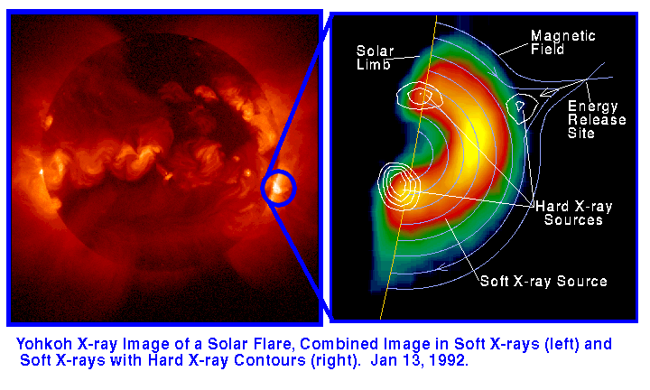
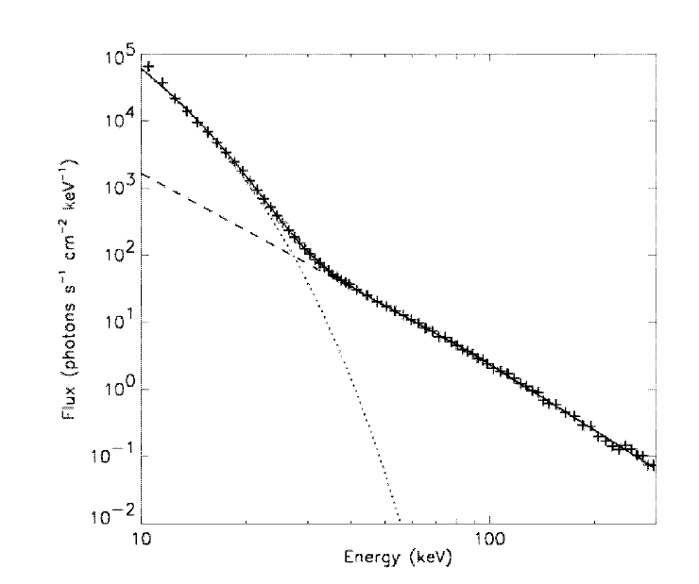
Particle acceleration in solar flares
Large numbers of non-thermal ions and electrons produced in flares (10³⁶-10³⁷ particles/s)
Energy: e: 10 -10000 keV p: 1 -10000 MeV
Spectral indices 1.5- 8
RHESSI, Lin et al (2003)
Large current sheets (Sui &Holman, 2003; Jaing et al, 2006; Liu et al., 2010)
HXR and gamma ray sources are often spatially separated
Gamma-ray emission appears 10-30 sec later after HXR

Slide 3
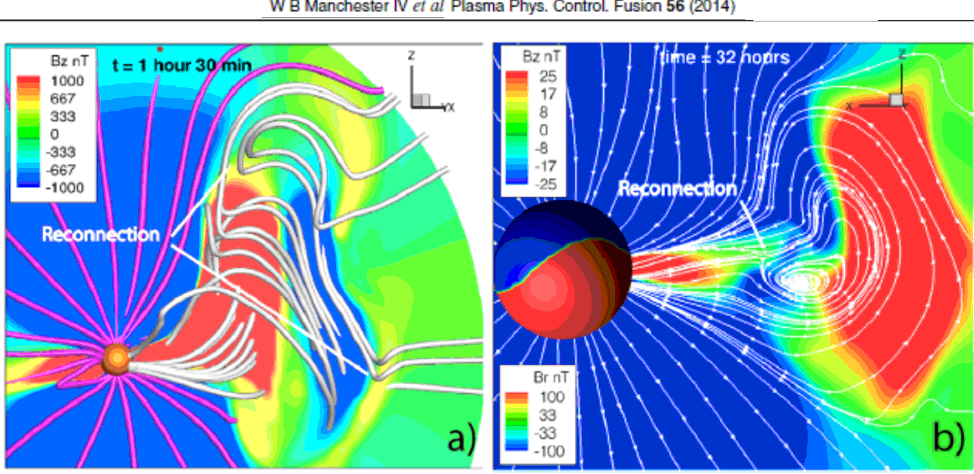
ICME current sheets
Magnetic reconnection
a) at the leading edge of an ICME; b) behind the ICME

Slide 4
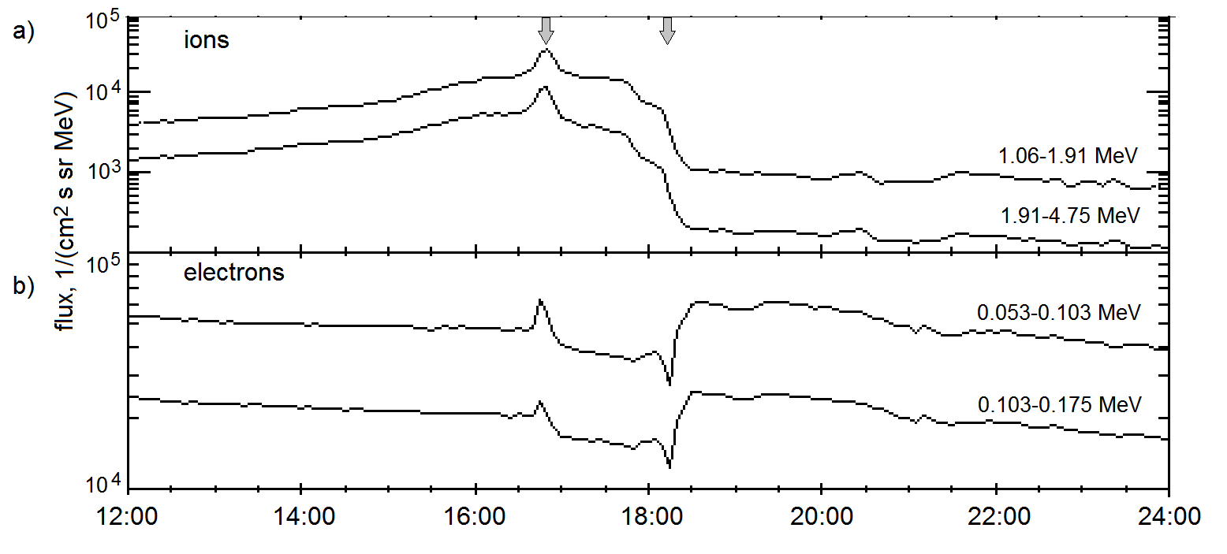
Solar wind particles passing ICME
Problems with particles in the interplanetary magnetic field
Problem 1: What makes particles to move perpendicular to the IMF in a vicinity of ICME
Problem 2 : Why there is asymmetry in motion of ion and electron flux about ICMEs? Why high energy strahls of electrons are often observed in anti-parallel direction?

Slide 5
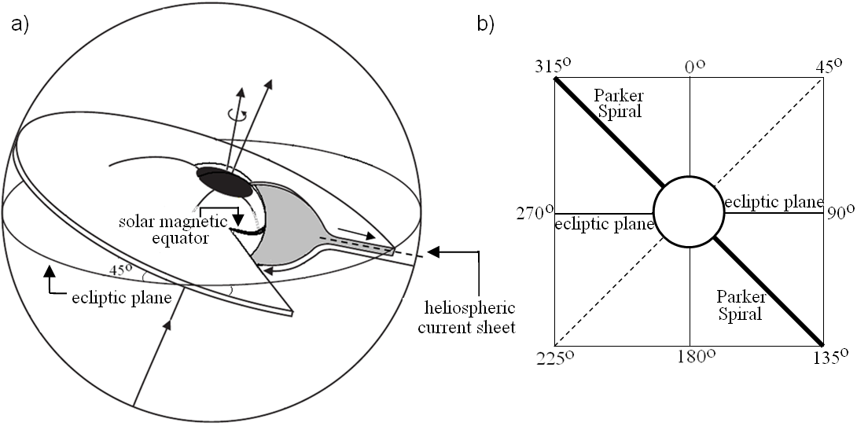
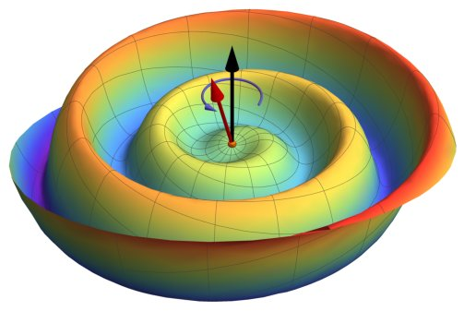
Problems in identification of sector boundaries
Heliospheric current sheet (HCS)
Azimuthal angle of magnetic field at 1 а.е. - ϕ_{B}
HCS
Sun
HCS
(HCS)
315° sector – toward the Sun
135° sector – outward the Sun
Using ϕ_{B} (if crosses 45° or 225° - change of IMP from or to the Sun).
Using components of IMP
Using change of direction of electron propagation

Slide 6
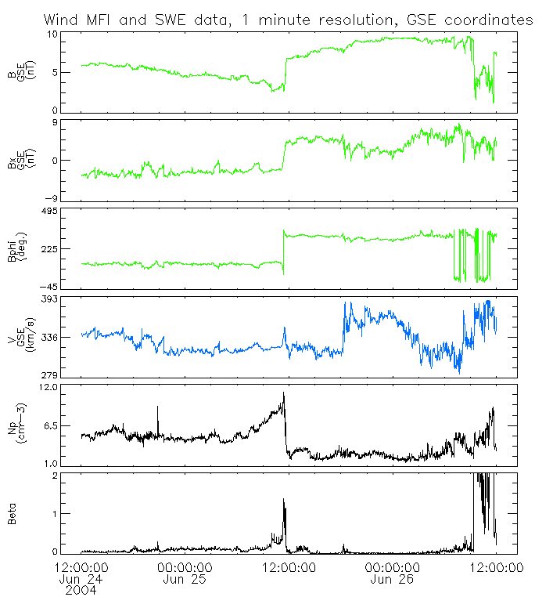
Zharkova&Khabarova, 2012 https://iopscience.iop.org/article/10.1088/0004-637X/752/1/35/pdf
IMP magnitude sharply
drops or increases
Horizontal component(Bx, GSE) = 0 nT;
Azimuthal angle (φ_{B}) changes by180°;
Problem 3 –ion velocity profile is asymmetric over the HCS
Problem 4 -Density is sharply increased about the HCS
Beta is also sharply increased
Zharkova and Khabarova, 2012, ApJ
Magnitude of IMP
Bx=0
Azimuthal angle
Velocity
Plasma density
Beta

Slide 7
Problems in identification of sector boundaries
Zharkova&Khabarova, 2012 https://iopscience.iop.org/article/10.1088/0004-637X/752/1/35/pdf
Crossing of a thin SB:
a) IMP magnitude;
b) IMP horizontal component (Bx, GSE);
c) IMP azimuthal angle (φ_{B});
d-f) Spectrograms of electron distribution in pitch angles
(in 3 energy channels)
Problem 5 – Electron pitch angle distribution with turning point far away
from HCS
sector
340 eV
84 eV
27 eV

Slide 8
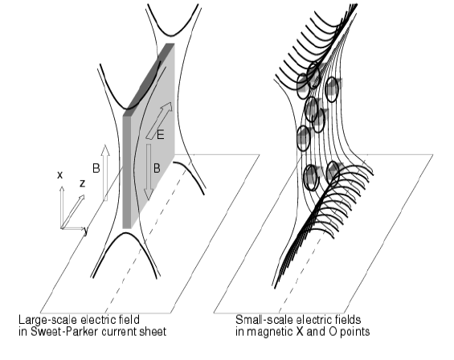
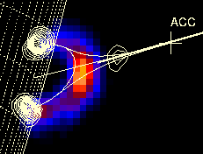
Magnetic reconnection
in solar corona and heliosphere
Zharkova et al, 2011, SSRv https://ui.adsabs.harvard.edu/abs/2011SSRv..159..357Z/abstract
Problems of particle acceleration:
Role of magnetic field topology
Timing of acceleration
Interaction between electrons and ions
Particle numbers
Energy spectra
Pitch-angle distributions
Generation of turbulence
Secondary acceleration energization
Notes:
Example 1
8

Slide 9
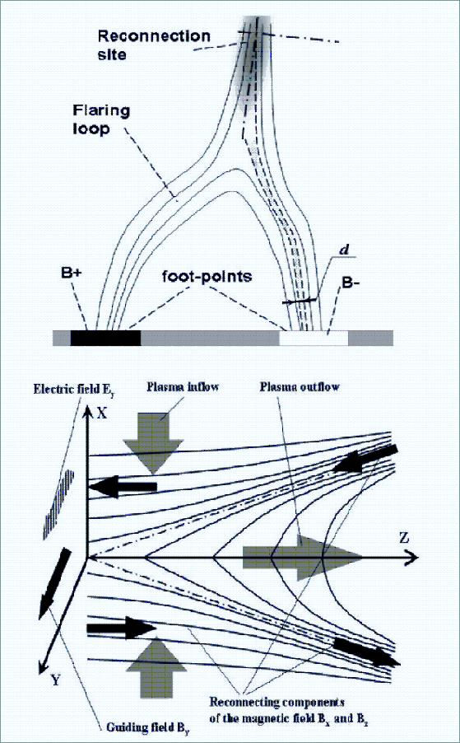
Test particle approach
Zharkova&Gordovskyy, 2004, ApJ; 2005, A&A; SSRv;
Zharkova & Agapitov, 2009, JPP (see also Wood &Neukirch, 2005, Dalla & Browning, 2005, 2010; Browning et al, 2010...)
B_{z} = B₀ tanh( - x/d)
B_{x} = B₀ (z/a)^{α}
B_{y} = +/- By₀ = 1-10 G
B₀ = 10-100 G
E_{y0} = B₀V_{inflow} – 1/σμ dB_{z}/dx
V_{inflow} ≈ 0.01 V_{alfven} ≈ 10⁴m/s
E_{y0} = 100 -250 V/m

Slide 10
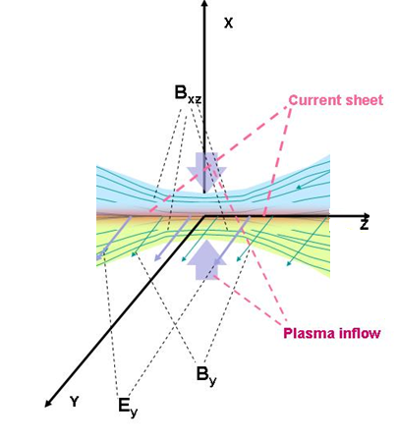
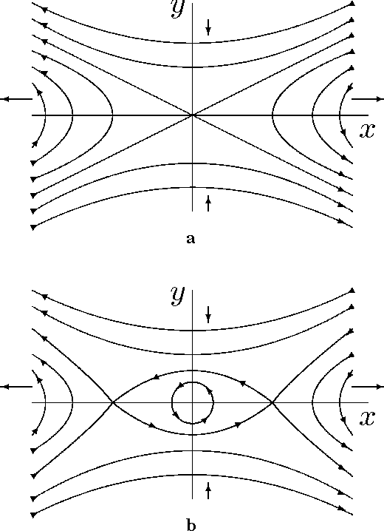
Physical model of reconnection current sheet
PIC simulations (2.5D - XOOPIC, 3D -VPIC)
A single X-null
O-type
(magnetic island)
Siversky and Zarkova, 2009, JPP, 75,
Zharkova and Khabarova, 2012, ApJ, 752, 35;
2015, Ann Geo, 33, 457;
Khabarova et al, 2020, ApJL, 894, L12
Xia and Zharkova, 2018, 2020, 2021a,b, A&A, Frontier
Notes:
Tracking the plasma inflow
10

Slide 11
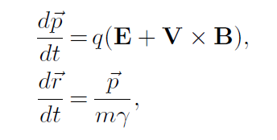
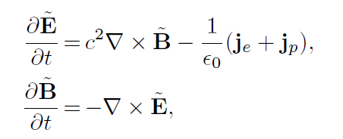
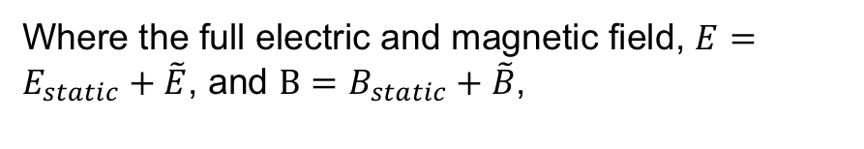
Particle-in-cell Approach
Static fields come from MHD scale,
Consider plasma feedback to a presence of accelerated particles – induced electric and magnetic fields
Particle motion equations
Plasma feedback – Maxwell Equations
Where the full electric and magnetic field, , and ,
J.P. Verboncoeur, et al 1995 – 2.5D XOOPIC
Bower et al, 2008 – 3D VPIC

Slide 12
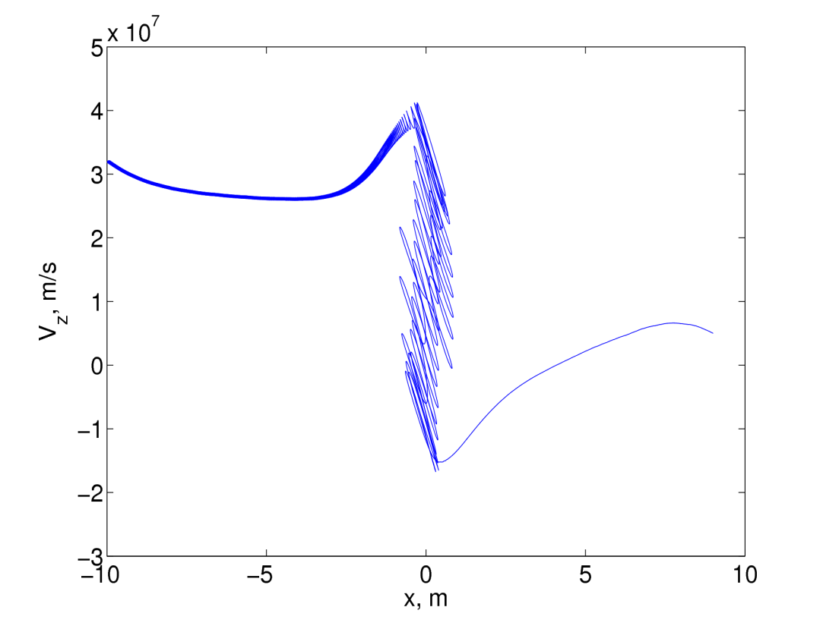
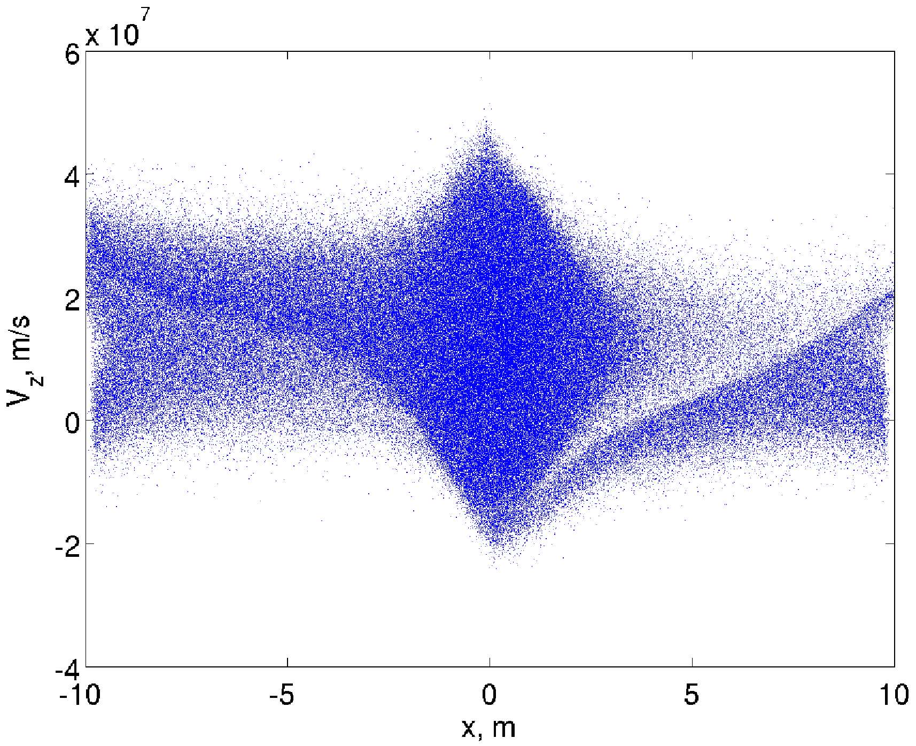
Trajectories of protons and electrons (both bounced and transit) in PIC model (solar corona) Siversky&Zharkova, 2009 https://ui.adsabs.harvard.edu/abs/2009JPlPh..75..619S/abstract
P, x=+-10m
Vx=0
N=10⁴ cm⁻³
e, x=-10m
Vx=-5x10⁶
N=10⁴ cm⁻³
e, x=-10m
Vx=-5x10^6
N=10⁶ cm⁻³
e, x=10m
Vx=-1x10⁷
Corona top source: electron clouds
N=10⁴ cm⁻³

Slide 13
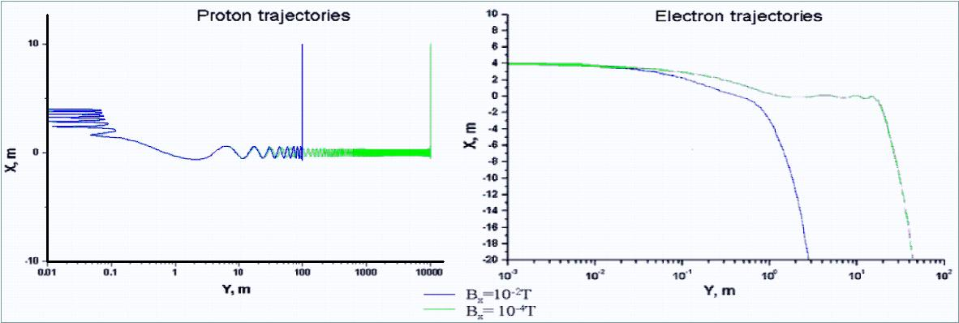
Particle trajectories: separation
(E~ B_{x}⁻² ~z⁻²) blue – RCS edge, green – close to X-point
TP: Zharkova & Gordovskyy, 2004, Apj; 2005, MNRAS, SSRv

Slide 14
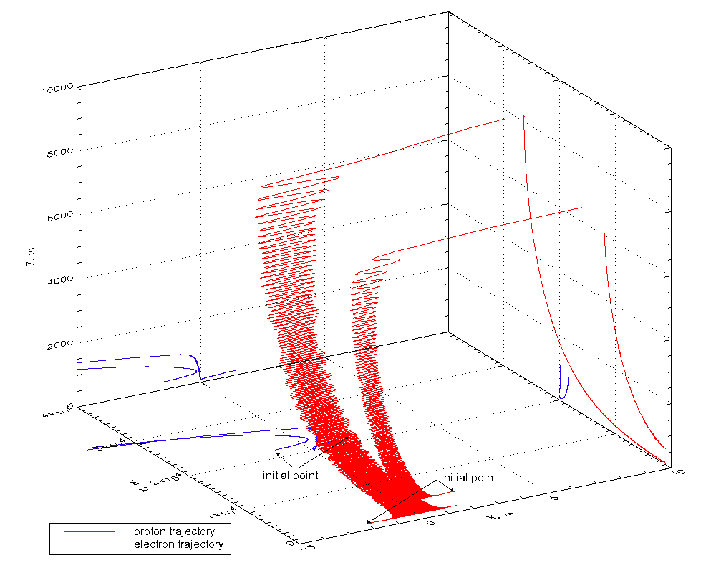
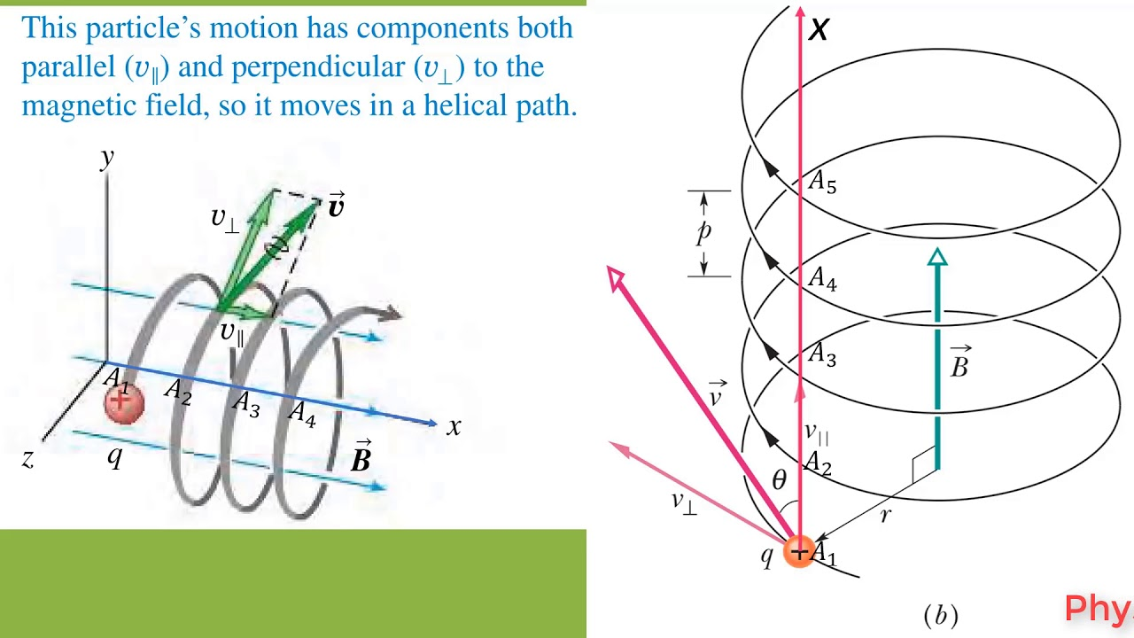
TP: Zharkova & Gordovskyy, 2004, Apj; 2005, MNRAS, SSRv,
Zharkova and Agapitov, 2009, JPP
dN/d ε ~ A ε^{-1.5}
dN/d ε ~ B ε^{-2.0}
ZA 2009, JPP

Slide 15
TP: Zharkova&Agapitov, JPP, 2009, 75/2, 159
dN/d ε ~ A ε^{-1.5}
dN/d ε ~ B ε^{-2.0}
ZA 2009, JPP
Myth 3 –charge neutrality of separation?

Slide 16
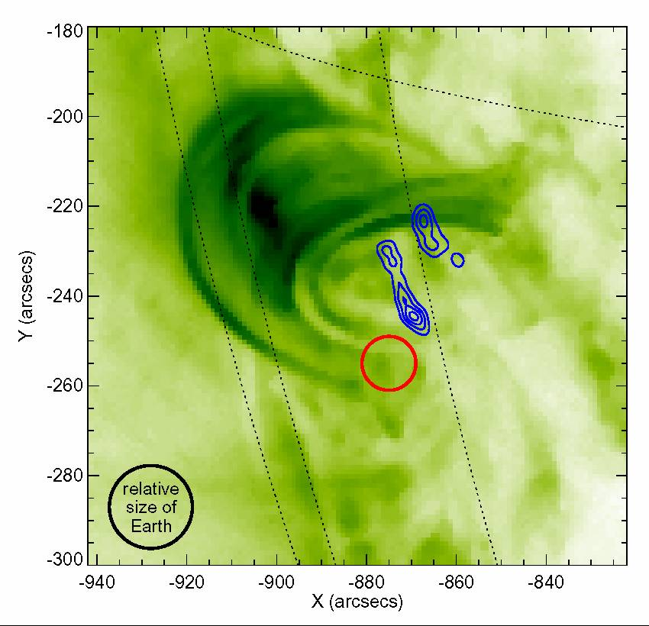
Separation of HXR (blue) and Gamma-ray (red) emission
Flare 23 July 2002, RHESSI,
Lin et al (2003)

Slide 17
Electron spectral indices γ dependence on α (B_{x}(z)) and λ (N(z))
ZA 2009, JPP
Electrons
γ= 1+ λ /(2 α) – strong guiding field (β > 10⁻²)
γ= ½(1+ λ /α) – weak guiding field (β< 10⁻²)
Protons
γ= 1+ λ /(2 α) – any guiding field

Slide 18
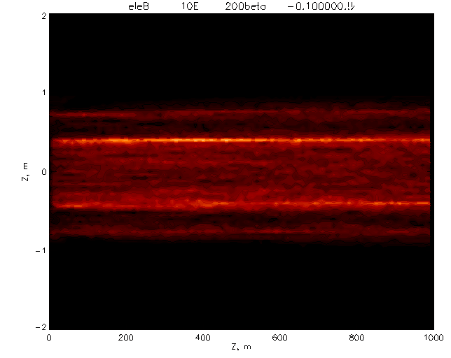
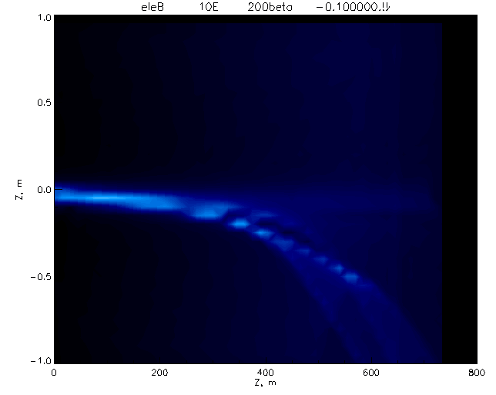
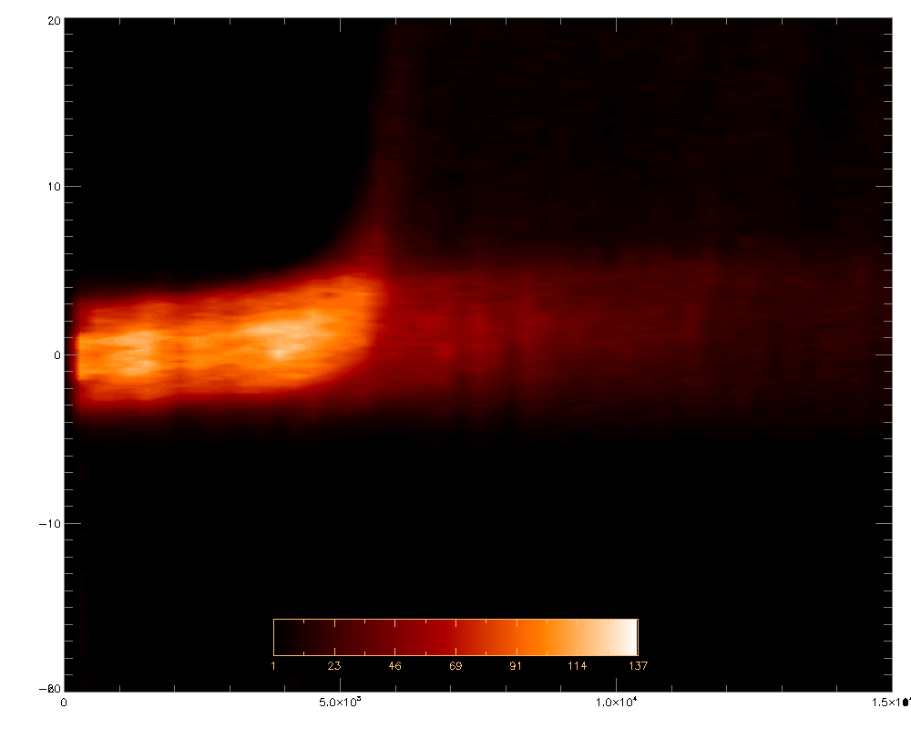
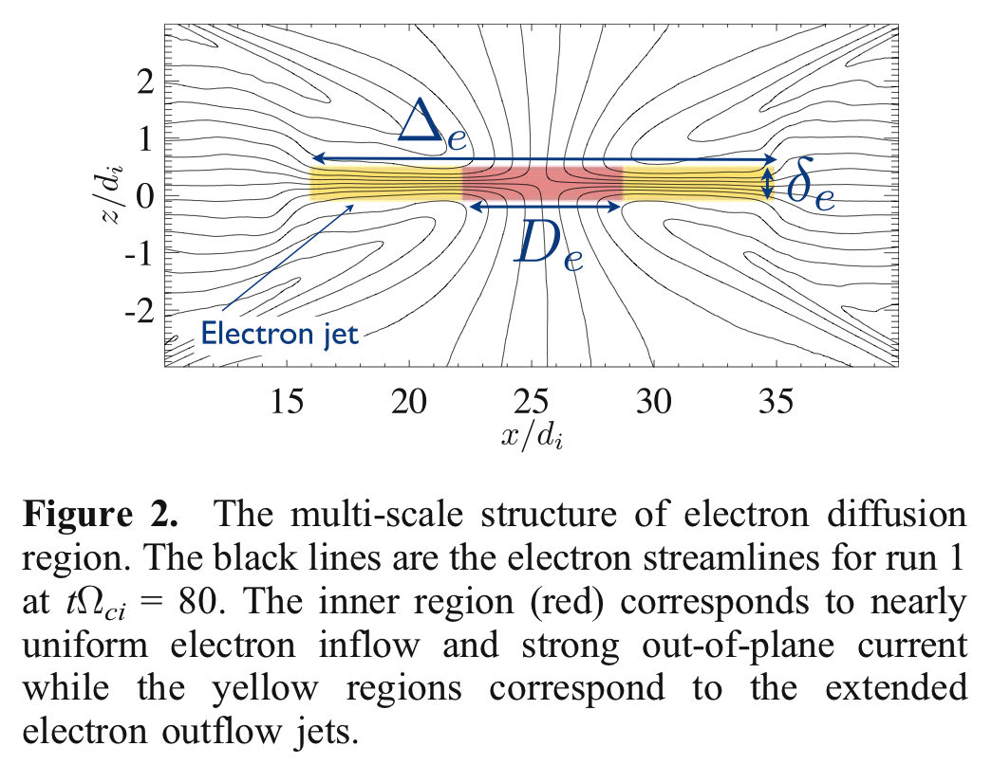
TP: Zharkova&Agapitov, JPP, 2009, 75/2, 159
https://ui.adsabs.harvard.edu/abs/2009JPlPh..75..159Z/abstract
TP: Zharkova&Agapitov, JPP, 2009, 75/2, 159
TP: ZA, JPP, 2009
places of acceleration of e vs p?
TP: ZA, JPP, 2009
Densities of protons and electrons in an RCS.
High energy electrons (with energy about 2*10⁵ – 1.2*10⁶ eV) form a particle jet ejected from the RCS. The same protons behavior is observed at a distance about 3-4x10³ m along Z axis
PIC: Karimabadi et al, 2007

Slide 19
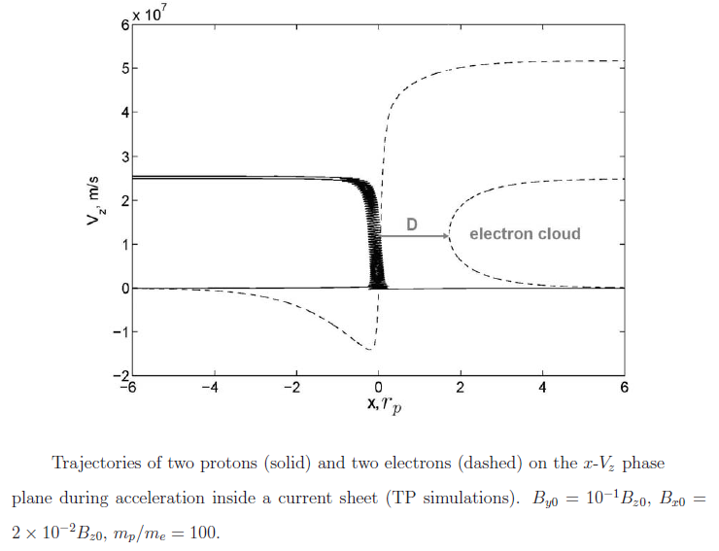
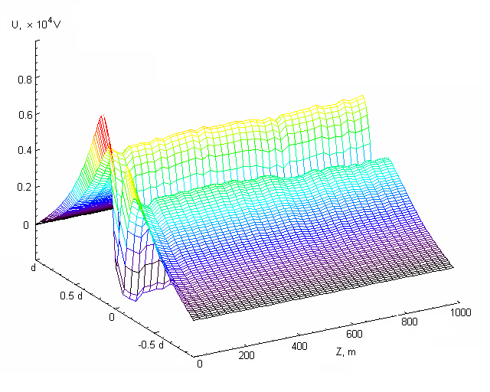


Trajectories of protons and electrons in PIC model of HCS
Zharkova and Khabarova, 2012, ApJ
transit e
Bounced e
transit p
Bounced p
×10⁴ V/km
Polarisation (Hall’s) electric field potential induced by separation of electrons from ions (Zharkova and Agapitov, 2009, JPP https://ui.adsabs.harvard.edu/abs/2009JPlPh..75..159Z/abstract )
- full separation

Slide 20
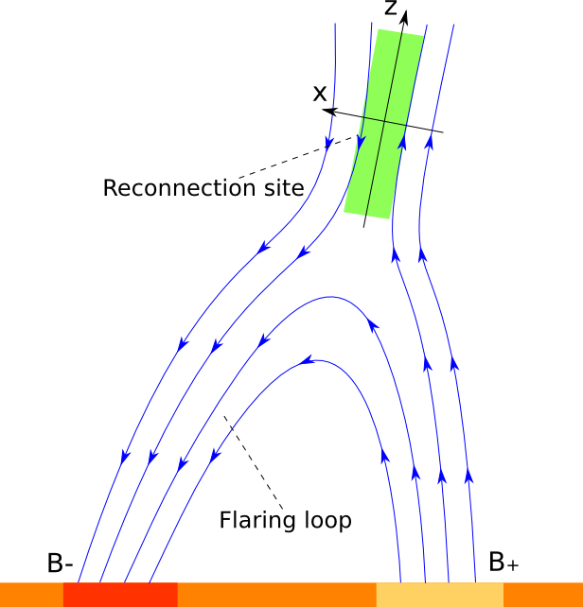
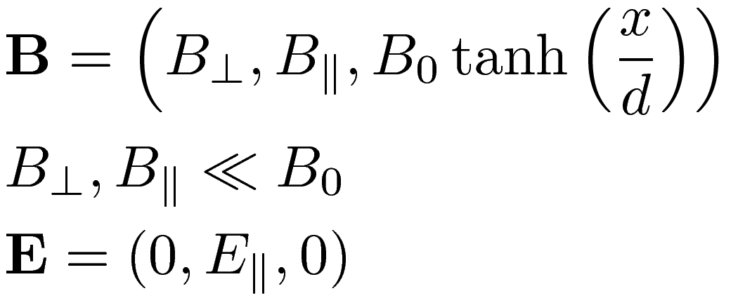
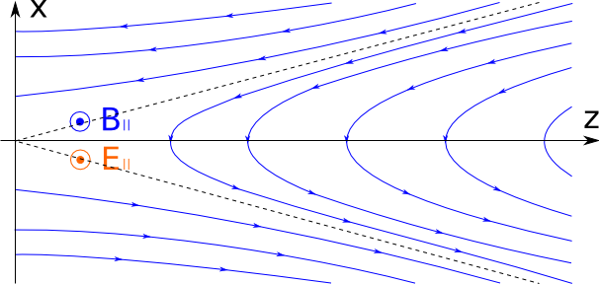
Kinetic model for Particle–in-Cell (PIC) →200 cells, 10⁸ particles in total
Siversky and Zharkova, 2009, JPP https://ui.adsabs.harvard.edu/abs/2009JPlPh..75..619S/abstract

Slide 21
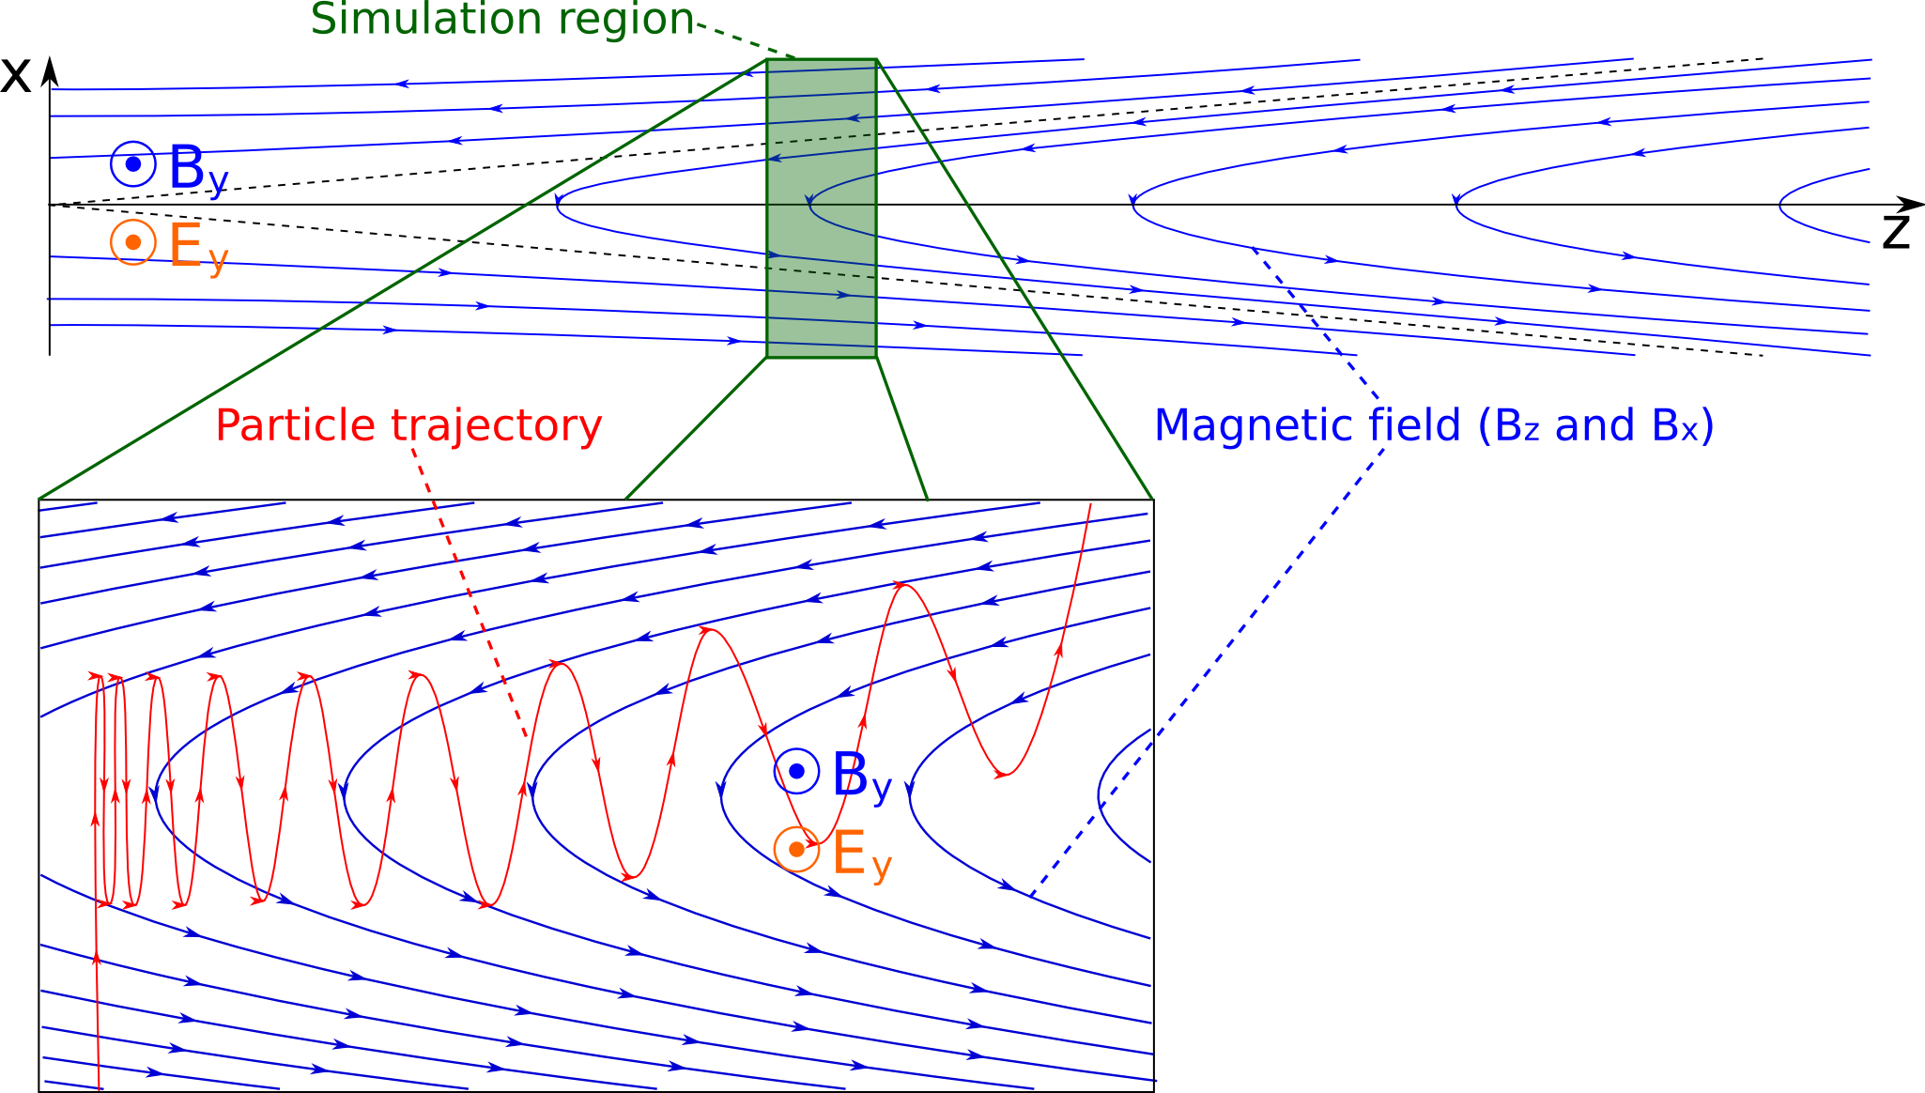
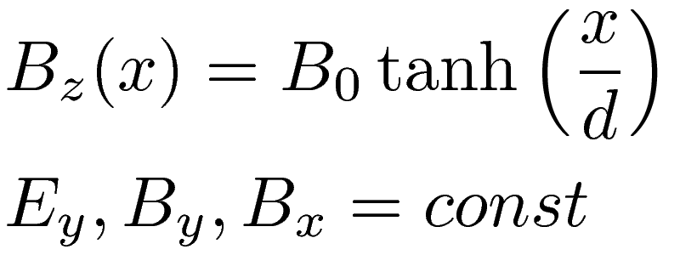
Physical model for PIC
→200 cells, 10⁸ particles in total
Siversky and Zharkova, 2009, JPP https://ui.adsabs.harvard.edu/abs/2009JPlPh..75..619S/abstract

Slide 22
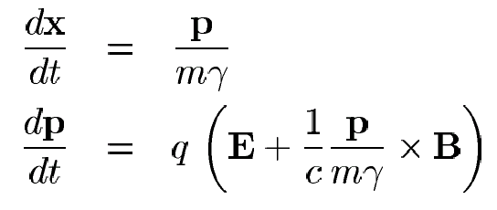
Plasma feedback in PIC simulations
Verboncouer et al, 1995,
Siversky and Zharkova, 2009, JPP https://ui.adsabs.harvard.edu/abs/2009JPlPh..75..619S/abstract
∂E/∂t = c² xB – 1/ε₀ (J_{e}+ J_{p)}
∂B/∂t = x E
Electron’s skin depth
Ion’s skin depth

Slide 23
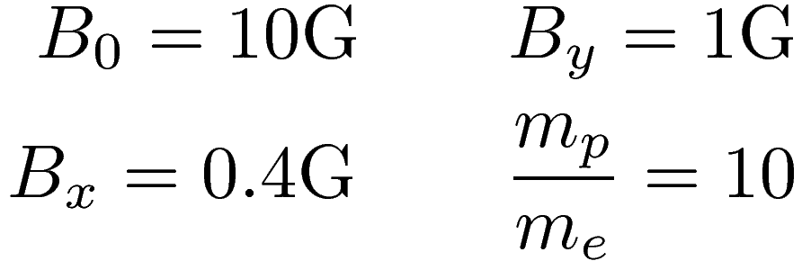

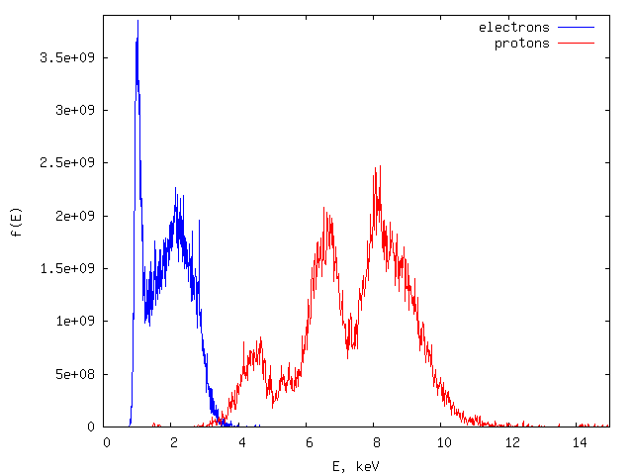
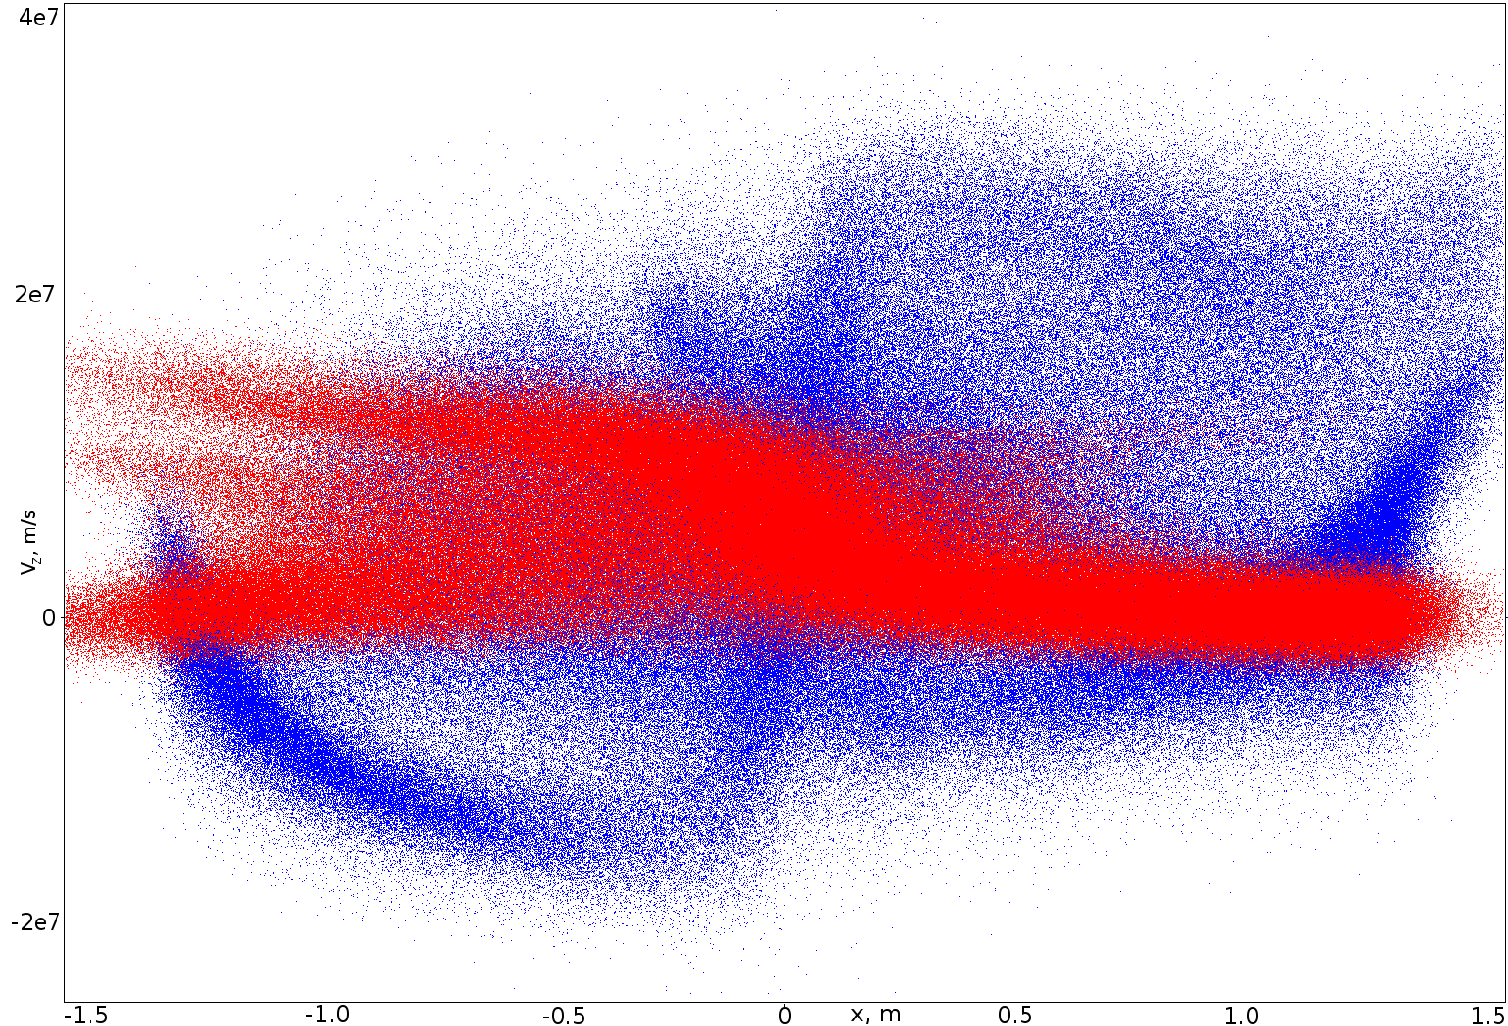
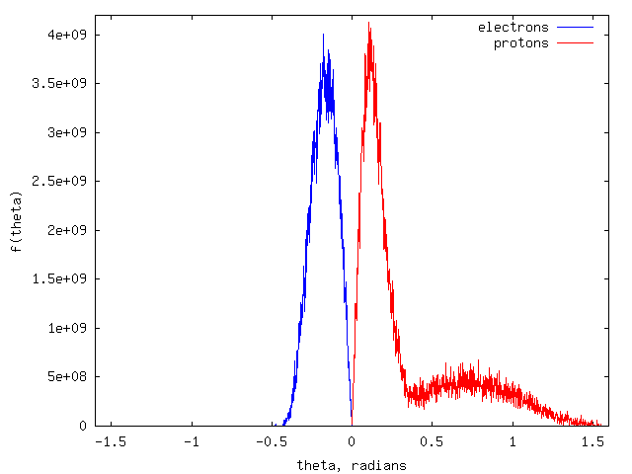
PIC – velocity/energy and PADs
Energy distributions
x-V_{z} phase space
Pitch angle distributions
Siversky & Zharkova, 2009, JPP, 75

Slide 24
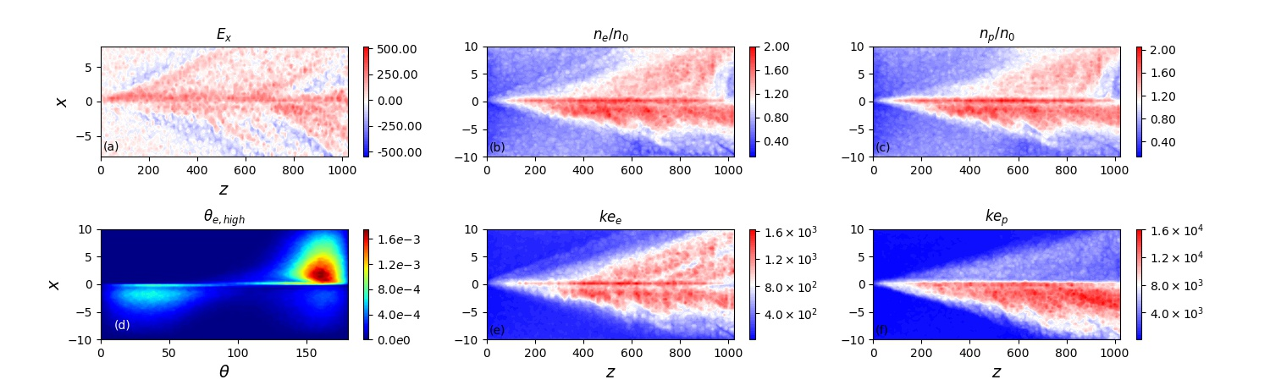
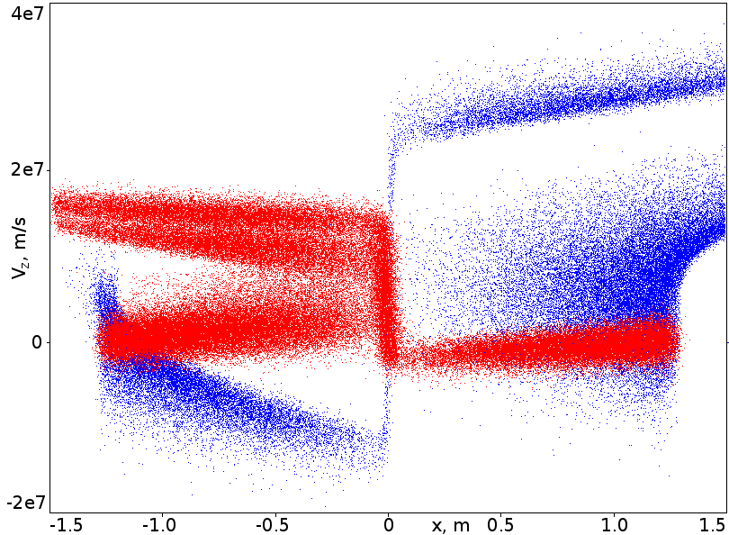
PIC: Separation of e from p
Transit and bounced particles (Xia & Zharkova, 2020)
Polarization electric field
The difference between “transit” and “bounced” particles
Pitch-angle distribution
x-V_{z} phase space
Protons
Transit bounced
Electrons transit
bounced
e+p
e+p
X=0 midplane
Notes:
24

Slide 25
Polarization electric field E_{x}–across a current sheet

Slide 26
Problems in identification of sector boundaries
Zharkova&Khabarova, 2012 https://iopscience.iop.org/article/10.1088/0004-637X/752/1/35/pdf
Azimuthal angle of magnetic field at 1 а.е. - ϕ_{B}
HCS
Sun
HCS
(HCS)
315° sector – toward the Sun
135° sector – outward the Sun
Using ϕ_{B} (if crosses 45° or 225° - change of IMP from or to the Sun).
Using components of IMP
Using change of direction of electron propagation

Slide 27
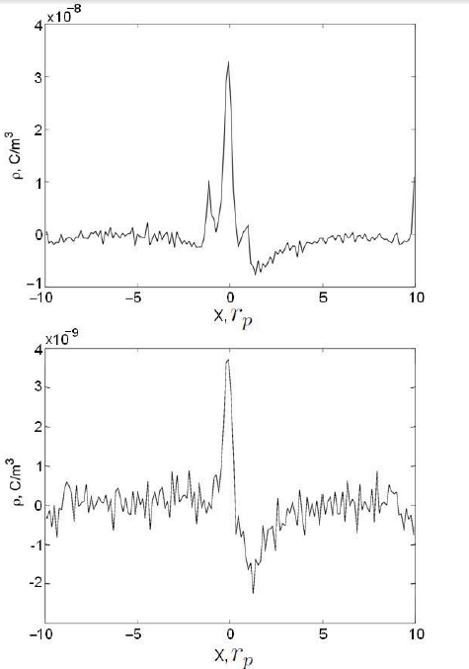
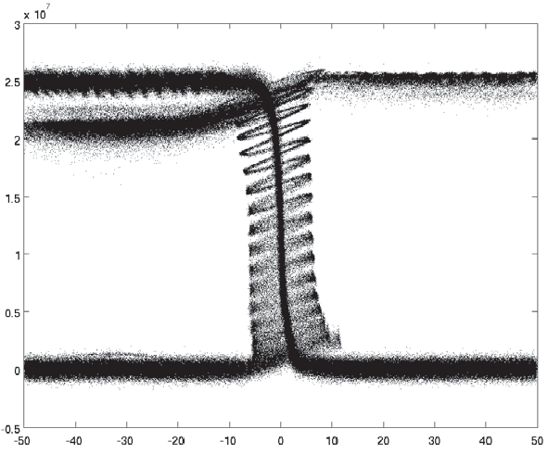

Zharkova&Khabarova, 2012 https://iopscience.iop.org/article/10.1088/0004-637X/752/1/35/pdf
Secondary density peaks about the sector boundary – acceleration of transit and bounced protons
main
secondary

Slide 28
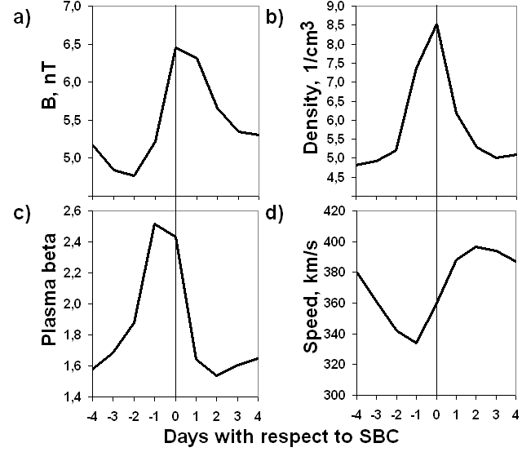
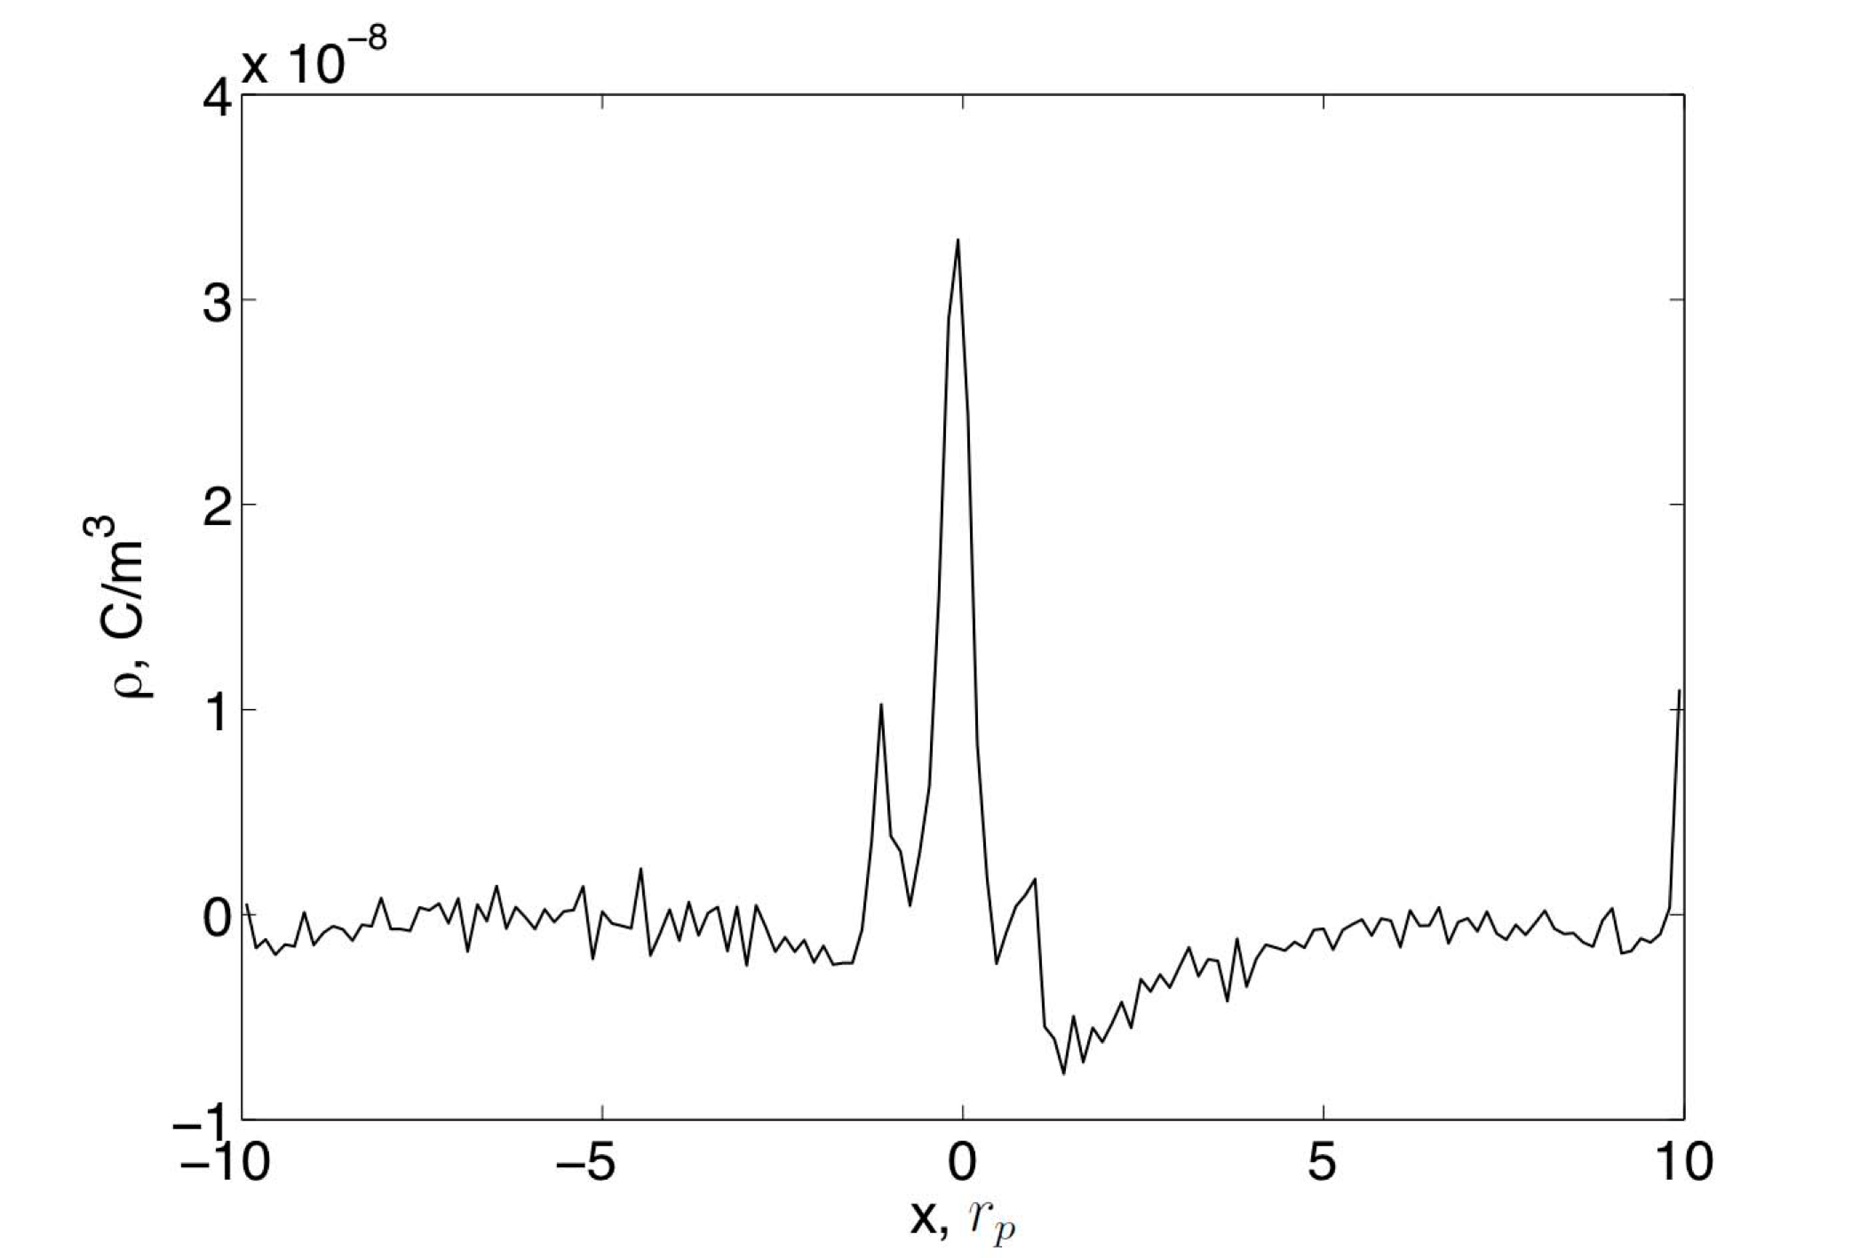
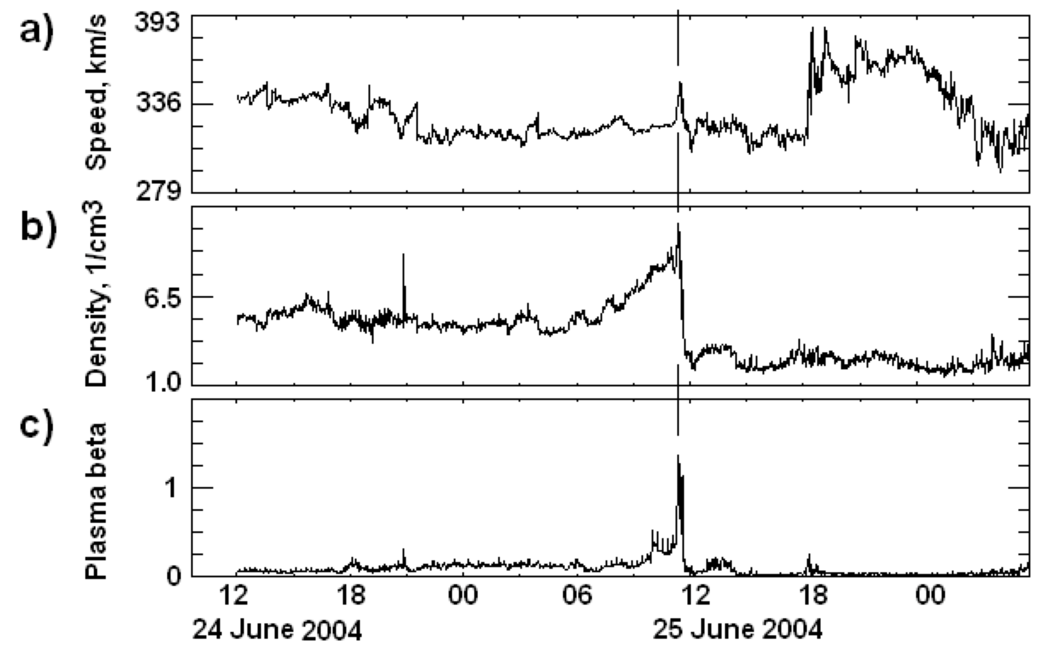
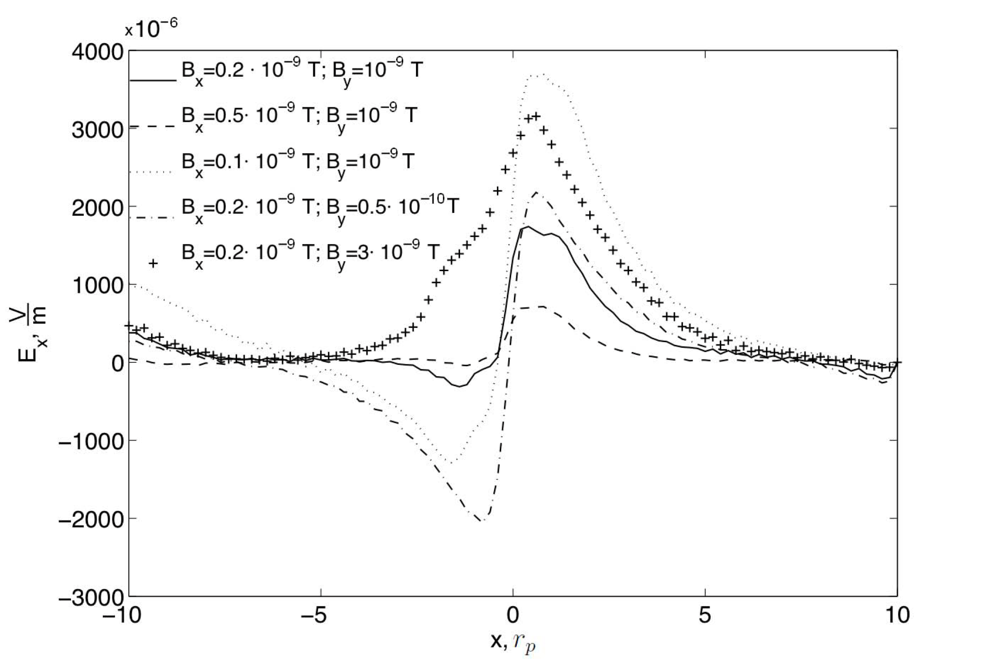
Averaged SB observations vs PIC simulations
Zharkova&Khabarova, 2012 https://iopscience.iop.org/article/10.1088/0004-637X/752/1/35/pdf

Slide 29
Problems in identification of sector boundaries
Zharkova&Khabarova, 2012 https://iopscience.iop.org/article/10.1088/0004-637X/752/1/35/pdf
Crossing of a thin SB:
a) IMP magnitude;
b) IMP horizontal component (Bx, GSE);
Sector boundary of HCS
c) IMP azimuthal angle (φ_{B});
d-f) Spectrograms of electron distribution in pitch angles (turn by 180º)
(in 3 energy channels)
where is SB - where electrons turn ()Crucker et al 2004 or where is
or IMF measured
340 eV
84 eV
27 eV

Slide 30
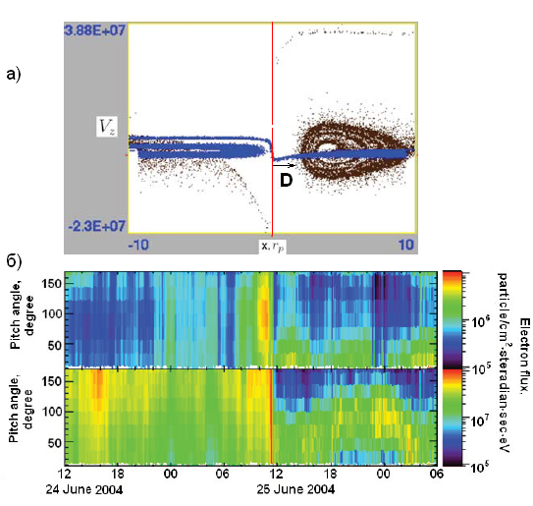
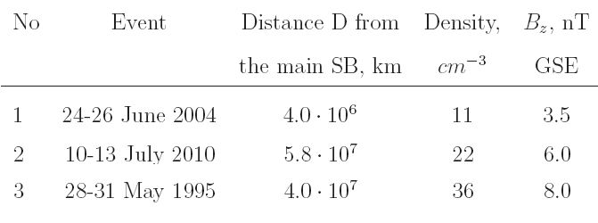
Zharkova&Khabarova, 2012 https://iopscience.iop.org/article/10.1088/0004-637X/752/1/35/pdf
Disagreement of the HCS SB (midplane) and electron turn by 180º (electron cloud) depends on magnitude of guiding field

Slide 31
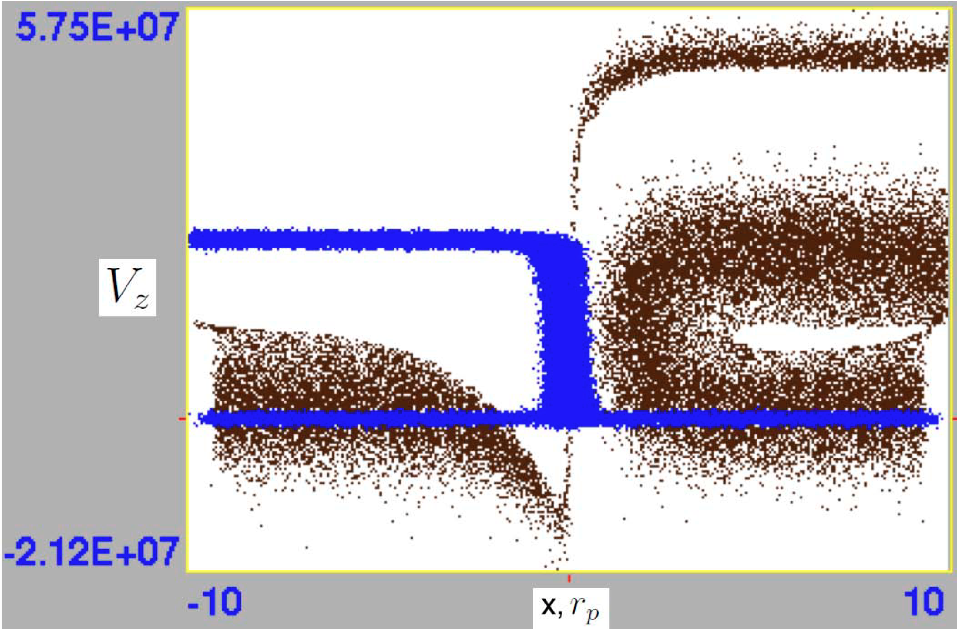
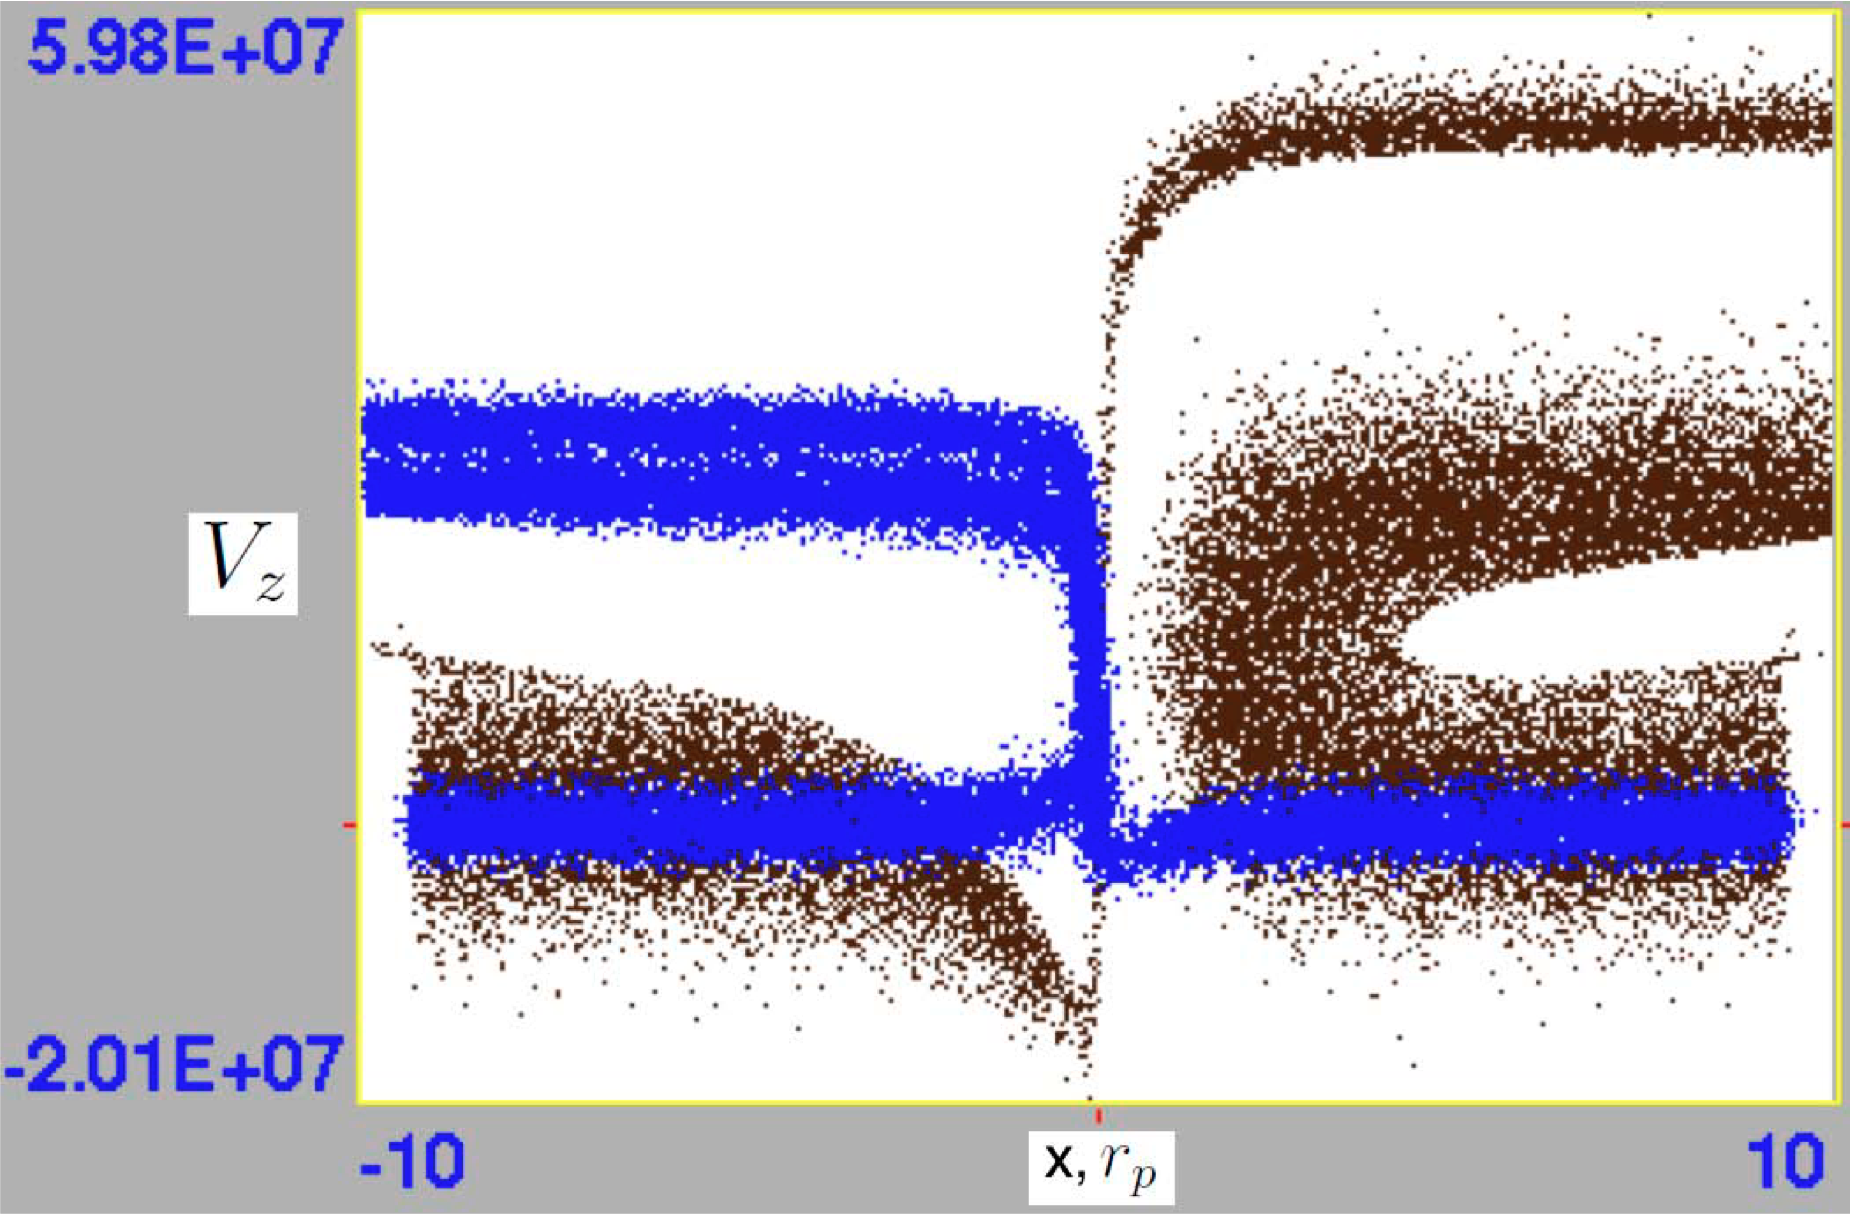
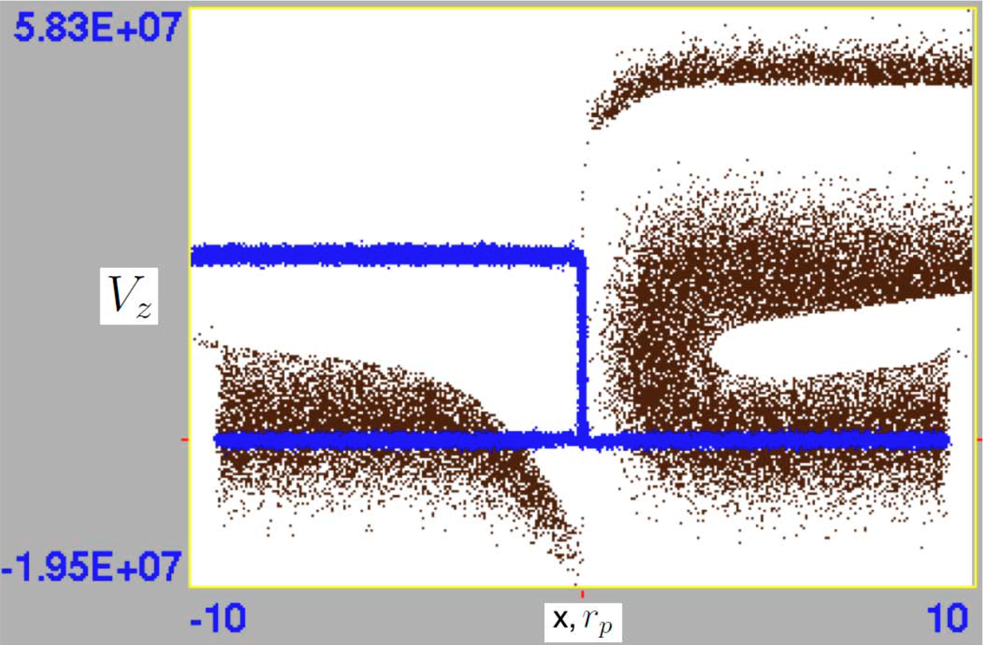

PIC - Application to the HCS: plasma density n=10-100 cm⁻³
Zharkova&Khabarova, 2012 https://iopscience.iop.org/article/10.1088/0004-637X/752/1/35/pdf
10 cm⁻³
10 cm⁻³
100 cm⁻³
By=10⁻²B_{z0}
^{Zharkova and Khabarova, 2012}
100 cm⁻³
10 cm⁻³
10 cm⁻³
100 cm⁻³
100 cm⁻³
10 cm⁻³
By=10⁻¹B_{z0}
Blue - -protons, black –electrons: h/shoe like –bounced lower energy e top – transit high energy e

Slide 32


Electron PADs and ion velocities
Heliospheric current sheet
Zharkova&Khabarova, 2012 https://iopscience.iop.org/article/10.1088/0004-637X/752/1/35/pdf
Quasi-continuous reconnection in the HCS can explain a few KEY puzzles in the observations of the dynamics of ions and electrons in the solar wind (see UKSP nugget 29)
.
T. Siversky, V.Zharkova, 2009, JPP, 75, 5
V. Zharkova et al, 2011, SSRv, 157, 359
V.Zharkova, O. Khabarova,2012, ApJ, 752, 35

Slide 33

Magnetic topology effects
on particle energy and pitch angle distributions (XZ2020)
electrons protons
By/B0 = 0 (a-first row), 0.1(b-second row), 1.0 (c-third row), and 1.0 with d = 10 m (d-fourth row)
1. Asymmetric ejection with respect to the current sheet midplane in a strong guiding field– separation of electrons from protons
2. Particle of the same charge – transit and bounced particles - with different energies and pitch-angle distributions
B0 = 10−3 T, Ey,0 = 250 V/m
Notes:
33

Slide 34



Asymmetric pitch-angle distributions of accelerated particles near X-nullpoint
Khabarova et al, 2020, Zharkova and Xia, 2021
Notes:
34

Slide 35

3D PIC simulation of RCS with MIs (VPIC)
Zharkova and Xia, 2021

Slide 36




Polarisation electric field in Mis
https://solargsm.com/wp-content/uploads/2020/03/xia_zharkova_tp_islands_aa18.pdf
Xia and Zharkova, 2018, A&A
The plasma inflow (green arrows) and outflow (black arrows) directions in a coalescent magnetic island chain.
The solid orange lines show the magnetic field in the X−Z plane [Fadeev et al. 1965].
The blue dash line and red dash-dot line show the E_{y} from coalescent and squashed islands on the midplane.
a)
in coalescent (merging) and squashed islands
b)

Slide 37

Guiding field increase → large energy gains
Xia and Zharkova, 2018, A&A
https://solargsm.com/wp-content/uploads/2020/03/xia_zharkova_tp_islands_aa18.pdf
Left panels:
test particle orbits (in blue lines);
right panels:
corresponding energy gains vs. z

Slide 38

Acceleration in squashed magnetic islands with large By
Xia and Zharkova, 2018
https://solargsm.com/wp-content/uploads/2020/03/xia_zharkova_tp_islands_aa18.pdf
Electrons can be accelerated in a single squashed island to relativistic energy. They circle about the O-point and are ejected from X-nullpoint.

Slide 39



Coalescent Mis: density, energy, PADs
Xia and Zharkova, 2020a
https://solargsm.com/wp-content/uploads/2020/03/AA_islands_PIC_2col_accept2020.pdf
C
PADs of transit and bounced electrons
Polarization electric field Ex

Slide 40

O-nulls: Coalescent vs Squashed
https://solargsm.com/wp-content/uploads/2020/03/AA_islands_PIC_2col_accept2020.pdf
C
S

Slide 41

Electron spectra in MIs –power-laws
Zharkova & Gordovskyy, 2005a.b
Xia and Zharkova, 2018, 2020
The more important factors:
The dimension of magnetic islands (k2)
The guiding field (By)
Coalescent → Squashed
Minor:
Proton-to-electron mass ratio

Slide 42


Simulated Pitch Angle Distributions: effect of a guiding field https://solargsm.com/wp-content/uploads/2021/02/zharkova_xia_PADs_aa21.pdf
By=0.01
By=1

Slide 43


Electron PADs observed by WIND (left) and simulated by PIC (right) https://solargsm.com/wp-content/uploads/2020/04/Khabarova_PAD_features_apjl20.pdf
Electrons of different energies, the IMF, and the density in the region filled with MIs as observed by the WIND spacecraft on 2007, May, 29.

Slide 44


PAD three top panels (right column):
650.7, 246.6, and 73-194 eV energy channels from STEREO A (a) and STEREO B (b) https://solargsm.com/wp-content/uploads/2020/04/Khabarova_PAD_features_apjl20.pdf
The highest-energy 650.7 eV STEREO PAD is completely different from the other PADs. It shows signatures of intermittent bi- directionality, following the location of MIs and CSs

Slide 45

Simulated Pitch Angle Distributions:
https://solargsm.com/wp-content/uploads/2021/02/zharkova_xia_PADs_aa21.pdf

Slide 46




Parker’s probe observations
Simulated PADs
https://solargsm.com/wp-content/uploads/2021/02/zharkova_xia_PADs_aa21.pdf

Slide 47

Kinetic turbulence generation in RCSs: two-beam instabilities
Transit e
Bounced e
PIC: electron distribution in RCS with a single X-nullpoint

Slide 48

Turbulent electric and magnetic fields induced by accelerated particles
(Siversky& Zharkova, 2009, JPP; Xia and Zharkova, 2020, A&A)
E
B

Slide 49
3D PIC simulation of reconnection with MIs d = 0.5 r_{i}; n_{b}/n₀=0.01, Zharkova and Xia, 2021 https://solargsm.com/wp-content/uploads/2021/10/frontiers_cs_turb.pdf.

Slide 50


Guiding field effects on turbulence
Weak guiding field – strong turbulence along By
Strong guiding field – turbulence is suppressed

Slide 51

Power spectra of turbulent fields from the whole region vs Xia & Zharkova, 2020
Zharkova & Xia, 2021b
-2.7
The turbulent electric (normalized by B_0 ^2 V_A^2) and magnetic fields (normalized by B_0 ^2). The wave vector is normalised to d_i ^{-1} of n_0. The corresponding k_{d_i}(n_0), k_{d_e}(n_0) are marked in dash lines.

Slide 52


RCS with X and O-nullpoints
The x-z magnetic field topology (black solid lines) (b_g=1) (a) with kinetic turbulence recorded in points A, B and C. The phase space structures in proton (b) and (electron c) beams are captured in the vertically elongated boxes with a width of $Δ$y=0.2 d_i.

Slide 53

Wavelet power spectrum
Local wavelet power
spectrum of B_x (the
purple point B at z=15, x=0.25).
The solid dark curve
encloses the regions of > 95\% confidence.

Slide 54

Frequency analysis
The spectra as functions of frequency of the parallel and
perpendicular components of kinetic turbulence in the
selected points A,B and C from Fig. 4.→
strongest turbulence at lower-hybrid frequency (whistler waves) and e plasma frequency (Langmuir and Bernstein waves)

Slide 55
Conclusions
Strong guiding field leads to the separation of electrons from protons with respect to the midplane (corona, or sector boundary – SB in the HCS), which generates a polarization electric field across the current sheet,
Magnetic field imposes its signatures on pitch-angle and energy distributions on particles entering a current sheet from the opposite (transit) and the same side (bounced particles)
Particles accelerated in magnetic islands still have the populations of transit and bounced particles leading to two beam instabilities often reported in observations and PIC models,
Electrons can be accelerated to sub-relativistic energies in a single magnetic island. They pass through a few islands while forming clouds about neighbouring X-nullpoints,
Particle energy gains in coalescent islands are lower than in squashed ones
PADs of accelerated particles are shown to reflect magnetic topology of current sheets and can be compared with in-situ observations
Bump-in-tail velocity distributions of transit and bounced particles of the same charge induce turbulence in different parts of current sheets
The turbulence index near ion inertial length is -2.7, it is strongest in lower-hybrid frequency (whistler waves), also has a peak at high frequencies near X-nullpoints (Langmuir and Bernstein waves)

