Slide 1


Joint effects of solar activity and solar orbital motion on terrestrial atmosphere
https://solargsm.com/solar-activity/
V. Zharkova^{1,2}
Thanks to I.Vasilieva^{2,3}, S.Shepherd⁴ and E.Popova^{2,5}
1 – MPEE, University of Northumbria, Newcastle upon Tyne, UK
2 - ZVS Research Enterprise Ltd., London, UK
3 – Solar Physics Dept., Main Astronomical Observatory, Kyiv, Ukraine
4 - PRIMAL Research Group, Sorbonne Universite, Paris, France
5 - Centro de Investigación en Astronomía, Universidad Bernardo O’Higgins, Santiago, Chile
https://www.scirp.org/journal/paperinformation.aspx?paperid=124007
https://solargsm.com/publications/

Slide 2
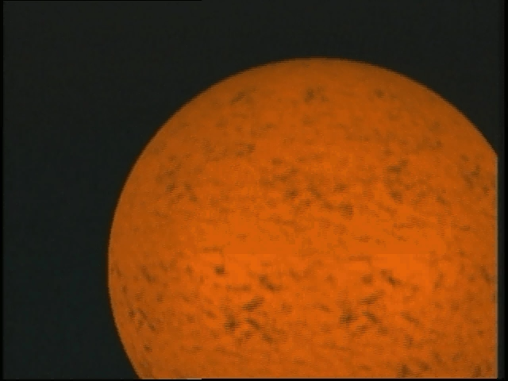
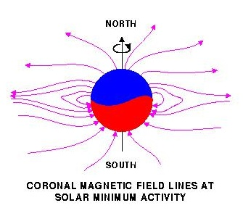
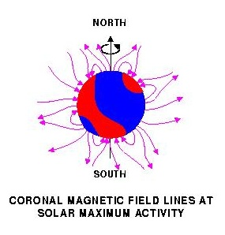
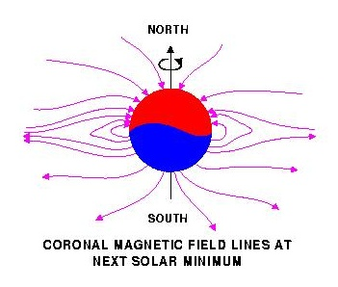
Solar magnetic field reversal
Strong toroidal magnetic fields (TMF) forming Active Regions (ARs)
are created in a shear layer beneath the base of the Solar Convection zone (SCZ).

Slide 3
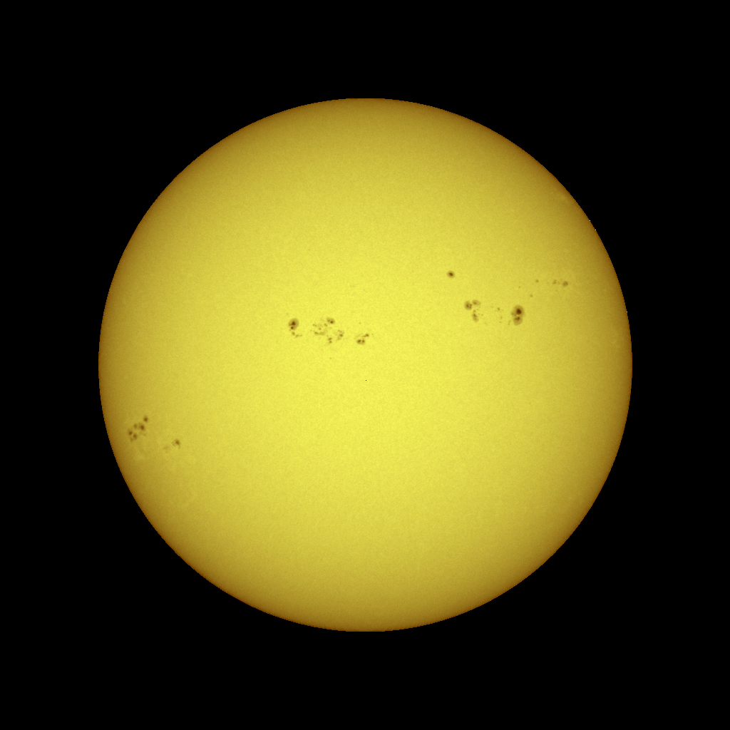
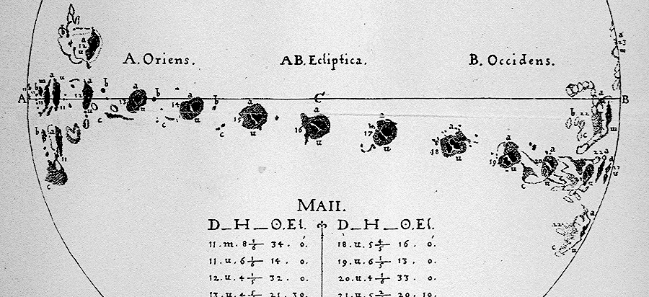

Solar activity
Sunspots are dark (and cooler) regions on the surface of the Sun. They have a darker inner region (the Umbra) surrounded by a lighter ring (the Penumbra).
Sunspots usually appear in groups that form over hours or days and last for days or weeks.
These early sunspot observations indicated that the Sun rotates once in about 27 days.
Solar activity index – average sunspot numbers
Sunspots

Slide 4
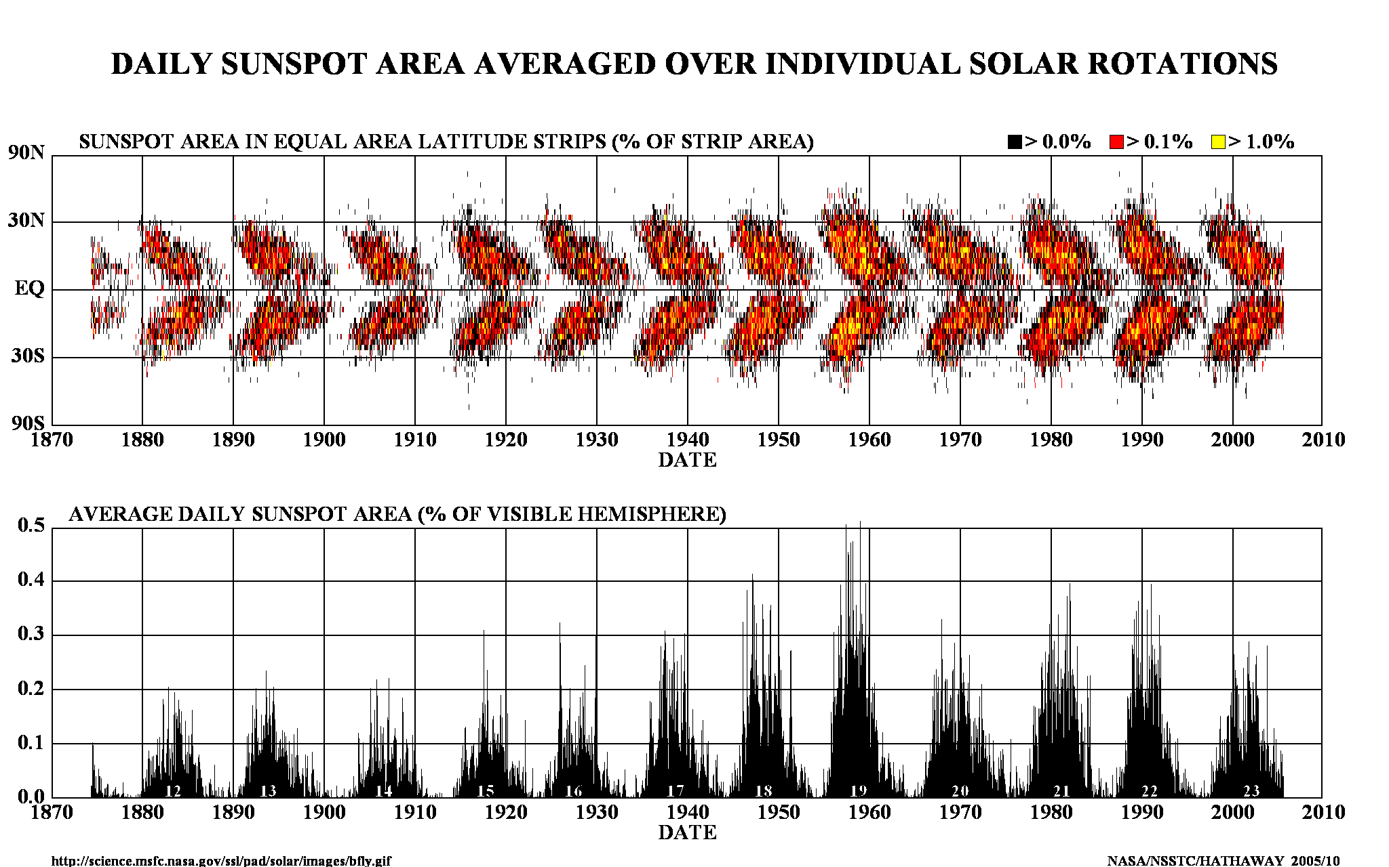
Current solar activity index

Slide 5
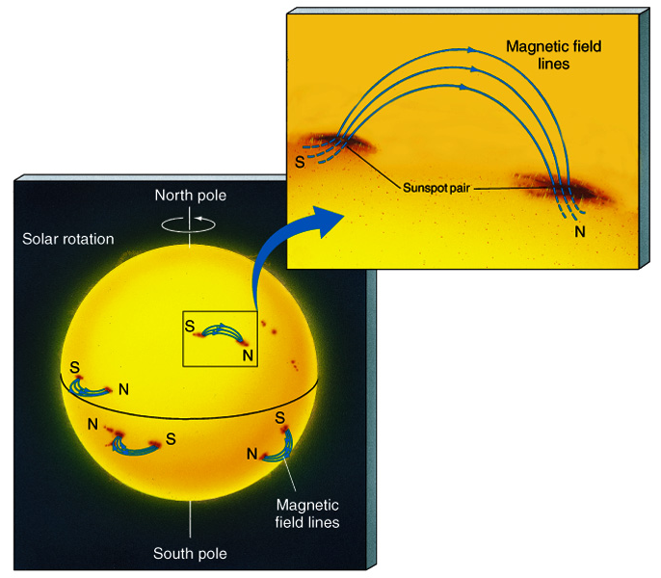
Sunspots & Magnetic Fields
The magnetic field in a sunspot is 1000x greater than the surrounding area
Sunspots are almost always in pairs at the same latitude with each member having opposite polarity
All sunspots in the same hemisphere have the same magnetic configuration

Slide 6
Solar magnetic field reversal
Strong toroidal magnetic fields (TMF) forming Active Regions (ARs)
are created in a shear layer beneath the base of the Solar Convection zone (SCZ).

Slide 7
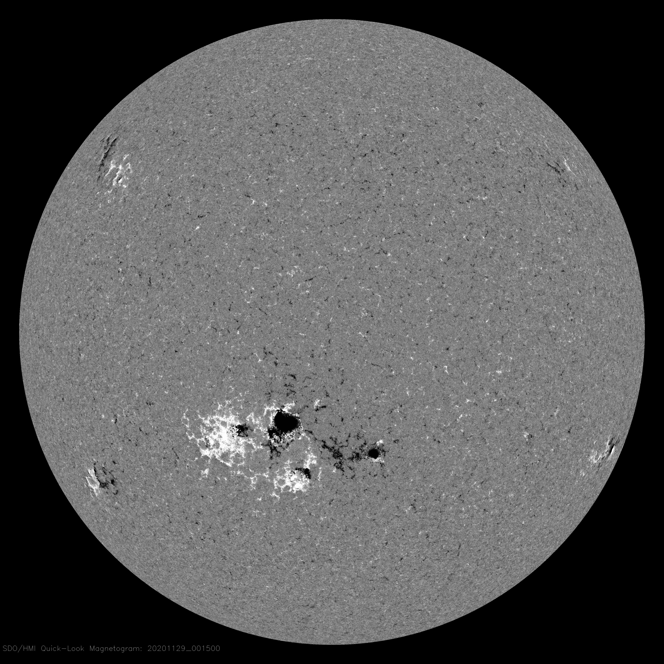
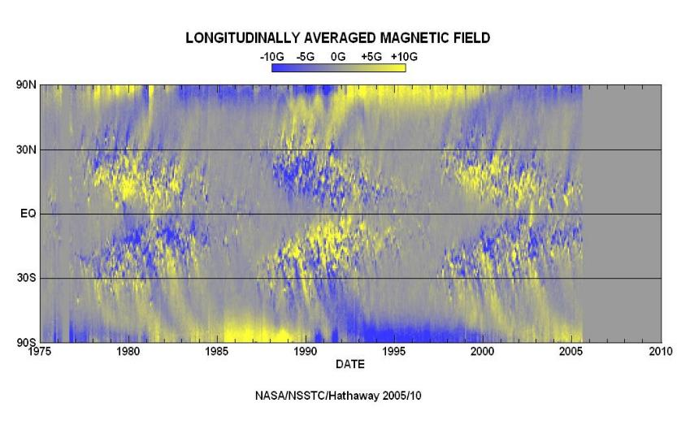
Magnetic field variations in cycles 21-23 (Hale’s law)
HMI Magnetogram 29 Nov 2020

Slide 8
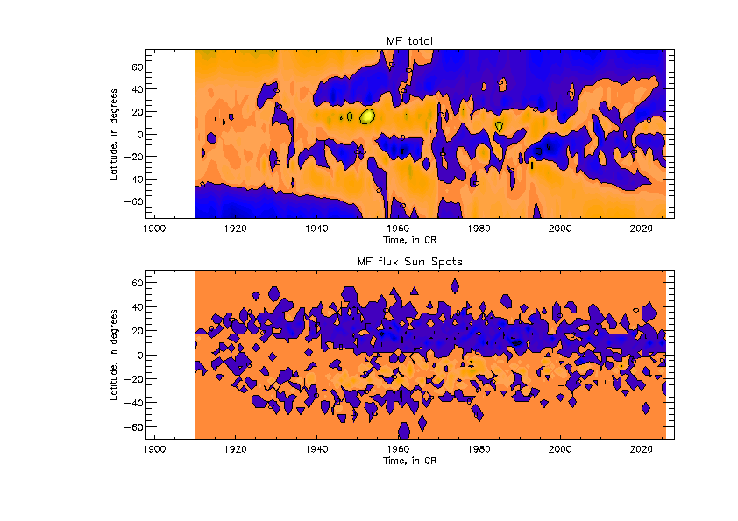
New proxy for solar activity index
SBMF (top) and sunspot MF (bottom)–
(Zharkov et al, 2008, Stix 1976)
Cycle 23 -Solar Background MF
Sunspot MF

Slide 9
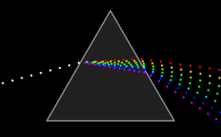

White light refraction into waves of different colors, or wavelengths

Slide 10
Fitting the PCs to measured in cycle 24 and prediction to 25-26
Eigen vectors come in pairs, here are PCs
(Shepherd et al, 2014, Zharkova et al, 2015)

Slide 11
Mathematical laws from PCs: Symbolic regression -Hamiltonian approach (Schmidt and Lipton, 2009, Science)Schmidt & Lipson, 2009, Science)
Mathematical law for the first principal component:
F₁(t) = Σ_{k=1,..,5} A_{k} cos(ω_{k,1}t +ϕ_{k,1})cos(B_{k,1} cos(ω_{k,1}t +ϕ_{k,1})
Mathematical law for the second principal component:
F₂(t) = Σ_{k=1,..,5} A_{k} cos(ω_{k,2}t +ϕ_{k,2})cos(B_{k,2} cos(ω_{k,2}t +ϕ_{k,2})

Slide 12
Fitting the PCs to measured in cycle 24 and prediction to 25-26
2-1. New proxy for solar activity index
two largest eigen vectors of SBMF (blue and red lines)
and their summary curve (black line)
Zharkova et al, 2015 https://www.nature.com/articles/srep15689

Slide 13
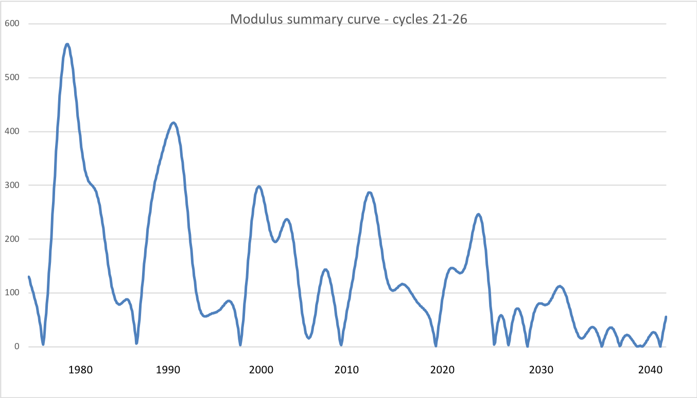
2-2. Modulus summary curve vs sunspot numbers SSN
Zharkova et al, 2015, SciRep; 2020, Temp., Zharkova et al, 2022, MNRAS s sunsdata
(Shepherd et al, 2014 ; Zharkova et al, 2015)
Cycle 21
Cycle 22
Cycle 23
Confirmed by
Katiashvili, 2020, ApJ;
Obridko et al, 2021, MNRAS
Velasco-Herrera et al, 2021
Cycle 21
Cycle 22
Cycle 23
Cycle 24
Cycle 25
Cycle 26

Slide 14
Predicted solar activity (Zharkova et al, 2015, SR https://www.nature.com/articles/srep15689)
Zharkova et al, 2015, Nature SR
Observational result, dynamo model was not yet considered
Discovery of grand solar cycles :350-400 years
In addition to 11 year cycles
https://solargsm.com/solar-activity/ - my webpage

Slide 15
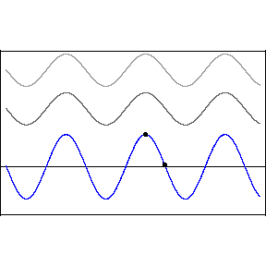
Interference
Two wave interference
the result of two or more → waves overlapping
y₁(x,t)=Acos(kx-ωt) (top wave)
y₂(x,t)=Acos(kx-ωt+D) (middle wave)
D – phase difference b/waves
Blue wave: resulting
D=0 constructive, 2A
D=π –destructive, 0

Slide 16
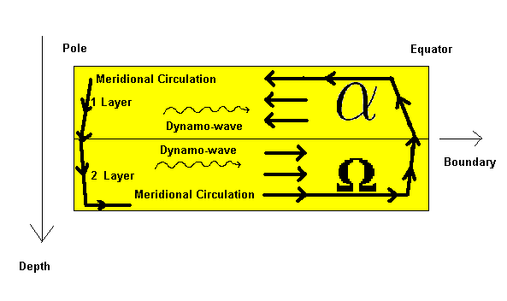
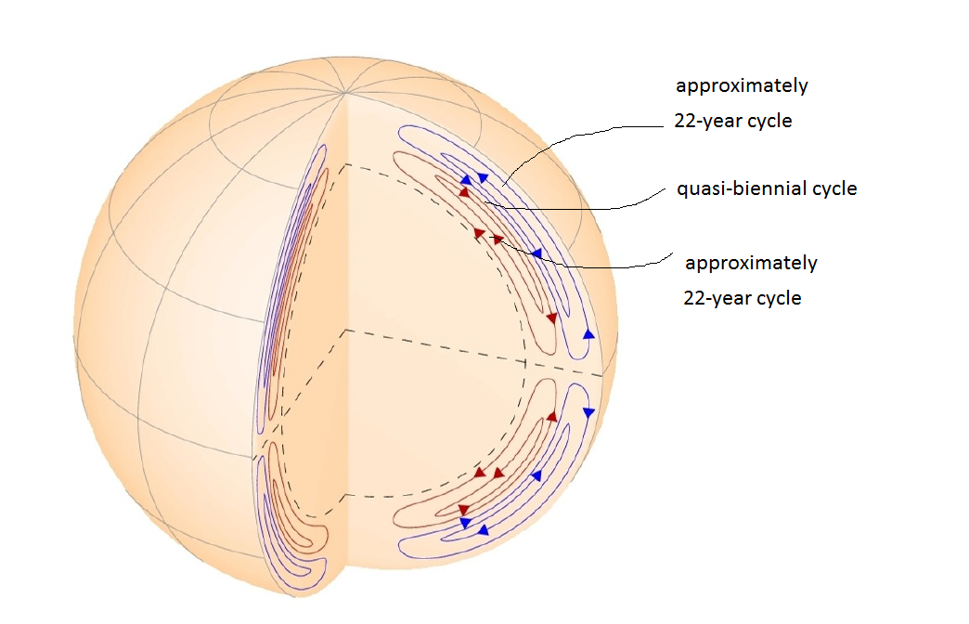
Two-Layer Medium observed with HMI
HMI/SDO heliosesimic observations
Zhao et al, 2013

Slide 17
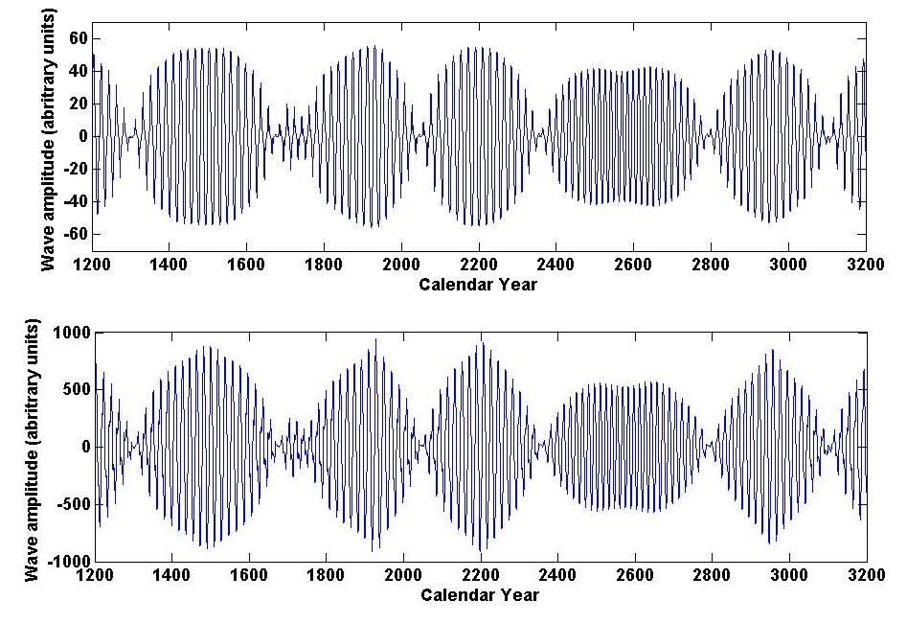
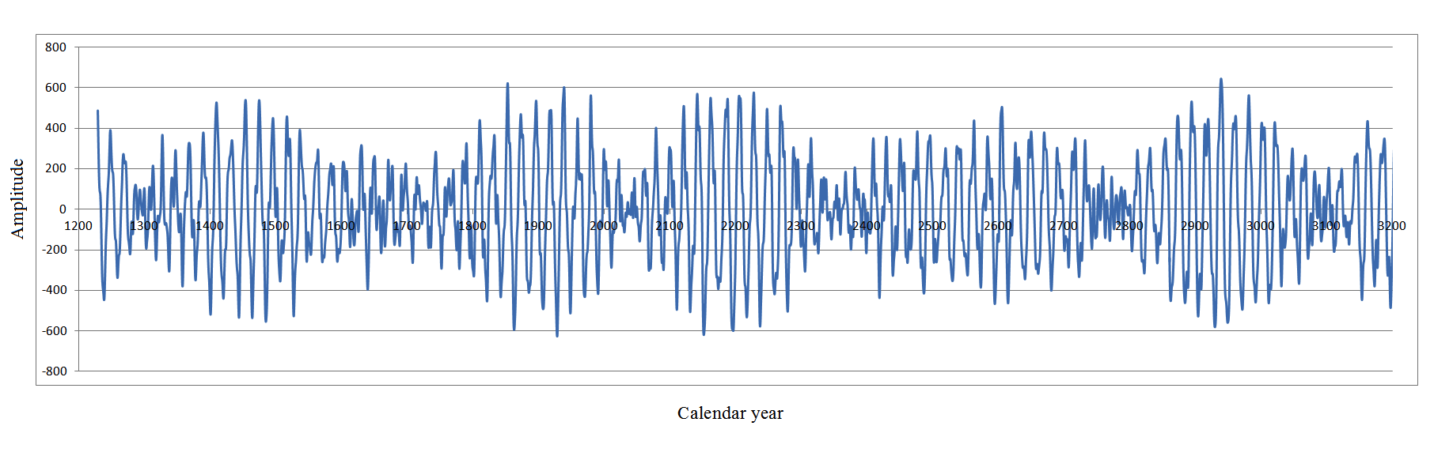
Dynamo model (top) and summary curve (bottom
Summary dynamo wave
on the millennium scale (Zharkova et al, 2015, Nature SR)
Popova et al, 2013
Zharkova et al, 2015, SR https://www.nature.com/articles/srep15689

Slide 18
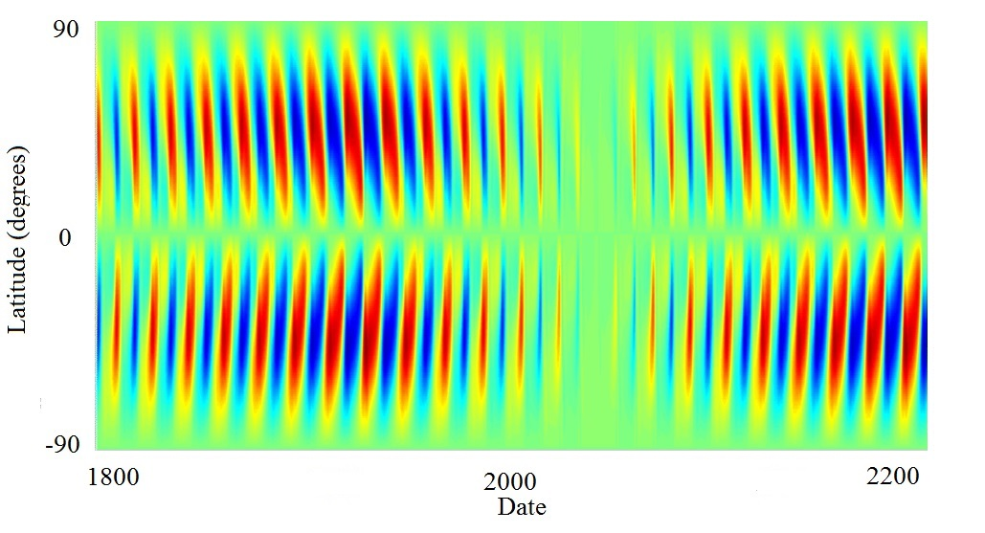
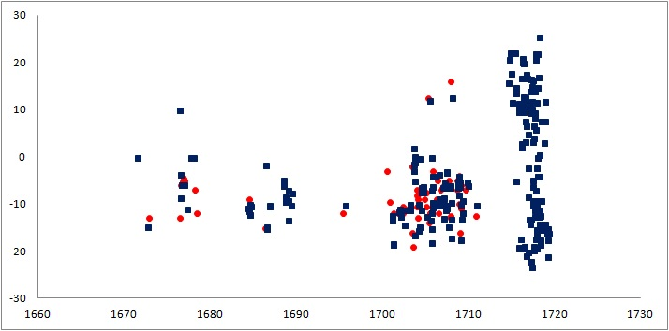
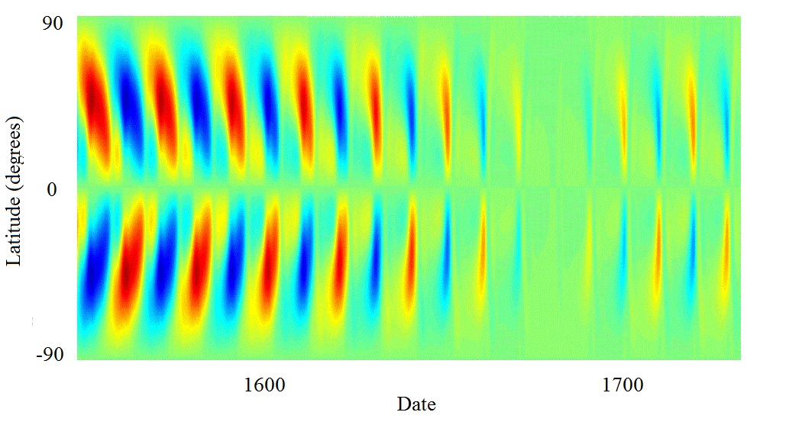
Upcoming Grand Solar Minimum
Maunder Grand Solar Minimum
Zharkova et al, 2015, Popova et al, 2018

Slide 19
This result was reported at
the National Astronomy Meeting in Llandudno and covered by the RAS press-release https://nam2015.org/index.php/press-releases/64-irregular-heartbeat-of-the-sun-driven-by-double-dynamo
media https://www.sciencedaily.com/releases/2015/07/150709092955.htm and https://www.chroniclelive.co.uk/business/business-news/mini-ice-age-could-freeze-11607587
U-tube talks https://www.youtube.com/results?search_query=double+dynamo+and+grand+solar+minimum
See more on https://solargsm.com

Slide 20
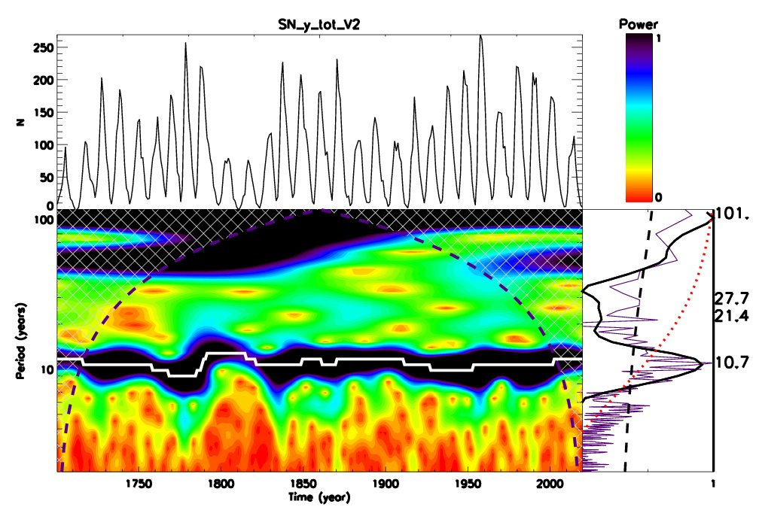
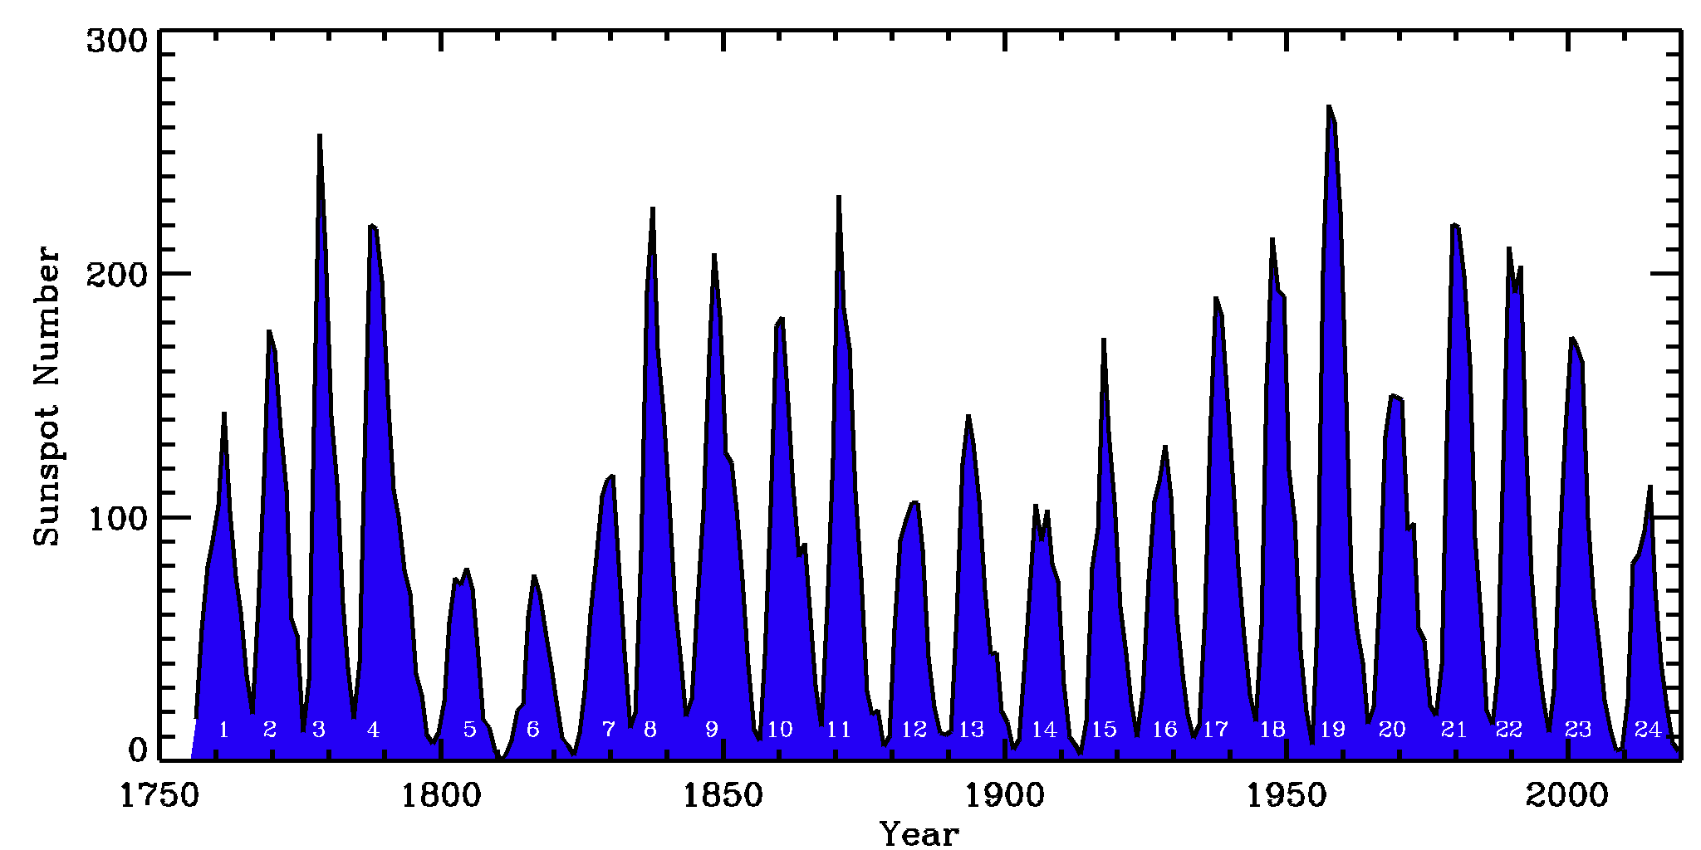
Wavelet spectral analysis of SSN – 10.7 and 101 years
Averaged sunspot numbers SSN Wavelet analysis
Global wavelet spectrum – black solid line
Fourier spectrum – indigo
95% CI – black dashed line
Axis Y: Main periods – 10.7 and 101 years
Period of 50-55 years – lower than a red noise level (red dotted line)

Slide 21
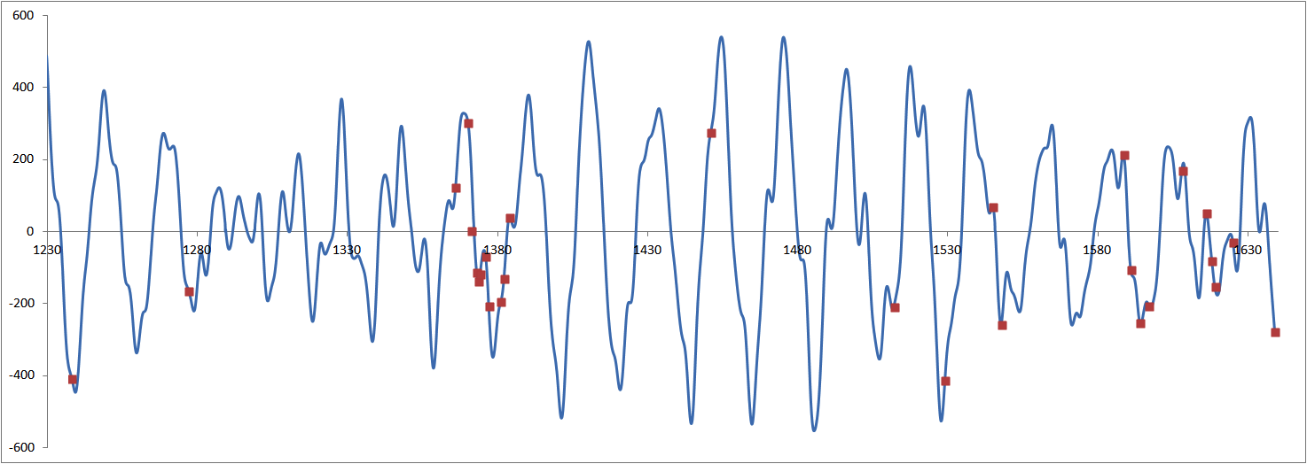
Verification of summary curve with large s/s for grand cycle prior MM (Zharkova etal, 2017, 2018) Wolf and Maunder grand minima
Zharkova et al, 2017
Severe diseases in China, no observers
New dynasty in China, Great Wall project

Slide 22
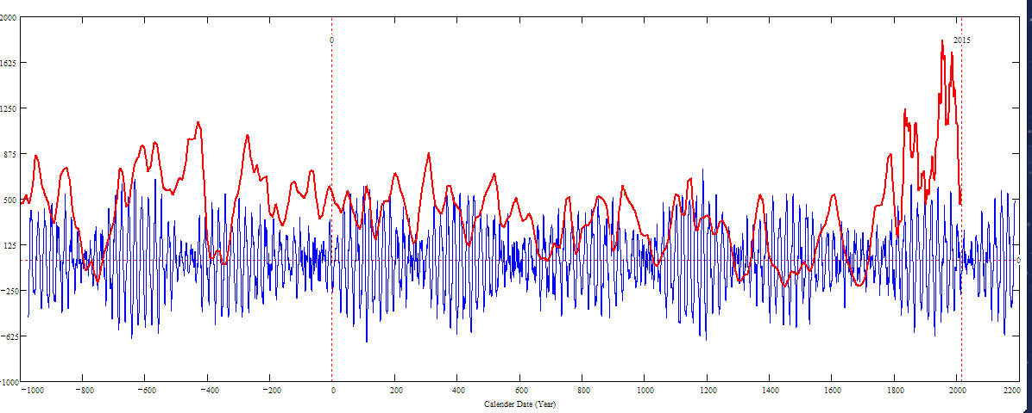
Updated curve for 3000 years (blue) versus a curve by Usoskin et al. (red)
1
2
3
4
5
Sporer minimum in1400-1600 in C¹⁴ is not from Sun!
1
2
3
4
5
1
2
Periods - grand:350-400 years and super-grand:1900-2000 years

Slide 23
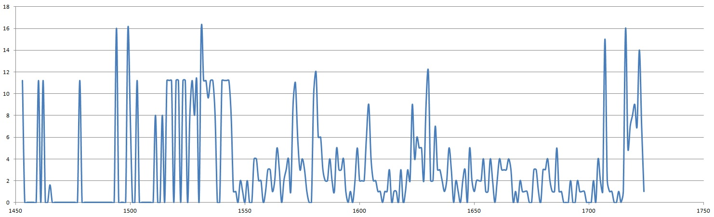

Slide 24
Double dynamo summary curve for 3000 years (blue) versus the s/s curve by Solanki et al. 2004 (red)
Homeric minimum^{[13]} | 750 BCE | 550 BCE
Oort minimum | 1040 CE | 1080 CE
Medieval maximum | 1100 | 1250
Wolf minimum | 1280 | 1350
Spörer Minimum | 1450 | 1550
Maunder Minimum | 1645 | 1715
Dalton Minimum | 1790 | 1820
Zharkova et al, 2015, 2018
Sporer minimum in 1400-1600 in C¹⁴ is caused by s/n Vela Junior
Oort
Wolf
Maunder
Homeric
Periods – grand cycle: 350-400 years and super-grand cycle :2000-2100 years

Slide 25
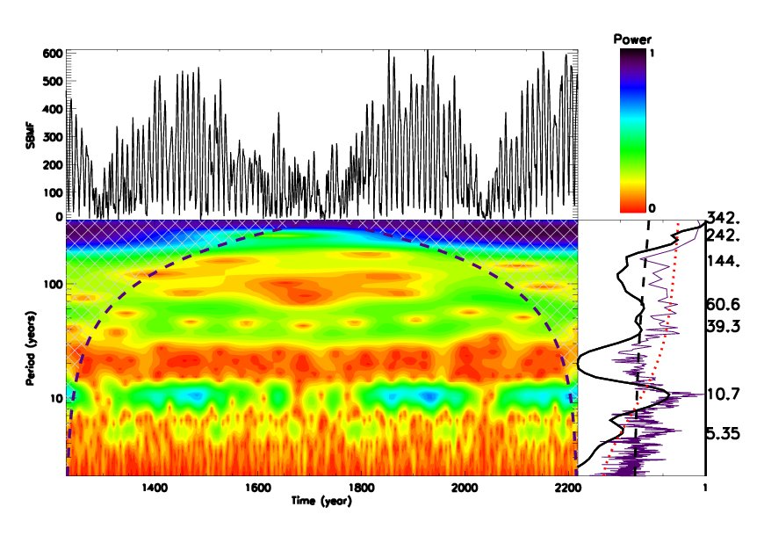
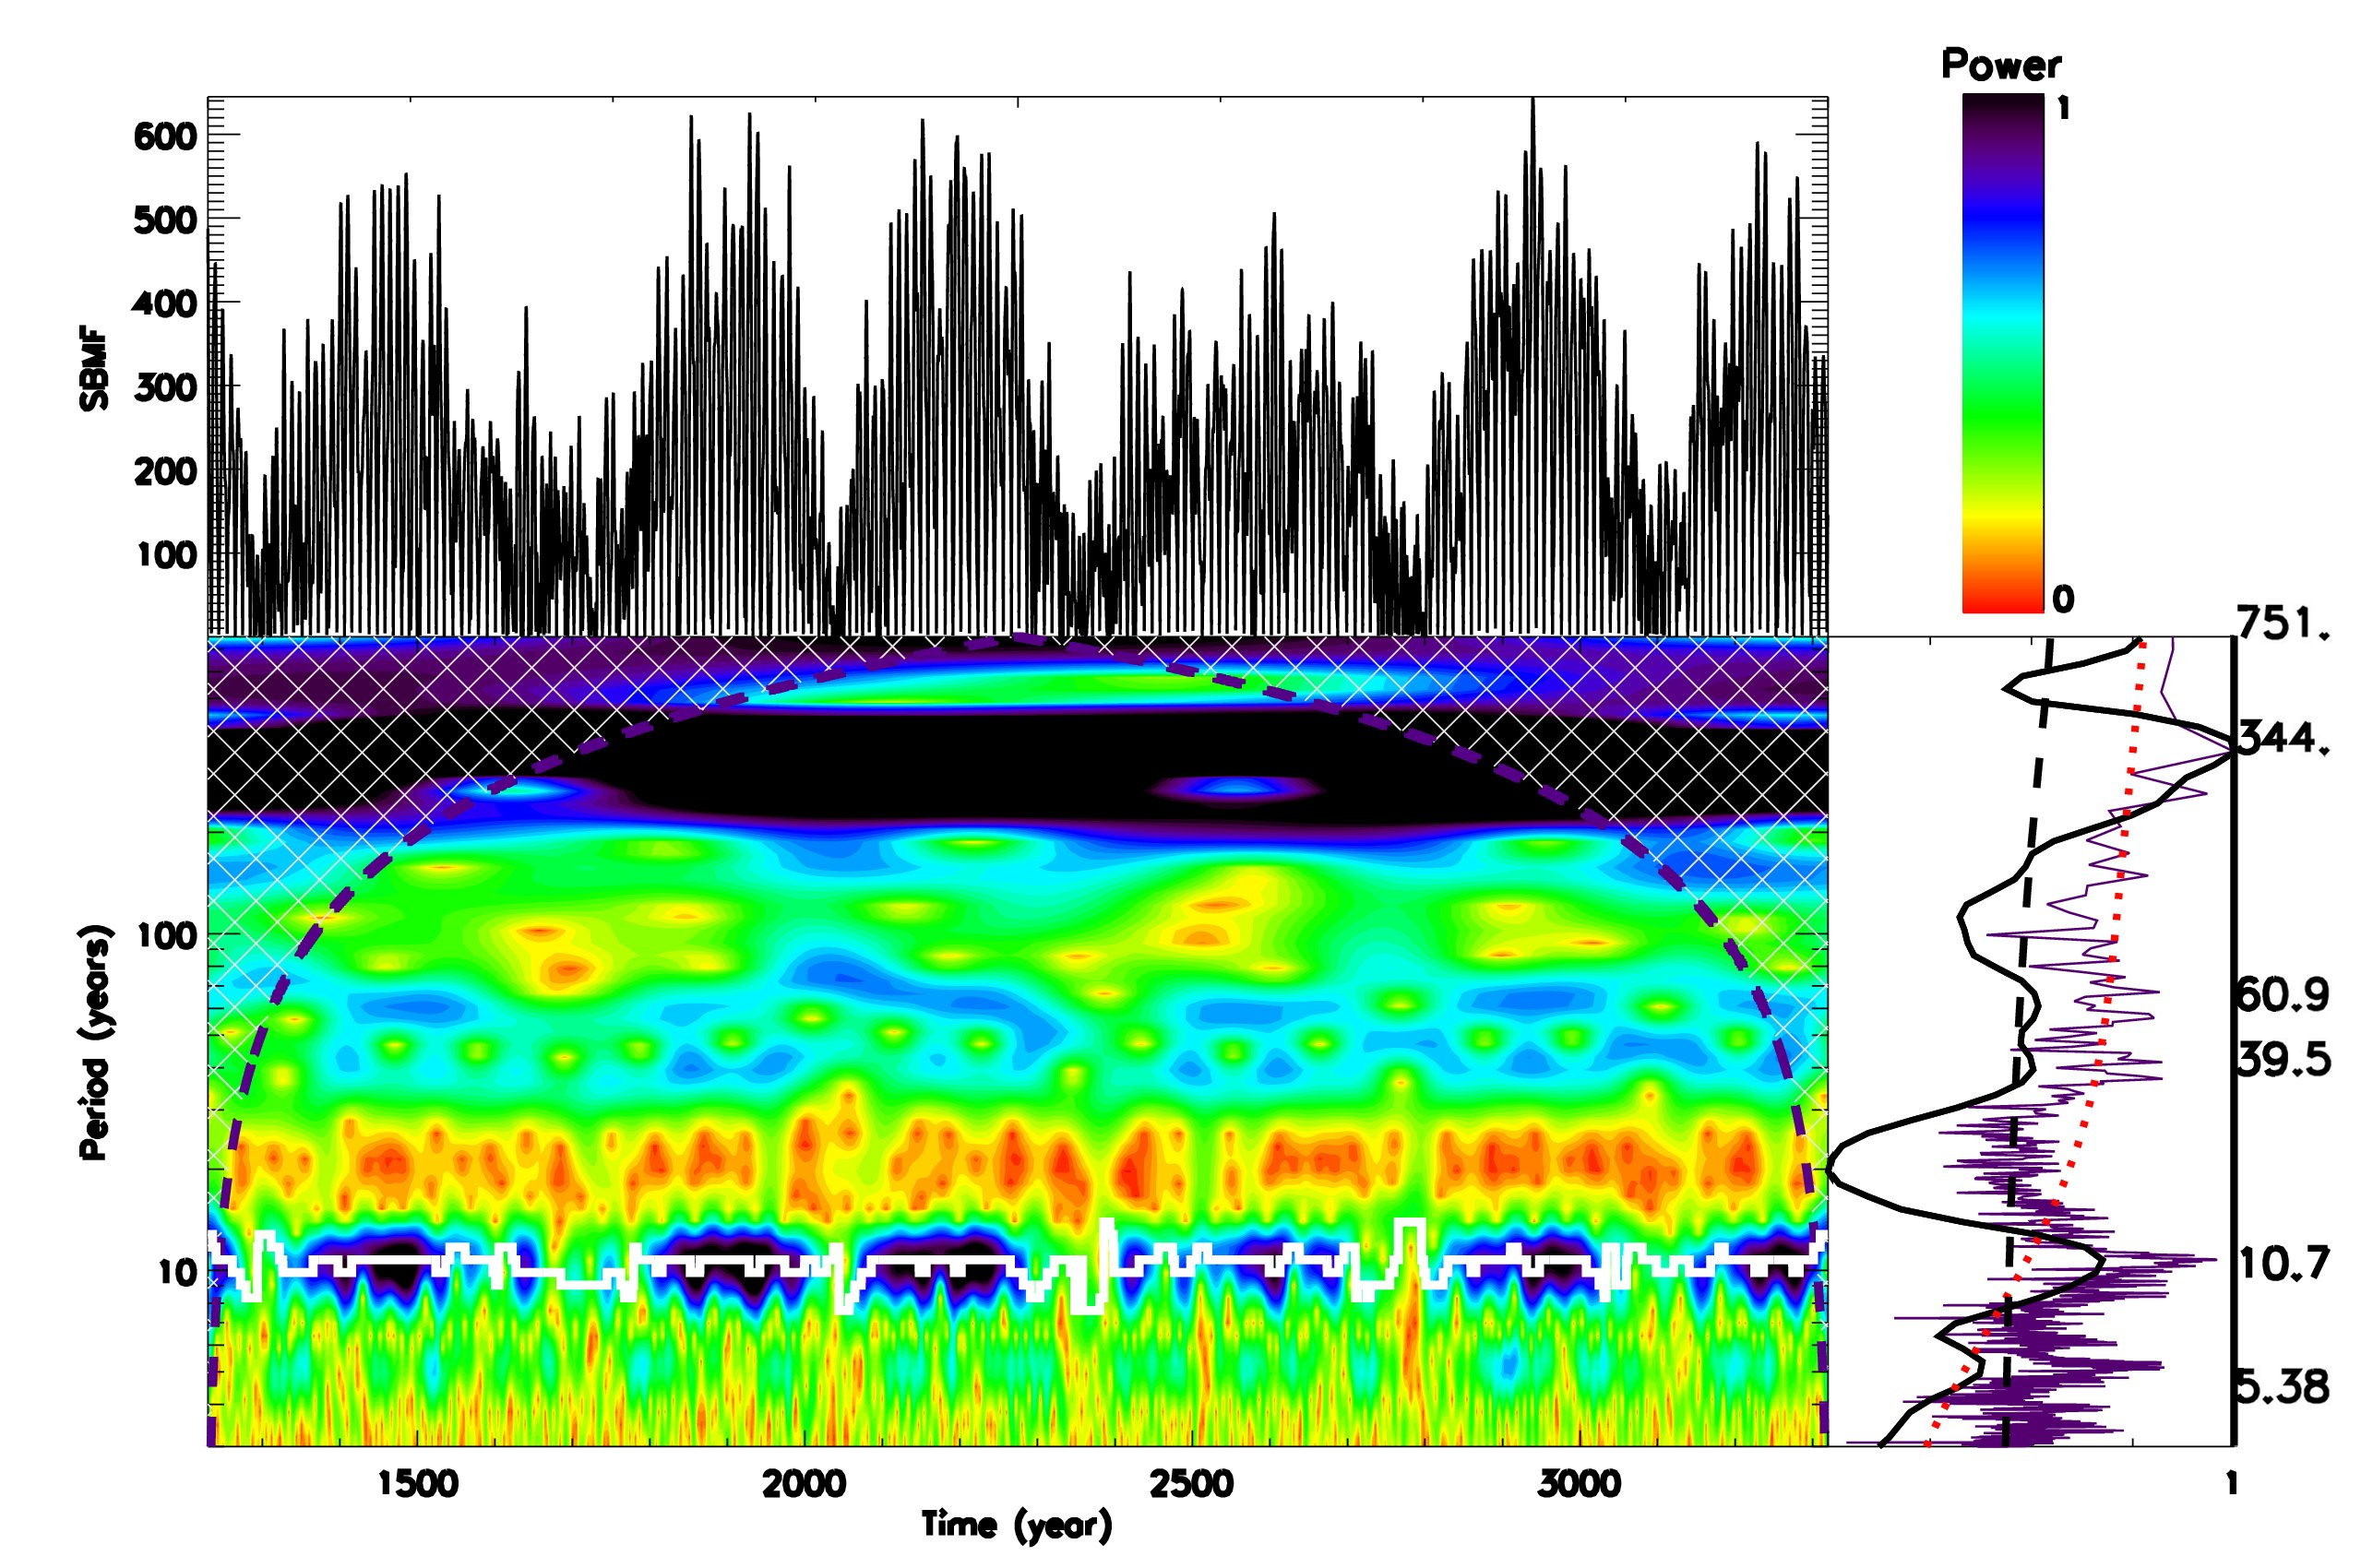
Wavelet spectral analysis of MSC
Modulus summary curve of two largest eigen vectors (dipole MF)
Global wavelet spectrum – black solid line
Fourier spectrum – indigo
95% CI – black dashed line
Main periods – 21.5 and 344 years

Slide 26
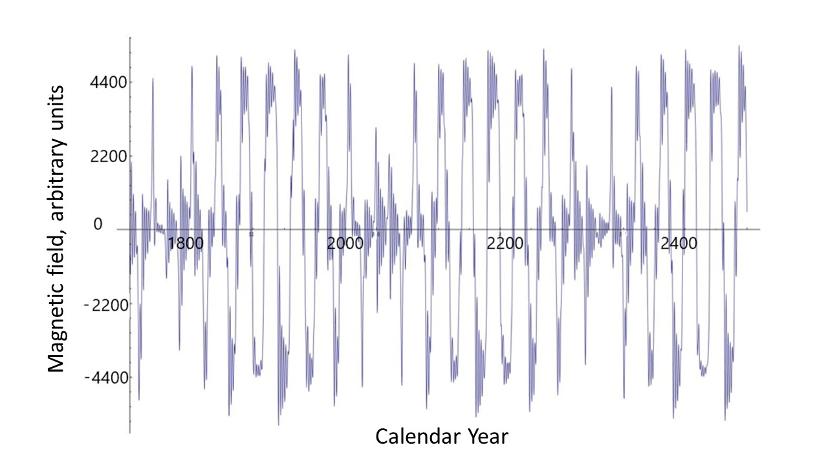
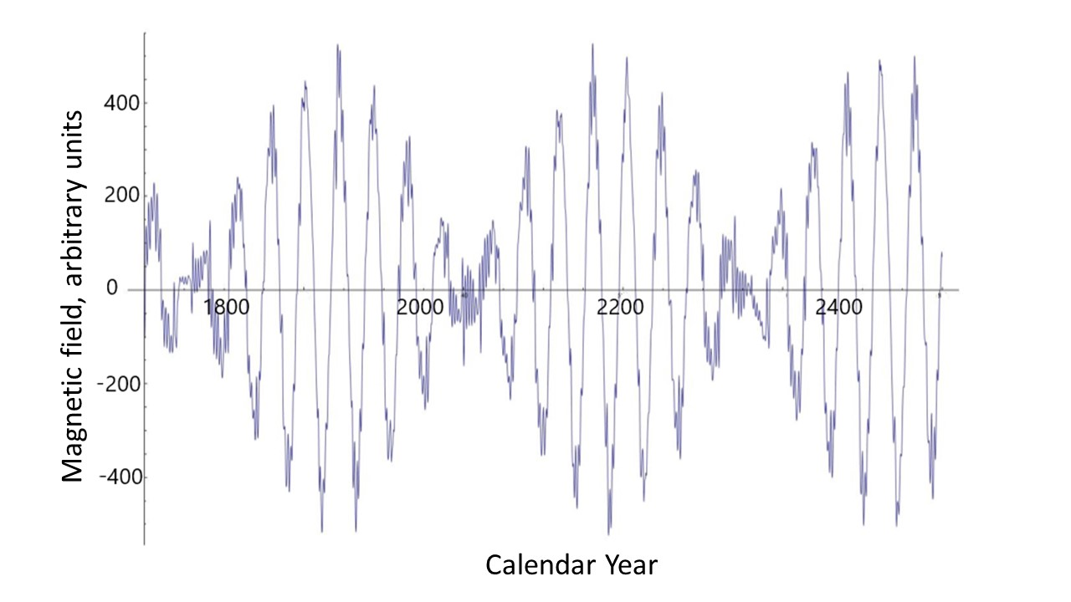
Poloidal (left) versus toroidal (right) magnetic fields
https://solargsm.com/wp-content/uploads/2023/04/zharkova_etal_mnras2023.pdf

Slide 27
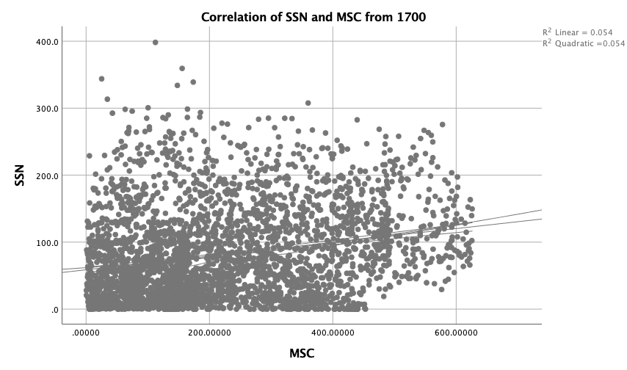
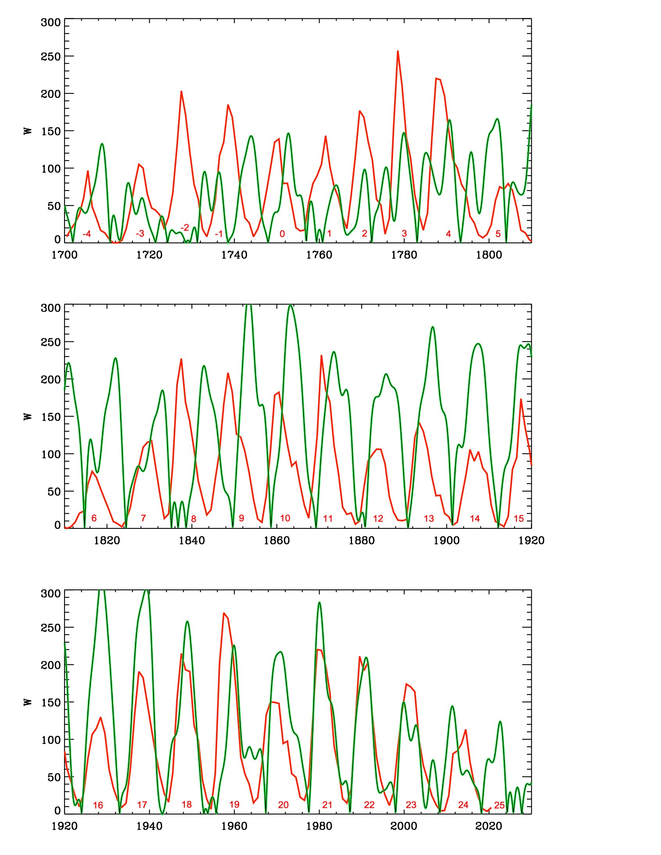
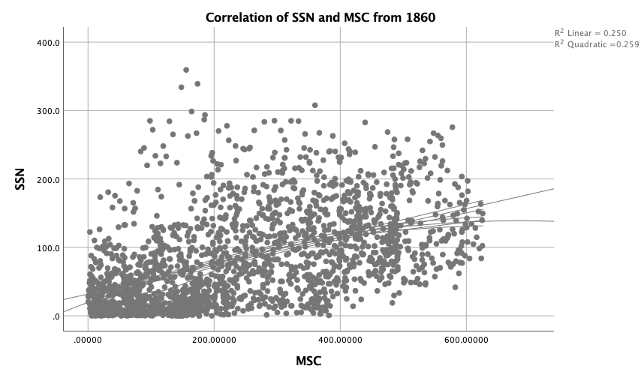
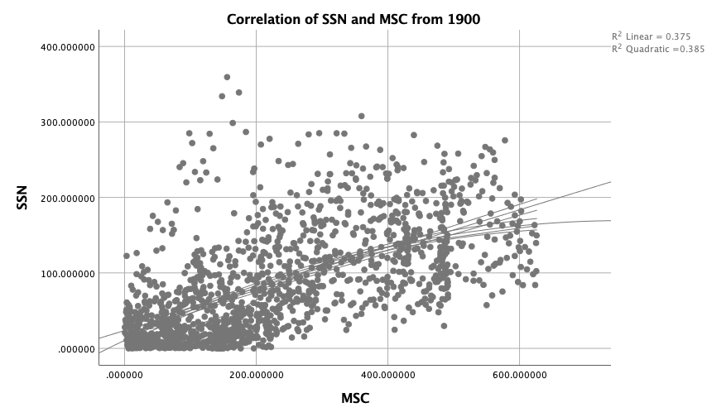
Correlation of SSN with MSC
25%
56%
67%
https://solargsm.com/wp-content/uploads/2023/04/zharkova_etal_mnras2023.pdf
With IBM SPSS package

Slide 28
Summary: new proxy of solar activity
New proxy of SA -Principal components of SBMF
PCs are paired – double dynamo waves
The strongest 2 PCs cover more than 40% of variance or 67% of SD
Prediction of the solar activity on a millennium scale shows grand solar cycle with a period of 350-400 years
Next grand solar minimum is underway in 2020-2053
Prediction for 3000-10000 years backwards fits the main grand minima and warming periods
https://solargsm.com/solar-activity/

Slide 29
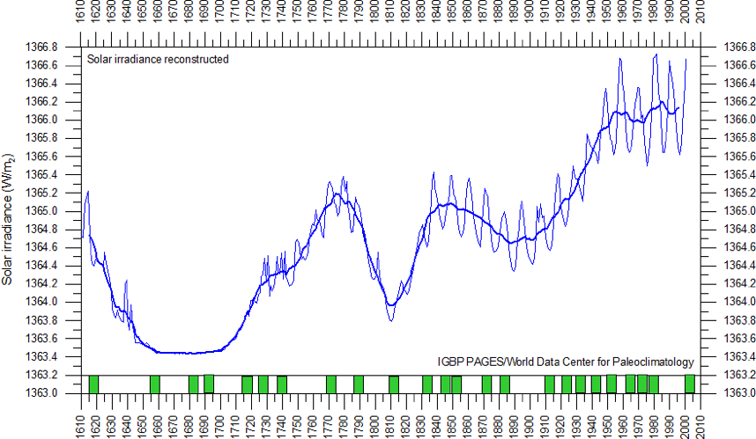
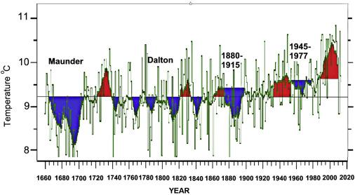
Solar irradiance and terrestrial temperature during MM
Lean et al, 1995, JGR
Lamb, 1972; Easterbrook, 2016
Authors | S, Maunder minimum, W/m² | S 1990-2000, W/m² | △S from MM, %
Lean et. Al., 1995 | 1363 | 1366 | 0.22
Steinhilber et al, 2012 | 1364 | 1366 | 0.22
Shirley et al., 1990 | --- | 1370 | 0.51
Wolff and Hickey, 1987 | --- | 1371 | 0.51
Lee et al., 1995 | --- | 1372 | 0.51
After the TSI data were re-normalized the old data are hardly usable

Slide 30
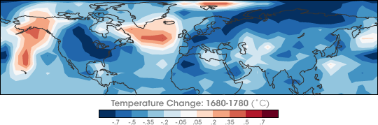
Temperature restoration during/after MM
(Shindell et al., 2001, Science)
The surface temperature of the Earth was reduced all over the Globe
Europe and North America went into a deep freeze
Alpine glaciers extended over valley farmland
Sea ice crept south from the Arctic
Danube and Thames rivers & canals in the Netherlands froze regularly

Slide 31
Temperature restoration during/after MM
(Shindell et al., 2001, Science)
https://earthobservatory.nasa.gov/images/7122/chilly-temperatures-during-the-maunder-minimum
The surface temperature of the Earth was reduced all over the Globe
Europe and North America went into a deep freeze
Alpine glaciers extended over valley farmland
Sea ice crept south from the Arctic
Dunab and Thames rivers & canals in the Netherlands froze regularly

Slide 32
Temperature restoration during MM
(Shindell et al., 2001, Science)
the drop in the temperature was related to dropped abundances of ozone created by solar ultra-violate light in the stratosphere, the layer of the atmosphere located between 10 and 50 kilometers from the Earth’s surface

Slide 33
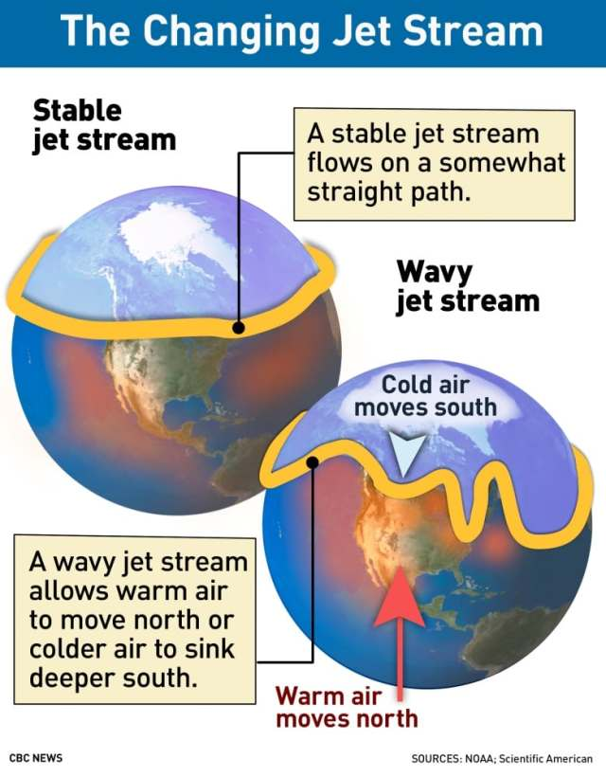
Less ozone affected planetary atmosphere waves
They, in turn, caused the giant wiggles in the jet stream as shown in picture on the left
It kicked the North Atlantic Oscillation (NAO)—the balance between a permanent low-pressure system near Greenland and a permanent high-pressure system to its south—into a negative phase
that led to Europe to remain unusually cold during the MM
Shindell et al., 2001

Slide 34
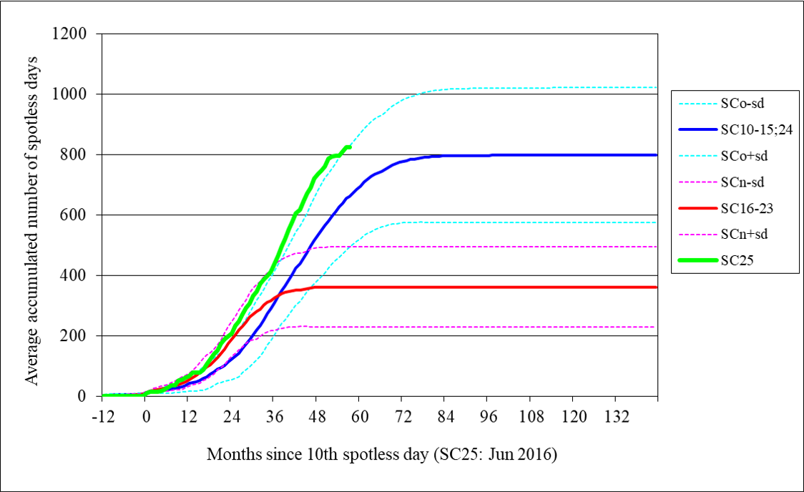
Cycle 25 (green line) shows a steeper growth of the number of spotless days than any other cycles including the ones during Dalton min (cycles 15 and 24) (blue line)

Slide 35
Modern Grand Solar Minimum 2020-2053
Snow in Carpathian mountains, snow Spain & Morocco, 2022
7, 14 July’19 July –Ukraine, 12 July 2019, 2021-2021 – many examples
Contrary to the prediction of JAMES HANSEN, 1989: “NEW YORK CITY’S WEST SIDE HIGHWAY WILL BE UNDERWATER BY 2009”
January 2020 snow and frost -2C was recorded in Amman, Arabia, first in 150 years
Early snow in Canada in September’ 20, May 21, Jan-Feb 24
Summer snow in south of Australia 2021

Slide 36
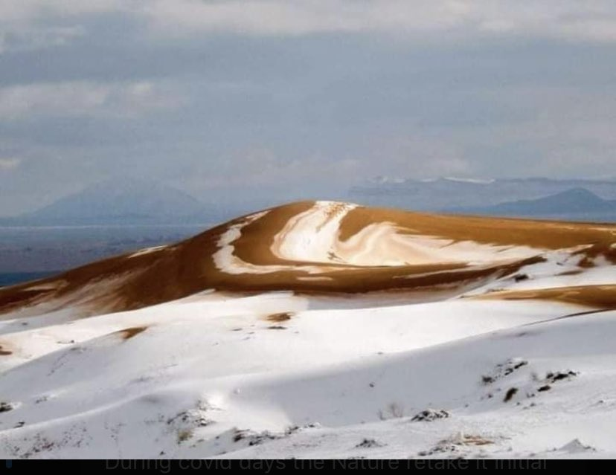
Snow in Africa’s desert 8 December 2020 https://twitter.com/GerryAMcG/status/1336420778582138886

Slide 37
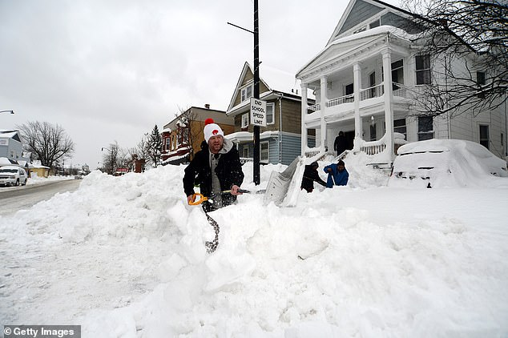
Snow blizzards in USA and Canada for 2 weeks in Dec ’22 –Jan’ 23

Slide 38
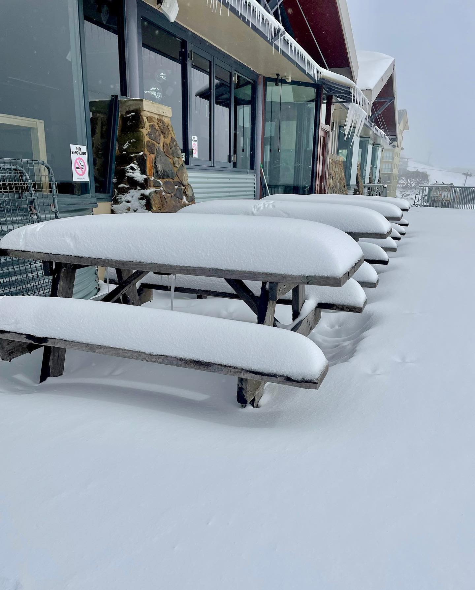
Late spring snow in Australia and NZ 22-30 November ’22
(analog of late May in Northern hemisphere)

Slide 39
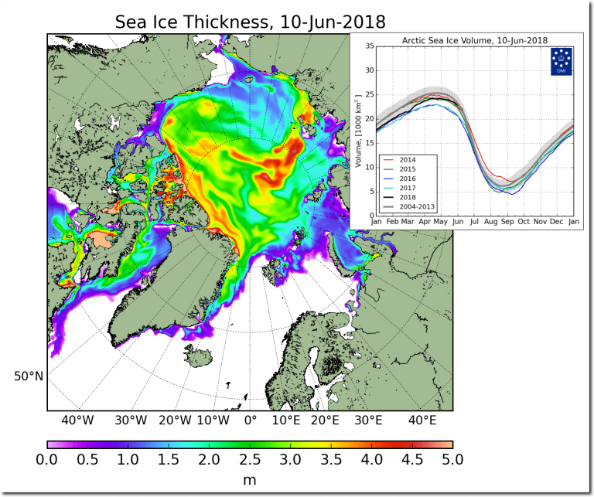
Modern GSM: Sea ice thickness increase in 2018-2020
Contrary to prediction of JAMES HANSEN, 1989: “NEW YORK CITY’S WEST SIDE HIGHWAY WILL BE UNDERWATER BY 2009”
Arctic sea ice thickness grown significantly in 2018 and continues to grow

Slide 40
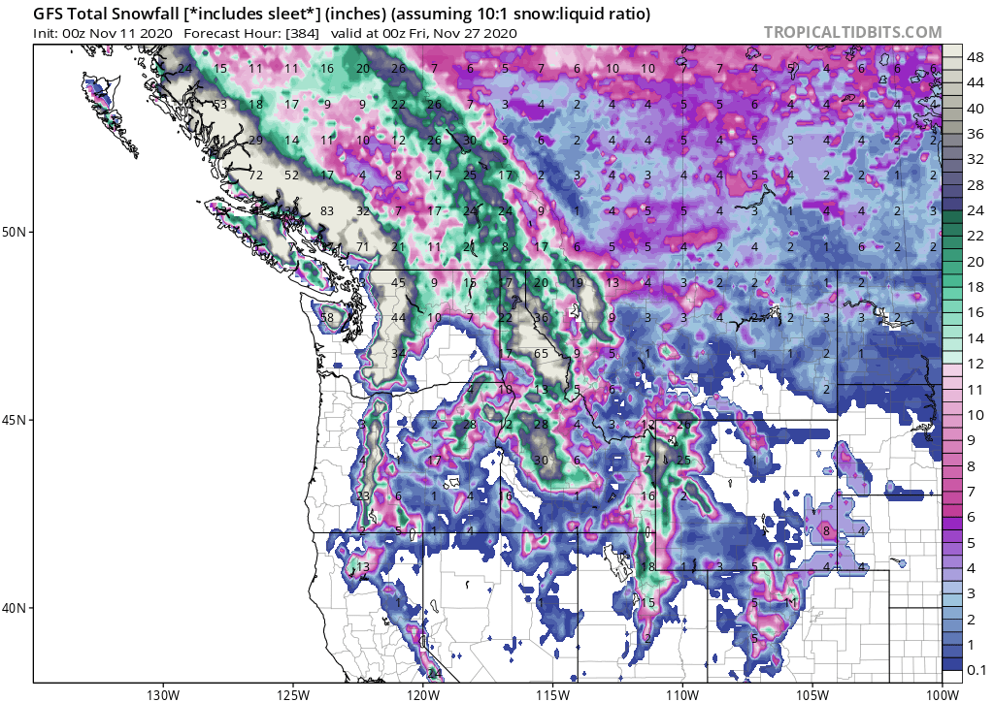
Modern GSM is progressing –November 2020- June 2022
UNPRECEDENTED WINTER STORM HITS BRITISH COLUMBIA
Both NOAA and NASA appear to agree, if you read between the lines, with NOAA saying we’re entering a ‘full-blown’ Grand Solar Minimum in the late-2020s
NASA seeing this upcoming solar cycle (25) as “the weakest of the past 200 years”, with the agency correlating previous solar shutdowns to prolonged periods of global cooling here.

Slide 41
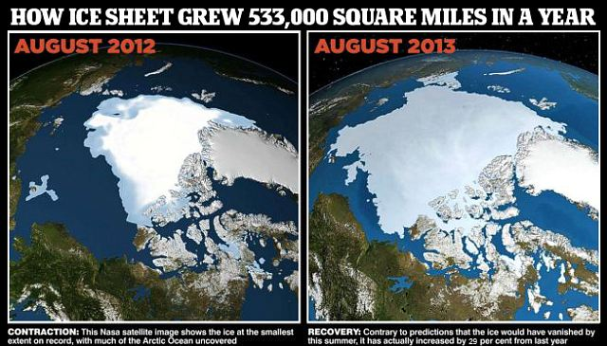

Slide 42
Modern Grand Solar Minimum https://solargsm.com/solar-activity/
To occur in 2020 – 2053
This is a unique event in solar-terrestrial connection → will reveal the pros and cons of solar dynamo models
Decrease of solar magnetic field → big impact ozone reduction, high cloud formation, jet direction changes, cosmic rays inclease
Increase of volcanic and earthquake activities
Effects on the terrestrial temperature via TSI, jets and volcanic activity
Shortage of vegetation periods can lead to possible food shortages in 2028-2042
Need inter-government efforts to avoid disasters

Slide 43
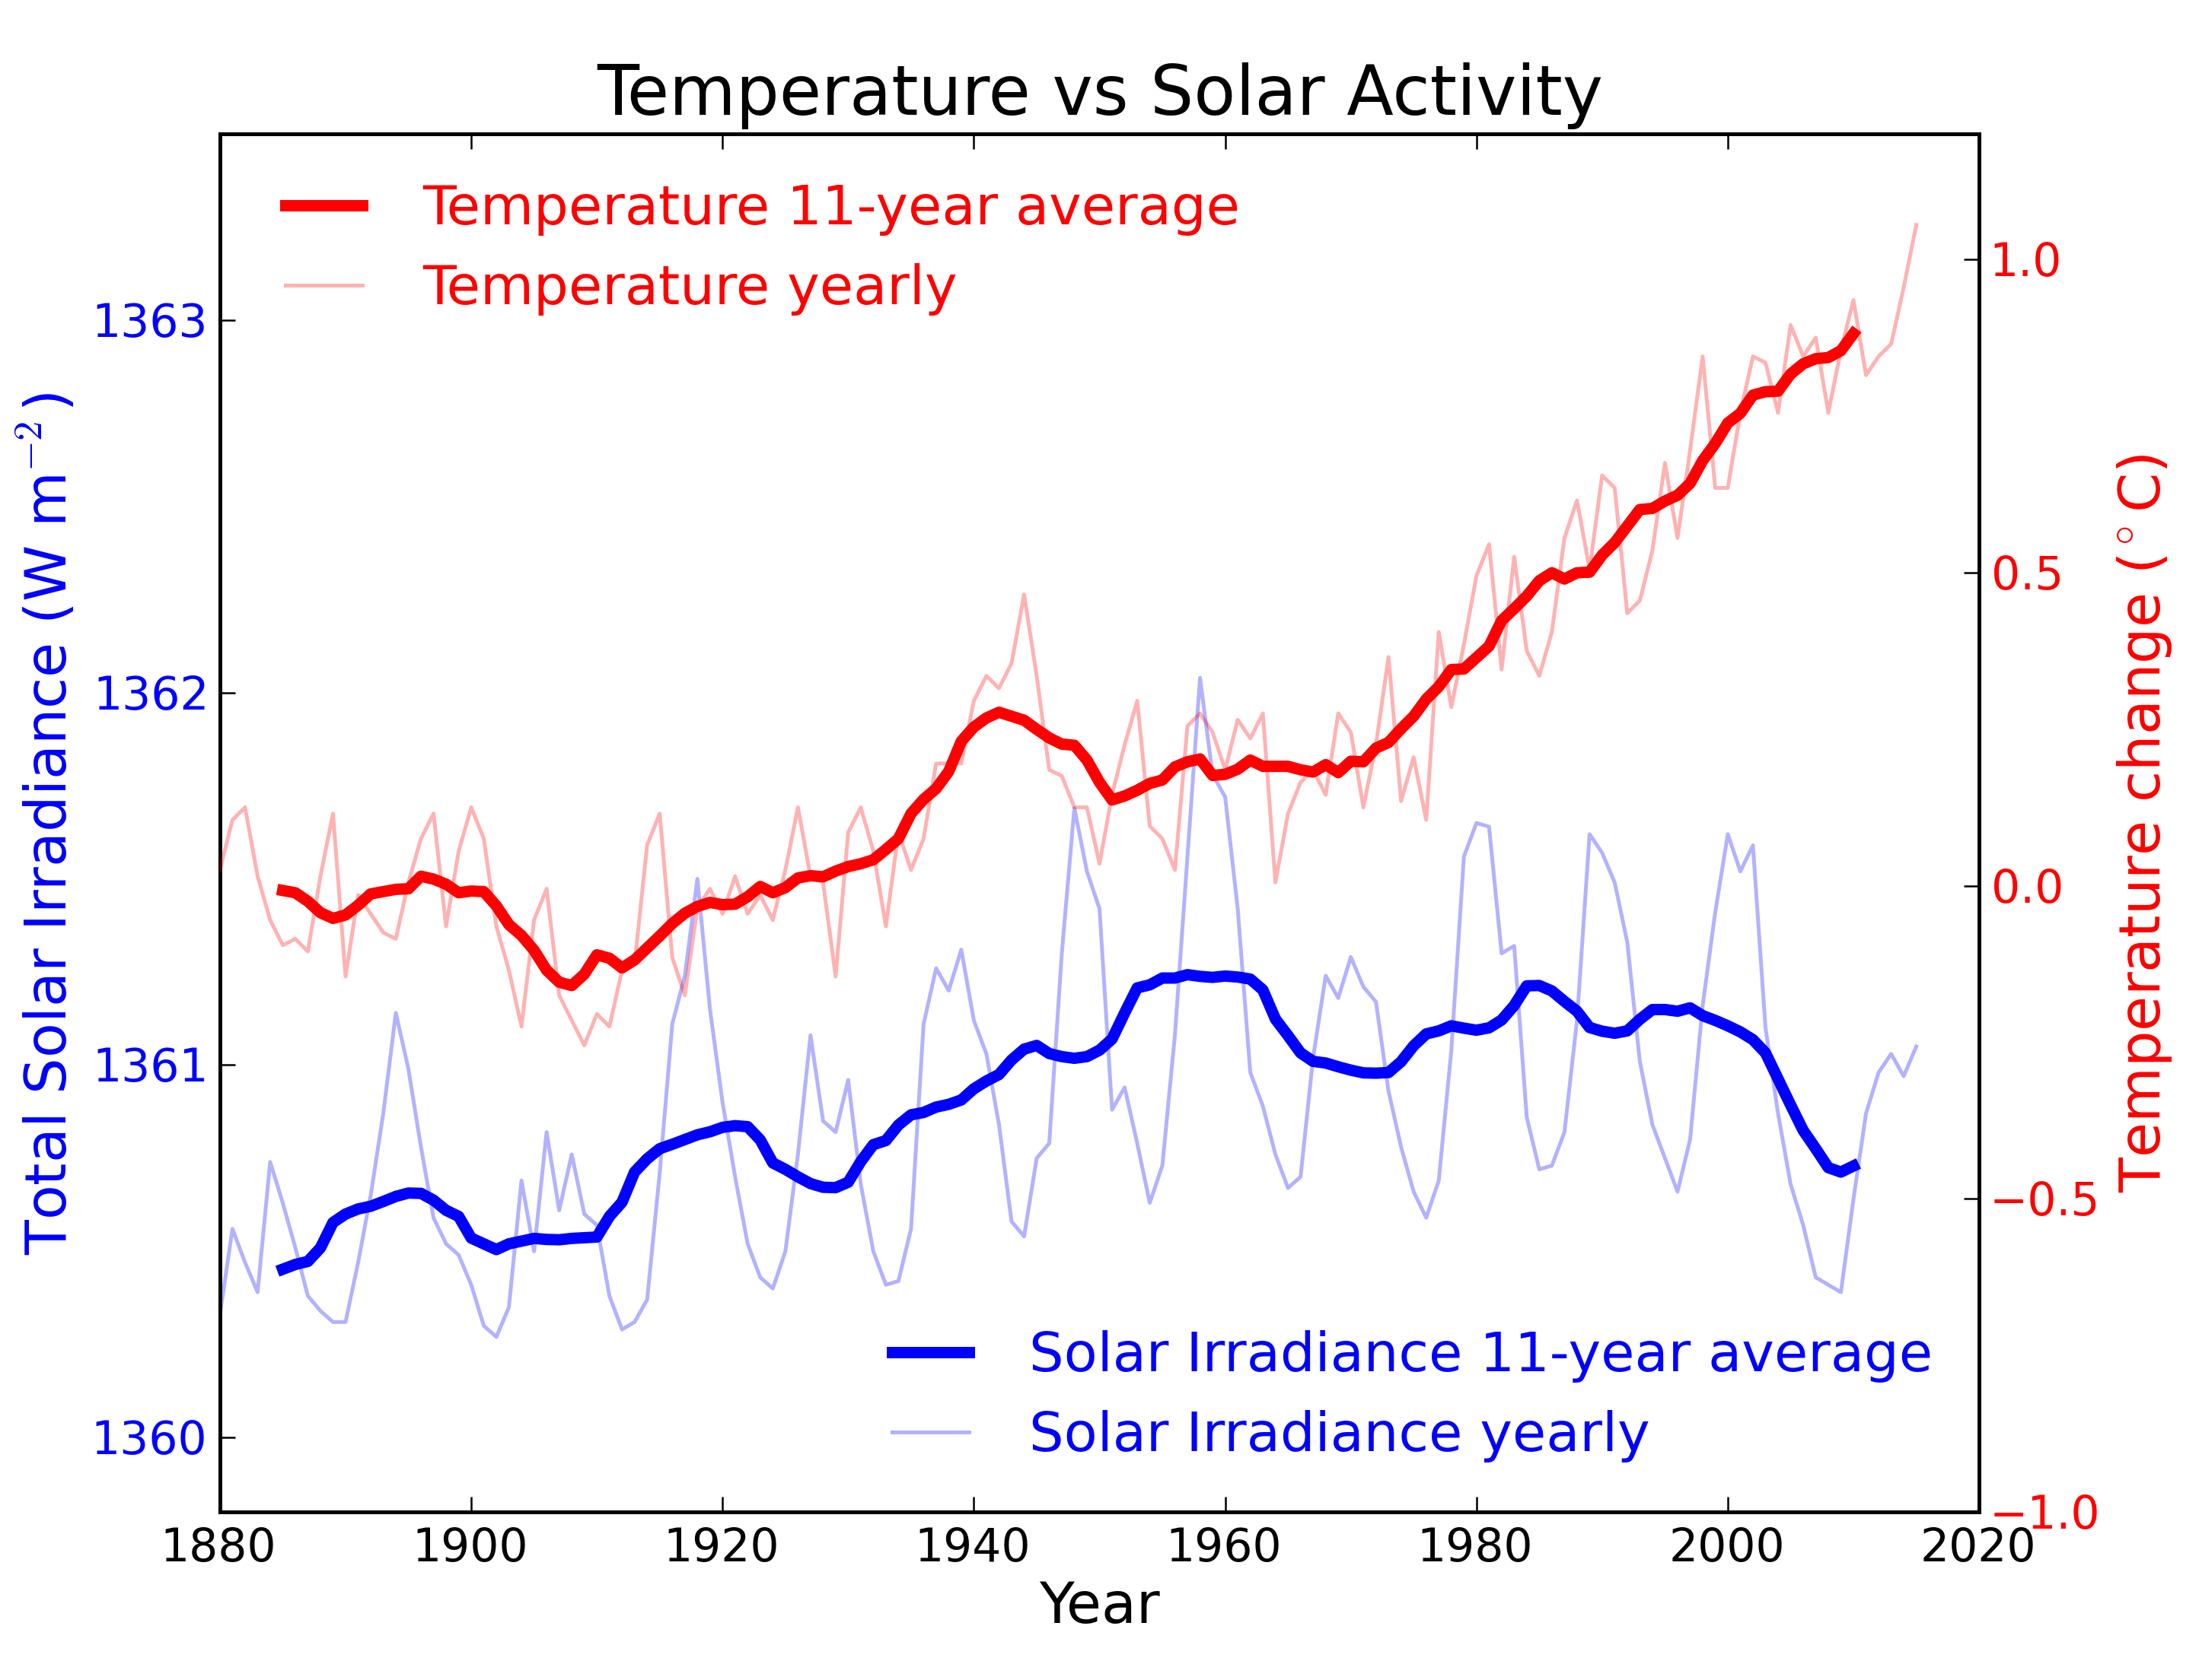
Terrestrial temperature recovery after mini ice age during MM
Akasofu, 2011

Slide 44
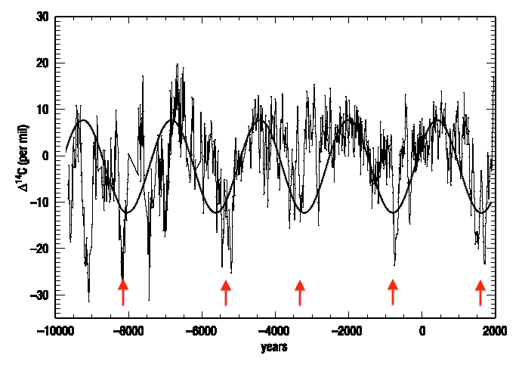
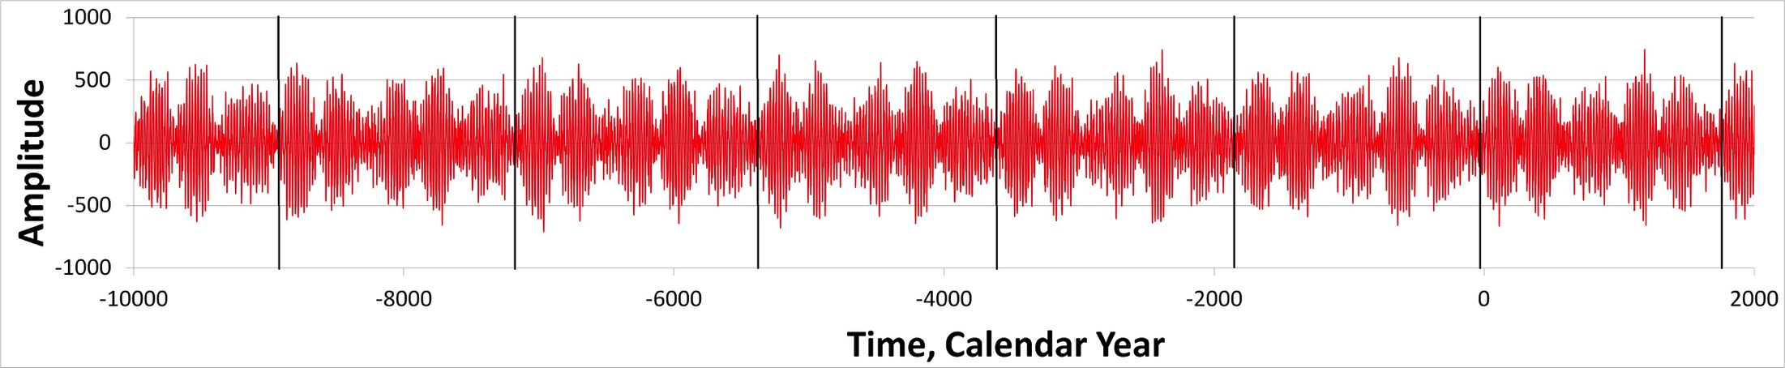
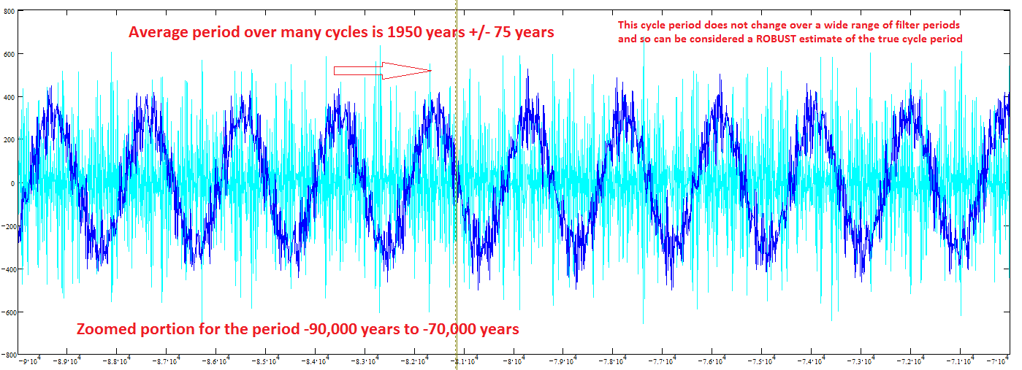
Solar magnetic field (top) and
Mbaseline oscillations (bottom)
(ZharkovlZharkova et., 2019, 2021al, 2018, 2019, 220 ture SR)
Reames et al, 2009
¹⁴C in trees
(Hallstatt’s cycle)

Slide 45
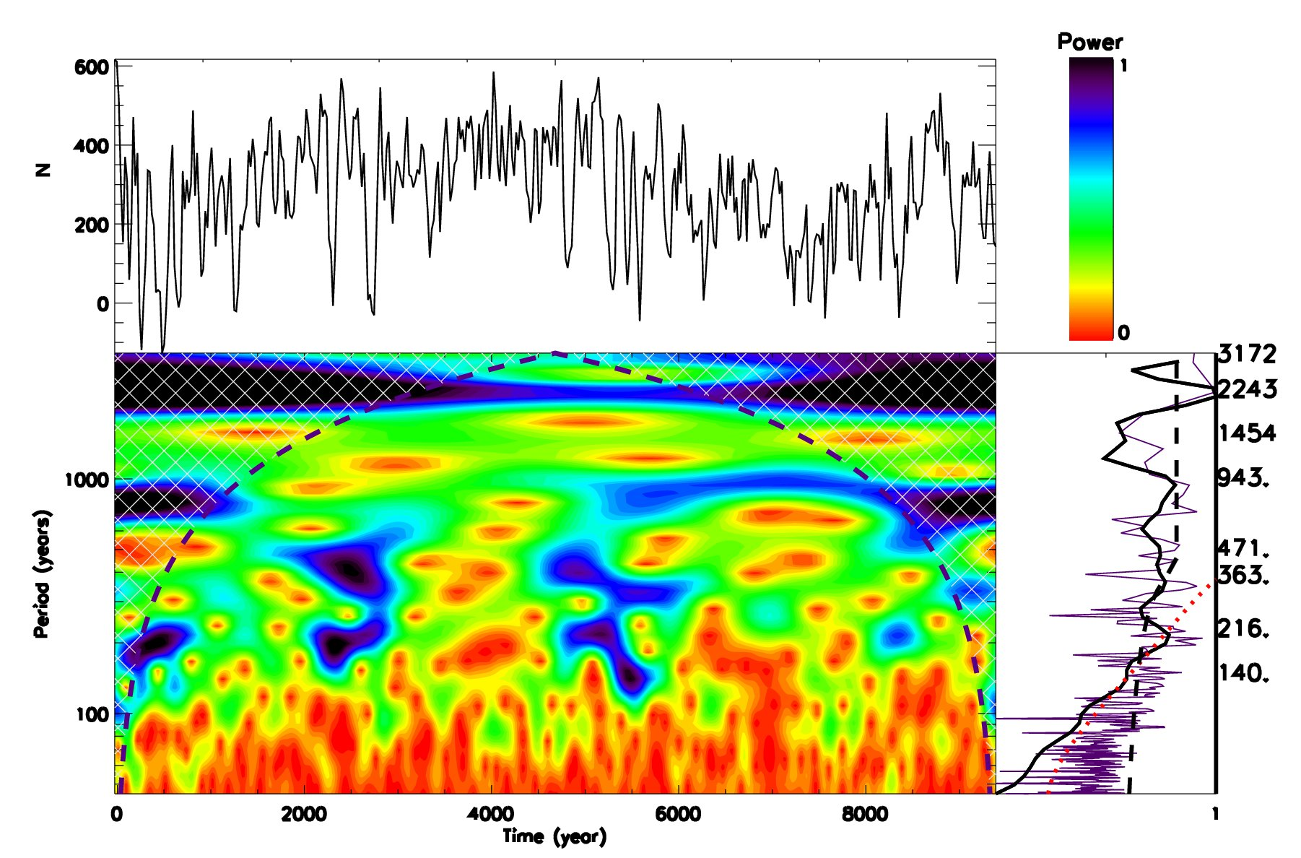

Hallstatt’s cycle - Wavelet spectral analysis of TSI (¹⁴C+¹⁰Be)
TSI by Steinhilber et al, 2012 TSI by Vieira et al, 2011
Main periods – 10.7, 216, 363 and 2243-2300 years (Hallstatt’s cycle)

Slide 46



Modern Hallstatt’s cycle (Zharkova et al, 2019, 2020)
MF baseline coincides with solar irradiance (Vierra et al, 2011) and T
(Akasofu, 2011)
Zharkova et al, 2019, 2020

Slide 47

What are the reasons of solar irradiance oscillations?
→ Sun, Earth and other planets motion (Milankovich cycles)

Slide 48

Obliquity (axial tilt) (ε) (22º.1-24º.5)
current 23.5 - T~41 000 years
Eccentricity (e). Change on semi-minor axis
T~100-400K years effects of Jupiter and Saturn
Longitude of perihelion (sin(ϖ) ).
Precession index (e sin(ϖ) ) –
Axial - Earth's axis of rotation relative to fixed
stars – T~ 25,771.5 y
Apsidal - orbit ellipse relative to fixed stars – T~113 000 y
Orbital inclination – T~ 70 000 y
Earth's movements:
  1.1 Orbital shape (eccentricity)
  1.1.1 Effect on temperature
  1.1.2 Effect on lengths of seasons
  1.2 Axial tilt (obliquity)
  1.3 Axial precession
  1.4 Apsidal precession
  1.5 Orbital inclination (
2

Slide 49

Solar Inertial Motion
Solar inertial motion is the motion of the Sun around the centre of mass of the Solar System due to variable positions of the giant planets (J-Jupiter, S-Saturn, U-Uranus, N-Neptune).
The Sun moves inside a circular area which has a diameter of 0.02 AU (= 4.3 solar radii = 3.106 km). The Sun moves with a velocity between 9 and 16 m/s.
6.96x10⁵ km
Charvátová, I., The solar motion and the variability of solar activity, Adv. Space Res., 8, 7, 147-150, 1988.
Charvátová, I., On the relation between solar motion and solar activity in the years 1730-1780 and 1910-60, Bull. Astr. Inst. Czech., 41, 200-204, 1990.
Charvátová, I., Solar-terrestrial and climatic variability during the last several millennia in relation to solar inertial motion, J. Coast. Res., 17, 343-354, 1995.
Charvátová, I., Can origin of the 2400-year cycle of solar activity be caused by solar inertial motion? Annales Geophysicae, 18, 399-405, 2000.

Slide 50


Slide 51


Slide 52


SIM effects on the Earth via solar irradiance
Objection from AGW people
https://youtu.be/vDgUmTq4a2Q
The Sun moves inside a circular area which has a diameter of 0.02 AU (= 4.3 solar radii = 3.106 km). The Sun moves with a velocity between 9 and 16 m/s.
S. Perminov, E.D. Kuznetsov, 2018
SIM imposed by planets Jupiter, Saturn, Neptune and Uranus
Charvatova, 1988,
Palus et al, 2007
Rice et al, PP comments #72, 96

Slide 53






600
1700
1100
2020
2600
1600
https://www.intechopen.com/online-first/millennial-oscillations-of-solar-irradiance-and-magnetic-field-in-600-2600

Slide 54







Slide 55







Slide 56







Slide 57











Ephemeris of S-E distances

Slide 58


Annual variations of mean S-E distances (ephemeris)
in M1 (600-1600) and M2 (1700-2600)
(Zharkova, 2020 https://arxiv.org/pdf/2008.00439.pdf )
M1 – aphelion is in June, shifting to mid-July in M2
a - Sun - in the ellipse focus
b - Sun shifted by SIM to spring equinox

Slide 59

Zharkova et al, 2023 https://www.scirp.org/journal/paperinformation.aspx?paperid=124007
2020
Aphelion →. 5 July
Perihelion → 5 January
2600
Aphelion →. 16 July
Perihelion → 16 January
SIM effects on the Earth via solar irradiance
https://youtu.be/vDgUmTq4a2Q
Solar Inertial Motion
S. Perminov, E.D. Kuznetsov, 2018
SIM imposed by planets Jupiter, Saturn, Neptune and Uranus
Charvatova, 1988,
Palus et al, 2007
Rice et al, PP comments #72, 96

Slide 60







Solar irradiance
2600
1600
2020
1100
$S=\frac{I_{sun}}{d^{2}}$ → S₁ $d^{2\text{1}}$ =S₂ $d^{2\text{2}}$
inverse squared law
600
1700

Slide 61







Slide 62







Slide 63







Slide 64


Annual TSI variations in M1 (600-1600) and M2 (1700-2600)
Zharkova, 2021 https://www.intechopen.com/online-first/millennial-oscillations-of-solar-irradiance-and-magnetic-field-in-600-2600 )
M1: TSI significantly increases in February – June, and decreases in June-December. M2: the aphelion shifts to mid-July →TSI decrease in July – January is not fully compensated!

Slide 65


Variations of the total annual TSI in M1 (600-1600) and M2 (1600-2600) taken from the TSI averaged for each month (left) and daily TSI (right)
https://arxiv.org/pdf/2008.00439.pdf
Zharkova et al, 2019, Zharkova, 2020
There is extra solar forcing caused by gravitation of planets, which is a likely reason of the main part of global warming
Extra solar forcing
Not considered so far!
Extra 5 W/m² of TSI, 60% warming comes to Sun, 40% - to green house gasses (Hardy, 2017).
We have found extra TSI of 20 W/m² in 2020! It will last until 2500!

Slide 66
Solar dynamo effects:
a) two double dynamo 11 year waves
b) grand solar cycles & GSMs –wave beating
Solar inertial motion effects
Period of 2100-2200 years
increase of T by 1.5C by 2100, and by further by 2.5-3.0 C by 2500 interrupted by T decreases during GSMs .
During GSMs: a decrease of temperature up to 1C

Slide 68
Conclusions
Solar activity is defined by action of solar dynamo converting solar poloidal (background) into toroidal (sunspot) magnetic fields and vice versa during the period of 10.7 years
Solar dynamo acts in two layers with different speed of meridional circulation as derived from the summary curve of eigen vectors varying with the periods of 21.5 years (magnetic solar cycle) and 344-350 years (grand solar cycle)
Spectral analysis of the TSI variations reveals the periods 2243 -2300 years (wavelet+Fourier) Hallstatt’s cycles
The baseline of the summary curve of SBMF also reveals weak variations with a period of ~2100-2200 years – Hallstatt’s cycle
Hallstatt’s cycle variations are closely linked to the solar inertial motion (SIM) about the barycentre of the solar system → the ephemeris of S-E distances shown
A change of S-E distances from 1600 to 2500 leads to the TSI increase by 20-25 W/m² per year (10-12 W/m² per hemisphere)
Increase of TSI with a decrease of S-E distances (SIM) leads to the increase of T by 1.5C by 2100, and by further by 2.5-3.0 C by 2600.
Although two GSMs (2020-2053 and 2375-2415) will cause large reduction of solar activity and terrestrial temperature by 1C
Next 30 years the main problem will be mini ice age caused by GSM – heating and food shoortages

