Slide 1


Links of eigen vectors of solar magnetic field with the indices of solar activity in sunspots and flares
https://solargsm.com/solar-activity/
Valentina Zharkova
University of Northumbria, Newcastle upon Tyne, UK
https://solargsm.com/publications/
With thanks to Drs. S. Shepherd (UK), E. Popova (Chile) and S. Zharkov (UK)

Slide 2
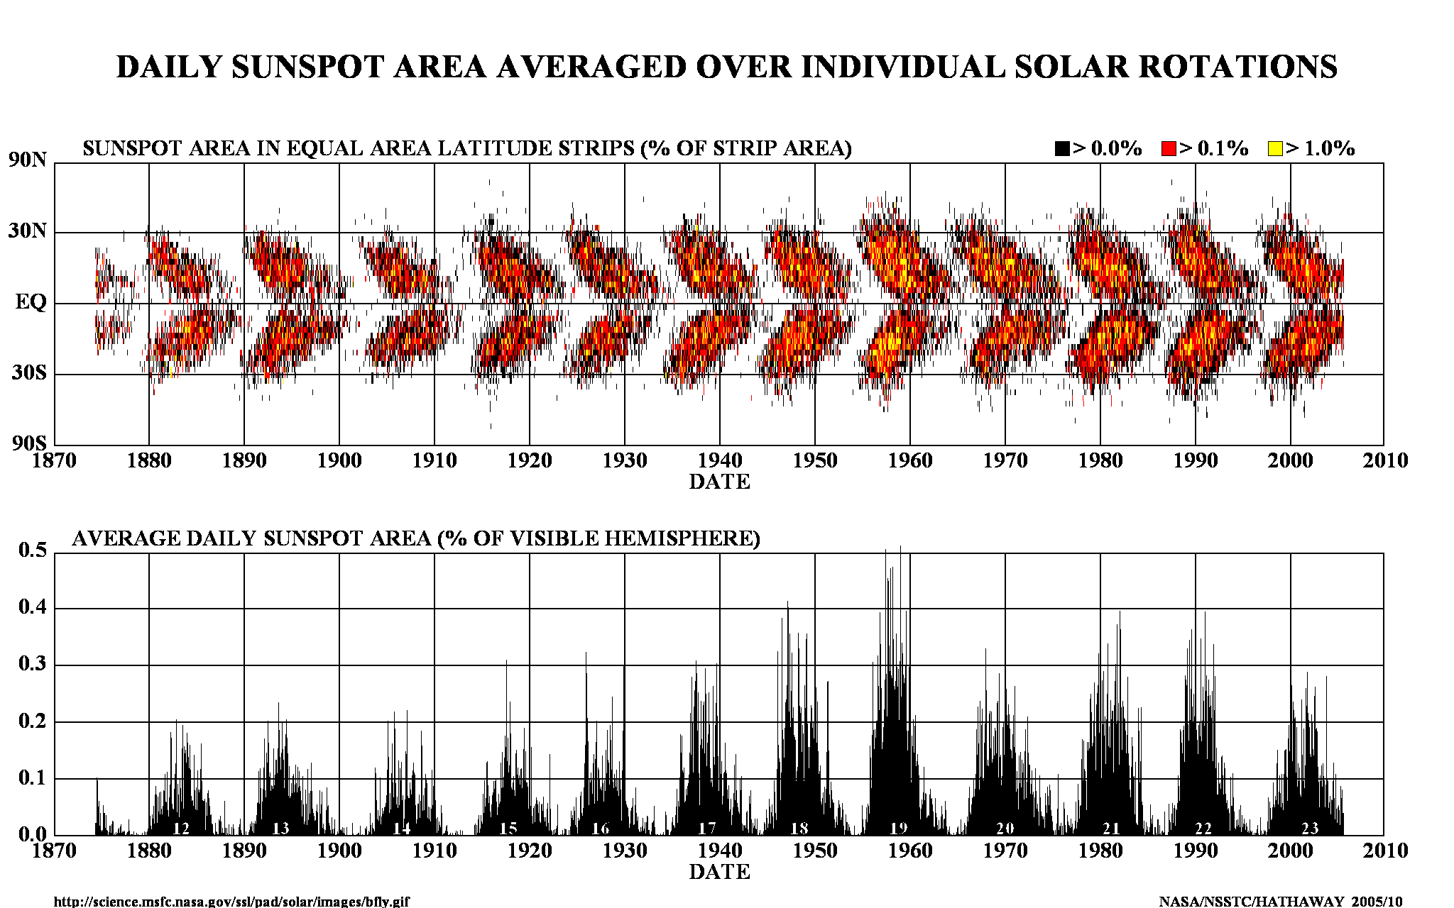
Current solar activity index

Slide 3
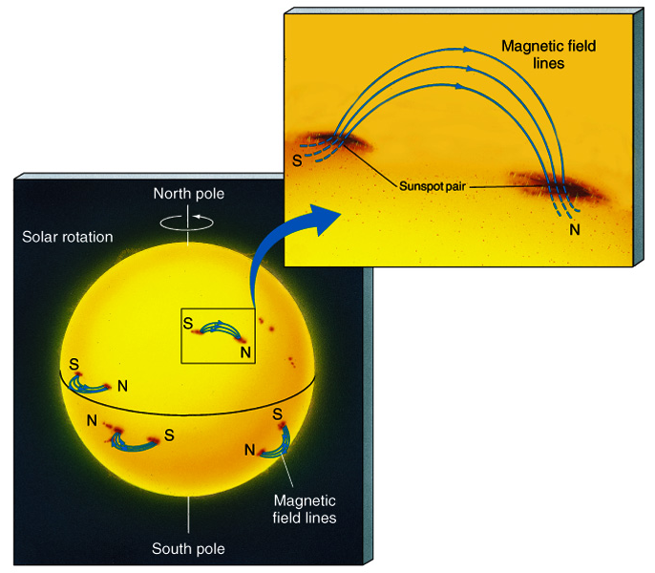
Sunspots & Magnetic Fields
The magnetic field in a sunspot is 1000x greater than the surrounding area
Sunspots are almost always in pairs at the same latitude with each member having opposite polarity
All sunspots in the same hemisphere have the same magnetic configuration

Slide 4
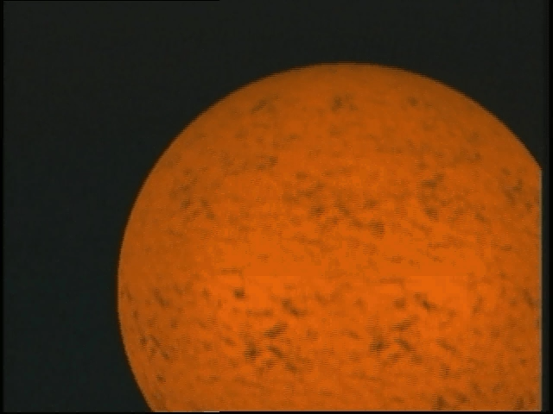
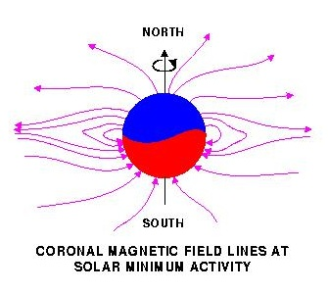
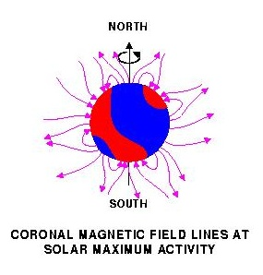
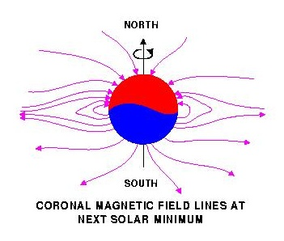
Solar magnetic field reversal
Strong toroidal magnetic fields (TMF) forming Active Regions (ARs)
are created in a shear layer beneath the base of the Solar Convection zone (SCZ).

Slide 5
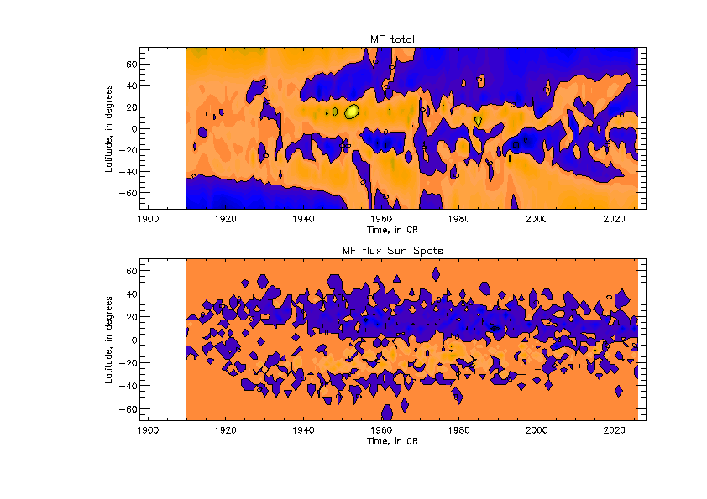
New proxy for solar activity index
SBMF (top) and sunspot MF (bottom)–
(Zharkov et al, 2008, Stix 1976)
Cycle 23 -Solar Background MF
Sunspot MF

Slide 6
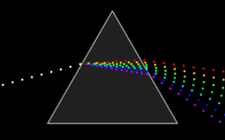
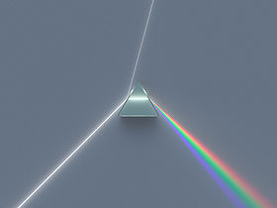
White light refraction into waves of different colors, or wavelengths

Slide 7
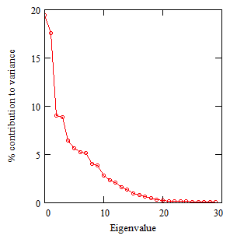
SBMF results: Scree plot (->prizm)
Eigenvalues vs variances (Zharkova et al, 2012)
- 2 main eigenvalues covering 40% of variance –
(67% of SDV) -
- 3 pairs (6 eigenvalues) to cover
Dipole magnetic sources
Quadruple magnetic sources

Slide 8
Fitting the PCs to measured in cycle 24 and prediction to 25-26
Eigen vectors come in pairs, here are PCs
(Shepherd et al, 2014, Zharkova et al, 2015)

Slide 9
Mathematical laws from PCs: Symbolic regression -Hamiltonian approach (Schmidt and Lipton, 2009, Science)Schmidt & Lipson, 2009, Science)
Mathematical law for the first principal component:
F₁(t) = Σ_{k=1,..,5} A_{k} cos(ω_{k,1}t +ϕ_{k,1})cos(B_{k,1} cos(ω_{k,1}t +ϕ_{k,1})
Mathematical law for the second principal component:
F₂(t) = Σ_{k=1,..,5} A_{k} cos(ω_{k,2}t +ϕ_{k,2})cos(B_{k,2} cos(ω_{k,2}t +ϕ_{k,2})

Slide 10
S Summary curve of 2 PCs v
(Zharkova et al, 2015)

Slide 11
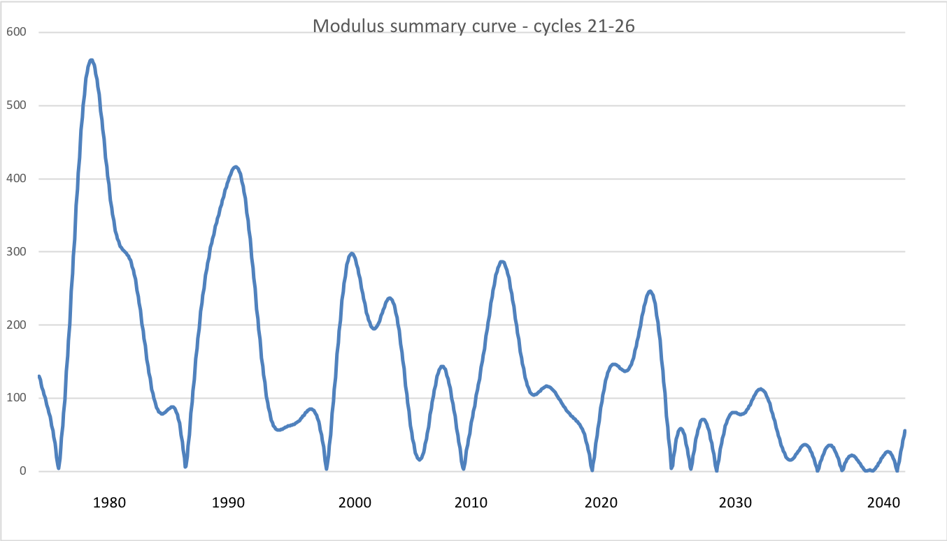
Modulus summary curve – dipole MF
Zharkova et al, 2015, SciRep; 2020, Temp., Zharkova et al, 2022, MNRAS https://solargsm.com/wp-content/uploads/2022/04/zharkova_shepherd_mnras22.pdf s sunsdata
(Shepherd et al, 2014 ; Zharkova et al, 2015)
Cycle 21
Cycle 22
Cycle 23
Confirmed by
Katiashvili, 2020, ApJ;
Obridko et al, 2021, MNRAS
Velasco-Herrera et al, 2021
Cycle 21
Cycle 22
Cycle 23
Cycle 24
Cycle 25
Cycle 26

Slide 12
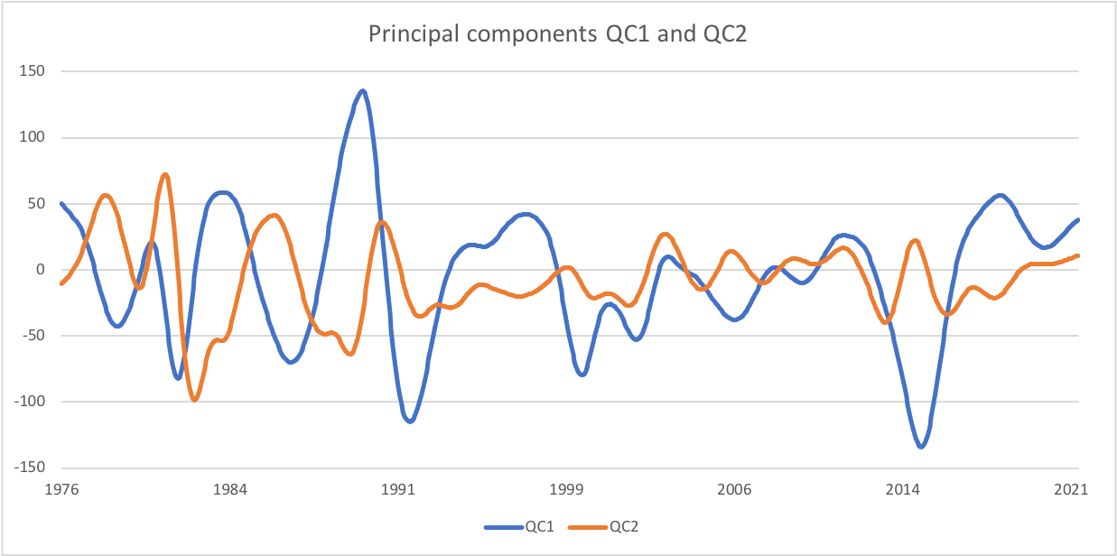
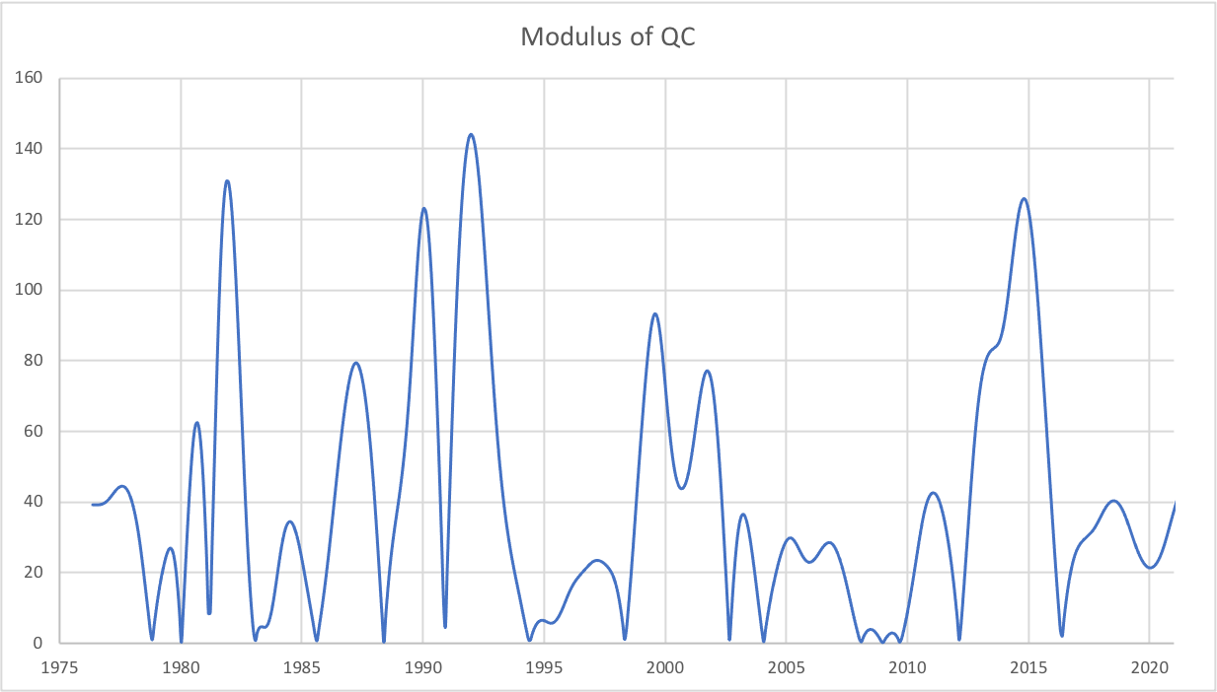
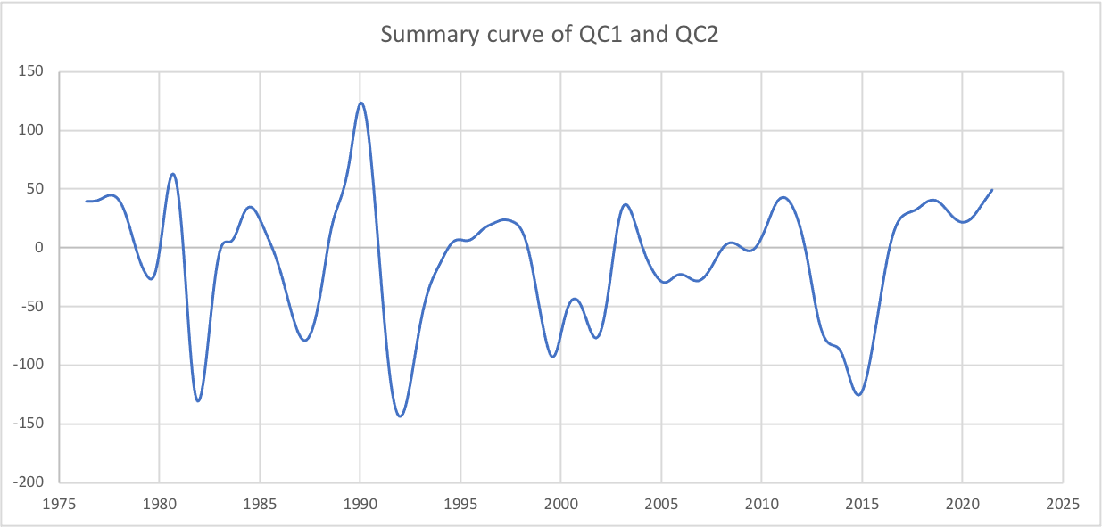
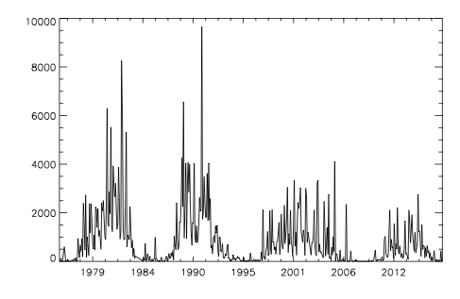
Modulus summary curve – quadruple MF
Zharkova et al, 2023 MNRAS https://solargsm.com/wp-content/uploads/2022/04/zharkova_shepherd_mnras22.pdf
SHR flare index

Slide 13
Predicted solar activity (Zharkova et al, 2015, SR https://www.nature.com/articles/srep15689)
Zharkova et al, 2015, Nature SR
Observational result, dynamo model was not yet considered
Discovery of grand solar cycles :350-400 years
In addition to 11 year cycles
https://solargsm.com/solar-activity/ - my webpage

Slide 14
This result was reported at
the National Astronomy Meeting in Llandudno and covered by the RAS press-release https://nam2015.org/index.php/press-releases/64-irregular-heartbeat-of-the-sun-driven-by-double-dynamo
media https://www.sciencedaily.com/releases/2015/07/150709092955.htm and https://www.chroniclelive.co.uk/business/business-news/mini-ice-age-could-freeze-11607587
U-tube talks https://www.youtube.com/results?search_query=double+dynamo+and+grand+solar+minimum
See more on https://solargsm.com

Slide 15
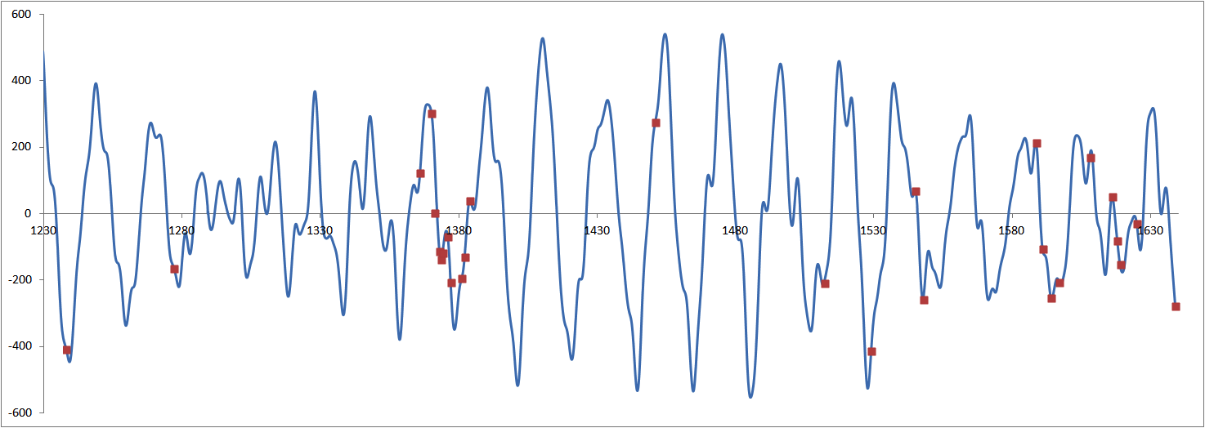
Verification of summary curve with large s/s for grand cycle prior MM (Zharkova etal, 2017, 2018) Wolf and Maunder grand minima
Zharkova et al, 2017
Severe diseases in China, no observers
New dynasty in China, Great Wall project

Slide 16
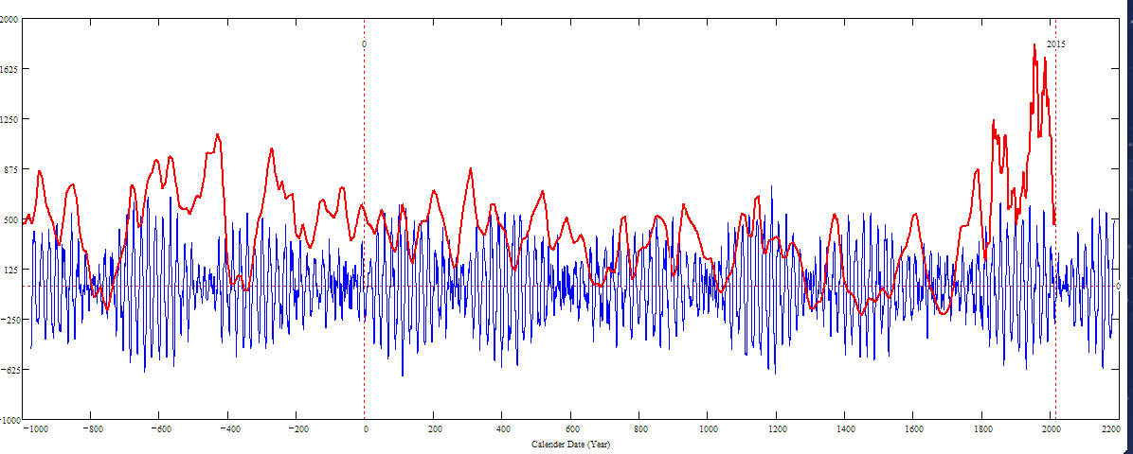
Double dynamo summary curve for 3000 years (blue) versus the s/s curve by Solanki et al. 2004 (red)
Homeric minimum^{[13]} | 750 BCE | 550 BCE
Oort minimum | 1040 CE | 1080 CE
Medieval maximum | 1100 | 1250
Wolf minimum | 1280 | 1350
Spörer Minimum | 1450 | 1550
Maunder Minimum | 1645 | 1715
Dalton Minimum | 1790 | 1820
Zharkova et al, 2015, 2018
Sporer minimum in 1400-1600 in C¹⁴ is caused by s/n Vela Junior
Oort
Wolf
Maunder
Homeric
Periods – grand cycle: 350-400 years and super-grand cycle :2000-2100 years

Slide 17
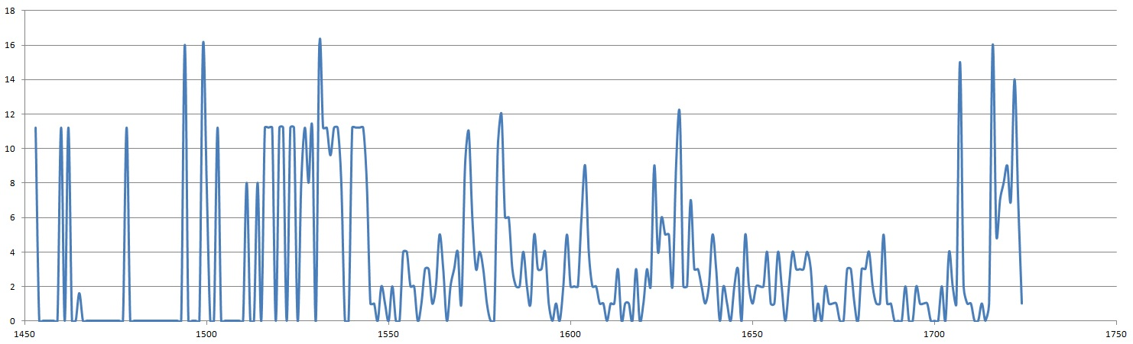

Slide 18
Summary new proxy of solar activity
New proxy of SA -Principal components of SBMF
PCs are paired – double dynamo waves
The strongest 2 PCs cover more than 40% of variance or 67% of SD
Prediction of the solar activity on a millennium scale shows grand solar cycle with a period of 350-400 years
Next grand solar minimum is underway in 2020-2053
Prediction for 3000-10000 years backwards fits the main grand minima and warming periods
https://solargsm.com/solar-activity/

Slide 19
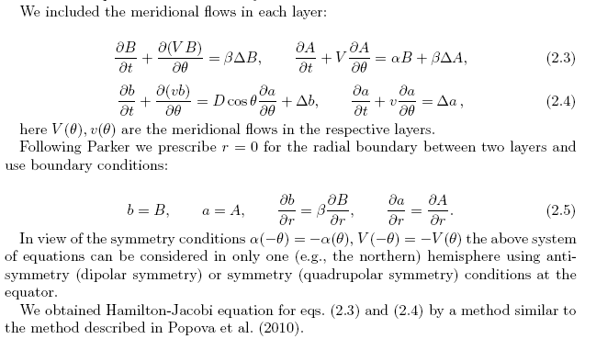
2 layer dynamo model explaining some PCA features
Zharkova et al, 2015, Popova et al, 2013

Slide 20
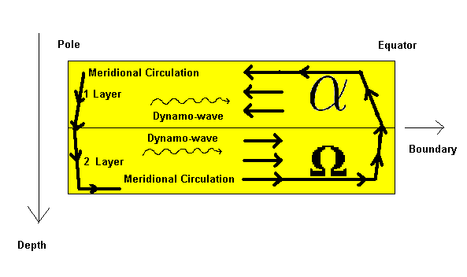
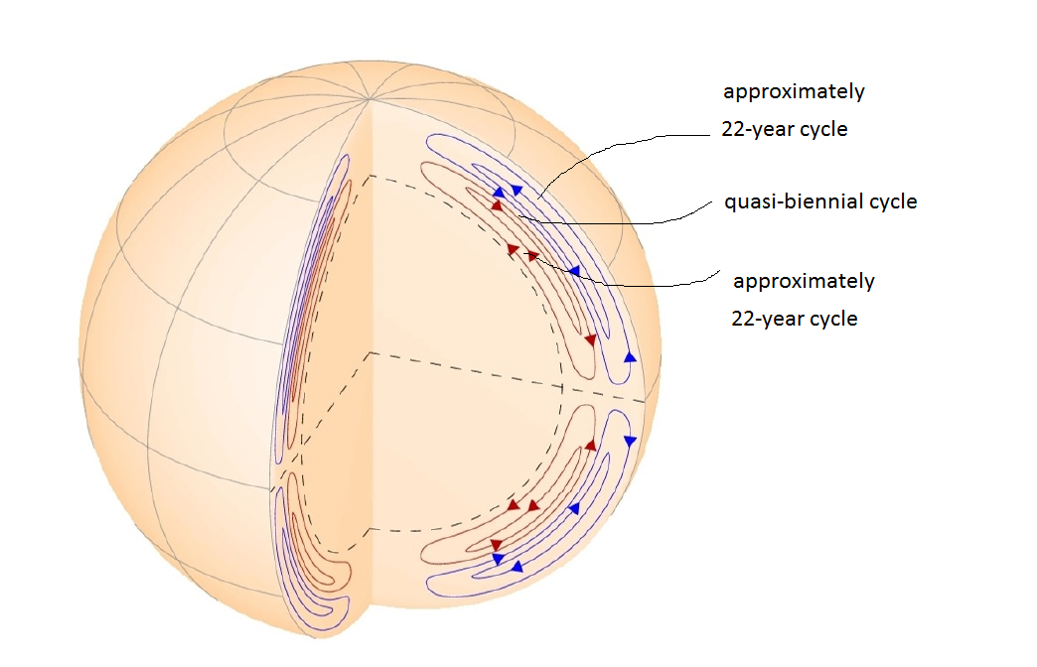
Two-Layer Medium observed with HMI
HMI/SDO heliosesimic observations
Zhao et al, 2013

Slide 21
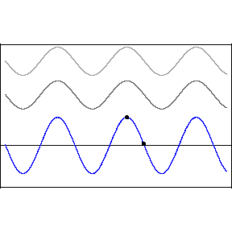
Interference
The two waves interference
y₁(x,t)=Acos(kx-ωt) (top wave),
y₂(x,t)=Acos(kx-ωt+D) (middle wave)
y(x,t)=y₁(x,t)+ y₂(x,t)
resulting wave with amplitude B
ω – frequency, k –wave number,
x – wave displacement
D – phase difference
A - Amplitude
D=0 constructive interference, B=2A
D=π (180º) –destructive interference, B= 0

Slide 22
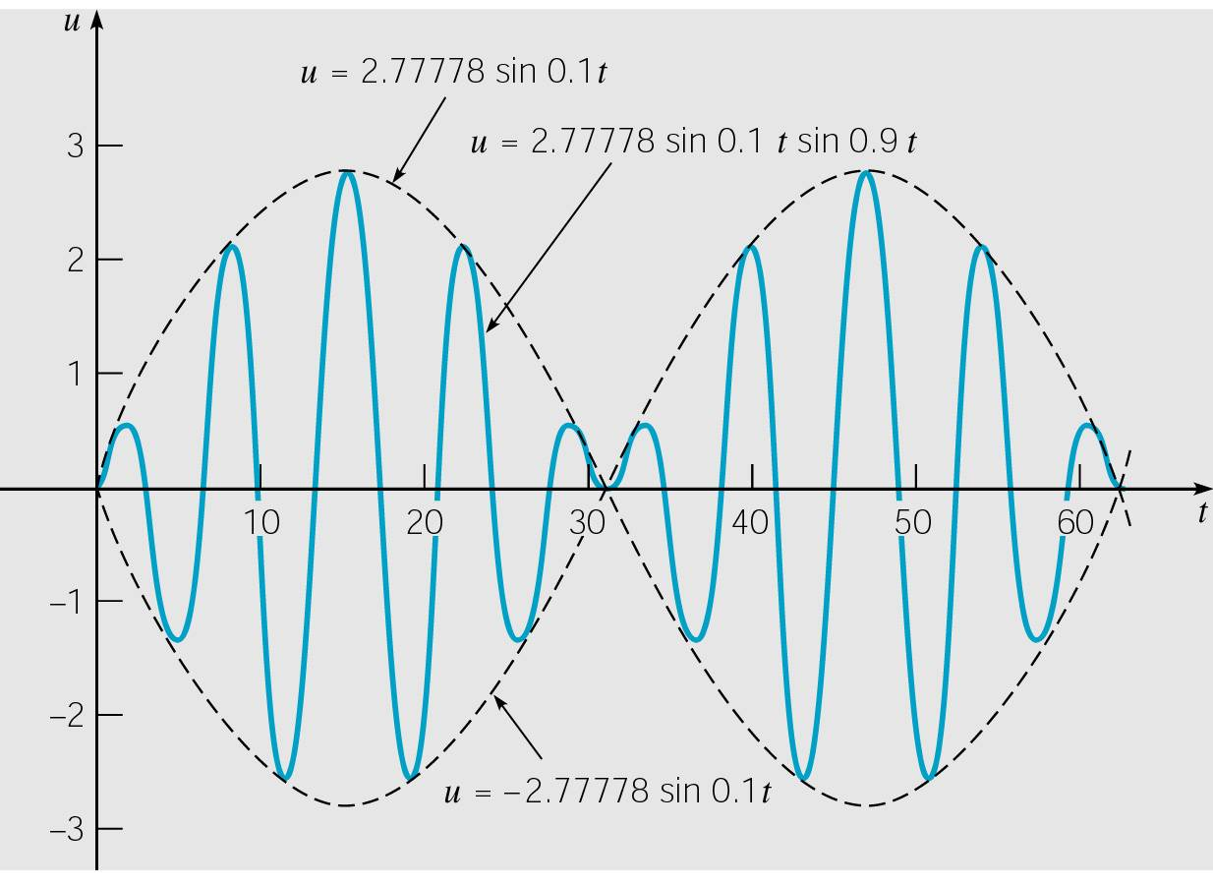
Undamped wave equation:
Solution to Initial Value Problem (2 of 3)
Thus our solution is
To simplify the solution even further, let A = (ω₀ + ω)/2 and B = (ω₀ - ω)/2. Then A + B = ω₀t and A - B = ωt. Using the trigonometric identity
it follows that
and hence

Slide 23
Undamped wave equation: Beats (3 of 3)
it follows that oscillations are described by the formula:
When |ω₀ - ω| ≅ 0, ω₀ + ω is much larger than ω₀ - ω, and
sin[(ω₀ + ω)t/2] oscillates more rapidly than sin[(ω₀ - ω)t/2] (amplitude of faster oscillation).
Thus motion is a rapid oscillation with frequency (ω₀ + ω)/2, but with slowly varying sinusoidal amplitude given by formula:
This phenomena is called a beat.
Beats occur with two tuning forks of
nearly equal frequency (beats used for tuning piano or violine)

Slide 24
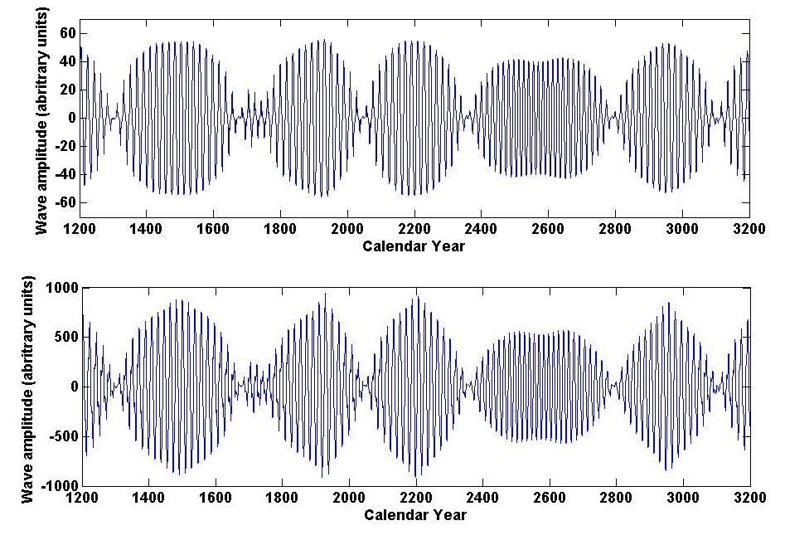
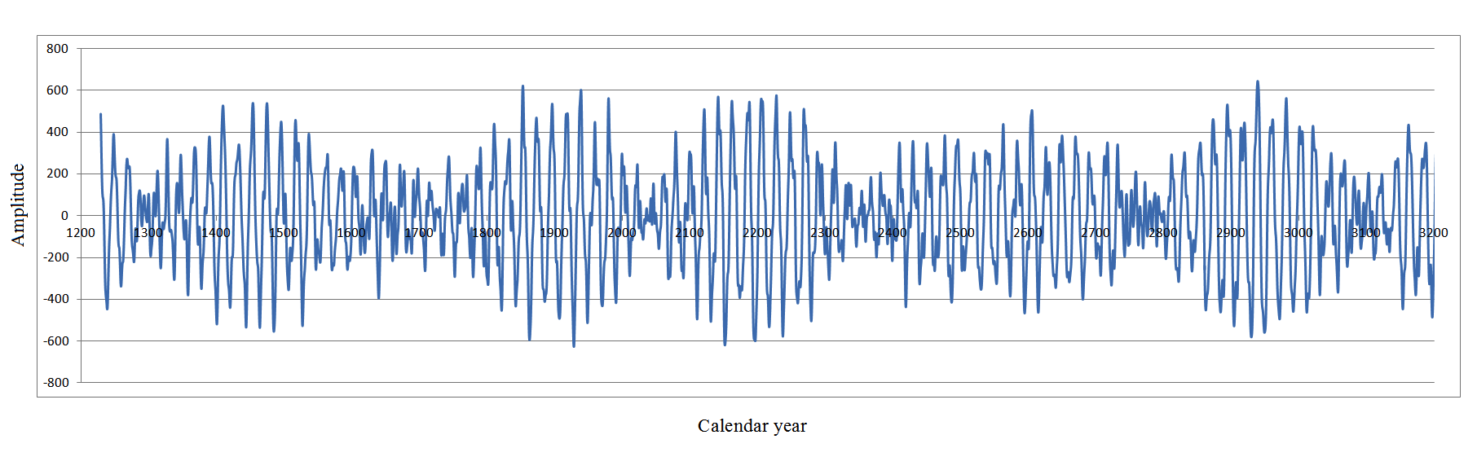
Dynamo model (top) and summary curve (bottom
Summary dynamo wave
on the millennium scale (Zharkova et al, 2015, Nature SR)
Popova et al, 2013
Zharkova et al, 2015, SR https://www.nature.com/articles/srep15689

Slide 25
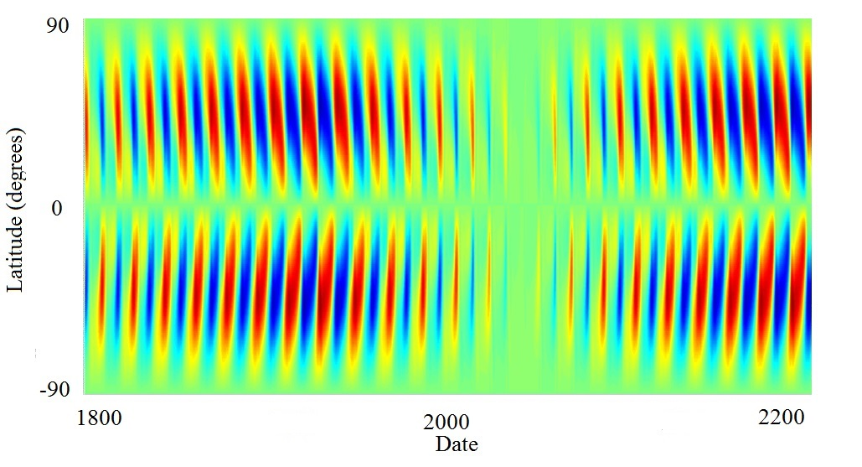
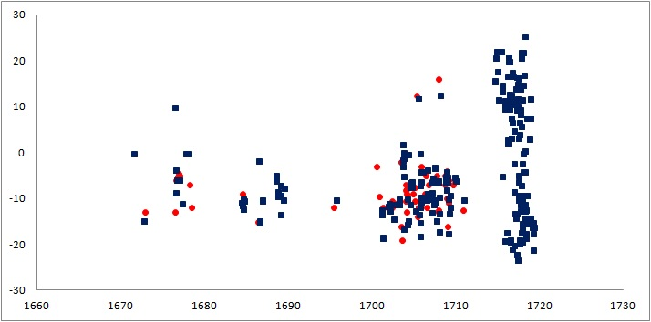
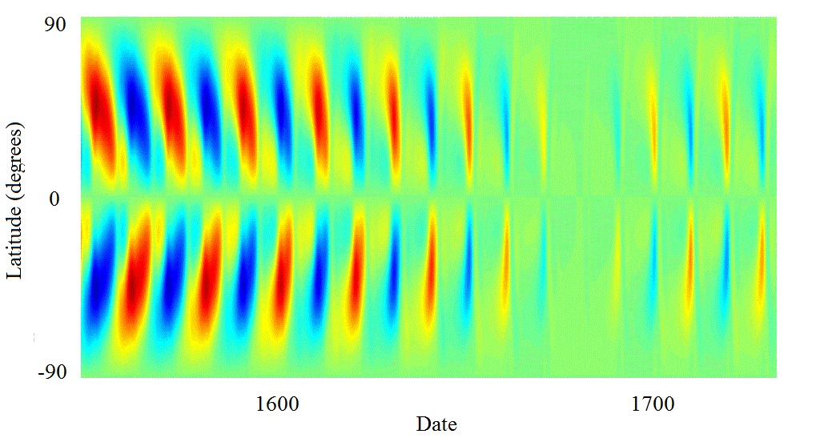
Upcoming Grand Solar Minimum
Maunder Grand Solar Minimum
Zharkova et al, 2015, Popova et al, 2018

Slide 26
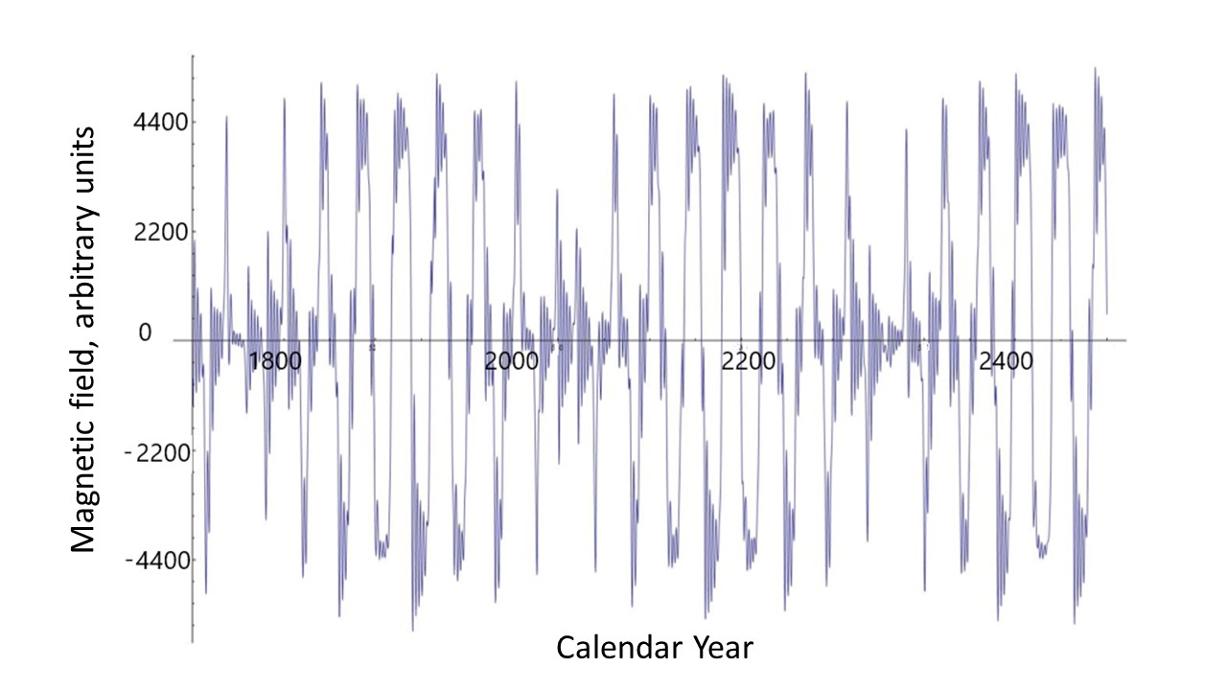
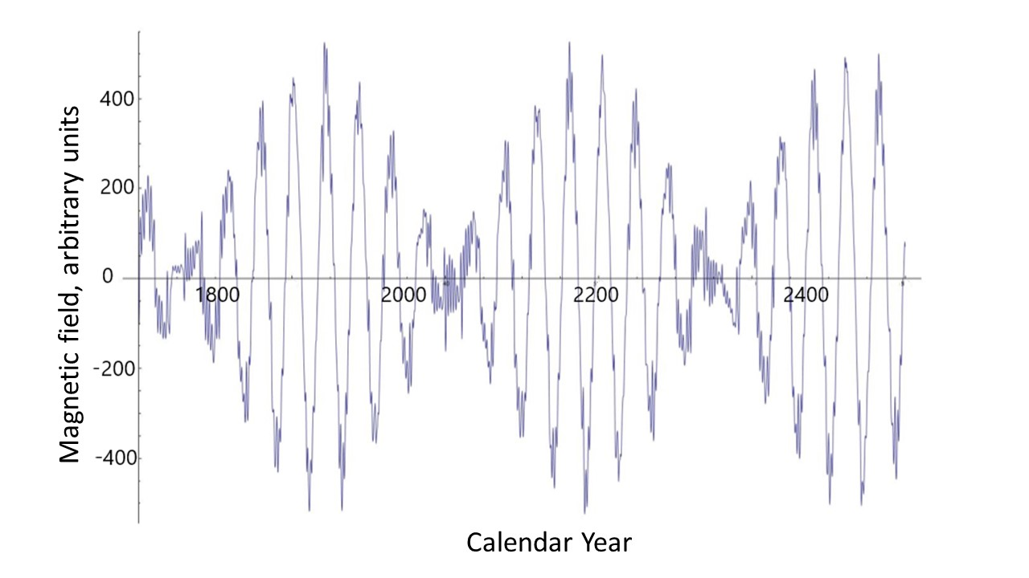
Poloidal (left) versus toroidal (right) magnetic fields

Slide 27
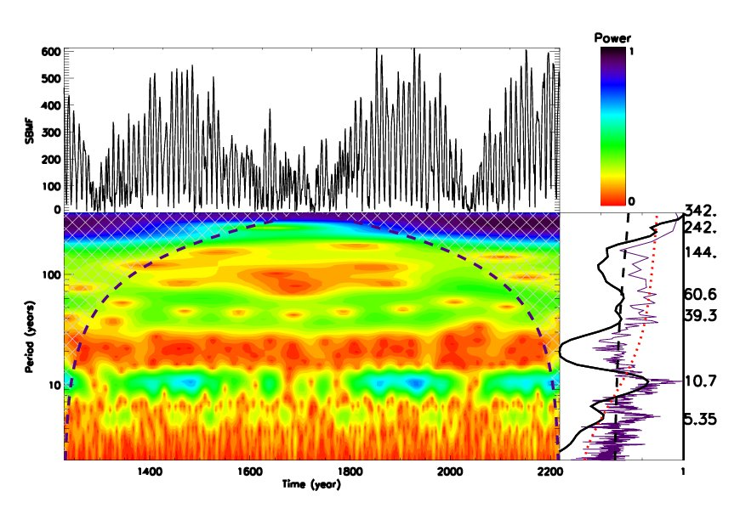
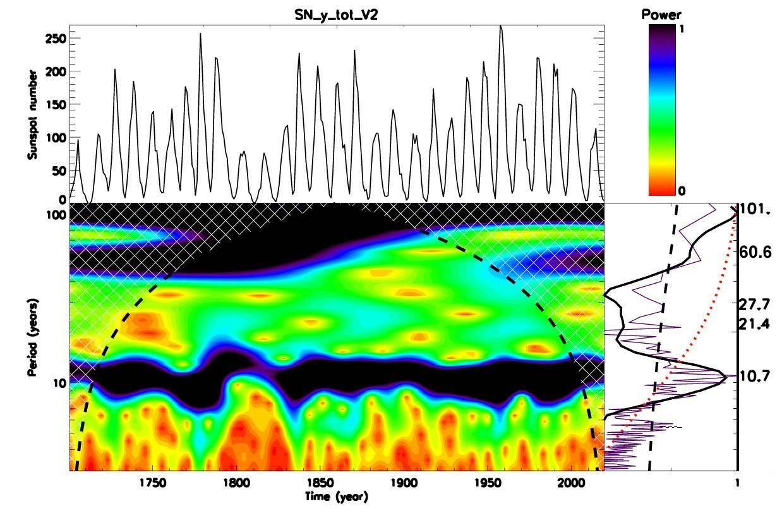
Wavelet spectral analysis
Averaged sunspot numbers Modulus summary curve of PCs Z15

Slide 28
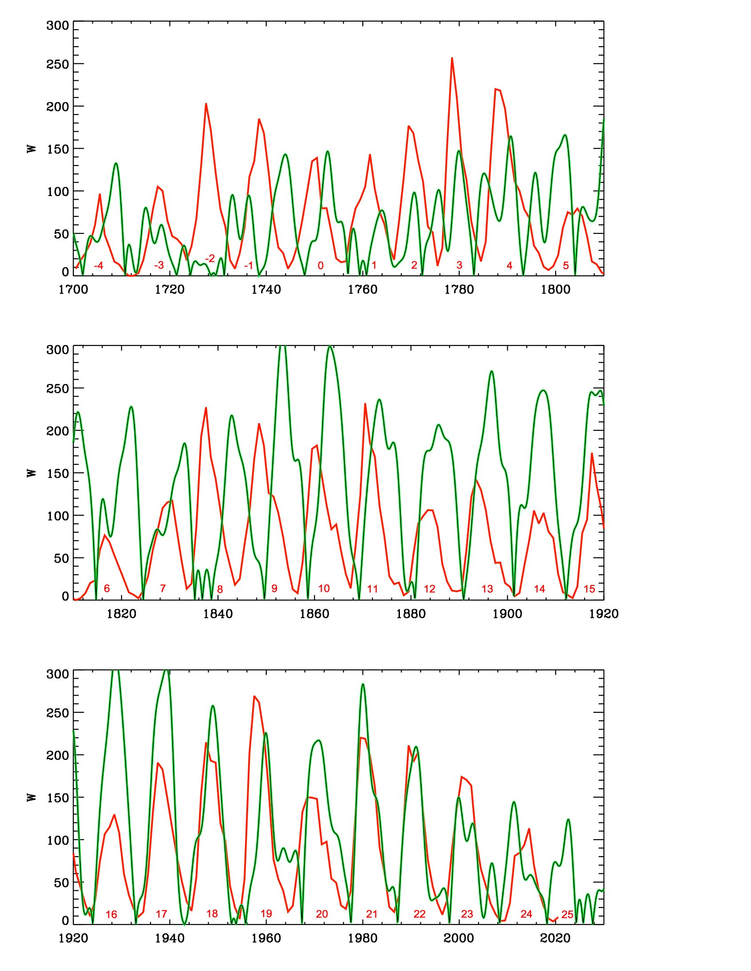
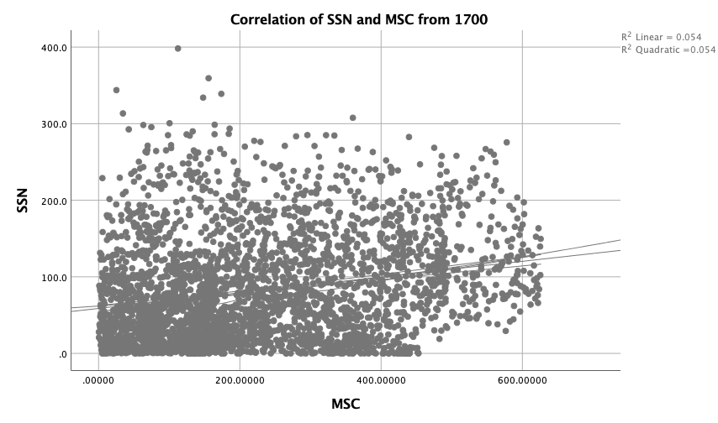
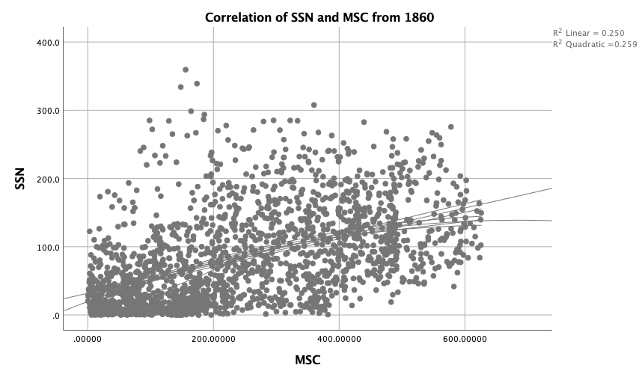
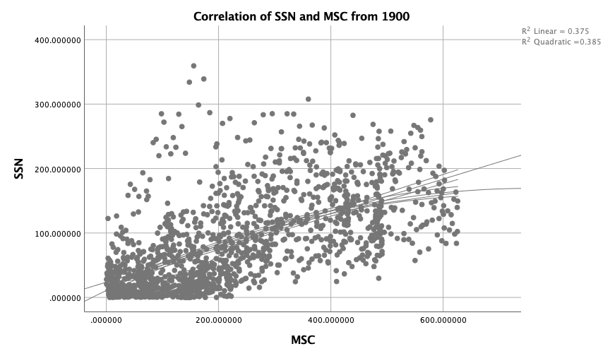
Correlation of SSN with MSC of eigen vectors
https://academic.oup.com/mnras/article/521/4/6247/7109272?searchresult=1&login=false
25%
56%
67%

Slide 29
Predicted solar activity (Zharkova et al, 2015, SR https://www.nature.com/articles/srep15689)
Zharkova et al, 2015, Nature SR
Observational result, dynamo model was not yet considered
Discovery of grand solar cycles :350-400 years
In addition to 11 year cycles
https://solargsm.com/solar-activity/ - my webpage

Slide 30
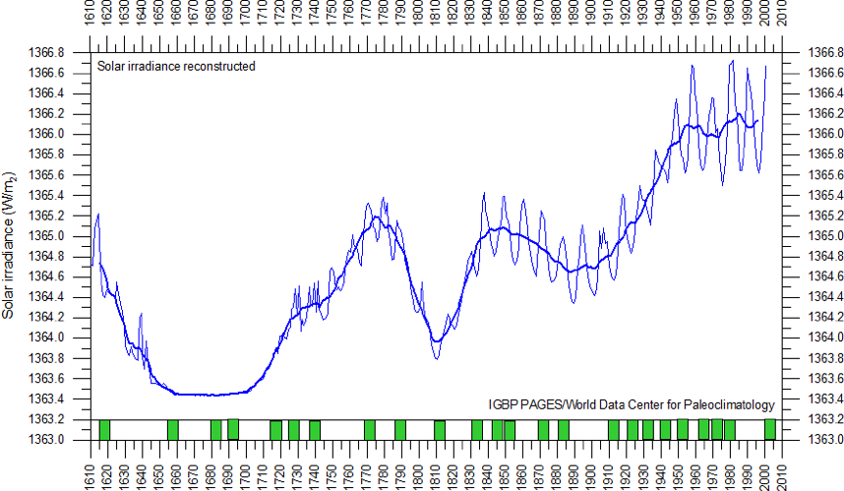
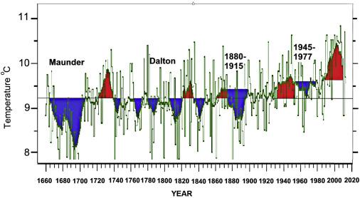
Solar irradiance and terrestrial temperature during MM
Lean et al, 1995, JGR
Lamb, 1972; Easterbrook, 2016
Authors | S, Maunder minimum, W/m² | S 1990-2000, W/m² | △S from MM, %
Lean et. Al., 1995 | 1363 | 1366 | 0.22
Steinhilber et al, 2012 | 1364 | 1366 | 0.22
Shirley et al., 1990 | --- | 1370 | 0.51
Wolff and Hickey, 1987 | --- | 1371 | 0.51
Lee et al., 1995 | --- | 1372 | 0.51
After the TSI data were re-normalized the old data are hardly usable

Slide 31
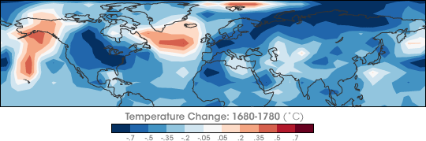
Temperature restoration during/after MM
(Shindell et al., 2001, Science)
The surface temperature of the Earth was reduced all over the Globe
Europe and North America went into a deep freeze
Alpine glaciers extended over valley farmland
Sea ice crept south from the Arctic
Danube and Thames rivers & canals in the Netherlands froze regularly

Slide 32
Temperature restoration during MM
(Shindell et al., 2001, Science)
the drop in the temperature was related to dropped abundances of ozone created by solar ultra-violate light in the stratosphere, the layer of the atmosphere located between 10 and 50 kilometers from the Earth’s surface

Slide 33
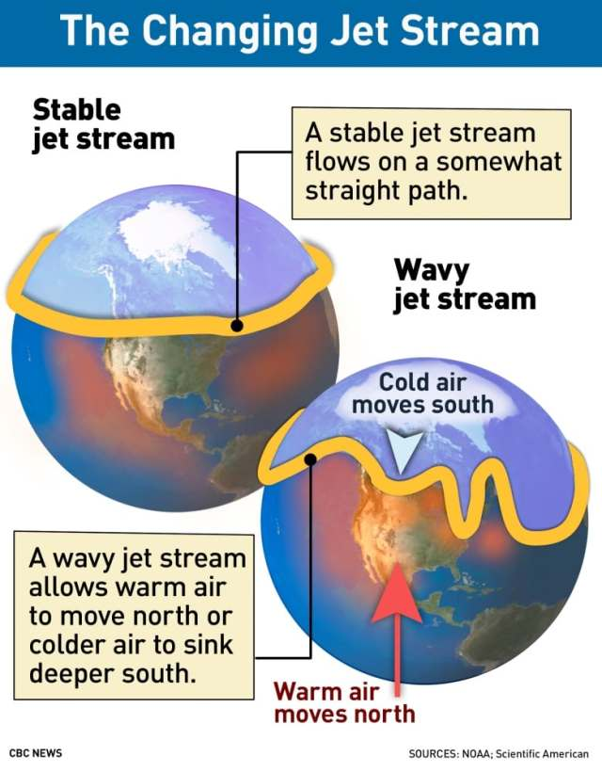
Less ozone affected planetary atmosphere waves
They, in turn, caused the giant wiggles in the jet stream as shown in picture on the left
It kicked the North Atlantic Oscillation (NAO)—the balance between a permanent low-pressure system near Greenland and a permanent high-pressure system to its south—into a negative phase
that led to Europe to remain unusually cold during the MM
Shindell et al., 2001

Slide 34
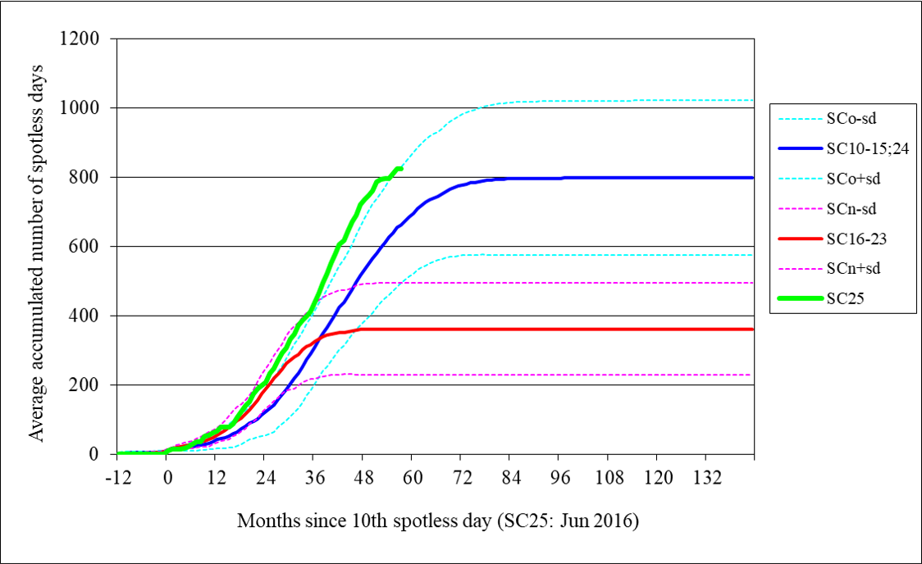
Cycle 25 (green line) shows a steeper growth of the number of spotless days than any other cycles including the ones during Dalton min (cycles 15 and 24) (blue line)

Slide 35
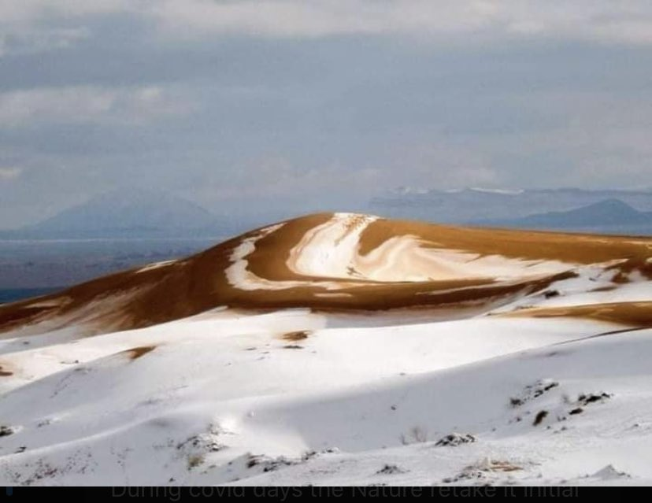
Snow in Africa’s desert 8 December 2020 https://twitter.com/GerryAMcG/status/1336420778582138886

Slide 36
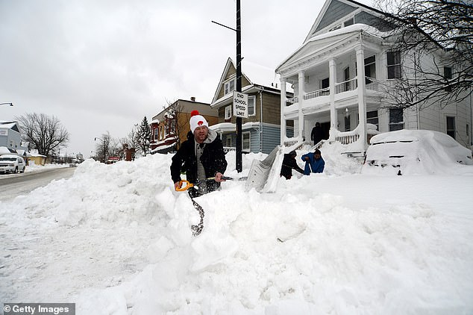
Snow blizzards in USA and Canada for 2 weeks in Dec ’22 –Jan’ 23

Slide 37
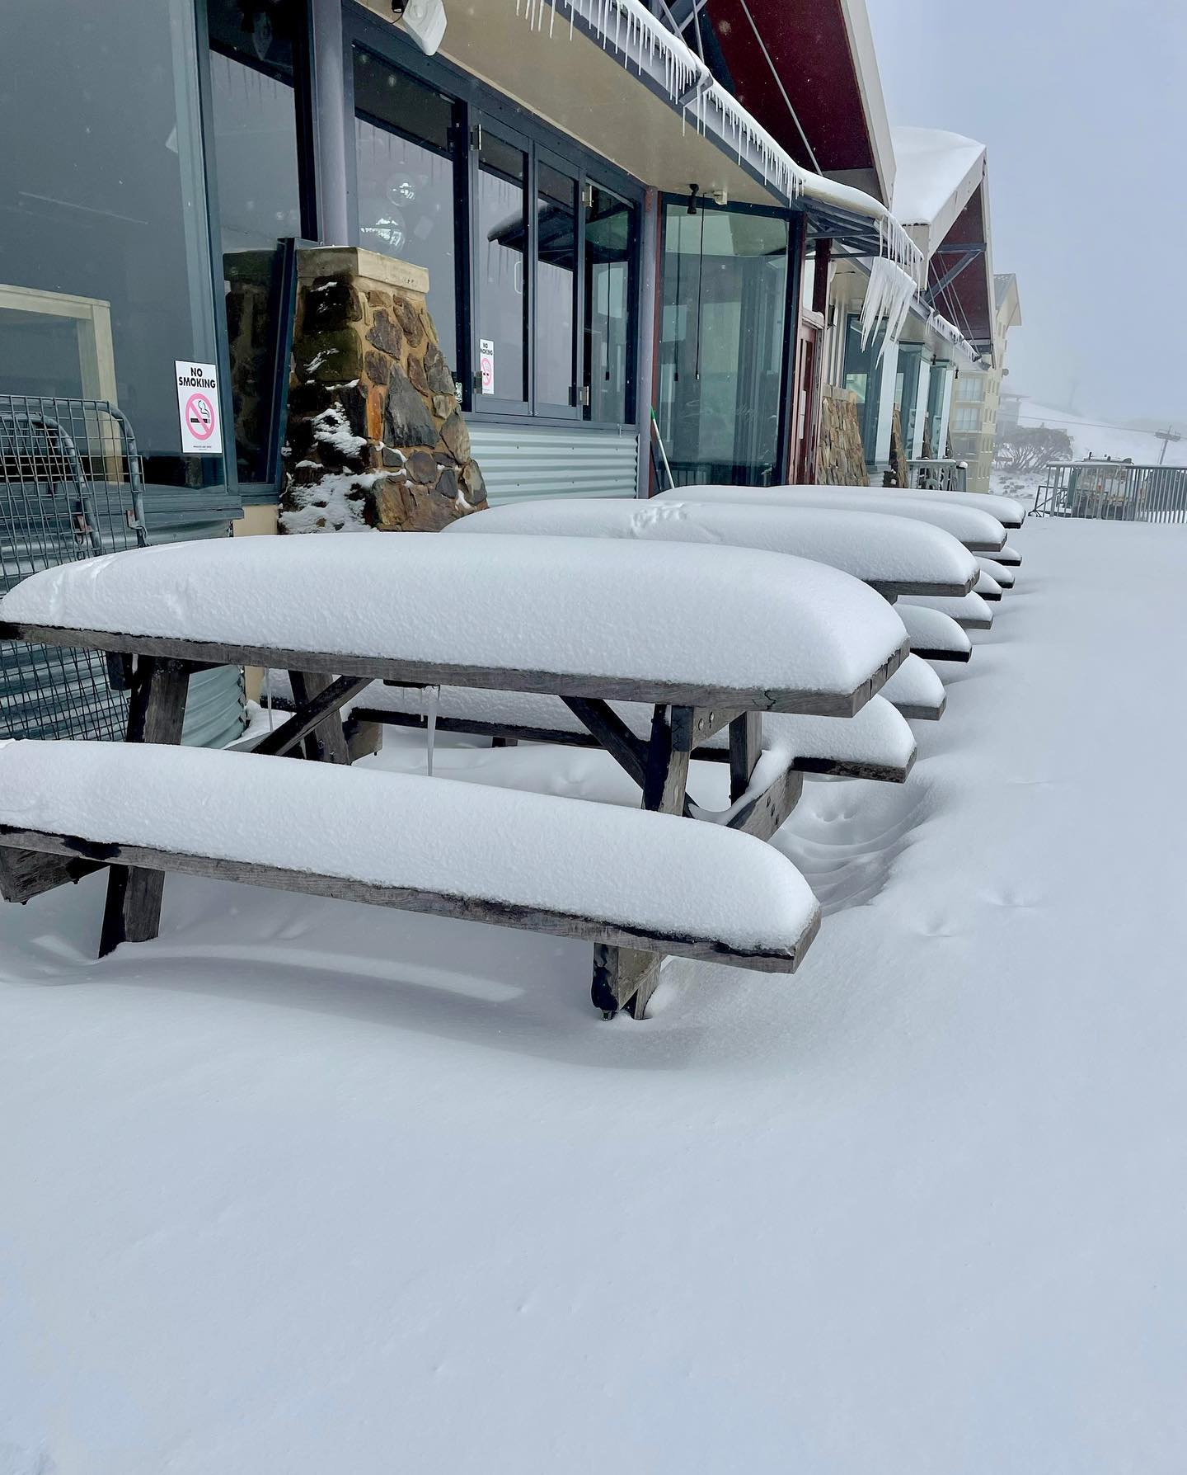
Late spring snow in Australia and NZ 22-30 November ’22
(analog of late May in Northern hemisphere)

Slide 38
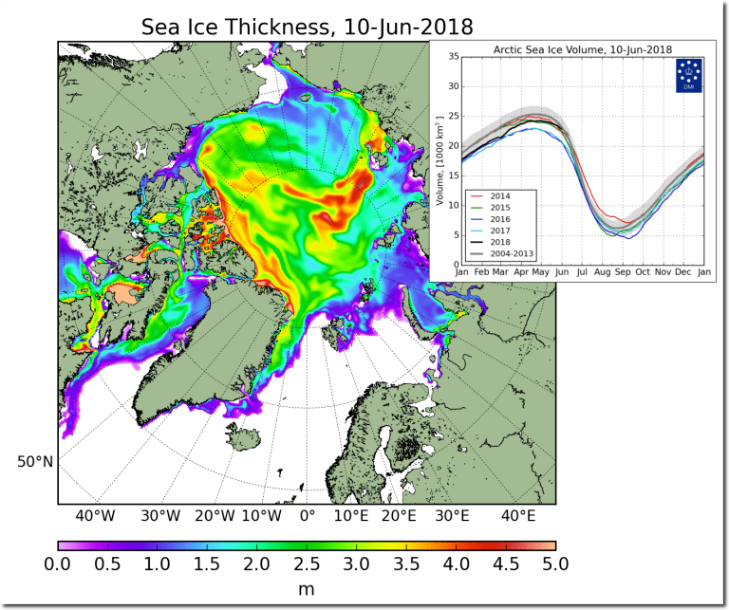
Modern GSM: Sea ice thickness increase in 2018-2020
Contrary to prediction of JAMES HANSEN, 1989: “NEW YORK CITY’S WEST SIDE HIGHWAY WILL BE UNDERWATER BY 2009”
Arctic sea ice thickness grown significantly in 2018 and continues to grow

Slide 39
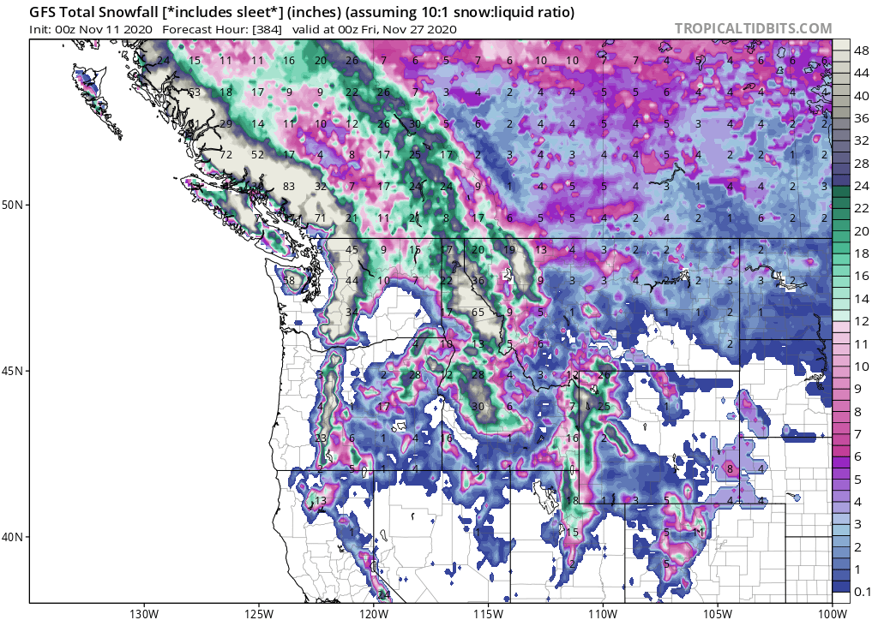
Modern GSM is progressing –November 2020- June 2022
UNPRECEDENTED WINTER STORM HITS BRITISH COLUMBIA
Both NOAA and NASA appear to agree, if you read between the lines, with NOAA saying we’re entering a ‘full-blown’ Grand Solar Minimum in the late-2020s
NASA seeing this upcoming solar cycle (25) as “the weakest of the past 200 years”, with the agency correlating previous solar shutdowns to prolonged periods of global cooling here.

Slide 40
Modern Grand Solar Minimum https://solargsm.com/solar-activity/
To occur in 2020 – 2053
This is a unique event in solar-terrestrial connection → will reveal the pros and cons of solar dynamo models
Decrease of solar magnetic field → big impact ozone reduction, high cloud formation, jet direction changes, cosmic rays inclease
Increase of volcanic and earthquake activities
Effects on the terrestrial temperature via TSI, jets and volcanic activity
Shortage of vegetation periods can lead to possible food shortages in 2028-2042
Need inter-government efforts to avoid disasters

Slide 41

Thanks for your attention!

