Slide 1


Terrestrial temperature, sea level and ENSO index variations linked with solar and volcanic activity
https://solargsm.com/solar-activity/
Valentina Zharkova 1,2 and Irina Vasilieva 2,3
1- University of Northumbria, Newcastle upon Tyne, UK
2- ZVS Research Enterprise Ltd. London SEIV 2NC, UK
3 – Main Astronomical Observatory, Kyiv, 03022, Ukraine
https://solargsm.com/publications/
With thanks to Drs. S. Shepherd (UK) and S. Zharkov (UK)

Slide 2
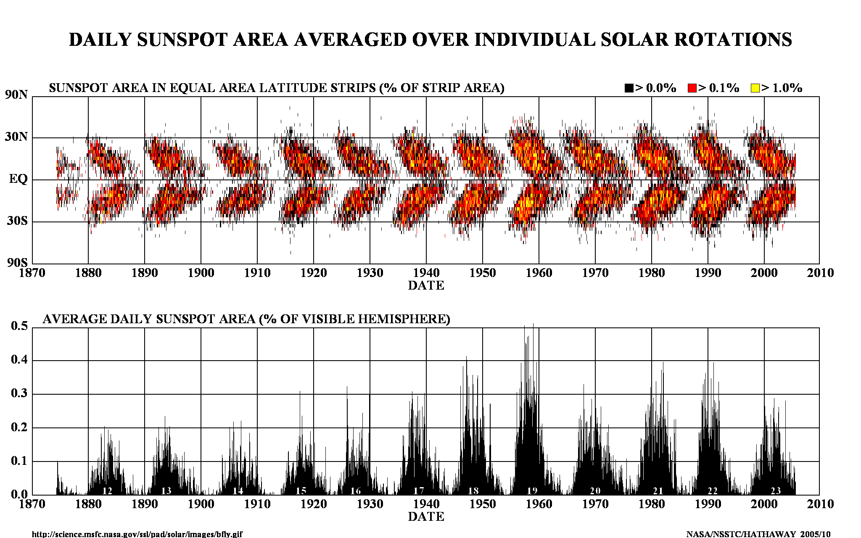
Current solar activity index

Slide 3
Fitting the PCs to measured in cycle 24 and prediction to 25-26
Eigen vectors come in pairs, here are PCs
(Shepherd et al, 2014, Zharkova et al, 2015)

Slide 4
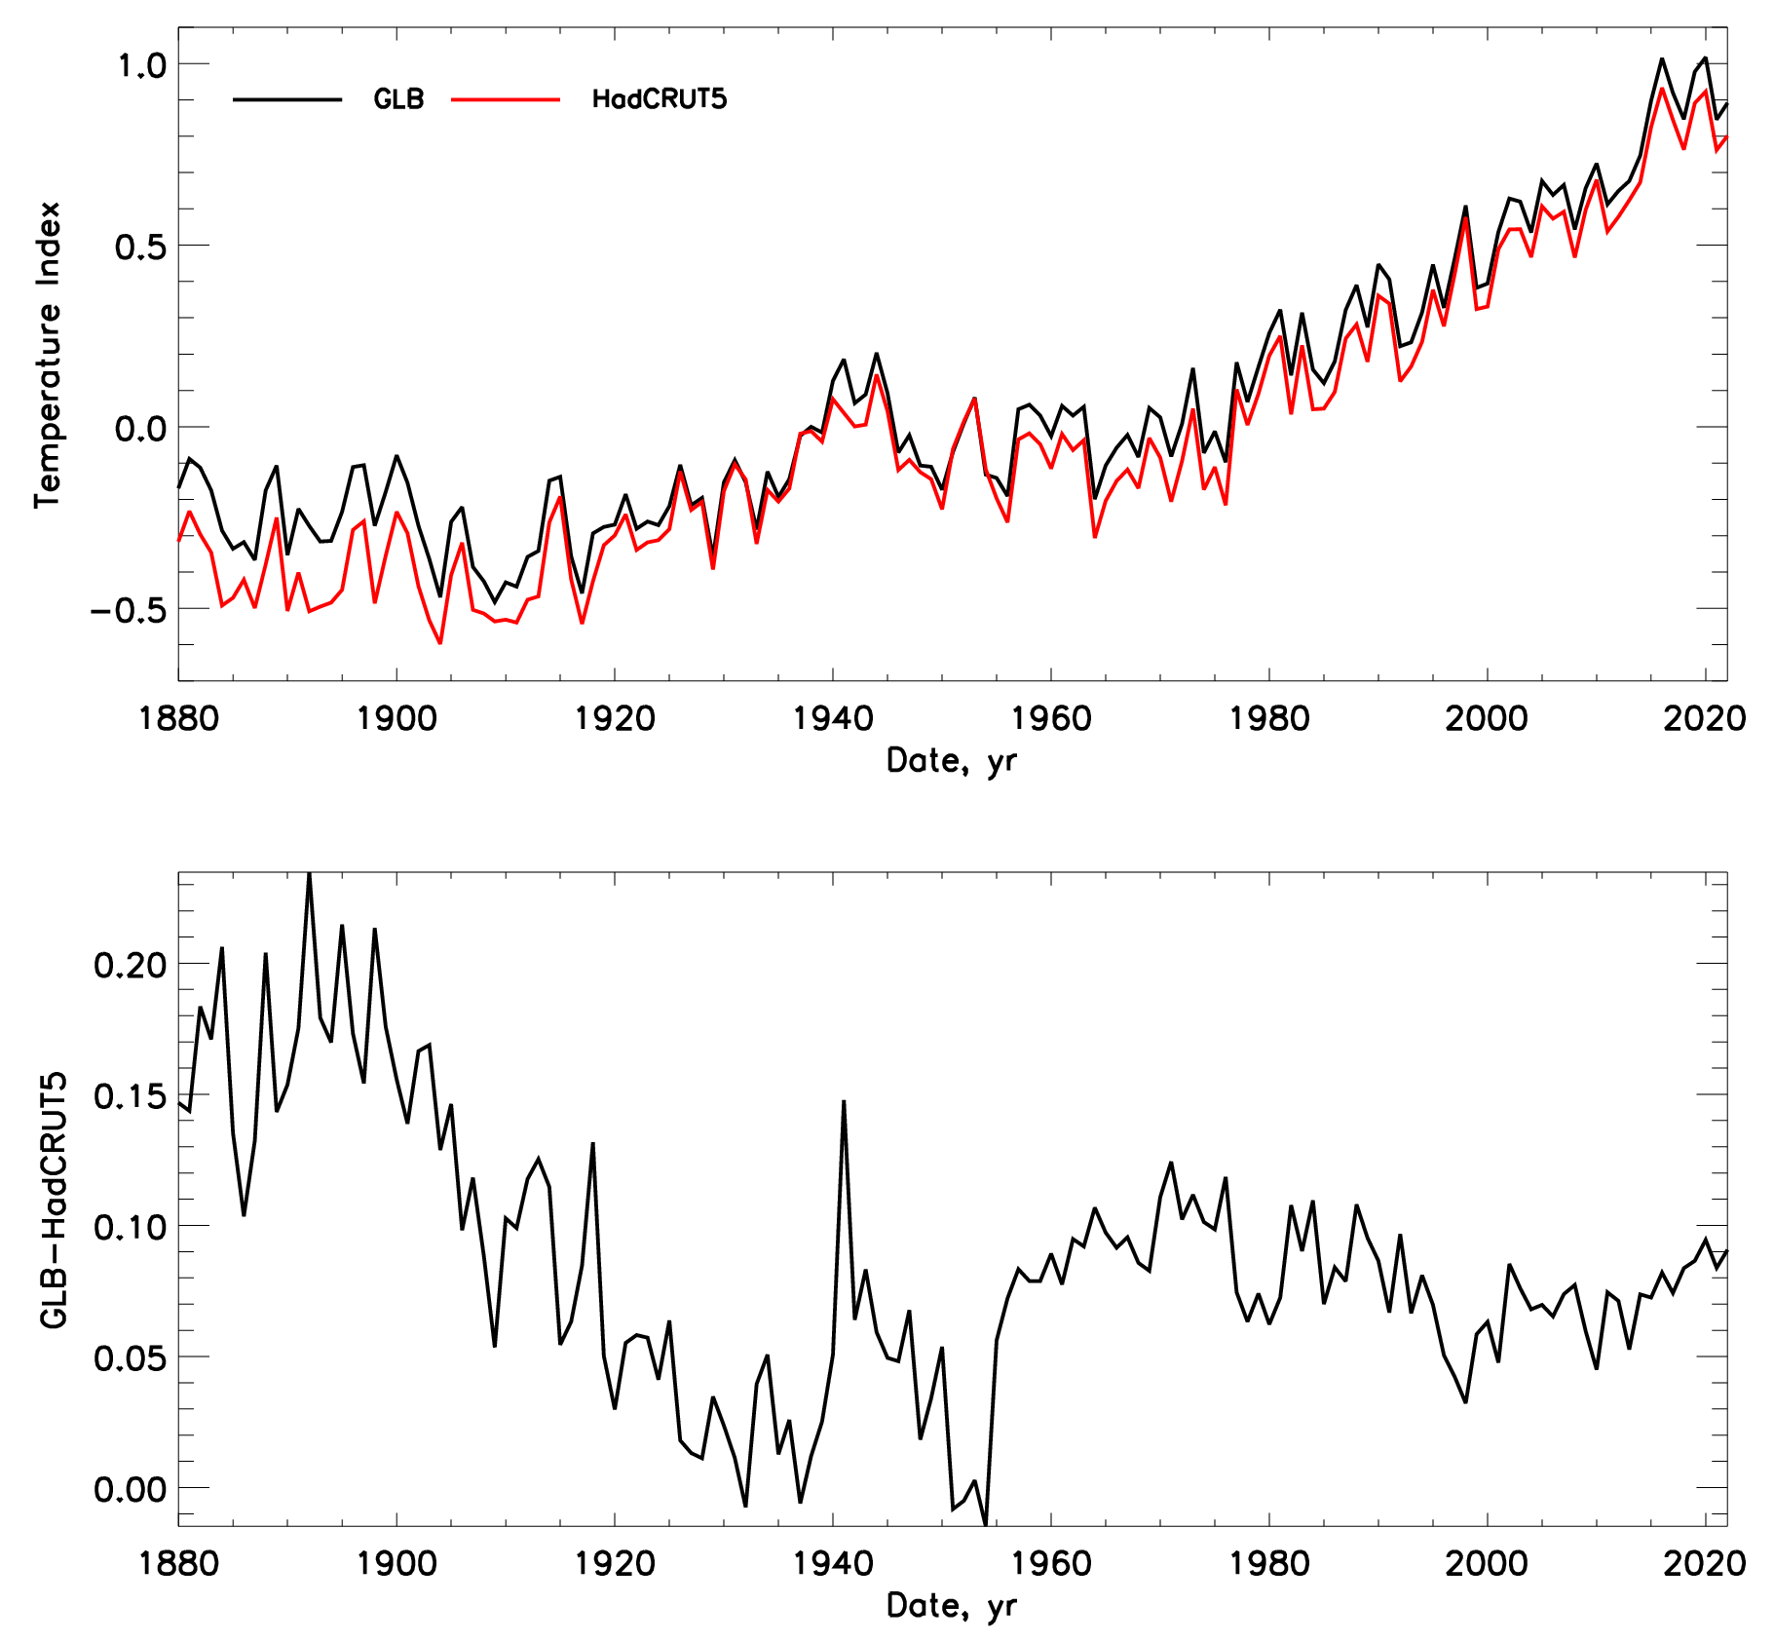
Temperature corre
Requirements for temperature datasets:
should have a stable temperature scale;
should have a global coverage of the terrestrial regions and this cover- age should not be affected by the local phenomena, like North Atlantic Oscillation (NAO), or El Nino/La NIna events in the Pacific ocean area.
HadCRUT - the British Meteorological Cen- ter in Hadley and the department of Climate Research of the East Anglia University [https : //www.metoffice.gov.uk/hadobs/hadcrut5/
GLB - the NASA Goddard Institute of Space Sci- ence (GISS) https : //data.giss.nasa.gov/gistemp/tabledatav4/GLB.Ts+ dSST.txt
      Difference between the datasets

Slide 5
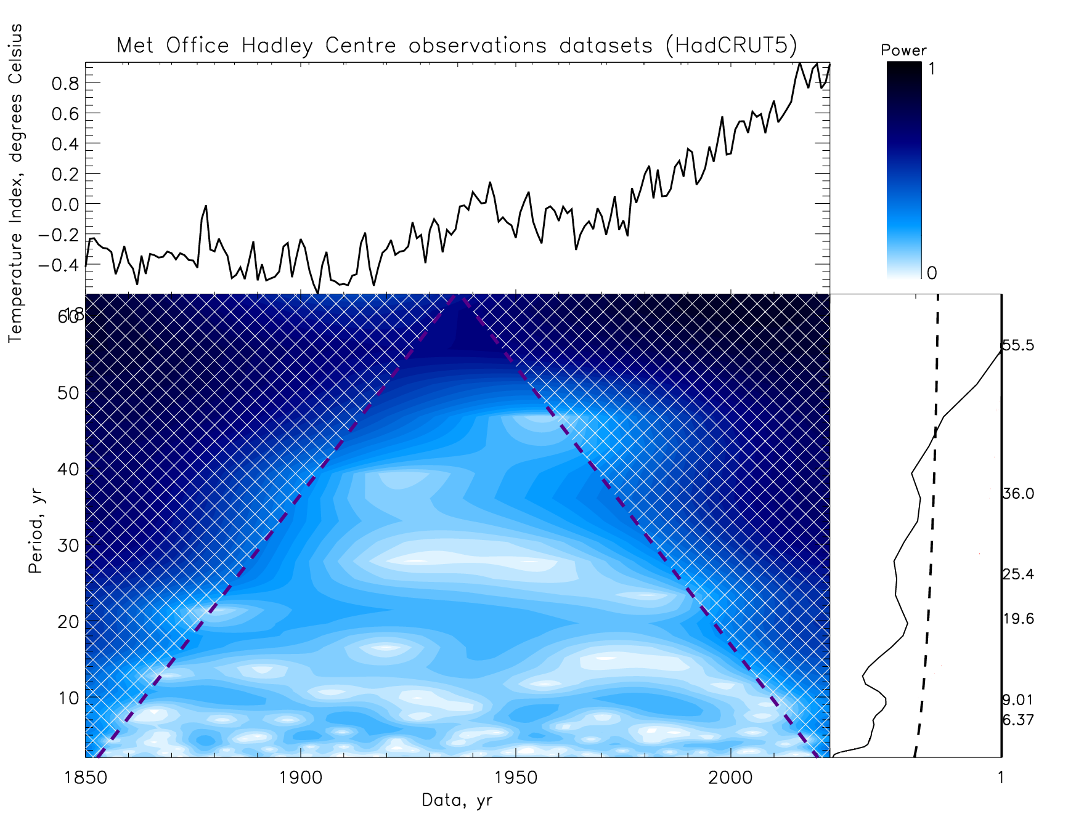
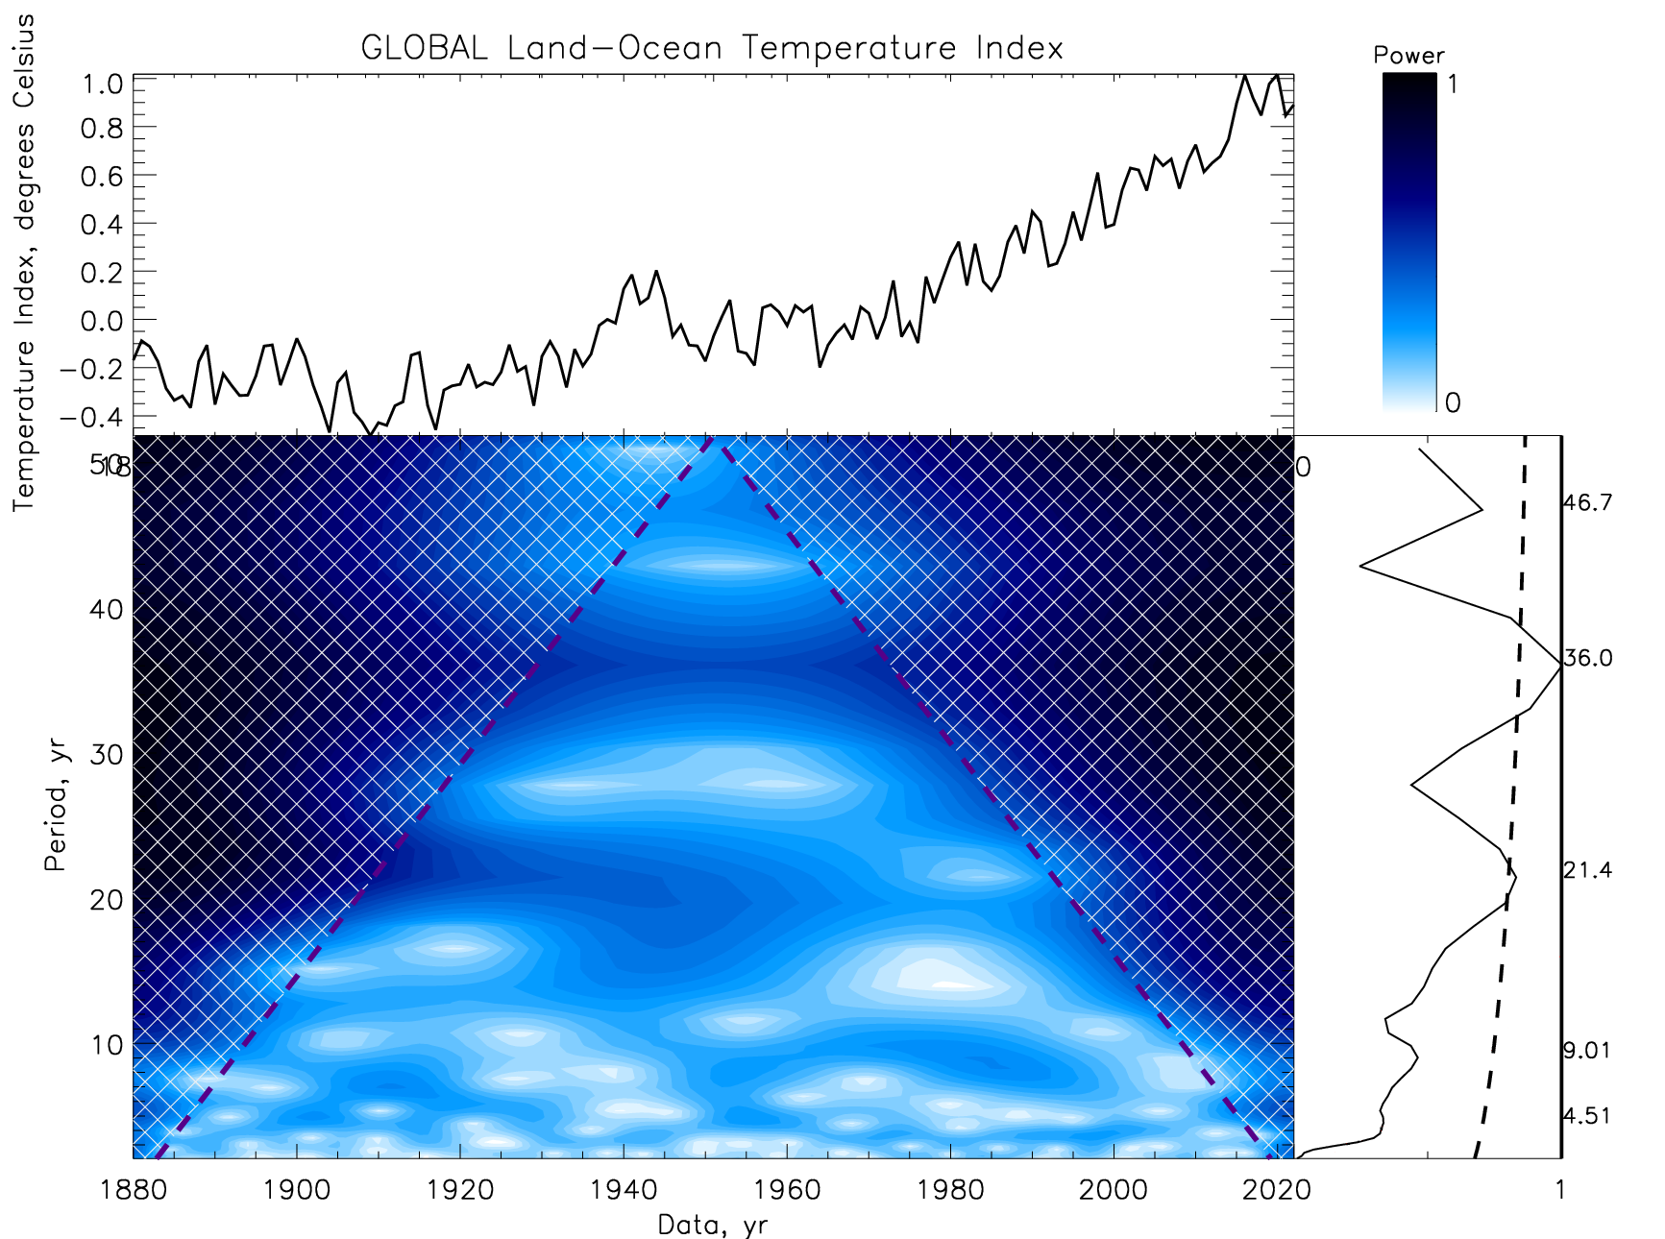
Wavelets of HadCRUT (left) and GLB (right) sets
Periods 21.4 and 36 ys

Slide 6
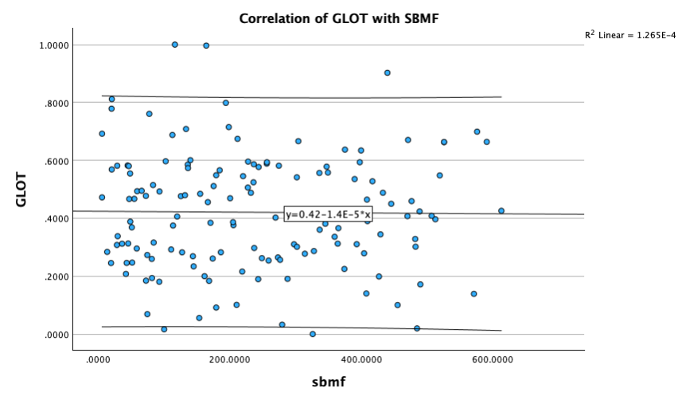
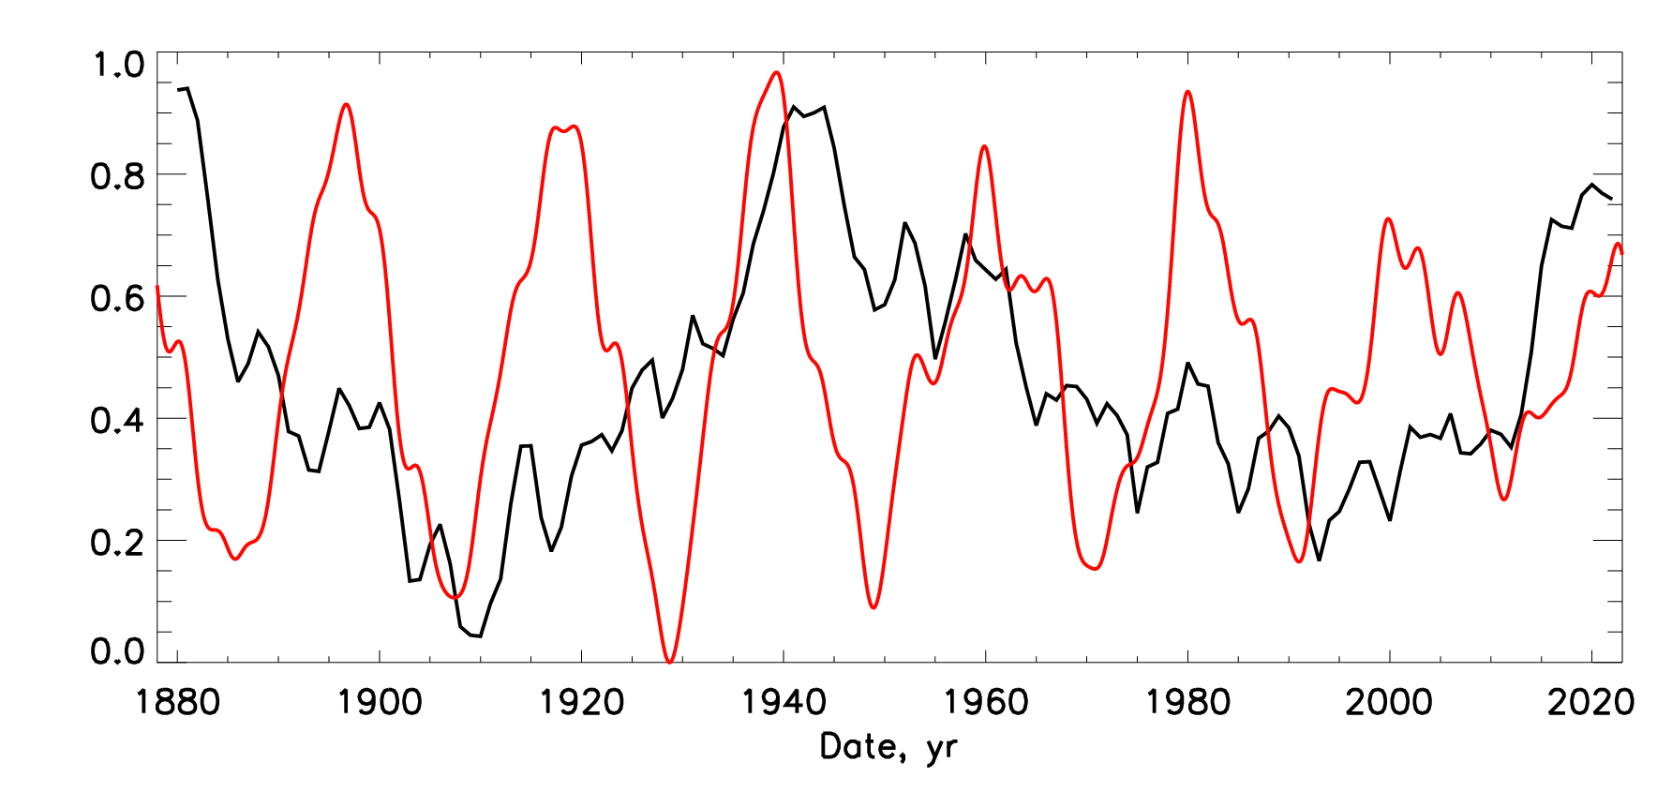
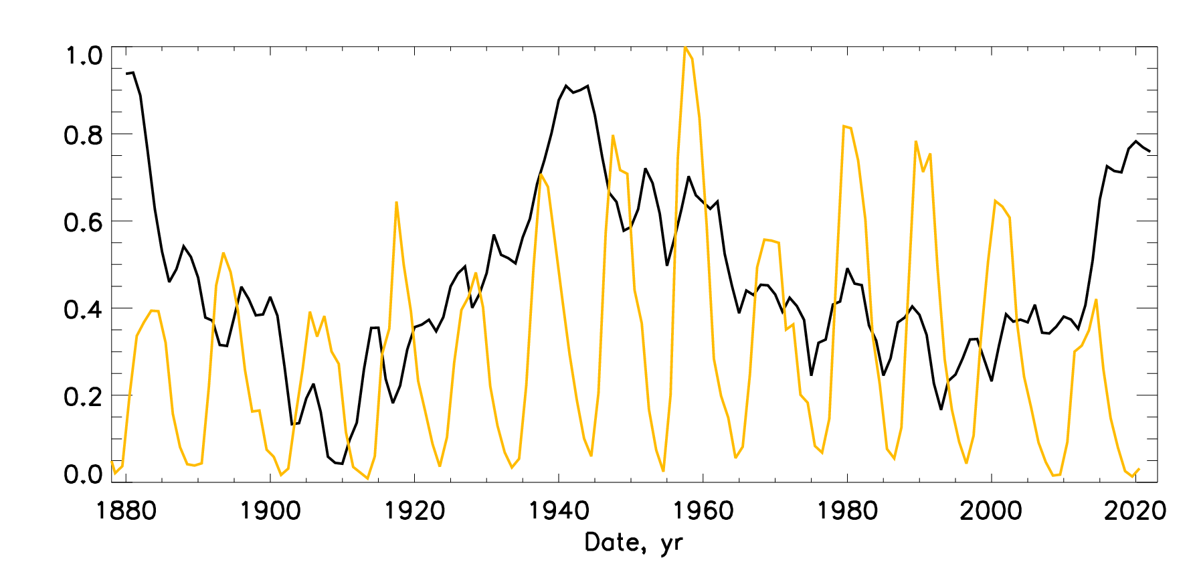
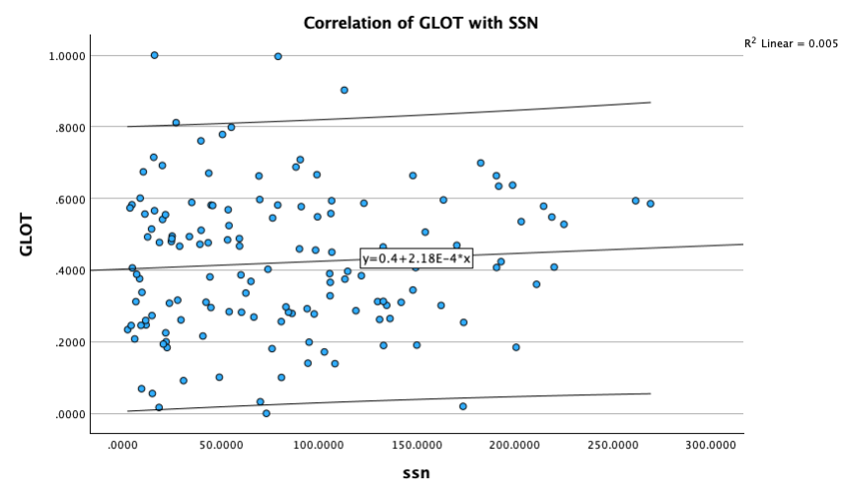
HadCRUT temperature variations vs summary curve (top) and SSN (bottom)
Top plot - The variations of a level of the terrestrial temperature (black curve) versus the summary curve of SBMF (red curve).
Bottom plot - The variations of the temperature (black curve) versus versus the averaged sunspot numbers (yellow curve).
R= 1%
R= 7%

Slide 7
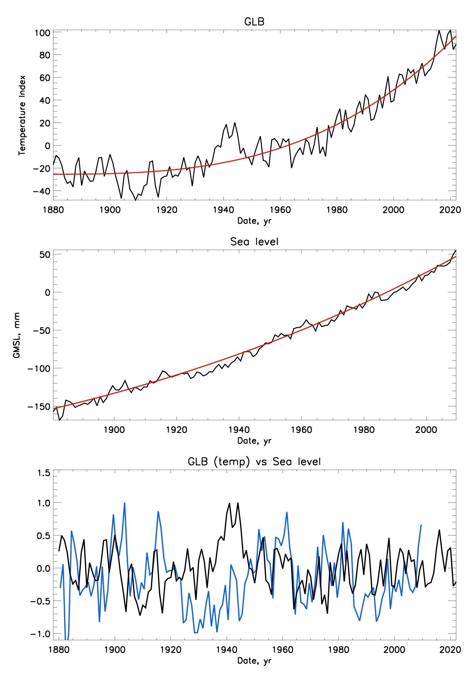
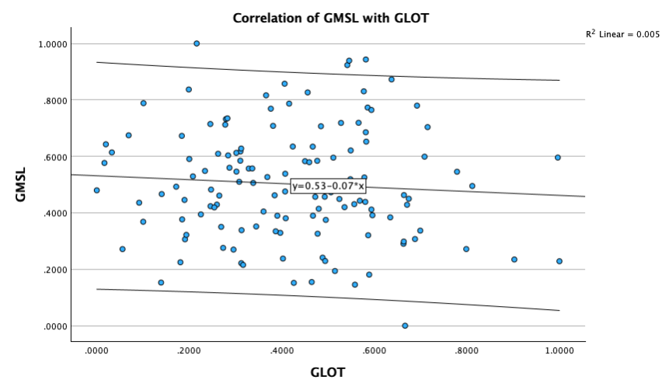
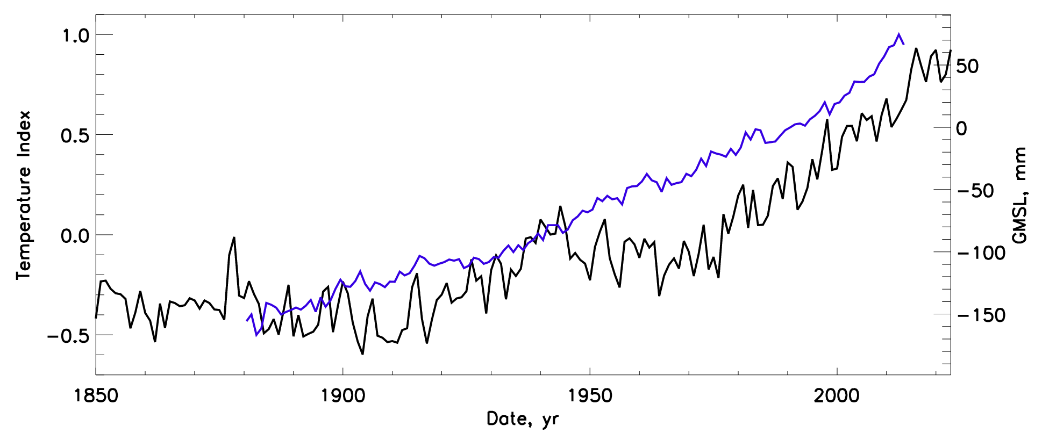
Temperature vs sea level
Top plot: The GLB temperature variations (black line) and averaged variations presented by a polynomial of the 4th degree (red curve).
Middle plot: the sea level variations (black curve) and averaged curve presented by a polynomial of the 4th degree (red curve).
Bottom plot: GLB temperature variations (black curve) with the de-trended sea level variations (blue curve) calculated by subtracting the averaged sea level from the real sea level curve
Scatter plot- anticorrelation r=-7.6% of sea level vs temp
sea level variations (blue curve), T – HadCRUT (black curve)

Slide 8
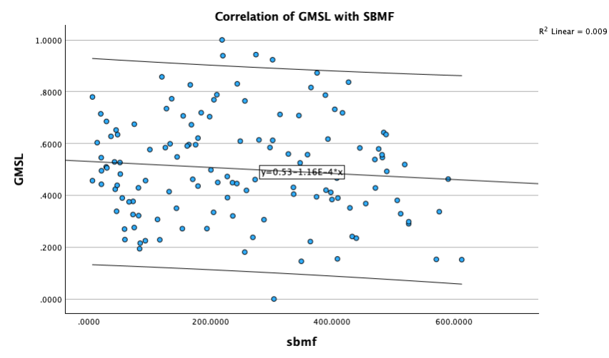
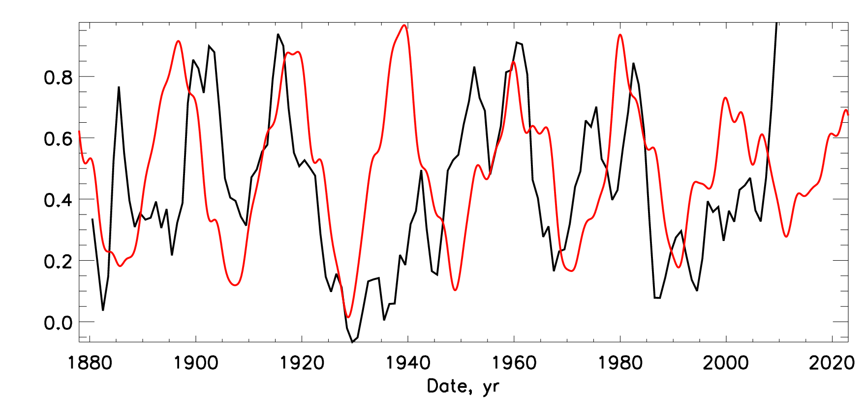
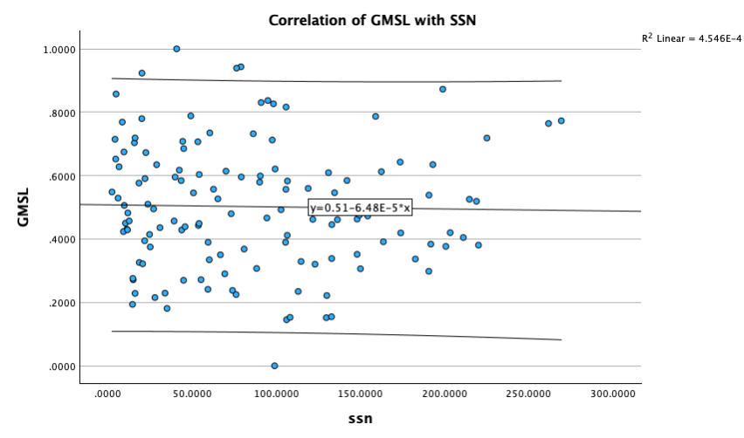
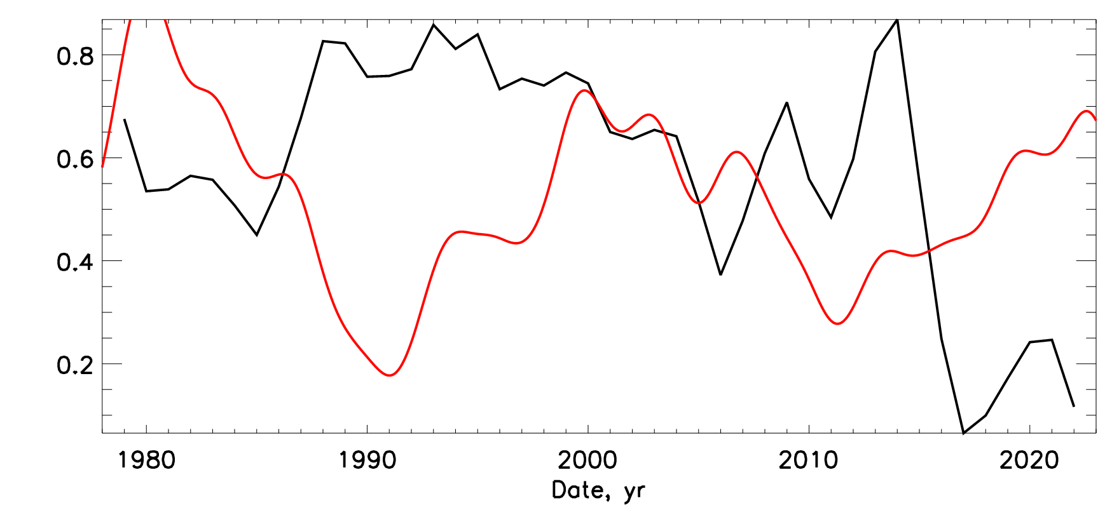
Sea levels vs summary curve of SBMF and SSN
R= 10%
Top plot - The variations of the level of the world ocean level (black line) versus the summary curve of SBMF (red curve)
Scatter → r=10% and for SSN – 2%
Bottom plot - The variations of the de-trended total ice areas in both hemispheres (black curve) versus the summary of the SBMF (red curve)
R= 2%

Slide 9
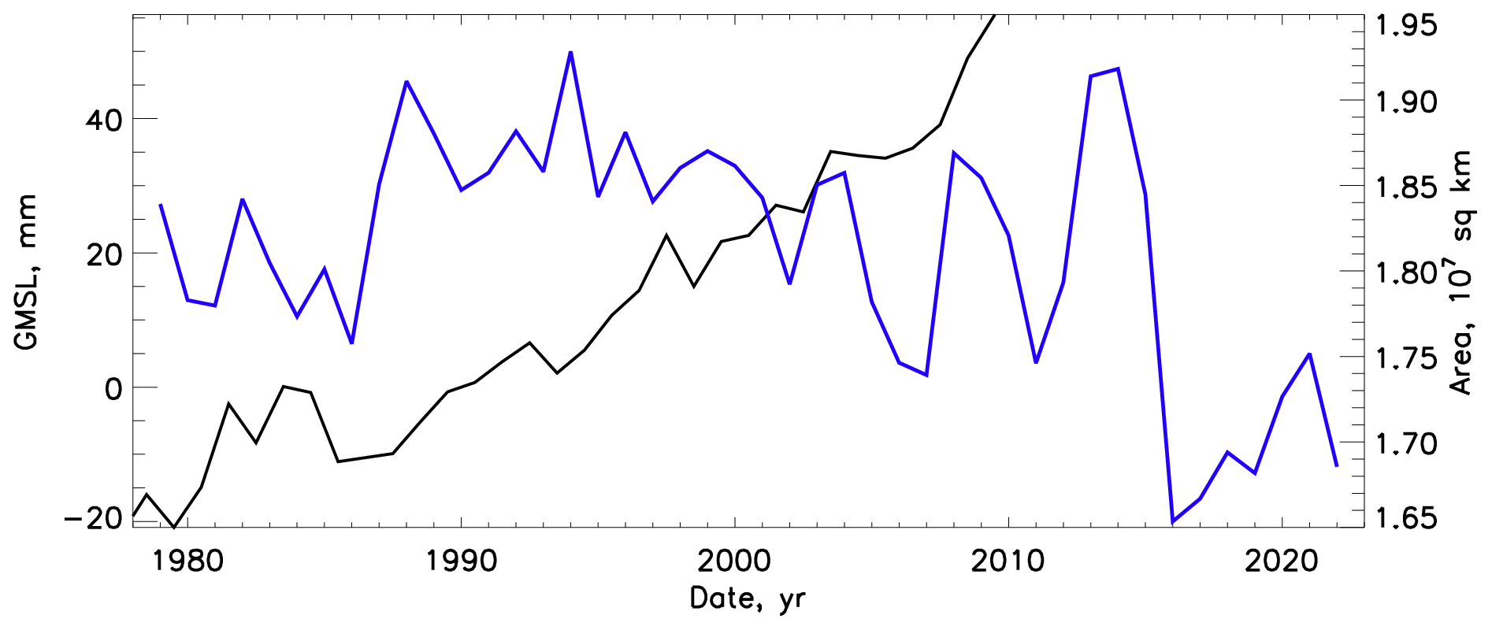
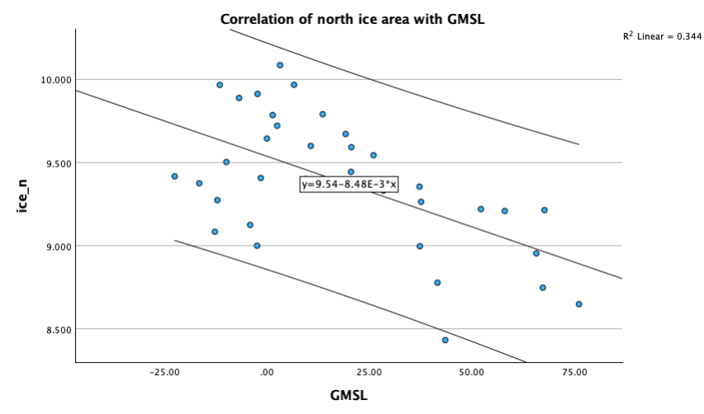
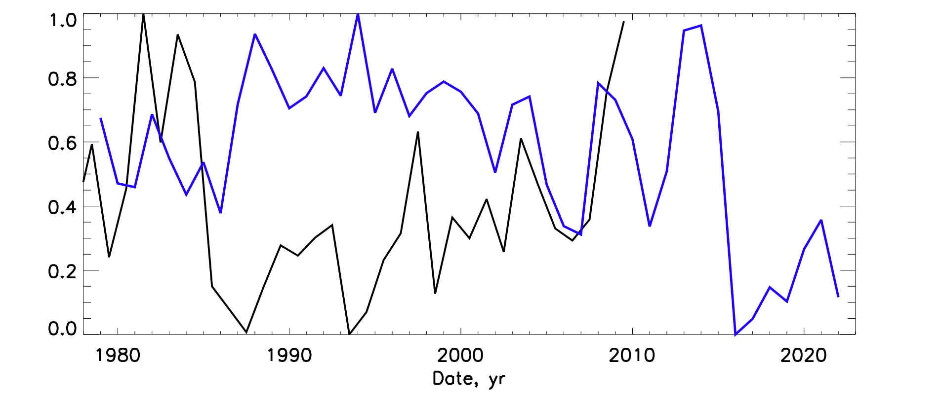
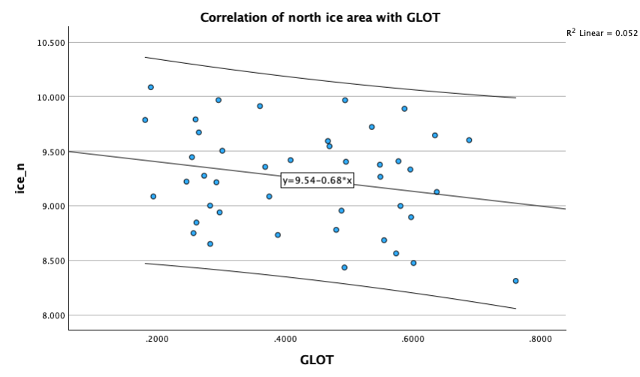
Sea levels vs ice areas
Top plot: The variations of the sea level of the world ocean (black curve) versus the aggregate ice areas of the Northern and Southern hemispheres (blue curve).
Bottom plot - same as above but with the de-trended sea level curve revealing the finest level variations calculated by subtracting from the real sea level curve the averaged sea level variations.
Scatter plot shows correlation of
-59% of ice areas with GMSL and -23% of ice area with GLB → ice comes from the sea water!
R= 59%
R= 23%

Slide 10
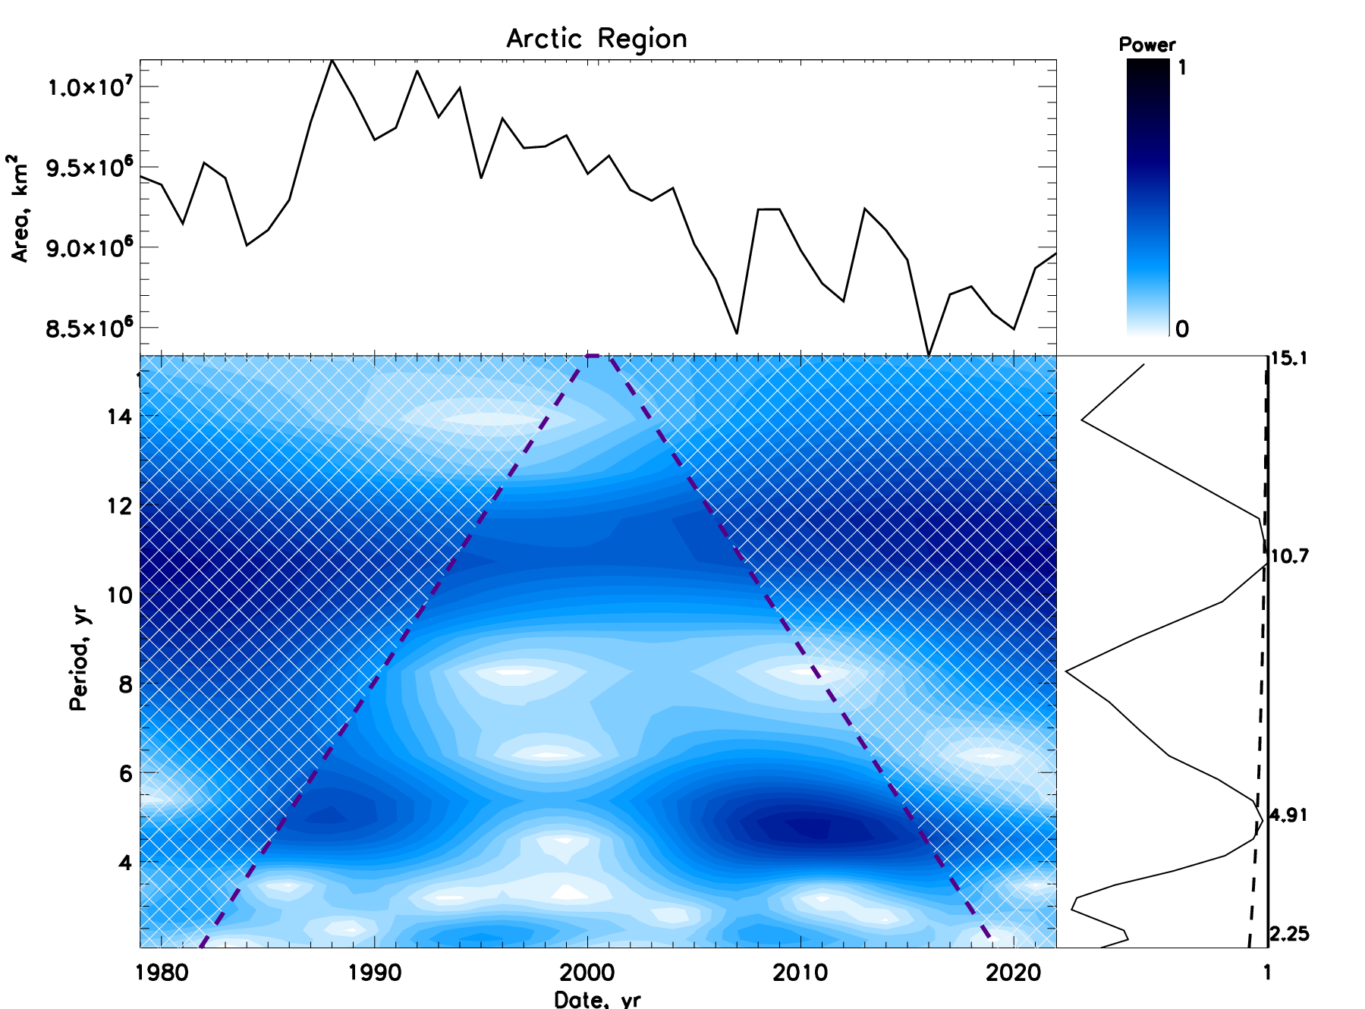
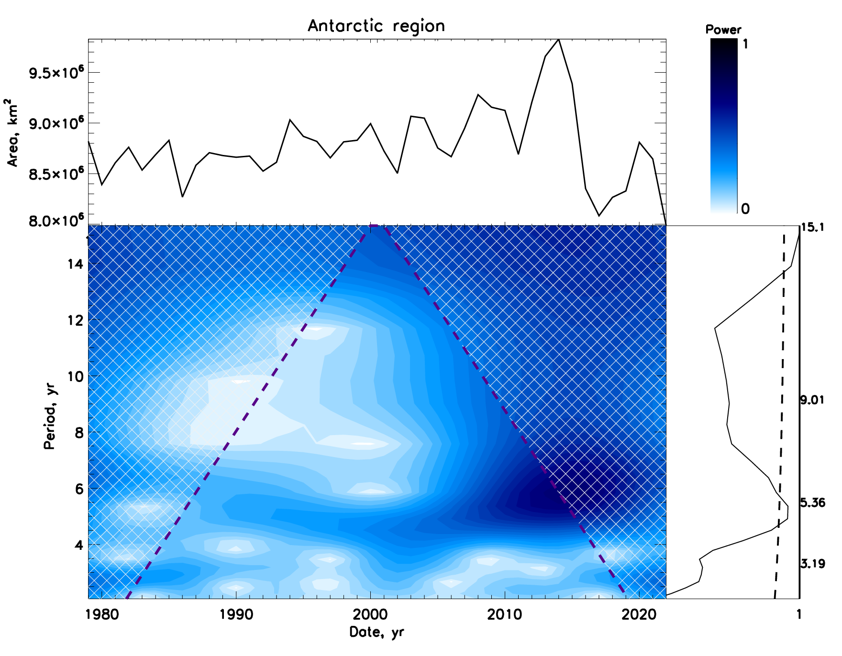
Wavelets of Arctic (left) and Antarctic (right) ice areas
Periods 4.9 and 10.7 ys
Periods 5.3 and 15 ys

Slide 11
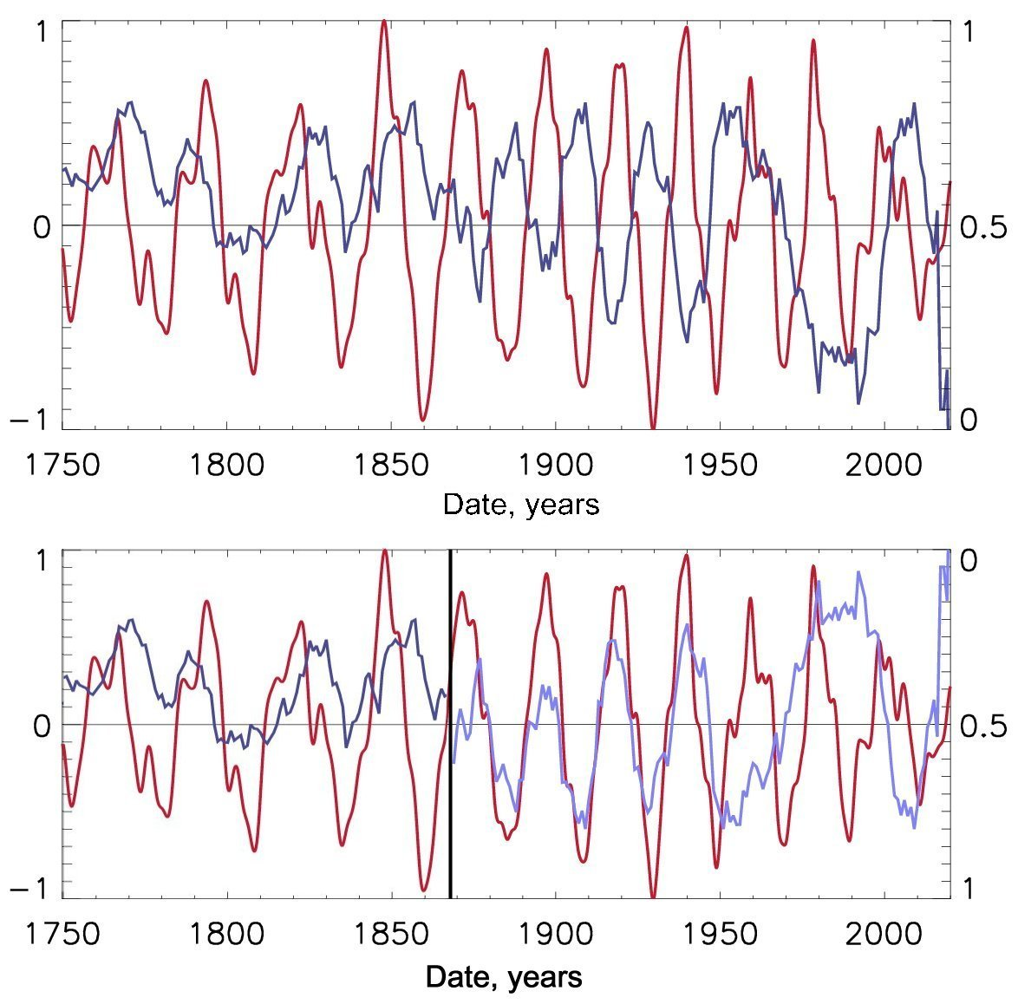
Top plot
Blue – frequencies of volcanic eruptions
Red - the summary curve of solar background magnetic field. Positive magnitudes – northern polarity, negative - southern polarity.
Bottom plot
Volcanic eruption frequencies highly (0.84) correlate with the summary curve with southern polarity with a period of 22 years (1860-1950).
Next maximum of volcanic eruptions will occur in cycle 26 (2031-2042).
Volcanic activity correlates with SA cycles of southern polarity
(Vasilieva and Zharkova, 2022)
https://solargsm.com/publications

Slide 12
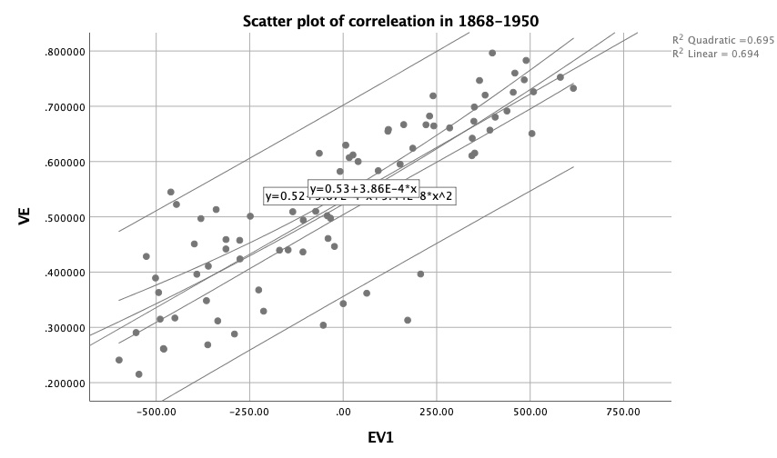
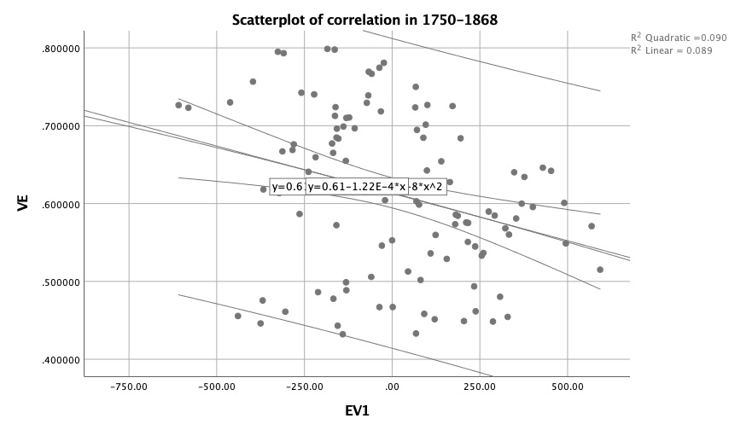
Scatter plots of correlation
of averaged sunspot number SSN and modulus summary curve MSC of eigen vectors of solar magnetic field
1868-1950 &1990-2020 Correlation 84%
1750-1868
Correlation -33%

Slide 13
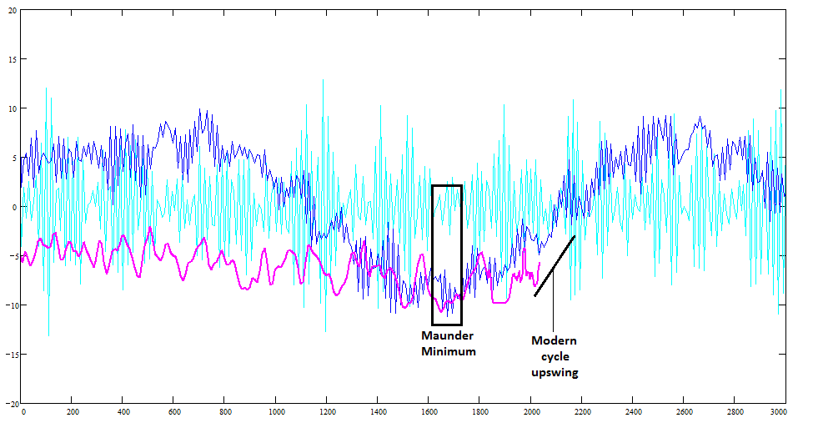
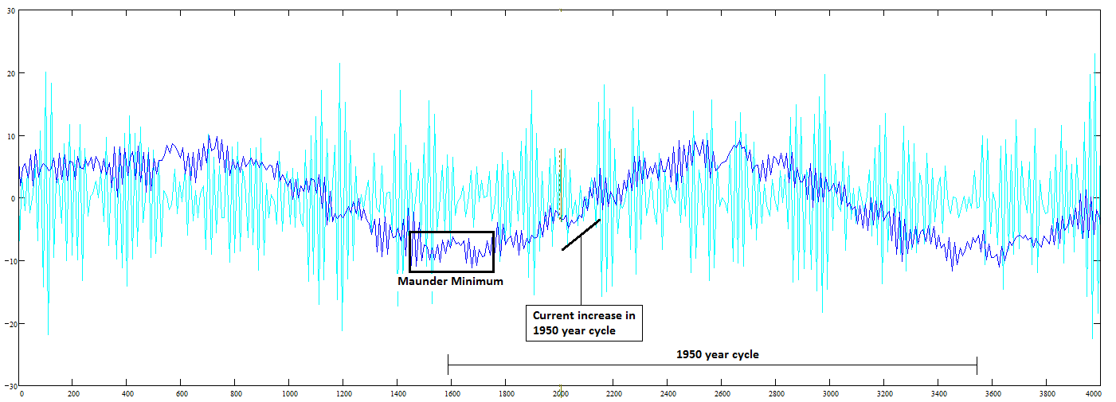
2000-2100 year oscillations (Zharkova et al, 2019, 2020) of the MF baseline coincides with that of the solar irradiance (Vierra et al, 2011)
The amount of TSI deposited on Earth in 2020 between the northern hemisphere the spring and autumn equinox constitutes 50.103% of the overall TSI while between the autumn and spring equinox it constitutes 49.897% of the TSI meaning that there is more than 0.203% TSI is deposited to the Northern hemisphere then to the Southern one Zharkova and Vasilieva, 2023.
Zharkova et al, 2019, 2020

Slide 14
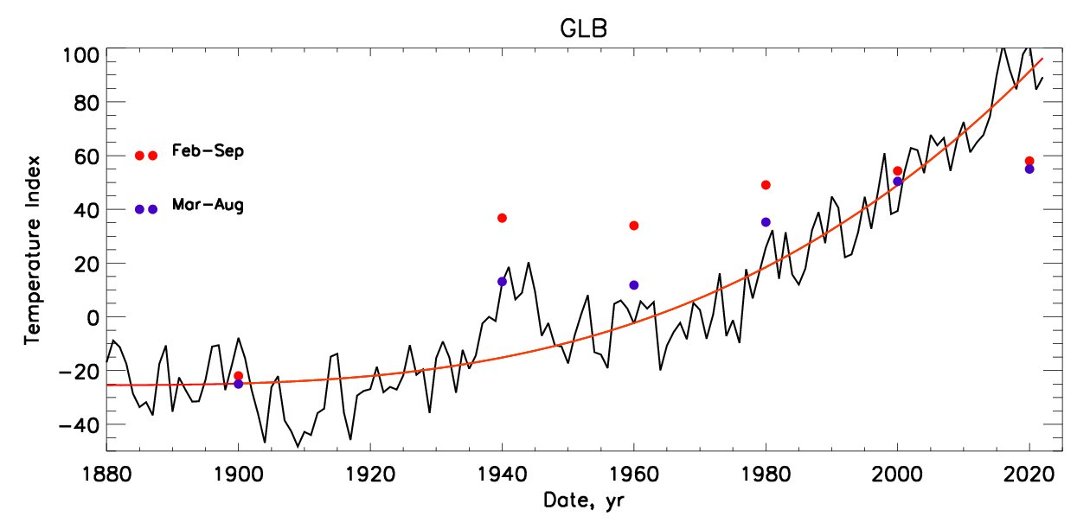
Temperature vs TSI because of SIM
Zharkova&Vasilieva 2023 https://www.scirp.org/journal/paperinformation?paperid=129477
The terrestrial temperature variations (black line) and averaged temperature (red line) versus the total solar irradiance (TSI) of the Sun affected by SIM in the spring- summer months as per the legend on the plot.
.
The solar irradiance is calculated by adding the daily irradiance for given spring-summer months in the Northern hemisphere when the Sun is closest to the Earth’s orbit Zharkova, 2021
1600-2020 - Increase of TSI by 20 W/m^2 → T increased by 2.5C
2020-2600 – increase of TSI by ~25 w/m^2 → T will increase by 2.5-3.0C

Slide 15
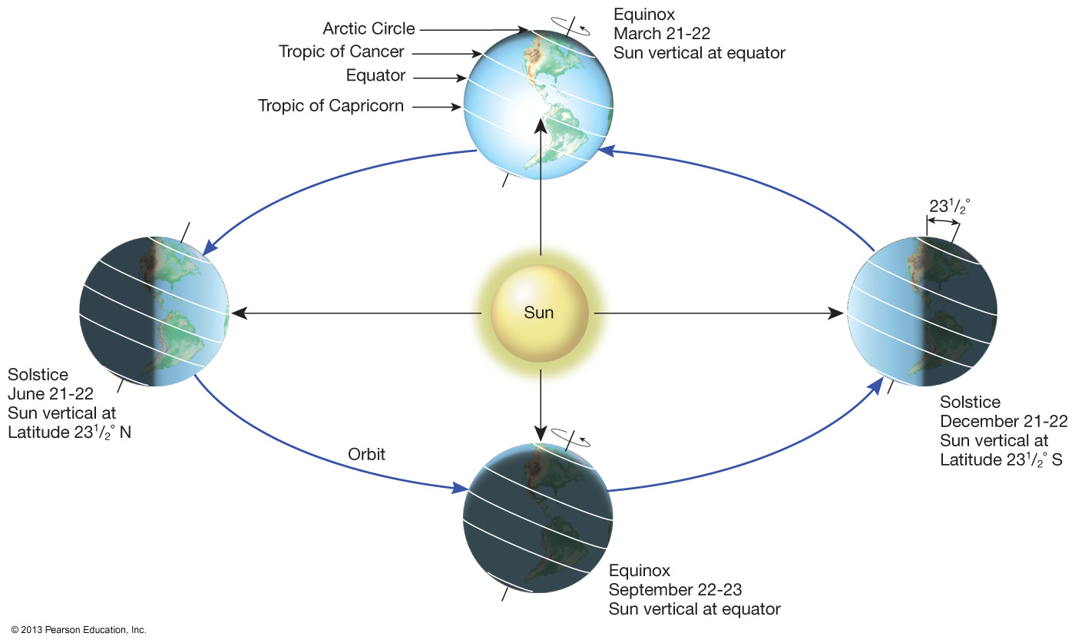
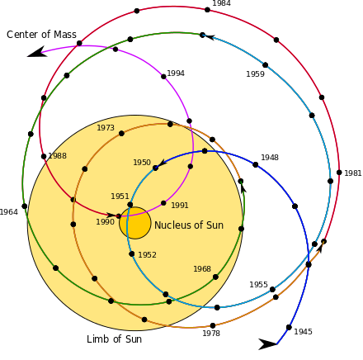
2600
Aphelion →. 16 July
Perihelion → 16 January
SIM effects on the Earth via solar irradiance
2020
Aphelion →. 5 July
Perihelion → 5 January
2600
Aphelion →. 16 July
Perihelion → 16 January
The amount of TSI deposited on Earth in 2020-21 between the northern hemisphere the spring and autumn equinox constitutes 50.103% of the overall TSI while between the autumn and spring equinox it constitutes 49.897% of the TSI meaning that there is more than 0.2% TSI is deposited to the Northern hemisphere then to the Southern one.
S. Perminov, E.D. Kuznetsov, 2018
SIM imposed by planets Jupiter, Saturn, Neptune and Uranus
Charvatova, 1988,
Palus et al, 2007

Slide 16
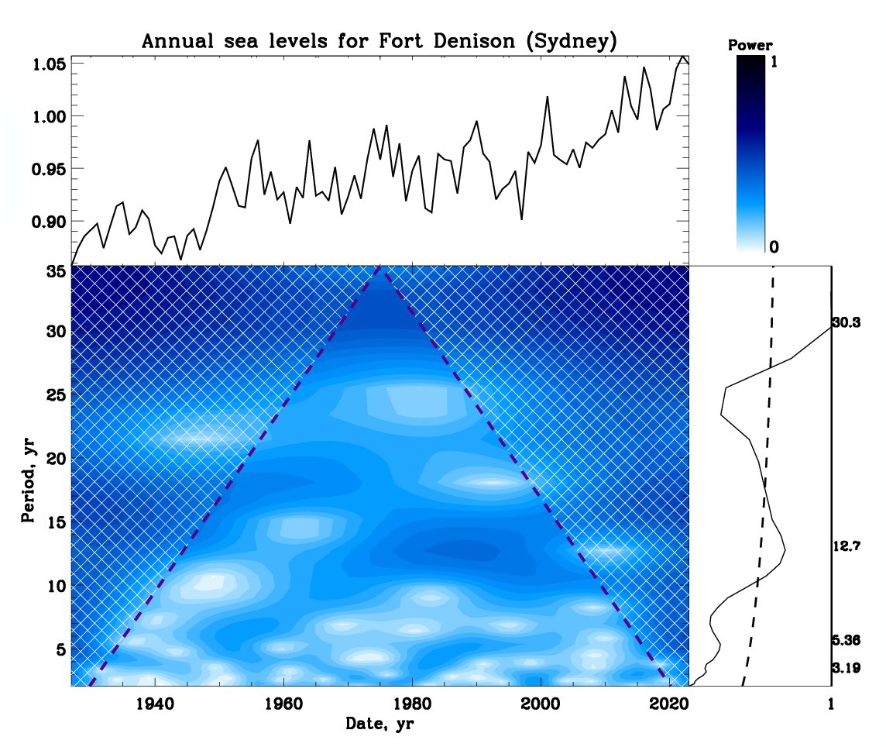
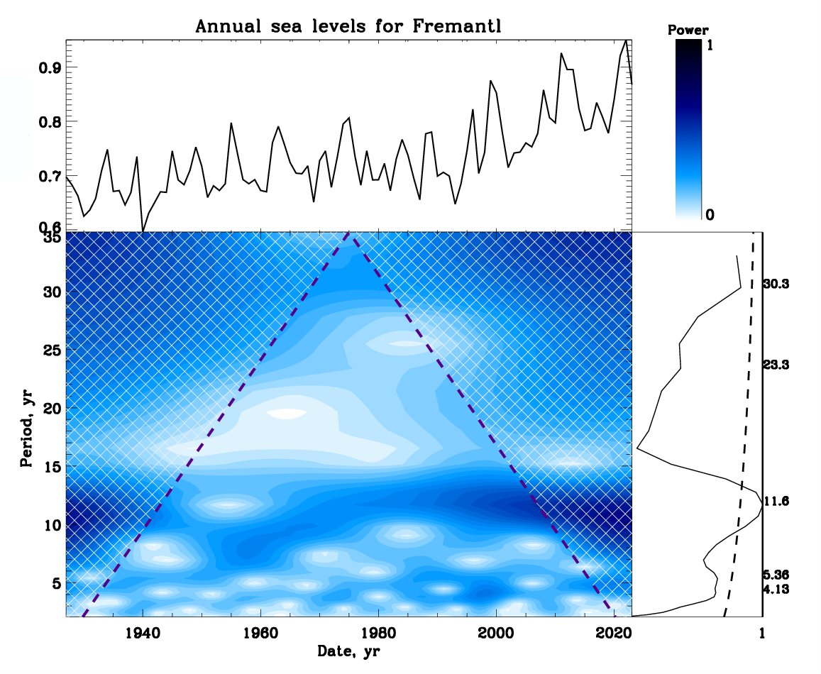
Wavelet spectra of sea levels - puzzle of
Fremantl (left) and Sydney (right) bays
Periods:11.8 yrs (F) and 12.7 and 30 yrs (S)

Slide 17
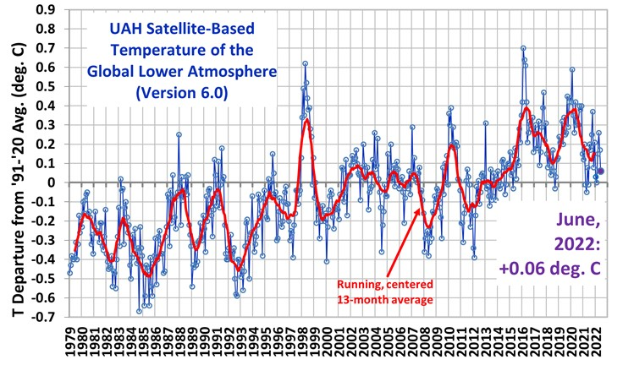
The Climate Change is turning into GSM and mini ice age
Stop The Climate Stupidity
Has the world warmed?
The atmosphere hasn’t warmed – in downtrend from 2016.

Slide 18
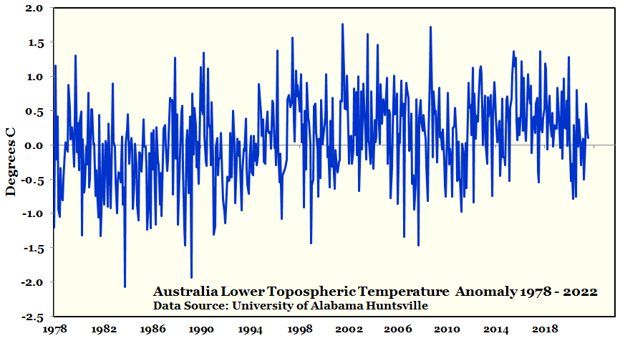
The Climate Change is turning into GSM and mini ice age
Stop The Climate Stupidity
Australia is much the same.
Nothing has happened really – sideways for the last 25 years.
Notes:
Solar climate/ UAH MSU

Slide 19
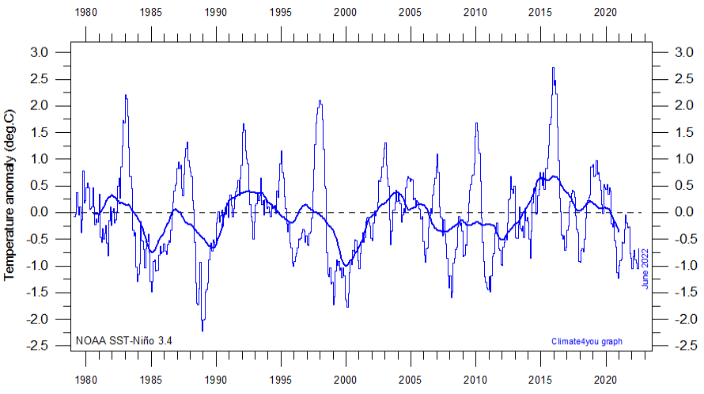
The Climate Change is turning into GSM and mini ice age
Cooling of the Nino 3.4 region also started in 2006.
The Nino 3.4 region is where a lot of Australia’s weather comes from.

Slide 20
Conclusions - 1 https://solargsm.com/solar-activity/
Terrestrial temperature variations in the past 200 years reveal clear periods of 21.4 and 36 yrs → period of the summary curve of SBMF is also 21.4 yrs
Sea level follows closely temperature variations slightly decreasing with increase T
Although Fremantl and Sydney bays show the sea level variations with periods of about 5 and 12 years → induced by lunar and Jupiter graaviation
Ice areas in both hemispheres reveal 59% anticorrelation with the GLB temperature
Arctic ice areas reveal period of 10.7 yrs linked with sunspot cycle while Antarctic ice areas have periods of 5.5 and 15 yrs not understood yet
Terrestrial temperature increase follows the increase of TSI owing to SIM in the past two centuries
The terrestrial temperature shows the signs of a decrease following grand solar minimum (GSM) (2020-2050) similar to Maunder minimum

Slide 21
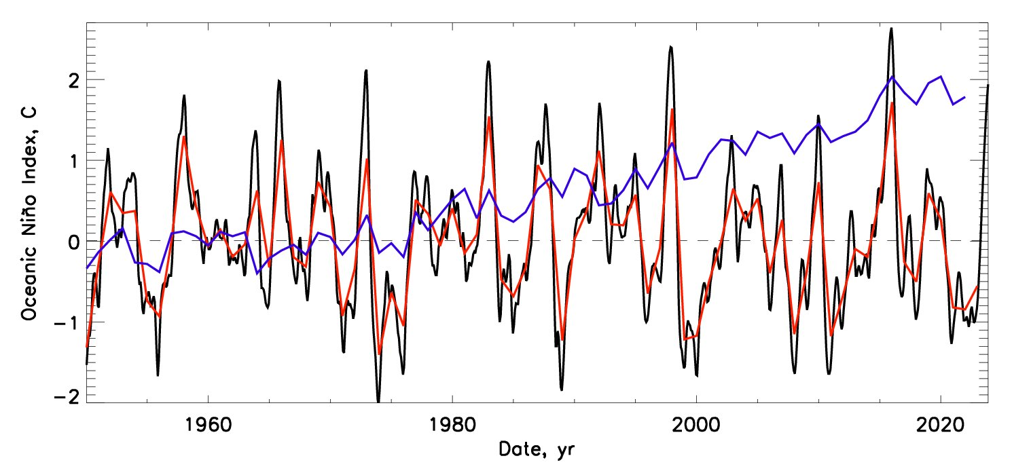
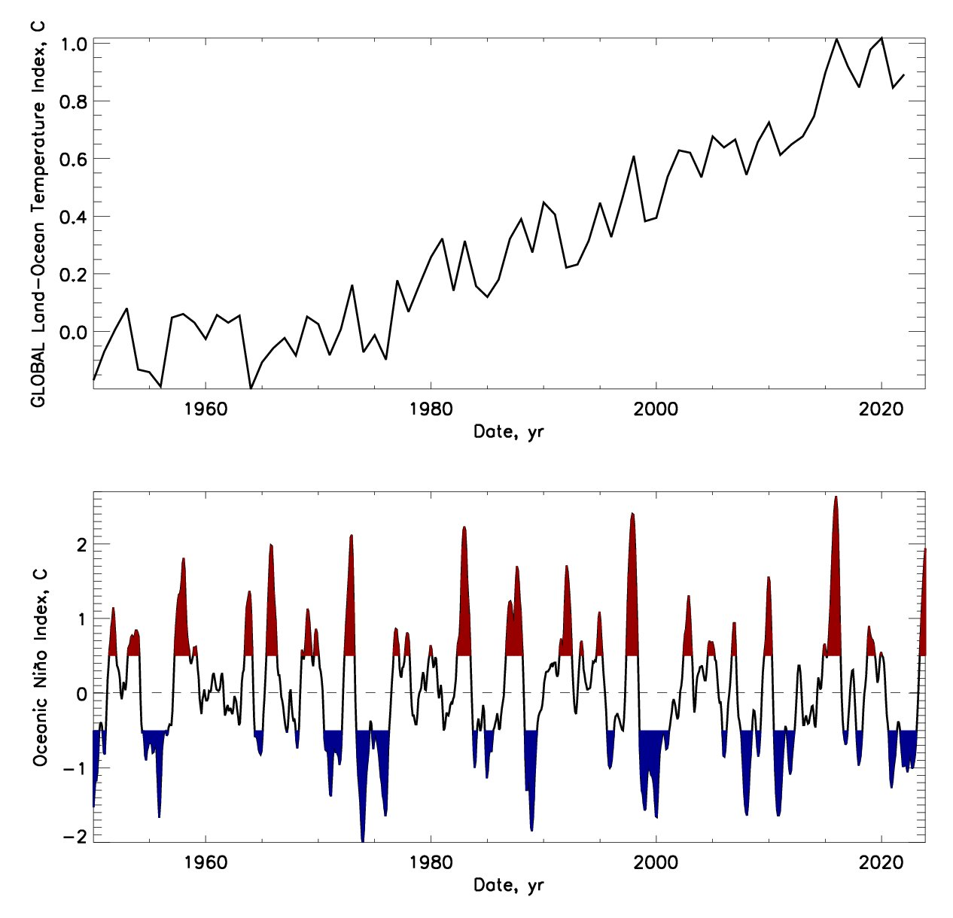
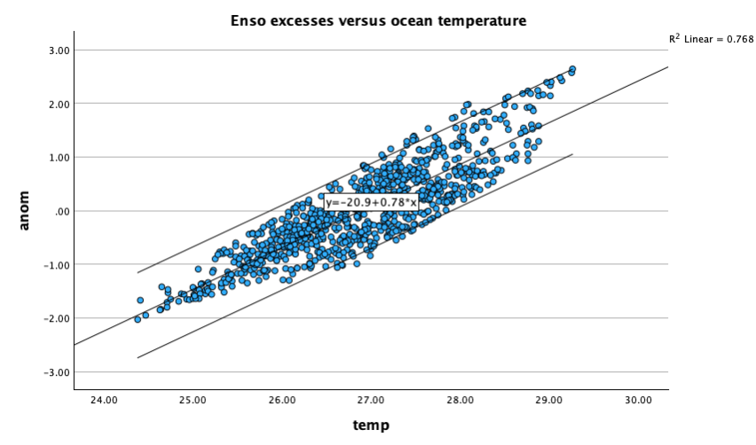
ENSO variations vs sea T (GLB)
Top plot—Temporal variations of the combined land-surface air and sea-surface temperature, GLB.
Bottom plot—Temporal variations of the El Nina Southern Oscillation (ENSO) index. The red colour shows the excesses (hot periods) above the averaged ENSO index and blue colour shows the reductions (cold periods) below the averaged ENSO index
Scatter plot - Correlation 87% of ENSO and GLB

Slide 22
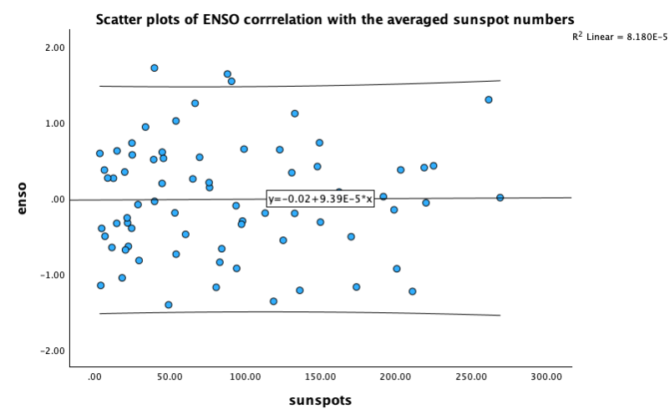
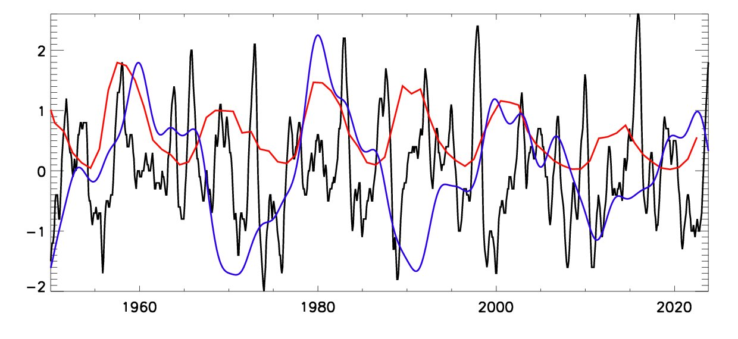
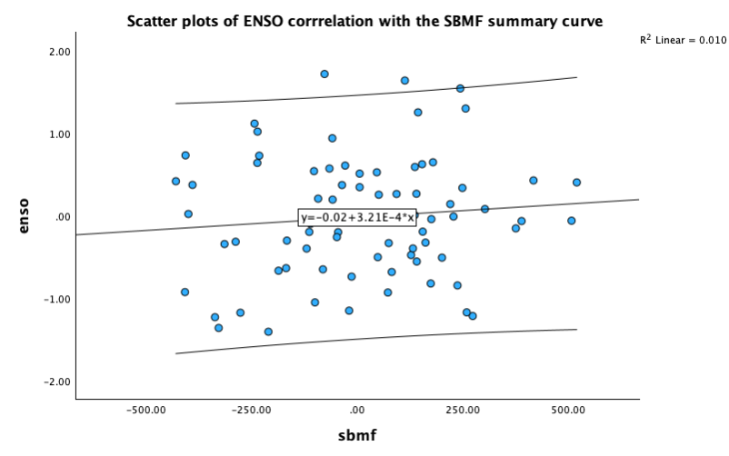
ENSO vs SSN and SC
SSN-ENSO - R= 1%
Comparison of temporal variations of the El Nina Southern Oscillation (ENSO) index (black curve) with the averaged sunspot numbers SSN (red curve) and the summary curve SC of eigenvectors of solar background magnetic field SBMF (blue curve).
SC-ENSO R= 10%

Slide 23
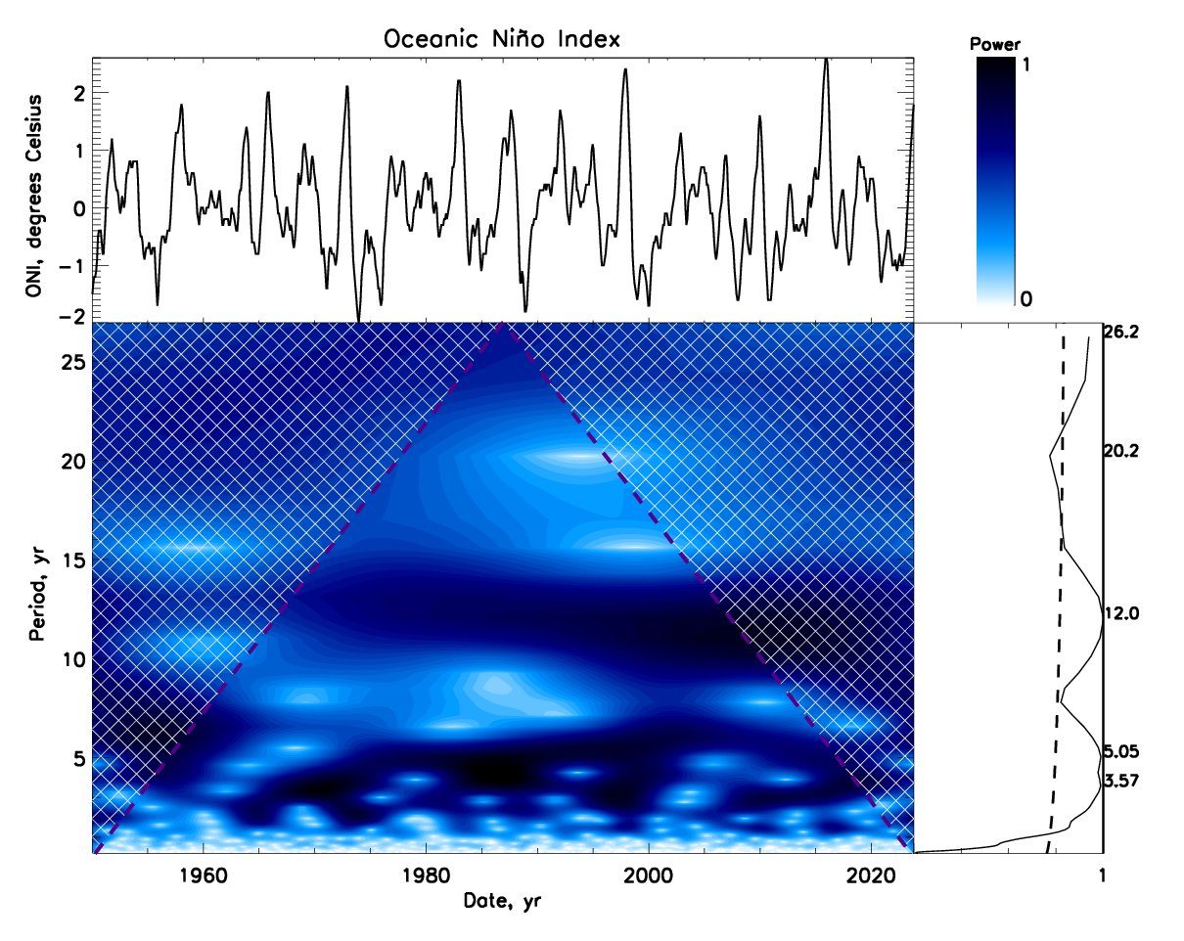
Wavelet spectra of ENSO index
Top left – ENSO index
Top right - The wavelet power marked by the colour bar
Bottom left - Wavelet spectrum of the El Nina Southern temperature variations (ENSO).
Bottom right - the global wavelet spectrum of the ENSO index (black solid line) with the 95% confidence interval of the detected spectral features marked by the black dashed line).
Key periods 4.5-5 and 12 years

Slide 24
Wavelet spectra of sea levels - puzzle of
Fremantl (left) and Sydney bays
Periods:11.8 yrs (F) and 12.7 and 30 yrs (S)

Slide 25
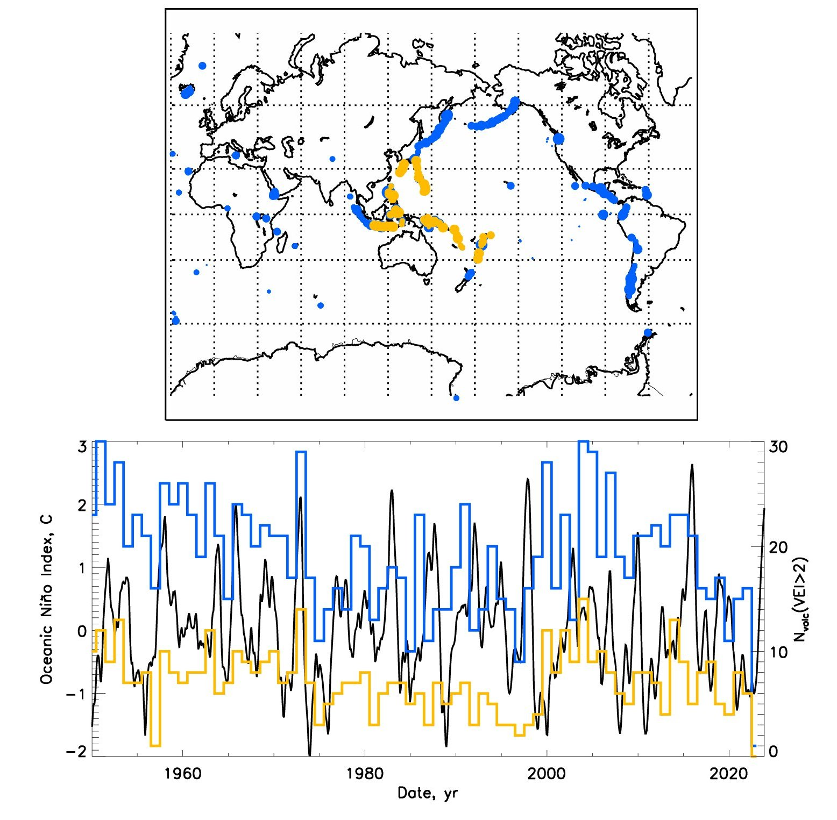
ENSO vs volcanic eruptions: all –blue, ENSO area - yellow
Top plot - Links of the ENSO index to volcanic eruptions. Top plot: presents the geographical locations of volcanic eruptions with those occurred in the ENSO locations marked by the yellow colour.
Bottom plot: shows temporal variations of ENSO index variations (black line ) versus frequencies of volcanic eruptions with the index VEI > 2 per year in 1950-2023 for the whole volcanic data (blue line) and for the volcanic (surface and underwater, or submarine) eruptions in the lo- cations of the ENSO occurrences (yellow plot).

Slide 26
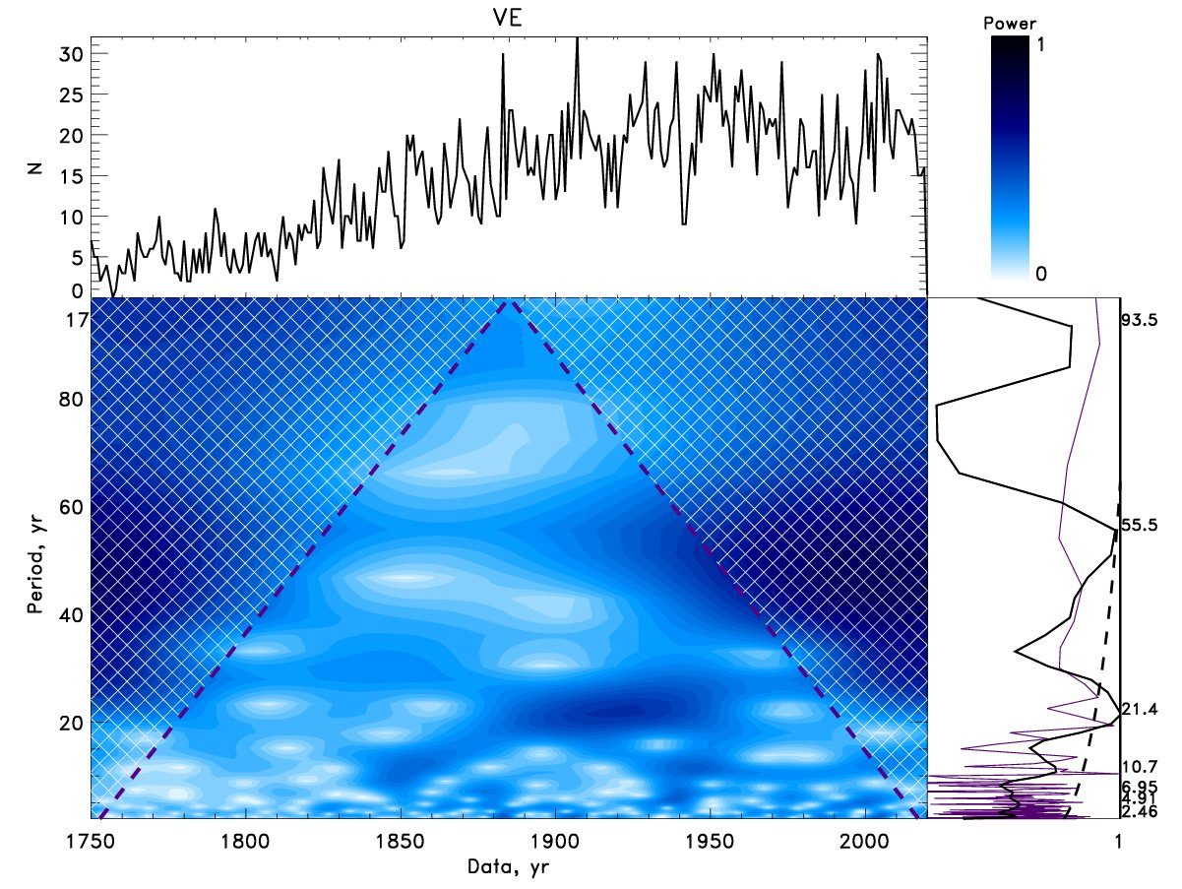
Wavelet spectral analysis of VE frequencies
Top plots: Time series of the annual volcanic eruptions in the period of 1750-2020 (top left) with the power bar for the wavelet spectrum (top right).
Bottom plots: The wavelet spectrum with periods (Y-axis) derived from frequencies of volcanic eruptions (bottom left) obtained using the Morlet wavelet.
The global wavelet spectrum (the solid black line) and Fourier spectrum (the indigo line) (bottom right).
The Cone of Influence (COI) marked by the black dashed lines
Key period is 21.4 years as SC of SBMF
https://solargsm.com/publications

Slide 27
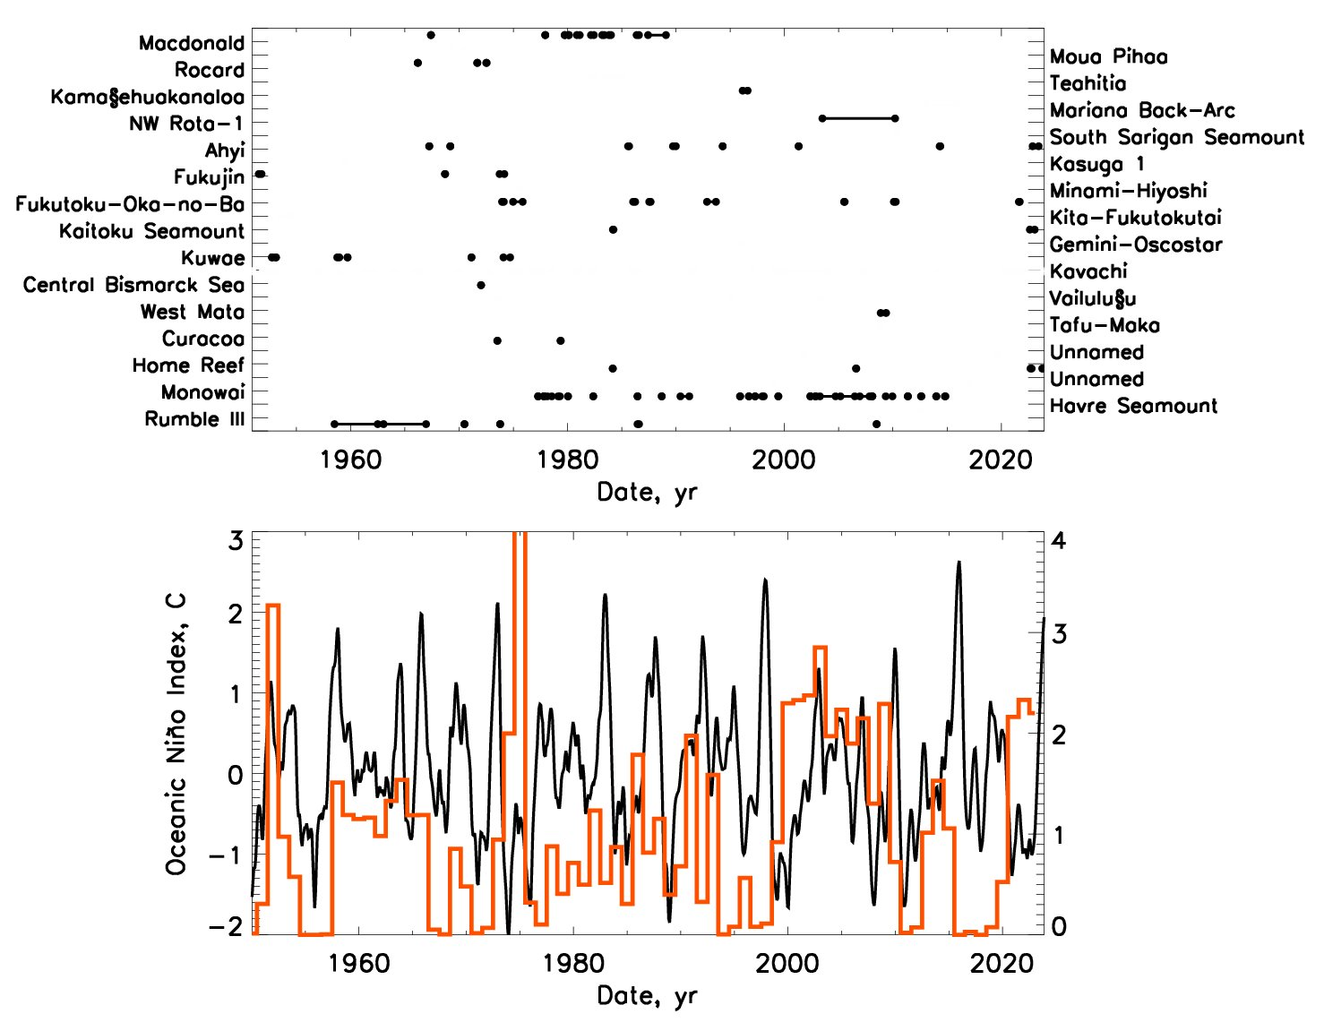
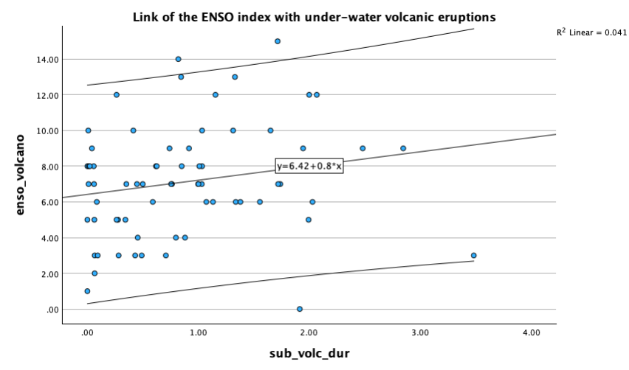
ENSO vs submarine (underwater) volcanic eruptions
ENSO –volc: r=25%
Top plot: The known submarine underwater volcanic eruptions with their durations.
Bottom plot: The temporal variations of ENSO index (black curve) versus the submarine (underwater) volcanic eruptions (red curve) with the index VEI > 0 including the volcanic strength and duration, which is calculated as a fraction of the number of eruption days to the whole year duration by taking into account the power of eruption

Slide 28
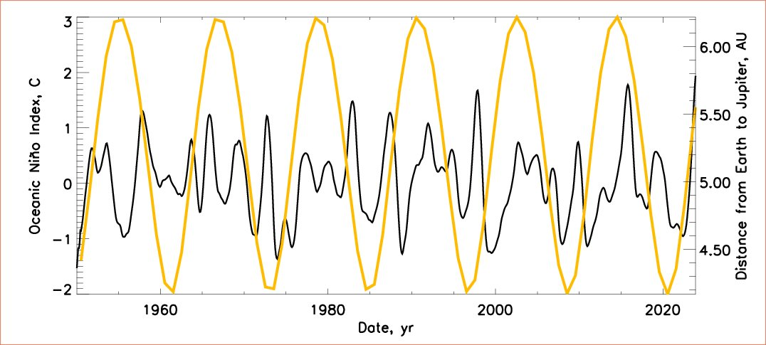
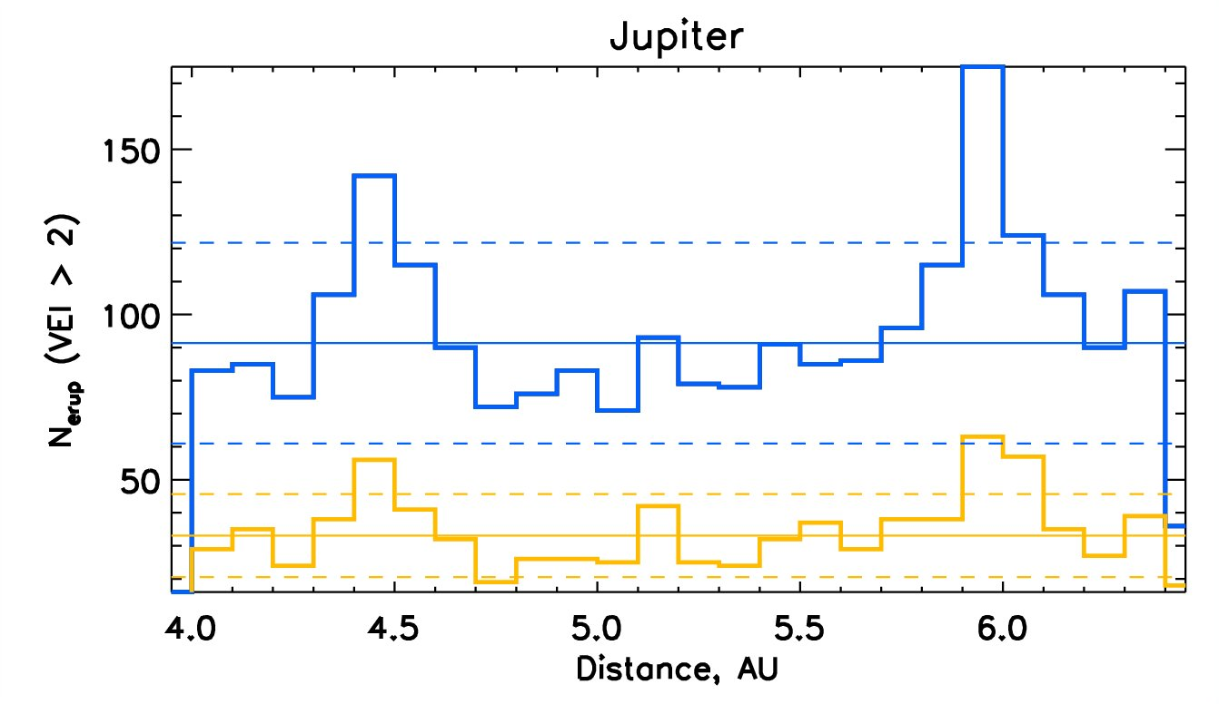
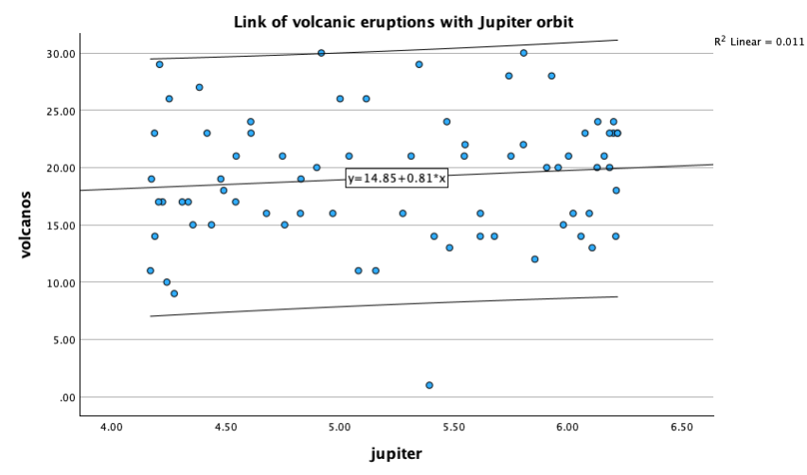
Top: ENSO (black) vs Jupiter distance (yellow). Bottom: volcanic eruptions: all and ENSO areas vs Jupiter distances
Explore:
Period of 12 years
Is linked to the revolution of Jupiter about the Sun
R= 11% for VEs–Jupiter dist of 4.5 au

Slide 29
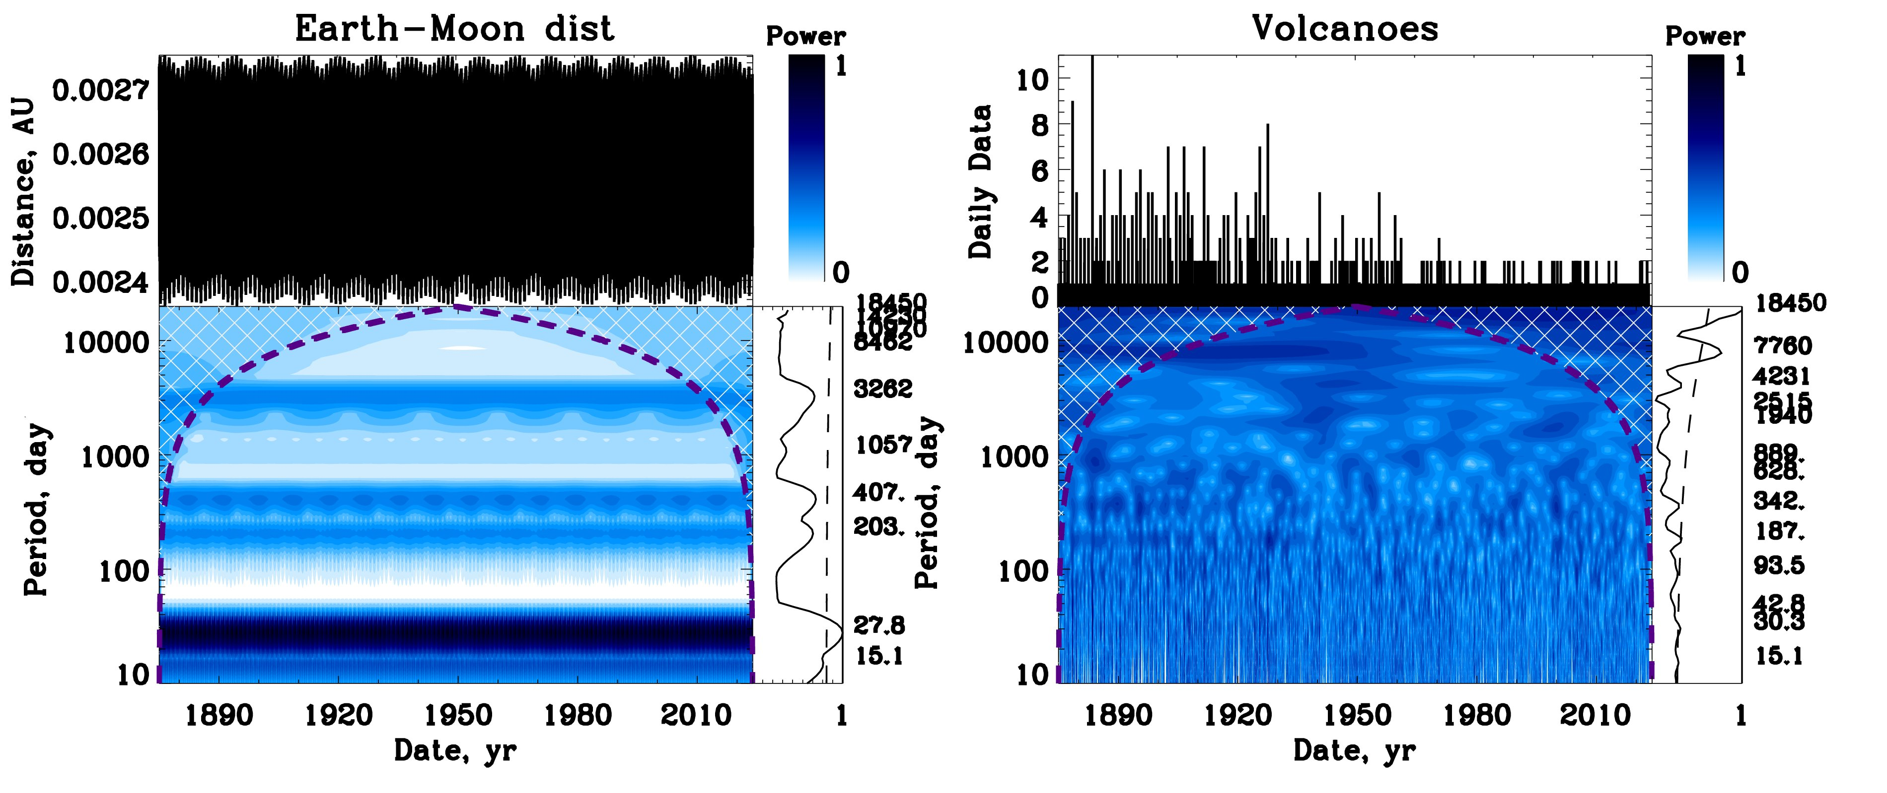
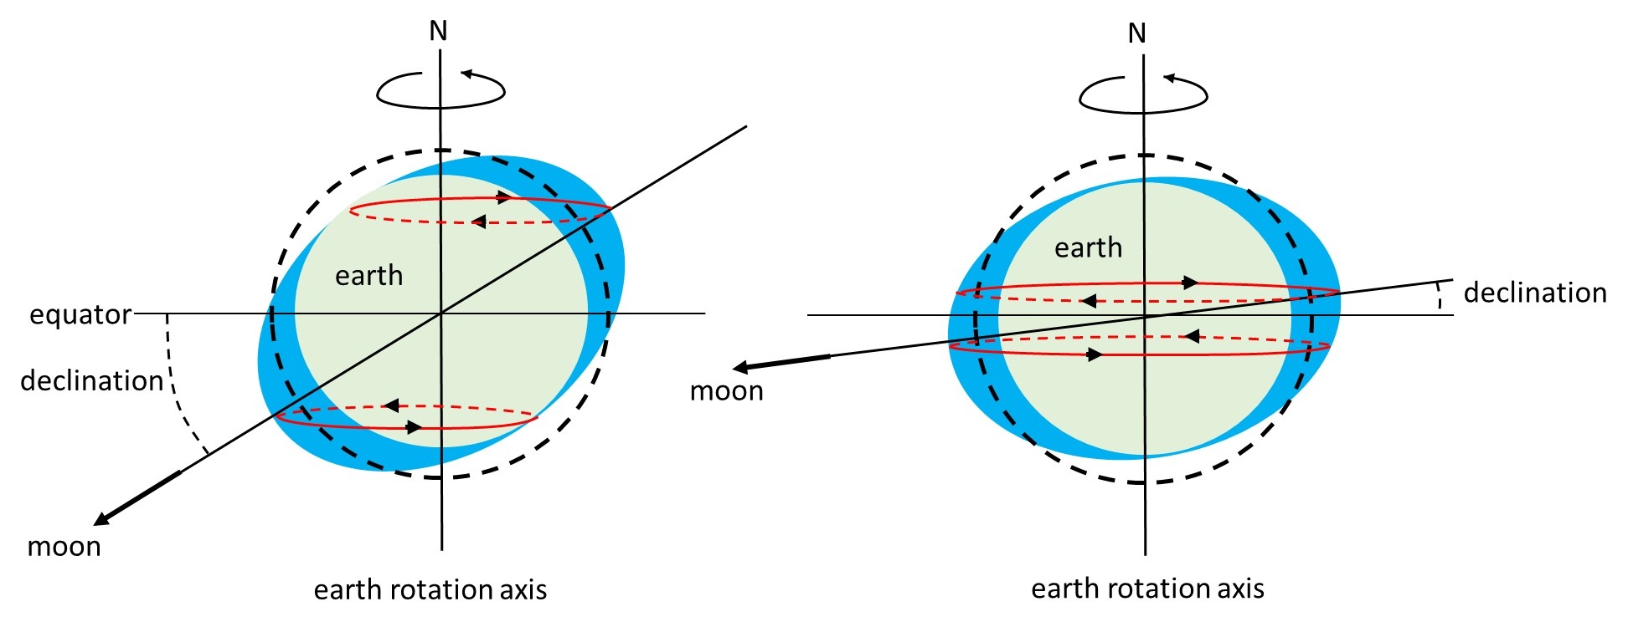
Wavelet spectra of lunar (left) and volcanic (right) periods
in 1875-2024
Left plot: Wavelet analysis of the Earth-Moon distances
There is aa significant period of 27 days and some additional periods of 203, 407 and 3282 days (8.9 years) that is the lunar semidiurnal perigee period for small inclination..
Right plot: Wavelet analysis of the frequencies of volcanic eruption with VEI $>$2 for the same years.
The periods in the wavelet spectra are marked in days. There is a significant period of 7760 days (21.3 years) detected, Also there are some indications of the periods of 373 and 3262 days (8.9 years).

Slide 30

Wavelet spectra of lunar (left) and volcanic (right) periods in 1875-2024
Top row: The frequencies of eruption as a function of the Right Accession (RA) ( left plot) and of the Earth-Moon distance (right plot).
The frequency of volcanic eruptions is reflected by the colour scheme placed on the left for the RA-Distance plot in the top left plot and on the right in the Distance - Declination for the top right plot.
Bottom row: The integrated frequency of volcanic eruptions as function of Right accession, RA, (left plot) and of the Earth-Moon distances (right plot).
Thin horizontal solid line indicates the averaged frequency oof volcanic eruptions, the horizontal dashed line shows the standard deviation magnitudes

Slide 31



R= 15% for VEs–Jupiter dist of 6.4 au
It is linked to SIM and distance from Sun to Earth

Slide 32
Conclusions - 1 https://solargsm.com/solar-activity/
Terrestrial temperature variations in the past 200 years reveal clear periods of 21.4 and 36 yrs → period of the summary curve of SBMF is also 21.4 yrs
Sea level follows closely temperature variations slightly decreasing with increase T
Although Fremantl and Sydney bays show the sea level variations with periods of about 5 and 12 years → induced by lunar and Jupiter graaviation
Ice areas in both hemispheres reveal 59% anticorrelation with the GLB temperature
Arctic ice areas reveal period of 10.7 yrs linked with sunspot cycle while Antarctic ice areas have periods of 5.5 and 15 yrs not understood yet
Terrestrial temperature increase follows the increase of TSI owing to SIM in the past two centuries
The terrestrial temperature shows the signs of a decrease following grand solar minimum (GSM) (2020-2050) similar to Maunder minimum

Slide 33
Conclusions
The wavelet analysis of ONI/ENSO revealed two periods of 4.5 and 12 years, linked to orbital motion of the Moon (perigee cycle) and Jupiter, respectively.
There is a noticeable correlation of 25% of the ONI/ENSO index with the frequencies of the under-water (submarine) volcanic eruptions.
Correlation of the under-water volcanic eruption frequency with the Jupiter-Earth distances is 11% while it increases to 15% for the Sun-Earth distances in January, when the Sun is closest to the Earth's southern hemisphere where the ONI/ENSO occurs.
the Sun moving closer to the Earth as shown by S-E distances from the NASA ephemeris owing to the gravitation of large planets (Jupiter, Saturn, Neptune and Uranus) called solar inertial motion (SIM) with a period of 2200-2300 years (Hallstatt's cycle).
The amount of TSI deposited on Earth in 2020 between the northern hemisphere the spring and autumn equinox constitutes 50.103% of the overall TSI while between the autumn and spring equinox it constitutes 49.897% of the TSI meaning that there is more than 0.203% TSI is deposited to the Northern hemisphere then to the Southern one.
Thanks for your attention!

