Slide 1

Additional acceleration of solar wind particles in the heliosphere and diagnostics from space observations
,
Valentina Zharkova^{1,2}, Olga Khabarova^{2,3}, Olga Malandraki⁴
1-University of Northumbria, Newcastle upon Tyne, UK
2- ZVS Research Enterprise Ltd. London, UK
3- Tel Aviv University, Israel
4 - National Observatory of Athens, Greece
1
Notes:
1

Slide 2
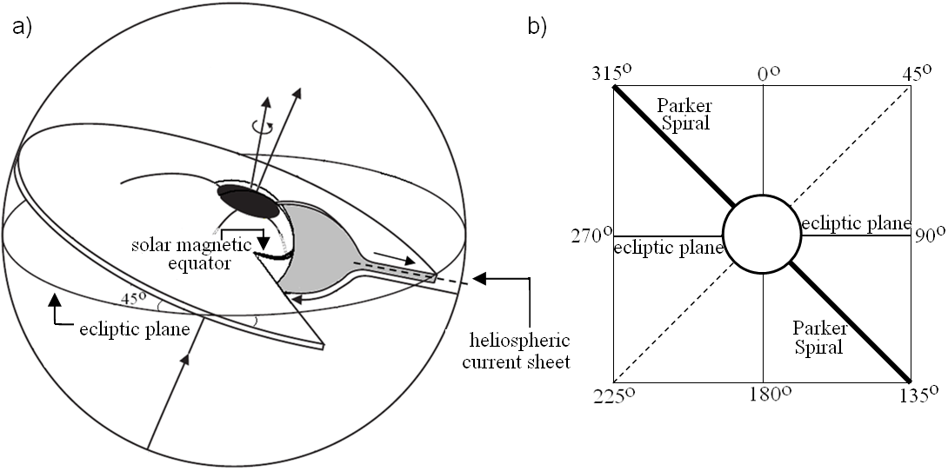
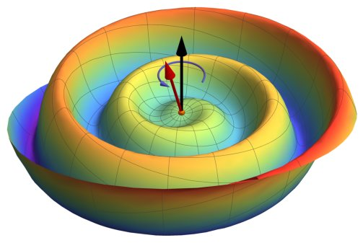
Problems in identification of sector boundaries
Heliospheric current sheet (HCS)
Azimuthal angle of magnetic field at 1 а.е. - ϕ_{B}
HCS
Sun
HCS
(HCS)
315° sector – toward the Sun
135° sector – outward the Sun
Using ϕ_{B} (if crosses 45° or 225° - change of IMP from or to the Sun).
Using components of IMP
Using change of direction of electron propagation

Slide 3
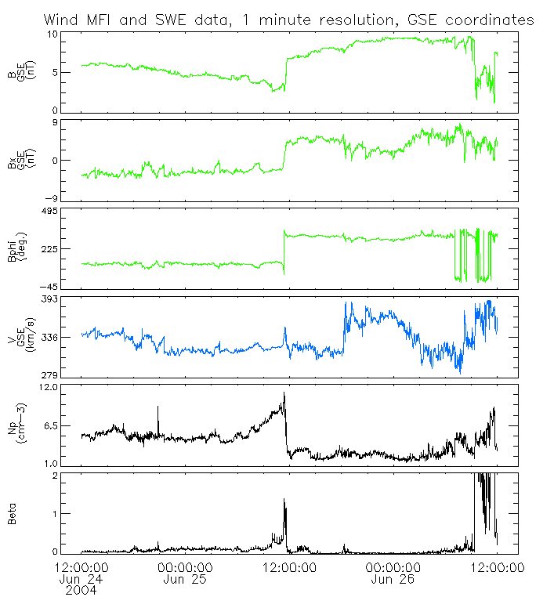
Zharkova&Khabarova, 2012 https://iopscience.iop.org/article/10.1088/0004-637X/752/1/35/pdf
IMP magnitude sharply
drops or increases
Horizontal component(Bx, GSE) = 0 nT;
Azimuthal angle (φ_{B}) changes by180°;
Problem 3 –ion velocity profile is asymmetric over the HCS
Problem 4 -Density is sharply increased about the HCS
Beta is also sharply increased
Zharkova and Khabarova, 2012, ApJ
Magnitude of IMP
Bx=0
Azimuthal angle
Velocity
Plasma density
Beta

Slide 4
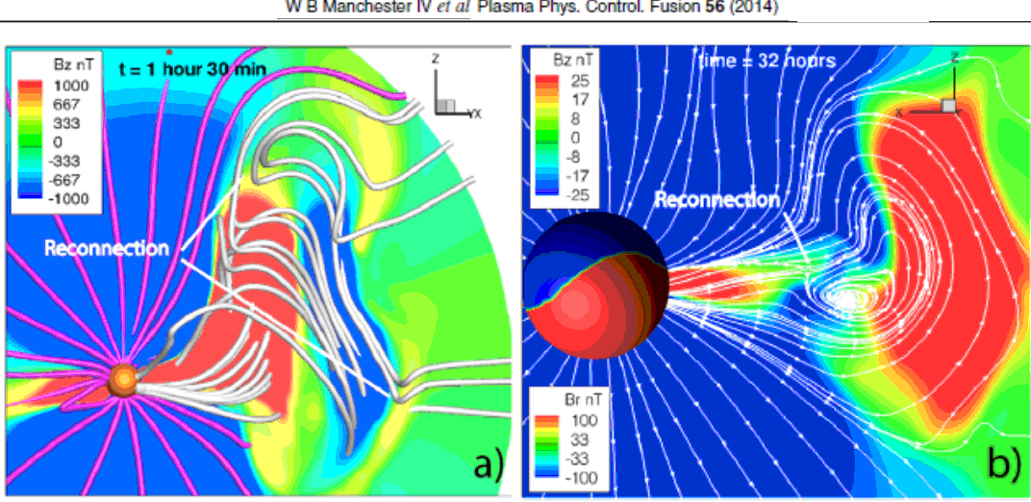
ICME current sheets
Magnetic reconnection
a) at the leading edge of an ICME; b) behind the ICME

Slide 5
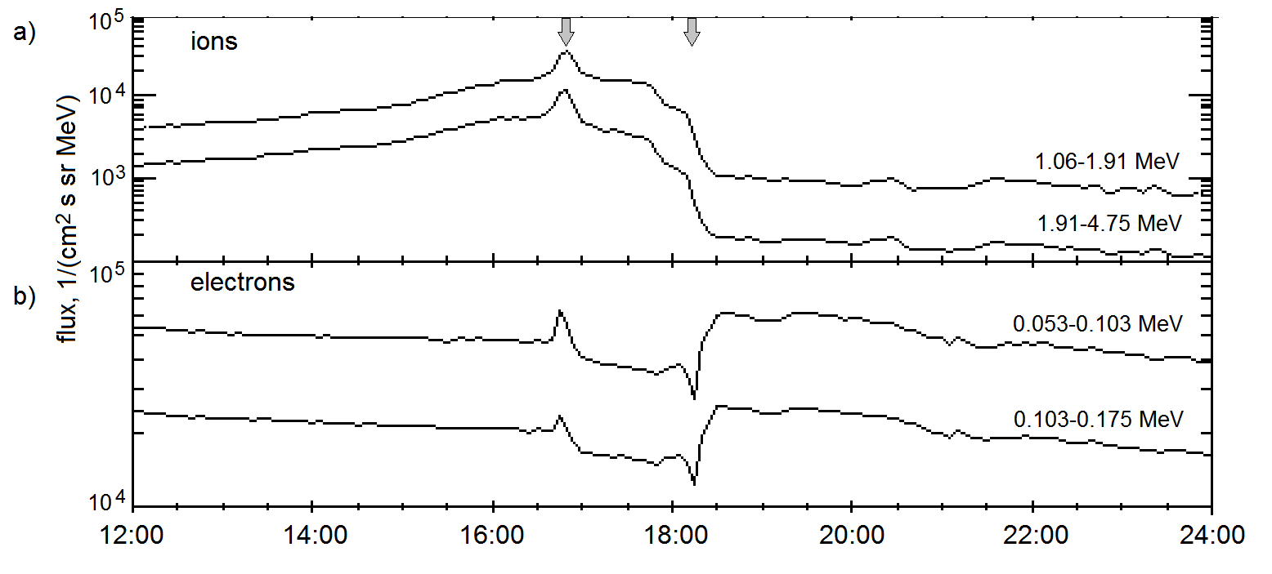
Solar wind particles passing ICME
Problems with particles in the interplanetary magnetic field
Problem 1: What makes particles to move perpendicular to the IMF in a vicinity of ICME
Problem 2 : Why there is asymmetry in motion of ion and electron flux about ICMEs? Why high energy strahls of electrons are often observed in anti-parallel direction?

Slide 6
Problems in identification of sector boundaries
Zharkova&Khabarova, 2012 https://iopscience.iop.org/article/10.1088/0004-637X/752/1/35/pdf
Crossing of a thin SB:
a) IMP magnitude;
b) IMP horizontal component (Bx, GSE);
c) IMP azimuthal angle (φ_{B});
d-f) Spectrograms of electron distribution in pitch angles
(in 3 energy channels)
Problem 5– Electron pitch angle distribution with turning point far away
from HCS
sector
340 eV
84 eV
27 eV

Slide 7
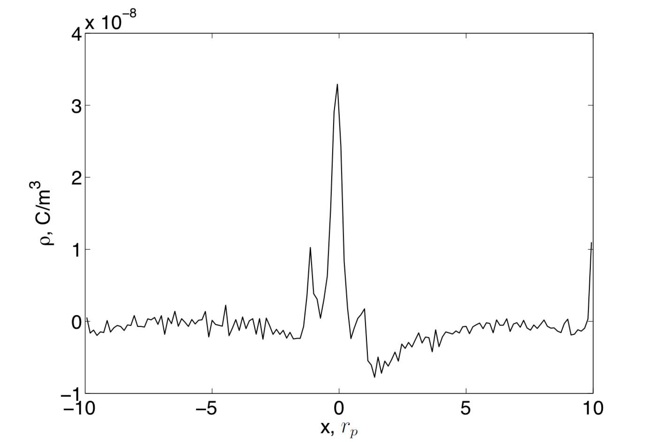
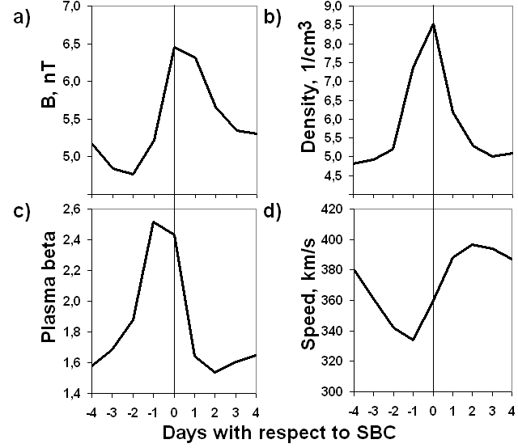
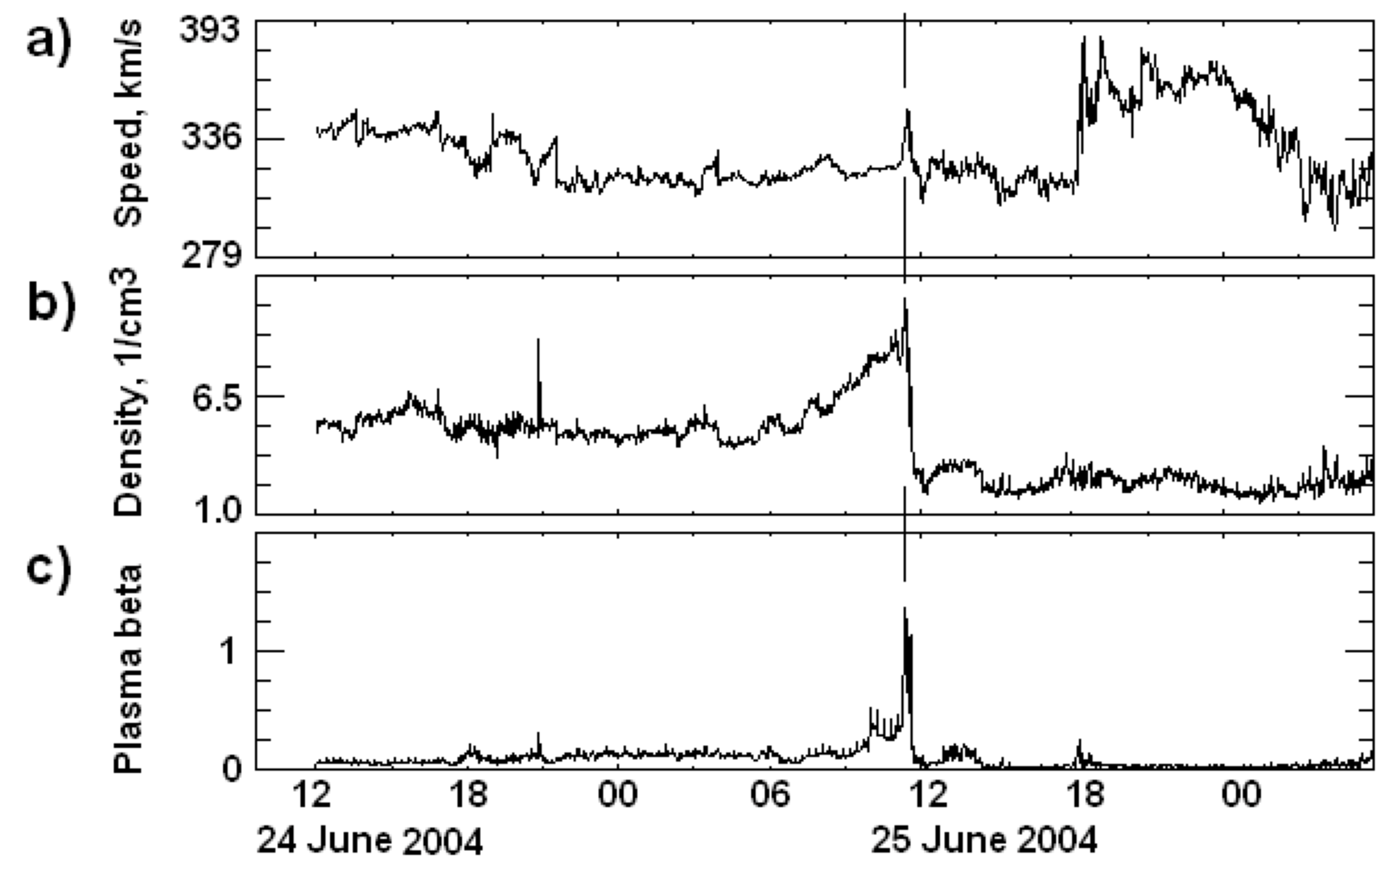
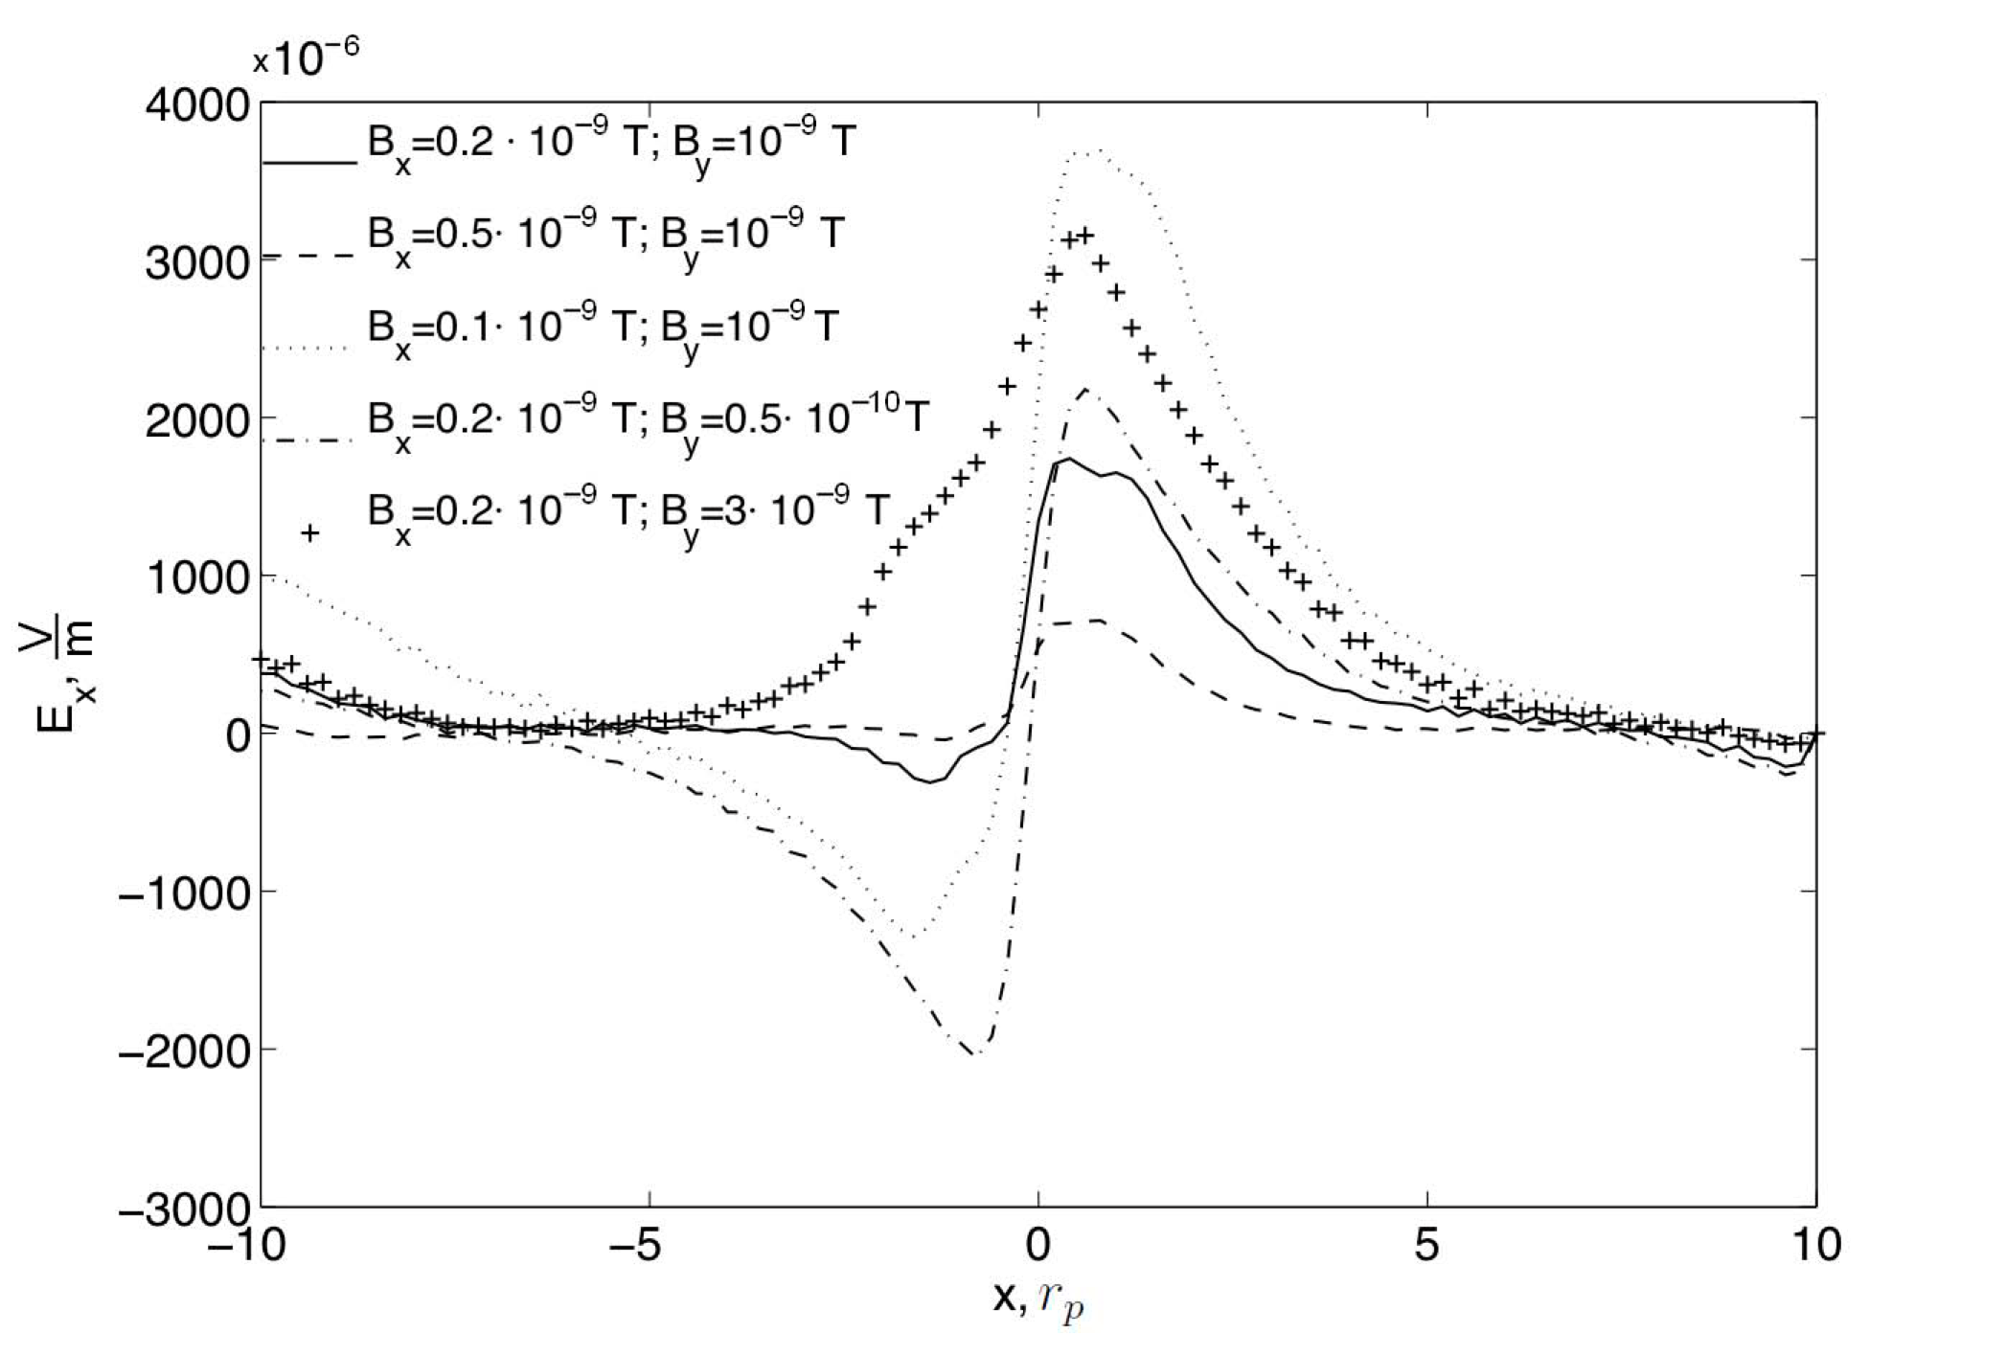
Averaged SB observations
Zharkova&Khabarova, 2012 https://iopscience.iop.org/article/10.1088/0004-637X/752/1/35/pdf
Problem 3– Ion densities about the SB – sharp peak and two smaller peaks
Problem 4– unusual Ion velocities across SB

Slide 8
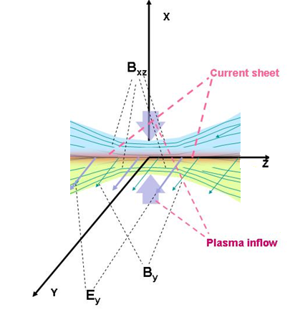
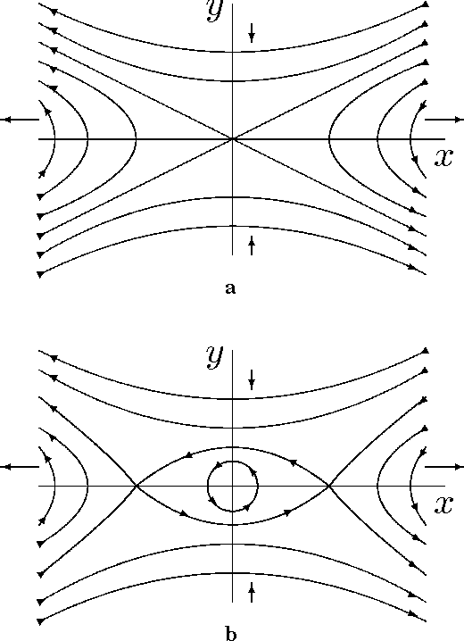
Physical model of reconnection current sheet
PIC simulations (2.5D - XOOPIC, 3D -VPIC)
A single X-null
O-type
(magnetic island)
Verboncoeur, et al 1995 – 2.5D XOOPIC
Bower et al, 2008 – 3D VPIC
Siversky and Zharkova, 2009, JPP, 75,
Zharkova and Khabarova, 2012, ApJ, 752, 35;
2015, Ann Geo, 33, 457;
Khabarova et al, 2020, ApJL, 894, L12
Xia and Zharkova, 2018, 2020, 2021a,b, A&A, Frontier
Notes:
Tracking the plasma inflow
8

Slide 9
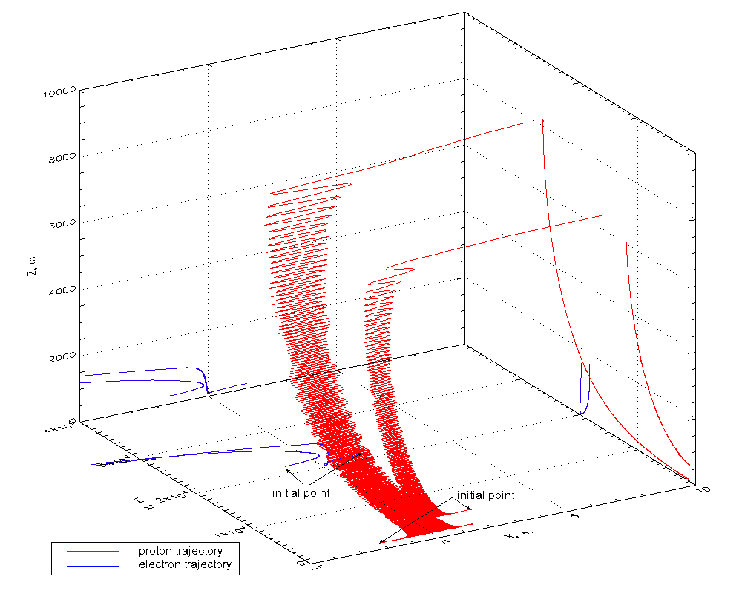
TP: Zharkova&Agapitov, JPP, 2009, 75/2, 159
dN/d ε ~ A ε^{-1.5}
dN/d ε ~ B ε^{-2.0}
ZA 2009, JPP
Myth 3 –charge neutrality of separation?

Slide 10
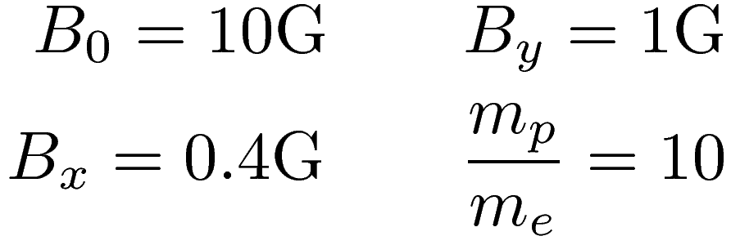

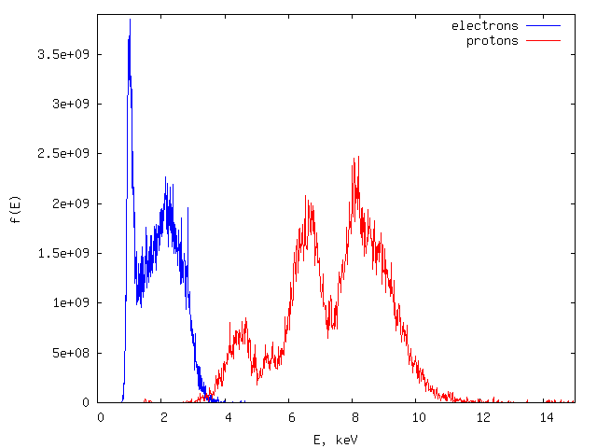
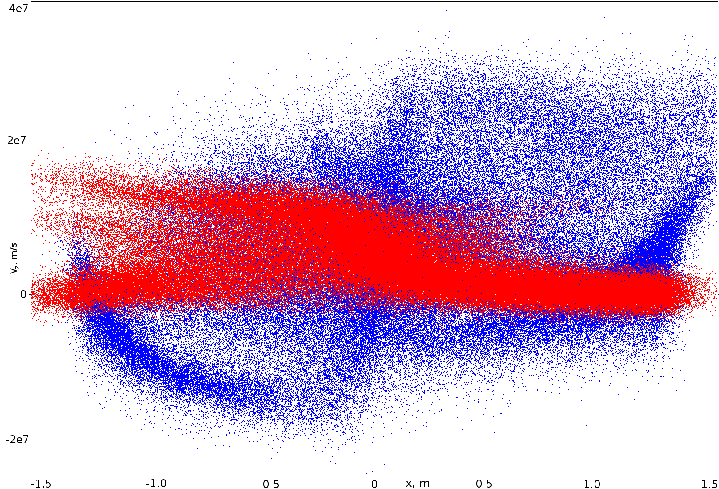
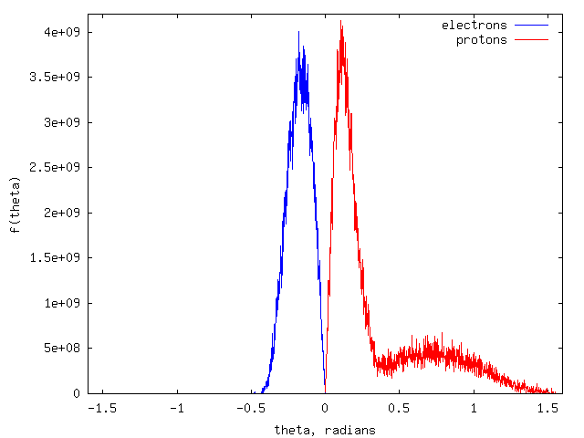
PIC – velocity/energy and PADs
Energy distributions
x-V_{z} phase space
Pitch angle distributions
Siversky & Zharkova, 2009, JPP, 75

Slide 11
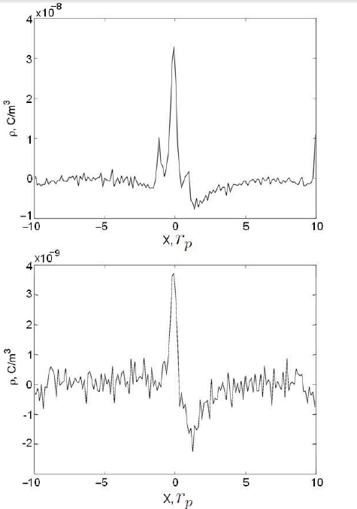
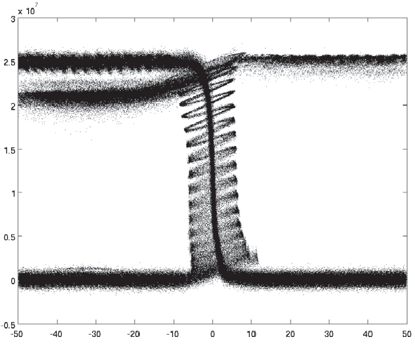

Zharkova&Khabarova, 2012 https://iopscience.iop.org/article/10.1088/0004-637X/752/1/35/pdf
Secondary density peaks about the sector boundary – acceleration of transit and bounced protons
main
secondary

Slide 12
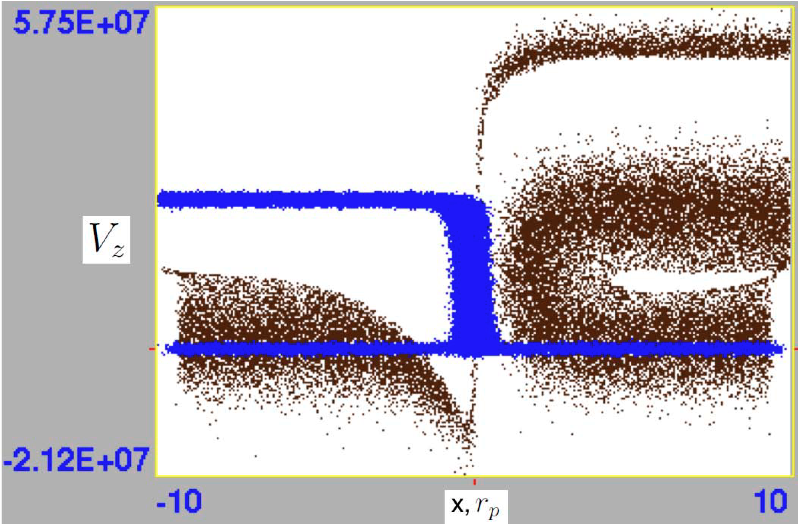
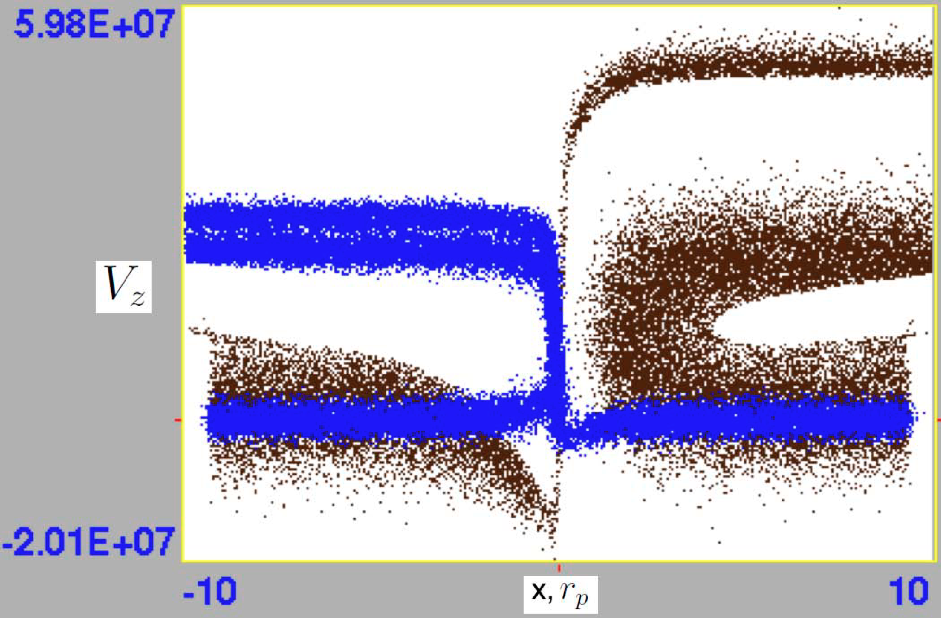
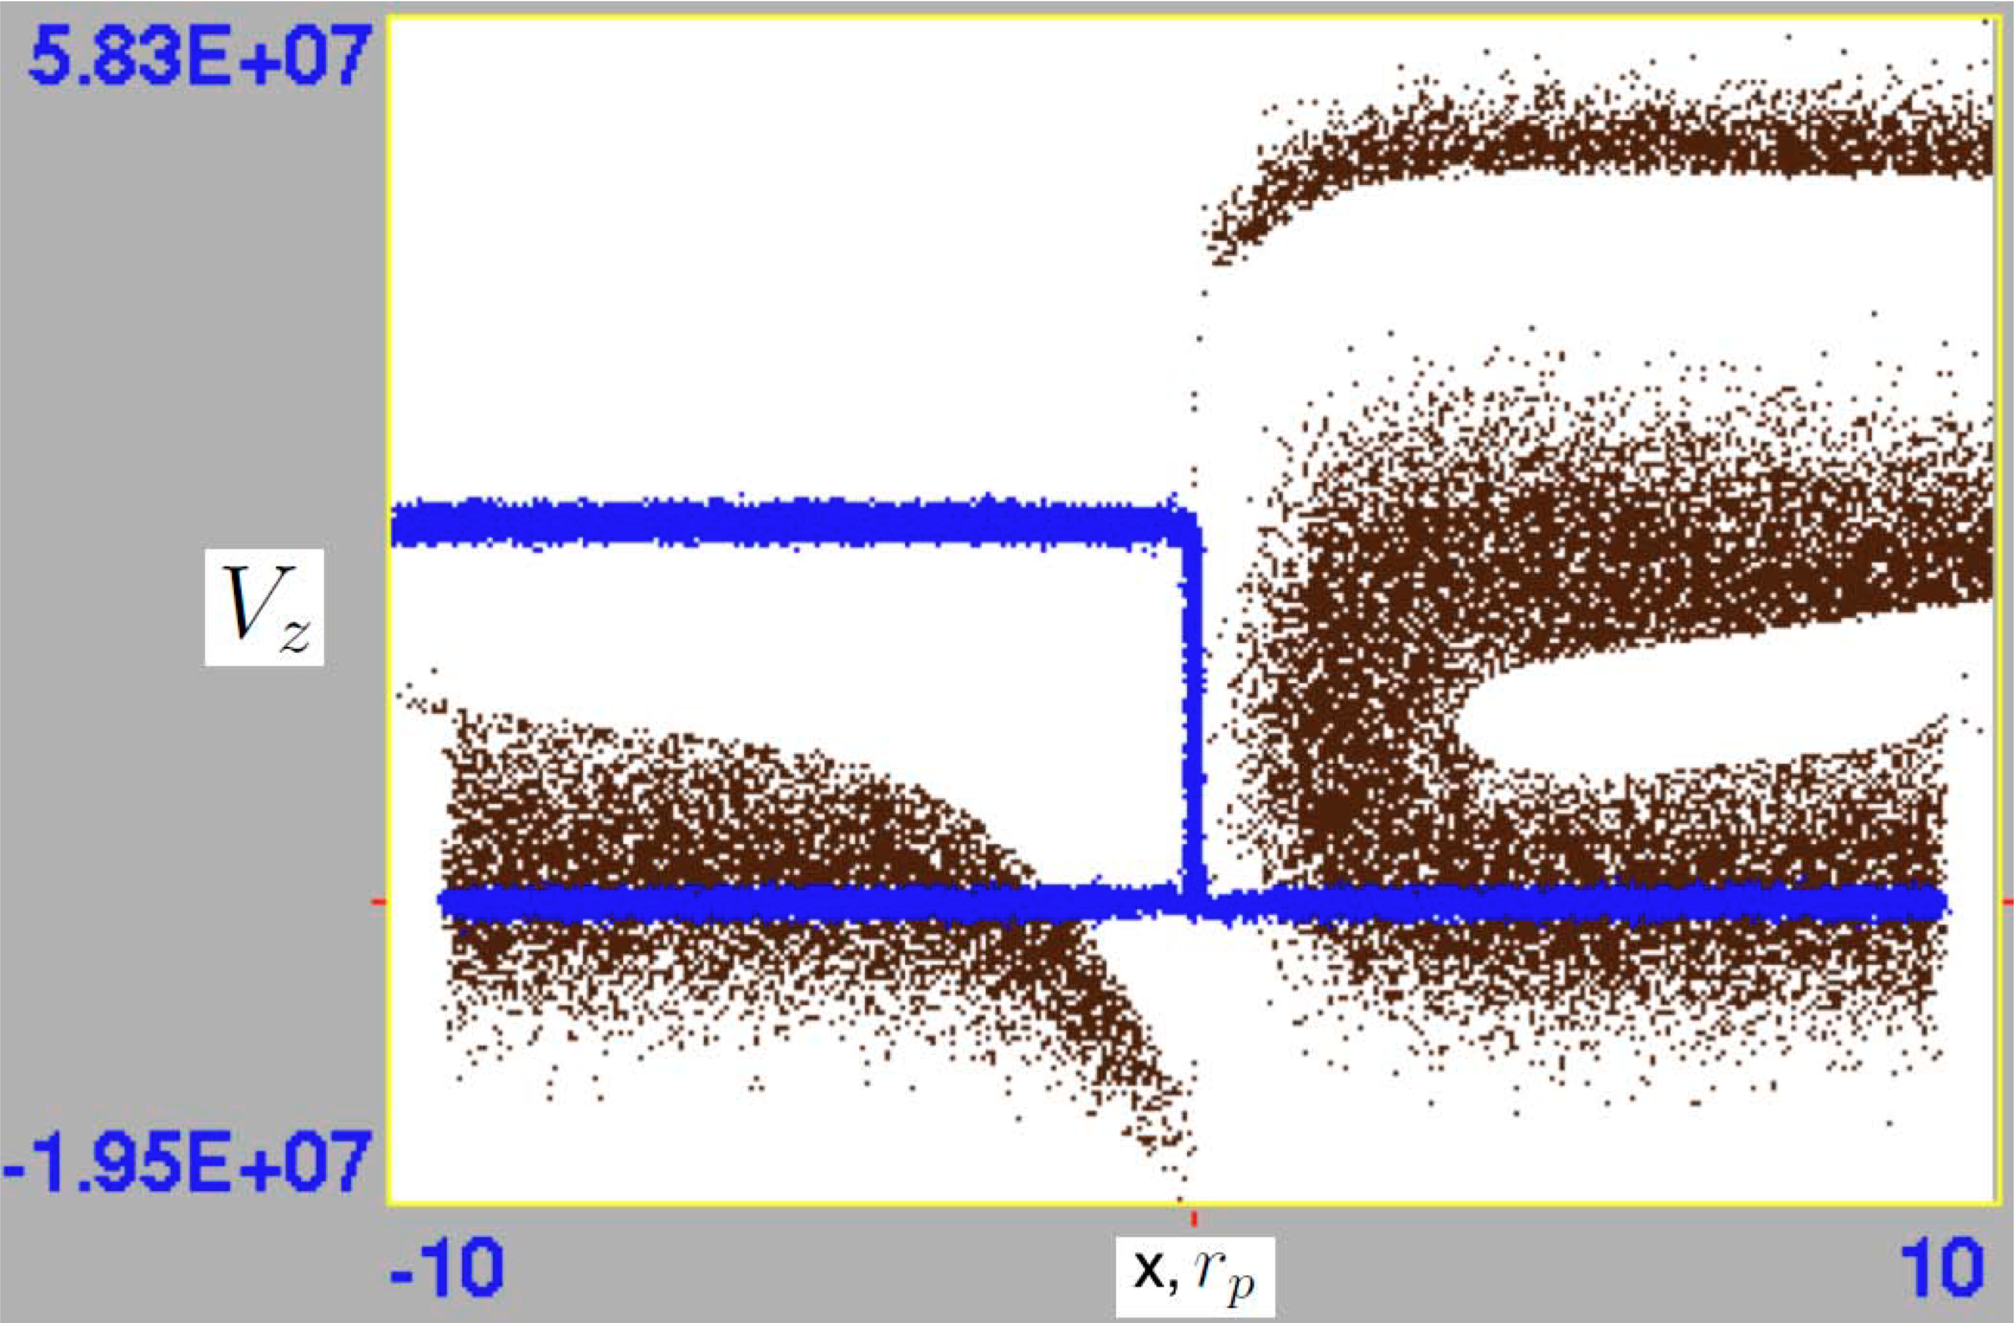
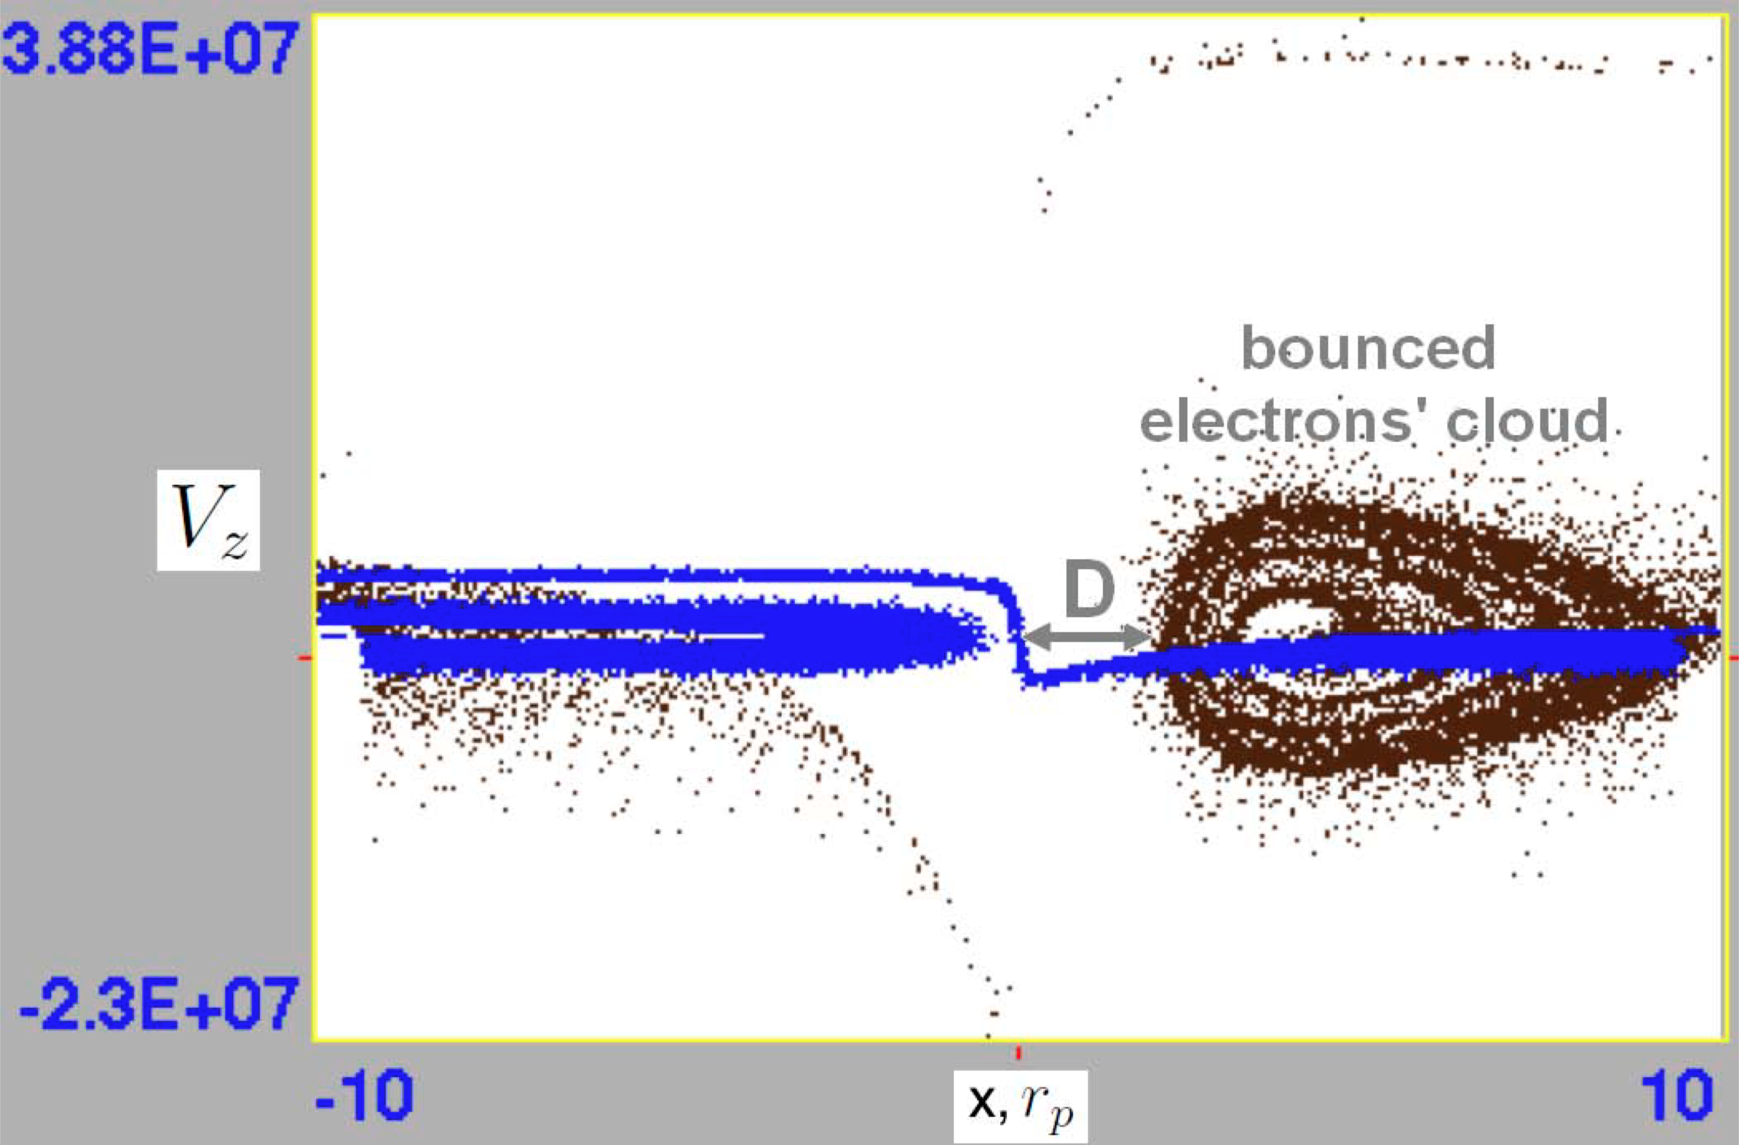
PIC - Application to the HCS: plasma density n=10-100 cm⁻³
Zharkova&Khabarova, 2012 https://iopscience.iop.org/article/10.1088/0004-637X/752/1/35/pdf
10 cm⁻³
10 cm⁻³
100 cm⁻³
By=10⁻²B_{z0}
^{Zharkova and Khabarova, 2012}
100 cm⁻³
10 cm⁻³
10 cm⁻³
100 cm⁻³
100 cm⁻³
10 cm⁻³
By=10⁻¹B_{z0}
Blue - -protons, black –electrons: h/shoe like –bounced lower energy e top – transit high energy e

Slide 13
Polarization electric field E_{x}–across a current sheet

Slide 14
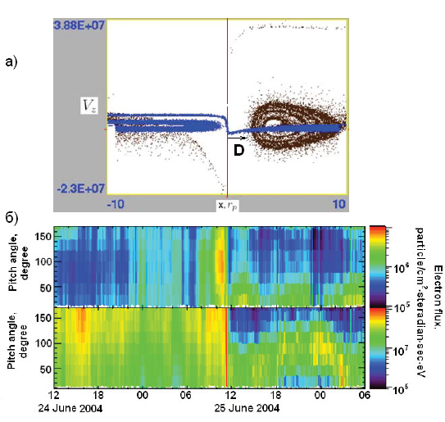
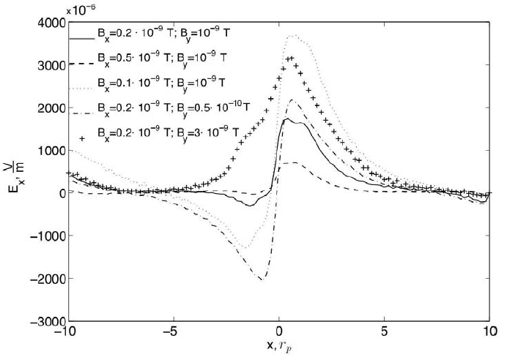
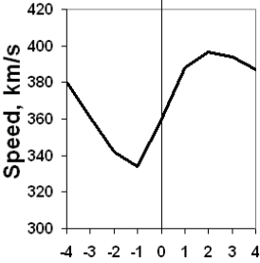
Electron PADs and ion velocities
Heliospheric current sheet
Zharkova&Khabarova, 2012 https://iopscience.iop.org/article/10.1088/0004-637X/752/1/35/pdf
Quasi-continuous reconnection in the HCS can explain a few KEY puzzles in the observations of the dynamics of ions and electrons in the solar wind (see UKSP nugget 29)
.
T. Siversky, V.Zharkova, 2009, JPP, 75, 5
V. Zharkova et al, 2011, SSRv, 157, 359
V.Zharkova, O. Khabarova,2012, ApJ, 752, 35

Slide 15
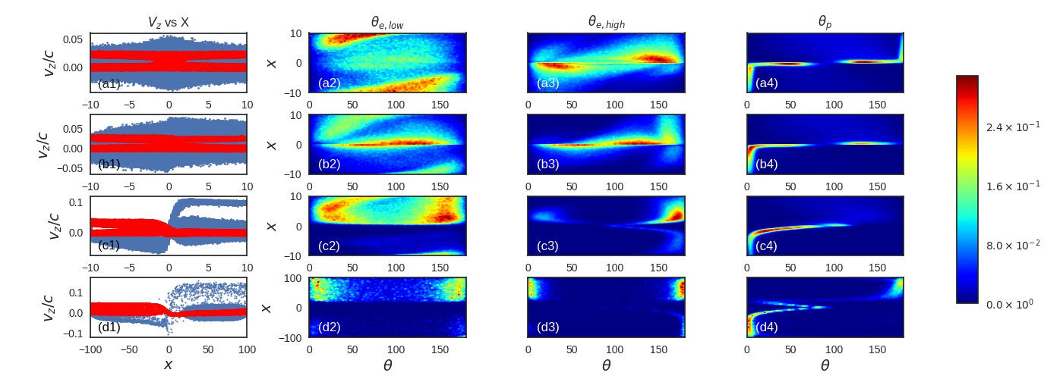
Magnetic topology effects
on particle energy and pitch angle distributions (XZ2020)
electrons protons
By/B0 = 0 (a-first row), 0.1(b-second row), 1.0 (c-third row), and 1.0 with d = 10 m (d-fourth row)
1. Asymmetric ejection with respect to the current sheet midplane in a strong guiding field– separation of electrons from protons
2. Particle of the same charge – transit and bounced particles - with different energies and pitch-angle distributions
B0 = 10−3 T, Ey,0 = 250 V/m
Notes:
15

Slide 16
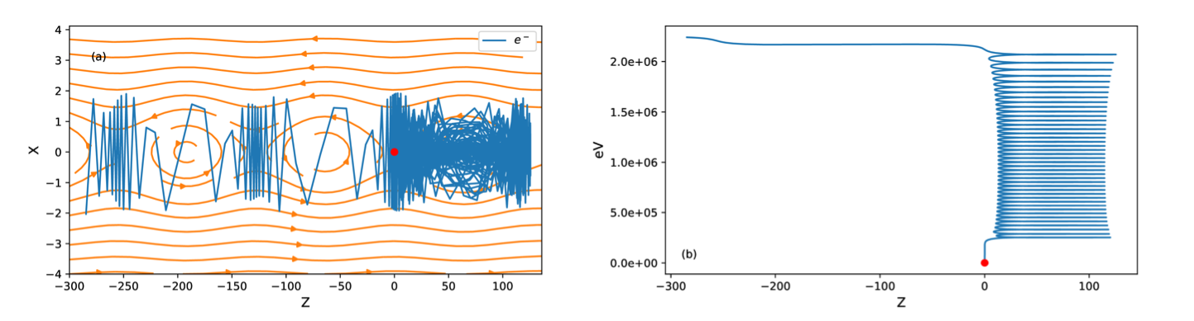
Acceleration in squashed magnetic islands with large By
Xia and Zharkova, 2018
https://solargsm.com/wp-content/uploads/2020/03/xia_zharkova_tp_islands_aa18.pdf
Electrons can be accelerated in a single squashed island to relativistic energy. They circle about the O-point and are ejected from X-nullpoint.

Slide 17
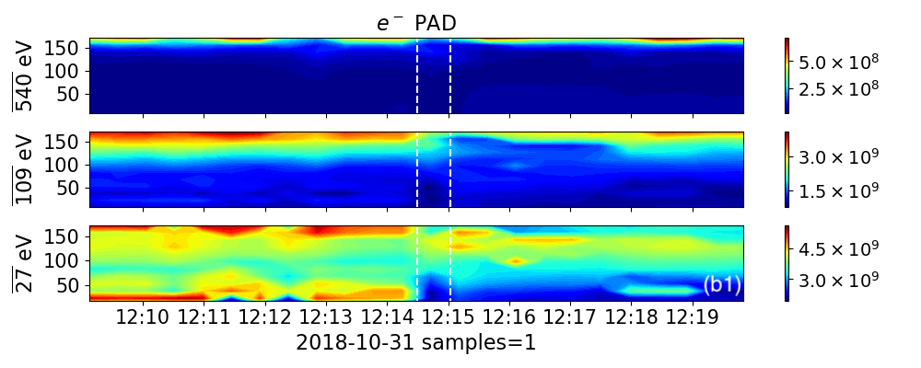
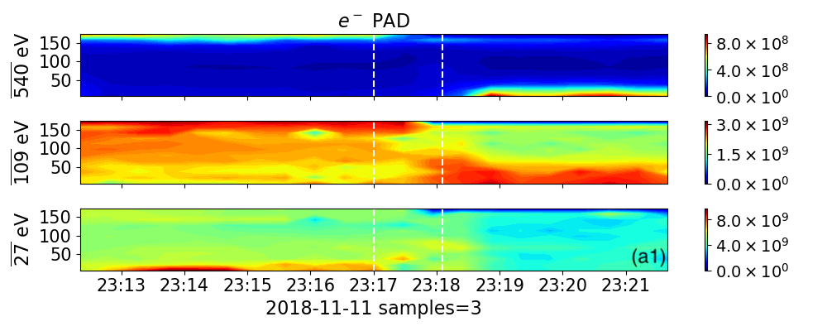
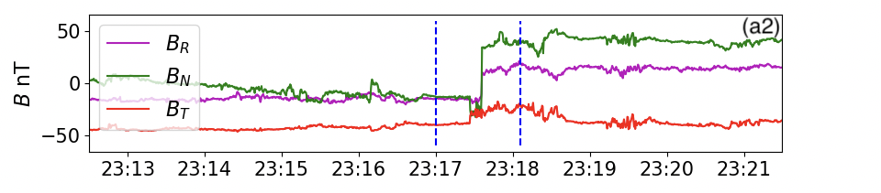
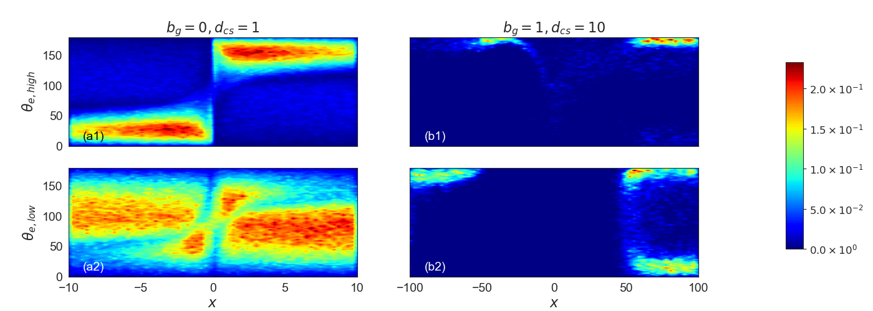
Parker’s probe observations
Simulated PADs
https://solargsm.com/wp-content/uploads/2021/02/zharkova_xia_PADs_aa21.pdf

Slide 18
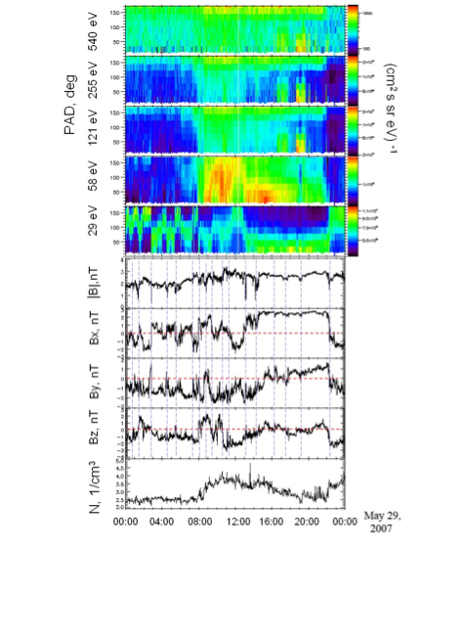
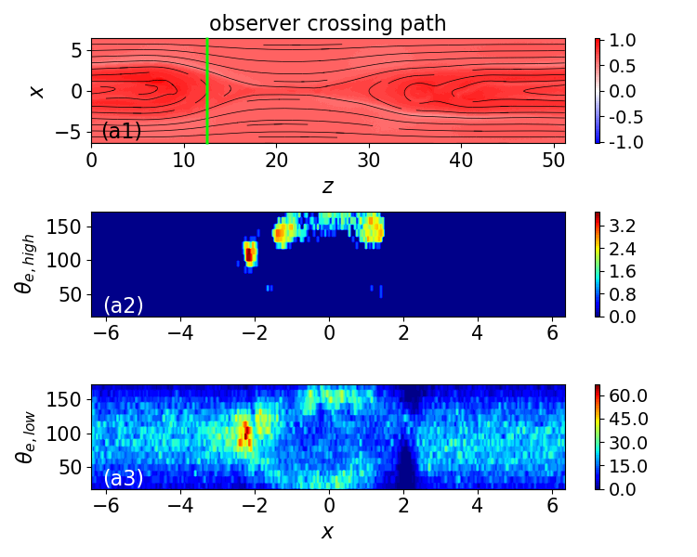
Electron PADs observed by WIND (left) and simulated by PIC (right) https://solargsm.com/wp-content/uploads/2020/04/Khabarova_PAD_features_apjl20.pdf
Electrons of different energies, the IMF, and the density in the region filled with MIs as observed by the WIND spacecraft on 2007, May, 29.

Slide 19
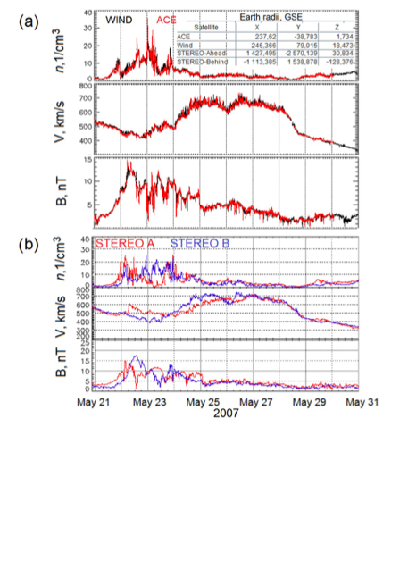
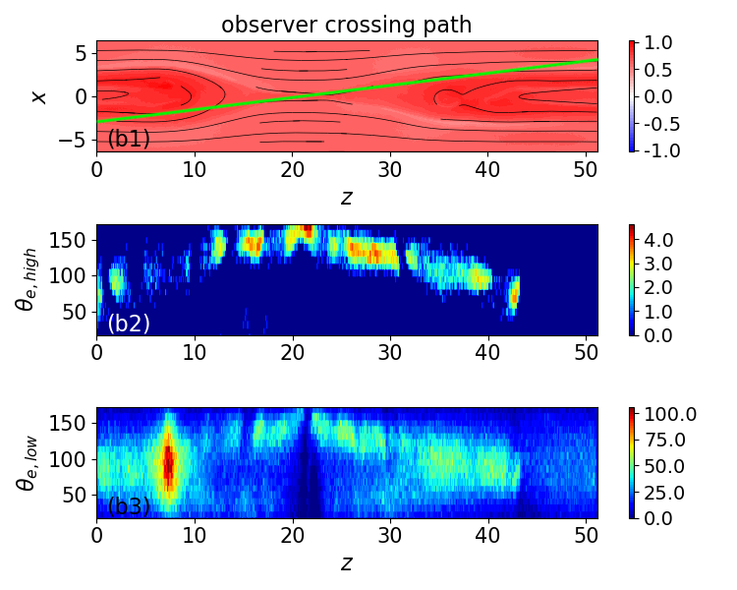
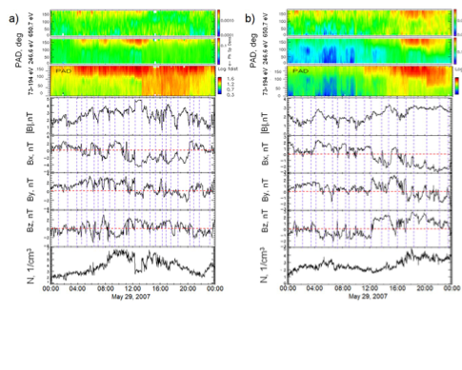
PAD three top panels (right column):
650.7, 246.6, and 73-194 eV energy channels from STEREO A (a) and STEREO B (b) https://solargsm.com/wp-content/uploads/2020/04/Khabarova_PAD_features_apjl20.pdf
The highest-energy 650.7 eV STEREO PAD is completely different from the other PADs. It shows signatures of intermittent bi- directionality, following the location of MIs and CSs

Slide 20
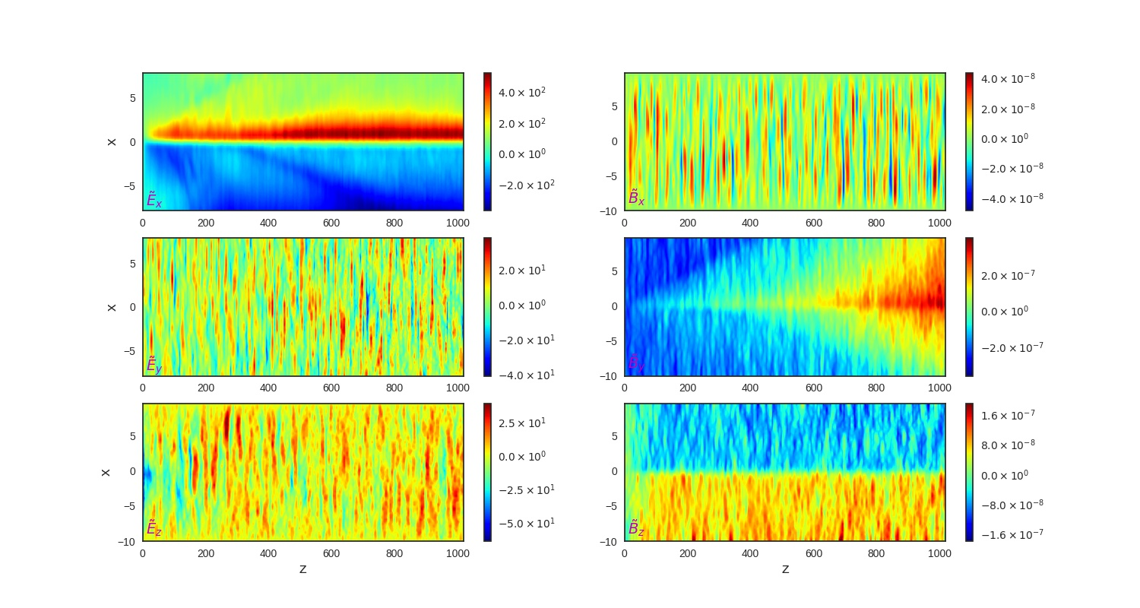
Turbulent electric and magnetic fields induced by accelerated particles
(Siversky& Zharkova, 2009, JPP; Xia and Zharkova, 2020, A&A)
E
B

Slide 21
Conclusions
There is the separation of electrons from protons in RCSs with respect to the midplane (sector boundary – SB in the HCS), which generates a polarization electric field across the current sheet
Magnetic field imposes its signatures on pitch-angle and energy distributions on particles entering a current sheet from the opposite (transit) and the same side (bounced particles)
Particles accelerated in magnetic islands still have the populations of transit and bounced particles leading to two beam instabilities often reported in observations and PIC models,
Particle energy gains in coalescent islands are lower than in squashed ones
PADs of accelerated particles are shown to reflect magnetic topology of current sheets and can be compared with in-situ observations accounting for energetic strahls (transit electrons) and diffusive drop-offs (bounced electrons) often observed in solar wind
Bump-in-tail velocity distributions of transit and bounced particles of the same charge induce turbulence in different parts of current sheets – see Zharkova and Xia, 2021, Frontier paper.

