Slide 1


Modern Grand Solar Minimum (GSM) and its impact on the terrestrial environment
https://solargsm.com/solar-mactivity/
Valentina Zharkova^{1,2}, Serhij Zharkov^{2,3} and Simon Shepherd
1 - University of Northumbria, Newcastle upon Tyne, UK
2 – ZVS Research Enterprise Ltd., London, UK
3 – University of Hull, Kingston upon Hull, UK
4 – Brackett University, Leeds, UK
https://solargsm.com/publications/

Slide 2
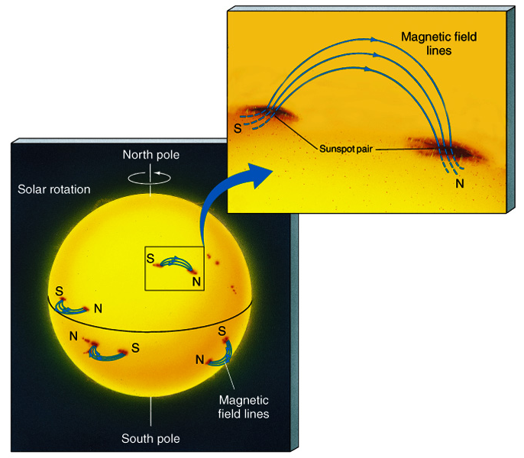
Sunspot & Solar Background Magnetic Fields
The magnetic field in a sunspot is 1000x greater than the surrounding area
Sunspots are almost always in pairs at the same latitude with each member having opposite polarity
Solar background magnetic field contains much more information than sunsaposts

Slide 3
Fitting the PCs to measured in cycle 24 and prediction to 25-26
Eigen vectors of SBMF come in pairs, here are PCs
(Shepherd et al, 2014, Zharkova et al, 2015)

Slide 4
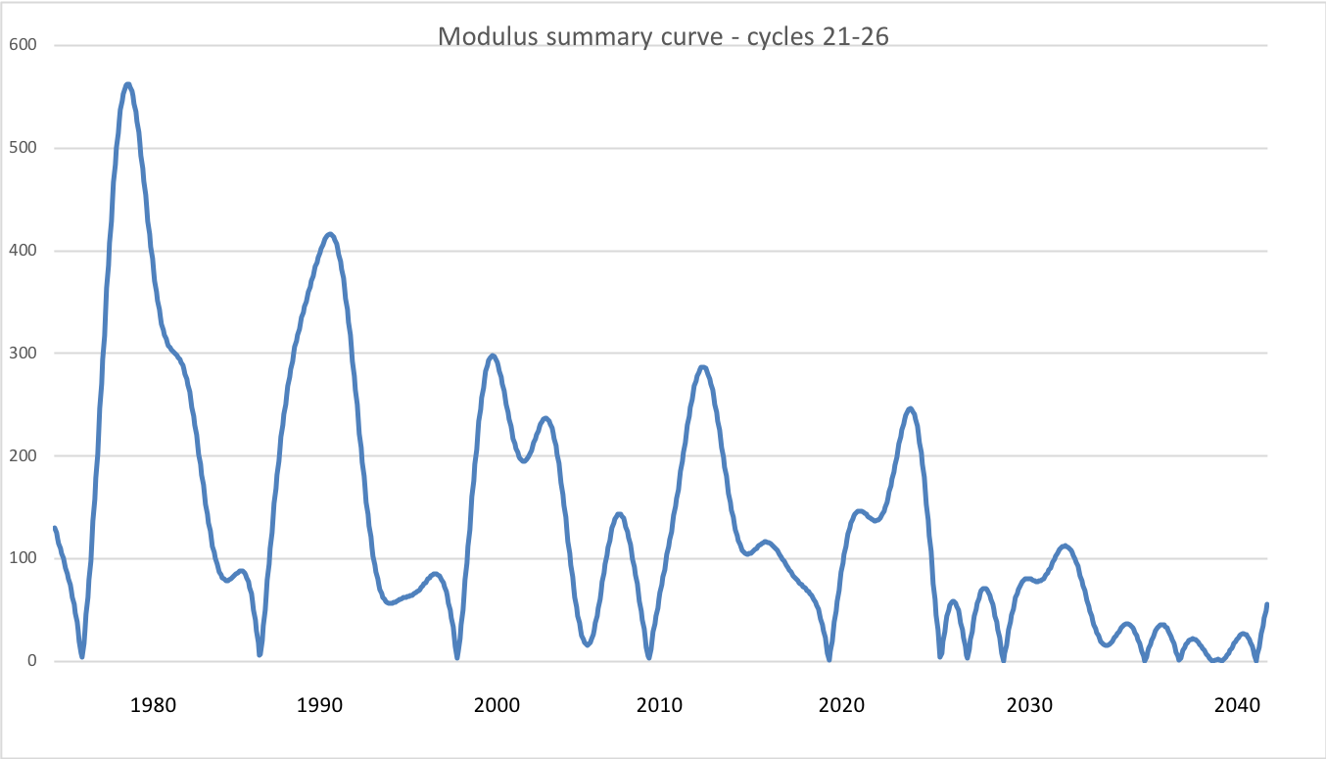
Modulus summary curve
Zharkova et al, 2015, SciRep; 2020, Temp., Zharkova et al, 2022, MNRAS s sunsdata
(Shepherd et al, 2014 ; Zharkova et al, 2015)
Cycle 21
Cycle 22
Cycle 23
Confirmed by
Katiashvili, 2020, ApJ;
Obridko et al, 2021, MNRAS
Velasco-Herrera et al, 2021
Cycle 21
Cycle 22
Cycle 23
Cycle 24
Cycle 25
Cycle 26

Slide 5
Predicted solar activity (Zharkova et al, 2015, SR https://www.nature.com/articles/srep15689)
Zharkova et al, 2015, Nature SR
Observational result, dynamo model was not yet considered
Discovery of grand solar cycles :350-400 years
In addition to 11 year cycles
https://solargsm.com/solar-activity/ - my webpage

Slide 6
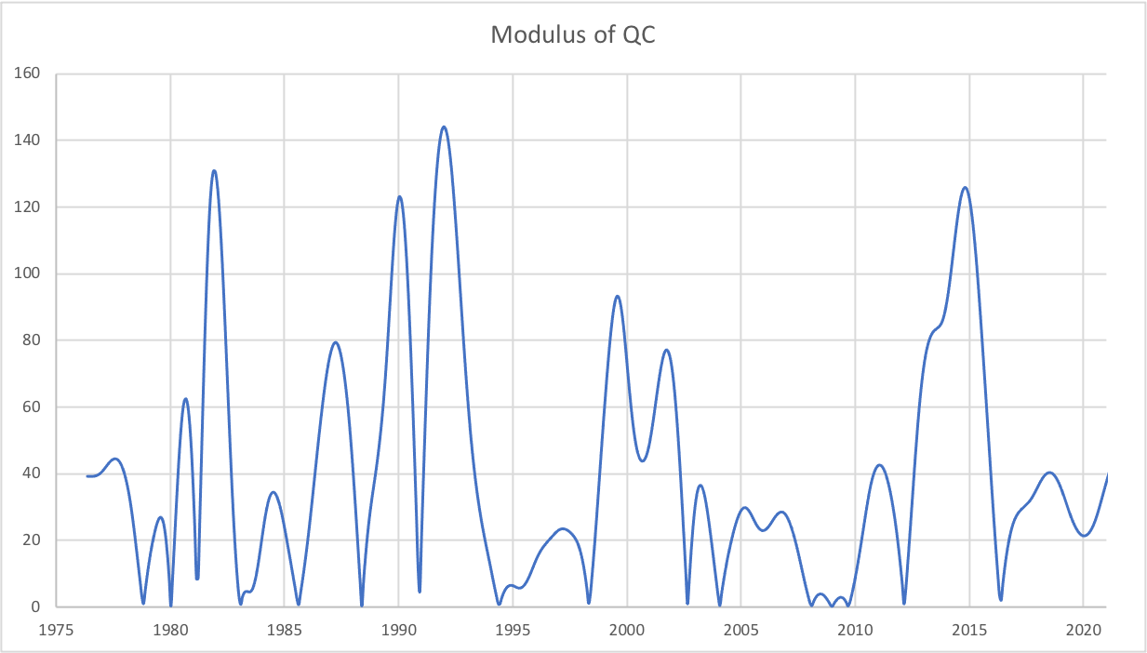
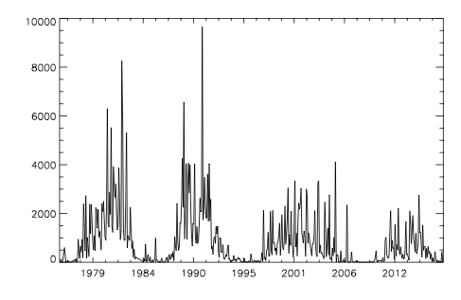
Quadruple summary curve linked
with SHR flare flux
https://solargsm.com/wp-content/uploads/2022/04/zharkova_shepherd_mnras22.pdf

Slide 7
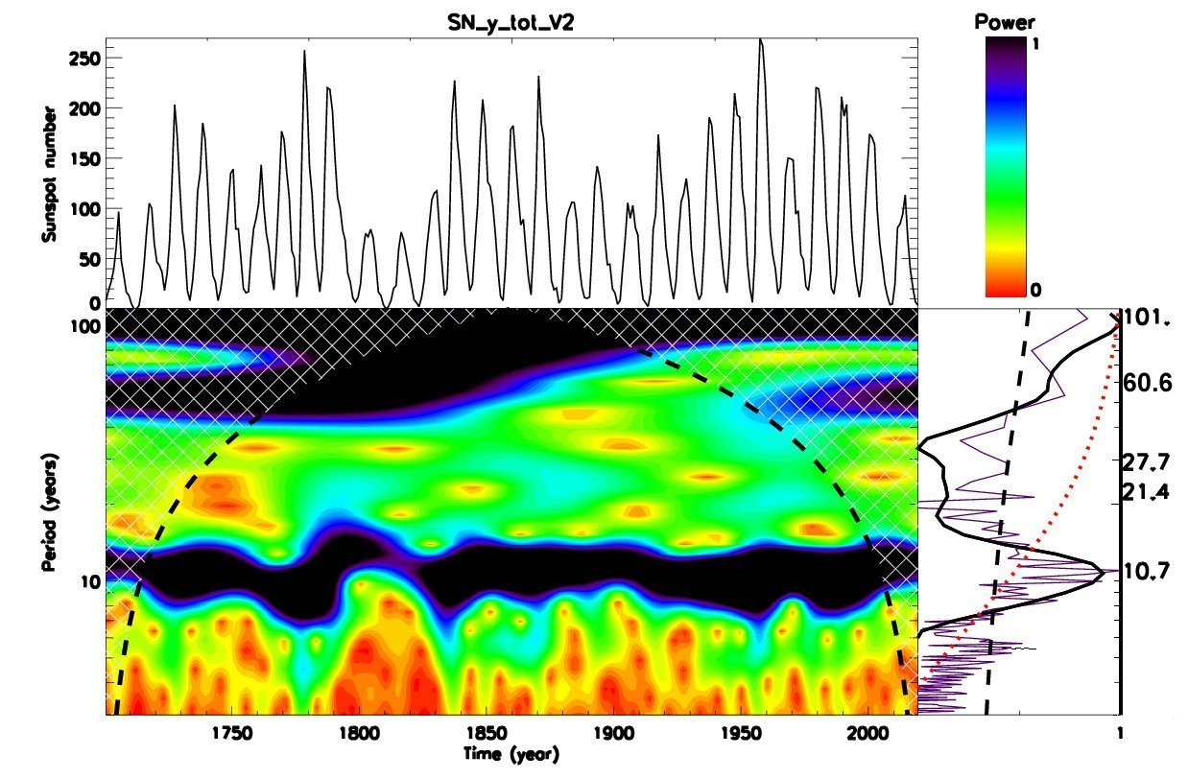
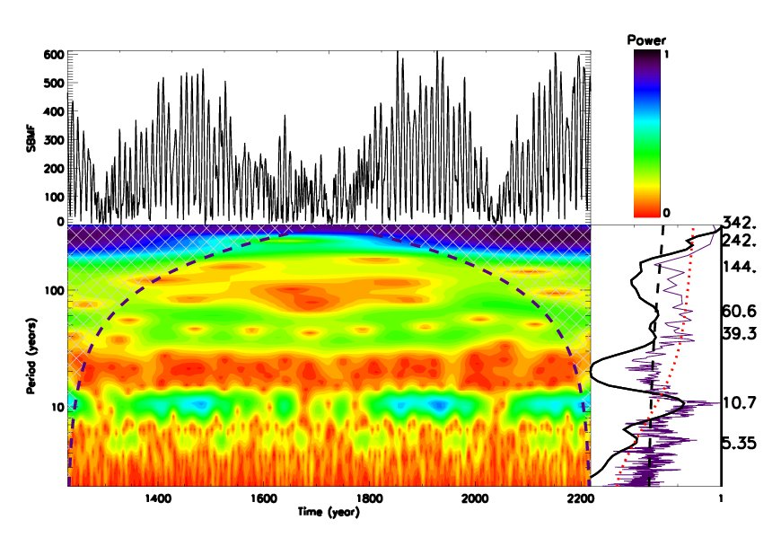
Wavelet spectral analysis
Averaged sunspot numbers Modulus summary curve of PCs Z15
https://solargsm.com/wp-content/uploads/2023/04/zharkova_etal_mnras2023.pdf

Slide 8
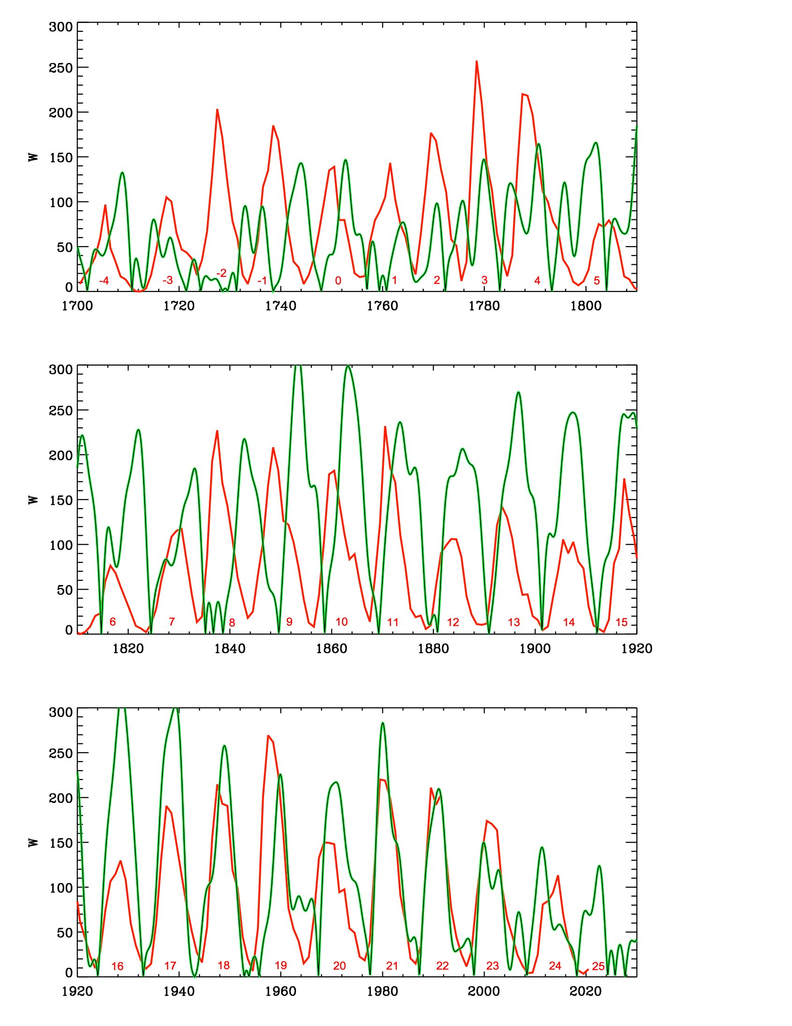
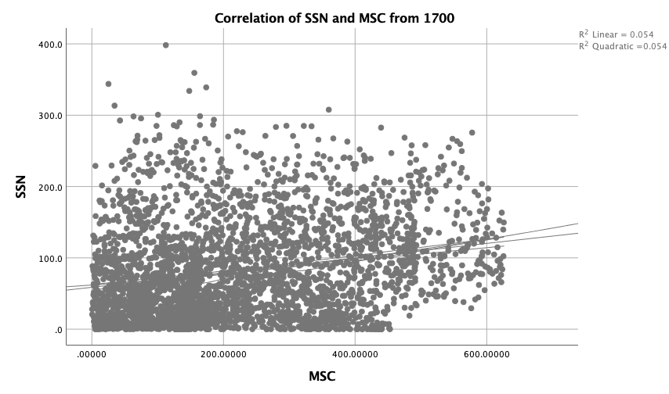
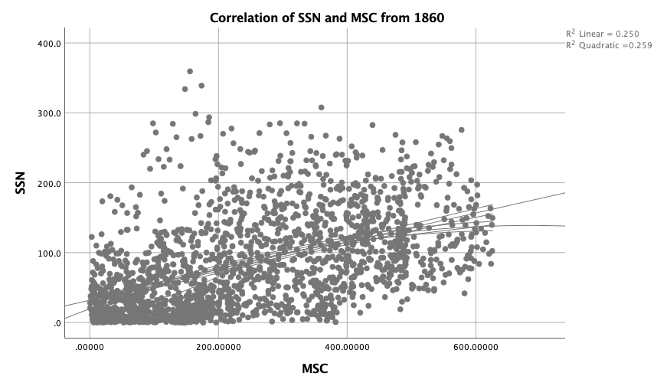
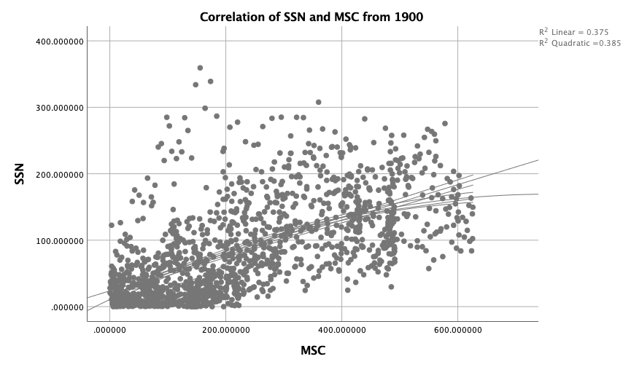
Correlation with SPSS of SSN with MSC - Zharkova et al, 2023, MNRAS
25%
56%
67%

Slide 9
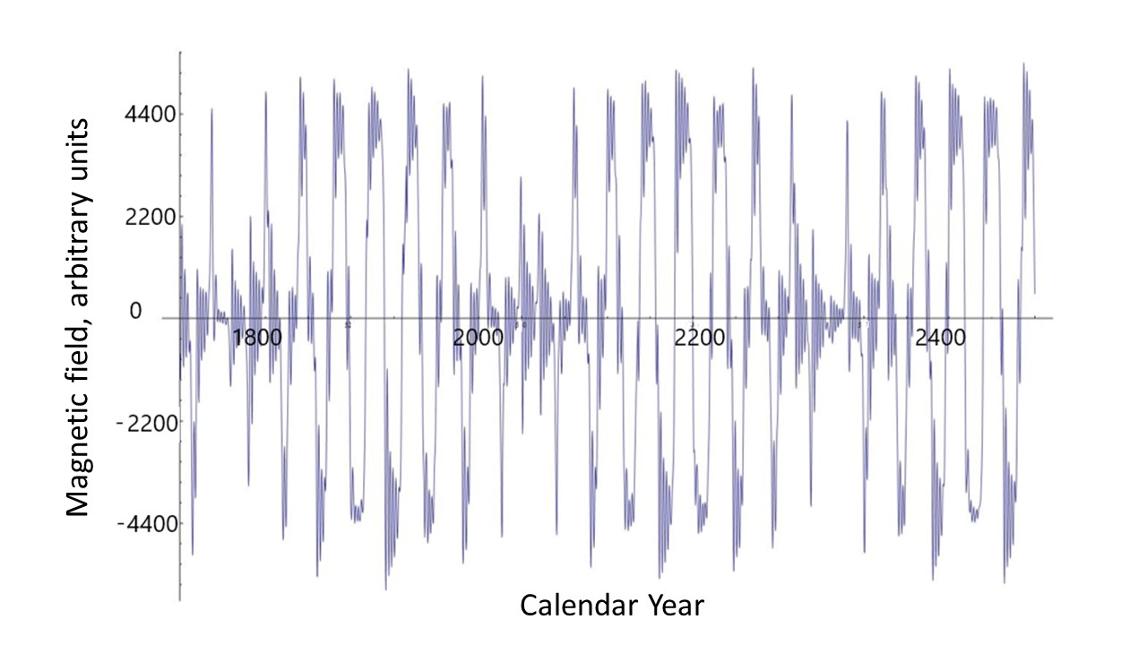
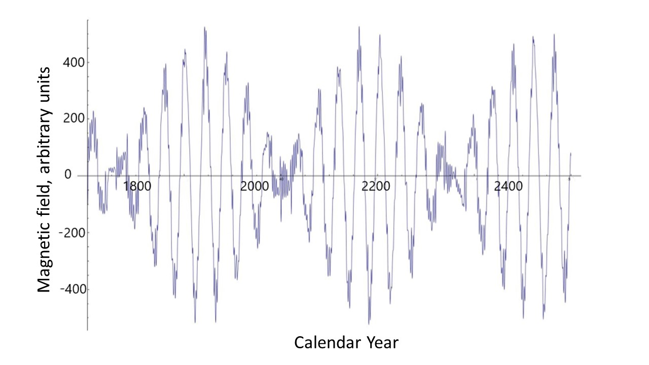
Poloidal (left) versus toroidal (right) magnetic fields
https://solargsm.com/wp-content/uploads/2023/04/zharkova_etal_mnras2023.pdf

Slide 10
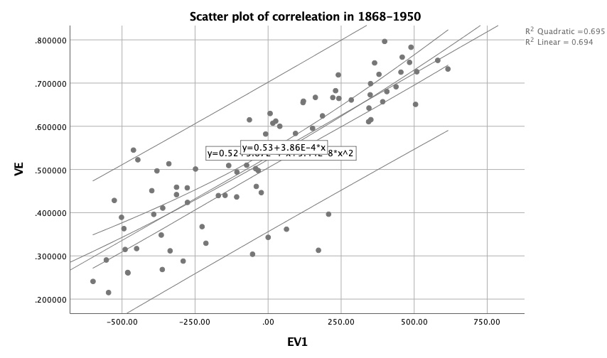
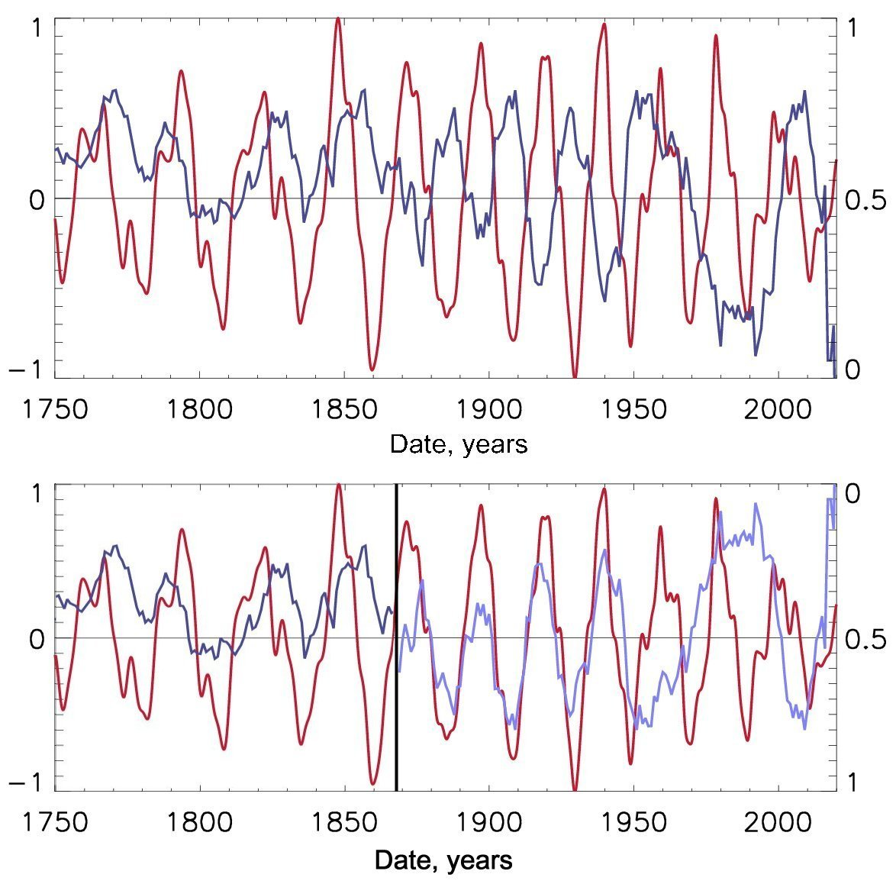
Top plot
Blue – frequencies of volcanic eruptions
Red - the summary curve of solar background magnetic field. Positive magnitudes – northern polarity, negative - southern polarity.
Bottom plot
Volcanic eruption frequencies highly (0.84) correlate with the summary curve with southern polarity with a period of 22 years (1860-1950).
Next maximum of volcanic eruptions will occur in cycle 26 (2031-2042).
Scatter plots of correlation of VE with the Southern polarity SC -87% (!)
Huge number of volcanic eruptions in cycle 26
Volcanic activity correlates with SA cycles of southern polarity
(Vasilieva and Zharkova, 2022)
https://solargsm.com/publications

Slide 11
Predicted solar activity (Zharkova et al, 2015, SR https://www.nature.com/articles/srep15689)
Zharkova et al, 2015, Nature SR
Observational result, dynamo model was not yet considered
Discovery of grand solar cycles :350-400 years
In addition to 11 year cycles
https://solargsm.com/solar-activity/ - my webpage

Slide 12
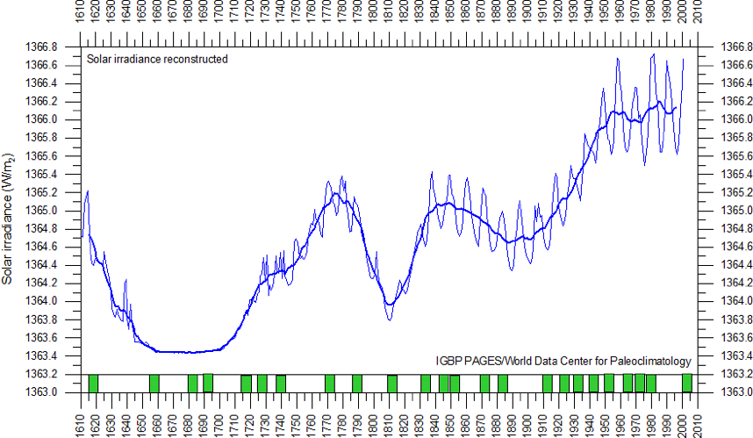
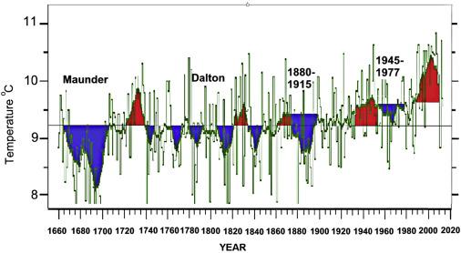
Solar irradiance and terrestrial temperature during MM Zharkova, 2021
Lean et al, 1995, JGR
Lamb, 1972; Easterbrook, 2016
Authors | S, Maunder minimum, W/m² | S 1990-2000, W/m² | △S from MM, %
Lean et. Al., 1995 | 1363 | 1366 | 0.22
Steinhilber et al, 2012 | 1364 | 1366 | 0.22
Shirley et al., 1990 | --- | 1370 | 0.51
Wolff and Hickey, 1987 | --- | 1371 | 0.51
Lee et al., 1995 | --- | 1372 | 0.51
After the TSI data were re-normalized the old data are hardly usable

Slide 13
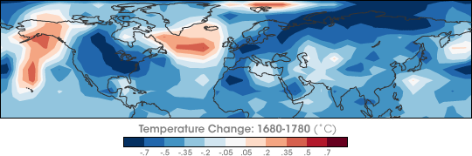
Temperature restoration during/after MM
(Shindell et al., 2001, Science)
The surface temperature of the Earth was reduced all over the Globe
Europe and North America went into a deep freeze
Alpine glaciers extended over valley farmland
Sea ice crept south from the Arctic
Danube and Thames rivers & canals in the Netherlands froze regularly

Slide 14
Temperature restoration during MM
(Shindell et al., 2001, Science)
the drop in the temperature was related to dropped abundances of ozone created by solar ultra-violate light in the stratosphere, the layer of the atmosphere located between 10 and 50 kilometers from the Earth’s surface

Slide 15
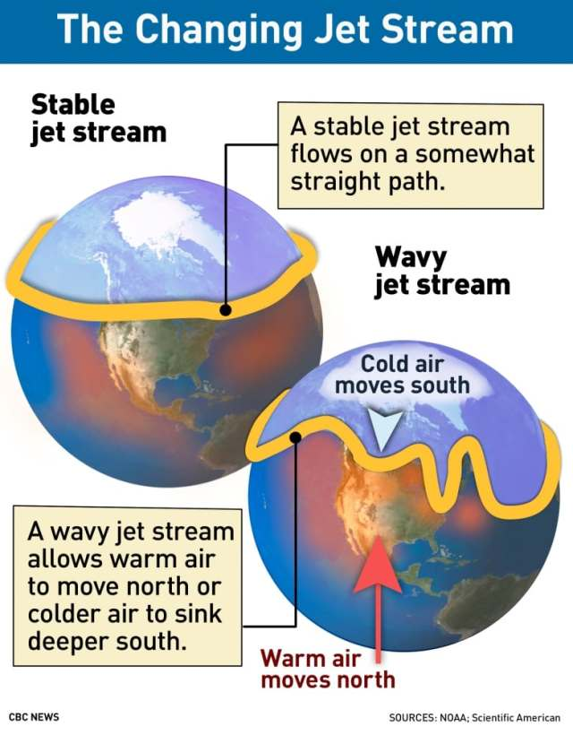
Less ozone affected planetary atmosphere waves
They, in turn, caused the giant wiggles in the jet stream as shown in picture on the left
It kicked the North Atlantic Oscillation (NAO)—the balance between a permanent low-pressure system near Greenland and a permanent high-pressure system to its south—into a negative phase
that led to Europe to remain unusually cold during the MM
Shindell et al., 2001

Slide 16
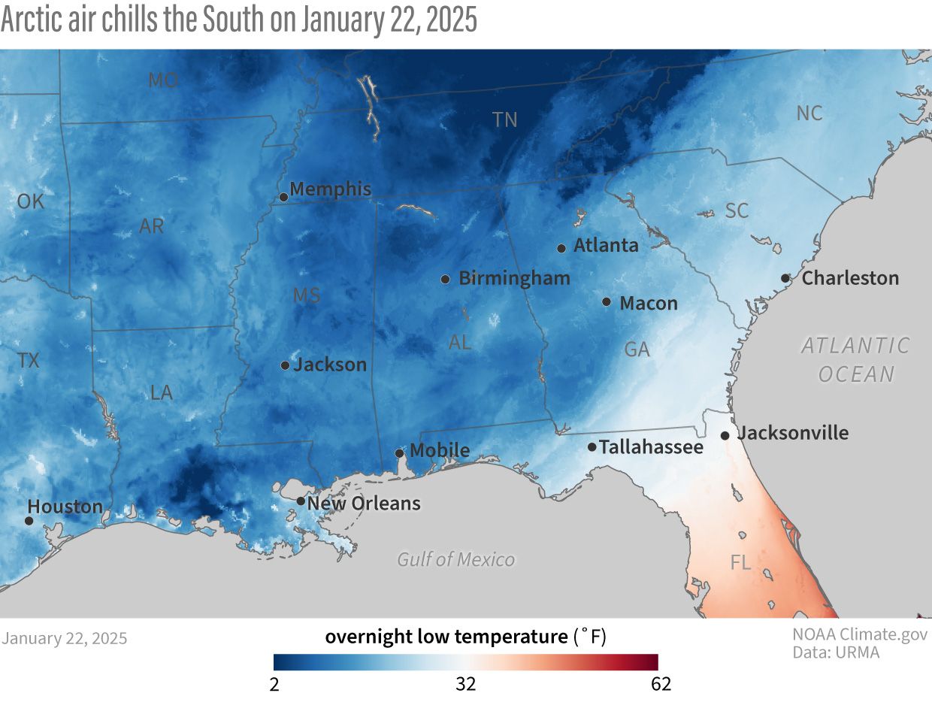
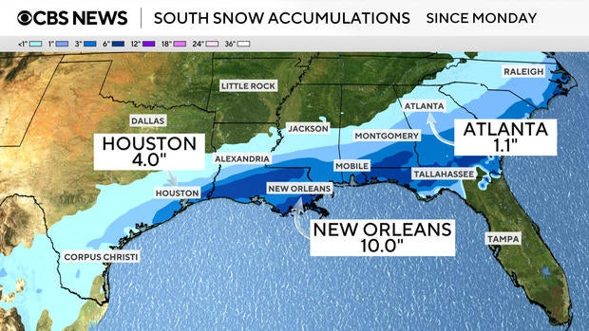
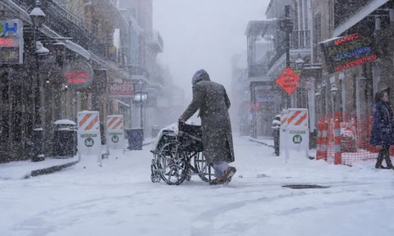
Snow and frost in Texas, Florida and Luisiana –Jan ’25,
T in F

Slide 17
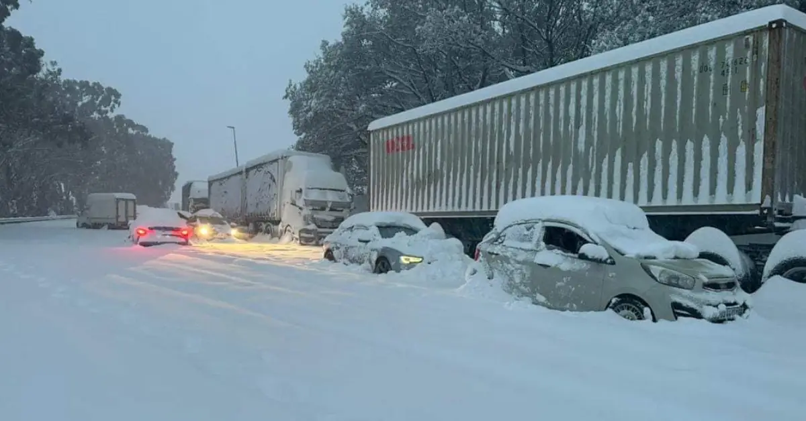
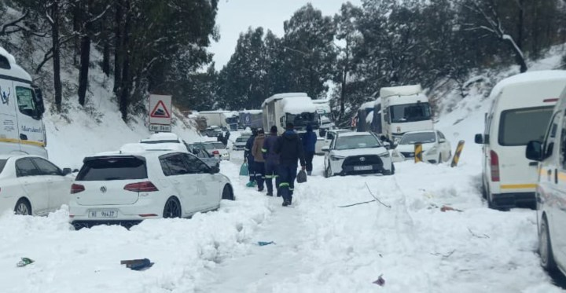
Snow in South Africa - 21-23 Sept ’24

Slide 18
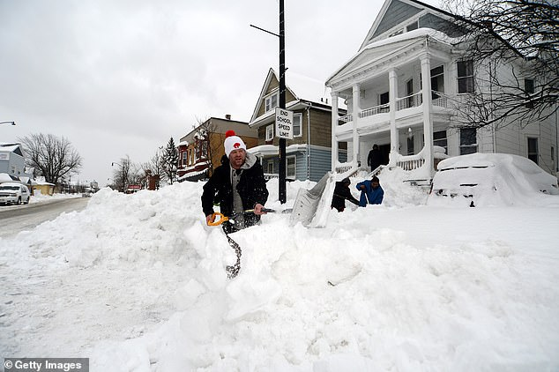
Strong snow blizzards in USA and Canada for 2 weeks in Dec ’22 –Jan’ 23

Slide 19
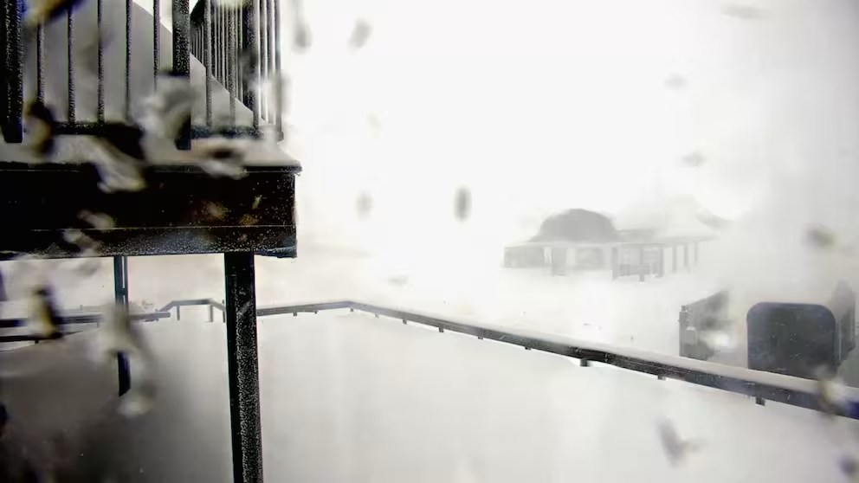
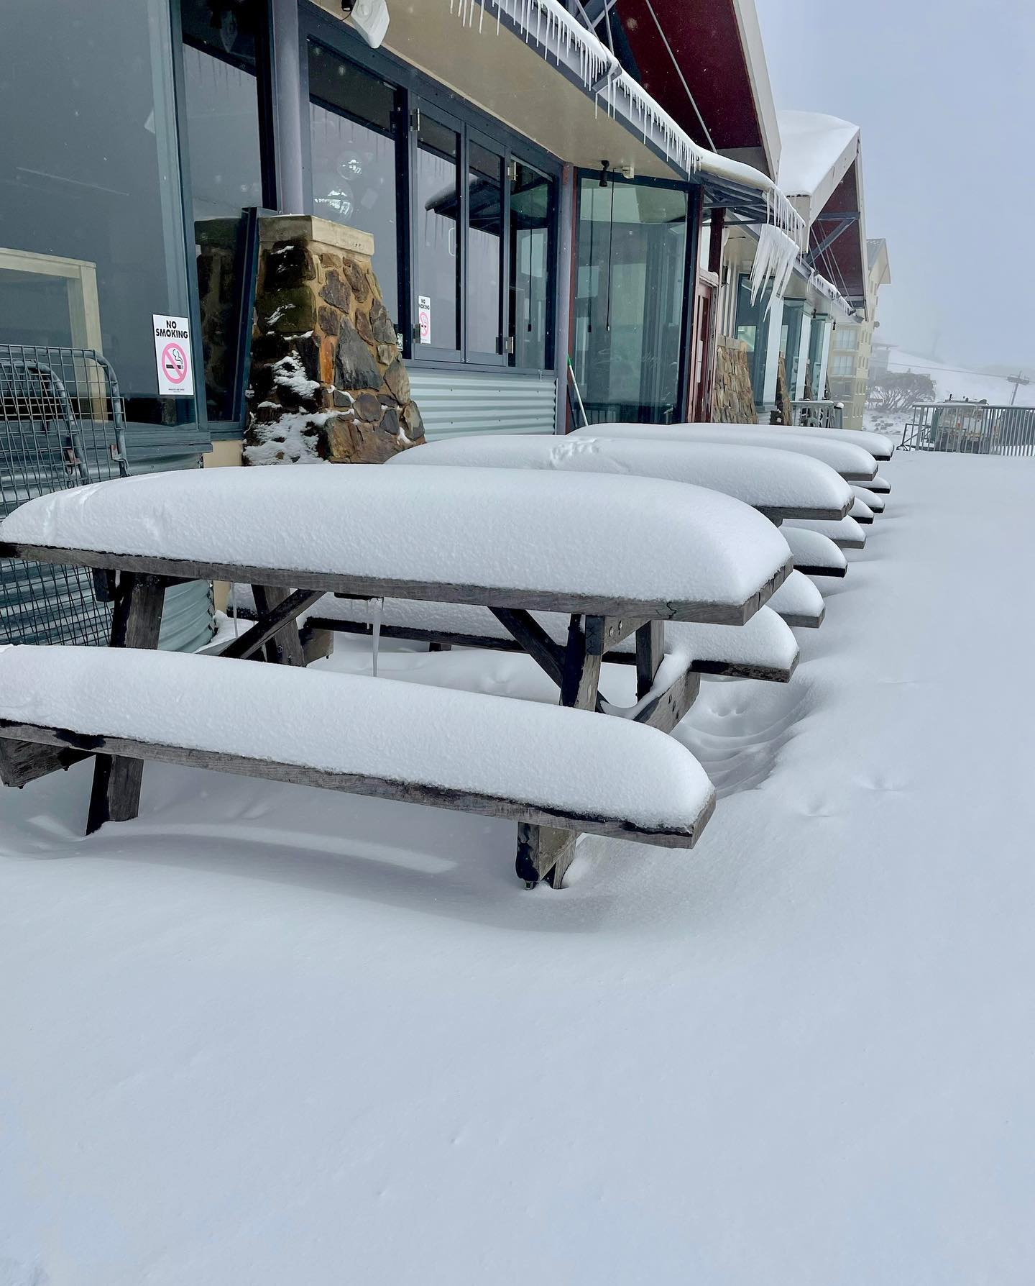
Late spring snow in Australia and NZ 22-30 November ’22
(analog of late May in Northern hemisphere)
1 May 2025 – early snow and frost in New Zeeland – informed by people from NZ

Slide 20
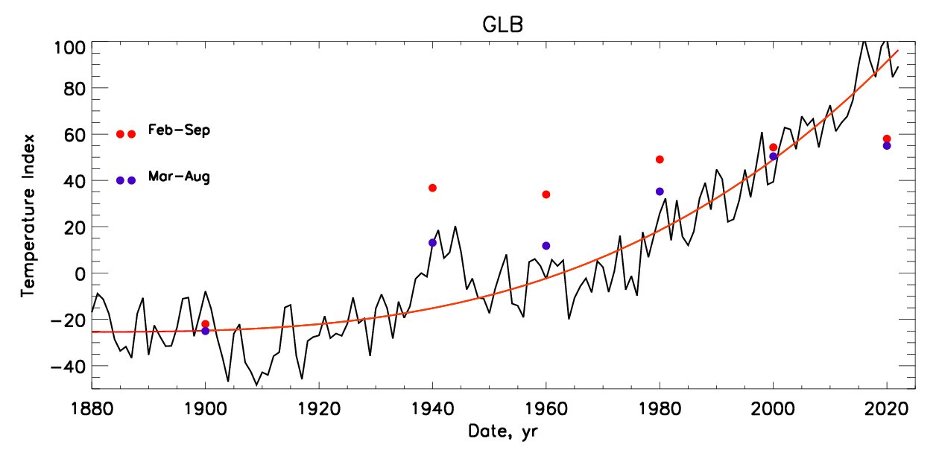
Temperature vs TSI because of SIM
The terrestrial temperature variations (black line) and averaged temperature (red line) versus the total solar irradiance (TSI) of the Sun affected by SIM in the spring- summer months as per the legend on the plot.
.
The solar irradiance is calculated by adding the daily irradiance for given spring-summer months in the Northern hemisphere when the Sun is closest to the Earth’s orbit Zharkova, 2021
1600-2020 - Increase of TSI by 20 W/m^2 → T increased by 2.5C
2020-2600 – increase of TSI by ~25 w/m^2 → T will increase by 2.5-3.0C
Zharkova and Vasilieva, 2023, https://solargsm.com/publications

Slide 21
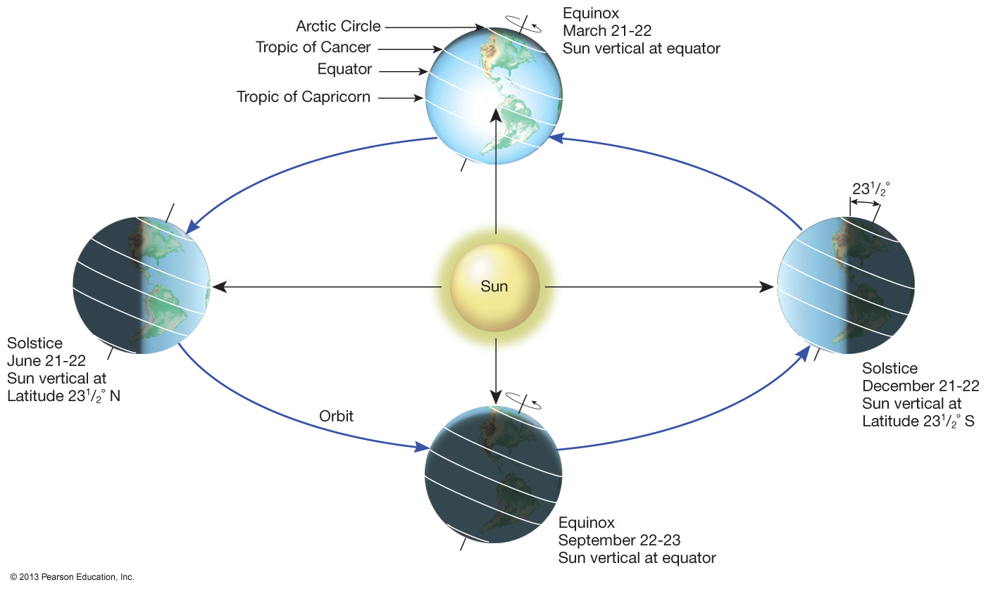
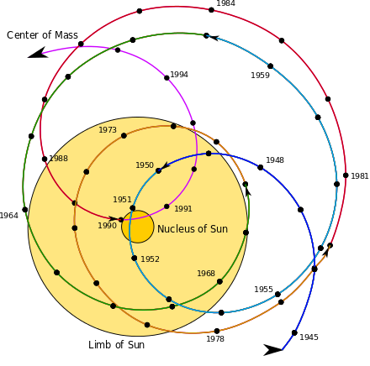
Solar Inertial Motion (SIM) causes the current heating
2600
Aphelion →. 16 July
Perihelion → 16 January
SIM effects on the Earth via solar irradiance
https://youtu.be/vDgUmTq4a2Q
S. Perminov, E.D. Kuznetsov, 2018
SIM imposed by planets Jupiter, Saturn, Neptune and Uranus
Charvatova, 1988,
Palus et al, 2007
Rice et al, PP comments #72, 96

Slide 22
Modern Grand Solar Minimum https://solargsm.com/solar-activity/
It started already in 2020 and will last until 2053
This is a unique event in solar-terrestrial connection → will reveal the pros and cons of solar dynamo models
Decrease of solar magnetic field → big impact ozone reduction, high cloud formation, jet direction changes, cosmic rays increase
Increase of volcanic and earthquake activities
Effects on the terrestrial temperature via TSI, jets and volcanic activity
Shortage of electricity as solar panels and wind mils cannot work in snow/frost →see expected consequences from the recent power cuts in Spain and Portugal
Shortage of vegetation periods can lead to possible food shortages in 2028-2042
Need inter-government efforts to avoid disasters. It requires urgent efforts now!

