Slide 1


Grand Solar Minimum versus Solar Orbital Motion and their impact on Earth
https://solargsm.com/solar-activity/
Prof. Valentina Zharkova
University of Northumbria, Newcastle upon Tyne, UK
ZVS Research Enterprise Ltd., London, UK
https://solargsm.com/publications/
With thanks to Drs. I.Vasilieva (MAO, Kyiv, Ukraine), S. Shepherd (UK),
E. Popova (US) and S. Zharkov (UK)

Slide 2
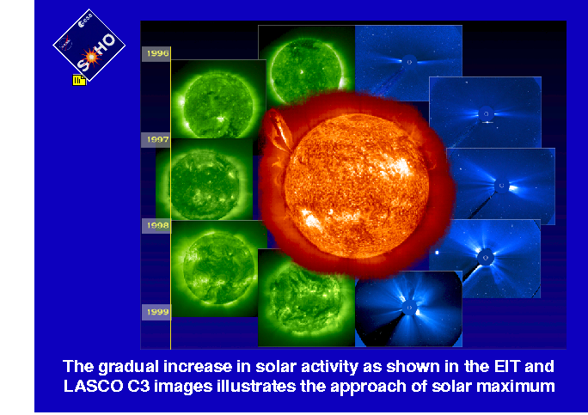
What is the active Sun?

Slide 3
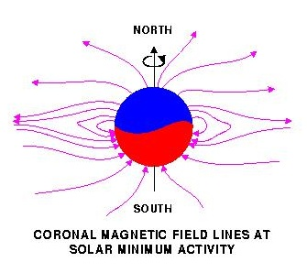
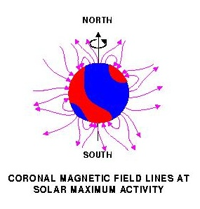
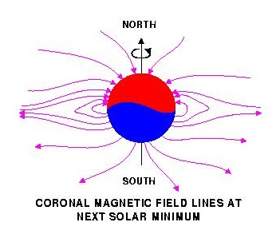
Solar magnetic field reversal
Strong toroidal magnetic fields (TMF) forming Active Regions (ARs)
are created in a shear layer beneath the base of the Solar Convection zone (SCZ).

Slide 4
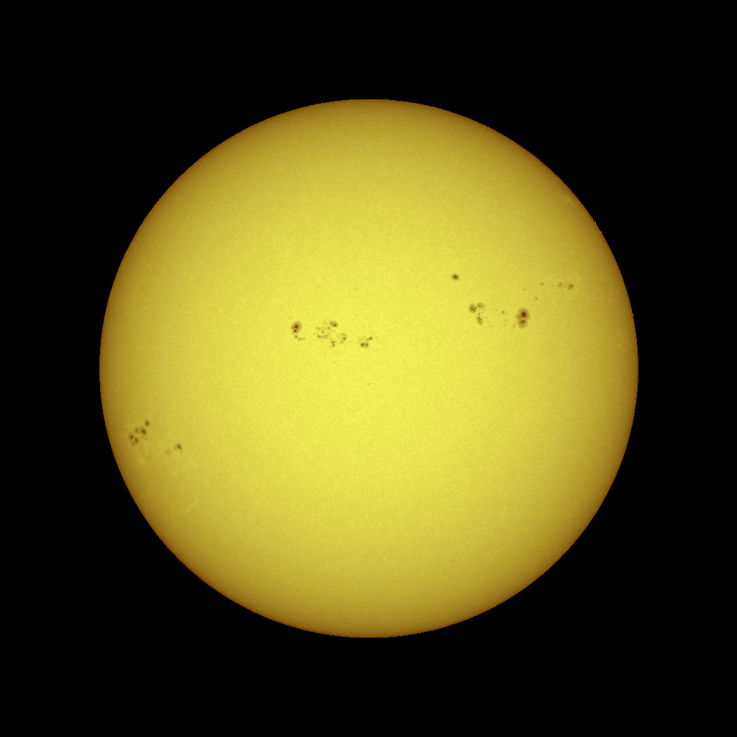
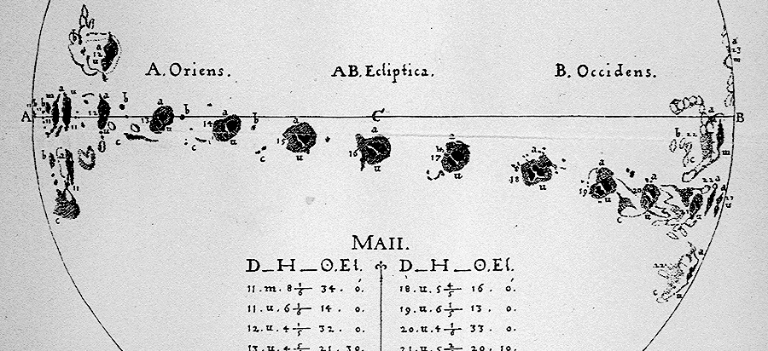

Solar activity
Sunspots are dark (and cooler) regions on the surface of the Sun. They have a darker inner region (the Umbra) surrounded by a lighter ring (the Penumbra).
Sunspots usually appear in groups that form over hours or days and last for days or weeks.
These early sunspot observations indicated that the Sun rotates once in about 27 days.
Solar activity index – average sunspot numbers
Sunspots

Slide 5
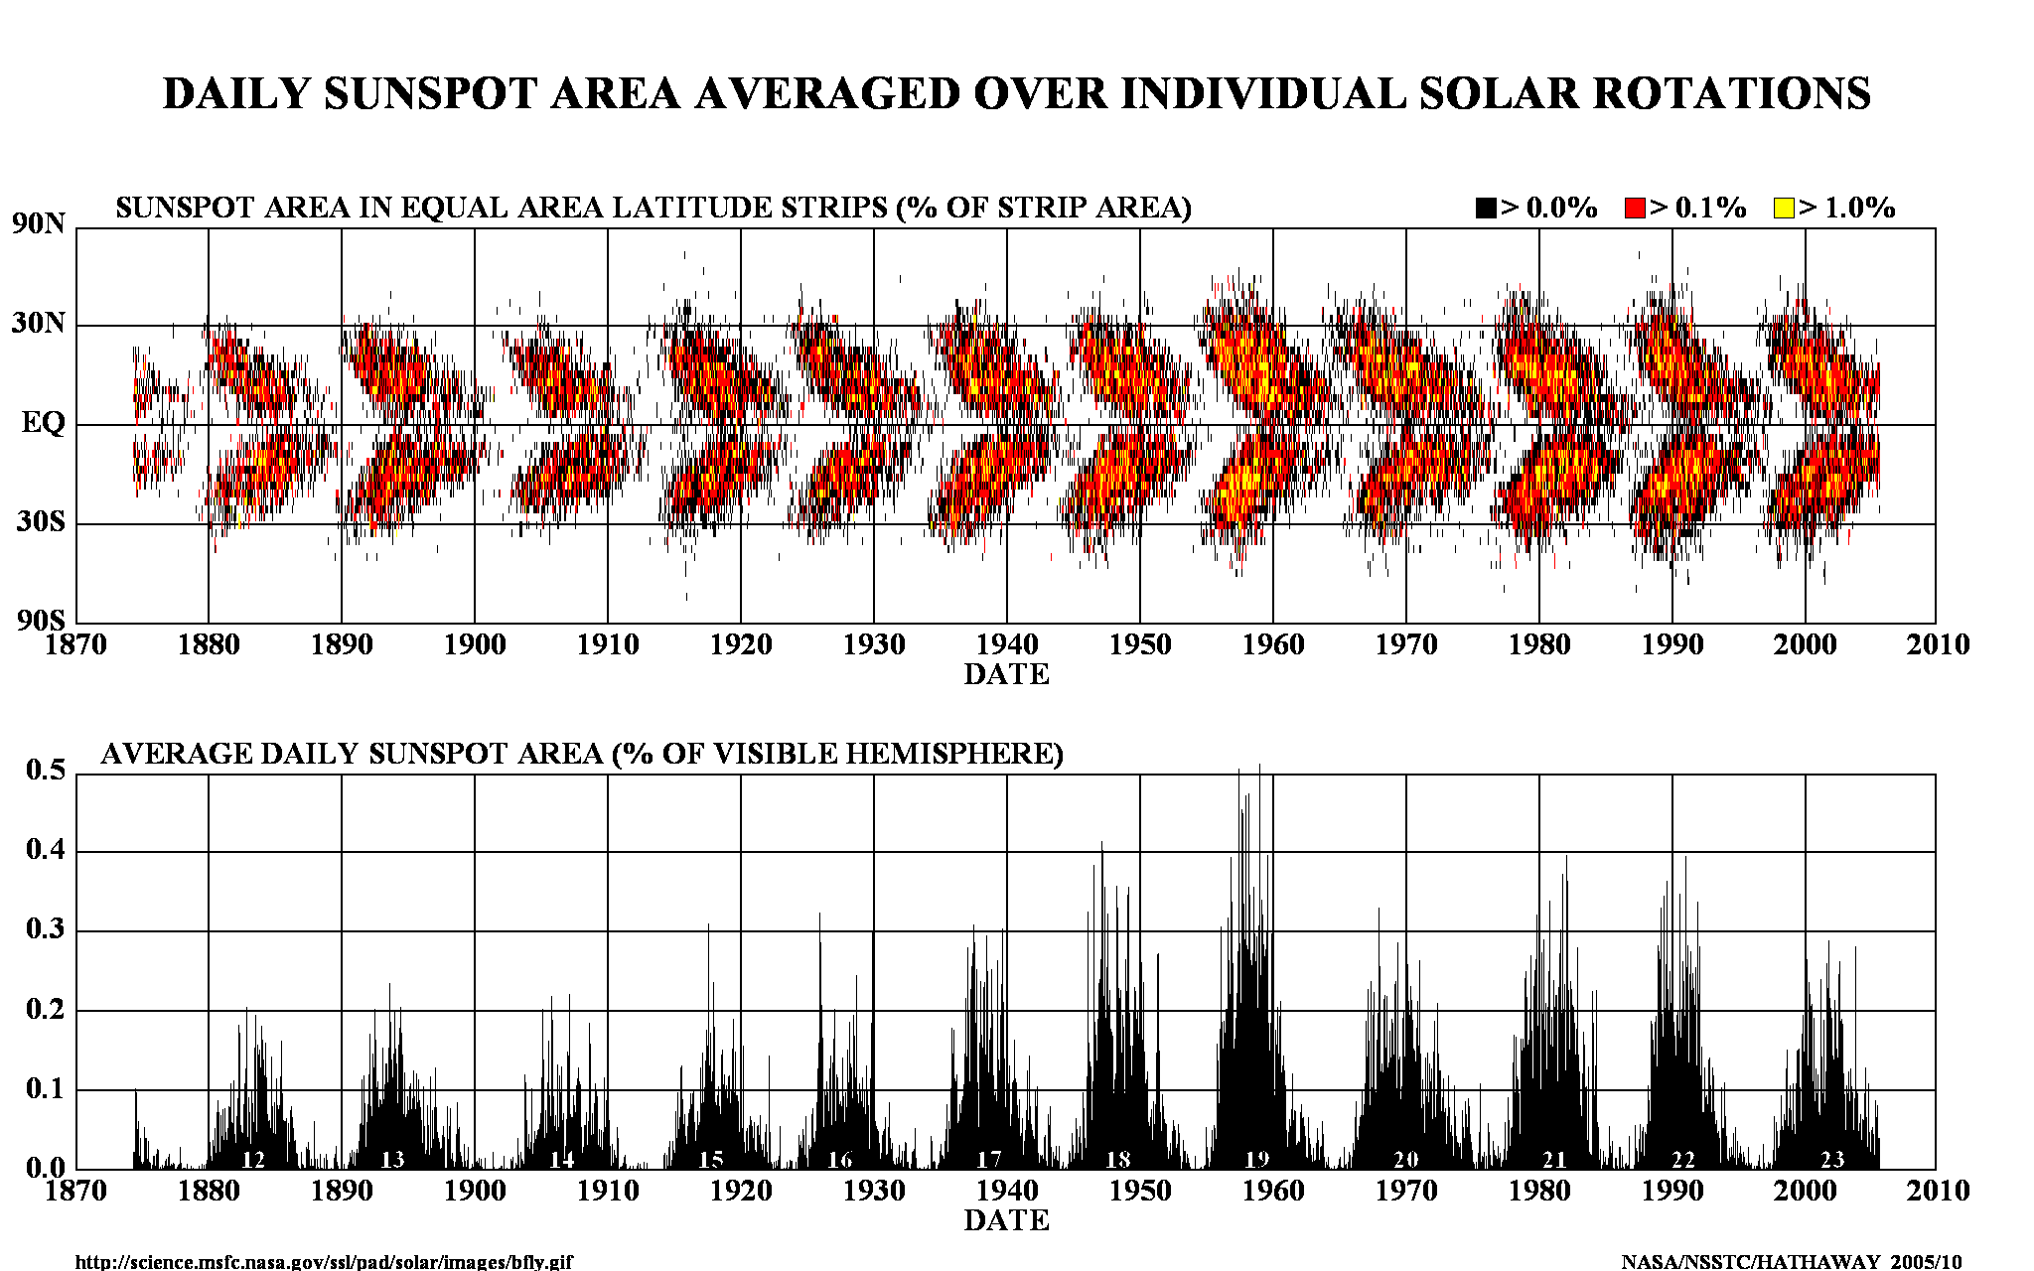
Current solar activity index of 11 years

Slide 6
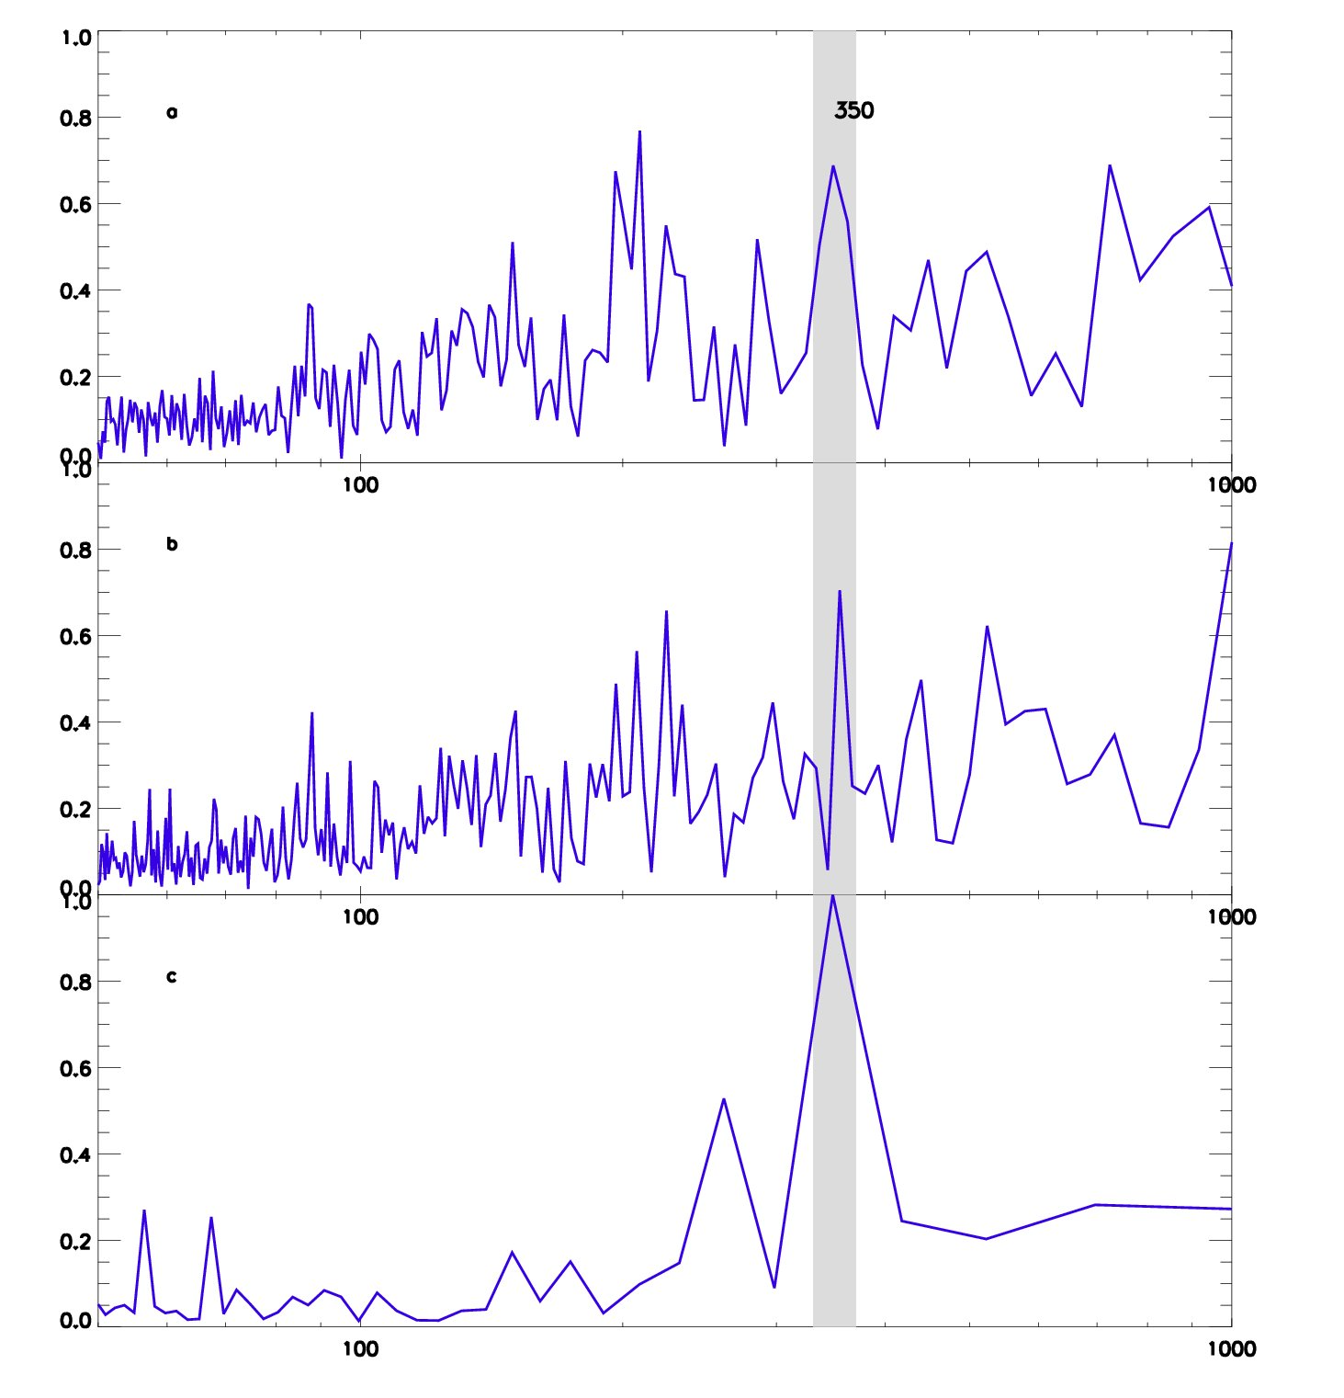
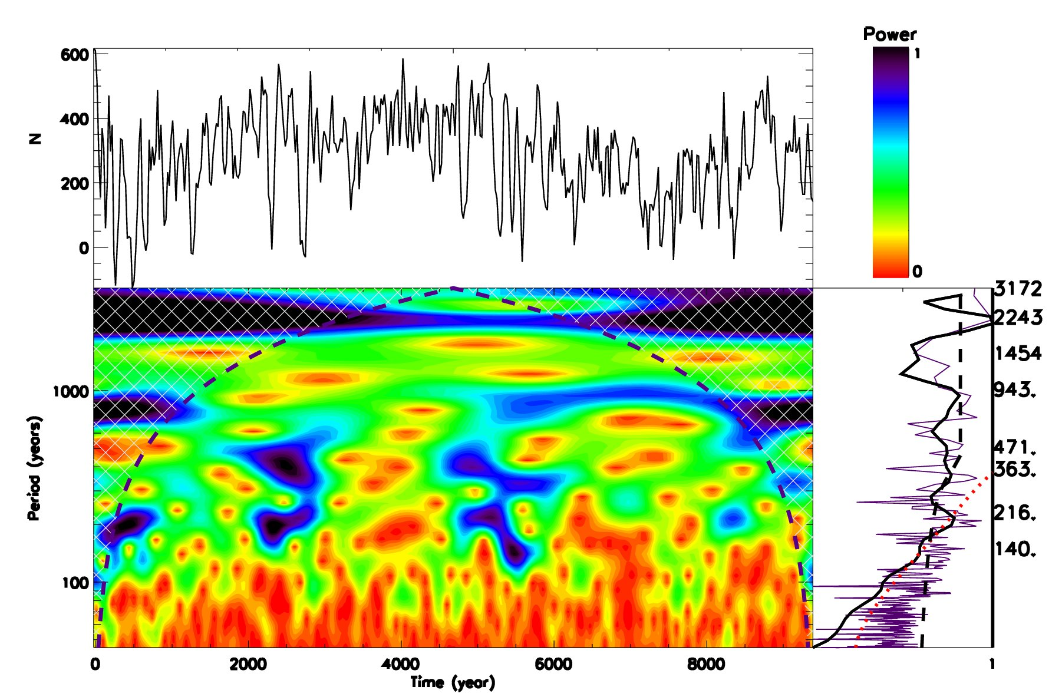
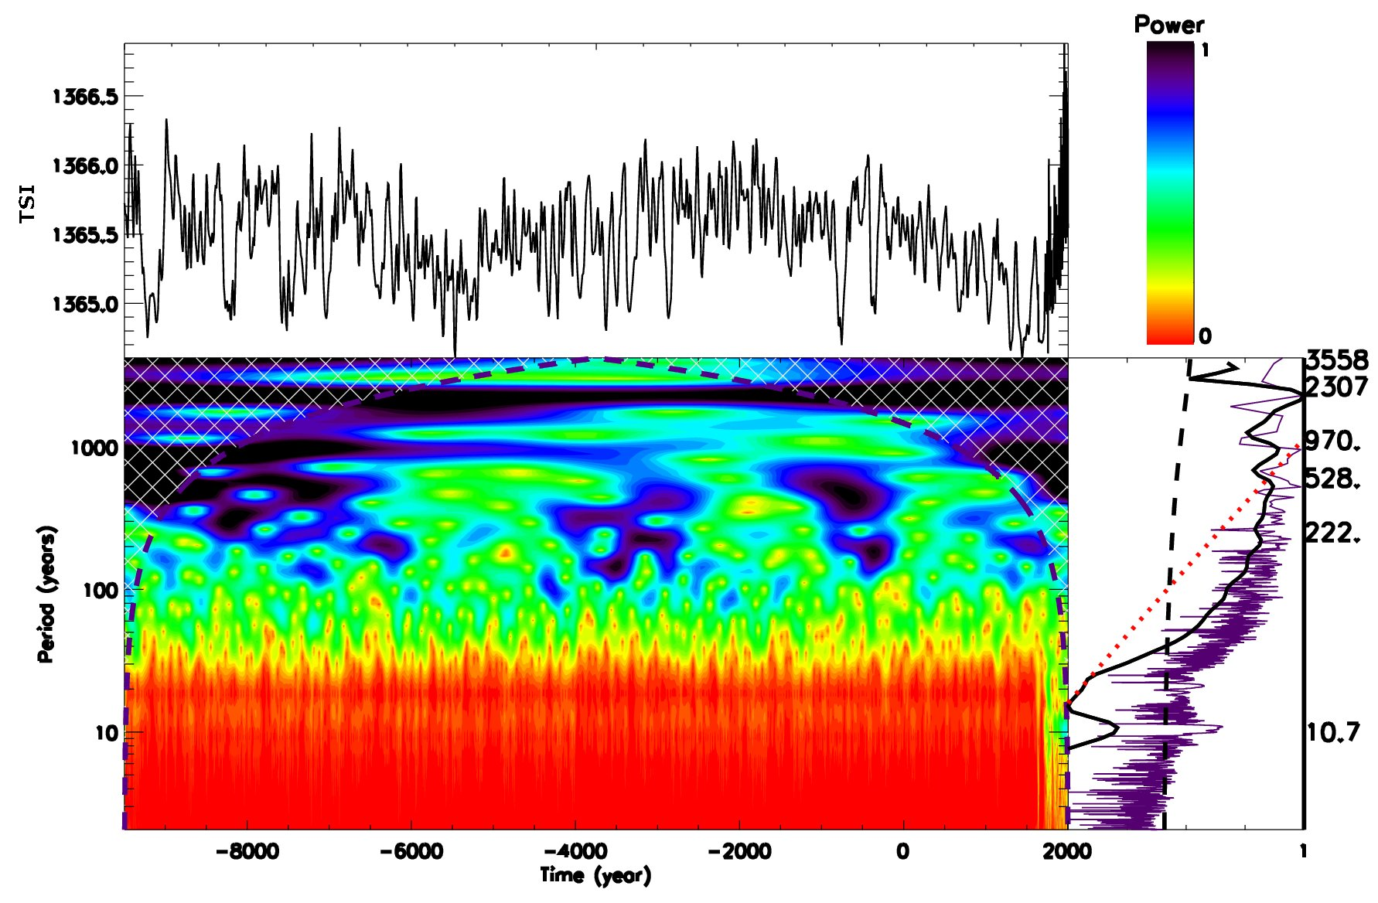
However, there are larger periods of TSI in the Holocene:
Hallstatt's cycle: 2200-2300y, GSC: 350-360y
350
What is causing all these oscillations?
Steinhilber, F., et al . (2012)
Vieira et al . (2011)

Slide 7
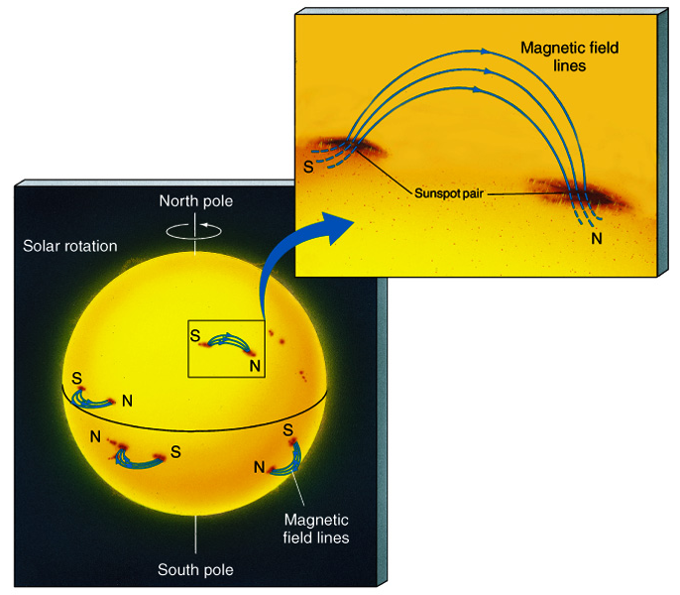
Sunspots & Magnetic Fields
The magnetic field in a sunspot is 1000x greater than the surrounding area
Sunspots are almost always in pairs at the same latitude with each member having opposite polarity
All sunspots in the same hemisphere have the same magnetic configuration

Slide 8
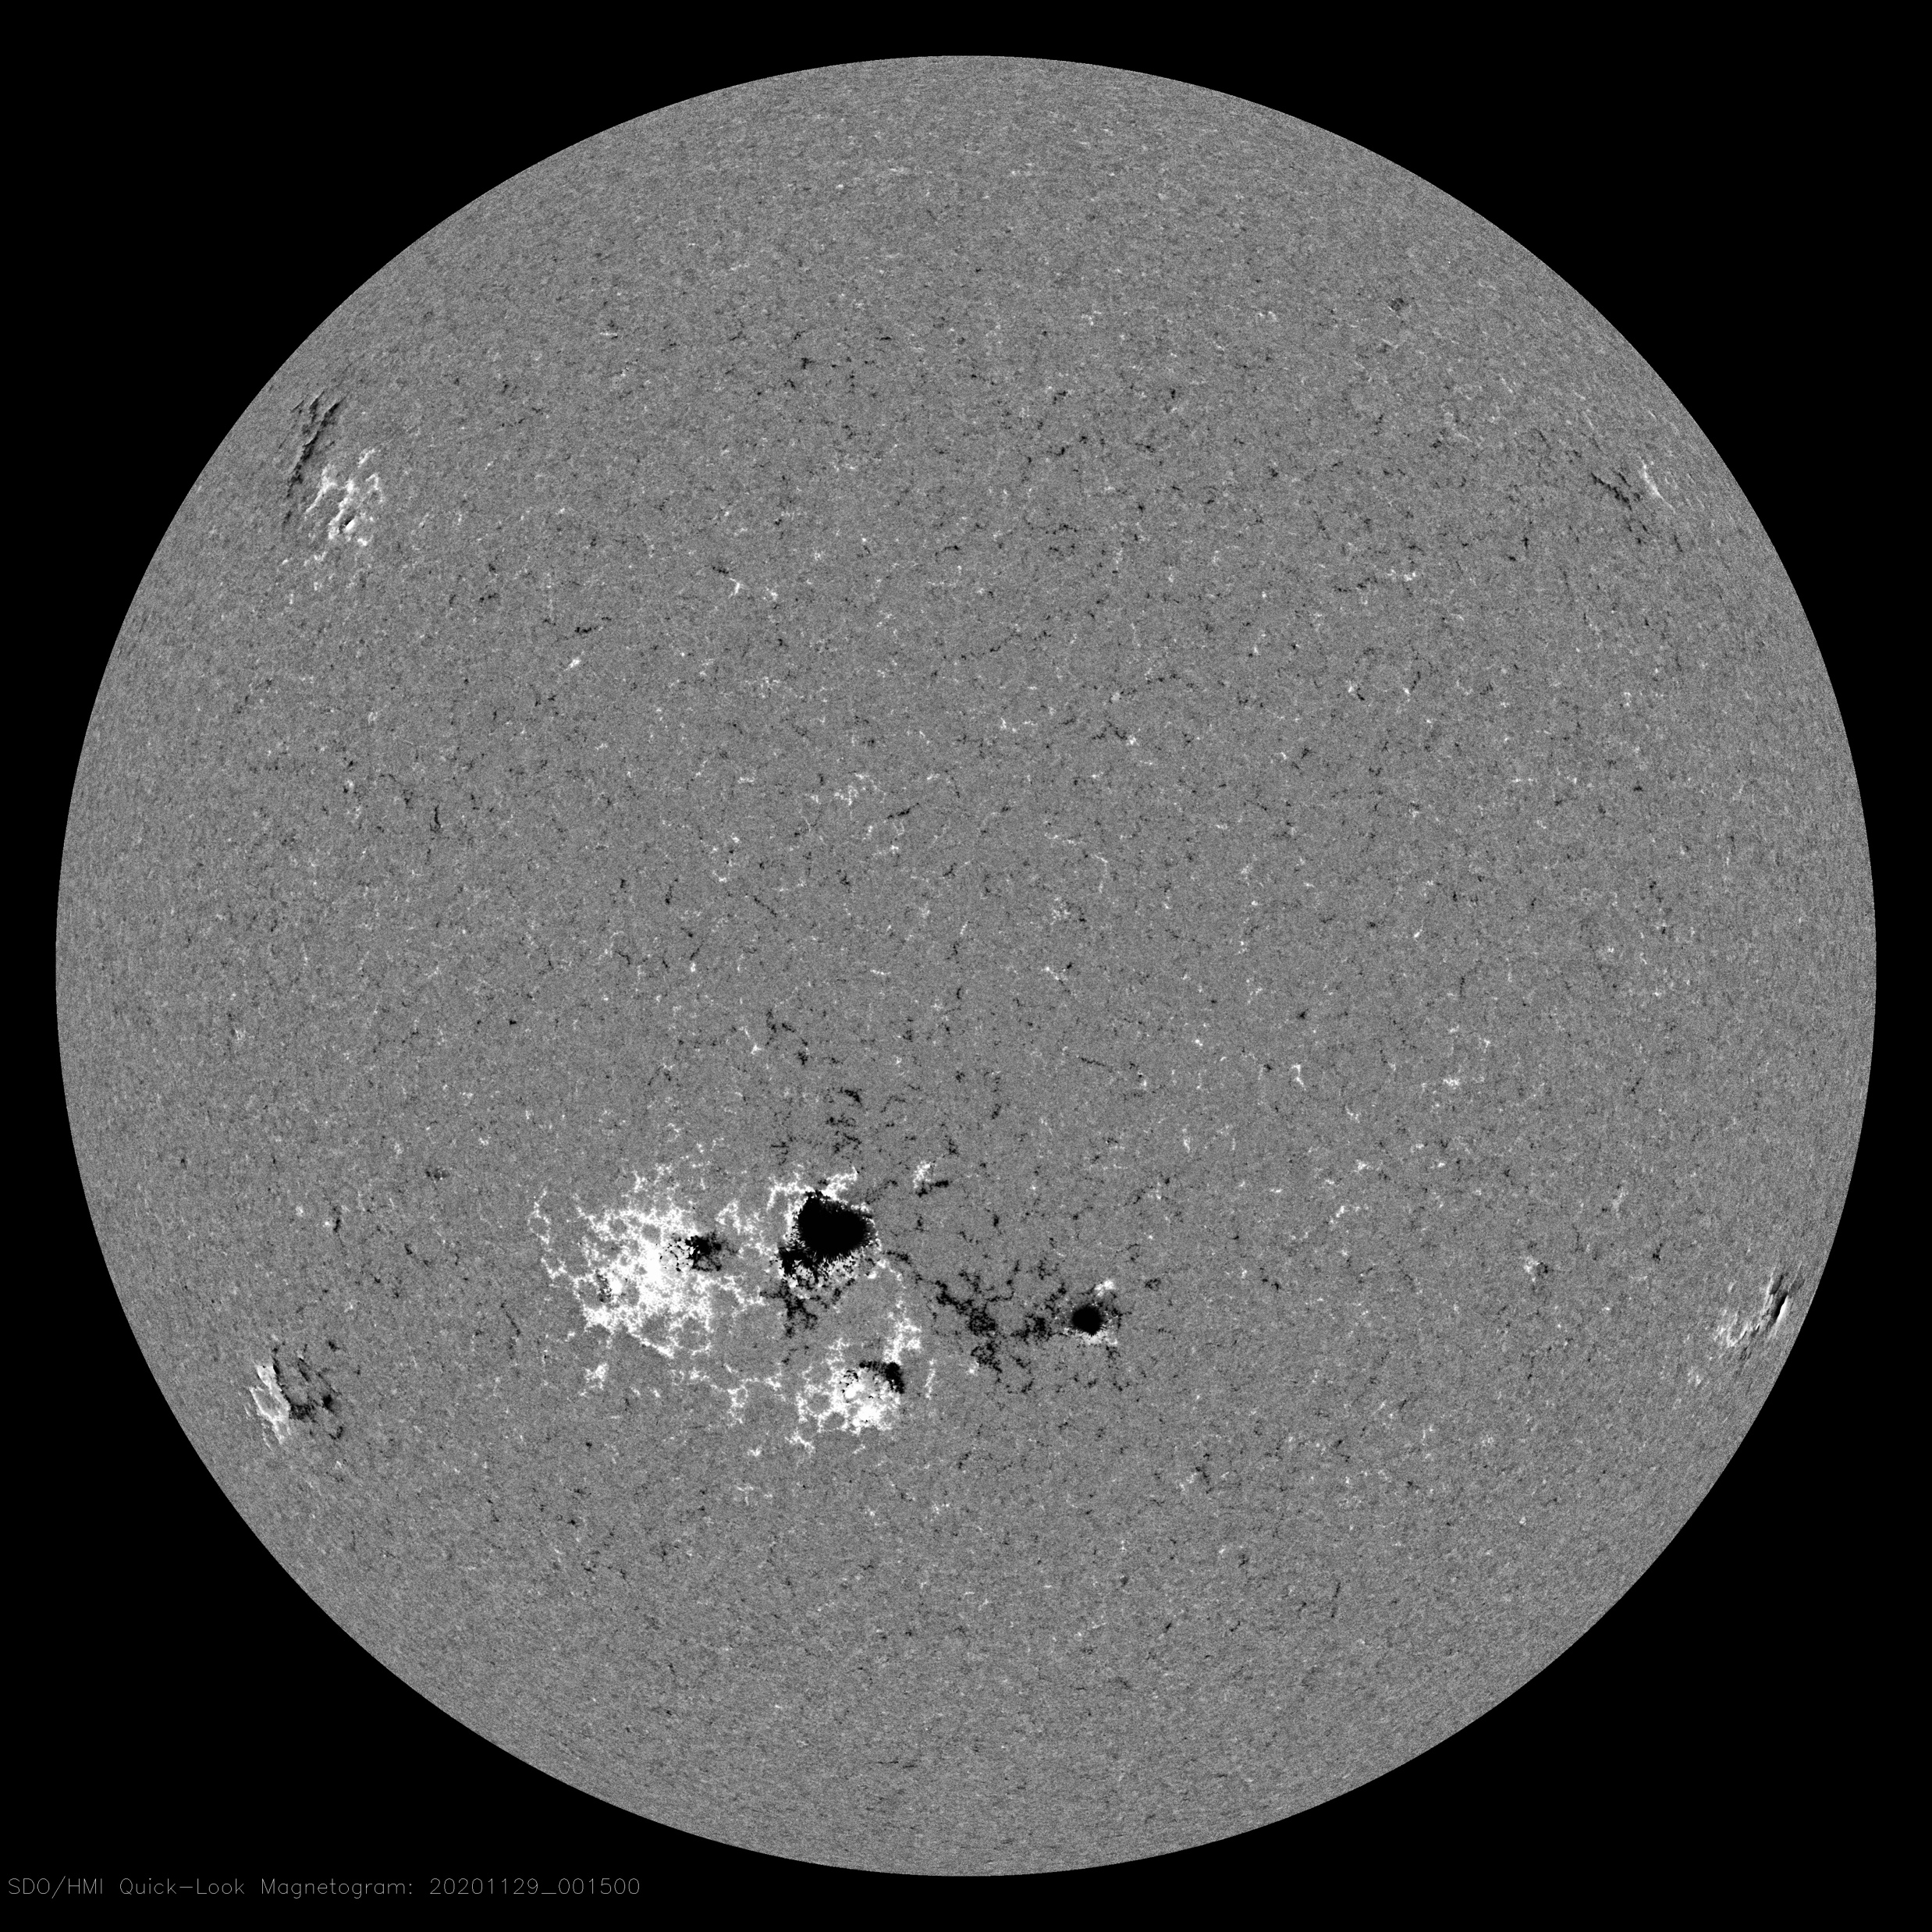
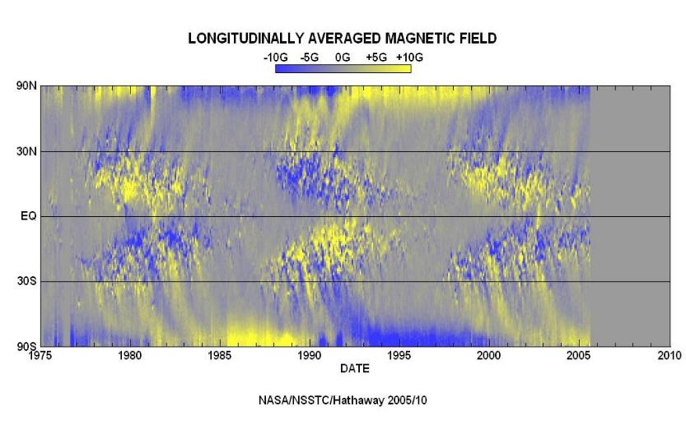
Magnetic field variations in cycles 21-23 (Hale’s law)
HMI Magnetogram 29 Nov 2020

Slide 9
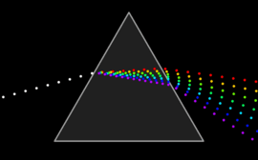

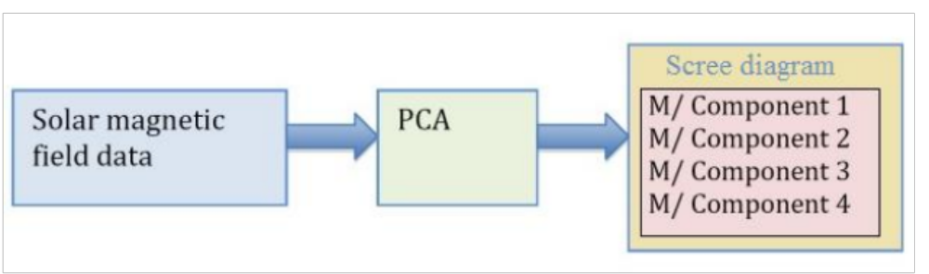
White light refraction into waves of different colors, or wavelengths

Slide 10
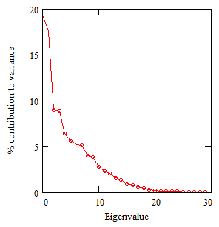
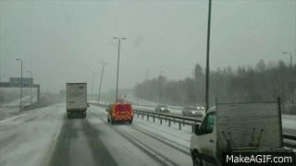
SBMF results: Scree plot (->prizm)
Eigenvalues (natural frequencies) vs variances (Zharkova et al, 2012)
- 2 main eigenvalues covering 40% of variance –
(67% of SDV) -
- 3 pairs (6 eigenvalues) to cover
Forced oscillations of light poles on natural frequency induced by gale in Jan 2018
Dipole magnetic sources
Quadruple magnetic sources

Slide 11
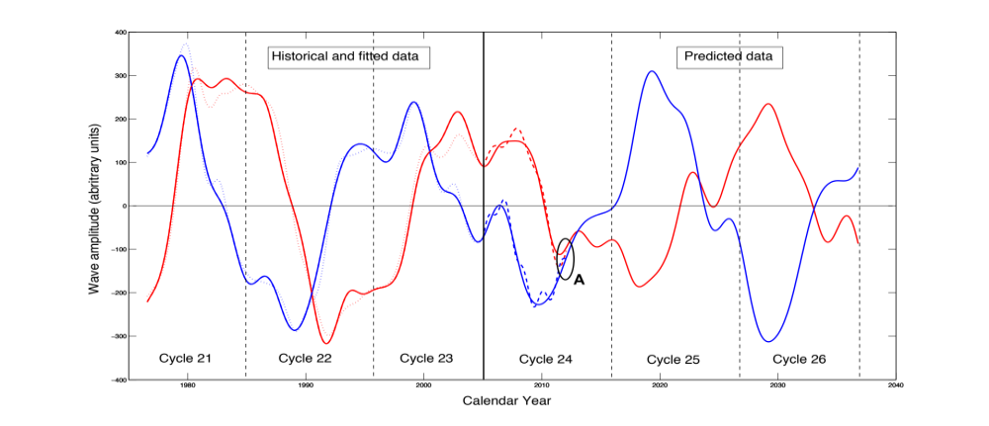
Fitting the PCs to measured in cycle 24 and prediction to 25-26
Eigen vectors come in pairs, here are PCs
(Shepherd et al, 2014, Zharkova et al, 2015)

Slide 12
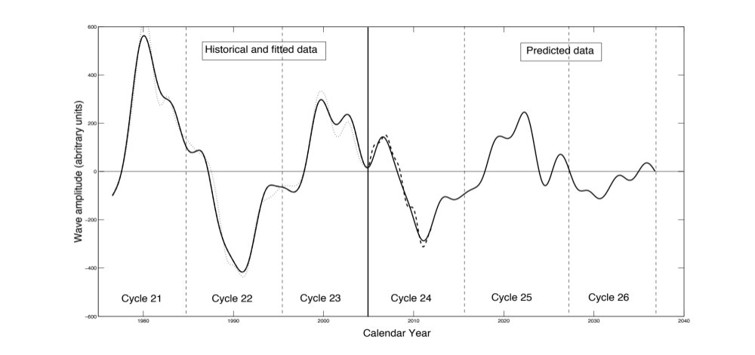
S Summary curve of 2 PCs v
(Zharkova et al, 2015)

Slide 13
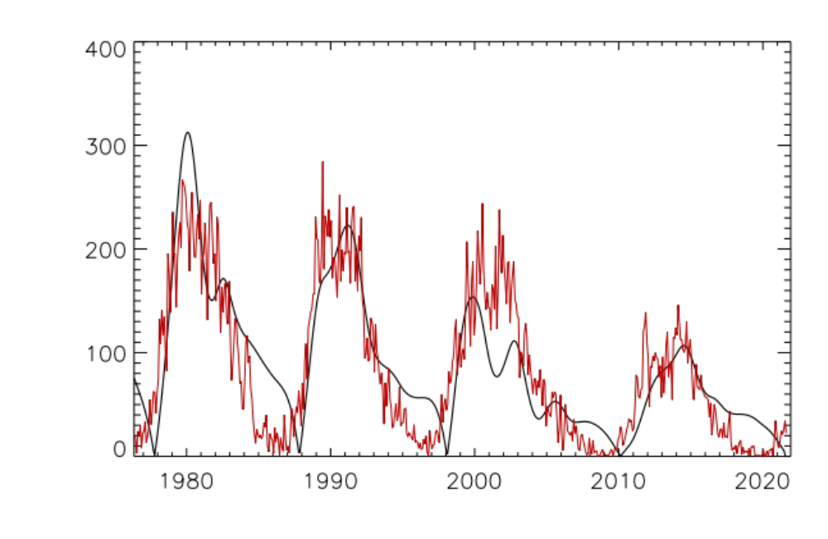
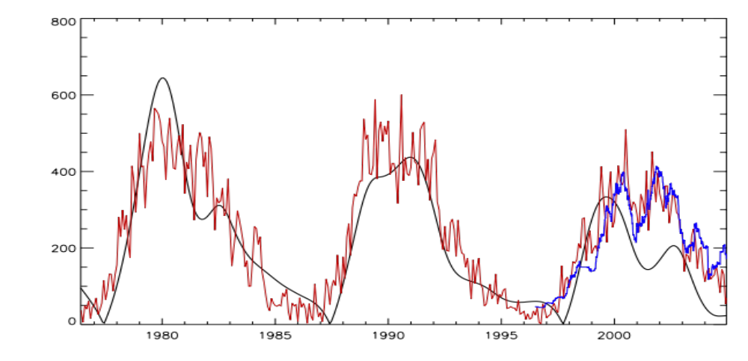
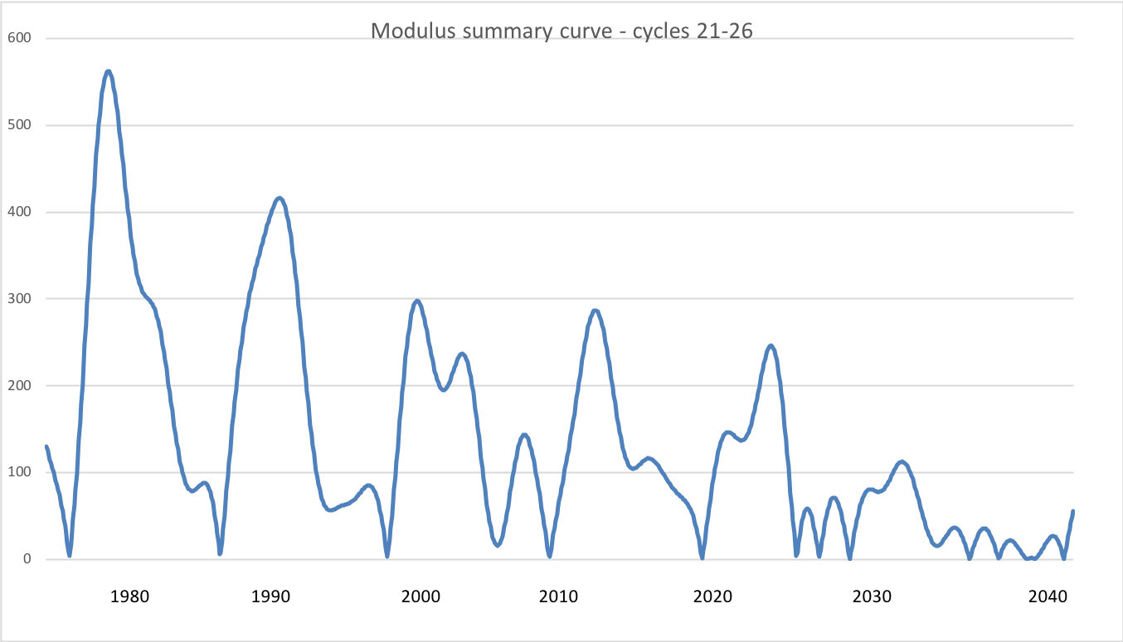
Modulus summary curve
Zharkova et al, 2015, SciRep; 2020, Temp., Zharkova et al, 2022, MNRAS s sunsdata
(Shepherd et al, 2014 ; Zharkova et al, 2015)
Cycle 21
Cycle 22
Cycle 23
Confirmed by
Katiashvili, 2020, ApJ;
Obridko et al, 2021, MNRAS
Velasco-Herrera et al, 2021
Cycle 21
Cycle 22
Cycle 23
Cycle 24
Cycle 25
Cycle 26

Slide 14
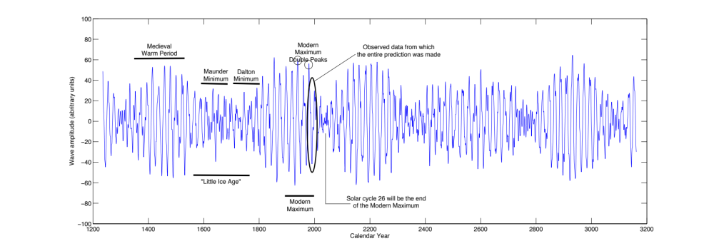
Predicted solar activity (Zharkova et al, 2015, SR https://www.nature.com/articles/srep15689)
Zharkova et al, 2015, Nature SR
Observational result, dynamo model was not yet considered
Discovery of grand solar cycles :350-400 years
In addition to 11 year cycles
https://solargsm.com/solar-activity/ - my webpage

Slide 15
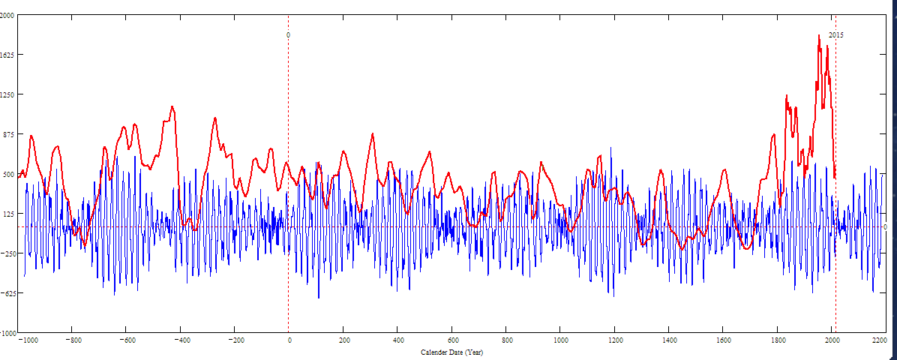
Double dynamo summary curve for 3000 years (blue) versus the s/s curve by Solanki et al. 2004 (red)
Homeric minimum^{[13]} | 750 BCE | 550 BCE
Oort minimum | 1040 CE | 1080 CE
Medieval maximum | 1100 | 1250
Wolf minimum | 1280 | 1350
Spörer Minimum | 1450 | 1550
Maunder Minimum | 1645 | 1715
Dalton Minimum | 1790 | 1820
Zharkova et al, 2015, 2018
Sporer minimum in 1400-1600 in C¹⁴ is caused by s/n Vela Junior
Byzantian
Oort
Wolf
Maunder
Homeric
Periods – grand cycle: 350-400 years and super-grand cycle :2000-2100 years

Slide 16
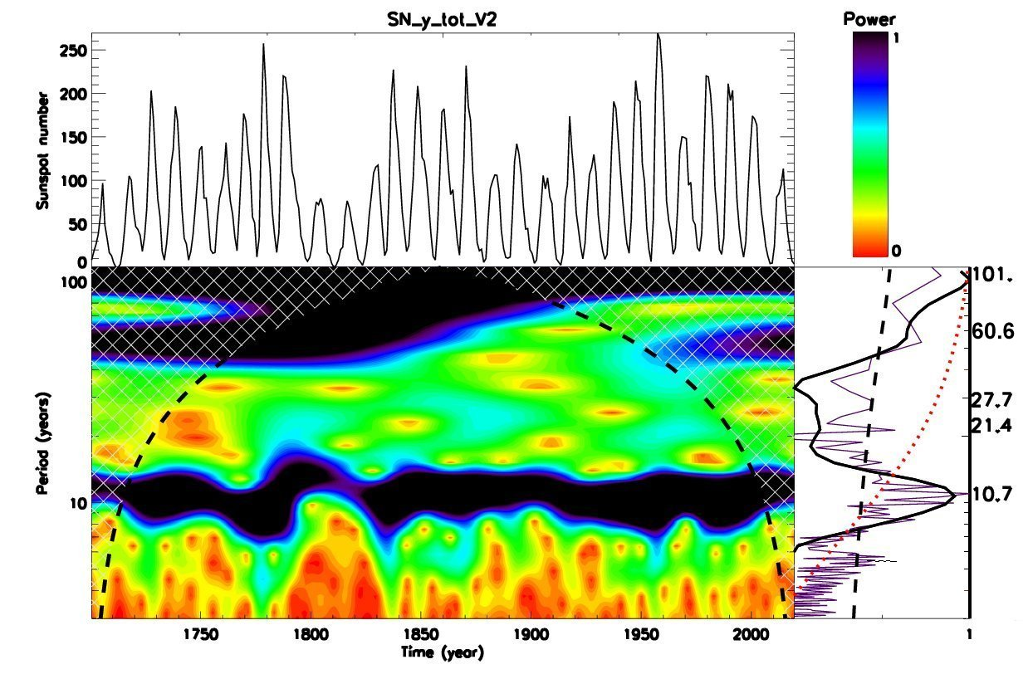
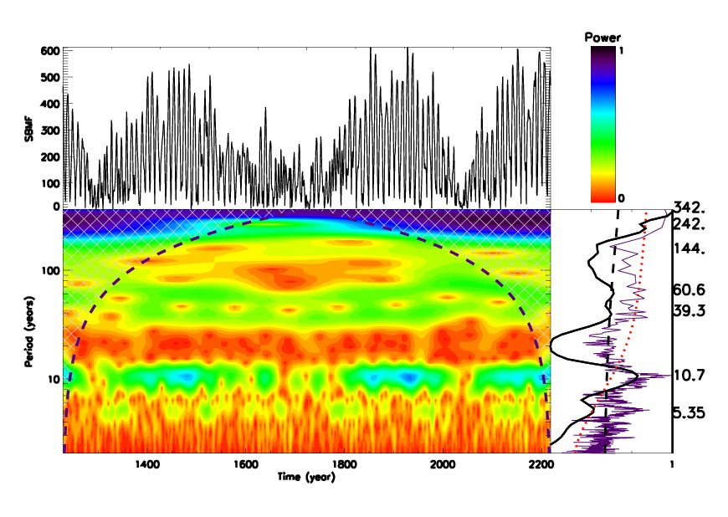
Wavelet spectral analysis
Averaged sunspot numbers Modulus summary curve of PCs Z15

Slide 17
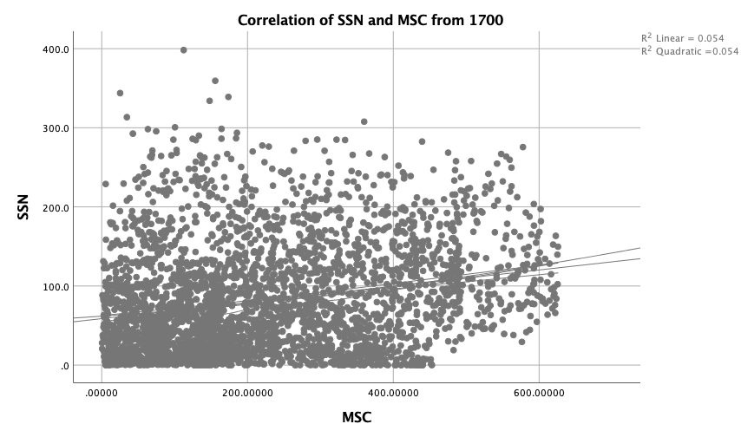
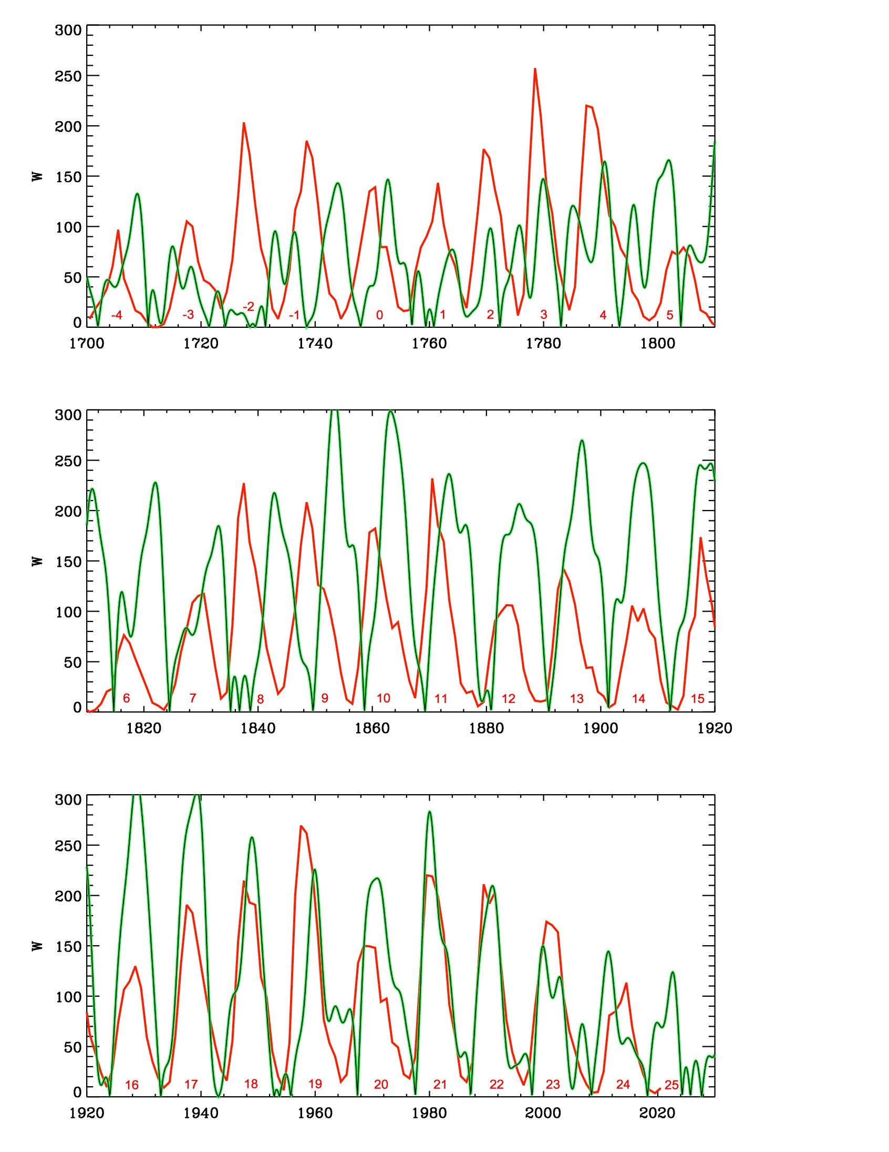
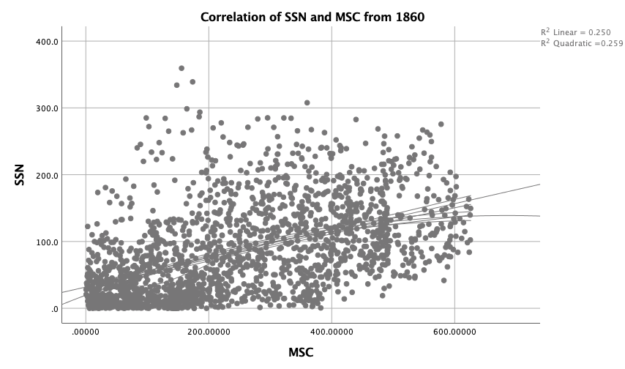
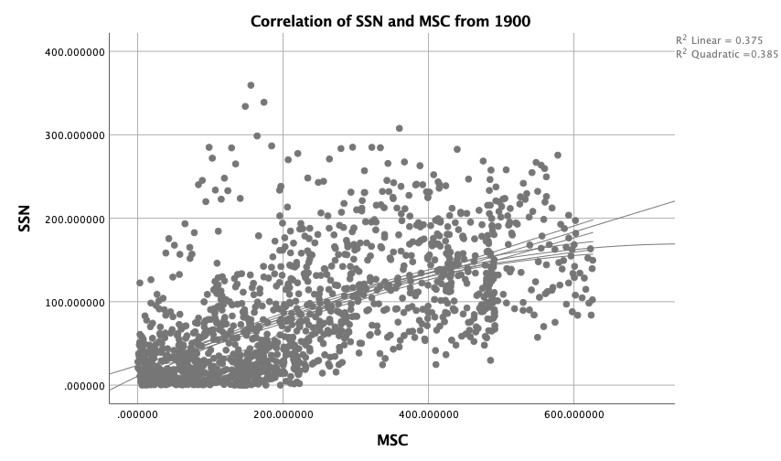
Correlation of SSN with MSC
25%
56%
67%
https://solargsm.com/wp-content/uploads/2023/04/zharkova_etal_mnras2023.pdf
With IBM SPSS package

Slide 18
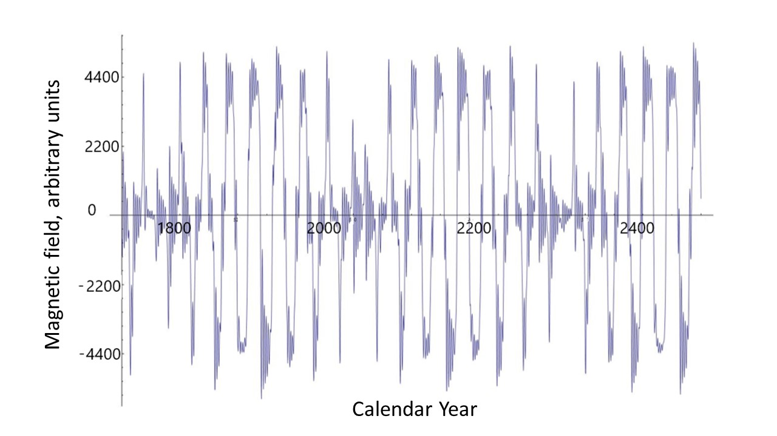
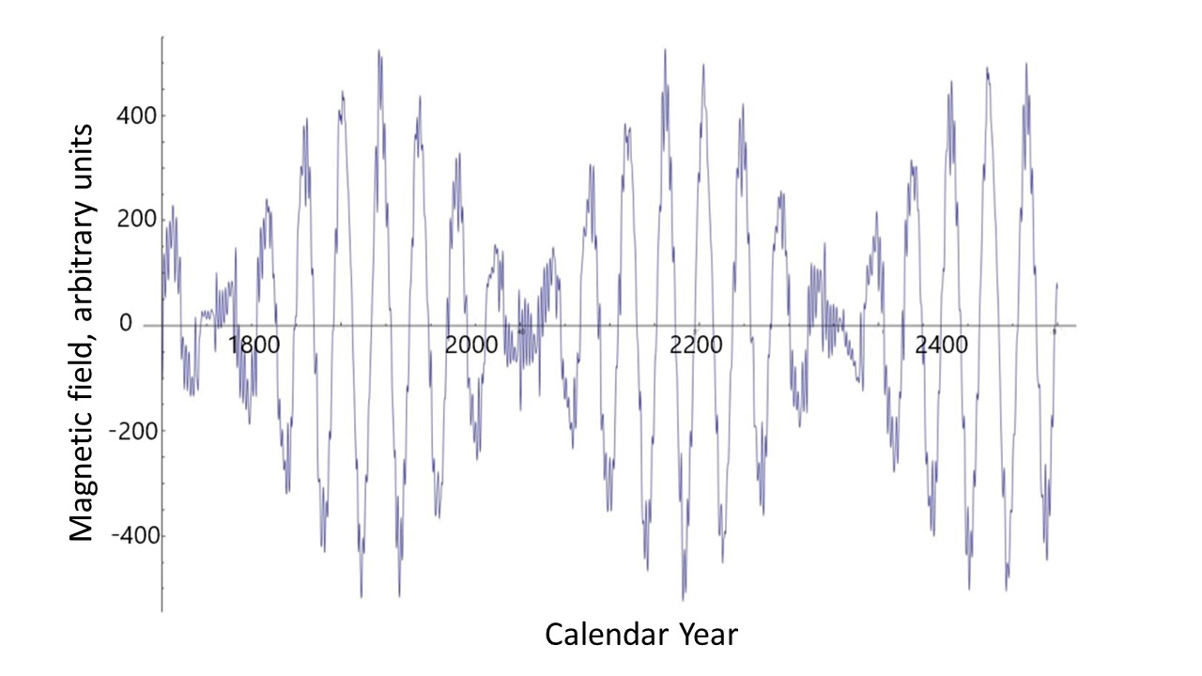
Poloidal (left) versus toroidal (right) magnetic fields
https://solargsm.com/wp-content/uploads/2023/04/zharkova_etal_mnras2023.pdf

Slide 19
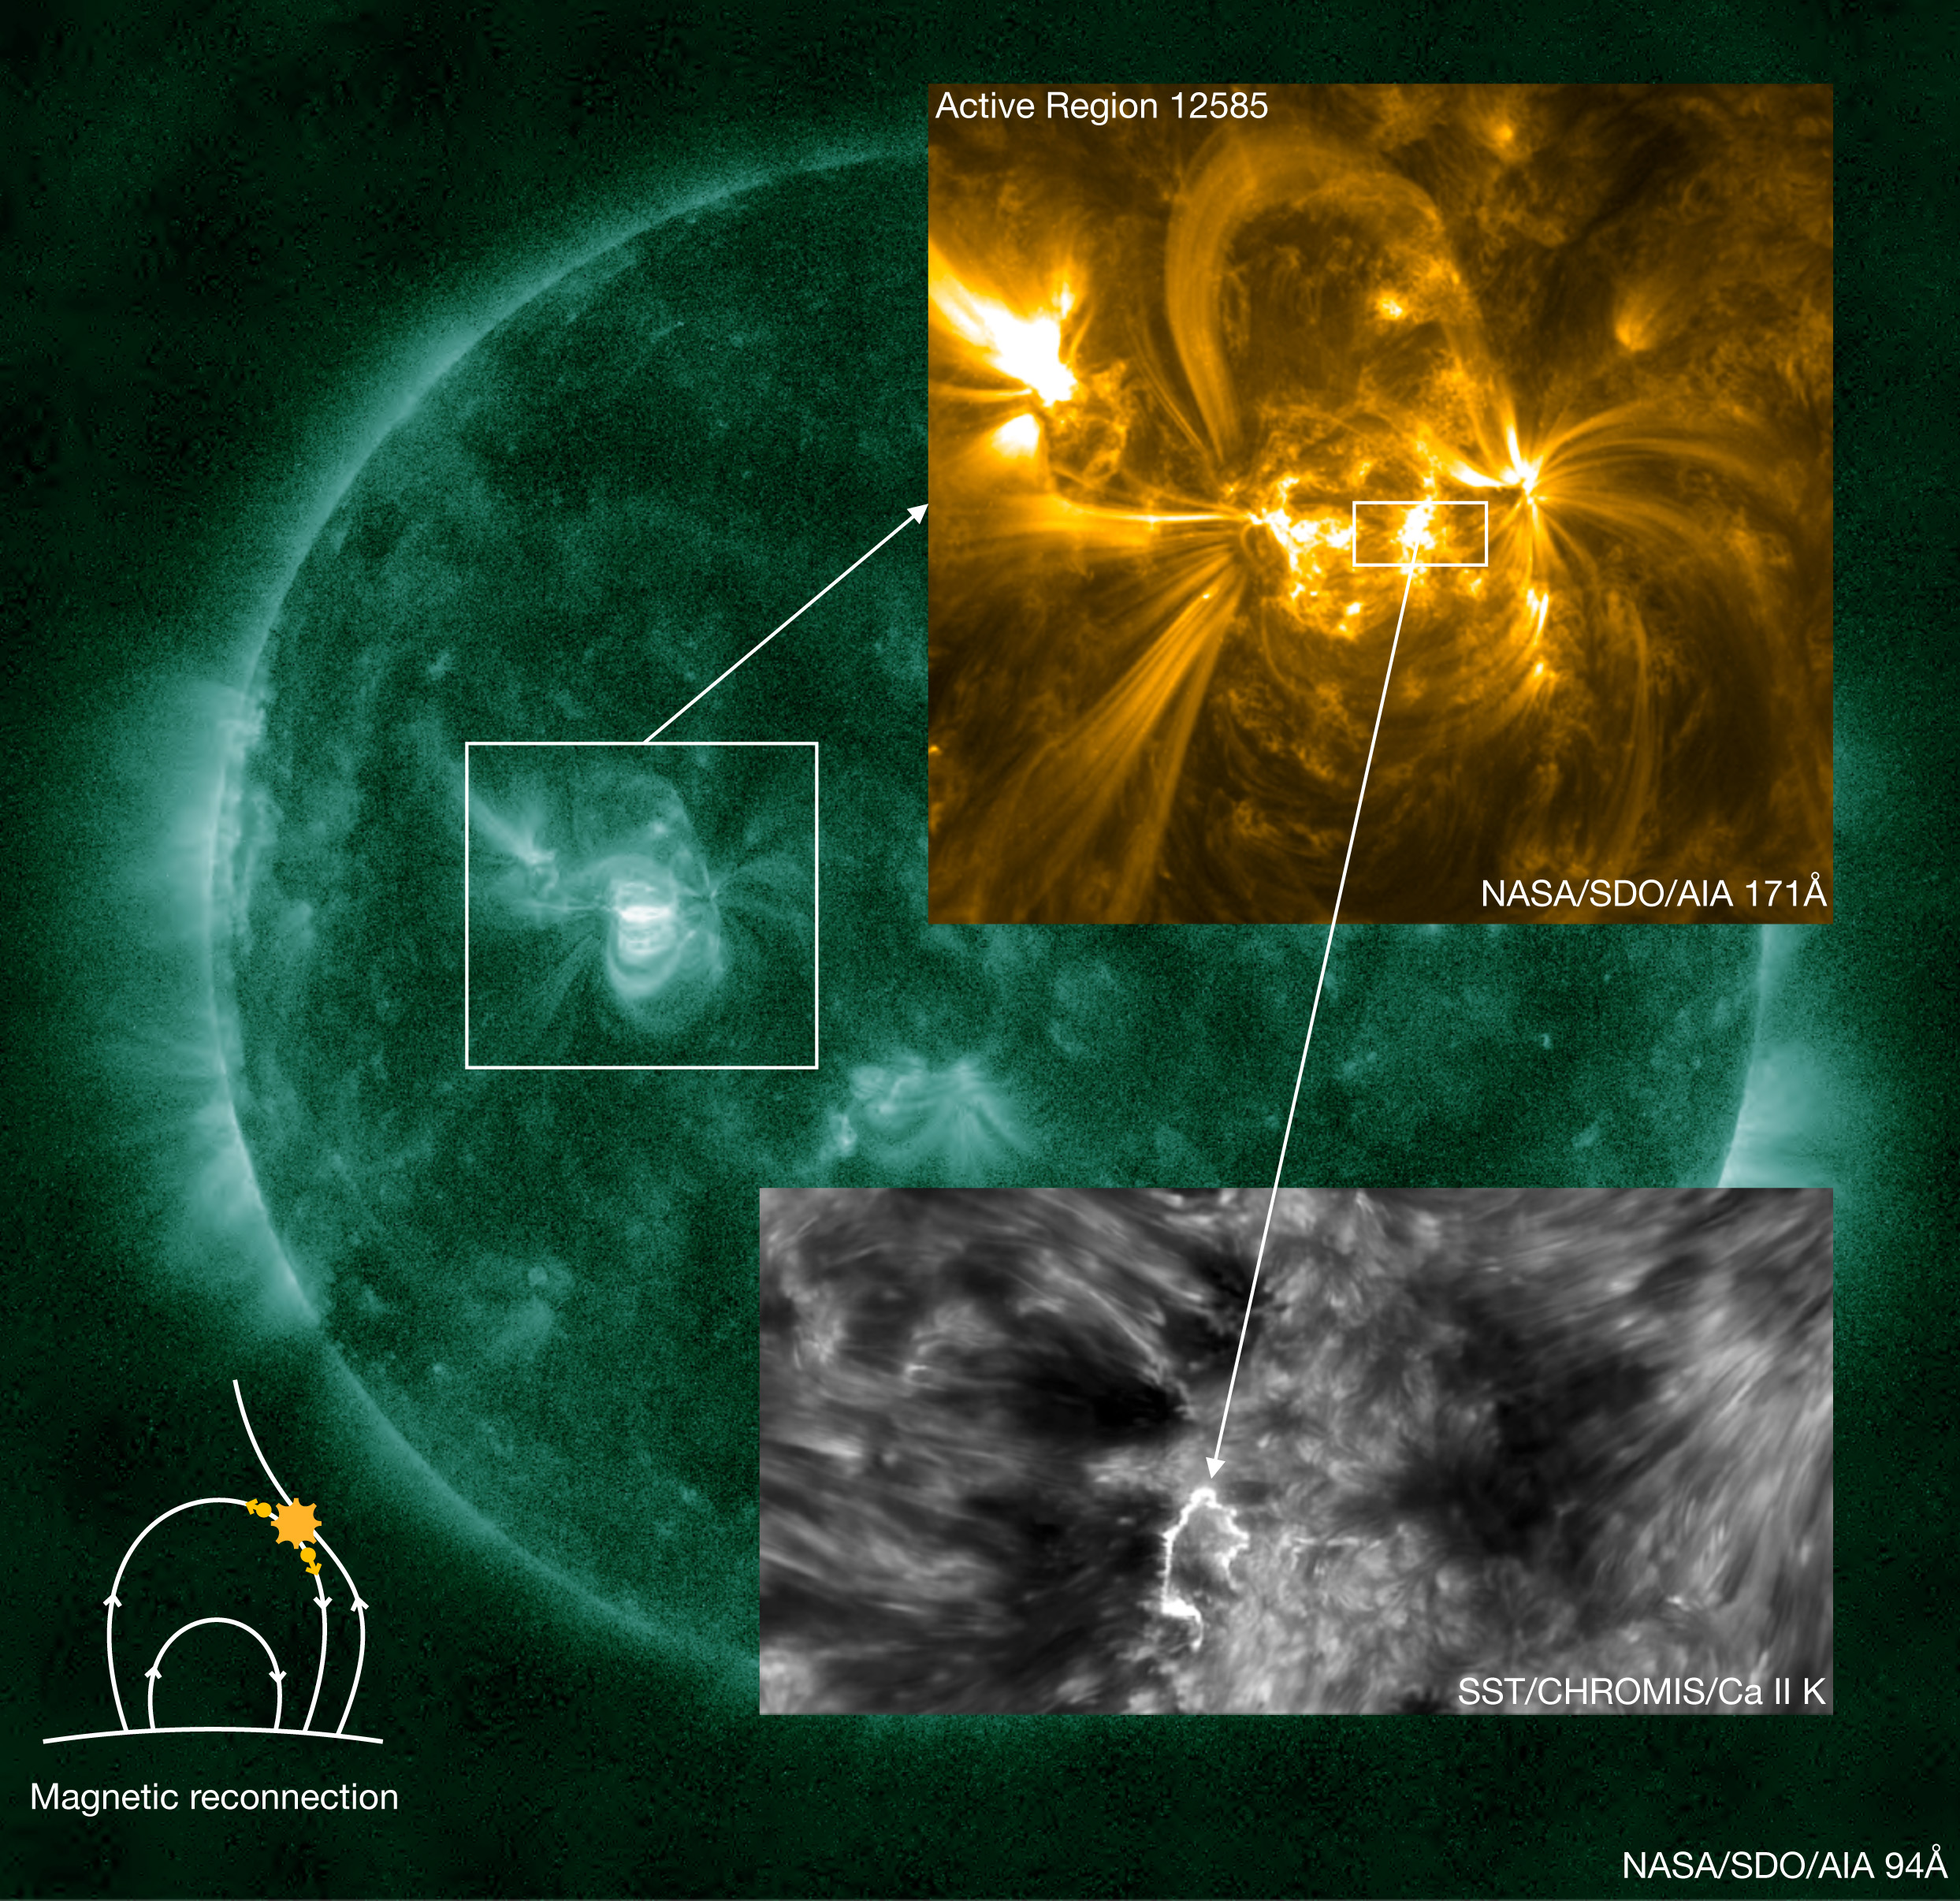
Solar dynamo produces magnetic loops (MLs) in the interior
MLs travel to the surface
Magnetic loops appear on photosphere as sunspots
Chromosphere and corona are formed by flaring processes in MLs
  Large flares (10^29-10^33 erg)
  Micro flares (10^25-10^28 erg)
  Nanoflares(10^21-10^24 erg)
Coronal heating is caused by nanoflares Parker, 1988

Slide 20
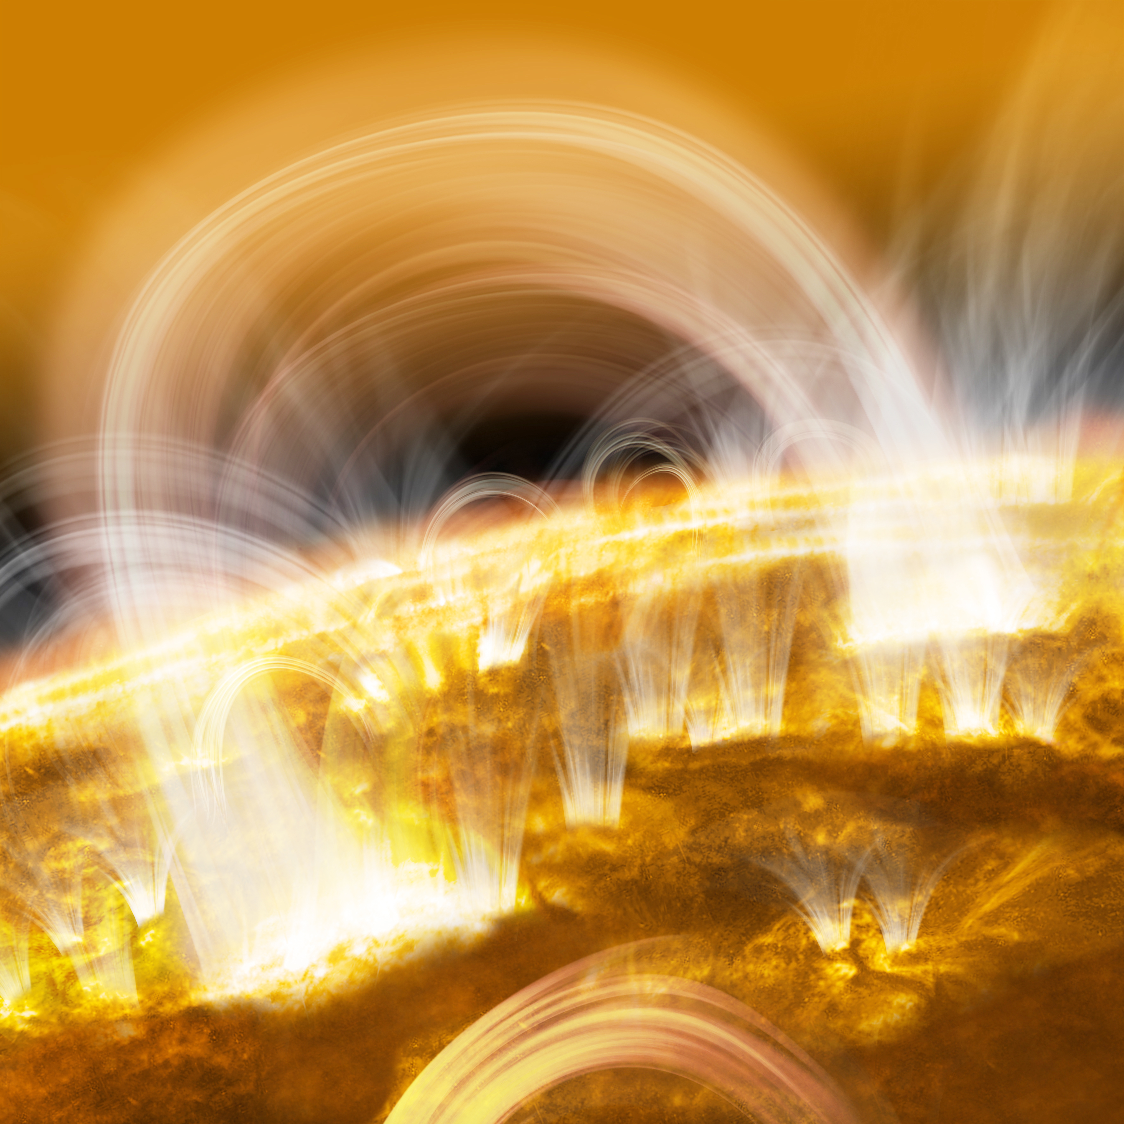
Magnetic loops – view from a side
An international research team led by Dr. Shin-nosuke Ishikawa, (ISAS/JAXA) succeeded in detecting the subtle signs of nanoflares (tiny flares) (FOKSI+Hinode)
Nature Astronomy, 9 October 2017

Slide 21
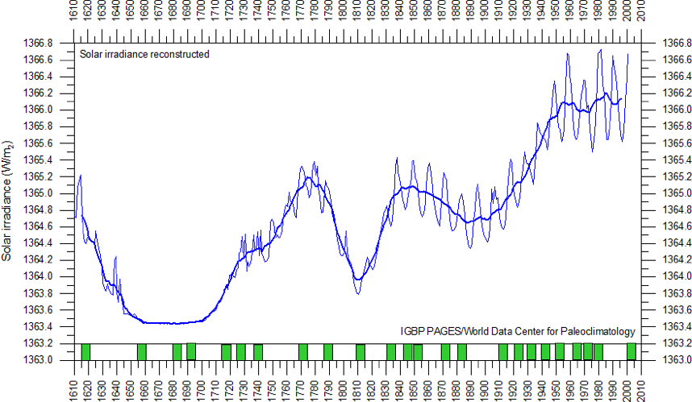
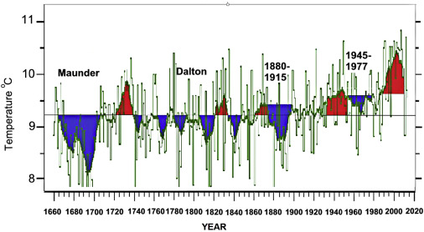
Solar irradiance and terrestrial temperature during MM
Lean et al, 1995, JGR
Lamb, 1972; Easterbrook, 2016
Authors | S, Maunder minimum, W/m² | S 1990-2000, W/m² | △S from MM, %
Lean et. Al., 1995 | 1363 | 1366 | 0.22
Steinhilber et al, 2012 | 1364 | 1366 | 0.22
Shirley et al., 1990 | --- | 1370 | 0.51
Wolff and Hickey, 1987 | --- | 1371 | 0.51
Lee et al., 1995 | --- | 1372 | 0.51
After the TSI data were re-normalized the old data are hardly usable

Slide 22
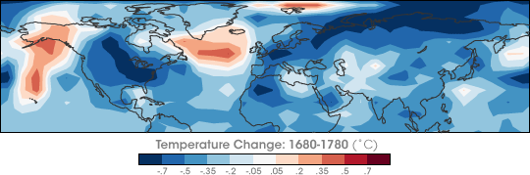
Temperature restoration during/after MM
(Shindell et al., 2001, Science)
https://earthobservatory.nasa.gov/images/7122/chilly-temperatures-during-the-maunder-minimum
The surface temperature of the Earth was reduced all over the Globe
Europe and North America went into a deep freeze
Alpine glaciers extended over valley farmland
Sea ice crept south from the Arctic
Dunab and Thames rivers & canals in the Netherlands froze regularly

Slide 23
Temperature restoration during MM
(Shindell et al., 2001, Science)
the drop in the temperature was related to dropped abundances of ozone created by solar ultra-violate light in the stratosphere, the layer of the atmosphere located between 10 and 50 kilometers from the Earth’s surface

Slide 24
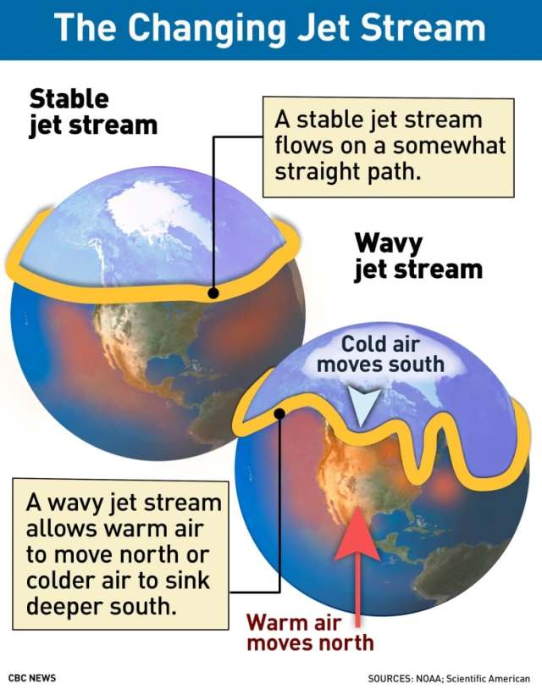
Less ozone affected planetary atmosphere waves
They, in turn, caused the giant wiggles in the jet stream as shown in picture on the left
It kicked the North Atlantic Oscillation (NAO)—the balance between a permanent low-pressure system near Greenland and a permanent high-pressure system to its south—into a negative phase
that led to Europe to remain unusually cold during the MM
Shindell et al., 2001

Slide 25
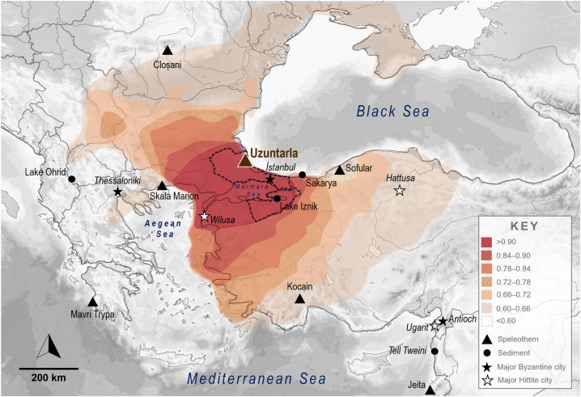
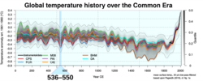
The Byzantine Cold Period
The Byzantine Cold Period—more scientifically recognized as part of the Late Antique Little Ice Age (LALIA)—was a prolonged phase of severe regional cooling and aridification that lasted from approximately 536 to 660 AD. This sudden environmental shift dramatically altered the course of the Byzantine Empire and the broader Mediterranean basin. 🌋
The Trigger: The Volcanic Winter of 536
The period was initiated by a series of massive tropical and high-latitude volcanic eruptions in 536, 539/540, and 547 AD. These events injected vast amounts of sulfate aerosols into the stratosphere, forming a giant "dust veil" that blocked solar radiation. [
Temperature Drops: Summer temperatures in Europe dropped by as much as 2.5°C to 2.7°C below normal.
Historical Notoriety: Modern historians frequently cite 536 AD as "the worst year to be alive" due to the sudden onset of persistent darkness, unseasonable frost, and immediate crop failures.
Morgan et al, 2025
The climate anomaly 536–550 in the context of global recent temperatures Tombstone in the chapel of Filippo e Giacomo, Nosedo, dated to AD 536 (the second year after the consulship of Decius Paulinus).
The volcanic winter of 536 was among the most severe and protracted episodes of climatic cooling in the Northern Hemisphere in the last two thousand years.^{[2]} The volcanic winter was caused by at least three eruptions of uncertain origin,^{[citation needed]} with several possible locations proposed in various continents.

Slide 26
Historical & Societal Impacts of BCP
The drastic change in climate combined with existing biological and socio-political factors to trigger what historians call the Byzantine Dark Ages:
Agricultural failure - sshortened growing seasons and intense regional droughts drastically reduced grain yields, leading to widespread famine.
Spread of disease - The climate stress directly coincided with the outbreak of the Plague of Justinian (541–542 AD). Cooler, drier conditions disrupted ecosystems, altering rodent populations and human migration, which accelerated the spread of the plague and killed millions.
Geopolitical shifts - The combination of famine, plague, and economic exhaustion crippled the military power of the Byzantine Empire. This vulnerability left its borders open to the Lombard migration into Italy, Slavic migrations into the Balkans, and the rapid Arab Muslim conquests of the 630s.

Slide 27
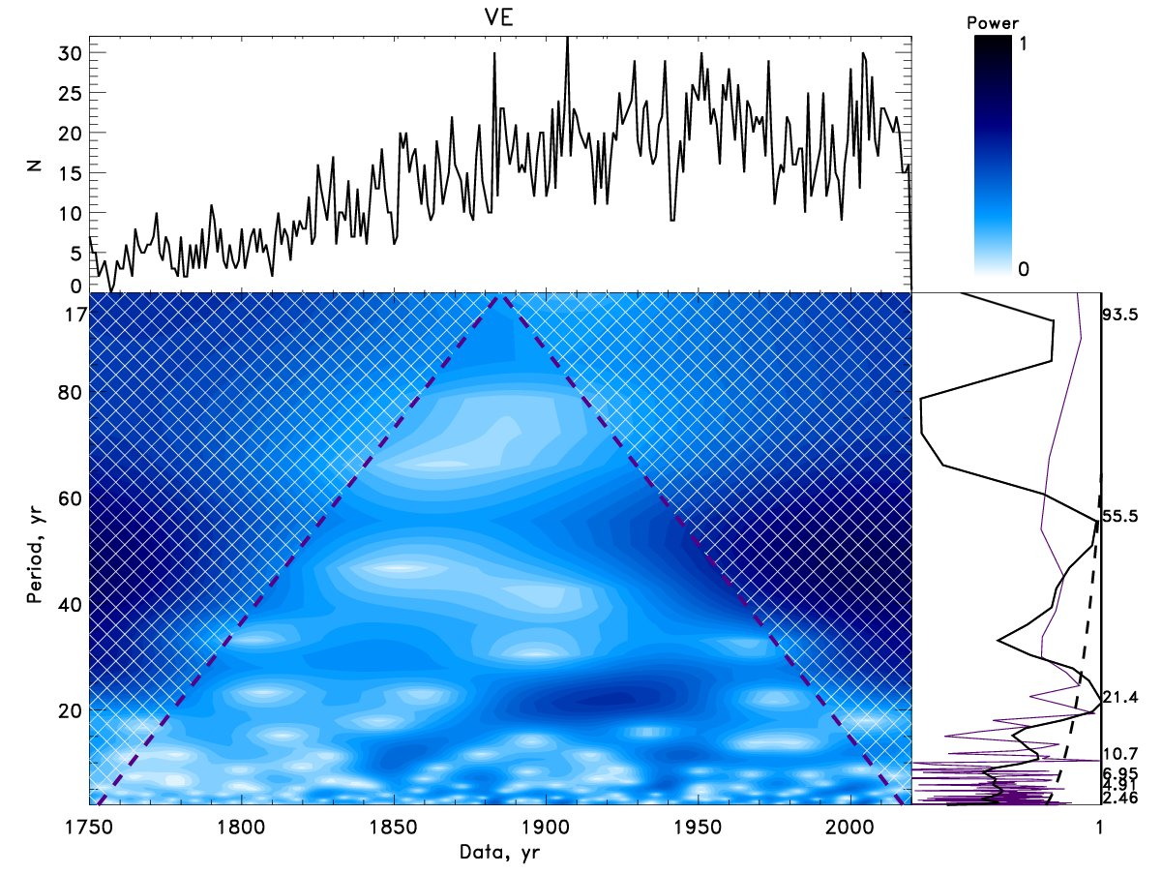
Wavelet spectral analysis of Volcanic Eruption frequencies Vasilieva & Zharkova, 2023
Top plots: Time series of the annual volcanic eruptions in the period of 1750-2020 (top left) with the power bar for the wavelet spectrum (top right).
Bottom plots: The wavelet spectrum with periods (Y-axis) derived from frequencies of volcanic eruptions (bottom left) obtained using the Morlet wavelet.
The global wavelet spectrum (the solid black line) and Fourier spectrum (the indigo line) (bottom right).
The Cone of Influence (COI) marked by the black dashed lines
Key period is 21.4 years as SC of EV
Next maximum of volcanic eruptions will occur in cycle 26 (2031-2042).
https://solargsm.com/publications

Slide 28
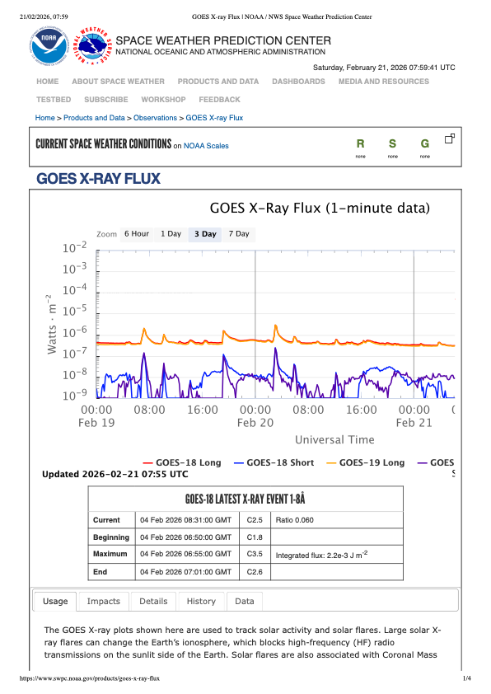
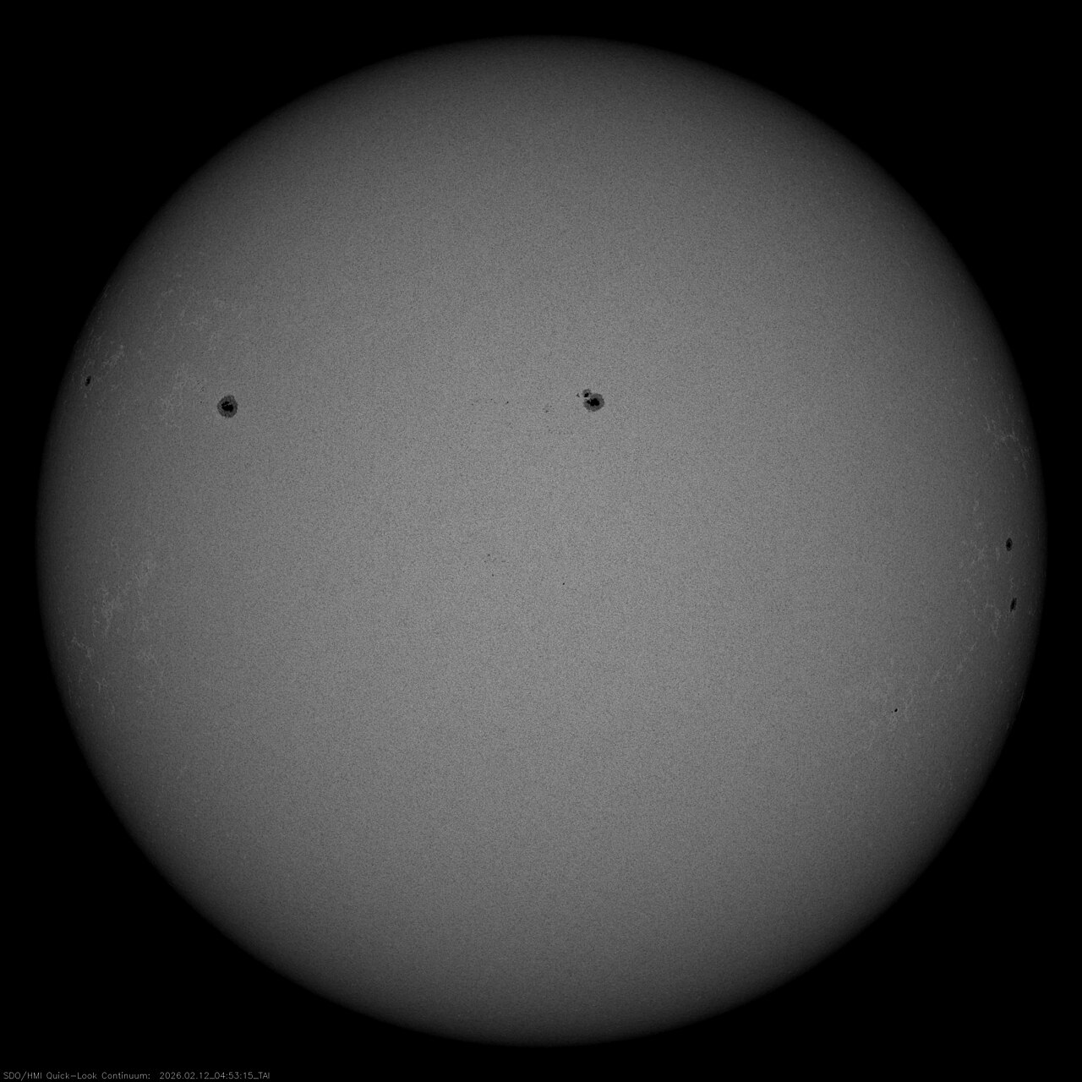
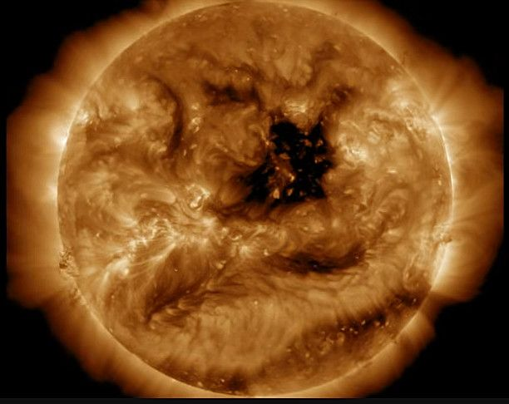
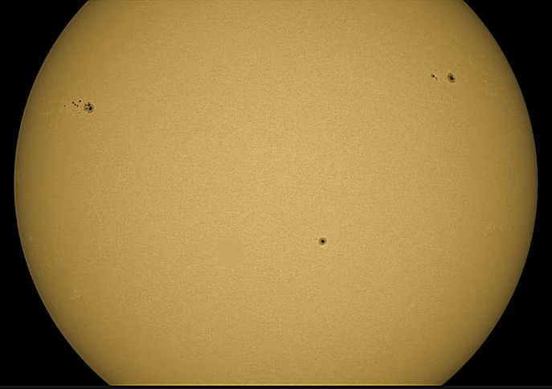
Solar activity
Sunspots are dark (and cooler) regions on the surface of the Sun. They have a darker inner region (the Umbra) surrounded by a lighter ring (the Penumbra).
Sunspots usually appear in groups that form over hours or days and last for days or weeks.
These early sunspot observations indicated that the Sun rotates once in about 27 days.
Solar activity index – average sunspot numbers
Where we are now…
12 February 2026
22 February 2026
15 April 2026
Sunspots

Slide 29
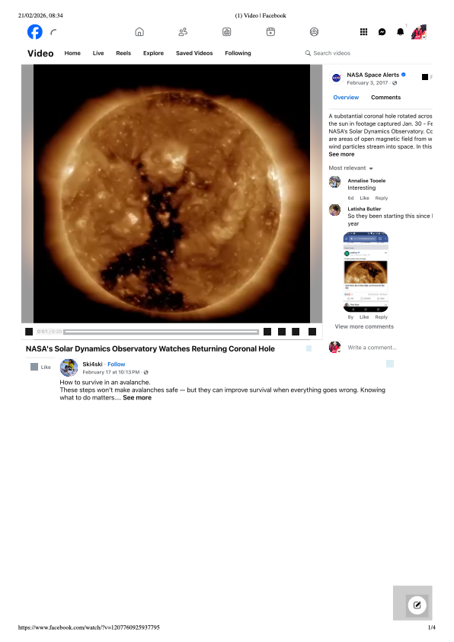
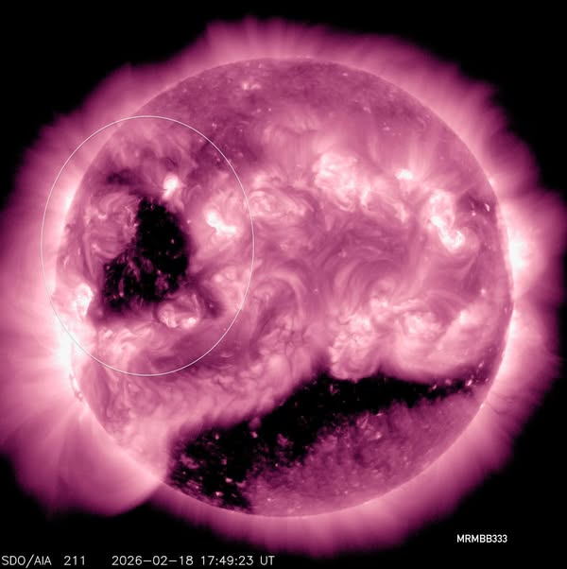
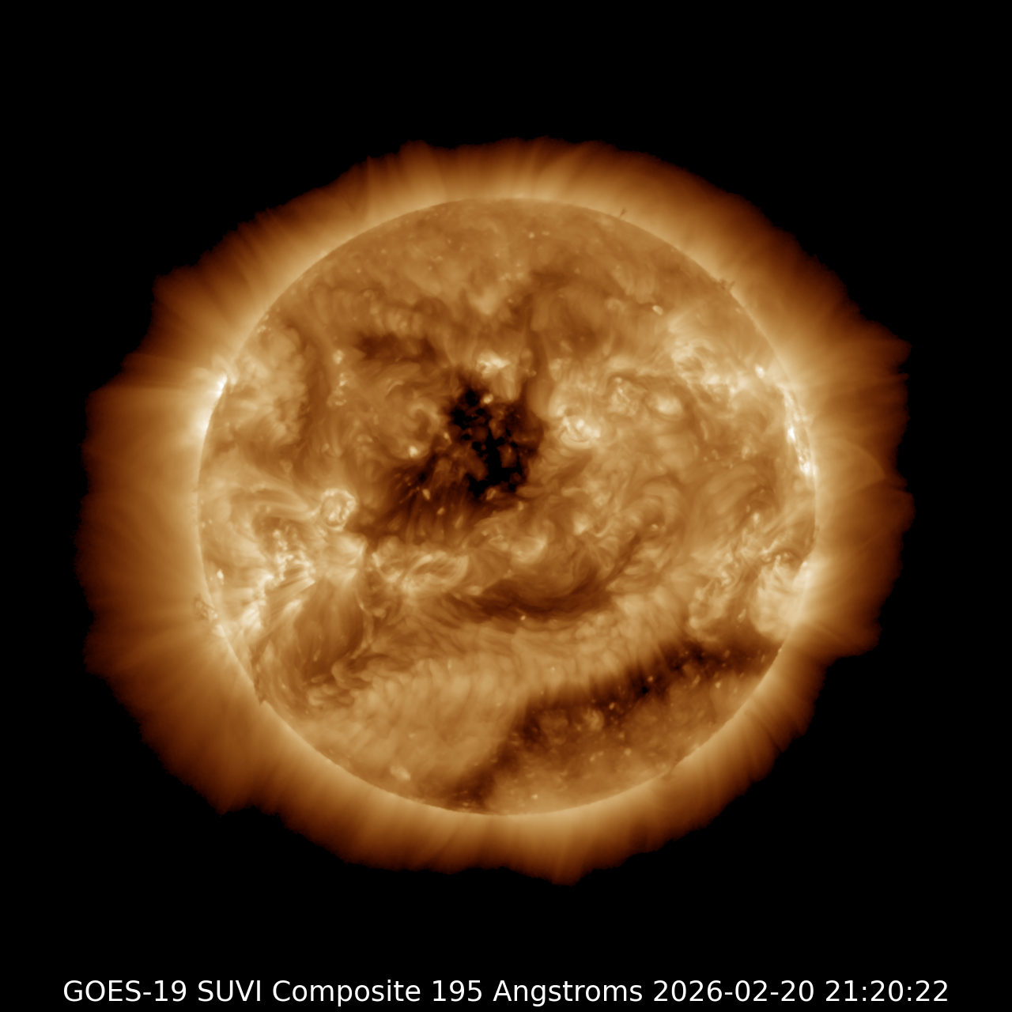
Coronal holes are large, temporary regions in the Sun’s outer atmosphere (corona) that appear dark in UV images because they are cooler, less dense, and possess "open" magnetic fields.
They appear as large, dark blotches in extreme ultraviolet (UV) or X-ray images, indicating lower plasma density and temperature.
Duration and Timing: They can persist for several solar rotations (27 days each) and are more common during the solar minimum phase of the 11-year solar cycle, though they can occur at any time.
22-23 Feb ‘26

Slide 30
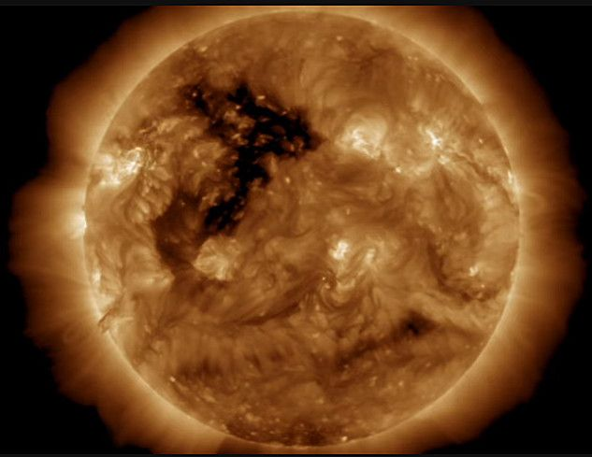
Sun with coronal holes since 18 Feb’26 (purple)
to 15 Apr’26 (orange)
CHs appear every week since Feb 26

Slide 31
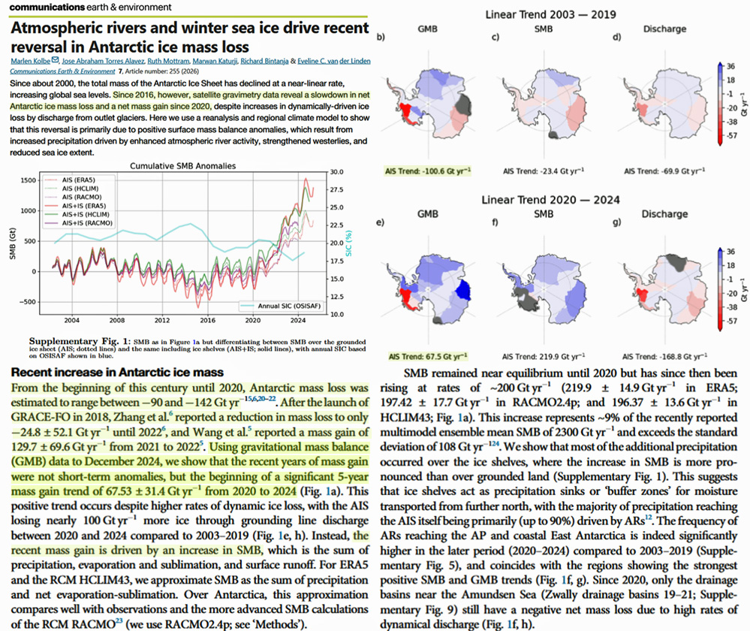
Evidences of GSM - Antarctica gained large ice mass since 2020
Nature study reports

Slide 32

Snow in Africa’s desert 8 December 2020 https://twitter.com/GerryAMcG/status/1336420778582138886

Slide 33

Snow blizzards in USA and Canada for 2 weeks in Dec ’22 –Jan’ 23

Slide 34

Late spring snow in Australia and NZ 22-30 November ’22
(analog of late May in Northern hemisphere)

Slide 35



Snow and frost in Texas, Florida and Luisiana –Jan ’25,
T in F

Slide 36

Winter 2026
Northern hemisphere

Slide 37

Winter 2026
- Japan

Slide 38




Snow in South Africa - 21-23 Sept ’24, Nov’26

Slide 39



Arctics had the coldest summer 2026 on record

Slide 40

Signs of the GSM in Australia – March’ 26
The seasons have shifted,
Autumn has barely begun and we have had snowfalls in NSW including inland in Orange.
Even though the highest summer temperatures are significantly lower than they used to be: 31C-33C compared to the previous usual 39C - 41C four years ago.
The UV readings are much higher than they used to be: 15, 16, 17. Levels I had not seen before.
Strangely we are suffering from the effects of heat much more, despite a lower temperatures
Recently SH had 3 earthquakes in Indonesia (7.5), Vanuatu (7.4) and Tonga (7.3).
The Antarctic ice sheet has massively expanded over the last 6/7 years and the temperatures there are dropping fast.
A new March 2026 record in Antarctica has been set at -76.4C.

Slide 41


Wintry summer and autumn in New Zealand – 17-27 Feb ‘26
The summer of 2025-2026 in New Zealand, particularly extending into early 2026, experienced a "wintry" feel despite having near-average overall temperatures (16.9C)
Unsettled weather, significant rain events, and unseasonal cold blasts—including hail and chilly, sub-Antarctic airflows—affected the country,
some regions experiencing a wet, disrupted season, contradicting expectations of a hot summer.
See picture of Canterbury flooding

Slide 42


September 2026 data about the Sun with coronal holes and August 2026 temperature

Slide 43
Modern Grand Solar Minimum https://solargsm.com/solar-activity/
GSM is in progress now in 2020 – 2053
This is a unique event in solar-terrestrial connection → will reveal the pros and cons of solar dynamo models
Decrease of solar magnetic field → big impact ozone reduction, high cloud formation, jet direction changes, cosmic rays increase
Increase of volcanic and earthquake activities
Effects on the terrestrial temperature via TSI, jets and volcanic activity
Shortage of vegetation periods can lead to possible food shortages in 2028-2042
Need inter-government efforts to avoid disasters

Slide 44


Global warming is real –
Terrestrial temperature increase

Slide 45



Solar magnetic field (top) and
Mbaseline oscillations (bottom)
(ZharkovlZharkova et., 2019, 2021al, 2018, 2019, 220 ture SR)
Reames et al, 2009
¹⁴C in trees

Slide 46



2000-2100 year oscillations (Zharkova et al, 2019, 2020) of the MF baseline coincides with that of the solar irradiance (Vierra et al, 2011)
(Akasofu, 2010)
Zharkova et al, 2019, 2020

Slide 47

Sun’s inertial motion about the barycentre
What are the reasons of TSI oscillations?
Orbital motion of Earth about the barycentre F0 of solar system
B and D are perihelion and aphelion for Earth orbit with Sun in F0
Sun shifts to point G from the barycentre F0 by SIM.
A and P are the aphelion and perihelion for Earth orbit with Sun shifted in point G.
Length GA is getting shorter than F0D, GP is getting larger then F0B
A
F0
B
D
P
G

Slide 48


Slide 49


2600
Aphelion →. 16 July
Perihelion → 16 January
SIM effects on the Earth via solar irradiance
https://youtu.be/vDgUmTq4a2Q
S. Perminov, E.D. Kuznetsov, 2018
SIM imposed by planets Jupiter, Saturn, Neptune and Uranus
Charvatova, 1988,
Palus et al, 2007
Rice et al, PP comments #72, 96

Slide 50


Annual variations of mean S-E distances (NASA ephemeris)
in M1 (600-1600) and M2 (1700-2600)
(Zharkova, 2020 https://arxiv.org/pdf/2008.00439.pdf )
M1 – aphelion is in June, shifting to mid-July in M2
a - Sun - in the ellipse focus
b - Sun shifted by SIM to spring equinox

Slide 51


Variations of the total annual TSI in M1 (600-1600) and M2 (1600-2600) averaged for each month (left) and daily (right)
https://arxiv.org/pdf/2008.00439.pdf
Zharkova et al, 2019, Zharkova, 2020
There is extra solar forcing caused by gravitation of planets, which is a likely reason of the main part of global warming
Extra solar forcing
Not considered so far!

Slide 52

Wavelet spectra of ENSO index
Top left – ENSO index
Top right - The wavelet power marked by the colour bar
Bottom left - Wavelet spectrum of the El Nina Southern temperature variations (ENSO).
Bottom right - the global wavelet spectrum of the ENSO index (black solid line) with the 95% confidence interval of the detected spectral features marked by the black dashed line).
Key periods 4.5-5 and 12 years

Slide 53



Top: ENSO (black) vs Jupiter distance (yellow). Bottom: volcanic eruptions: all and ENSO areas vs Jupiter distances
Explore:
Period of 12 years
Is linked to the revolution of Jupiter about the Sun
R= 11% for VEs–Jupiter dist of 4.5 au

Slide 54


Slide 55

Holocene TSI derived from SIM vs temperature 2000BC-4000AD (Zharkova and Vasiliva, 2027)

Slide 56
However…Little ice age takes over in next 28 years GSM will prevail any global warming

Slide 57
Conclusions: cooling vs warming https://solargsm.com
GSM: Prediction of the solar activity on a millennium scale shows grand cycle variations with a period of 350-400 years – separated by grand solar minima
Global cooling: the modern GSM occur in 2020 – 2053 → Different narratives for all the governments and the whole humankind!
Death frequencies from cold are 10 times higher than from those caused by heat
What about global warming? It occurs independently to any solar activity because of SIM imposed on Sun by gravitation of large planets!
Analysis of summary curve of SBMF for 100,000 years detects weak variations of the magnetic field baseline with a period of ~2300 years – Hallstatt’s cycle
Increase of TSI with a decrease of S-E distances would lead to the increase of T from now by further 2.5-3.0 C by 2700-2800.
Warning: Global cooling owing to GSM will dominate in the next 28 years (2053)
People need reliable heating and food for humans and animals in cold weathers

Slide 58

Thanks for your attention!

